Slide 1
Physical and physiological factors affecting athletic performance
Physical and
Physiological Factors
Affecting Muscle
Performance
TEXTBOOK OF MEDICAL PHYSIOLOGY
GUYTON & HALL 12TH EDITION
UNIT XV CHAPTER 84
Dr.Mohammed Alotaibi
Department of Physiology
College of Medicine
King Saud University

Slide 2
Learning Objectives
At the end of this lecture, you should be able to:
1-Discuss the 3 physiological metabolic systems which are important in physical activity 2- Describe the recovery of the aerobic system after exercise and physiology of O2 dept. 3-Recognize the Effects of smoking on pulmonary ventilation in exercise & its effect of heart disease on physical activity 4-Recognize the factors affecting athletic performance 5- Describe the causes and the effect of fatigue on athletes performance 6- Describe and recognize the overtraining syndrome

Slide 3
There are 3 metabolic systems
exceedingly important in
understanding the limits of physical
activity.
1- Phosphocreatine-creatine system (PCr) 2- Glycogen-lactic acid system 3- Aerobic system

Slide 4
1-Adenosine Triphosphate (ATP)
Adenosine-PO3 ˜ PO3 ˜ PO3
-Each one of the last 2 high energy phosphate bonds store 7300 calories , used to energize the muscle contractile process.
-Removal of one bond converts ATP to ADP then removal of one more forms AMP
All ATP in muscle is sufficient for how long period of muscle power?

Slide 5
2-Phosphocreatine-creatine system (PCr)
(Creatine ˜ PO3)
- Contains high energy phosphate bond 10300 calories/mole
- PCr provides enough energy to reconstruct high energy bond of ATP
-Most muscle cells have 2- 4 times as much PCr as ATP
-Energy transfer from PCr to ATP occurs within a small fraction of a second .
- Energy of muscle PCr is instantously available for contraction just as stored energy of ATP.

Slide 6
Phosphagen energy system
-Formed of combined amounts of cell
ATP+PCr
-Energy of phosphagen system is useful for maximal short bursts of muscle power

Slide 7
3-Glycogen-lactic acid system
Anaerobic metabolism ( glycolysis)/ Oxidative metabolism :-
Glycogen → Glucose (No O2) → 2 pyruvic acids + 4 ATP
Mitochondria (O2) to form more ATP
Lactic acid into blood

Slide 8
-Glycogen-lactic acid system can form ATP molecules ( - anaerobically) 2.5 times as rapidly as can oxidative mechanism of mitochondria
- Anaerobic glycolysis can provide large ATP amounts - needed for short to moderate periods of muscle contraction
- Glycogen-lactic acid system provides 1.3-1.6 minutes of maximal muscle activity

Slide 9
Aerobic process:-
- The aerobic system is the oxidation of foodstuffs (glucose, F.A A.A,) in the mitochondria to provide energy (O2).
Energy

Slide 11
Recovery of the Muscle Metabolic Systems After Exercise

Slide 12
1-Recovery of phosphagen and glycogen-lactic acid system
-Energy from PCr reconstitutes ATP
-Energy from glycogen-lactic acid system reconstitute phosphagen
- Energy from oxidative metabolism of aerobic system
reconstitutes all other systems: glycogen-lactic acid & phosphagen
Reconstitution of the lactic acid system means mainly the removal of the excess lactic acid that has accumulated in the body fluids (causes extreme fatigue)
1- a small portion is converted back into pyruvic acid and then metabolized oxidatively by the body tissues
2-the remaining is reconverted into glucose in the liver to replenish
glycogen stores of muscles

Slide 14
3-Recovery of muscle glycogen
-Depletion of glycogen stores by heavy exercise needs days to be replenished
-On high CHO diet , recovery occurs in 2 days
-On high fat+high protein or or no food all show very little recovery
Message:
1- athlete should have high CHO diet before exercise
2- not to participate in exhausting exercise during 48
hours preceding the event

Slide 17
Factors affecting athletic performance
1- Caffeine increases athletes performance
2- Anabolic steroids and androgens (e.g. Testosterone)
-They increase risk of heart attacks due to hypertension
-In males: male sex hormones decrease testicular functions& decrease natural testosterone
- In women: develop facial hair, stoppage of menses, ruddy skin and bass voice

Slide 18
3- CNS Stimulants (such as ephedrine, amphetamine, and cocaine)
Stimulants increase reaction speed ( i.e., decrease reaction-time ) ,
reduce perception of pain and raise aggression
They are highly addictive and have side-effects including high blood pressure, cardiac problems , strokes, and liver disease .
-amphetamine&cocaine improve performance but overuse reduce performance -reaction of these drugs with epinephrene and norepinephrene secreted during exercise cause death by ventricular fibrillation
4- Narcotic analgesics
These are pain killers which athletes use to mask pain from an injury or overtraining . Act in the central nervous system (CNS) to relieve pain.
They are also highly addictive and cause withdrawal symptoms when
the athlete stops using them.

Slide 19
5- Glucose Availability
* Plasma glucose is maintained by an equal rate of glucose appearance (entry into the blood) and glucose disposal (removal from the blood).
* In the healthy individual, rate of appearance and disposal are essentially equal during exercise of moderate intensity and duration.
* However, prolonged , intense exercise can result in a fall in blood glucose level and the onset of fatigue .
* During exercise , rate of glucose appearance depends mainly on the liver ( glycogenloysis & gluconeogenesis ) , and to a lesser extent , on absorption from the gut .
6- Oxygen Availability
Which depends upon →
(1) cardiac output (the quantity of blood distributed by the heart ) ,
(2) the ability of the lung to oxygenate the blood ,
(3) arterio-venous (a-v) oxygen difference ( i.e., the ability of the exercising muscle to take up oxygen from blood ).

Slide 20
7-Age
Youth are better in sport performance than elderly e.g., a footballer getting old may retire or be a coach
8-Gender
Because of difference between genders in body build and physical ability, men can perform better than women in contact sports such as boxing, rugby and wrestling .
(ii) Menstruation : women may perform differently at different times during their monthly menstrual cycle
9-Sleep
Sufficient, restful sleep is important for physical and mental health .
Lack of sleep makes the athlete nervous and irritable, & deteriorates the physical performance

Slide 21
10-Disease
Musculoskeletal disease e.g., sprain , disk, or
General disease e.g. colds, flu, etc. All may affect muscular exercise performance
What is the difference between strain and sprain?
- Effect of Smoking on Pulmonary Ventilation in Exercise:
Nicotine constricts the terminal bronchioles of the lungs, which increases the resistance of airflow into and out of the lungs.
The irritating effects of the smoke cause increased fluid secretion into the bronchial tree, as well as some swelling of the epithelial linings.
Nicotine paralyzes the cilia on the surfaces of the respiratory epithelial cells.
- Heart disease: reduce C.O& reduce muscle power
- patient with CHF can not climb the bed
- There is 50% decrease in C.O between 18-80 years & decrease in breathing capacity, muscle mass & power with age

Slide 22
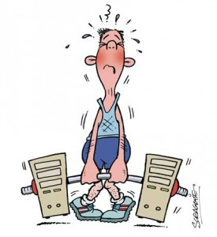
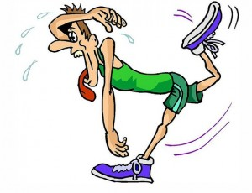
Muscle fatigue (physical fatigue)
-It is the decline in the ability of a muscle to generate force. It can be a result of vigorous exercise but abnormal fatigue may be caused by barriers to or interference with the different stages of muscle contraction.

Slide 23
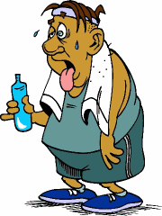
Causes of Muscle Fatigue:
1- Glycogen depletion: Studies in athletes have shown that muscle fatigue increases in direct proportion to the rate of muscle glycogen depletion.
- lack of ATP and PCr. These energy substrates are depleted during exercise, resulting in a lack of intracellular energy sources to fuel contractions & the muscle stops contracting.
2- Interruption of blood flow through a contracting muscle leads to almost complete muscle fatigue in 1 or more minutes because of loss of nutrient supply and oxygen loss.

Slide 24
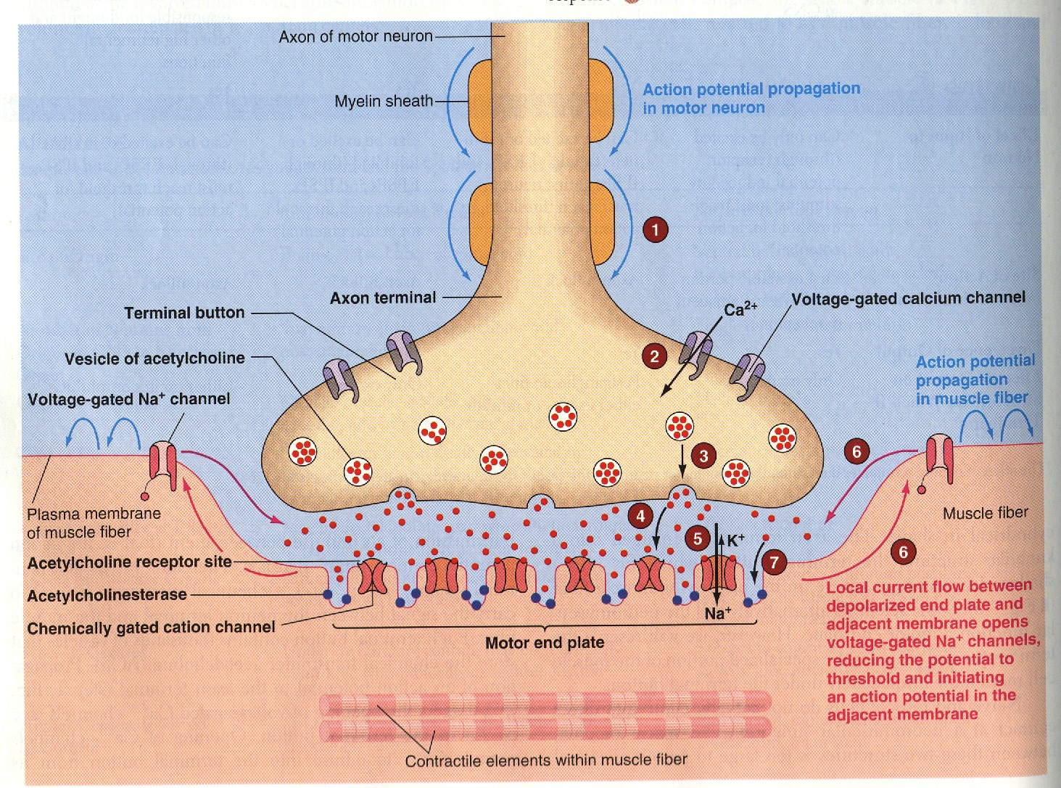
3- Neuromuscular Fatigue ( reduced neurotransmitter release= reduced Ach release)

Slide 25
4- Metabolic changes associated with fatigue
Lactic acid accumulation in the muscles often is associated with muscular fatigue.
The accumulation of hydrogen ion generated by lactic acid decreases muscle pH and increase intracellular acidity of muscles which impairs the cellular processes that produce energy and muscle contraction, muscle acidity can lower the sensitivity of contractile apparatus to Ca²⁺.

Slide 26
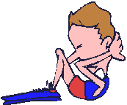
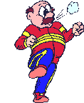
The Overtraining Syndrome
Overtraining syndrome frequently occurs in athletes who are training for competition or a specific event and train beyond the body's ability to recover.
-The "overtraining syndrome" is the collection of emotional, behavioral, and physical symptoms due to overtraining that has persisted for weeks to months

Slide 27
Common Signs and Symptoms of Overtraining Syndrome:
Tireness, lack of energy
Mild leg soreness, general aches and pains
Pain in muscles and joints
Sudden drop in performance and increase incidence to injuries.
Insomnia
The normal fine balance in the interaction between the autonomic nervous system and the hormonal system is disturbed.
Decreased immunity (increased number of colds, and sore throats)
Decrease in training capacity / intensity
Moodiness, depression and irritability
Loss of enthusiasm for the sport
Decreased appetite and weight loss
The treatment for the overtraining syndrome is
1- REST: The longer the overtraining has occurred, the more rest required
2-Avoiding monotonous training and maintaining adequate nutrition are other recommendations for prevention.

