Slide 1
Muscle Adaptation to Exercise
TEXTBOOK OF MEDICAL PHYSIOLOGY
GUYTON & HALL 12TH EDITION
UNIT XV CHAPTER 84
Dr.Mohammed Alotaibi
Department of Physiology
College of Medicine
King Saud University

Slide 2
LECTURE OBJECTIVES
At the end of this lecture the student should be able to recognize:
Strength, power, and endurance of muscles
The effect of athletic training on muscles and muscle performance
Muscle hypertrophy
Fast-twitch and slow-twitch muscle fibers
Respiration in exercise
Oxygen consumption and pulmonary ventilation in exercise
Effect of training on vo₂ max
Cardiovascular system in exercise
Work output, oxygen consumption, and cardiac output during exercise
Effect of training on heart hypertrophy and on cardiac output
Role of stroke volume and heart rate in increasing the cardiac output
Body heat in exercise & heatstroke

Slide 3
Strength of Muscles
Muscle Strength: Refers to the amount of force a muscle can produce.
The strength of a muscle is determined mainly by its size with a maximal contractile force between 3 and 4 kg/cm² of muscle cross-sectional area.
e.g a cross-sectional area of 150 cm² causes maximal contractile strength of 525 kg.

Slide 4
Power of Muscles
Muscle Power is a measure of the total amount of work that the muscle performs in a unit period of time ( kg-m/min)
The maximal power achievable by all the muscles in the body of a highly trained athlete with all the muscles working together is approximately the following:

Slide 5
Endurance of Muscles
Muscle Endurance is the ability of muscles to sustain repeated contractions against a resistance for period of time.
Depends on glycogen stored in the muscle
Endurance is enhanced by a high-CHO diet

Slide 6
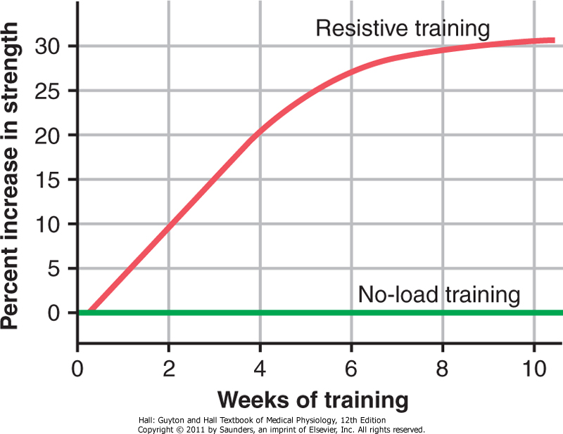
Effect of Training on Muscle Performance
Maximal Resistance Training:
6 maximal muscle contractions performed in three sets 3 days a week ↑ increase in muscle strength, and muscle mass (muscle hypertrophy)
Muscles function under
no load ↑ little in strength

Slide 7
Muscle Hypertrophy:
The average size of a person’s muscles is determined to a great extent by heredity plus the level of testosterone secretion.
With training muscles hypertrophied 30- 60 %
Due to ↑ diameter of the muscle fibers
↑ number of fibers
Changes in hypertrophied muscle fiber are:
↑ myofibrils
120% ↑ in mitochondrial enzymes
60-80% ↑ in phosphagen metabolic system
50 % ↑ in stored glycogen
75 -100 % ↑ in stored triglyceride
oxidation rate ↑ 45 %

Slide 8
Fast-Twitch and Slow-Twitch Muscle Fibers
In the human being, all muscles have varying percentages of fast-twitch and slow-twitch muscle fibers.
fast-twitch fibers: forceful and rapid contraction
(deliver power seconds to a minute). e.g gastrocnemius muscle
slow-twitch fibers: for prolonged muscle activity
(provide endurance, prolonged strength of contraction minutes to hours). e.g soleus muscle

Slide 9
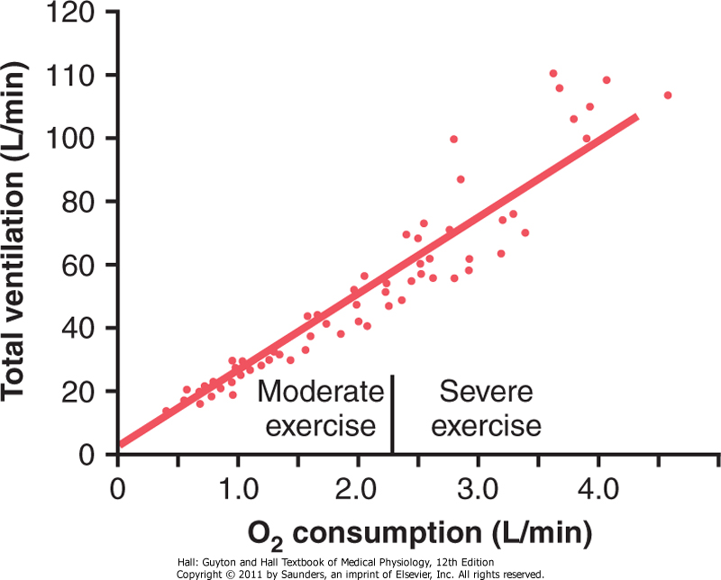
Respiration In Exercise
Oxygen Consumption (VO2) and Pulmonary Ventilation in Exercise
VO2 at rest is about 250 ml/min , However !!! at Maximal efforts (VO₂ max)
The relation between oxygen consumption and total pulmonary ventilation at different levels of exercise
VO2 and total pulmonary ventilation increase about 20-fold between the resting state and maximal intensity

Slide 10
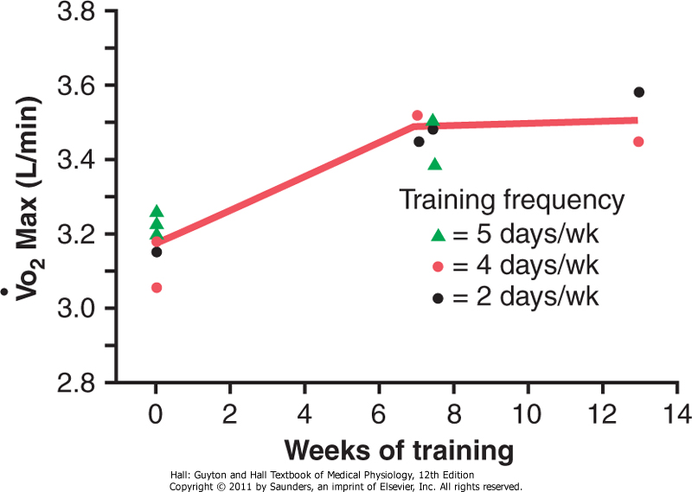
Effect of Training on VO₂ Max
VO₂ max is the rate of oxygen usage under maximal aerobic metabolism.
Vo₂Max increases only about 10 percent by training, Moreover other factors (Genetic)!!!
Chest sizes in relation to body size
Stronger respiratory muscles
It is also likely that many years of training increase the marathoner’s VO2max

Slide 11
Oxygen-Diffusing Capacity of Athletes.
The oxygen diffusing capacity is a measure of the rate at which oxygen can diffuse from the pulmonary alveoli into the blood.
The following values are measured values for different diffusing capacities:

Slide 12
Cardiovascular System in Exercise
Work Output, Oxygen Consumption, and Cardiac Output During Exercise
All these are directly related to one another, muscle work output increases oxygen consumption, and increases oxygen consumption in turn dilates the muscle blood vessels, thus increasing venous return and cardiac output C.O
Typical cardiac outputs at several levels of exercise are as follows:

Slide 13
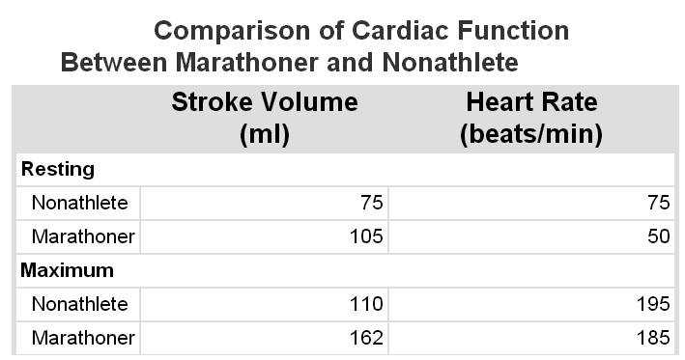
Cardiovascular System in Exercise
Effect of Training on Heart Hypertrophy and Cardiac Output:
The heart-pumping effectiveness of each heartbeat is 40 to 50% greater in the highly trained athlete than in the untrained person.
Heart size of marathoner is larger than normal person.
Resting cardiac output is almost exactly the same as that in a normal person. This normal cardiac output is achieved by a large stroke volume at a reduced heart rate.

Slide 14
Body Heat In Exercise
Almost all the energy released by the body's metabolism of nutrient is converted into body heat.
Working muscle uses only 20 - 25 %.
Remainder of nutrient is converted into heat.
Almost all the energy that goes into creating muscle work still becomes body heat because small portion of this energy is used for:
(1) Overcoming resistance to the movement of the muscles and joints.
(2) Overcoming friction of the blood flowing through the blood vessels, and all of which convert the muscle contractile energy into heat...
What will happen during hot and humid condition if sweating mechanism cannot eliminate the heat ????

Slide 15
Heatstroke
During endurance training body temperature rises 37° to 40°C
In hot and humid conditions the body temperature can rise to 41° to 42°C
At this level, the elevated temperature becomes destructive to tissue cells, especially the brain cells.
Body weakness, exhaustion, headache, dizziness, nausea, sweating, confusion, uncontrolled gait, collapse, and unconsciousness, this is called heatstroke and may lead to death

Slide 16
Treatment of heatstroke
Reduce the body temperature as rapidly as possible
The most practical way:
Remove all clothing
Maintain a spray of cool water on all surfaces of the body or continually sponge the body.
Blow air over the body with a fan.
Physicians and physiotherapists prefer total immersion of the body in water containing a mush of crushed ice if available.

