Slide 1
بسم الله الرحمن الرحيم

Slide 2
Phospholipid Compounds of Physiological Importance
By
Reem M. Sallam, M.D.; Ph.D.

Slide 3
Objectives
By the end of this lecture, students are expected to:
Discuss selected members of phospholipids
Describe the physiological importance of phospholipids with specific examples
Distinguish various Plospholipases and describe their roles:
Phospholipases A1, A2, C and D
Lysosomal phospholipase: Sphingomyelinase

Slide 4
Functions of Phospholipids
Membrane-bound phospholipids: Structural: Predominant lipids of cell membranes Anchoring: Attaching some proteins to membranes Signaling: Source of IP3 and DAG
Myelin sheath: insulator and speeds up transmission of nerve impulses

Slide 5
Functions of Phospholipids
CONT’D
(B)Non-membrane-bound phospholipids:
Easy re-inflation of alveoli by air: Lung surfactant
Detergent effect: Essential component of bile
Solubilize cholesterol
Preventing gall stones
Emulsifying lipids
Helping lipid digestion
Structural: Coat of lipoproteins

Slide 6
Background: Lipid Compounds
Heterogeneous group
Relatively water-insoluble (Exception: Ketone bodies)
Soluble in non-polar solvents

Slide 7
Lipid Compounds:
Heterogeneous Group
A. Simple Lipids:
Fatty acids
Ketone bodies
Triacylglycerol
Cholesterol
B. Complex Lipids:
Phospholipids
Lipoproteins
Glycolipids

Slide 8
Phospholipids
A. Glycerophospholipids
Glycerol-containing phospholipids
Degraded and remodeled by phospholipases
B. Sphingo-phospholipids:
Sphingosine-containing phospholipids
Degraded by lysosomal phospholipase (sphingomyelinase)

Slide 9
Phospholipids
A. Glycerophospholipids:
Phosphatidylcholine (Lecithin)
e.g., Surfactant (Dipalmitoylecithin)
Phosphatidylinositol (Signaling & Anchoring molecule)

Slide 10
Phospholipids:
Glycerophospholipids
Members:
1.Phosphatidylcholine
(Lecithin) e.g., Surfactant
(Dipalmitoylecithin)
Parent Compound:
Phosphatidic acid

Slide 11
Phospholipids: Glycerophospholipids
1. Dipalmitoylecithin (Lung surfactant)
Synthesis and secretion: by granular pneumocytes
It is the major lipid component of lung surfactant (65%) (Remaining 35% is: Other phospholipids, cholesterol & proteins)
Surfactant decreases surface tension of fluid layer
lining of alveoli, reducing the pressure needed for their
inflation by air, and preventing alveolar collapse (atelectasis)
Congenital Respiratory distress syndrome (RDS):
Insufficient production of lung surfactant (especially in pre-term babies) → neonatal death

Slide 12
Congenital Respiratory distress syndrome (RDS)
Pre-natal diagnosis by: Lecithin/sphingomyelin (L/S) ratio in amniotic fluid
Ratio of 2 or above indicates lung maturity and no RDS
(i.e., shift from sphingomyelin to lecithin synthesis by pneumocytes that normally occurs by 32 wks. of gestation)
Prevention:
Glucocorticoids to the pregnant mother with
low L/S ratio shortly before delivery
Treatment:
Intratracheal administration of surfactant to
pre-term infants with RDS

Slide 13
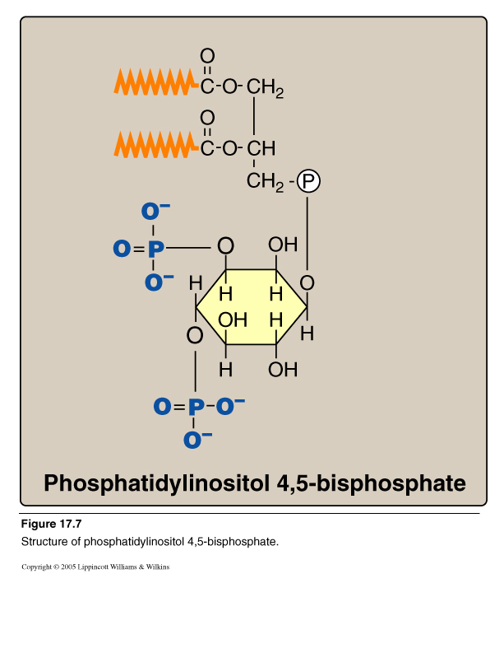
Phospholipids: Glycerophospholipids
2. Phosphatidylinositol 4,5 bisphosphate (PI)

Slide 14
Calcium/Phosphatidylinositol System
Diacylglycerol
(DAG)
InositolTrisphosphate
(IP₃)
Phospholipase C

Slide 15
Phosphatidylinositol System
Role in signaling
Signal: Hormones or neurotransmitters
e.g., Acetylcholine, antidiuretic hormone (V1- receptor) and catecholamines (α₁ actions)
Receptor: G-protein coupled receptor
Effects:
Activation of phospholipase C Hydrolysis of phosphatidylinositol 4,5-bisphosphate→ Production of IP3 ( Ca²⁺) and DAG
Activation of protein kinase C
Response: Phosphorylation of cellular proteins → and responses to hormones

Slide 16
*
*
Acetylcholine Antidiuretic hormone (ADH) Catecholamines
Intracellular Signaling by Inositol trisphosphate

Slide 17
Phosphatidylinositol
Role in Protein Anchoring
Anchoring of proteins to membranes
via
Carbohydrate-Phosphatidylinositol
Bridge
Examples of anchored proteins:
1. Alkaline phosphatase
(to the surface of small intestine)
2. Acetylcholine esterase (to postsynaptic membrane)
These proteins can be cleaved from
their attachment to the membranes
by phospholipase C

Slide 18
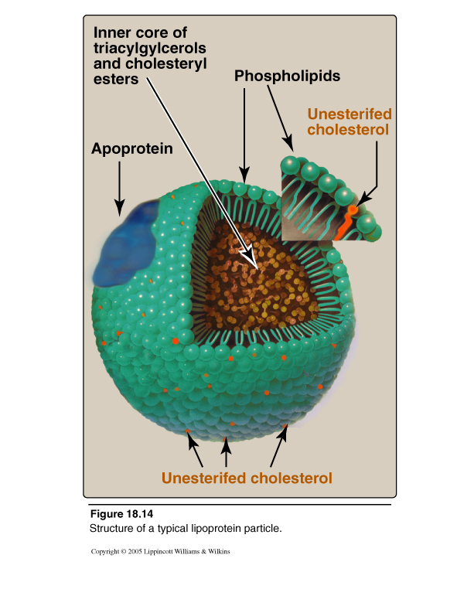
Lipoprotein Structure
Outer part (coat):
Apoproteins or apolipoproteins
Phospholipids (Why?)
Free cholesterol (Relatively hydrophilic)
Allowing transport of lipid particles of the core in the aqueous plasma
Inner part (core):
According to the type of lipoproteins
Different lipid components in various combinations

Slide 19
Lipoprotein Structure

Slide 20
HDL has the highest content of
phospholipids among all
classes of lipoproteins
Different classes of lipoproteins:
1- Chylomicrons
2- Low density lipoproteins (LDL)
3. High density lipoproteins (HDL)
4- Very low density lipoproteins (VLDL)
HDL has the highest content of Phospholipids.
Phosphatidyl choline (lecithin) acts as a source for fatty acids necessary for esterification of cholesterol on the surface of HDL by lecithin-cholesterol acyl transferase (LCAT/PCAT)

Slide 21
Phospholipases
(1) For glycerophospholipids:
Phospholipases A1, A2, C and D
Present in all tissues and pancreatic juice
Present in snake venoms and bacterial toxins
Phospholipase A2 is important for the remodeling of phospholipids to produce the lung surfactant
(2) For sphingophospholipids:
Lysosomal phospholipase (Sphingomyelinase)

Slide 22
Glycero-phospholipases

Slide 23
Functions of Phospholipases
(1) Degradation of phospholipids
Production of second messengers
Digestion of phospholipids by pancreatic juice
Pathogenic bacteria degrade phospholipids of membranes and causing spread of infection
(2) Remodeling of phospholipids:
Specific phospholipase removes fatty acid from phospholipid (e.g. Phospholipase A2 is important for the remodeling of phospholipids to produce the lung surfactant
Replacement of fatty acid by alternative fatty acid using fatty acyl CoA transferase
e.g., Binding of 2 palmitic acids in Dipalmitoylphosphatidylcholine (DPPC)
Binding of arachidonic to carbon 2 of PI or PC

Slide 24
Take Home Message
Phospholipids are Complex lipids
Phospholipids have important physiological functions: A. Membrane-bound: Structural Signaling & anchoring: e.g., PI Myelin sheath: e.g., sphingomyelin
B. Non-membrane bound:
Structural: Lipoprotein coat Alveolar re-inflation: Lung surfactant Detergent effect: Phospholipids of bile

Slide 25
Take Home Message
CONT’D
Phospholipases: Phospholipases A1, A2, C and D Lysosomal Phospholipase: Sphingomyelinase
Function of phospholipases:
Degradation of phospholipids e.g., production of second messengers
Remodeling of phospholipids
e.g., production of DPPC (lung surfactant)

