Slide 1

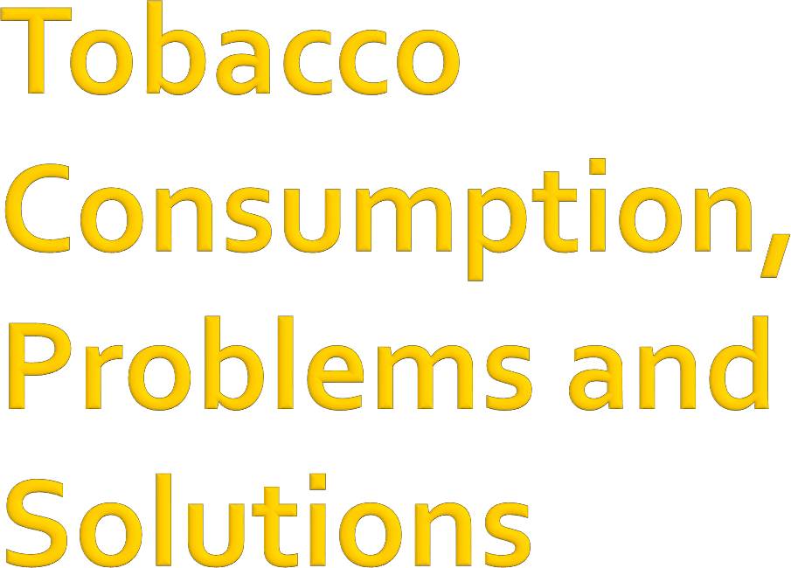
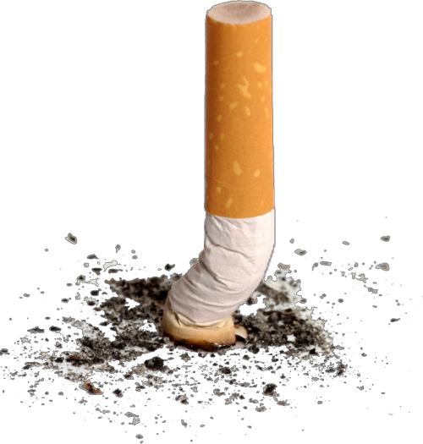
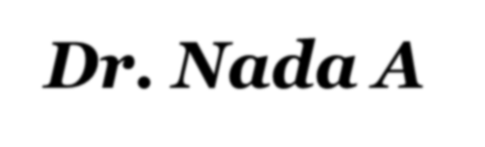
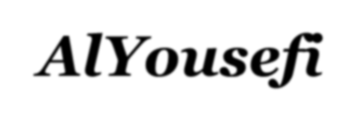
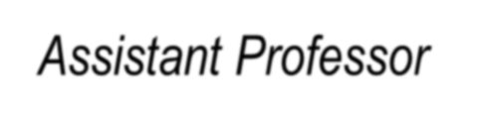
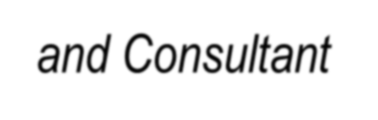
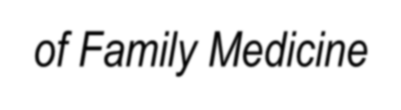
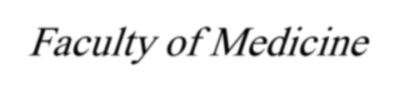

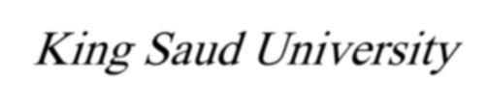

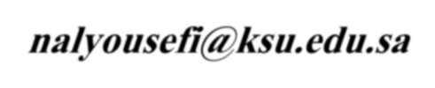
Dr. Nada A AlYousefi
Assistant Professor and Consultant of Family Medicine
Faculty of Medicine - King Saud University
EM: nalyousefi@ksu.edu.sa

Slide 2

Magnitude of the problem
What is in tobacco ? is smoking addictive ?
Consequences of tobacco use
Why do we smoke ?
Prevention and control efforts
Can we quit ?
1 February 2016
Tobacco Use
2

Slide 4

5 million deaths world wide each year
10 million deaths estimated by year 2030
WHO estimates, there are approximately 1.1 billion smokers in the world
4

Slide 5
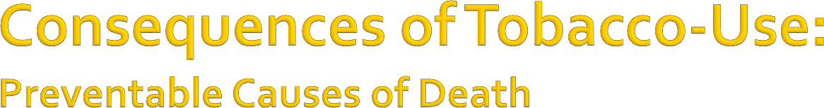
Smoking 400,000
Accidents 94,000
2nd Hand Smoke 38,000 Alcohol 45,000
HIV/AIDS 32,600
Suicide 31,000
Homicide 21,000
Drugs 14,200

Slide 6



In 2012, 21% of the global population aged 15 and above smoked tobacco.
Men smoked at five times the rate of women. the average rates were 36% and 7% respectively.

Slide 7
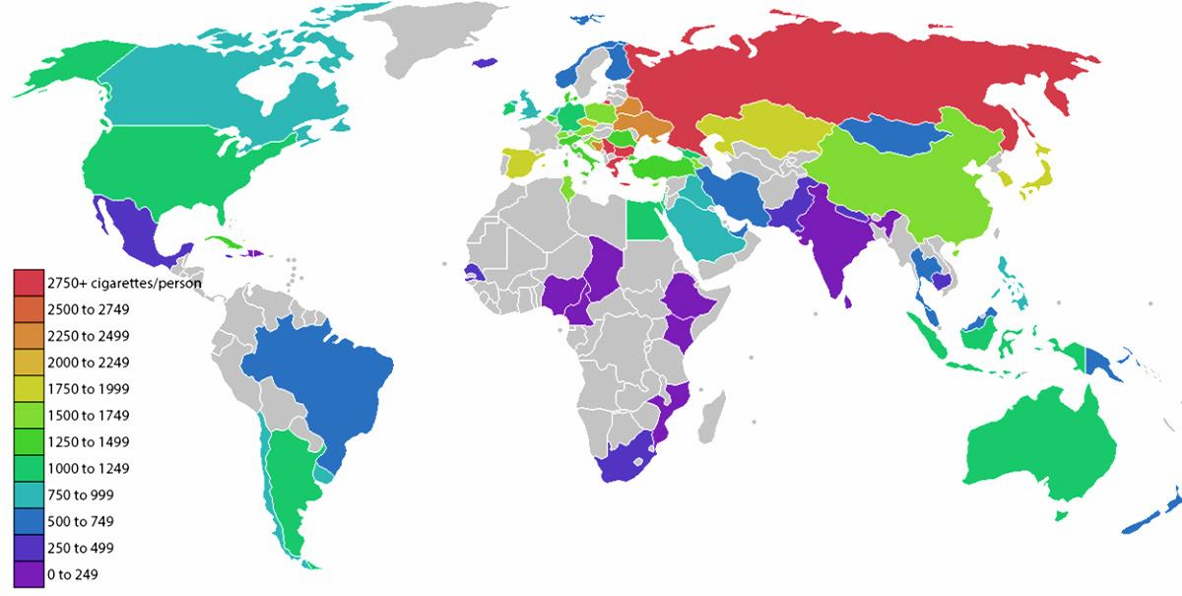
The highest rates are all in Eastern Europe : average annual consumption can exceed 2,000 cigarettes per person.
The biggest smokers outside of Eastern Europe are South Koreans, Kazakhs, and Japanese

Slide 8

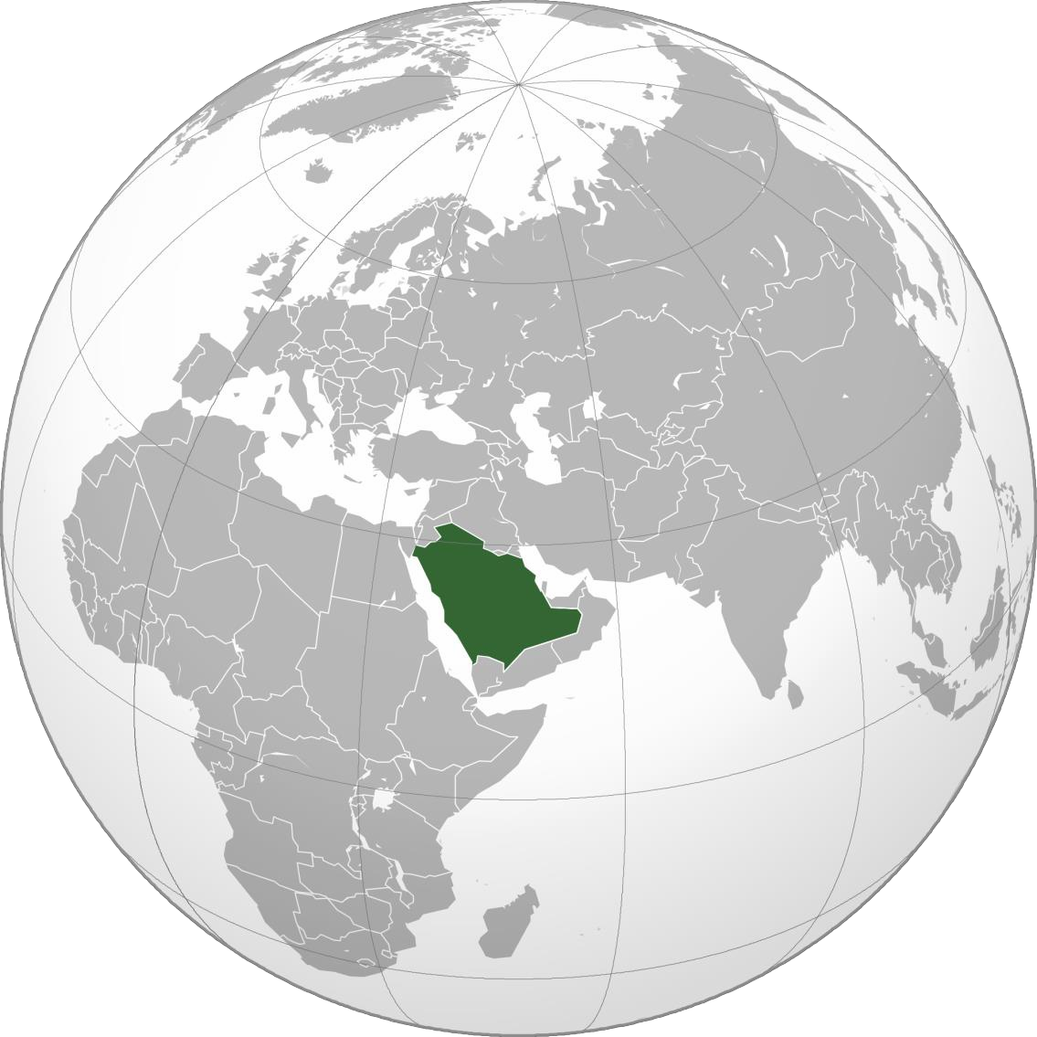
In 2010, WHO estimates that about 16% of Saudi Arabia's population smoked (3,092,300 persons).
If tobacco control efforts continue at the same intensity, WHO projects that in 2025 around 24% of the population (approximately 6,268,400 persons) will be smokers.
26% of men and about 3% of women smoked in Saudi Arabia.
The highest rate of smoking among men was seen in the
age-group 25 – 39
and among women in the age-group 70+.

Slide 9



smokers represented 28.6% of the students.
The most common reasons for smoking
were:
having free time (81.6%)
relief of stress (63.2%)
seeing some of their teachers smoking (61.8%)
Most of the smokers started the habit before the age of 15 years old (89%).
42.2% of students were planning to start
smoking in future.
Sultan Nohair. Prevalence of Smoking and its Related Behaviors and Beliefs Among Secondary
School Students in Riyadh, Saudi Arabia. 2011. Available from
http://www.ncbi.nlm.nih.gov/pmc/articles/PMC3312769

Slide 10

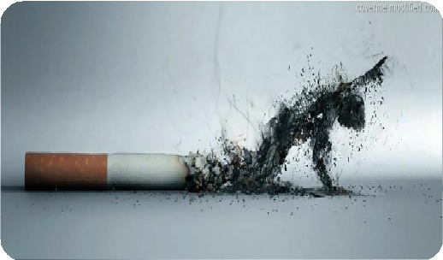

Tobacco use is the leading cause of preventable death in United States, causing more than 440,000 deaths annually
Authors. Reducing Tobacco-Related Cancer Incidence and Mortality: Workshop Summary - PubMed – NCBI [Internet]. 2015. Available from http://www.ncbi.nlm.nih.gov/m/pubmed/24901191/
In 1964-2012, an estimated
17.7 million deaths were
related to smoking
Holford TR. Tobacco control and the reduction in smoking-related premature deaths in the United States, 1964-2012. - PubMed – NCBI [Interenet]. 2015. Available from http://www.ncbi.nlm.nih.gov/m/pubmed/24399555/

Slide 11

○ 30% population of Saudi Arabia
○ nearly six million people expose
themselves to death is inevitable
http://www.sha.org.sa
1 February 2016
Tobacco Use
11

Slide 12

The KSA medical students WHO-GHPSS was a school-based survey of 3rd year medical students attending the 13 medical schools conducted in 2006. Student response rate was 62.6 %, n = 481 students
Results: 11.6% currently smoke cigarettes (Males = 13.1%, Females = 9.6%); 12.8% currently use any form of tobacco other than cigarettes (Males = 13.9%, Females = 11.3%)
1 February 2016
Tobacco Use
12

Slide 13

The KSA school-based WHO-GYTS was conducted in 2010. A two-stage cluster sample design was used to produce representative data. Student response rate was
83.4 % (n = 1,797 school children aged 13-15)
Results: 14.9 % currently use any tobacco product (boys
= 21.2 %, girls = 9.1%) ; 8.9 % currently smoke cigarettes (boys = 13.0 %, girls = 5.0%); 9.5 % currently smoke shisha (boys = 13.3 %, girls = 6.1%)
1 February 2016
Tobacco Use
13

Slide 15
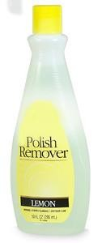
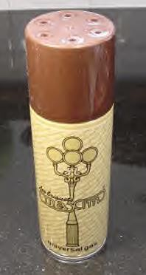
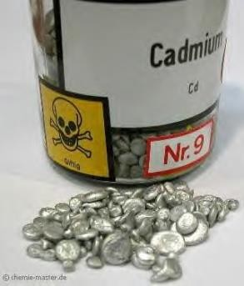
More than 4,000 substances, including:
Tar: black sticky substance used to pave roads
Nicotine: Insecticide
Carbon Monoxide: Car exhaust
²¹⁰ Polonium: radio-active substance
Acetone: Finger nail polish remover
Ammonia: Toilet Cleaner
Cadmium: used batteries
Ethanol: Alcohol
Arsenic: Rat poison
Butane: Lighter Fluid
1 February 2016
Tobacco Use
15

Slide 16
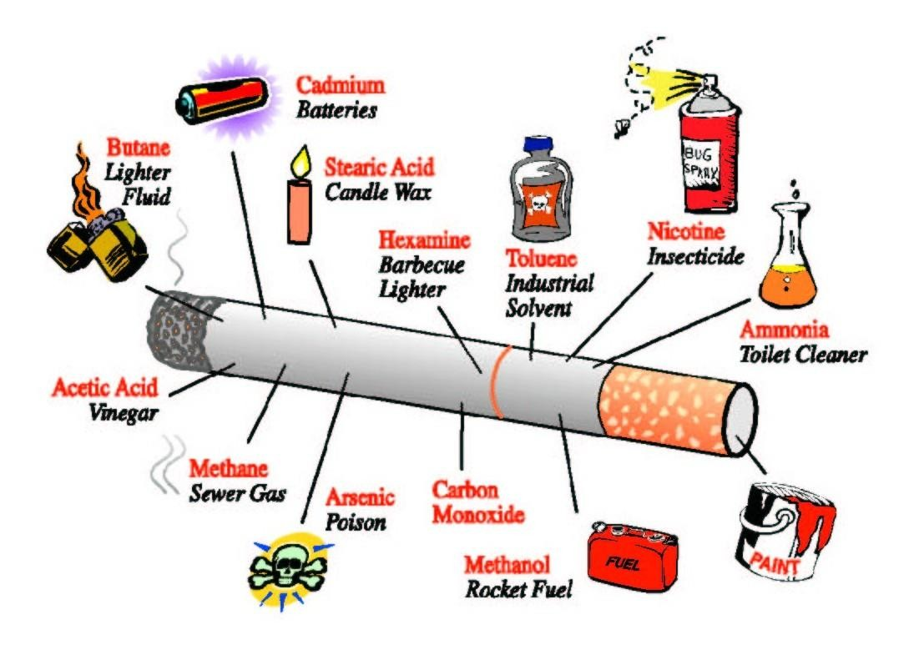
1 February 2016 Tobacco Use 16

Slide 17
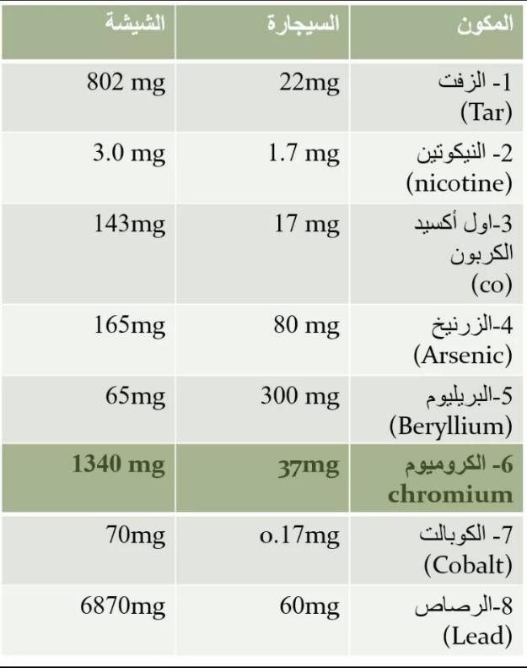
1 February 2016
Tobacco Use
17

Slide 18
All tobacco products contain nicotine
Nicotine has been clearly recognized as a drug of addiction
tobacco dependence has been classified as a mental and behavioral disorder according to the WHO
International Classification of Diseases, lCD-l0 (Classification F17.2).
1 February 2016
Tobacco Use
18

Slide 19
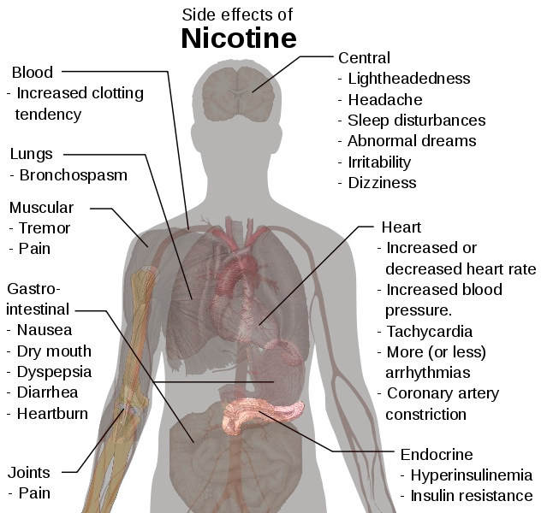
1 February 2016 Tobacco Use 19

Slide 20
Smoking typically begins in adolescence
if a person remains smoke-free throughout adolescence, it is highly unlikely that he or she will ever begin smoking
intensive efforts be made to help young people stay
smoke-free.
1 February 2016
Tobacco Use
20

Slide 21
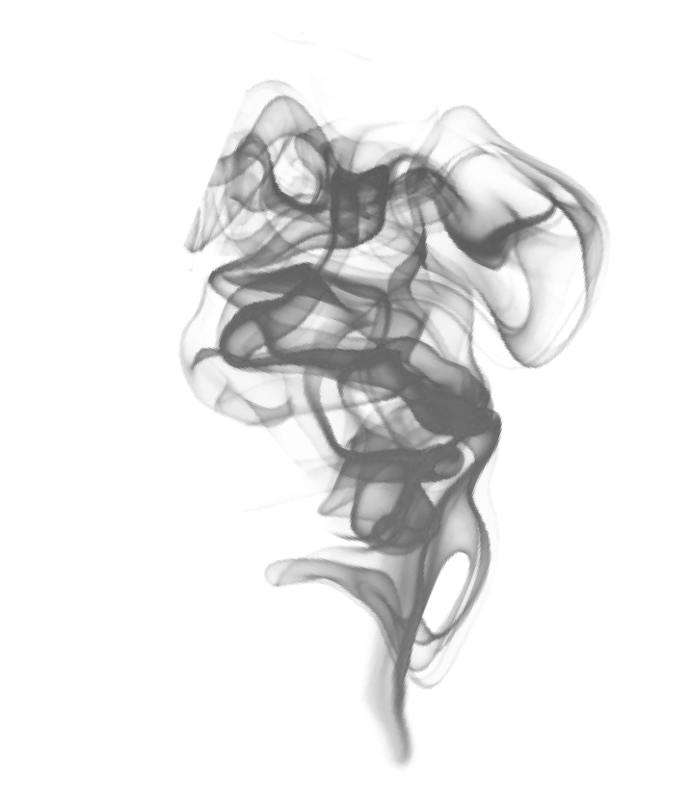

Smoking refers to the inhalation and exhalation of fumes from burning tobacco in cigars, cigarettes and pipes

Slide 22

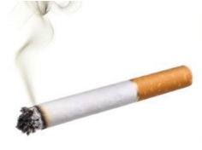



Cigarettes: Cigarettes are uniform in size and contain less than 1g of tobacco each. They are made from different blends of tobaccos, and wrapped with paper.
Cigars
Most cigars are composed primarily of a single type of tobacco (air-cured and fermented), and they have a tobacco wrapper.
They can vary in size and shape and contain between 1 gram and 20 grams of tobacco.

Slide 23
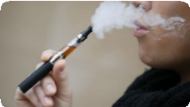

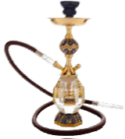

E- cigarette :
electronic nicotine delivery systems (ENDS). According to the FDA, e-cigarettes are devices that allow users to inhale an aerosol (vapor) containing nicotine or other substances.
Hookah (Shisha) :
A water pipe with a smoke chamber, a bowl, a pipe and a hose. Specially made tobacco is heated, and the smoke passes through water and is then drawn through a rubber hose to a mouthpiece.
The average shisha-smoking session lasts an hour and research has shown that in this time you can inhale the same amount of smoke as from more than 100 cigarettes.

Slide 24


Not safer than regular tobacco smoke.
Causes the same diseases
Raises the risk of lip cancer, spreading infections like tuberculosis.
Users ingest about 100 times more lead from hookah smoke than from a cigarette.
1 February 2016
Tobacco Use
24

Slide 26
Health (short term, long term)
Economic (individual, family, community)
Social (family, community)
Development (community)
Religious (individual, community)
Premature dealth
1 February 2016
Tobacco Use
26

Slide 27

Causes more than 25 different diseases
Affects different body-systems, especially:
  Gastro-intestinal system
  Respiratory tract
  Cardio-vascular system
  Urinary system
  Others
1 February 2016
Tobacco Use
27

Slide 28
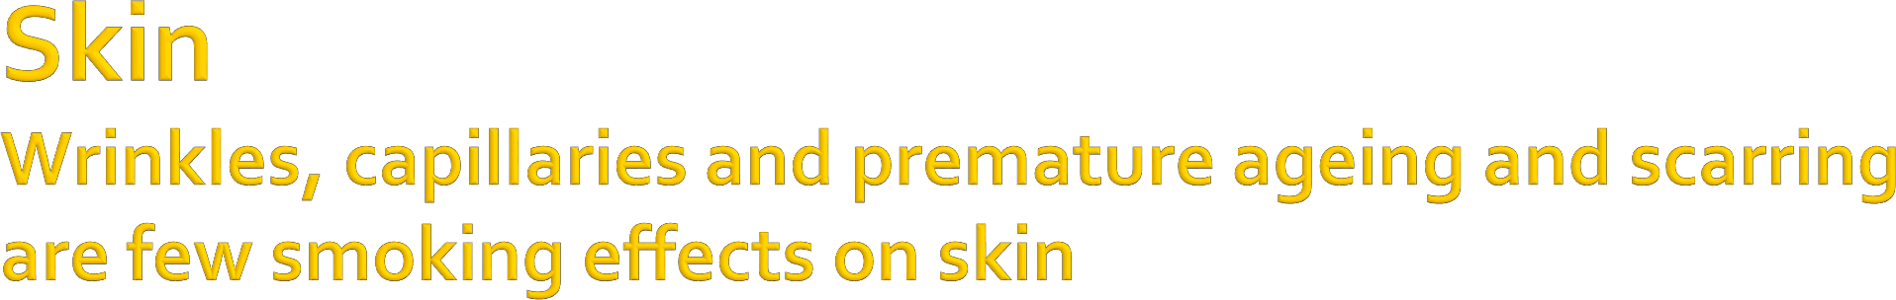
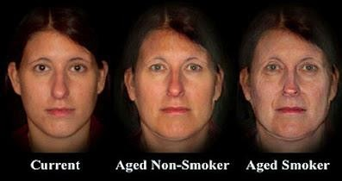

Slide 29
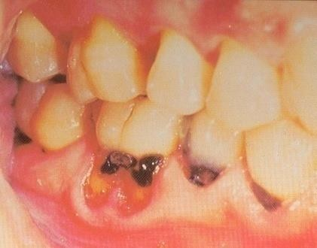
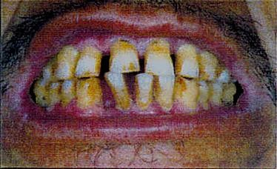
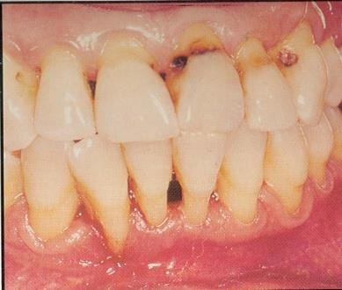
•Stained teeth
•Gum inflammation
•Black hairy tongue
•Oral cancer
Above: Cavities
Below: Gingivitis
Overall poor oral
health
•Delayed healing
of the gums

Slide 30
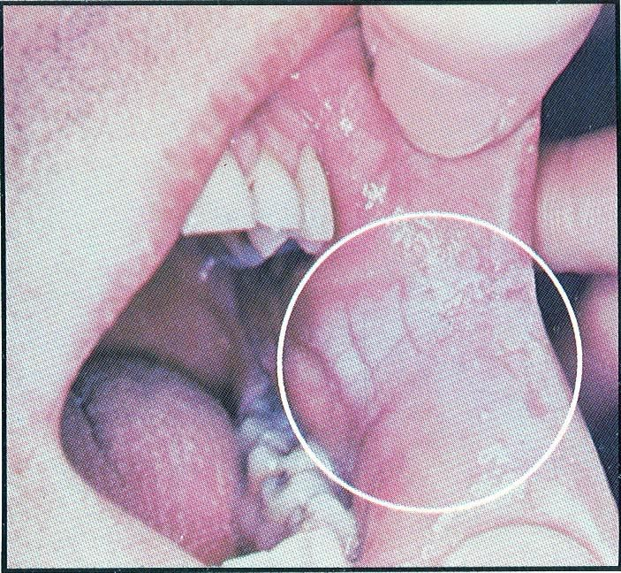
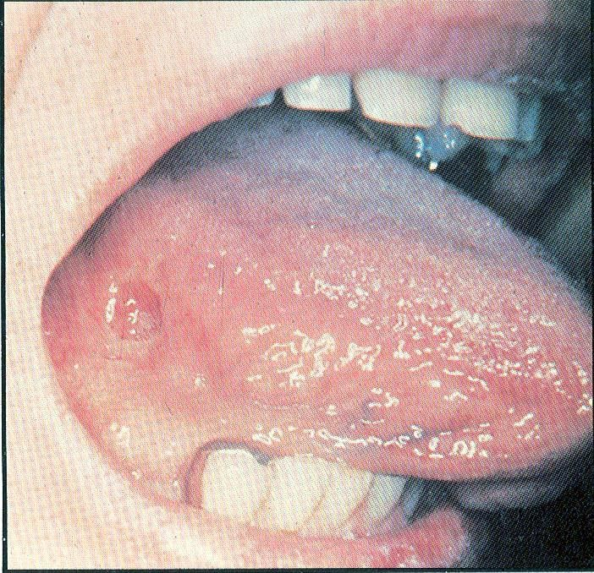
Leukoplakia
Oral cancer
1 February 2016
Tobacco Use
30

Slide 31

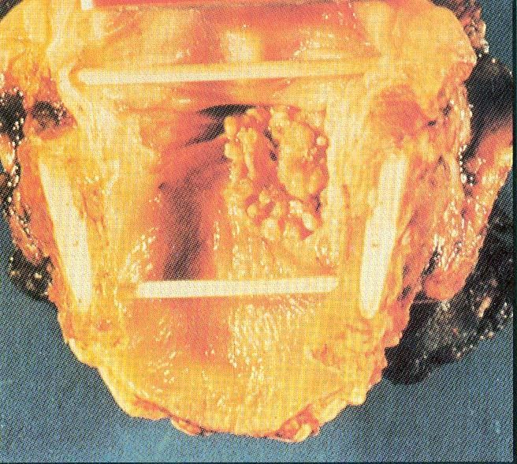
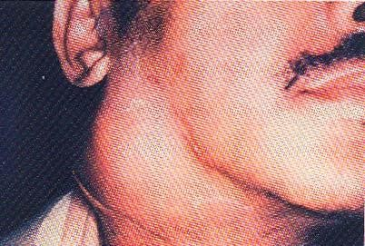
Symptoms:
•Persistent hoarseness
•Chronic sore throat
•Painful swallowing
•Pain in the ear
•Lump in the neck
Over 80% of deaths from laryngeal cancer are linked to smoking
1 February 2016
Tobacco Use
31

Slide 32

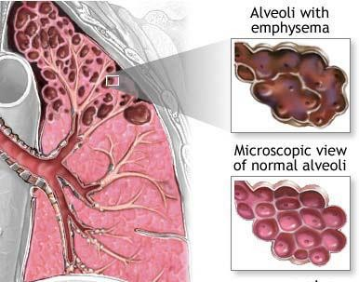
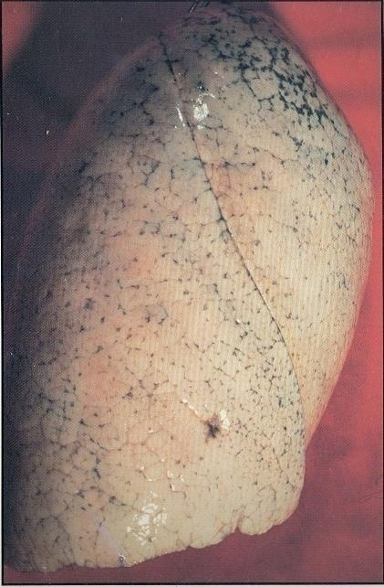
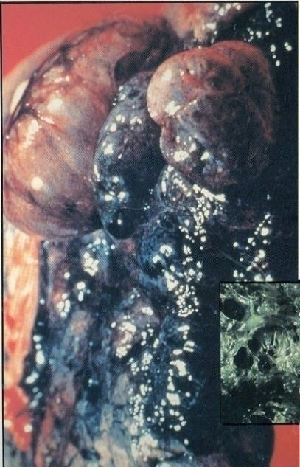
Healthy lung
Emphysema lung
Symptoms Include Shortness of breath; chronic cough;
wheezing; anxiety; weight loss; ankle, feet and leg swelling; fatigue, etc
1 February 2016
Tobacco Use
32

Slide 33

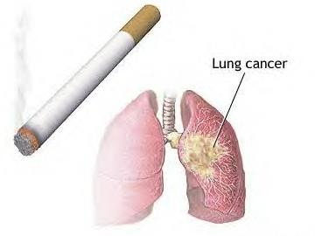
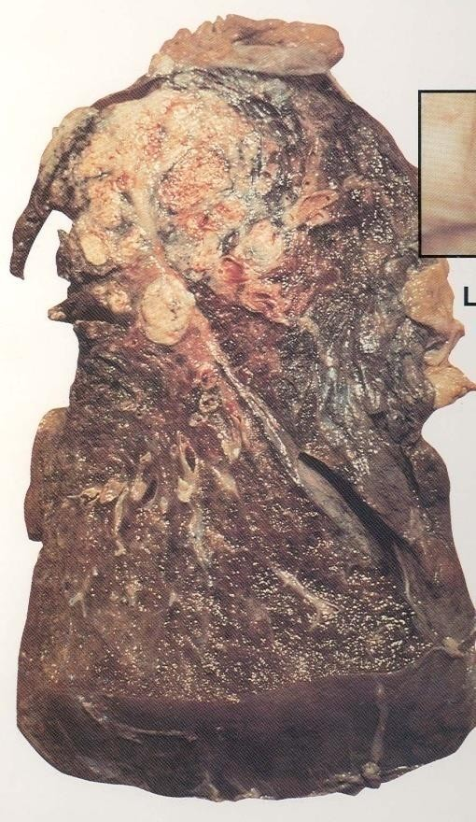
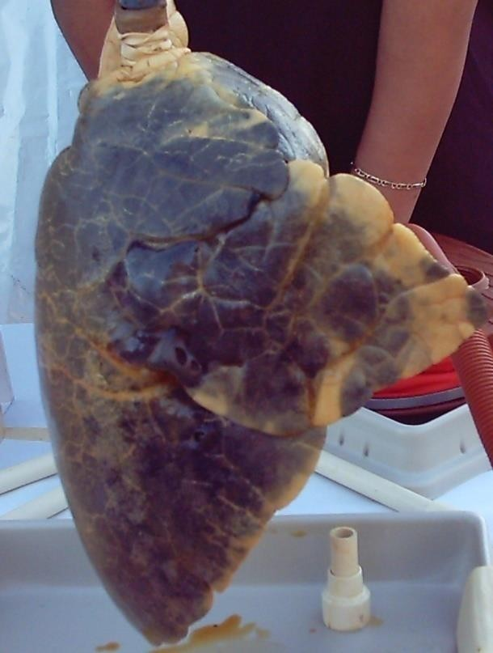
Lung cancer kills more people than any other type of cancer
1 February 2016
Tobacco Use
33

Slide 34
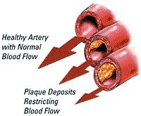
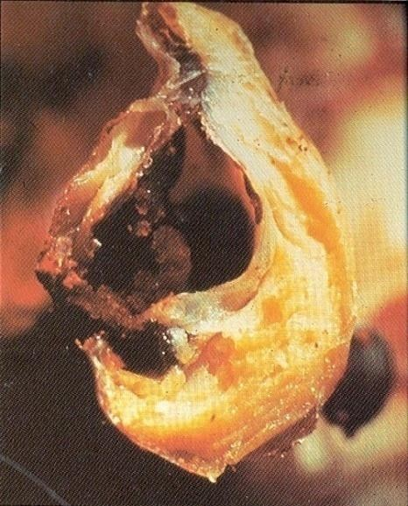
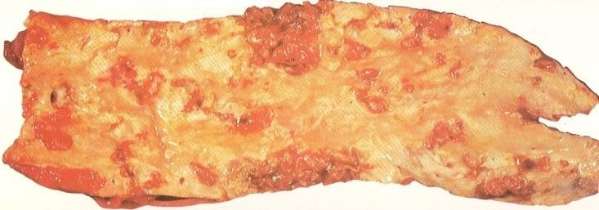
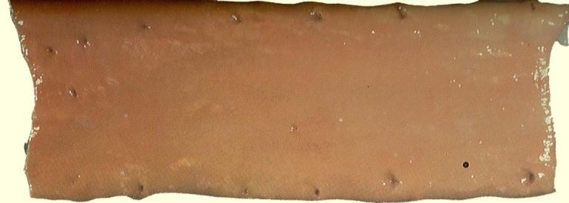
Healthy artery
Damaged artery
1 February 2016
Tobacco Use
34

Slide 35
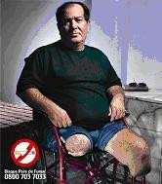
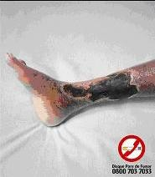
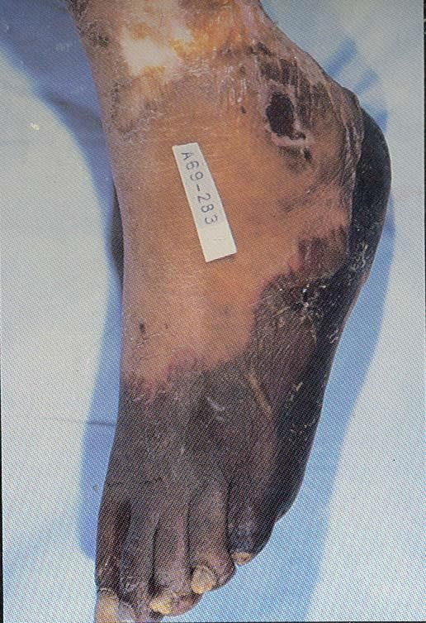
1 February 2016
Tobacco Use
35

Slide 36

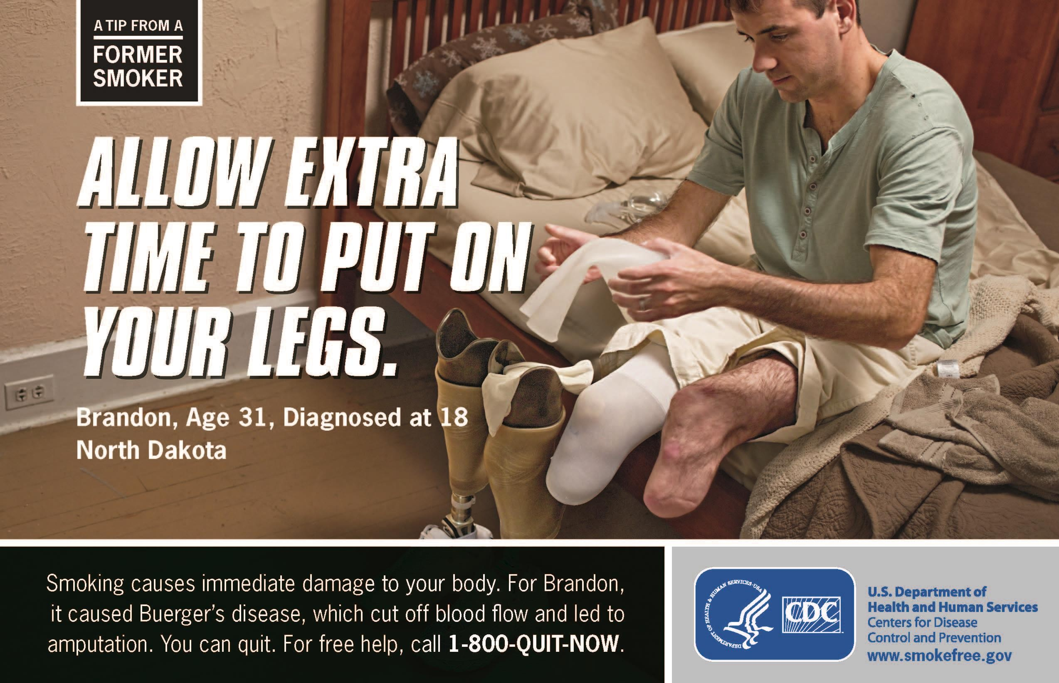

36
http://www.cdc.gov/tobacco/campaign/tips/

Slide 37

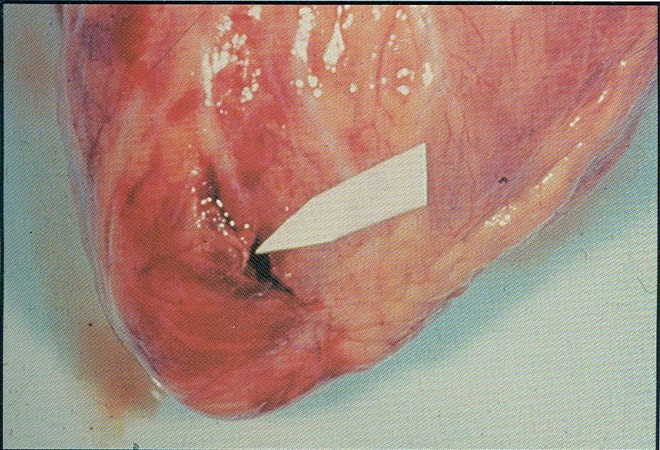
Smokers are twice as likely as Nonsmokers to have a heart attack
Quitting smoking rapidly reduces the risk of coronary heart disease
Torn heart wall: Result of
over-worked heart muscle
1 February 2016
Tobacco Use
37

Slide 38

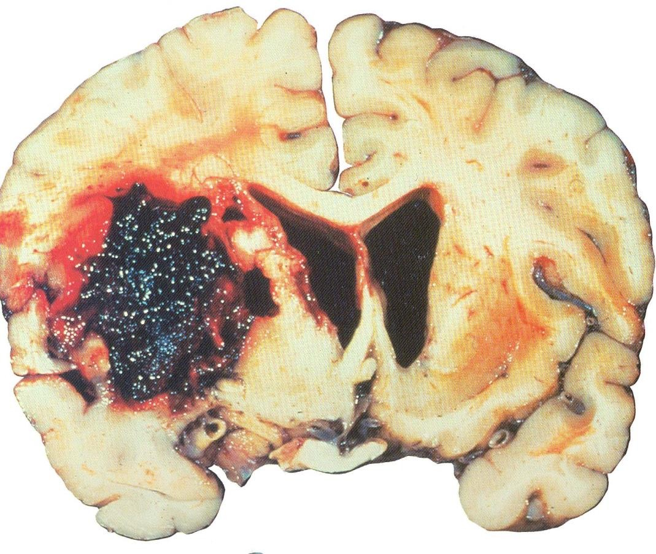
This brain shows stroke damage, which can cause death or severe mental or physical
disability
1 February 2016
Tobacco Use
38

Slide 39
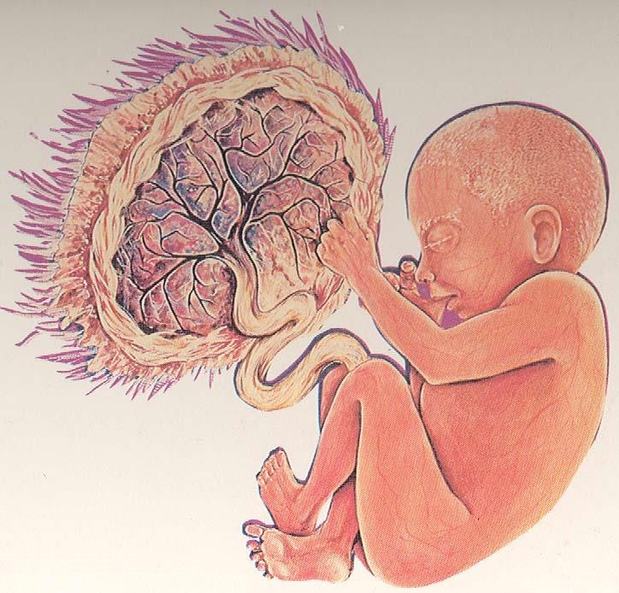
•Birth defects
•Premature stillbirth
•Low birth weight
•Lowered immune capacity
•Proneness to Sudden Infant Death Syndrome (SIDS)
1 February 2016
Tobacco Use
39

Slide 40

1 February 2016
Tobacco Use
40

Slide 41


There’s no single reason why people begin
to smoke.
It Has been estimated that 80% of Adult smokers start smoking as children, and 30% of children have tried smoking by the age of 11.

Slide 42

Parental influences
friendship groups
Influence of peer
Low socioeconomic status
The need to fit In.
It looks cool.
1 February 2016
Tobacco Use
42

Slide 43





Self medication
Stress reliever

Slide 44




Peer pressure
Despite the knowledge of the damage that results from smoking. The fear of being labeled the “black sheep” of a group often proves strong enough to move us to sacrifice our long-term health.
Social rewards

Slide 45


Parents as a role model

Slide 46

Experimentation
& adventure

Slide 47


Weight control
Young-Hwan Jo, David A. Talmage. Nicotinic receptor-mediated effects on appetite and food intake [internet]. 2002. Available from http://www.ncbi.nlm.nih.gov/pmc/articles/PMC2367209/

Slide 48
Wrong personal beliefs and values about smoking
Self esteem
Curiosity
1 February 2016
Tobacco Use
48

Slide 49
Availability
Accessibility
Price
Media
Tobacco industry intensive advertising
1 February 2016
Tobacco Use
49

Slide 50




Slide 51

Philip Morris executive: "hitting the youth can be more efficient even though the cost to reach them is higher, because they are willing to experiment.
They have more influence over others in their age group than they will later in life, and they are far more loyal to their starting brand."
The younger the age when smoking begins, the longer the smoking cycle.
Young persons are also more vulnerable because they are likely to be less aware of the addictive nature of nicotine and the harmful effects of tobacco consumption.
1 February 2016
Tobacco Use
51

Slide 52



These principles
also work for:
Sports
Concerts
Parties
Movies
Other media
1 February 2016
Tobacco Use
52

Slide 53


“You’re clearly someone who considers others. That’s
why Superslim Capri is the choice for you…great
tobacco flavor, but less smoke for those around you.”
1 February 2016
Tobacco Use
53

Slide 54


Slide 55



Slide 56

Active smoking

Slide 57


Mainstream smoke:
The smoke exhaled by a smoker.
Sidestream smoke: Smoke from the lighted end of a cigarette, pipe, or cigar.
•Sidestream smoke has higher concentrations of cancer-causing agents (carcinogens) and is more toxic than mainstream smoke.
•it has smaller particles than mainstream smoke. These smaller particles make their way into the lungs and the body’s cells more easily.

Slide 58

1 February 2016
Tobacco Use
58

Slide 59

Secondhand smoke is dangerous.
I don’t smoke. Why should I be
concerned about being around someone who does?
Secondhand smoke is a mixture of gases and fine particles that includes
  Smoke from a burning
cigarette, cigar, or pipe tip
  Smoke that has been exhaled or breathed out by the person or people smoking
59

Slide 60
Third-hand smoke exposure — Third hand
smoke exposure refers to exposure to smoke components and their metabolic by-products from contact with surfaces that have adsorbed smoke. The smoke leaves a residue of nicotine and other toxic substances in household dust and on surfaces. Although not yet well studied, there is concern that contact with third hand smoke will result in absorption of toxins through the skin or ingestion from contamination of the hands.

Slide 61
Solutions: Prevention & Control

Slide 62
Globally: governed / advised by the Framework Convention on Tobacco Control FCTC (ratified by KSA in 2005); WHO-MPOWER (first launched in 2008)
Nationally: coordinated by Ministry of Health - Tobacco Control Program in KSA (TCP); other agencies’ efforts
Conceptually:
  Primary prevention = tobacco use [smoking] prevention
  Secondary prevention = tobacco use [smoking] cessation
(quitting smoking)
  Tertiary prevention = dealing with its consequences
1 February 2016
Tobacco Use
62

Slide 63

Monitoring tobacco use and prevention policies
Protecting people from tobacco smoke
Offering help to quit
Warning of dangers of tobacco
Banning tobacco advertising, promotion and sponsorship
Increasing taxing on tobacco
1 February 2016
Tobacco Use
63

Slide 64

Strengthening religious beliefs / “fatwas”
Legislations for banning smoking in public places
Banning advertising, especially to youngsters
Increasing taxation on tobacco products
Public health education through:
  Health warning labeling on tobacco products
  Using mini and mass media
  Banning smoking in drama
1 February 2016
Tobacco Use
64

Slide 65

dramatically reduces the risk of most smoking- related diseases.
One year after quitting, the risk of coronary heart
disease decreases (CHD) by 50%.
Within 15 years, the relative risk of dying from CHD for an ex-smoker approaches that of a lifetime non- smoker.
1 February 2016
Tobacco Use
65

Slide 66

No amount of tobacco use is safe
Moreover, the relative risks of developing lung cancer, chronic obstructive lung diseases and strokes also decrease, but more slowly
Smoking cessation also shows a beneficial effect on pulmonary function, particularly in younger subjects, and the rate of decline among former smokers returns to that of those who have never smoked.
1 February 2016
Tobacco Use
66

Slide 67

Picking a quit date
Keeping a record of why, when, where and with whom
you smoke
Getting support and encouragement from your family, friends, and health providers.
Joining a quit group
Getting individual counseling
Quitting Clinics available at: KSU; MoH-TCP; Naqa’ (Charitable Society for Tobacco control ءاقن ةيعمج, others
1 February 2016
Tobacco Use
67

Slide 68

Treating oneself well
Drinking lots of water
Changing routines
Reducing stress
Deep breathing
Regular exercise
Doing something enjoyable every day
Increasing non-smoking social support
1 February 2016
Tobacco Use
68

Slide 69




1 February 2016
Tobacco Use
69

Slide 70
Physicians should address smoking cessation with all patients who use tobacco.
The five A's framework (ask, advise, assess, assist, arrange) has been developed to allow physicians to incorporate smoking cessation counseling into busy clinical practices.

Slide 71



All patients should be asked about tobacco use and assessed for motivation to quit at every clinical encounter.
Have you ever been a smoker or used other tobacco products? Do you use tobacco now? How much?”

Slide 72



Advice to patients should be clear (direct expression of the need for smoking cessation), strong (highlighting the importance of cessation), and personalized (linking the patient's health goals to cessation)
Setting a follow-up appointment specifically to discuss this advice further.

Slide 73

Smoking history and current level of nicotine dependence.
Willingness to quit and barriers to quitting should be assessed.
3. Patients should be asked about their timeline for quitting and about previous attempts.

Slide 74



Offer support and help patients to anticipate difficulties and encourage them to prepare their social support systems and their environment for the impending change.

Slide 75


These difficulties include:
1) Nicotine withdrawal symptoms:
e.g., irritability, anxiety, restlessness.
Peak within the first week and last for 2 – 4 weeks.
NRTs can be helpful.
Depression:
Smokers are more likely than nonsmokers to have a depressive episode.
Weight Gain.

Slide 76


Follow-up plans should be
set.
It is important to elicit the benefits of quitting and ask patients to anticipate situations that might lead to relapse.

Slide 77

World Health Organization (WHO): www.who.int/tfi
Global Health Observatory (GHO) data: http://www.who.int/gho/tobacco/use/en/
WHO 2015 global report on trends in prevalence of tobacco
smoking:http://apps.who.int/iris/bitstream/10665/156262/1/9 789241564922_eng.pdf
Centers for Disease Control and Prevention: www.cdc.gov/
Tobacco Control Journal. www.tobaccocontrol.com
WHO-MPOWER:
http://www.who.int/tobacco/mpower/2008/en/index.html
Machen MB. Tobacco. City of Berkeley Tobacco Prevention Program , USA
Ling P, Glantz SA. Why and how the tobacco industry sells
cigarettes to young adults. University of California San Francisco, USA
1 February 2016
Tobacco Use
77

