Slide 1
MERS-CoV & other viruses transmitted by respiratory system
Dr. MONA BADR
Assistant Professor
College of Medicine & KKUH

Slide 2
Outline
Introduction to severe respiratory viral infections and examples of childhood fever
Characteristics of MERS-CoV, Measles, Mumps, Parvovirus B19 viruses
Mode of transmission
Clinical features
Lab diagnosis
Management & treatment

Slide 3
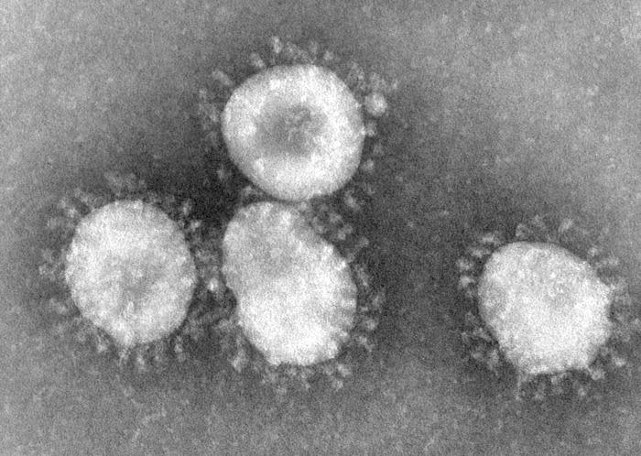
Severe forms OF Coronavirus
Family: Coronaviridae.
Structural features: Enveloped virus with + polarity ss-RNA genome.
Transmission: Inhalation of infectious aerosol droplets.
Clinical symptoms: The 2nd cause of common cold.
Coronavirus also causes zoonotic disease (the virus is capable of infecting humans and animals including birds, camels and others).

Slide 5
SARS-CoV
Severe Acute Respiratory Syndrome (SARS)
In winter of 2002, a new respiratory disease known as (SARS) emerged in China after a new mutation of coronavirus.
The disease spread worldwide due to travelling.
The animal reservoir may be cats.
SARS starts with high fever followed by cough with difficulty in breathing (atypical pneumonia).
Associated with high mortality due to respiratory failure.

Slide 7
MERS-CoV
In September 2012 ,a case of novel coronavirus infection was reported involving a man in Saudi Arabia who was admitted to a hospital with pneumonia and acute kidney failure.
This virus has been named as Middle East Respiratory Syndrome coronavirus (MERS-CoV) ,virus closely related to several bat coronaviruses.
MERS-CoV infected several human cells , including lower but not upper respiratory, kidney ,intestinal, and liver cells.

Slide 10
MERS-CoV
Middle East Respiratory Syndrome (MERS-CoV) is viral respiratory illness first reported in Saudi Arabia in 2012 . It is caused by a coronavirus. Cases have also been reported from other regions, including North Africa, Europe, Asia, and North America
Epidemiology: So far, all the cases have been linked to countries in and near the Arabian Peninsula.
Highly infectious, peak in winter.
Incubation period 2-14 days.
Transmission:
This virus spread from ill people to others through close contact, such as caring for or living with an infected person. However, there is no evidence of sustained spreading in community settings.
Evidence also suggested that the virus can be acquired from direct close contact with animals.

Slide 11
MERS-CoV
Possible sources and modes of transmission:
It seems likely that dromedary camels are the primary animal host for MERS-CoV , the presence of case clusters strongly suggests that human-to human transmission can occure.
Bats — Studies performed in Europe, Africa, and Asia, including the Middle East, have shown that coronavirus RNA sequences are found frequently in bat fecal samples and that some of these sequences . In a study from Saudi Arabia, 823 fecal and rectal swab samples were collected from bats, and, using a PCR assay, many coronavirus sequences were found are closely related to MERS-CoV sequences ,

Slide 12
Clinical Features:
Most people with confirmed MERS-CoV infection developed severe acute respiratory illness.
They had fever, cough, and shortness of breath.
Some people also had gastrointestinal symptoms including diarrhea and nausea/vomiting.
Some infected people had mild symptoms (such as cold-like symptoms) or no symptoms at all and they recovered completely.
Complications:
Severe complications include pneumonia and kidney failure. About 30% of people with MERS-Co died.
Most of the people who died had an underlying medical condition. People with pre-existing medical conditions ( co morbidities) such as diabetes, cancer, and chronic lung, heart, and kidney disease may be more likely to become infected with MERS-Co, or have a severe case. Individuals with weakened immune systems are also at higher risk for getting MERS or having a severe case.

Slide 13
Lab diagnosis: Detection of the viral nucleic acid by PCR,& serology by detection of IgM , and by isolation of the virus from Nasopharyngeal aspiration (NPA) by cell culture.
Treatment: No specific antiviral treatment. For severe cases, current treatment includes care to support vital organ functions.
Prevention:
People are advised to protect themselves from respiratory illnesses by taking everyday preventive actions:
• Wash your hands often with soap and water for 20 seconds, and use an alcohol-based hand sanitizer.
• Cover your nose and mouth with a tissue when you cough or sneeze, then throw the tissue in the trash.
• Avoid touching your eyes, nose and mouth with unwashed hands.
• Avoid personal contact, such as kissing, or sharing cups or eating utensils, with sick people.
• Clean and disinfect frequently touched surfaces such as toys and doorknobs.

Slide 14
●A novel coronavirus, Middle East respiratory syndrome coronavirus (MERS-CoV), causing severe respiratory illness emerged in 2012 in Saudi Arabia. Many additional cases and clusters of MERS-CoV infections have been detected subsequently in the Arabian Peninsula, particularly in Saudi Arabia , Isolated cases have also occurred in North Africa, Europe, Asia, and the United States. The number of cases in the Arabian Peninsula increased dramatically in March and April 2014, then declined sharply in mid-May 2014.
●MERS-CoV is closely related to coronaviruses found in bats, suggesting that bats might be a reservoir of MERS-CoV. Camels likely serve as intermediate hosts for MERS-CoV. The presence of case clusters strongly suggests that human-to-human transmission occurs.
●Real-time reverse-transcriptase polymerase chain reaction (rRT-PCR) testing applied to respiratory secretions is the DIAGNOSTIC assay of choice. Lower respiratory tract specimens should be a priority for collection and testing. To increase the likelihood of detecting MERS-CoV, we suggest collection of multiple specimens from different sites and at different times. Obtaining acute and convalescent serum is also important.
●Individuals with an acute respiratory infection who have an epidemiologic link to MERS-CoV or who have had an unusual or unexpected clinical course (especially sudden deterioration despite appropriate treatment) should be tested for MERS-CoV. Certain other patients may also require evaluation for MERS-CoV infection.
●There is currently no treatment recommended for coronavirus infections except for SUPPORTIVE care as needed.
●An increased level of infection control precautions is recommended when caring for patients with probable or confirmed MERS-CoV infection compared with that used for patients with community-acquired coronaviruses or other community-acquired respiratory VIRUSES . The United States Centers for Disease Control and Prevention (CDC) recommends the use of standard, contact, and airborne precautions for the management of hospitalized patients with known or suspected MERS-CoV infection.
●There is no licensed vaccine for MERS-CoV.
●The World Health Organization (WHO) does not recommend either special screening for MERS-CoV at points of entry or the application of any travel or TRADE restrictions. The Ministry of Health of Saudi Arabia recommends that in 2014, older adults, those with chronic diseases, immunocompromised patients, pregnant women, and children postpone their plans to travel to Mecca, Saudi Arabia, for Hajj and/or Umra

Slide 15
Measles Virus
Family: Paramyxovidae.
Structural features: Enveloped virus with ss-RNA genome.
Measles virus infects human only.
Transmission: Inhalation of infectious aerosol droplets.
Epidemiology and pathogenesis: Most cases in preschool children, very infectious cases mainly in winter and spring.
Virus infects first epithetical cells of respiratory tract then virus spread to the blood causing vireamia the virus widely disseminated to the skin with maculopopular rash.
Clinical features:
I.P.: 7- 14 days.
Prodromal symptom: Fever, cough, conjunctivitis and running nose
Koplik’s spot: Small white papule appear in buccal mucosa.
Rash: Maculopapular rash first on face trunk then extremities.
Recovery complete in normal children with life long immunity.
Complication also can occur.

Slide 16
Complication:
1- Encephalitis :Acute or Subacute sclerosing pan encephalitis (SSPE)
2- Giant cell pneumonia: rare in immunocompromised children due to direct invasion of measles virus to the lung tissue.
Lab diagnosis: Serology by detection of IgM Ab, and in case of SSPE detection of measles antibodies in CSF.
Treatment and prevention: No specific treatment, Prevention by giving the live attenuated vaccine (MMR) for Measles, Mumps and Rubella (given to all children 15 month and booster dose at school entry. Give excellent long last protection.

Slide 17
Koplik’s Spot

Slide 18
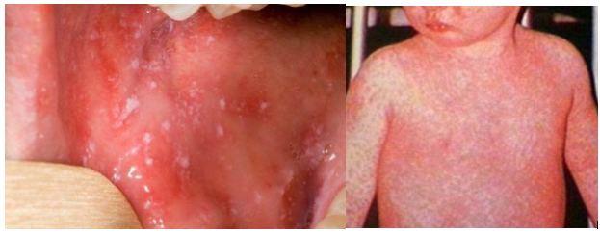
Measles

Slide 19
Mumps Virus
Mumps: is an acute benign viral parotids . . Parotids (painful inflammation and swelling of salivary gland), it is a disease of children (5-15 years), but also can be seen in young adult with more complicated feature.
Virology Aspect:
Family: Paramyxoviridae.
Structural features: Enveloped virus with ss-RNA genome.
Transmission: Inhalation of infectious aerosol droplets.
Epidemiology and pathogenesis : Mumps virus infect only human
Highly infectious, peak in winter.
Long incubation period 18-21 days.
Infection started in the epithelial cells of upper respiratory tract, then virus spread by Vireamia to parotid gland mainly and to other organs as: testes, ovary, pancreas and CNS.

Slide 20
Clinical Features:
Classic mumps
Sudden onset of fever and painful swelling of parotid gland.
Self-limiting disease resolve within one week.
Solid and long life immunity occurs.
Aseptic meningitis: rare presentation.
Complications: Seen mainly if infection occur in young adult as:
Orchitis bilateral can lead to sterility
Oophoritis, Thyroditis, Meningitis
Lab diagnosis: Serology by detection of IgMAb, viral culture and isolation from saliva or CSF.
Treatment and prevention:
No specific antiviral treatment
MMR: Live attenuated vaccine
For Measles, Mumps and Rubella given to all children 15 month and booster dose at school entry. Give excellent long last protection.

Slide 21
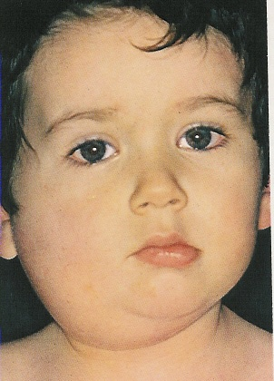
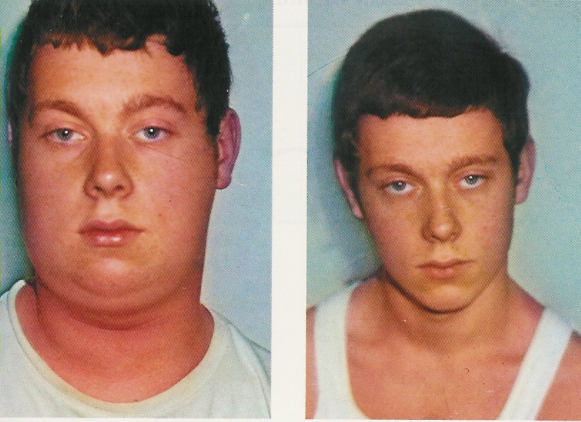
During Infection
After Recovery

Slide 22
Parvovirus B19
Family: Parvoviridae.
Structural features: Small unenveloped ss-DNA with icosahedral capsid. One antigenic type.
IP: 4-10 days.
Transmission: Inhalation of respiratory droplets. Blood transfusion, mother to baby.
Epidemiology and target group: Worldwide and mostly in winter and spring, Children (5-10 years).
The virus causes slapped cheek, erythema infectiosum, fifth disease.
Pathogenesis:
The virus infects the endothelial cells of the blood vessels in the skin, and the red blood cells precursors (erythroblast) in the bone marrow, which account for aplastic anemia.
Immunocomplexes may attribute to the development of the rash.

Slide 23
Clinical features:
The disease starts with fever, sneezing and coughing.
Followed by the development of the maculopapular rash.
The rash is red, confluent, fine, most intense on the cheek.
The rash may appear on the trunk and limbs.
Lesions fades from the center leaving the periphery red, developing characteristic reticular or lace-like pattern.
There is mild generalized lymphadenopathy.
Arthralgia with swelling and pain in the joints are seen in women.
Recovery: is complete.

Slide 24
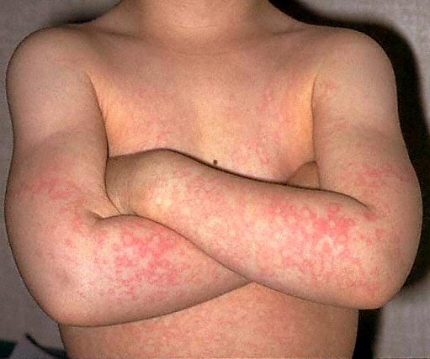
Slapped cheek / erythema infectiosum

Slide 25
Complications:
Aplastic crisis sudden and temporary disappearance of erythroblasts from the bone marrow, seen in patients with hemolytic anemia. The bone marrow does not produce RBC.
Chronic anemia occurs in the immunocompromised when the immune system is unable to produce antibodies to neutralize the virus.
Hydrops fetalis occurs during pregnancy when the mother become infected with parvovirus B19
Lab diagnosis: detection of Ig-M antibody by ELISA or PCR.
Prevention: There is no vaccine available.
Treatment: There is no specific antiviral drug therapy.

Slide 26
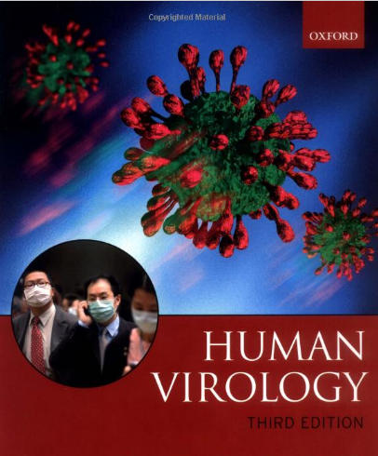
Reference books &the relevant page numbers
Notes on Medical Microbiology
By; Katherine N. Ward, A. Christine McCartney, and Bishan Thakker.
(2009)
Pages; 329-340.
Human Virology
By; Leslie Collier and John Oxford.
(2006)
Pages, 71-95.

