Slide 1
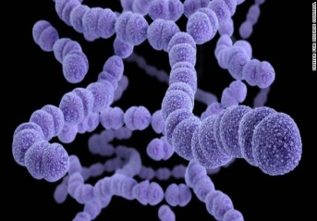
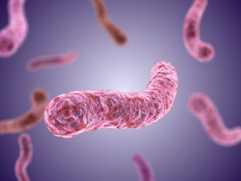
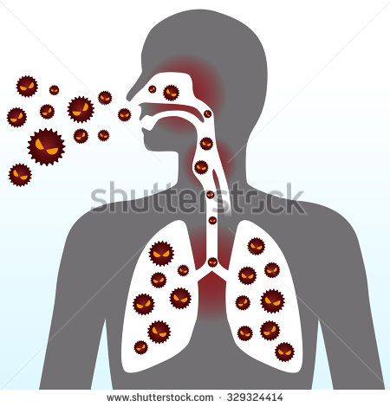
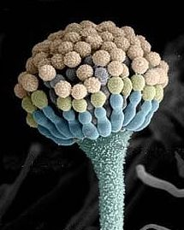
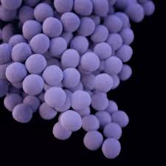
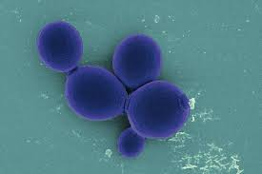
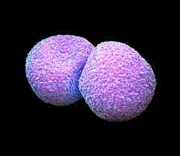
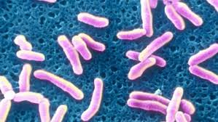
Respiratory Tract Infection Practical
RESPIRATORY BLOCK

Slide 2
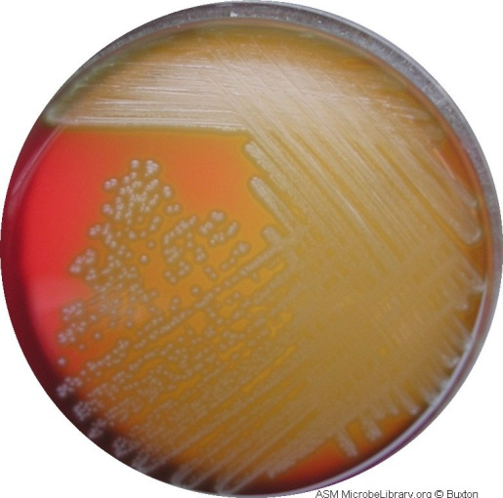
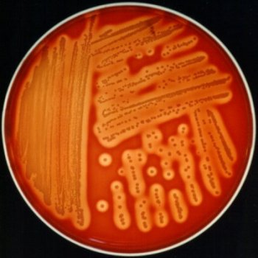
Type of Haemolysis on Blood Agar
IMAGE | DESCRIPTION | HAEMOLYSIS TYPE
 | colonies surrounded by partial haemolysis with greenish color | Alpha haemolysis
 | colonies are surrounded by a clear zone | Beta haemolysis

Slide 3
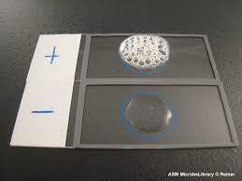
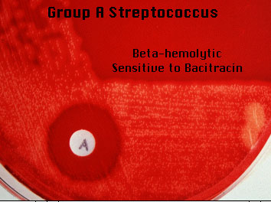
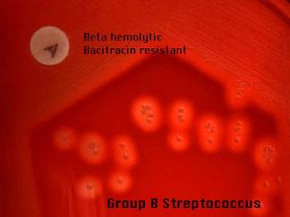
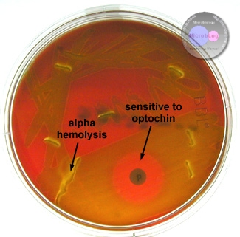
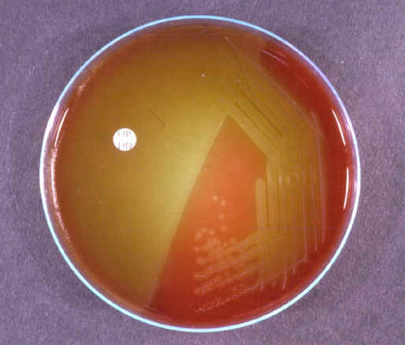
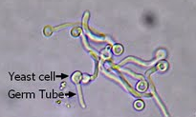
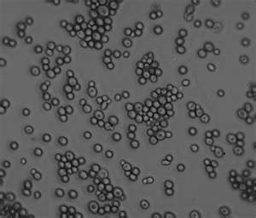
Different Test Used in Lab.
negative | Positive | Use | Test
Streptococcus | Staphylococcus | To differentiate between Staphylococcus & Streptococcus | CATALASE TEST
 |  | To differentiate between Streptococcus (gp.A) & any other group | BACITRACIN SUSCEPTIBILITY
 |  | To differentiate between Streptococcus pnumoniae & other alpha haemolysis Streptococcus spec. | OPTOCHINSUSCEPTIBILITY
 |  | FOR IDENTIFICATION OF CANDIDA ALBICANS | GERM TUBE TEST

Slide 4
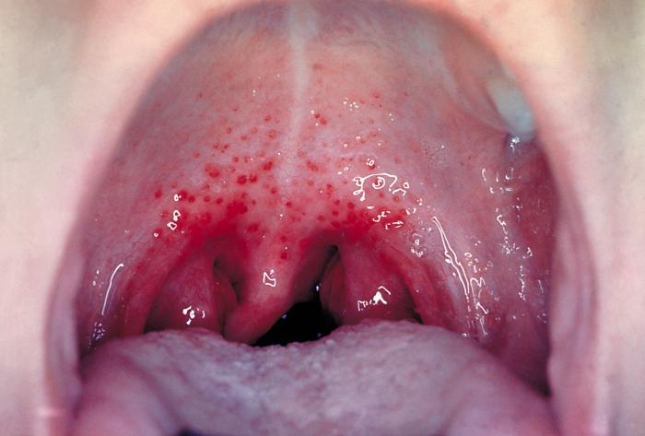
Case1
A 5 year boy was brought to KKUH, outpatient department complaining of fever and sore throat. He had regular vaccination history. On examination his temp. was 38.5°C, the tonsil area and pharynx were obviously inflamed with some foci of pus.

Slide 5
1. What is the differential diagnosis?
2. What investigation should be done?

Slide 6
LAB. TESTS
(Rapid Antigen Detection Test) RADT
CULTURE OF THROAT SWAB ON BLOOD AGAR.
CATALASE TEST .
GRAM STAIN FROM CULTURE.
BACITRACIN SUSCEPTIBILITY TEST.

Slide 7
Clinical and Epidemiologic Features

Slide 8

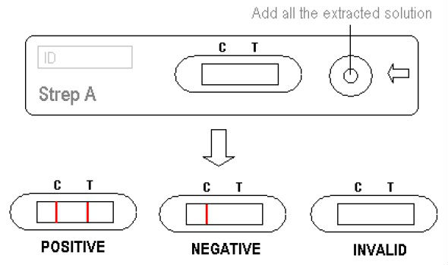
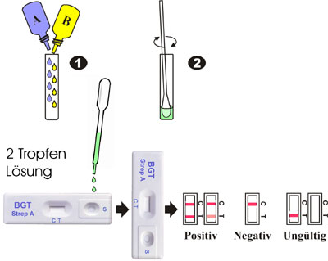
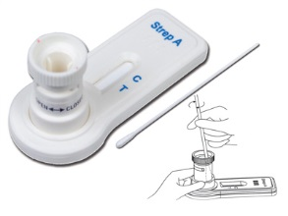
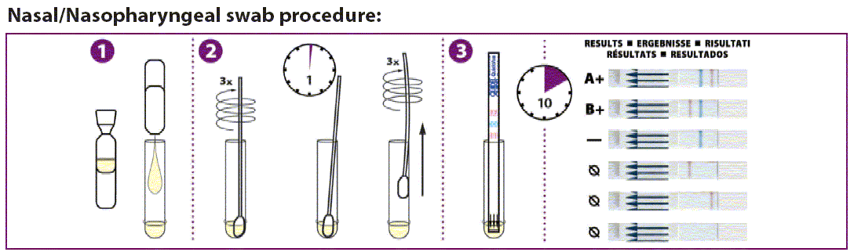
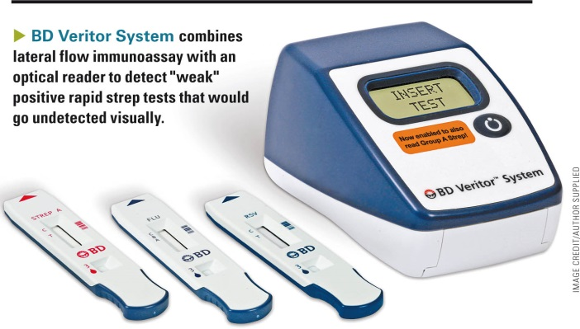
 RADT

Slide 9
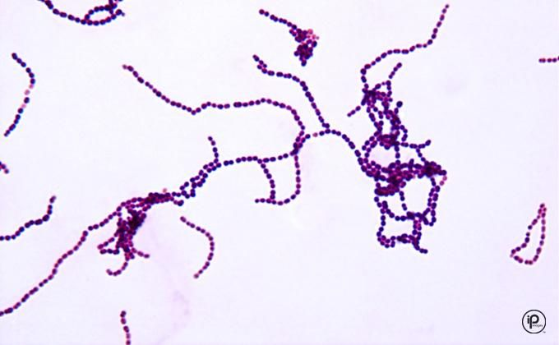
Throat swab culture showed:
Beta haemolysis on blood agar (colonies are surrounded by a clear zone).
MICROSCOPIC APEARANCE
 culture
Gram stain From culture showed :
Gram positive cocci in Chains

Slide 10
CATALASE TEST
Catalase –ve test

Slide 11
Bacitracin Susceptibility
Bacitracin susceptible colonies
B
B

Slide 12


Lab. Tests Results(Summary)
IMAGE | RESULT | TEST
 | Beta haemolysis (colonies surrounded with clear zone of haemolysis) | CULTURE ON BLOOD AGAR
 | No bubbles → catalase negative | CATALASE TEST
 | gram positive cocci in chains | GRAM STAIN FROM CULTURE
 | Bacitracin Susceptible colonies | BACITRACIN SUSCEPTIBILITY TEST
Streptococcus pyogenes

Slide 13
1. What is the likely identity of the organism?
2. What is the best antibiotic therapy for this
child?
3. If not treated what complication may this
child have after 6 weeks period?

Slide 14
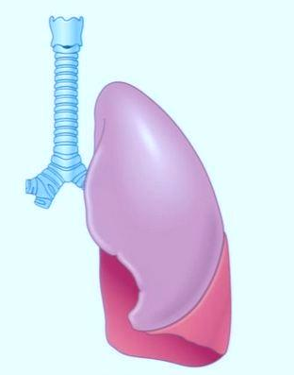
Case2
A 28 Year Old Female presented to the accident and emergency of KKUH with a sudden onset of fever, right sided chest pain and productive cough of purulent sputum. On examination her temperature was 39 °C. There were Rhonci and dullness on the right side of the chest X-ray showed massive consolidation on the right side of the chest.

Slide 15
1. What is the differential diagnosis?
2. What investigation should be done?

Slide 16
LAB. TESTS
CBC.
Gram stain from sputum .
Culture of The sputum on blood agar.
catalase test.
Optochin susceptibility test.
Antibiotic susceptibility test

Slide 17
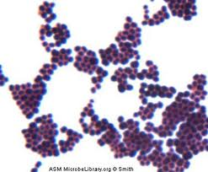
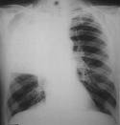
The chest X- ray done showed massive consolidation on the right side of the chest.
 X - Ray

Slide 18
What should have been the empirical therapy for this case and why?

Slide 19
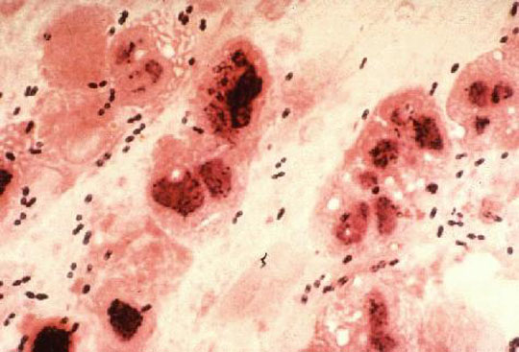
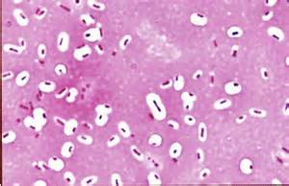
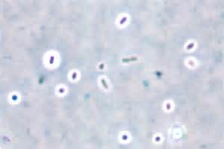
Sputum culture showed:
Alpha haemolysis on blood agar (colonies surrounded by partial haemolysis with greenish color).
MICROSCOPIC APEARANCE
 culture
Gram stain From sputum showed :
Gram positive diplococci (arranged in piers
Negative Stains showing capsule:
Capsule stain
India ink stain

Slide 20
CATALASE TEST
Catalase –ve test

Slide 21
Optochin Susceptibility
Optochin susceptible colonies
B

Slide 22
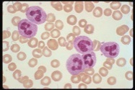
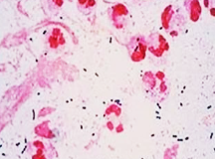
Lab. Tests Results(Summary)
 | Result | TEST
 | 45,000/ ml 90% of the cells were neutrophils | CBC
 | Alpha haemolysis (colonies surrounded by partial haemolysis with greenish color) | CULTURE ON BLOOD AGAR
 | No bubbles → catalase negative | CATALASE TEST
 | gram positive diplococci in pairs | GRAM STAIN
 | Optochin Susceptible colonies | Optochin SUSCEPTIBILITY TEST
Streptococcus pneumoniae (Pneumococcus)

Slide 23
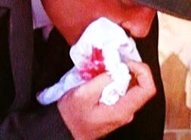
Case3
Abdul Karim is a 45 year old Saudi man who was admitted to KKUH because of 2-3 month history of loss of appetite, weight loss, and on and off fever with attacks of cough. On examination Abdul Karim looked weak with a temperature 38.6 °C, CVS and Respiratory system examination was unremarkable.
Two days before admission .he coughed blood (haemoptysis), Abdul karim is diabetic for the last 5 years. His father died of tuberculosis at the age of 45 yrs.

Slide 24
1. What is the differential diagnosis?
2. What investigation should be done?

Slide 25
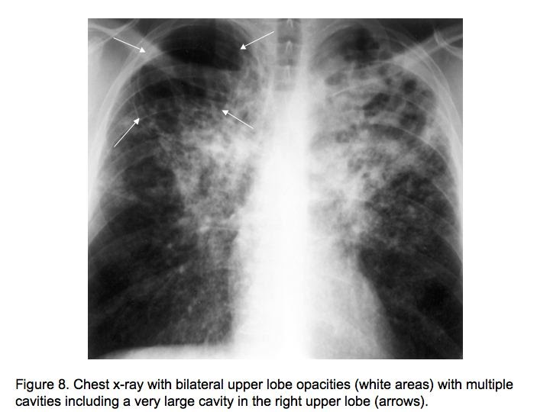
The chest X- ray done showed multiple opacities and cavities
X - Ray
Mycobacterium tuberculosis

Slide 26
On examination Abdul Karim looked weak with a temperature 38.6 °C, CVS and Respiratory system examinnation was unremarkable.
The chest X- ray done showed multiple opacities and cavities.
The ESR was increased (85 m /hour).
What further tests should be done?

Slide 27
LAB. TESTS
Sputum smear showed AFB
Culture on L.J medium ( selective for mycobacteria.

Slide 28
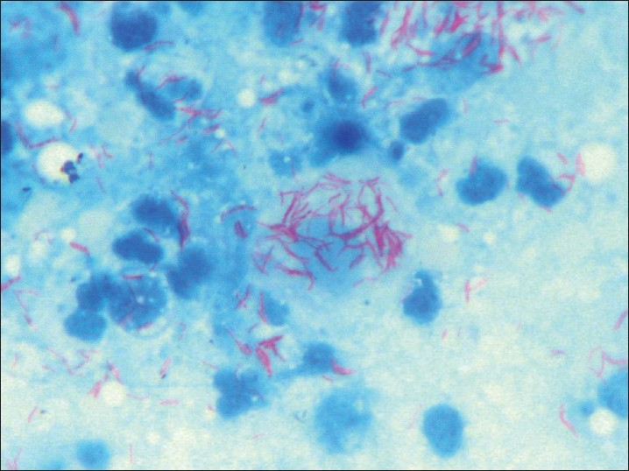
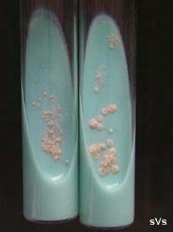
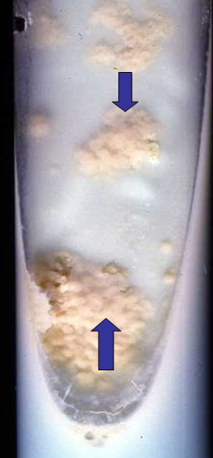
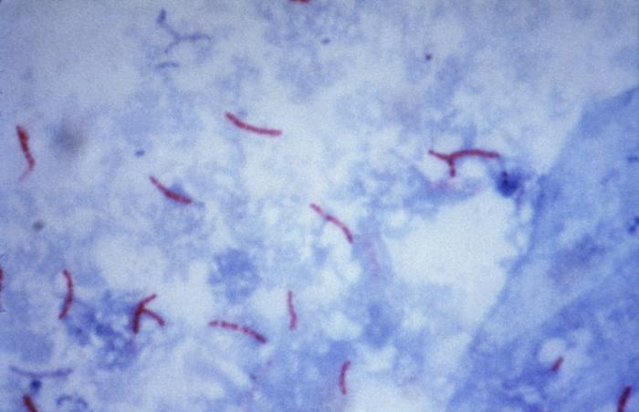
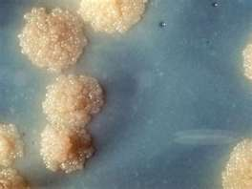
Sputum culture on Lowenstein–Jensen medium (selective for mycobacteria) showed: showing growth of Rough, Tough and Buff colonies
MICROSCOPIC APEARANCE
 culture
Ziel – Neelsen Stained Smear From Sputum Showing:
Acid – Fast Bacilli AFB

Slide 29
What is the probable diagnosis?
How can the diagnosis be confirmed?
Mycobacterium tuberculosis

Slide 30
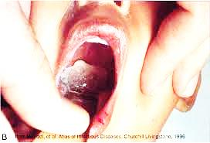
Case4
A 5 year-old boy attended to the emergency department complaining of sore throat , fever (38.5°C), and a noticed pharyngeal pseudomembrane

Slide 31
1. What is the differential diagnosis?
2. What investigation should be done?

Slide 32
LAB. TESTS
Throat swab culture on blood tellurite.
Gram stain From culture.
ELEK test

Slide 33
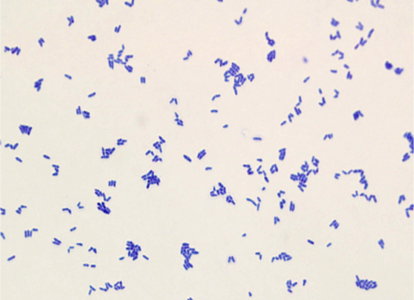
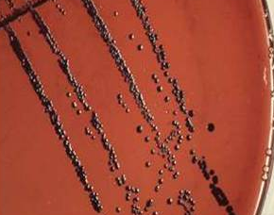
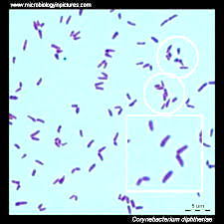
Throat swab culture on blood tellurite showed:
Black color colonies
MICROSCOPIC APEARANCE
 culture
Gram stain From culture showed :
Gram positive bacilli (chains' litter appearance)
Corynebacterium diphtheriae

Slide 34
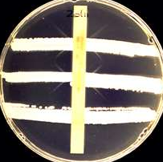
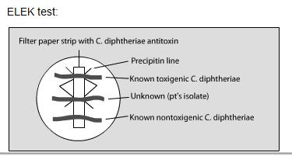
 ELEK TEST
Toxin from culture of C. diphtheriae diffused and react with the diphtheria antitoxin defused from strip and produce precipitation lines → which demonstrate positive test (Diphtheria exotoxin production)

Slide 35
1. What is the likely identity of the organism?
2. What is the best antibiotic therapy for this
child?
3. what complication may this child develop?

Slide 36
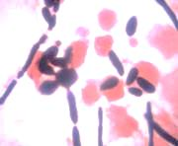
Case5
A 45-year old women who underwent bilateral lung transplant developed fever and respiratory failure 4 days post-operatively. She received immunosuppressive therapy. Gram stain of lung tissue biopsy shown below figer:

Slide 37
1. What is the differential diagnosis?
2. What investigation should be done?

Slide 38
LAB. TESTS
Gram stained of lung tissue.
Culture from sputum on SDA.
Germ tube test.
chlamydospore test.

Slide 39
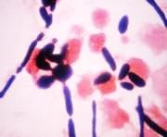
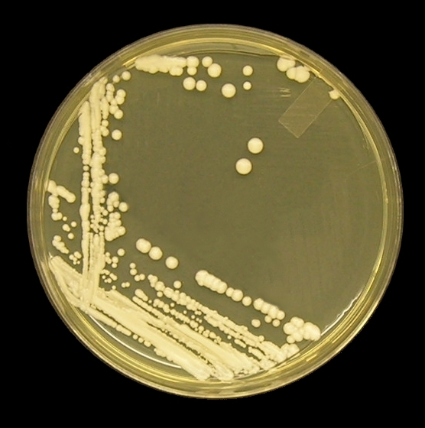
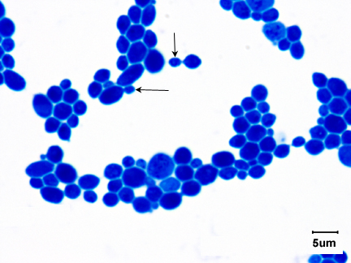
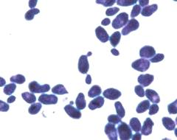

Culture from sputum on SDA (Sabouraud's Dextrose Aagar) showed:
Cream color colonies.
MICROSCOPIC APEARANCE
 culture
1- Gram stained of lung tissue showed :
Budding yeast cells & pseudohyphae.
2- Gram stain From culture showed :
Gram positive oval budding yeast cells.

Slide 40



+Ve Test
CHLAMEDOSPORE TEST
 GERM TUBE TEST
CULTURE ON CORN MEAL AGAR
+Ve Test

Slide 41

Lab. Tests Results(Summary)
 | Result | TEST
 | Budding yeast cells & pseudohyphae. | Gram stained of lung tissue
 | Cream color colonies | CULTURE ON SDA
 | Chlamydospores, blastosconidia and pseudohyphae | CHLAMEDOSPORE TEST
 | Germination of tube | GERM TUBE TEST
Candida albicans

Slide 42

Case6
A 15-yaer old girl who recently diagnosed as acute leukemia developed prolonged granulocytopenia (less than 100/muL) and refractory fever for 14 days and pulmonary signs or symptoms of pneumonia. Lung biopsy showed the below figer:

Slide 43
LAB. TESTS
Methenamine silver (GMS).
H&E Stain.
Culture from sputum on SDA.
LPCB preparation from culture

Slide 44







Culture from sputum on SDA (Sabouraud's Dextrose Aagar) showed: “salt and pepper appearance”.
MICROSCOPIC APEARANCE
 culture
1- Methenamine silver (GMS) stained tissue section of lung showing:
Dichotomously branching fungal element.
2- Methenamine silver (GMS) stained tissue section of lung showing:
Dichotomously branching fungal element.
LPCB preparation from culture showed :

Slide 45
Lab. Tests Results(Summary)
Images | Result | TEST
 | Dichotomously branching fungal element | Methenamine silver (GMS) tissue stain
 | Dichotomously branching fungal element | H&E tissue Stain
 | Salt and pepper appearance | Culture
 | Dark brown conidial heads and true hyphae | LPCB preparation from culture
Aspergillus niger

