Slide 1
Bronchial Asthma
RESPIRATORY BLOCK
Dr. Maha Arafah
Department of Pathology
KSU
marafah@ksu.edu.sa
Jan 2016

Slide 2
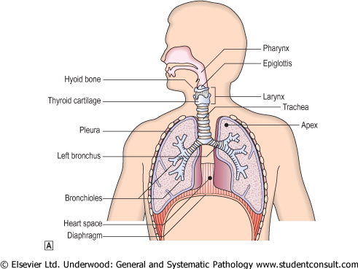
INTRODUCTION TO THE RESPIRATORY TRACT

Slide 3
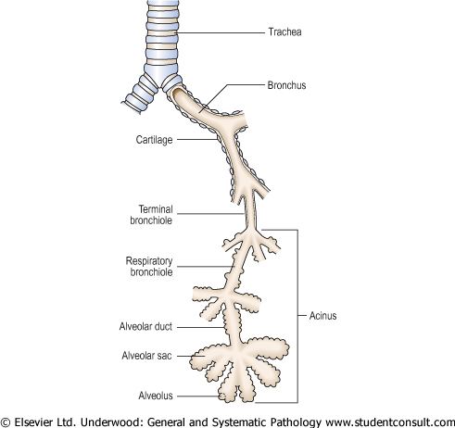
The right and left main bronchi divide into lobar bronchi.
The lobar bronchi divide into tertiary/segmental bronchi, each of which supplies a bronchopulmonary segment.
The segmental bronchi divide into primary bronchioles which divide into terminal bronchioles and then divide into respiratory bronchioles, which go on to divide into alveolar ducts.
Each alveolar duct divides into five or six alveolar sacs.
The alveolar sacs are made up of alveoli. The alveolus is the basic anatomical unit of gas exchange in the lung.
Beyond terminal bronchiole gas exchange occurs
The distal airspaces are kept open by elastic tension in alveolar walls

Slide 4
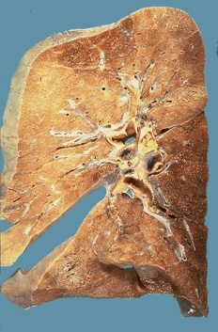
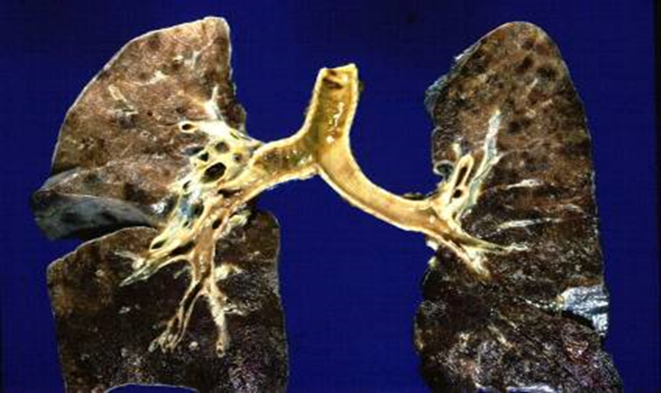
normal lung

Slide 5
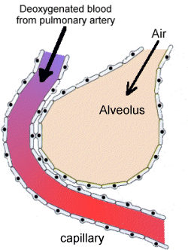
Function of lungs….
Gas exchange (O2, CO2)
  Depends on compliance (stretchability) of lungs
  Can only occur in alveoli that are both ventilated and perfused

Slide 6
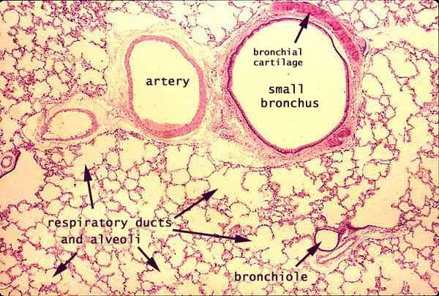
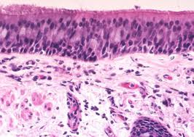
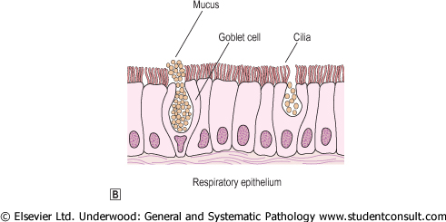
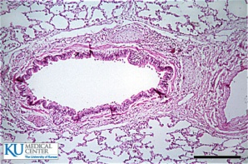
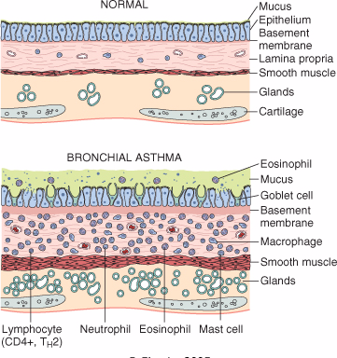

Slide 7

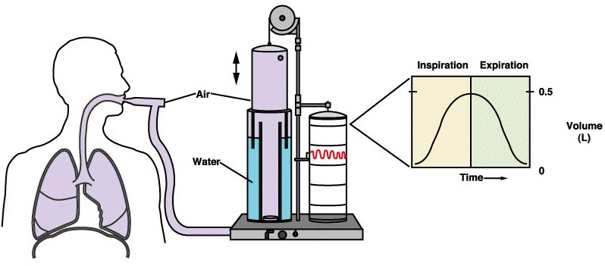
Spirometer
is an equipments used for measuring the volume of air inspired and expired by the lungs ( Pulmonary Function Tests)

Slide 8
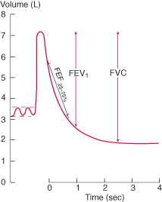

Slide 9
Spirometry (pulmonary physiology)
Forced expiratory volume (FEV1): volume of air blown out forcibly in 1 second. A function of large airways. Dependent on body size.
Vital capacity (VC): total volume of expired air.
Diffusing capacity or Transfer factor of the lung for carbon monoxide (D_{LCO} or T_{LCO}): absorption of carbon monoxide in one breath (gas exchange). It is dependent on the concentration of blood haemoglobin, which has a strong affinity for CO and it assesses the ability of the lungs to exchange gas efficiently.

Slide 10
Classification of Lung Disease based on distinctive clinical and physiological features:
Obstructive lung diseases:
Is a category of respiratory disease characterized by airway obstruction due to partial or complete obstruction at any level from trachea to respiratory bronchioles. It is generally characterized by inflamed and easily collapsible airways, obstruction to airflow and problems exhaling.
Pulmonary function test: decreased FEV1 and decreased FEV1/VC.
Restrictive lung diseases:
Are a category of diseases that restrict lung expansion, resulting in a decreased total lung capacity, increased work of breathing, and inadequate ventilation and/or oxygenation.
Both forced expiratory volume in one second (FEV1) and forced vital capacity (FVC) are reduced, however the FEV1/VC is normal to high. The Tco is decreased. The expiratory flow rate is near normal.

Slide 11
Types of Obstructive Lung Diseases
(diffuse)
Common symptoms in lung disease
  Dyspnea: difficulty with breathing
  Cough
  Hemoptysis
Bronchial Asthma
2) Chronic obstructive pulmonary disease (COPD). It is also known as Chronic obstructive airway disease (COAD) or Chronic obstructive lung disease (COLD).They are of two types:
a) Chronic bronchitis
b) Emphysema
3) Bronchiectasis

Slide 12
BRONCHIAL ASTHMA

Slide 13
BRONCHIAL ASTHMA (BA)
It is a chronic relapsing inflammatory obstructive lung disease characterized by hyper-reactive airways.
It is reversible bronchoconstriction/spasm characterized by hyper-irritability of the airways due to increased responsiveness of the tracheobronchial tree to various stimuli.

Slide 14
BRONCHIAL ASTHMA (BA)
It is a triad of:
    intermittent and reversible airway obstruction
    chronic bronchial inflammation with eosinophils
    bronchial smooth muscle cell hypertrophy and hyper-reactivity
Primarily targets the bronchi and terminal bronchioles
Most common chronic respiratory disease in children. More common in children than adults
Asthma animation: http://link.brightcove.com/services/player/bcpid236059233?bctid=347806802

Slide 15
Bronchial asthma :
It has been divided into two basic types:
1. Extrinsic asthma.
2. Intrinsic asthma.
Sometimes extrinsic and intrinsic can co-exist in the same patient
Extrinsic (atopic, allergic) Asthma 70%
- Initiated by type 1 hypersensivity reaction induced by exposure to extrinsic antigen/allergens e.g. food, pollen, dust, etc.
- Subtypes include:
atopic (allergic)asthma.
occupational asthma.
allergic bronchopulmonary aspergillosis.
- Develop early in life
Intrinsic (non-atopic)Asthma 30%
- Initiated by diverse, non-immune mechanisms e.g. infections, drugs like aspirin, pollutants, inhaled chemical irritants, cold, stress and exercise.
- No personal or family history of allergic reaction.
- Develop later in life

Slide 16
Extrinsic/ Allergic BA
It is also known as allergic, immune mediated, atopic or reaginic asthma.
In extrinsic (allergic) BA, bronchospasm is induced by inhaled antigens, usually in children with a personal or family history of allergic disease
Symptoms are brought about by IgE mediated type I hypersensitivity reaction to inhaled allergens.
Serum levels of IgE and eosinophils usually are elevated.

Slide 17
Extrinsic/ Allergic BA
Atopic (allergic) asthma is the most common type and begins in childhood
Other allergic manifestation may be present: allergic rhinitis, urticaria, eczema or hay fever.
Skin test with antigen is positive and results in an immediate wheel and flare reaction
immune related with the involvement of TH2 subset of CD4+ T cells

Slide 18
Intrinsic / Non-Atopic/ Idiosyncratic BA
(non-immune mediated asthma)
Intrinsic asthma is a disease of adults in which the bronchial hyper-reactivity is precipitated by a variety of factors unrelated to immune mechanisms.
It has an unknown basis.
Symptoms are precipitated by non allergic factors such as inhaled irritants/pollutants (e.g. sulfur dioxide, ozone) or infection(viruses).
Positive family history is uncommon.
Serum IgE – normal.
No other associated allergies.
Skin test – negative.
Subtypes:
1. Drug-induced asthma (aspirin or nonsteroidal drug sensitivity).
2. Occupational asthma(fumes, dusts, gases)

Slide 19
Pathogenesis of Bronchial Asthma
The pathophysiology of asthma is complex and involves the following components:
Chronic airway inflammation
Intermittent airflow obstruction. Airflow obstruction can be caused by a variety of changes, including acute bronchoconstriction, airway edema, chronic mucous plug formation, and airway remodeling
Bronchial hyper-responsiveness causes exaggerated bronchoconstriction.
The degree of airway hyper-responsiveness generally correlates with the clinical severity of asthma.

Slide 20
Pathogenesis of Bronchial Asthma
Principal cells in asthma: mast cells, eosinophils, epithelial cells, macrophages, and activated T lymphocytes (TH2 subset) and neutrophils.
T lymphocytes play an important role in the regulation of airway inflammation through the release of numerous cytokines
The pathogenetic mechanisms have been best studied in atopic asthma

Slide 21
Pathogenesis of Bronchial Asthma using type 1 IgE-mediated Atopic Asthma as a model
First there is initial sensitization or priming: first time exposure to an inhaled allergen which stimulates induction of Th2-type T cells (CD4 T_{H}2) to produce cytokines(interleukin IL- 4, IL-5 and IL-13)
    IL-4 plays a role in cross-linking of immunoglobulins in B lymphocytes, promote production of IgE and mast cells.
    IL-5 stimulates production and activation (recruitment) of eosinophils.
    IL-13 is needed for IgE formation.
And then there is subsequent re-exposure to the allergen will leads to an IgE mediated reaction.
This IgE-mediated reaction to inhaled allergens elicits:
  1. an acute response (within minutes)
  2. a late phase reaction (after 4-8 hours)

Slide 22
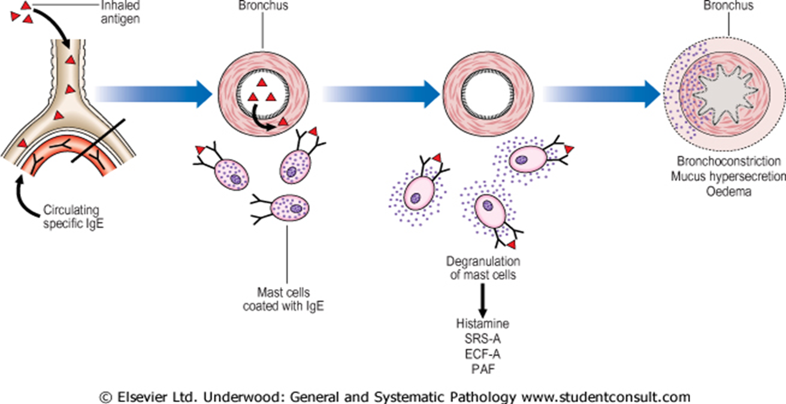
Pathogenesis of Bronchial Asthma using type 1 IgE-mediated Atopic Asthma as a model
Acute-phase response
Begin 30 to 60 minutes after inhalation of antigen/aeroallrgens(e.g. allergens, drugs, cold, exercise).
The exposure results in the stimulation and degranulation of mast cells, eosinophils, and basophils with the release of inflammatory mediators from these cells and also from activated macrophages. The released mediators induce bronchoconstriction/spasm, increased vascular permeability, inflammation and injury of the bronchial walls and bronchial epithelium and excess mucous secretion.

Slide 23
Pathogenesis of Bronchial Asthma using Atopic Asthma as a model
Late phase reaction/ late asthmatic response:
It is the airway edema which occurs 6-24 hours following allergen exposure.
The arrival of leukocytes at the site of mast cell degranulation leads to release of more mediators to activate more mast cells
Discharge of eosinophil granules releases major basic protein, eosinophilic cationic protein and eosinophil peroxidase into the bronchial lumen. These substances are toxic to epithelial cells and cause epithelial cell damage and further impair mucociliary function.
Moreover, chemotactic factors like leukotriene B_{4,} eosinophil chemotactic factor and PAF recruit more eosinophils, neutrophils and platelets to the bronchial wall, and so the vicious circle continues and prolongs and amplifies the asthmatic attack.
All these factors amplify and sustain injury without additional antigen.

Slide 24
Inflammatory Mediators of Bronchial Asthma using Atopic Asthma as a model
Inflammatory mediator produced are :
  Leukotrienes C4, D4 & E4 (induce bronchospasm, vascular permeability & mucous production)
  Prostaglandins D2, E2, F2 (induce bronchospasm and vasodilatation)
  Histamine from the mast cells (induce bronchospasm and increased vascular permeability)
  Platelet-activating factor (cause aggregation of platelets and release of histamine)
  Mast cell tryptase (inactivate normal bronchodilator).
  Tumor necrosis factor (amplify the inflammatory response)
The inflammatory mediators lead to
(1) smooth muscle contraction, bronchospasm
(2) mucous secretion, and
(3) increased vascular permeability and edema.

Slide 25
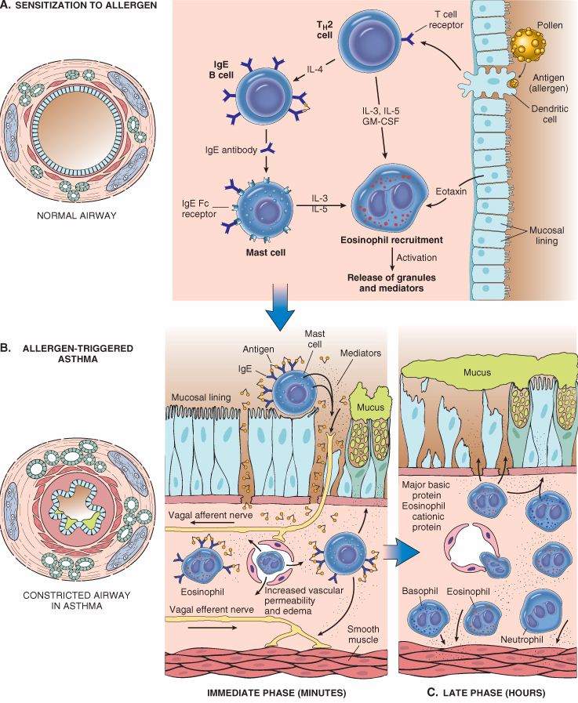

Slide 26
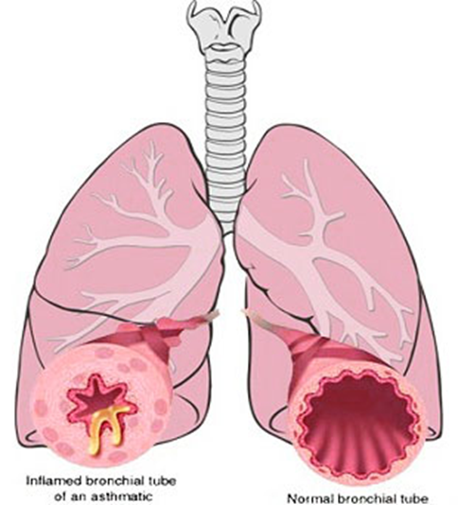
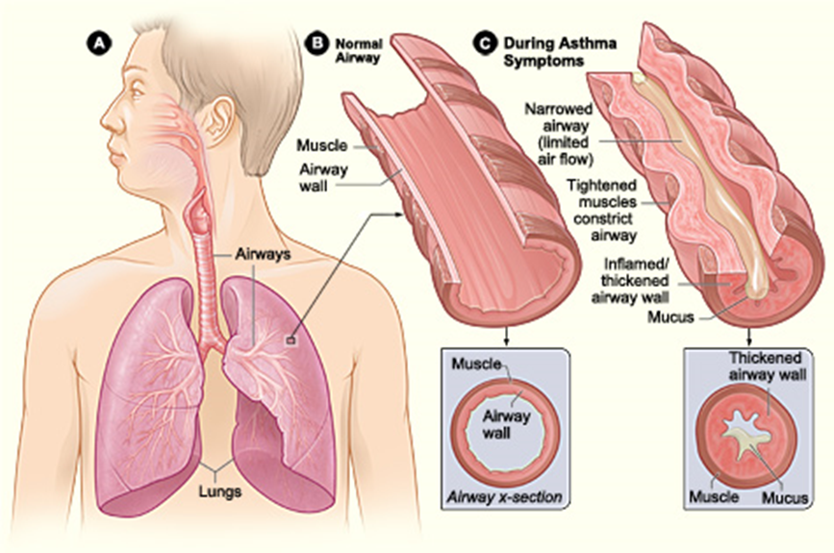
Morphology of Asthma: the pathologic findings are similar in both types BA
Grossly: - lung over distended (over inflation), occlusion of bronchi and bronchioles by thick mucous.
  the bronchi have thickened walls with narrowed lumina and generally are filled with plugs of mucus in acute attack

Slide 27
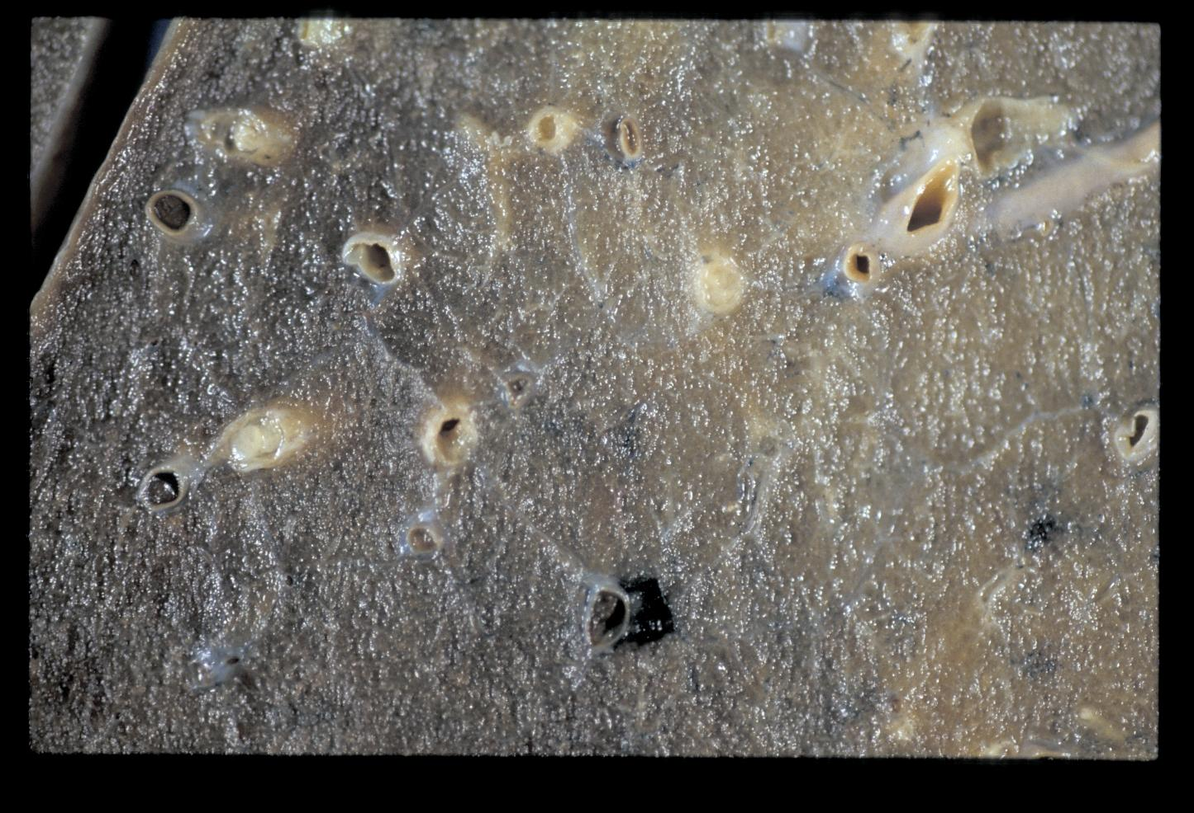
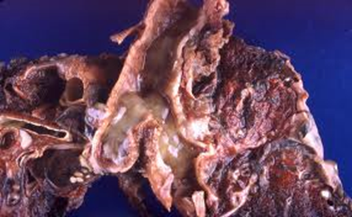
Mucus plugs

Slide 28
Morphology of Asthma
Histologic finding:
  Thick Basement Membrane.
  Edema and inflammatory infiltrate in bronchial wall.
  mucous contain Curschmann spirals, eosinophil and Charcot-Leyden crystals.
  Submucosal glands increased.
  Hypertrophy of the bronchial wall muscle.

Slide 29
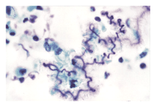
Curschmann spirals
Coiled, basophilic plugs of mucus formed in the lower airways and found in sputum and tracheal washings

Slide 30
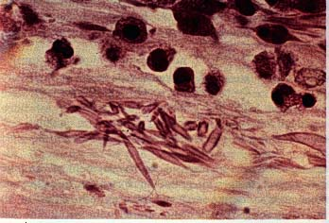
Charcot-Leyden crystals.
Eosinophilic needle-shaped crystalline structures.

Slide 31
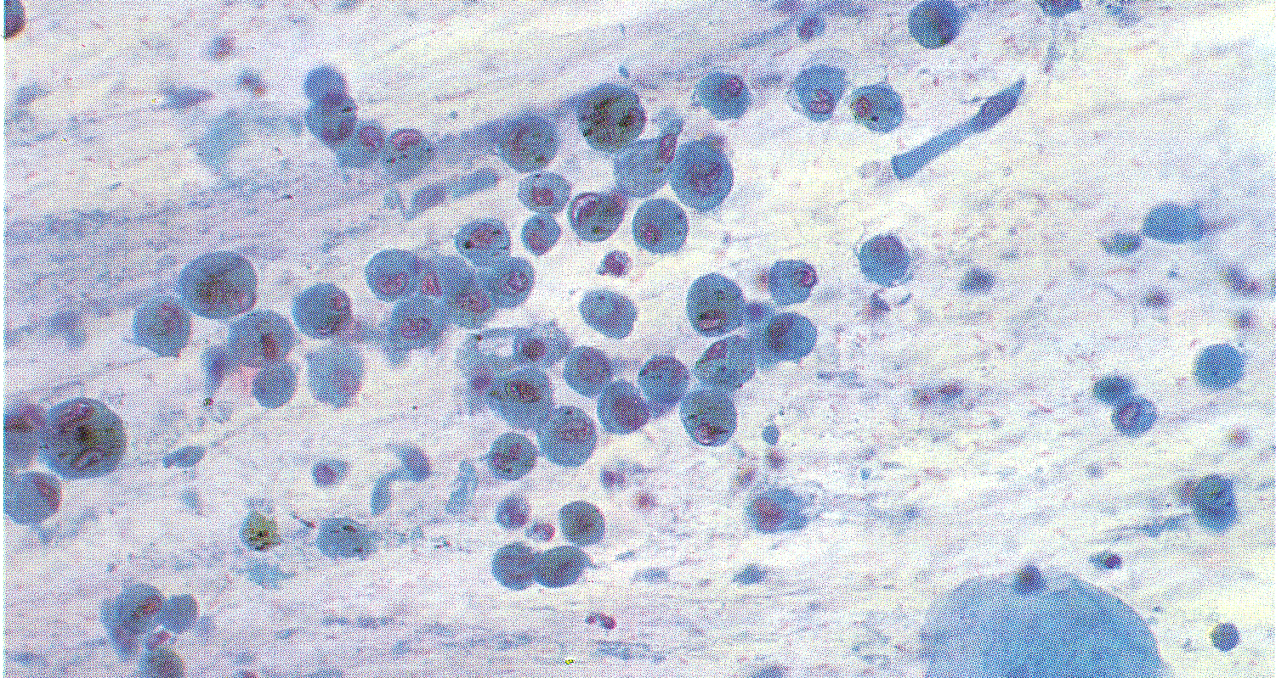
Ciliated columnar epitheliu
Alveolar macrophage containing carbon dust
Composition of satisfactory specimen : Sputum

Slide 32
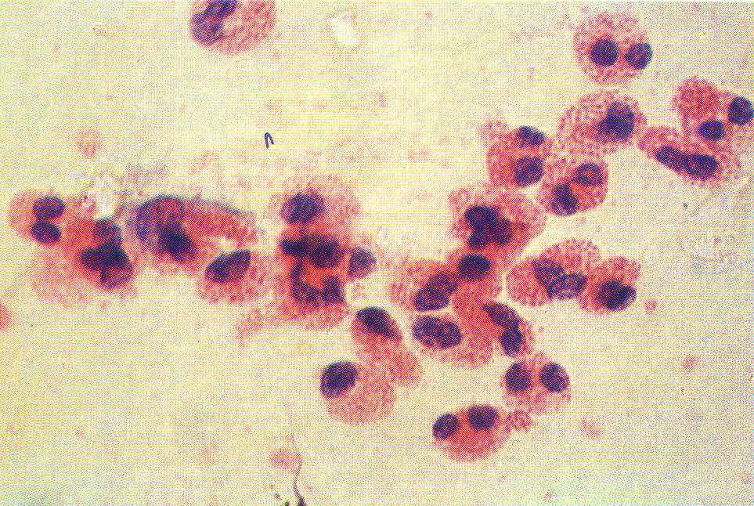
Eosinophils from a case of Bronchial Asthma

Slide 33
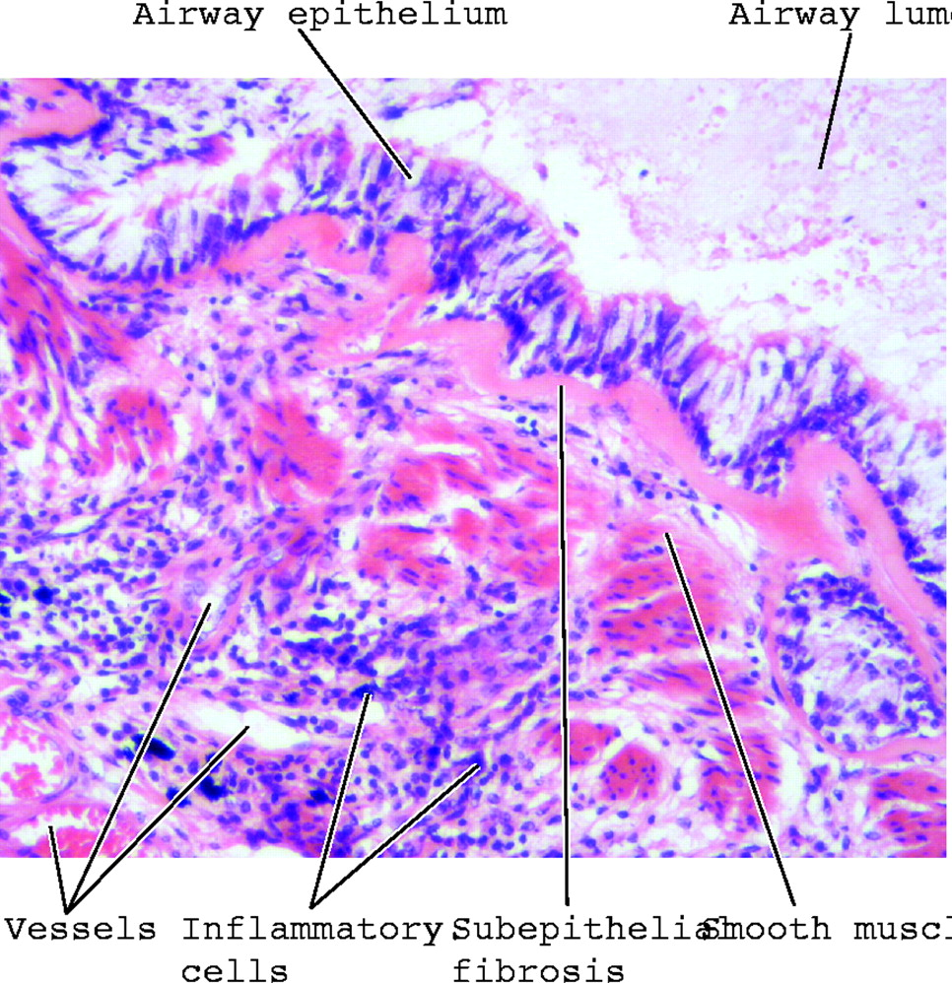
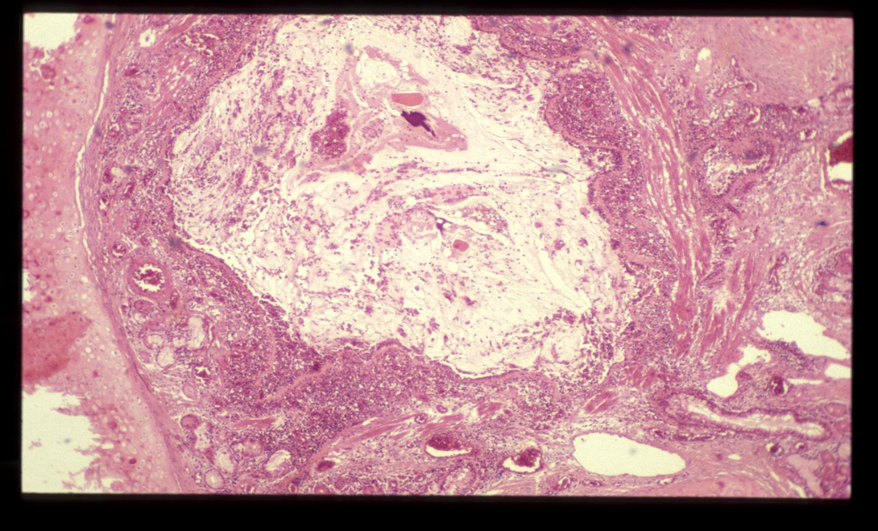

Slide 34
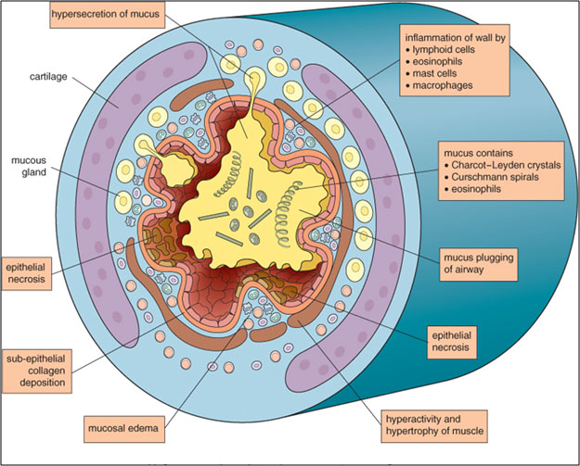

Slide 35
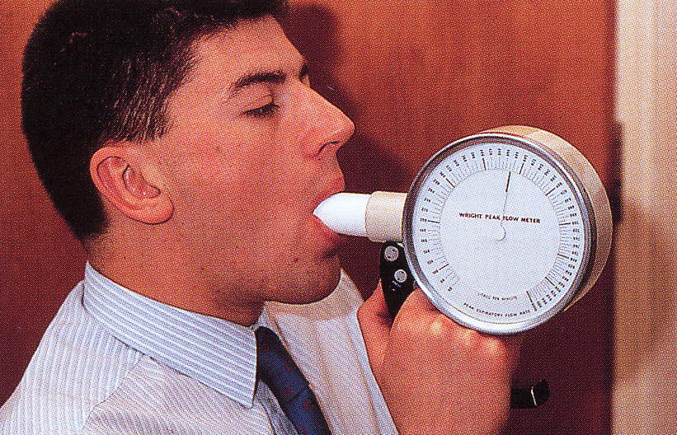
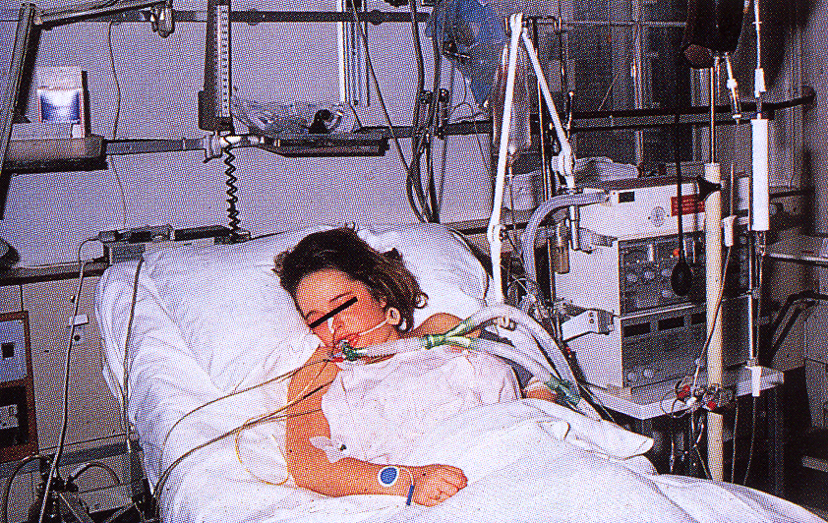
CLINICAL COURSE of BA
The clinical manifestations vary from occasional wheezing to paroxysms of dyspnea and respiratory distress.
In a classic asthmatic attack there is dyspnea, cough, difficult expiration, progressive hyperinflation of lung and mucous plug in bronchi. This may resolve spontaneously or with treatment.
Nocturnal cough
Increased anteroposterior diameter, due to air trapping and increase in residual volume
Status asthmaticus – severe cyanosis and persistent dyspnea, may be fatal
The range of presentation in asthma.
medical emergency with acute severe breathlessness, diagnosed as a case of status asthmaticus which required immediate intensive care including intermittent positive-pressure ventilation.
This patient was found incidentally to have a degree of reversible airways obstruction during a routine medical examination.

Slide 36
STATUS ASTHMATICUS
It is the most severe form of asthma. It refers to severe bronchoconstriction that does not respond to the drugs that usually abort the acute attack. There is severe acute paroxysm of respiratory distress.
This situation is potentially serious and requires hospitalization. Patients in status asthmaticus have hypoxemia and often hypercapnia.
In particularly severe episodes the ventilatory functions may be so impaired so as to cause severe cyanosis and even death.
They require oxygen and other pharmacologic interventions.
It may persists for days and even weeks.

Slide 37
COMPLICATIONS OF ASTHMA
Airway remodeling: some persons with long standing asthma develop permanent structural changes in the airway with a progressive loss of lung function that increase airflow obstruction and airway responsiveness.
Superimposed infection i.e. pneumonia
Chronic bronchitis (i.e.Asthmatic bronchitis: chronic bronchitis with superimposed asthma)
Emphysema, pneumothorax and pneumomediastinum
Bronchiectasis
Respiratory failure requiring intubation in severe exacerbations i.e. status asthmaticus
In some cases cor pulmonale and heart failure develop.

Slide 38
Prognosis
Approximately half the children diagnosed with asthma in childhood outgrow their disease by late adolescence or early adulthood and require no further treatment.
Patients with poorly controlled asthma develop long-term changes over time (i.e. with airway remodeling). This can lead to chronic symptoms and a significant irreversible component to their disease.
Many patients who develop asthma at an older age also tend to have chronic symptoms.

Slide 39
Prevention
control of factors contributing to asthma severity. Exposure to irritants or allergens has been shown to increase asthma symptoms and cause exacerbations.
Clinicians should evaluate patients with persistent asthma for allergen exposures and sensitivity to seasonal allergens. Skin testing results should be used to assess sensitivity to common indoor allergens.
All patients with asthma should be advised to avoid exposure to allergens to which they are sensitive.

Slide 40
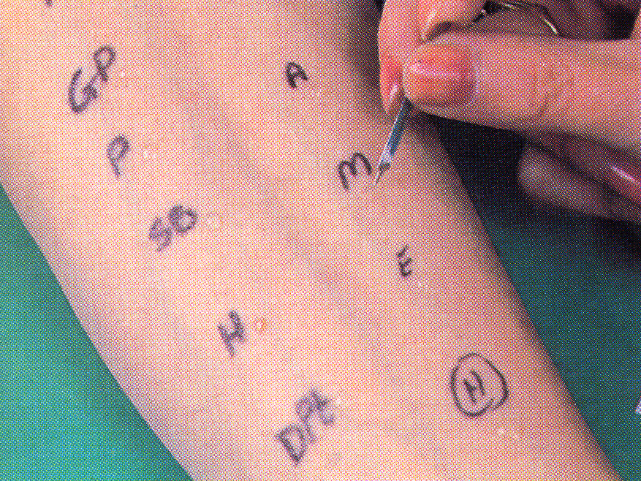
Skin prick testing in a patient with asthma.

Slide 41
Asthma: Summary:
Episodic attacks of bronchoconstriction
Types
Extrinsic asthma: Type 1 Hypersensitivity reaction, IgE, childhood, family Hx of allergy.
Morphology
Hypertrophy of bronchial smooth muscle & hyperplasia of goblet cells e eosinophils, thickened basement membrane
Mucous plug e Curschmann spirals & Charcot-Leyden crystals.
Complication
Superimposed infection
Chronic bronchitis
Pulmonary emphysema
Status asthmaticus
Intrinsic asthma: associated e bronchial asthma, aspirin, exercise, cold induced. No Hx of allergy

