Slide 1
Pathology of Chronic obstructive airway diseases
Respiratory block
Jan 2016
Dr. Maha Arafah and Dr. Ammar Rikabi
Department of Pathology
KSU, Riyadh

Slide 2
Objectives:
Chronic Bronchitis
a. Define chronic bronchitis.
b. Describe the pathogenesis and the morphology of chronic bronchitis.
c. Describe the mechanism of airway obstruction in a patient with chronic bronchitis. Understand that when severe obstruction is present in chronic bronchitis, significant emphysema is nearly always present
Emphysema
a. Define emphysema.
b. Describe the gross and microscopic changes in emphysema.
c. Discuss the typical clinical presentation and causes of death.
c. Describe the most likely mechanism of emphysema (the protease-antiprotease mechanism).
e. Describe the pathophysiologic mechanisms of emphysema
Explain why emphysema and bronchitis are both considered to be examples of chronic obstructive pulmonary disease (COPD). Compare and contrast the major clinical and functional differences between predominant chronic bronchitis versus predominant emphysema in patients with COPD.
Define Bronchiectasis and its significant.

Slide 3
Obstructive and Restrictive Pulmonary Diseases
Diffuse pulmonary diseases are divided into:
1. Obstructive disease:
characterized by limitation of airflow owing to partial or complete obstruction at any
level from trachea to respiratory bronchioles.
Pulmonary function test:
limitation of maximal
airflow rate during forced expiration (FEVI).
2. Restrictive disease: characterized by reduced expansion of lung parenchyma with decreased total lung capacity while the expiratory flow rate is near normal.
Occur in:
1. Chest wall disorder.
2. Acute or chronic, interstitial and infiltrative diseases,
e.g. ARDS and pneumoconiosis.

Slide 4
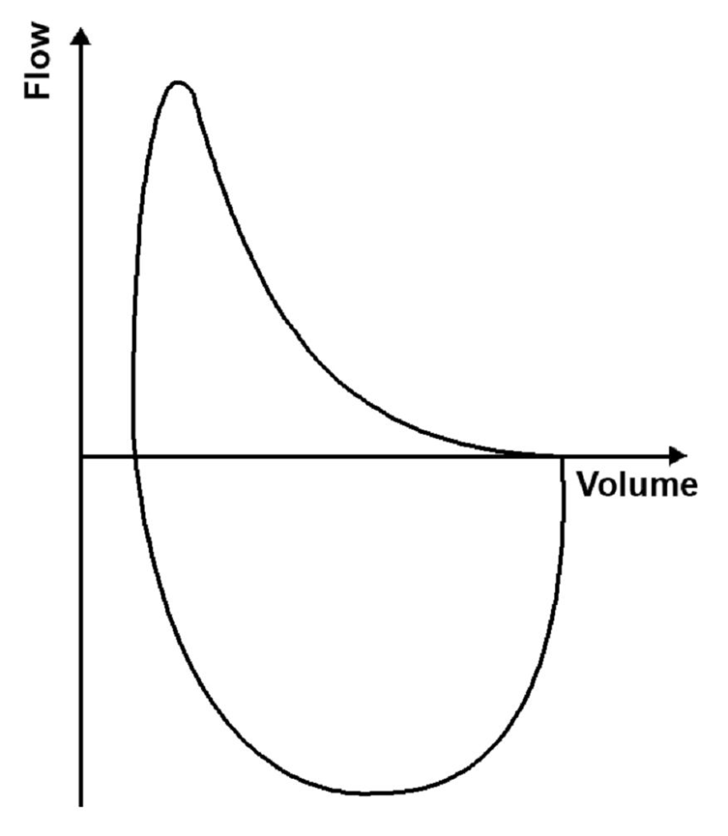
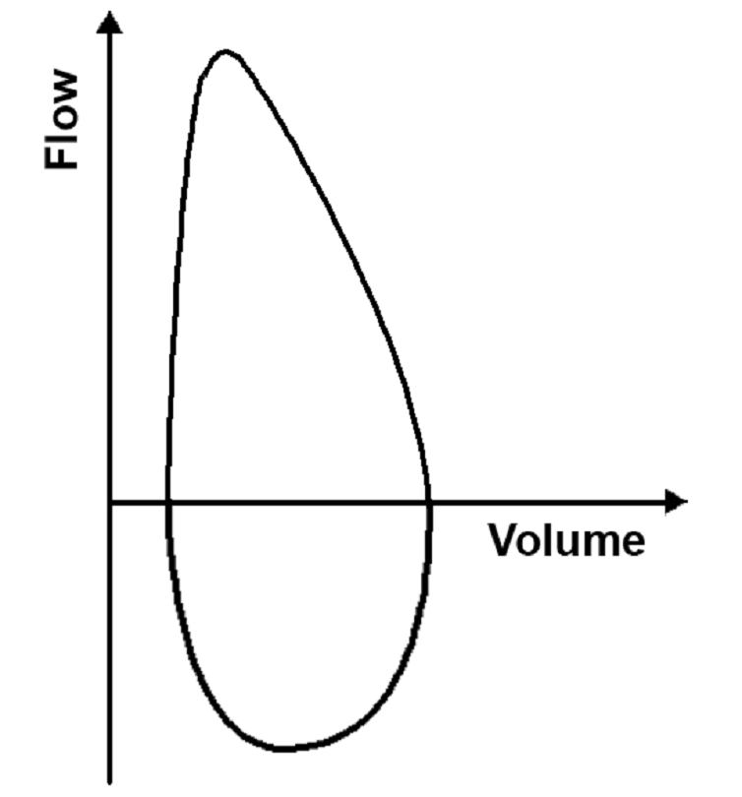
Obstructive disease
Restrictive disease

Slide 5
Main Categories of (diffuse) Obstructive Disease
1) Asthma
2) Chronic obstructive pulmonary/airway/lung disease(COPD/COAD/COLD).They are of two types:
a) Chronic bronchitis
b) Emphysema
3) Bronchiectasis
COPD:
Irreversible obstruction to airflow out of the lungs
Cigarette smoking is the principal cause of COPD
Greater than 10% of the population >45 years old has airflow obstruction.
Majority of patients with COPD have both emphysema (air space destruction) and chronic bronchitis

Slide 6
Chronic Bronchitis

Slide 7
Chronic Bronchitis
Common among cigarette smokers and urban dwellers, age 40 to 65
The diagnosis of chronic bronchitis is based on clinical features.
Persistent productive cough (with sputum) for at least 3 consecutive months in at least 2 consecutive years
Can occur in several forms:
1. Simple chronic bronchitis.
2. Chronic mucopurulent bronchitis.
3. Chronic asthmatic bronchitis.
4. Chronic obstructive bronchitis.
Some patients with a clinical definition of chronic bronchitis have hyperresponsive airways with intermittent bronchospasm..

Slide 8
Chronic bronchitis
Causative factor are:
Cigarette smoking and pollutants. Most patients are smokers
Infection
Genetic factors e.g. cystic fibrosis
Often, there are features of emphysema as well
Pathogenesis
Chronic irritation of inhaled substances or microbial infection leads to
Hypersecretion of mucus that starts in the large airways with associated hypertrophy of the sub-mucosal glands.
As chronic bronchitis persists the small bronhi and bronchioles also get affected.
Inflammation and irreversible fibrosis may occur in chronically inflamed segmental bronchi and bronchioles.

Slide 9
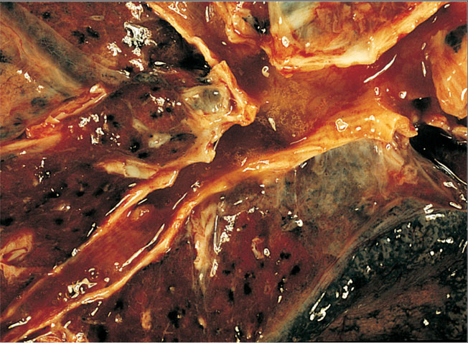
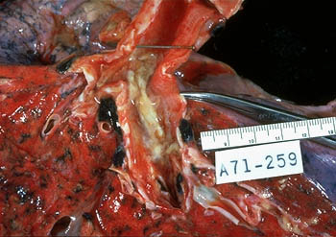
Chronic bronchitis morphology
Chronic bronchitis does not have characteristic pathologic findings, but is defined clinically as a persistent productive cough for at least three consecutive months in at least two consecutive years.
In bronchitis the airway mucosa is red and edematous

Slide 10
Chronic bronchitis: morphology
Inflammation of airways, fibrosis and resultant narrowing of bronchioles.
Hypertrophy and hyperplasia of mucus producing cells increased number of goblet cells,
Squamous metaplasia which can progress to dysplasia and even invasive carcinoma.
Injury to cilia with loss of ciliated epithelial cells
squamous metaplasia.
Coexistent emphysema.
How do these changes differ from the changes seen in a typical case of allergic asthma?
n typical allergic asthma, which also has mucous gland hyperplasia, the bronchial wall has an inflammatory infiltrate in which eosinophils are prominent. There is also hypertrophy and hyperplasia of smooth muscle cells in asthma.
How do the changes differ from those seen in bronchiectasis?
Infection-related destruction of the bronchial wall is the characteristic appearance of bronchiectasis

Slide 11
Chronic bronchitis: Clinical Course
Prominent cough and the production of sputum.
Hypercapnia, hypoxemia and cyanosis. Patients with severe chronic bronchitis are termed blue bloaters.
Patients can have:
increased sleepiness due to CO2 narcosis
cyanosis due to very poor oxygenation
elevated red cell counts (secondary polycythemia) as a result of chronic hypoxemia
Cardiac failure (Cor pulmonale/right heart failure): diseases of the lung or pulmonary vasculature leads to pulmonary hypertension which leads to right ventricular dilation and hypertrophy (right heart failure).

Slide 12
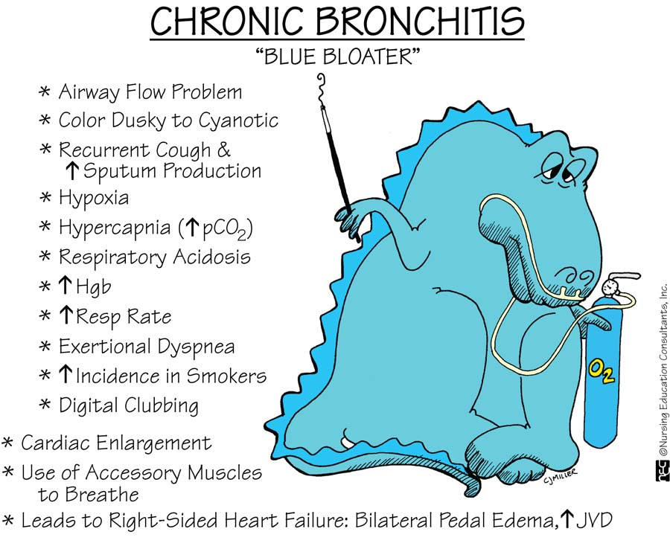

Slide 13
Emphysema
Permanent enlargement of all or part of the respiratory unit

Slide 14
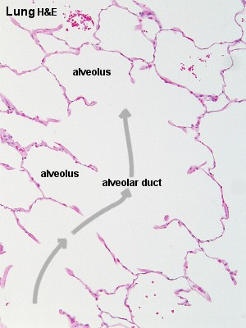
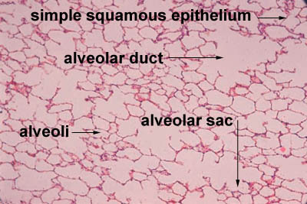
normal

Slide 15
Emphysema
Is abnormal permanent enlargement of the airspaces distal to the terminal bronchioles accompanied by destruction of their walls, without obvious fibrosis.
Element of chronic bronchitis coexists
Types of emphysema:
1. Centriacinar
2. Panacinar
3. Distal acinar /paraseptal
4. Irregular
“Dilatation” is due to destruction and loss of alveolar walls (tissue destruction)
Appears as “holes” in the lung tissue
Emphysema Impairs Respiratory Function:
-Diminished alveolar surface area for gas exchange (decreased Tco)
-Loss of elastic recoil and support of small airways leading to tendency to collapse with obstruction

Slide 16
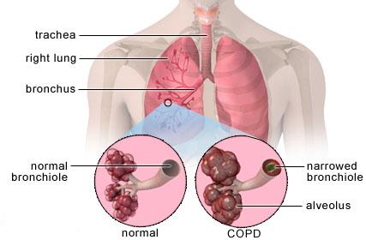
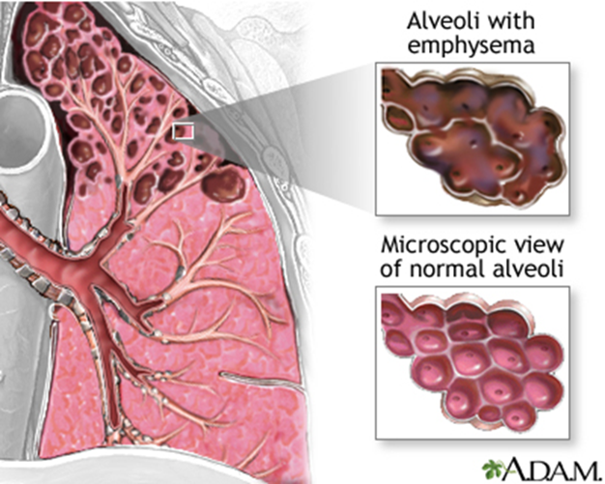

Slide 17
Normal
Emphysema

Slide 19
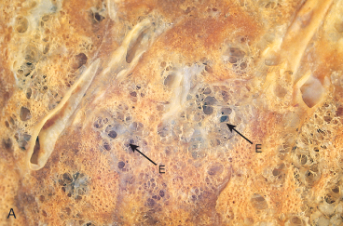
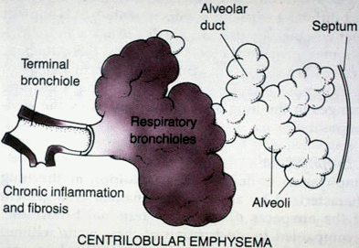
Centriacinar (centrilobular) emphysema
Occur in heavy smoker in association with chronic bronchitis
The central or proximal parts of the acini are affected, while distal alveoli are spared
More common and severe in upper lobes (apical segments)
The walls of the emphysematous
space contain black pigment.
Inflammation around bronchi & bronchioles.

Slide 20
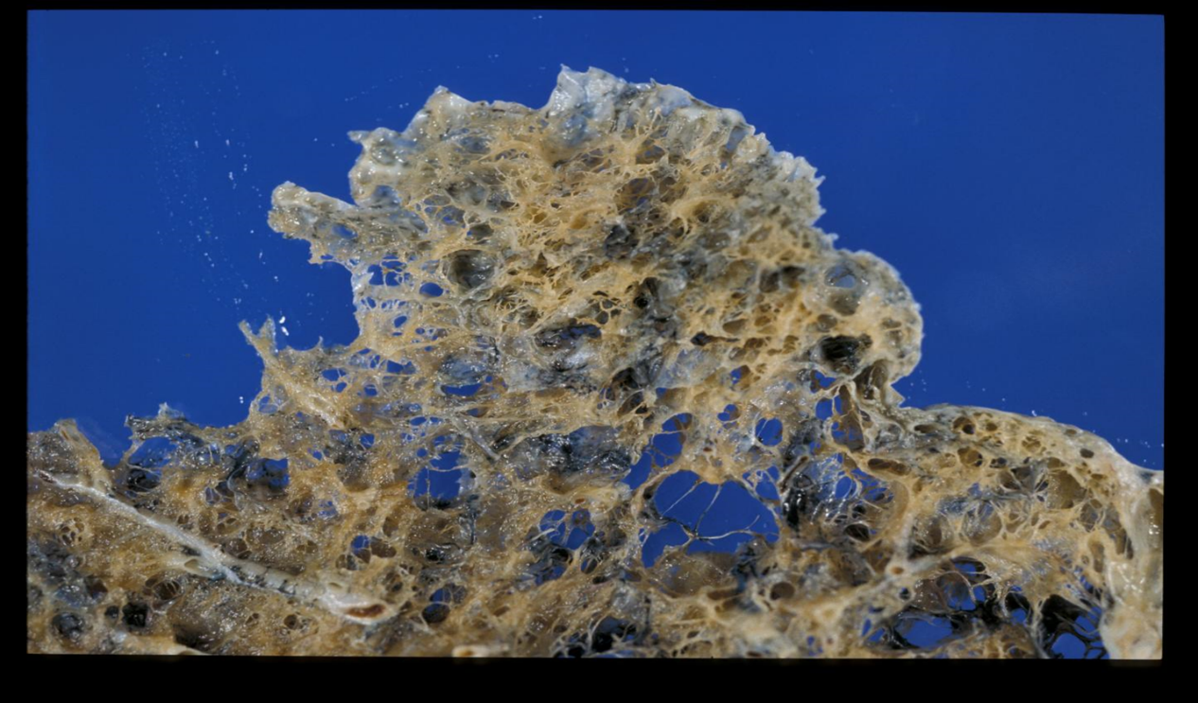
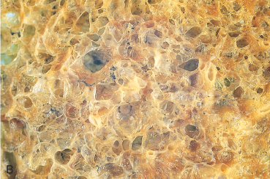
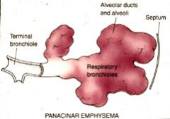
Panacinar (panlobular) emphysema
Cause :Occurs in α₁-anti-trypsin deficiency.
Uniform injury: Acini are uniformly enlarged from the level of the respiratory bronchiole to the terminal blind alveoli.
More commonly in the lower lung zones.

Slide 21
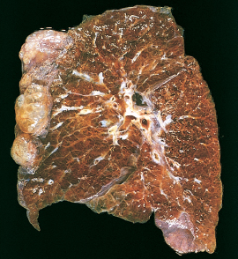
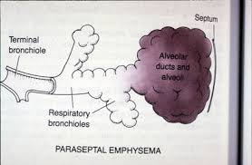
Distal acinar (paraseptal) emphysema
The proximal portion of the acinus is normal but the distal part is dominantly involved.
Occurs adjacent to areas of fibrosis, scarring or atelectasis.
More severe in the upper half of the lungs.
Sometimes forming multiple cyst-like structures with spontaneous pneumothorax.

Slide 22
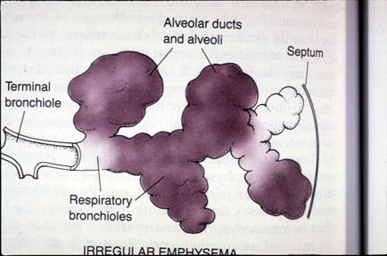
Irregular Emphysema
The acinus is irregularly involved, associated with scarring.
Most common form found in autopsy.
Asymptomatic.
usually a complication of various inflammatory processes including chronic pulmonary tuberculosis

Slide 23
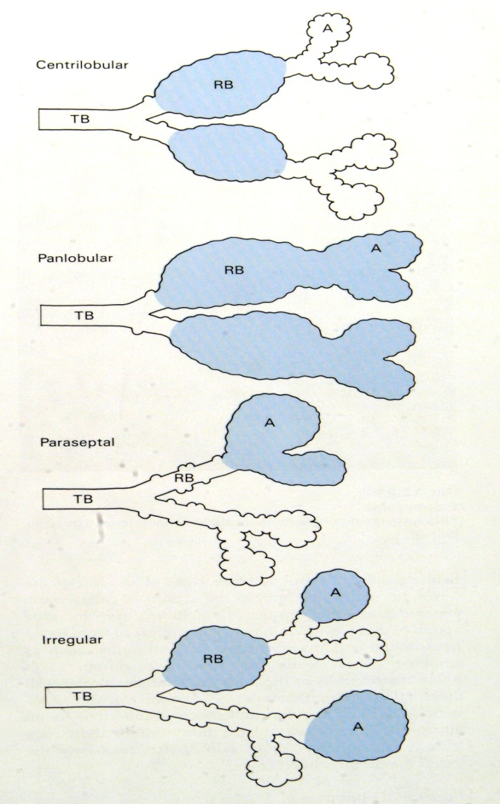
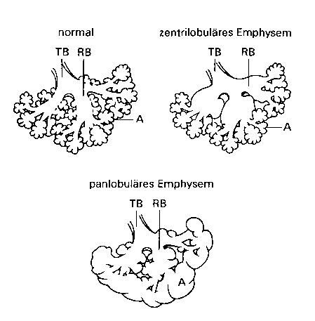

Slide 24
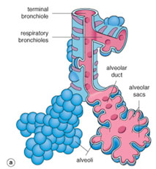
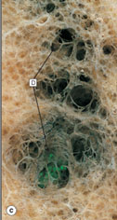
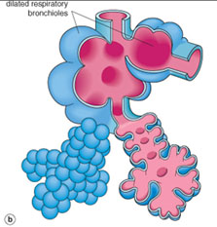
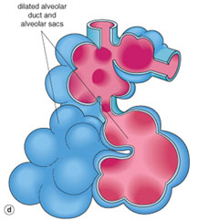
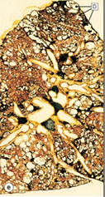
Diseases of Lung
Generalized emphysema. (a) Normal distal lung acinus. (b) Centriacinar emphysema. (c) Centriacinar emphysema. (d) Panacinar emphysema. (e) Panacinar emphysema (Gough-Wentworth section).

Slide 25
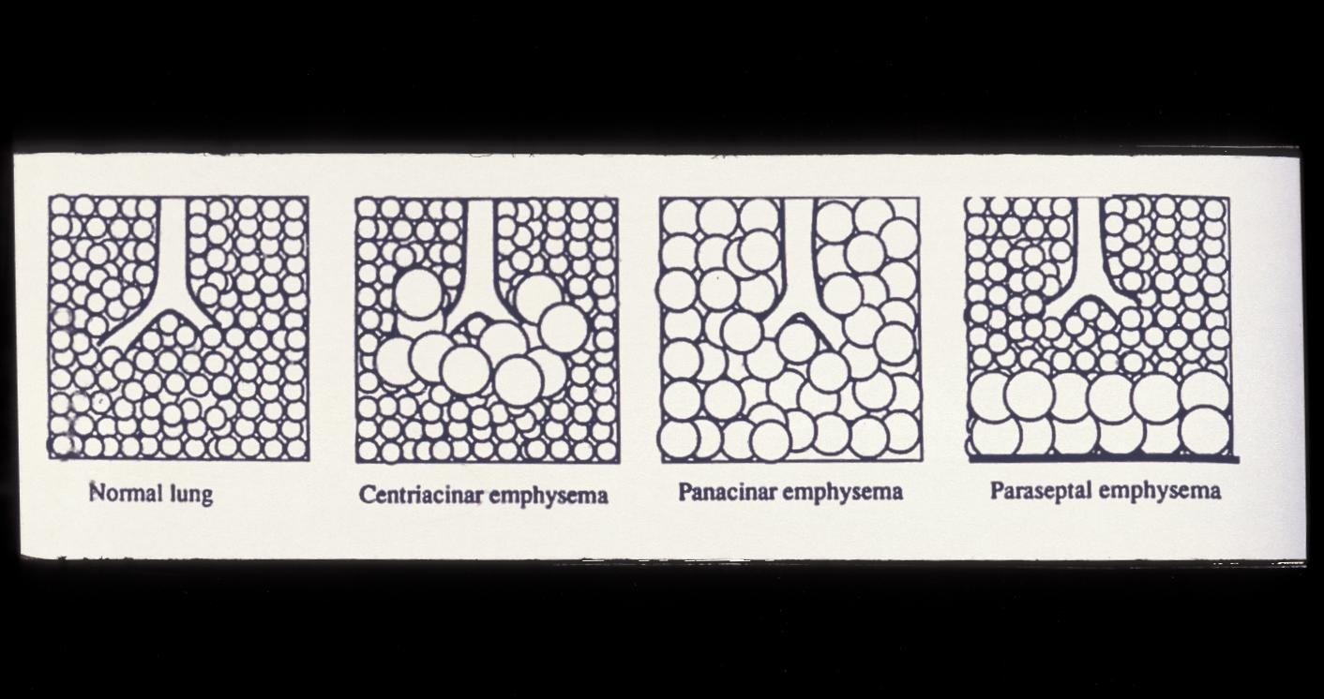
Loss of surface area (emphysema)

Slide 26
Why is emphysema considered to be an obstructive airway disease? Is there any mechanical obstruction?
Because emphysema affects the peripheral airways, it is not, anatomically speaking, an obstructive disease, and there is no mechanical obstruction. However, it is functionally an obstructive disease, because destruction of the wall of the air spaces prevents the elastic recoil that is necessary to push air out of the lungs. Thus, in effect, there is limitation of airflow, just as there would be if there were mechanical obstruction.

Slide 27
Pathogenesis of Emphysema
Is not completely understood
Elastic tissue of the alveolar wall is broken down by action of proteolytic enzymes like protease (e.g.elastase).
Protease is produced by neutrophils and macrophages.
Alpha 1 antitrypsin is an anti-protease (anti-elastase) and it counter acts the protease. It is a major inhibitor of proteases secreted by neutrophils during inflammation. α₁-antitrypsin is normally present in the serum, in tissue fluids and in macrophages.
Normally there is a balance between protease and anti protease activity.

Slide 28
Pathogenesis of Emphysema
Any condition that increases the neutrophils or macrophages in the lung will lead to release of protease enzyme which causes damage to the elastic tissue of the alveolar wall.
Therefore one of the key mechanisms in emphysema is alveolar wall destruction which occurs due to excess proteases (elastase) activity coupled with low anti-protease level and inflammation (protease-antiprotease hypothesis)
Elements of chronic bronchitis may co-exist
Hereditary alpha 1-antitrypsin deficiency leads to panacinar emphysema.

Slide 29
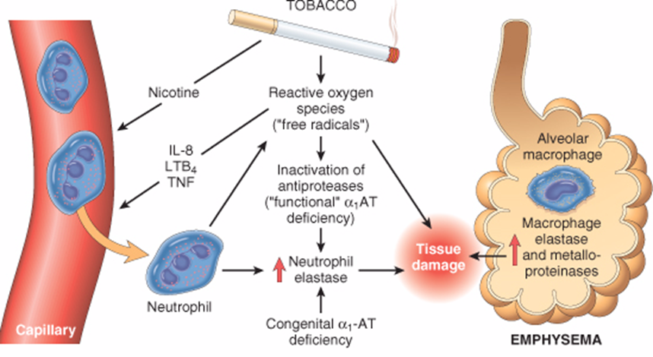
Pathogenesis of Emphysema
Smokers have increases number of neutrophils and macrophages in their alveoli
Smoking stimulates release of elastase and enhances elastase activity in macrophages.
Smoking Inhibits alpha 1 antitrypsin.
Tobacco smoke contains reactive oxygen species with inactivation of anti-proteases.
The protease-antiprotease hypothesis explains the effect of cigarette smoking in the production of centriacinar emphysema

Slide 30
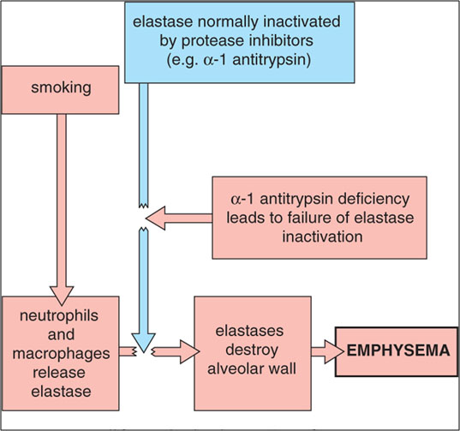
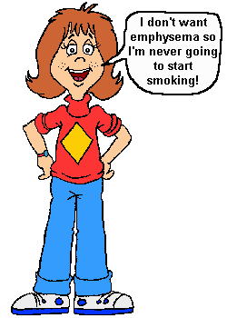
Diseases of Lung
Pathogenesis of emphysema.

Slide 31
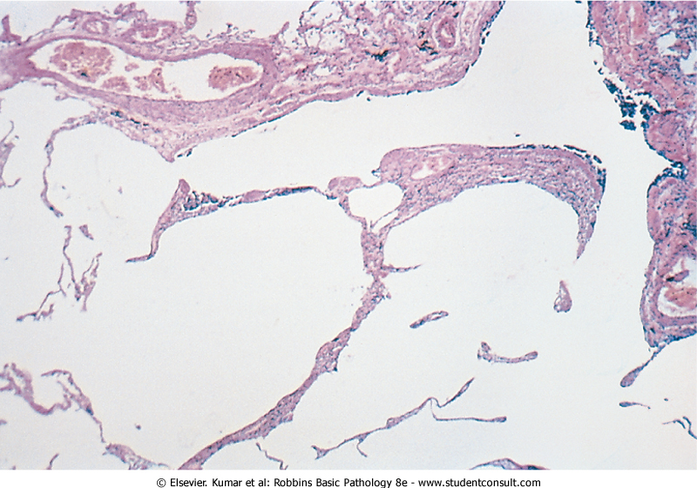
Emphysema: Morphology
The lungs are pale, voluminous.
Histologically, thinning and destruction of alveolar walls creating large airspaces.
Loss of elastic tissue.
Reduced radial traction on the small airways.
Alveolar capillaries is diminished.
Accompanying bronchitis and bronchiolitis.

Slide 32
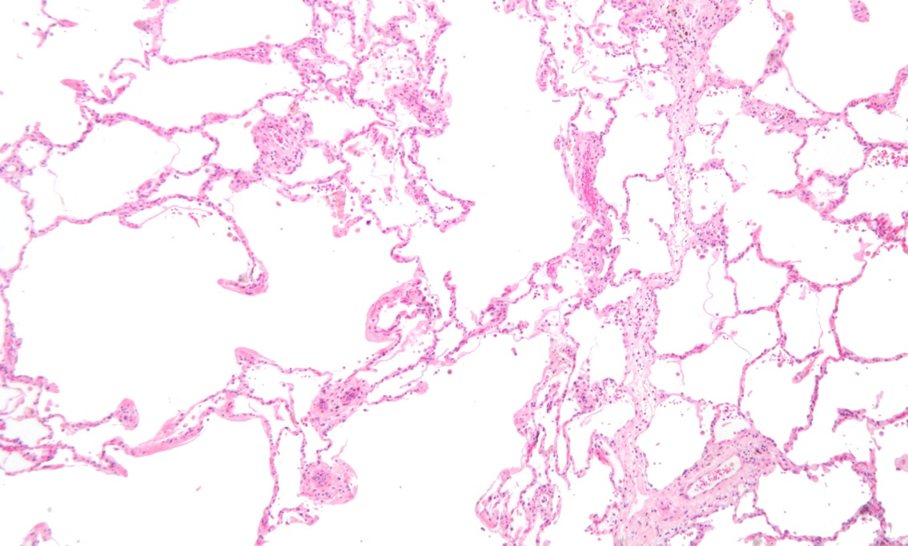
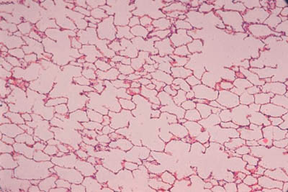
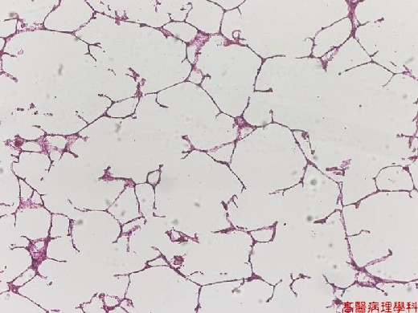
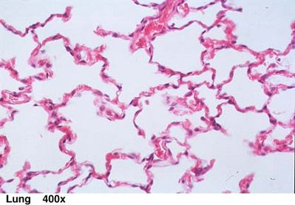
Normal
Emphysema

Slide 33
Emphysema:
Complications
Coexistent chronic bronchitis
Interstitial emphysema in which air escapes into the interstitial tissues of the chest from a tear in the airways.
may also be complicated by rupture of a surface bleb with resultant Pneumothorax
Death from emphysema is related to::
Pulmonary failure with respiratory acidosis, hypoxia and coma.
Cor pulmonale : (Right-sided heart failure induced by pulmonary disease)
Clinical course
Cough and wheezing
Weight loss
Barrell chest
( anteroposterior diameter of chest)
Pulmonary function tests reveal reduced FEV1
Advanced: hypoxia, cyanosis, respiratory acidosis
Patients are known as pink puffers

Slide 35
Emphysema:
Dilated air spaces beyond respiratory arteriols
Types
Centriacinar: Smoking
Clinical features
Cough and wheezing. Respiratory acidosis
Complications
Pneumothorax
Panacinar: deficiency of α1 AT
Paraseptal
Irregular: scar
Weight loss.
Pulmonary function tests reveal reduced FEV1.
Pulmonary failure with respiratory acidosis, hypoxia and coma.
Right-sided heart failure ( Cor pulmnale)
Death from emphysema is related to:

Slide 36
Emphysema and Chronic Bronchitis
 | Predominant Bronchitis | Predominant Emphysema
Appearance Age Dyspnea Cough Infection Cor pulmonale Airway resistance Elastic recoil Chest radiography PaCO₂ Cyanosis | “Blue bloaters” 40-45 Mild, late Early, copious sputum Common Common Increased Normal Prominent vessels, large heart Increased Present | “Pink Puffers” 50-75 Severe, early Late, scanty sputum Occasional Rare, terminal Normal or slightly increased Low Hyperinflation, small heart Normal to decreased Absent

Slide 38
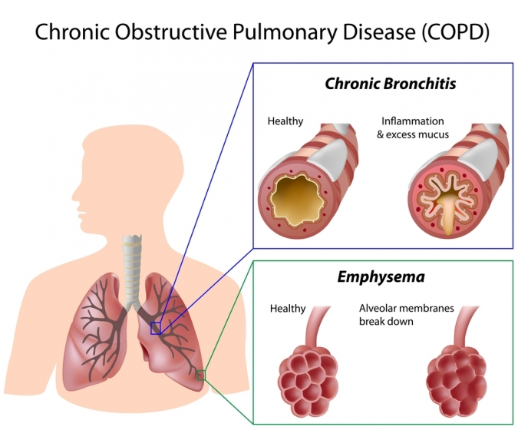
Chronic bronchitis vs. Emphysema

Slide 39
Bronchiectasis

Slide 40
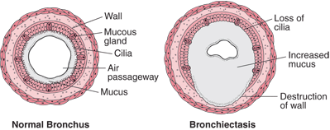
Bronchiectasis
is chronic necrotizing infection and inflammation of the bronchi and bronchioles leading to abnormal permanent dilation of these airways. It represents the end stage of a variety of pathologic processes that cause destruction of the bronchial wall.
most often involves the lower lobes of both lungs.
is characterized by fever and cough with production of copious purulent foul smelling sputum,
and recurrent pulmonary infection that may lead to lung abscess.

Slide 41
Bronchiectasis is a result of chronic inflammation compounded by an inability to clear mucoid secretions. Conditions commonly associated with Bronchiectasis are as follows:
Bronchial obstruction
Congenital or hereditary conditions:
Chronic or severe infection / necrotizing pneumonia
Localized:
- tumor, foreign bodies or mucous impaction
Generalized:
- bronchial asthma
- chronic bronchitis
- Congenital bronchiectasis
- Cystic fibrosis.
- Intralobar sequestration of the lung.
- Immunodeficiency status.
- Immotile cilia and kartagner syndrome
Caused by TB, staphylococci or mixed infection.

Slide 42
Pathogenesis
Any of the previously mentioned conditions can cause damage to the airways resulting in impaired mucociliary clearance, mucus stasis and accumulation which in turn further makes the airways susceptible to microbial colonization. The persistence of the pathology with superadded infection leads to a "vicious circle" of inflammation and tissue damage.
Inflammation results in progressive destruction of the normal lung architecture, in particular the elastic fibres of bronchi.
Neutrophils are thought to play a central role in the pathogenesis of tissue damage that occurs in bronchiectasis.

Slide 43
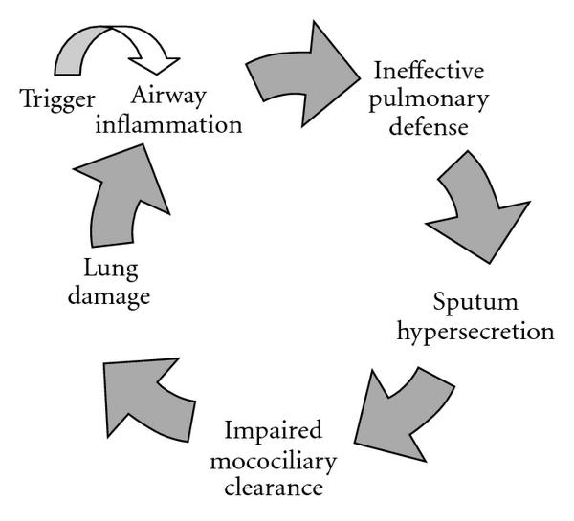
Pathogenesis of bronchiectasis

Slide 44
Kartagener Syndrome/ immotile cilia syndrome
It is a genetic condition resulting in the failure to clear sputum (Primary ciliary dyskinesia) caused by a defect in the motility of respiratory, auditory, and sperm cilia.
Inherited as autosomal recessive trait.
Patient develop bronchiactasis, sinusitis and situs invertus sometimes with hearing loss and male sterility.
Lack of ciliary activity interferers with bronchial clearance of mucus.

Slide 45
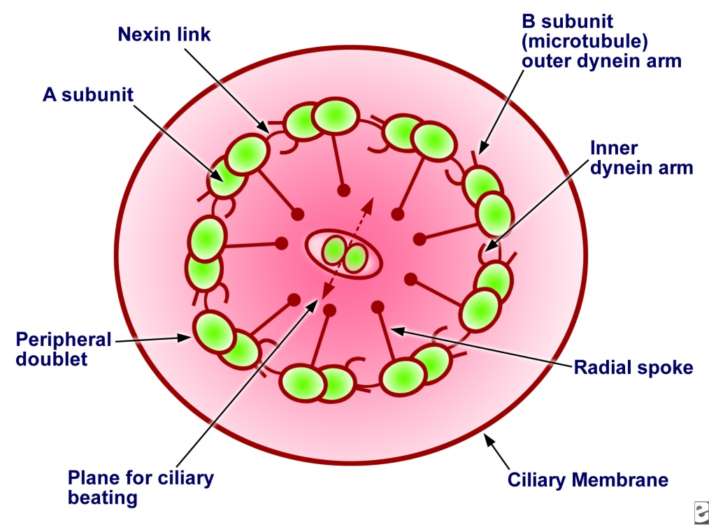
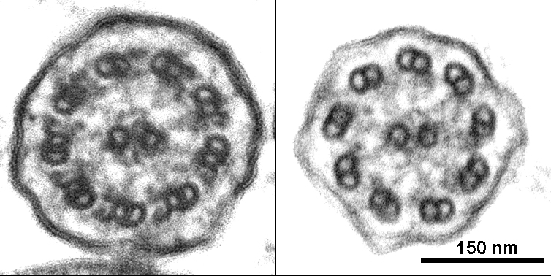
absence of outer and inner dynein arms in a patient with primary ciliary dyskinesia.
Dynein, a type of ATPase, provides energy for microtubule sliding and the longitudinal displacement of adjacent microtubular doublets, resulting in ciliary bending.

Slide 46
Cystic fibrosis
Cystic fibrosis is an inherited disease that causes thick, sticky viscus mucus to build up in the lungs and digestive tract. It is one of the most common chronic lung diseases in children and young adults, and may result in early death.
It may lead to bronchiectasis.

Slide 47
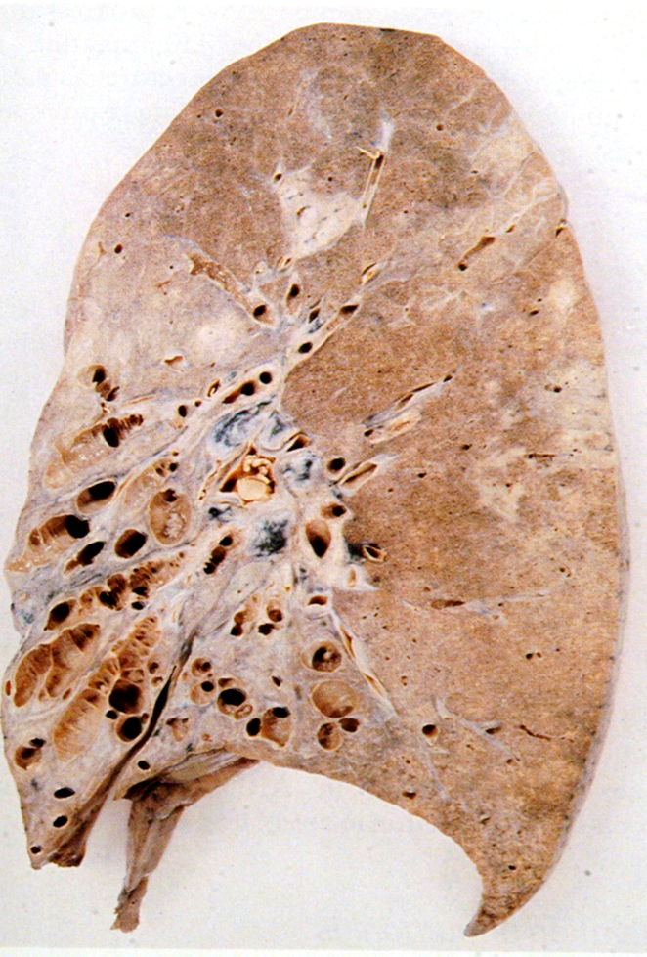
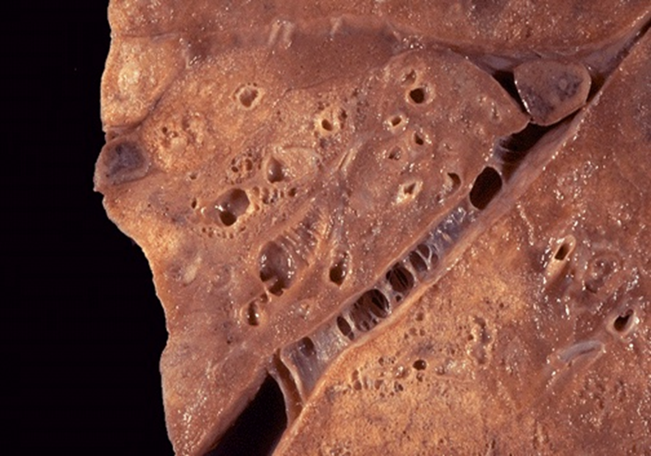
Morphology of Bronchiectasis
Usually affects lower lobes bilaterally (vertical airways).
Dilated airways up to four times of normal, reaching the pleura.
Acute and chronic inflammation (neutrophils, lymphocytes, histiocytes and plasma cells)
Necrosis and ulceration in the wall of the bronchi and bronchioles with loss of cilia, squamous metaplasia and fibrosis.

Slide 48
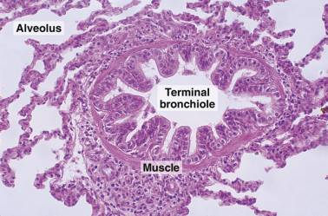
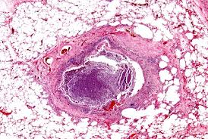
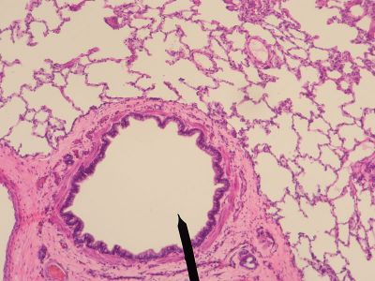
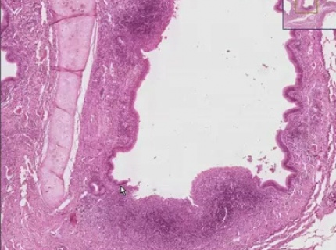
Normal
bronchiectasis
Fibrosis
Dilated airways
Inflammation
Fibrosis

Slide 49
Bronchiectasis
Clinical course:
Sever persistent cough with sputum (mucopurulent, fetid sputum) sometime with with blood.
Clubbing of fingers.
If sever, obstructive pulmonary function develop.
Other complications: metastatic brain abscess and amyloidosis

Slide 50
Bronchiectasis:
Dilatation of bronchi and bronchioles secondary to chronic inflammation
Causes
Infection/ Necrotizing pneumonia
Congenital (Cystic fibrosis, Kartagener’s Syndrome)
Clinical features
Sever persistent cough with sputum (mucopurulent sputum) sometime with blood.
complications
Rare complications: metastatic brain abscess and amyloidosis.
Obstruction
Clubbing of fingers.
Lung Abscess
If sever, obstructive pulmonary function develop.

