Slide 1
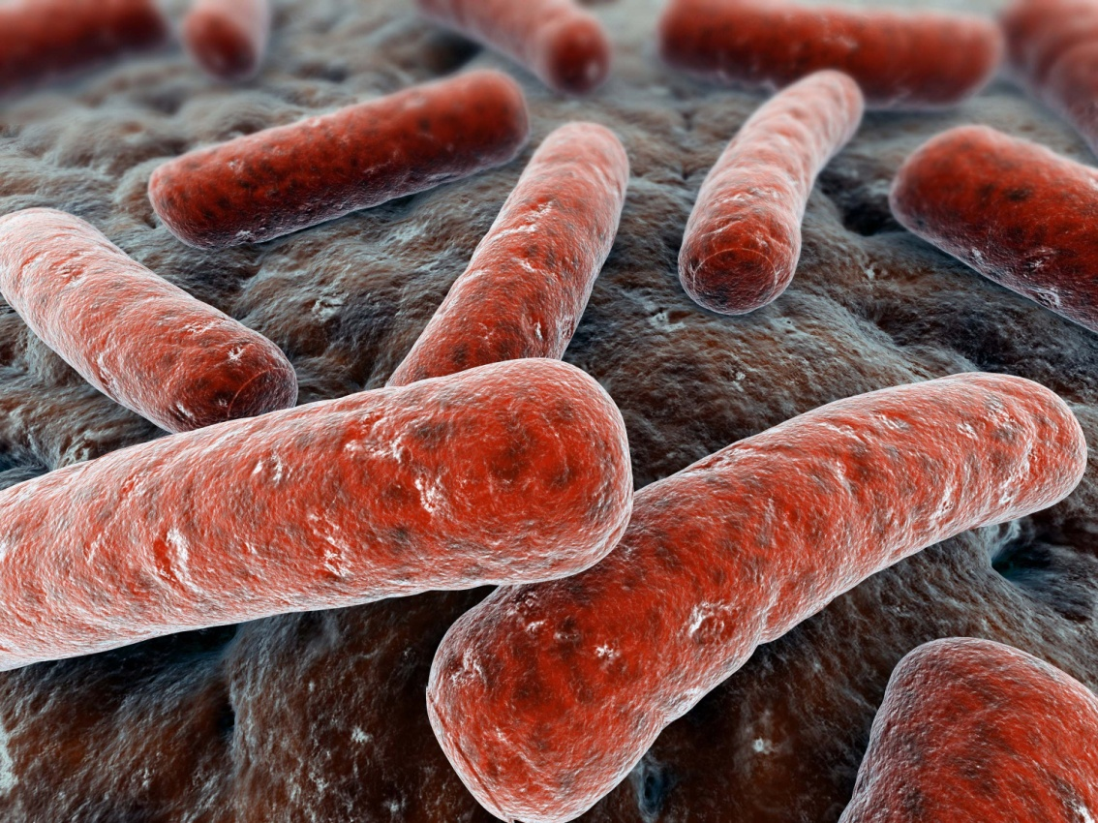
PATHOLOGY OF TUBERCULOSIS
Dr. Maha Arafah and Prof. Ammar Rikabi
Department of Pathology
KSU, Riyadh
2016

Slide 2
My objectives
Discuss Pathogenesis and different pathologic features seen in TB

Slide 3
TUBERCULOSIS
TB is a chronic communicable granulomatous disease in which the lungs are the prime target, although any other organ may be infected.
Important pulmonary problem as the incidence is rising worldwide.
This disease is mainly caused by Mycobacterium tuberculosis hominis (Koch bacillus) but also occasionally by Mycobacterium tuberculosis bovis.

Slide 4
Diseases caused by Mycobacterium
The important species are
Mycobacterium tuberculosis is the etiologic agent of tuberculosis in humans. Humans are the only reservoir for the bacterium.
Mycobacterium bovis is the etiologic agent of TB in cows and rarely in humans. Both cows and humans can serve as reservoirs. Humans can also be infected by the consumption of unpasteurized milk. This route of transmission can lead to the development of extrapulmonary TB.
M. leprae : causes leprosy

Slide 5
Diseases caused by Mycobacterium
Others:
More than 50 species of the genus Mycobacterium are now recognized as potential human pathogens. Species other than M. tuberculosis and M. leprae have been designated as “non-tuberculous mycobacteria”
M. kansasii, M. avium intracellulare cause atypical mycobacterial infections in humans esp in AIDS. They cause respiratory and gastrointestinal symptoms and can involve other organs too.
They cause atypical TB.
M. ulcerans causes buruli ulcers of skin.

Slide 6
TUBERCULOSIS: Increase risk
Flourishes wherever there is
Poverty
crowding
malnutrion
chronic debilitating illness e.g.chronic lung disease (particularly silicosis), chronic renal failure etc.
a disease of the elderly,
people with AIDS,
Diabetes mellitus,
Hodgkin's lymphoma,
Alcoholism,
Immunosuppression e.g. with glucocorticoids

Slide 7
TB is a Granulomatous disease. What is Granuloma?
A granuloma is a microscopic aggregation of macrophages that are transformed into epithelium-like cells surrounded by a collar of mononuclear leukocytes, principally lymphocytes and occasionally plasma cells.
Epithelioid cells fuse to form giant cells containing 20 or more nuclei.
The nuclei arranged either peripherally (Langhans-type giant cell) or haphazardly (foreign body-type giant cell). Both Langhans ("classic TB") and foreign-body giant cells are common.
These giant cells can be found either at the periphery or the center of the granuloma.
Fibrous connective tissue often surrounds granulomas (remodeling of tissue)
In TB Areas within the granuloma can undergo necrosis (caseous necrosis). Necrosis can lead to calcification
TB granulomas are called tubercles, and if they are caseating in the center, they are called soft tubercles.

Slide 8
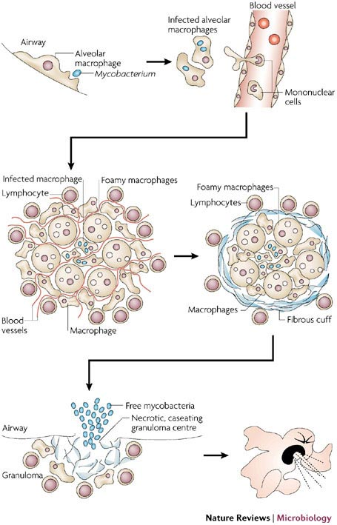

Slide 9
Granuloma: the predominant cell type is an activated macrophage with a modified epithelial-like (epithelioid) appearance. Also seen are lymphocytes, multinucealted giant cells and occasional plasma cells.

Slide 10
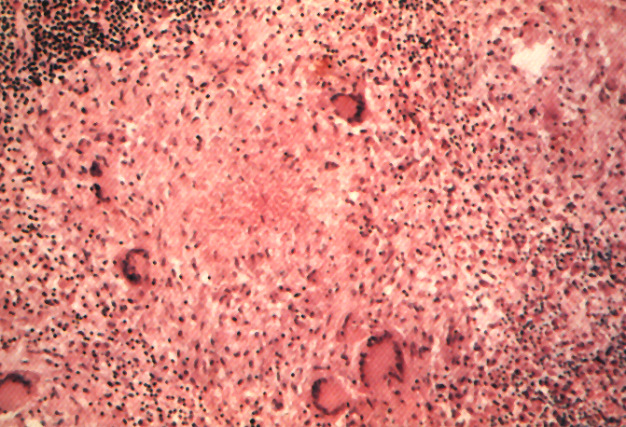
Langhans Giant Cell
Lymphocytic Rim
Caseous Necrosis
Epithelioid Macrophage

Slide 11
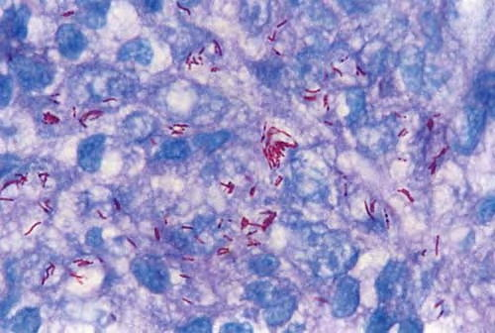
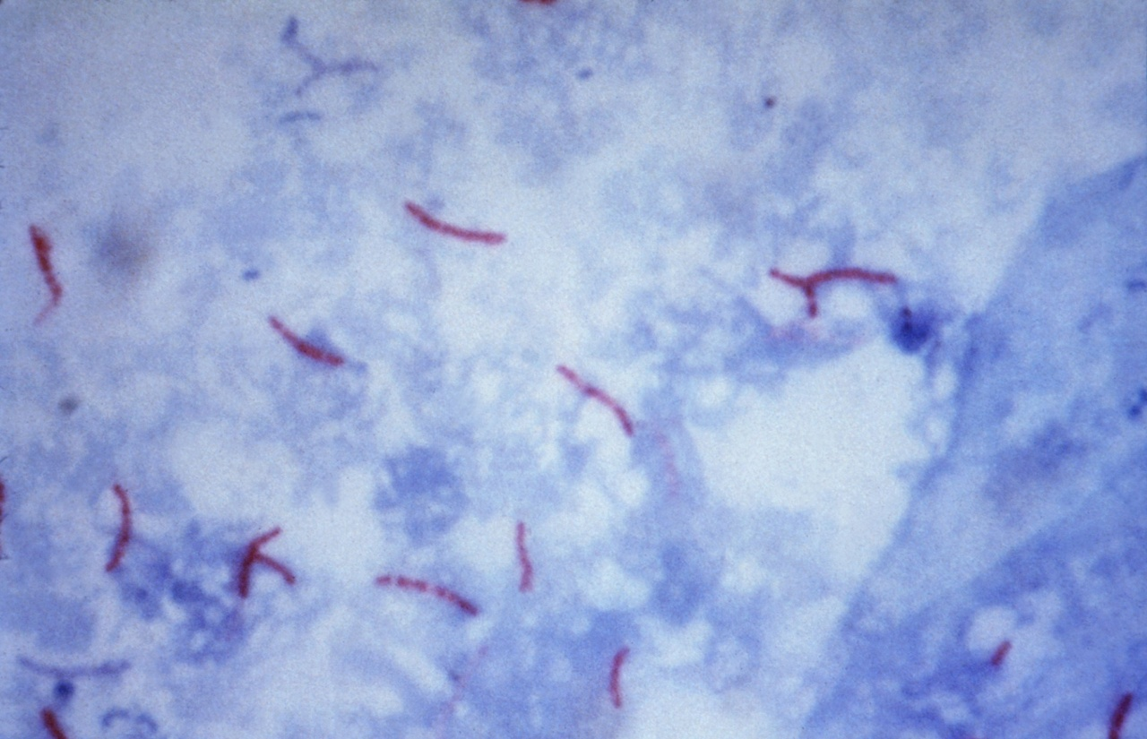
Ziehl-Neelsen stain is an acid-fast staining method to stain M. tuberculosis. The Acid-fast bacilli appear pink in a contrasting background.
Acid-fast (due to mycolic acid in cell wall)

Slide 12
Pathogenesis
The steps in M. tuberculosis infection are:
1. Entry into macrophages phagocytosis mediated by several receptors expressed on the phagocyte, including mannose binding lectin and other receptors
2. Replication in macrophages. M. tuberculosis inhibits maturation of the phagosome and blocks formation of the phagolysosome, protected from the microbicidal mechanisms of lysosomes.
The bacterium blocks phagolysosome formation, mechanism:
-Produces a protein (cord factor) that prevents fusion of lysosomes with phagosome
- inhibiting Ca²⁺ signals and the recruitment and assembly of the proteins that mediate phagosome-lysosome fusion.

Slide 13
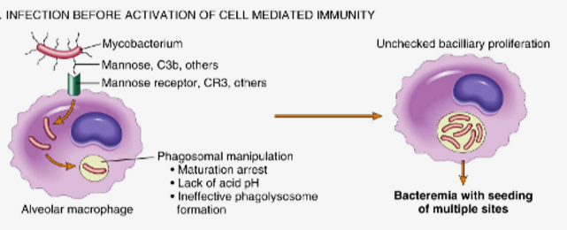
Pathogenesis of granuloma: Replication in macrophages
During the earliest stage of primary tuberculosis (<3 weeks) in the nonsensitized individual, bacteria proliferate in the pulmonary alveolar macrophages and air spaces, resulting in bacteremia and seeding of multiple sites. Despite the bacteremia, most people at this stage are asymptomatic or have a mild flu-like illness

Slide 14
Pathogenesis of granuloma
3. The T_{H}1 response. About 3 weeks after infection, a T-helper 1 (T_{H}1) response is mounted that activates macrophages, enabling them to become bactericidal.
Differentiation of T_{H}1 cells depends on IL-12, which is produced by antigen-presenting cells that have encountered the bacilli
T_{H}1-mediated macrophage activation and killing of bacteria by produce IFN-γ
Macrophages activated by IFN-γ differentiate into the “epithelioid histiocytes” that aggregate to form granulomas

Slide 15
Pathogenesis of granuloma IFN-γ
4. T_{H}1-mediated macrophage activation and killing of bacteria.
IFN-γ is the critical mediator that enables macrophages to contain the M. tuberculosis infection.
How?
IFN-γ stimulates maturation of the phagolysosome in infected macrophages, exposing the bacteria to a lethal acidic, oxidizing environment.
IFN-γ stimulates expression of inducible nitric oxide synthase, which produces nitric oxide (NO
IFN-γ mobilizes antimicrobial peptides (defensins) against the bacteria
IFN-γ stimulates autophagy, a process that sequesters and then destroys damaged organelles and intracellular bacteria such as M. tuberculosis.

Slide 16
Pathogenesis of granuloma
5. Granulomatous inflammation and tissue damage
Macrophages activated by IFN-γ differentiate into the “epithelioid histiocytes” that aggregate to form granulomas; some epithelioid cells may fuse to form giant cells (langhans gaint cell)
Activated macrophages also secrete TNF and chemokines, which promote recruitment of more monocytes

Slide 17
Pathogenesis of granuloma
Role of other immune cells. In addition to the T_{H}1 response, NKT cells that recognize mycobacterial lipid antigens bound to CD1 on antigen-presenting cells, or T cells that express a γδ T-cell receptor, also make IFN-γ.
However, it is clear that T_{H}1 cells have a central role in this process, since defects in any of the steps in generating a T_{H}1 response result in absence of resistance and disease progression.

Slide 18
Pathogenesis of granuloma: Host susceptibility to disease
People with genetic deficiencies in the IL-12 pathway and the IFN-γ pathway, including STAT1 a signal transducer for IFN-γ, are vulnerable to severe mycobacterial infections.
Polymorphisms in a large number of genes, including HLA, IFN-γ, IFN-γ receptor, and TLR2 have been found to be associated with susceptibility to tuberculosis, but the contribution of these associations to disease development is still under investigation.

Slide 19
Summary of Pathogensis
Immunity to M. tuberculosis is primarily mediated by T_{H}1 cells, which stimulate macrophages to kill the bacteria
This immune response, while largely effective, comes at the cost of accompanying tissue destruction
Reactivation of the infection or re-exposure to the bacilli in a previously sensitized host results in rapid mobilization of a defensive reaction but also increased tissue necrosis
loss of T-cell immunity (indicated by tuberculin negativity in a previously tuberculin-positive individual) may be an ominous sign that resistance to the organism has faded

Slide 20
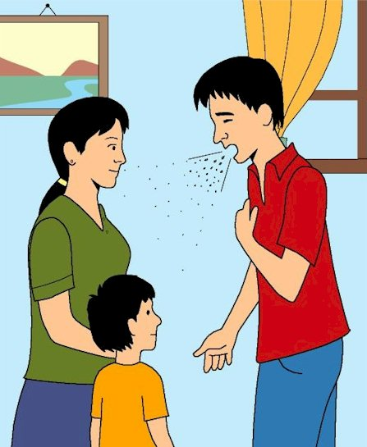
Route of transmission of TB
1. person-to-person transmission of airborne organisms from an active case to a susceptible host

Slide 21
Route of transmission of TB
2. M. bovis infections, acquired through drinking infected milk, usually start in the tonsils or Peyer's patches.

Slide 22
Pathogenesis of TB:
Infection - Immunity
Infection with M. tuberculosis typically leads to the development of delayed hypersensitivity, which can be detected by the tuberculin (Mantoux) test.

Slide 23
When the bacilli enter the body……
The bacilli have 4 potential fates upon entering the human body:
They may be killed by the immune system,
they may multiply and cause primary TB,
they may become dormant and remain asymptomatic,
they may proliferate after a latency period (reactivation disease). Reactivation TB may occur following either (2) or (3) above.
if immunosuppressed ---- Primary Progressive TB or Miliary TB

Slide 24
The clinical course or presentation of TB
The course of TB depends on the age and the immunity of the patient and the total burden of organism.
Not everyone who is infected develops clinical symptoms. Some patients have only an indolent, asymptomatic infection while in others TB is a destructive disseminated disease.
Clinical tuberculosis is separated into three important pathophysiologic types:
Primary TB occurs on first exposure to the organism and can pursue either an indolent or aggressive course (primary progressive TB).
Secondary TB develops long after a primary infection, mostly as a result of reactivation of a primary infection. It can also be produced by exposure to exogenous organisms. Secondary TB is always an active disease.
Miliary TB

Slide 25
PRIMARY TB
Primary TB is a first exposure to tubercle bacilli. The inhaled organism is deposited in the alveoli. It is the form of disease that develops in a previously unexposed and unsensitized person.
They are ingested by macrophages and they ellicit a type IV delayed hypersensitivity response to the tuberculous bacillus which elicit a cell-mediated immune response which will resists the growth and spread of the mycobacterium.
In a immunologically competent person a granulomatous response in produced. It takes 5-6 days invoke granuloma formation which are usually formed by 3 to 4 weeks. In immunocompromised persons, granulomas are poorly formed or not formed at all.

Slide 26
PRIMARY TB
The lung lesion of primary TB is known as Ghon focus.
It is commonly found in the sub-pleural area.
It drains into the hilar lymph nodes.
The combination of the Ghon focus and the involved medistinal or hilar lymph nodes is called as Ghon complex.
Most of the time this Ghon complex heals undergoing shrinkage fibrous scarring and calcification. It takes 2 to 8 weeks for healing.

Slide 27
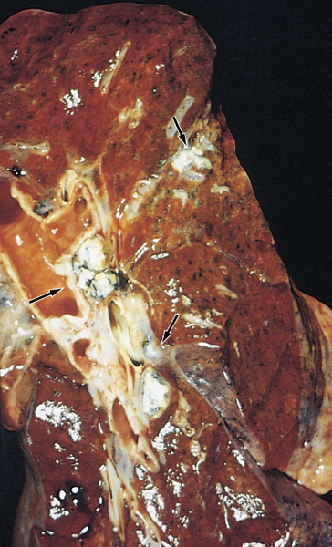
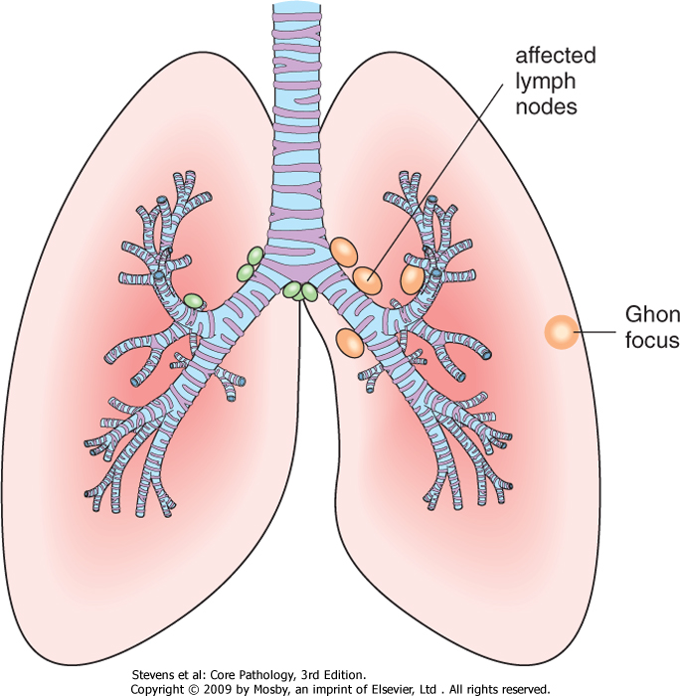
PRIMARY TUBERCULOSIS: Ghon Focus & Ghon complex
Ghon Focus: lung lesion of primary TB, involves upper segments of the lower lobes or lower segment of the upper lobe.
Ghon complex: combination of a peripheral ghon focus and involved mediastinal or hilar lymphnode.
Microscopically the classic lesion of TB is a caseous granuloma

Slide 28
Caseating granulomas

Slide 29
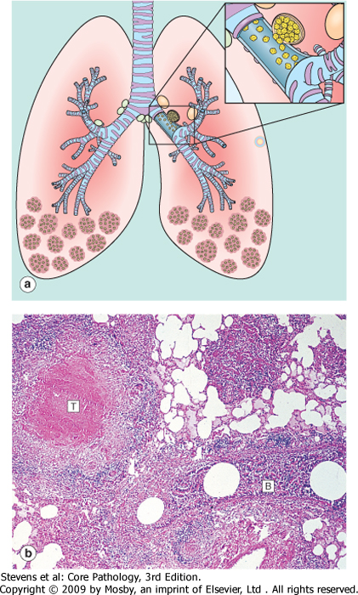
progressive primary tuberculosis
Possible sequalae of primary tuberculosis
No problems.
The disease may advance into progressive primary tuberculosis in immunocompromised patients such as AIDS patients, elderly, and malnourished children. The infection progresses and spreads to other areas of lung, lymph nodes or other multiple sites.
The foci of scarring may harbor a small number of organisms that remain viable for years and later if immune mechanisms wane or fail, these bacilli may multiply and cause reactivation of TB (secondary TB).

Slide 30
SECONDARY TUBERCULOSIS
It is post primary infection in an immunized individual.
The mycobacteria in secondary TB may be either coming
from:
A reactivation of dormant organisms from old granulomas (dormant primary lesion) many decades after initial infection when the host resistance is weakened (in a previously sensitized host). This is more common. Various conditions including cancer, chemotherapy, AIDS and old age predispose to the re-emergence of endogenous dormant M. Tuberculosis. It may develop even decades after primary infection.
Or exogenous re-infection (newly acquired bacilli) by a high dose of virulent bacilli. Seen more in endemic areas.

Slide 31
Pathologic features of secondary tuberculosis:
Secondary pulmonary tuberculosis can involve any organ but the lungs are the most common site. In the lungs it is classically localized to the apex of the upper lobes of one or both lungs. (M.tuberculosis bacilli love oxygen and prefer to grow where it is most abundant so it starts at the apical and subapical regions of the lungs).
Appear grossly as sharply circumscribed firm areas with central caseation and cavitation surrounded by fibrous wall. The cavitation is loaded with the mycobacteria.
It becomes an important source of infection because the patient now coughs sputum that contains bacilli.
Histologically: epithelioid granulomas with central caseation and Langhan’s type And foreign body type giant cells.

Slide 32
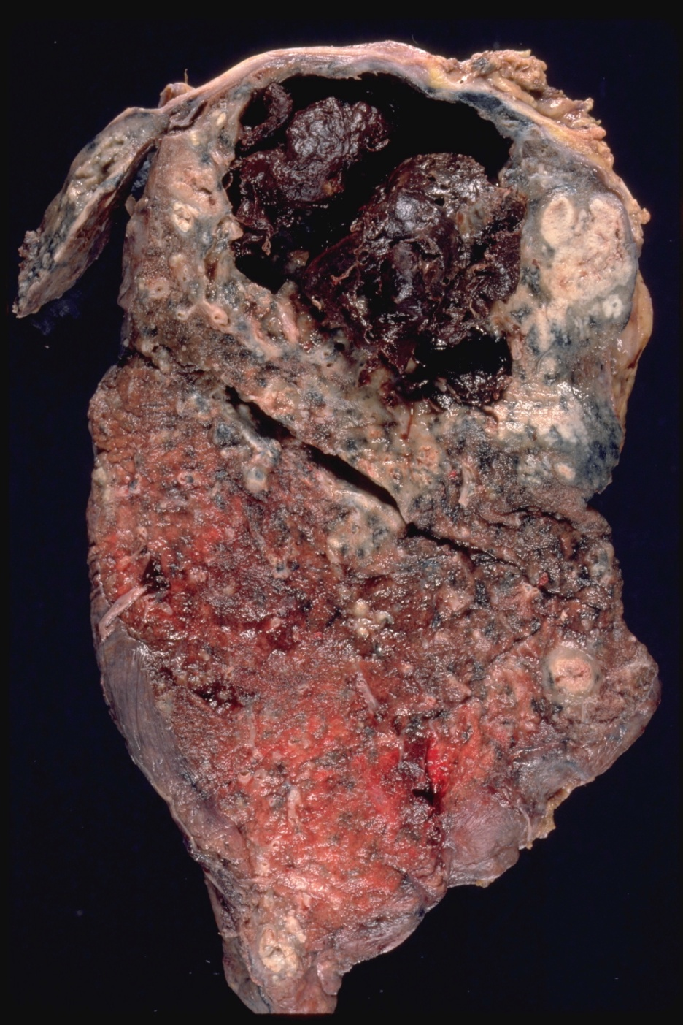
Scondary TB lung
Cavitatory tuberculosis with intracavitary hemorrhage. Extensive necrosis with cavitation, usually occurring in the upper lung lobe .

Slide 33
Complications of TB
Scarring: It can heal by fibrosis leaving a residual apical scar.
Calcification (dystrophic)
Local spread e.g. implantation of bacteria in the larynx leading to hoarseness or bronchial spread leads to bronchopneumonia
Systemic spread/milary TB, via:
Vein – via left ventricle to whole body
Artery – miliary spread within the lung
Pleural effusion (cause an exudative pleural effusion with a protein content of more than 30g/litre) fibrosis & adhesions
Rupture of caseous lesion

Slide 34
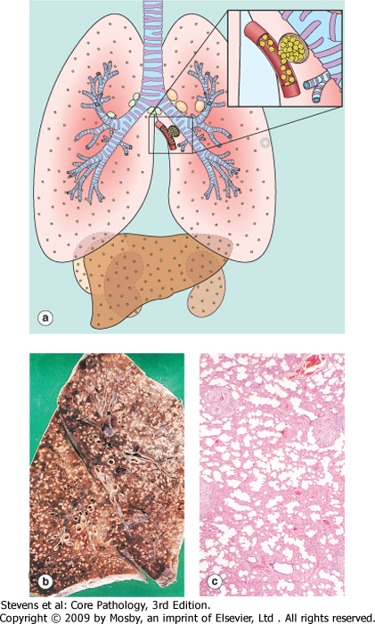
Miliary Tuberculosis:
when bacteria in the lungs enters the pulmonary venous return to the heart; the organisms subsequently disseminate through the systemic arterial system and the lymphatic channels
Systemic miliary tuberculosis
It produces multiple small yellow nodular lesions in several organs. Almost every organ in the body may be seeded. Lesions resemble those in the lung.
In the lungs there multiple lesions either microscopic or small, visible (2-mm) foci of yellow-white consolidation scattered through the lung parenchyma.

Slide 35
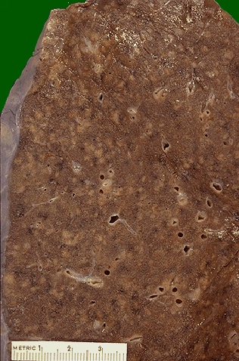
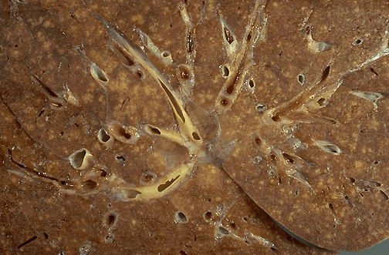
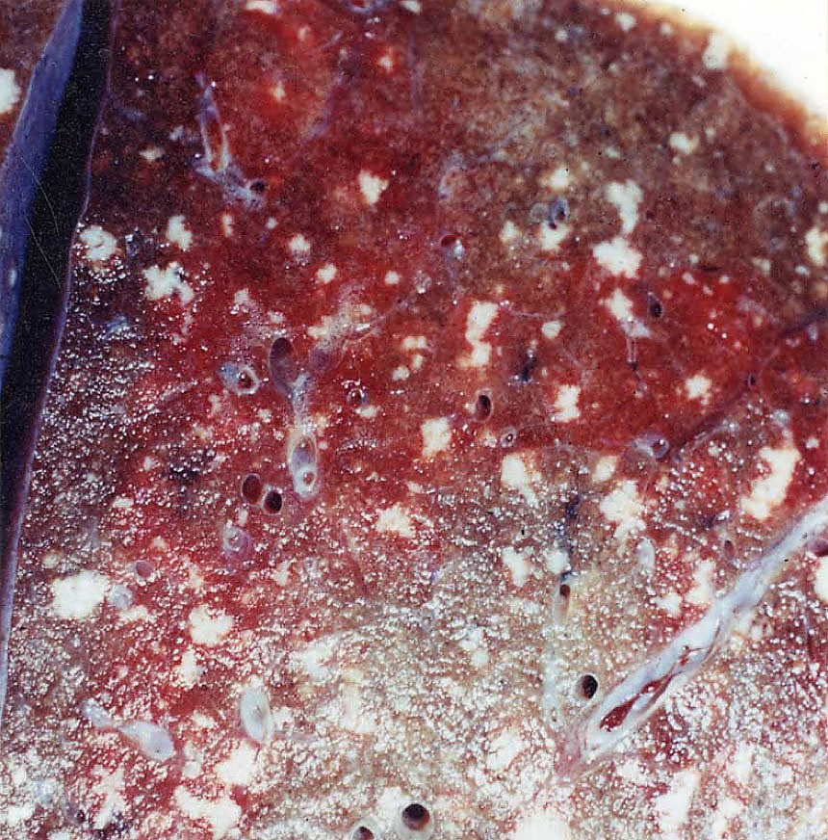
Miliary TB
Millet like – grain.
blood or bronchial spread

Slide 36
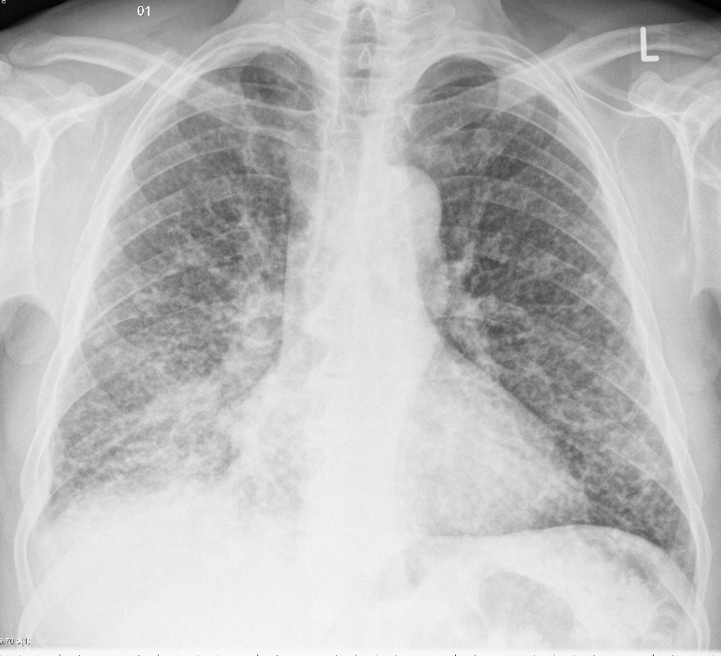
Miliary TB
Chest x-ray shows numerous small dense nodules each measuring 1 to 3 mm in diameter in both lung fields
Patient present with weight loss, intermittent fever, productive blood-stained cough and night sweats.

Slide 37
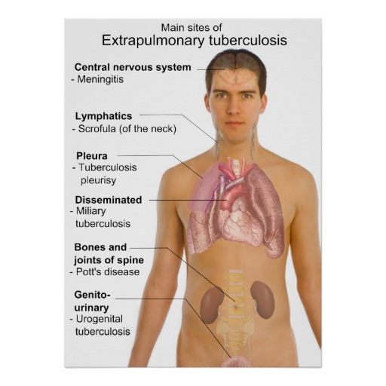
Extrapulmonary tuberculosis
May appear in any of the organs or tissues seeded hematogenously (as
in milary TB) and may be the presenting manifestation of tuberculosis.
Lymph nodes/ tuberculous lymphadenitis : are the most frequent form of extrapulmonary tuberculosis esp. in the cervical region ("scrofula").
Liver and spleen
adrenals
fallopian tube and endometrium
Epididymis and prostate
kidneys
meninges around the base of the brain (tuberculous meningitis),
Bone marrow
Vertebrae (Pott's disease). It collapses the spine and leads to paraspinal "cold" abscesses in these patients may track along the tissue planes to present as an abdominal or pelvic mass
Intestinal tuberculosis contracted by the drinking of contaminated milk. In developed countries today, intestinal tuberculosis is more often a complication of protracted advanced secondary tuberculosis, secondary to the swallowing of coughed-up infective material.

Slide 38
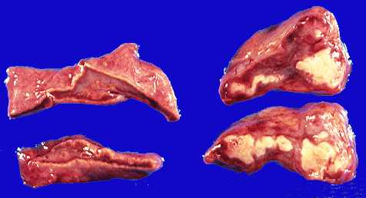
TB epididymis
TB adrenal gland
Tuberculous Addison's disease is still an important cause of primary adrenocortical insufficiency particularly in the developing countries.

Slide 39
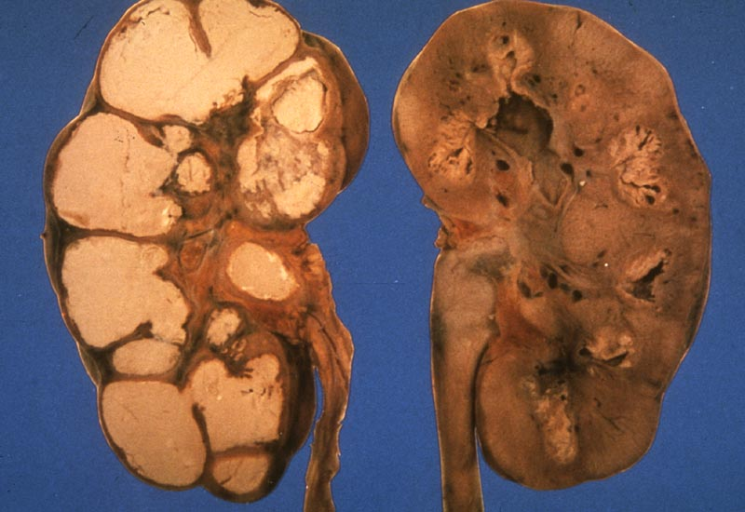
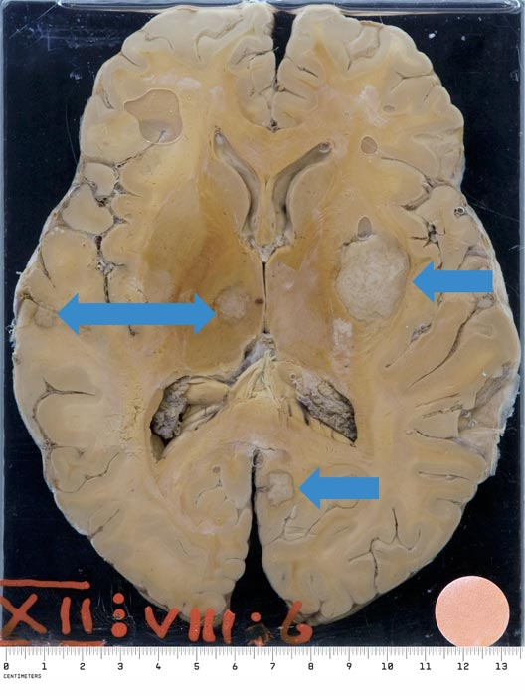
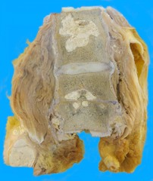
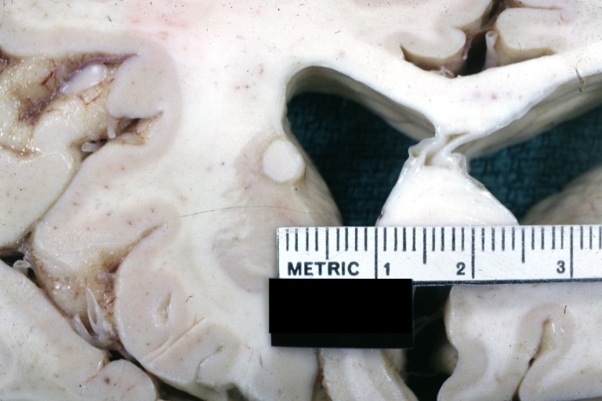
Tuberculoma
Renal TB
TB Vertebra (Potts Spine)

Slide 40
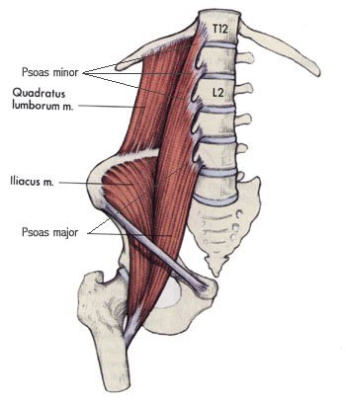
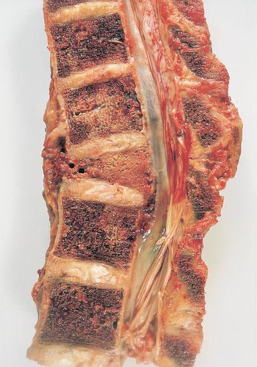
Pott’s disease
Psoas abscess

Slide 41
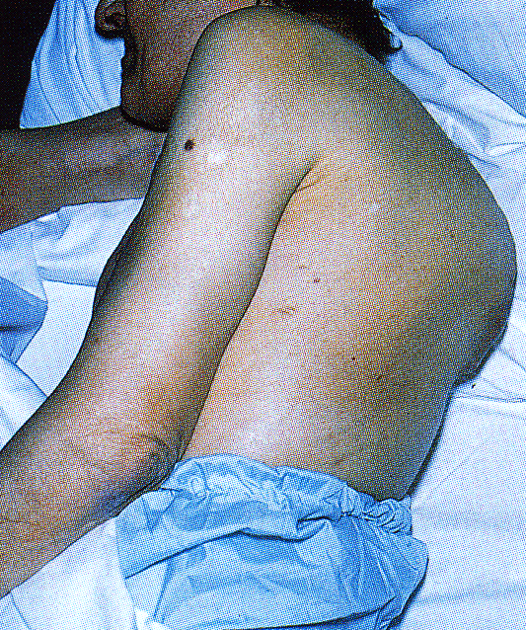
Pott’s disease
kyphoscoliosis: Flexion (kyphosis) and lateral deviation (scoliosis)

Slide 42
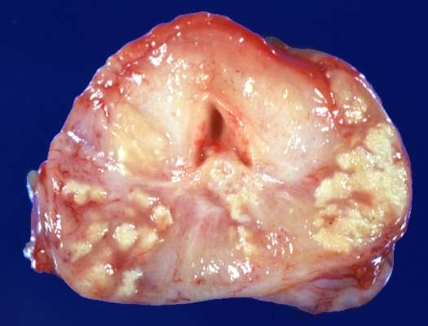
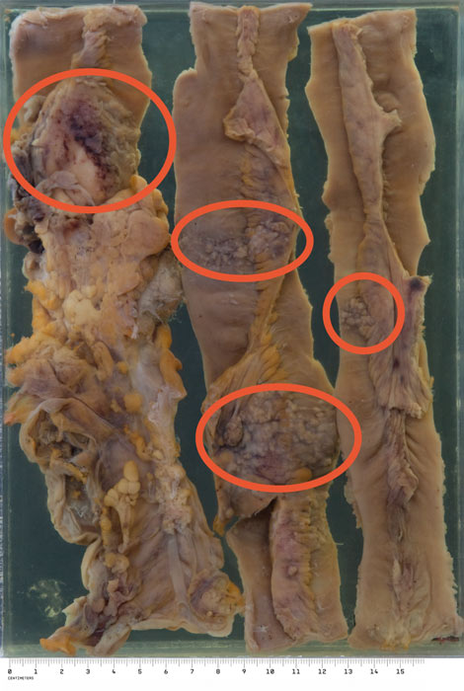
TB Prostate gland
TB intestine

Slide 43
Prognosis
The prognosis is generally good (with proper medication) if infections are localized to the lungs, except when they are caused by drug-resistant strains or occur in aged debilitated, or immunosuppressed persons, who are at high risk for developing miliary TB.

Slide 44
TAKE HOME MESSAGES:
Mycobacterium tuberculosis is the causative organism of tuberculosis (TB) in the lungs and elsewhere.
Mycobacterium tuberculosis gains access to the lung by inhalation and causes pulmonary TB.
A granuloma in TB, termed a 'tubercle', is composed of activated macrophages, Langhans’ giant cells with surrounding lymphoid cells and fibroblasts with central caseation necrosis.
Primary tuberculosis is the form of disease that develops in a previously unexposed, and therefore unsensitized, person.
Secondary (reactivation) tuberculosis arises in previously exposed individuals when host immune defenses are compromised, and usually manifests as cavitary lesions in the lung apices.
Both progressive primary tuberculosis and secondary tuberculosis can result in systemic seeding, causing life-threatening forms such as miliary tuberculosis and tuberculous meningitis.
The outcome of tuberculosis depends on the adequacy of the host immune response.

Slide 45
