Slide 1
Tumors of the Lung
Respiratory block
Dr. Maha Arafah & Dr. Ammar Rikabi
Department of Pathology, KSU, Riyadh, 2016

Slide 2
Lung Tumors
Most lung tumors are malignant.
Lungs are frequently the site of metastases.
Primary lung cancer is a common disease BUT metastatic tumors are more common than the primary tumors.
The most common benign lesions are hamartomas.

Slide 3
Bronchogenic carcinoma
Bronchogenic carcinoma is a malignant neoplasm of the lung arising from the epithelium of the lung.
is a common cause of cancer death in both men
and women.
Most patients are between 50 and 80 years old.
The former male predominance is decreasing, owing to increased smoking among women.
For therapeutic purposes, bronchogenic carcinoma are classified into:
  Non- Small cell lung carcinoma (NSCC) which includes squamous cell, adenocarcinomas, and large-cell carcinomas.
  Small cell lung carcinoma (SCC)
It is important to differentiated NSCC from SCC because treatment are different.
For NSCC therapy:
  Surgical - offers the best chance for curing.
  Radiation - controls local disease. Radiation therapy is most commonly used to palliate symptoms.
  Chemotherapy – not effective.
SCC therapy
  Chemotherapy is effective because small cell carcinomas are highly responsive to chemotherapy
Accounts for >30% of cancer deaths in men Accounts for >25% of cancer deaths in women

Slide 4
Lung Tumors
Malignant epithelial tumors/ bronchogenic carcinoma
      I. Non-Small Cell Lung Carcinoma (NSCC) most common 70%-75%:
        1. Squamous cell carcinoma
        2. Adenocarcinoma
        3. Large cell carcinoma
      II. Small cell lung carcinoma (SCC) 20%-25%.
      III. Combine patterns (5%-10%).
      IV. Carcinoid tumors (2%)
      V. Others
Malignant mesothelial tumors
    - Malignant mesothelioma
    · Epithelial
    · Fibrous (spindle cell)
    · Biphasic
Miscellaneous malignant tumor
    - Carcinosarcoma
    - Pulmonary blastoma
    - Melanoma
    - Lymphoma
    - Others

Slide 5
Etiology of bronchogenic carcinoma
1. Tobacco smoking:
Some 85% of lung cancers occur in cigarette smokers. Most types are linked to cigarette smoking, but the strongest association is with squamous cell carcinoma and small cell carcinoma
The nonsmoker who develops cancer of the lung usually has an adenocarcinoma.
is directly proportional to the number of cigarettes smoked daily and the number of years of smoking.
The risk is 20 to 40 times greater among habitual heavy smokers.
Cessation of cigarette smoking for at least 15 years brings the risk down.
Passive smoking increases the risk to approximately twice than non-smokers.
cigarette smokers show various histologic changes, including squamous metaplasia of the respiratory epithelium which may progress to dysplasia, carcinoma in situ and ultimately invasive carcinoma.

Slide 6
The Cancer Letter • Jan. 25, 2013
Female smokers have a much greater risk of death from lung cancer and chronic obstructive lung disease in recent years than female smokers 20 or 40 years ago, reflecting changes in smoking behavior according to an article published in New England Journal of Medicine.
Female smokers today smoke more like men than women in previous generations, beginning earlier in adolescence and, until recently, smoking more cigarettes per day.

Slide 7
Etiology of brochogenic carcinoma
Radiation:. All types of radiation may be carcinogenic and increase the risk of developing lung cancer. There is increased incidence increased of lung cancer in radium and uranium workers
Asbestos: increased incidence of cancer with asbestos exposure, especially in combination with cigarette smoking. In addition to bronchogenic carcinoma, it also causes mesotheliomas.
Industrial exposure to nickel and chromates, coal, mustard gas, arsenic, iron etc.
Air pollution: May play some role in increased incidence. Indoor air pollution especially by radon.
Scarring: sometimes old infarcts, wounds, scar, granulomatous infections are associated with adenocarcinoma.

Slide 8
Precursor Lesions.
Three types of precursor epithelial lesions are recognized:
  (1) squamous dysplasia and carcinoma in situ can lead to squamous cell carcinoma
  (2) atypical adenomatous hyperplasia can lead to adenocarcinoma
  (3) diffuse idiopathic pulmonary neuroendocrine cell hyperplasia can lead to neuroendocrine tumors.
It should be noted that the term "precursor" does not
imply that progression to invasion will occur in all cases.

Slide 9
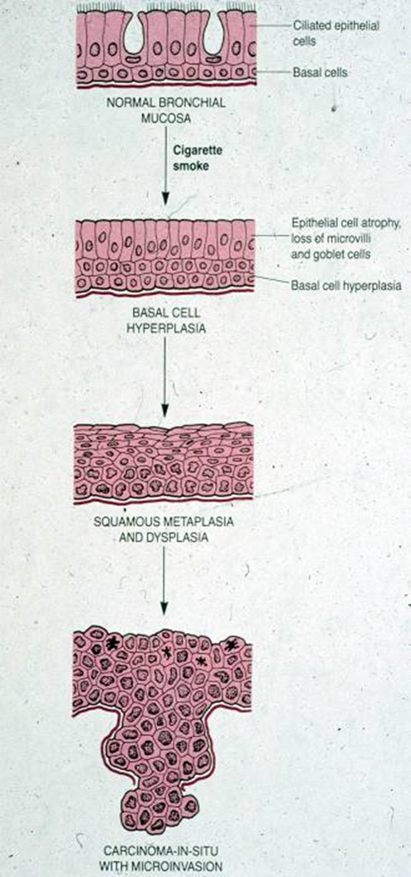
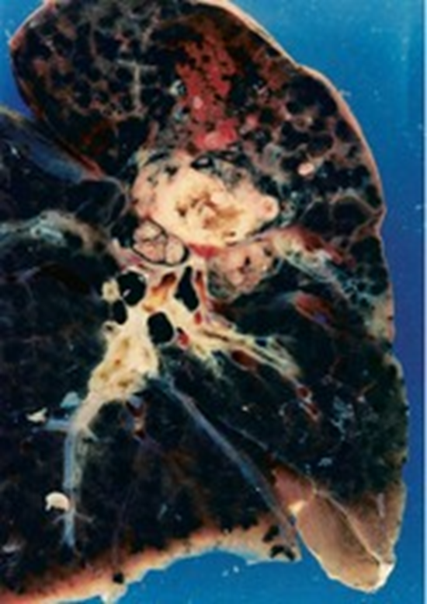
Squamous cell carcinoma (SCC)
Second most common bronchogenic carcinoma;
strong association with smoking (25 times increased risk)
Before Males > females, now incidence in female rising because of smoking.
Poor prognosis
This type of cancer is preceded by years of progressive mucosal changes of respiratory epithelium to squamous metaplasia to dysplasia to carcinoma in situ to invasive SqCC.
SCC arise in the central airways (centrally located). So they appears as a hilar mass.
Frequently cavitate
Tumor cells secrete a parathyroid hormone (PTH)- like peptide leading to hypercalcemia.

Slide 10
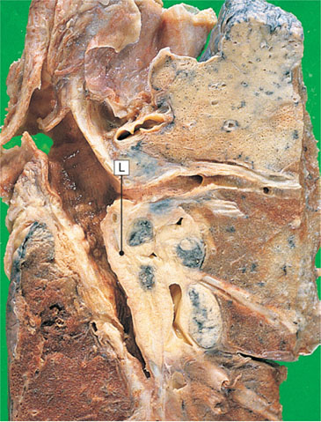
Central carcinoma of the bronchus
Central carcinomas of the lung (L) appear as friable white masses of tissue that extend into the lumen of bronchi and invade into the adjacent lung.

Slide 11
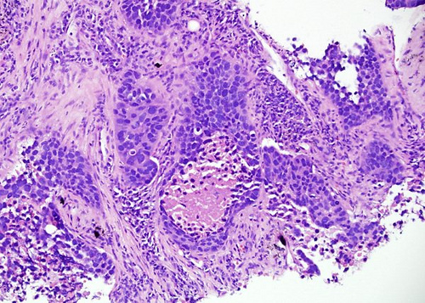
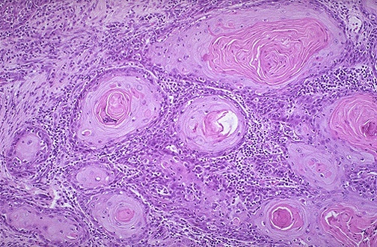
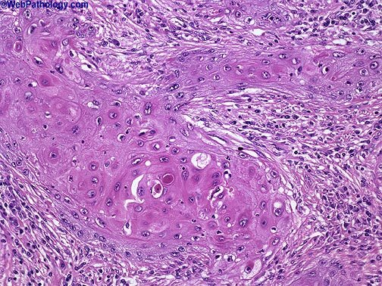
Squamous cell carcinoma (SCC)
Histologically, these tumors are graded according to degree of squamous differentiation and tumors ranges from:
  well-differentiated squamous cell carcinoma (A),
  moderately differentiated SCC (B) to
  poorly differentiated SCC (C).
C
A
B

Slide 12
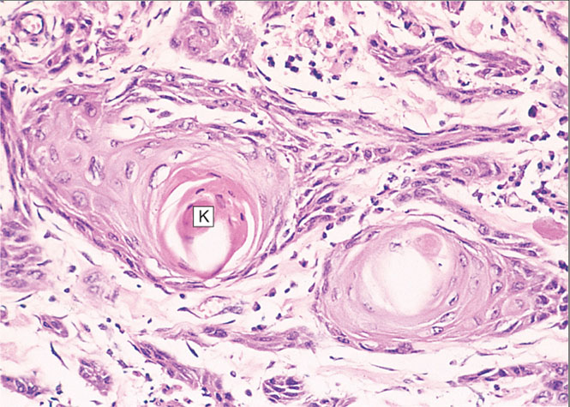
Diseases of Lung
Squamous cell carcinoma of the lung: Produce ectopic parathyroid hormone with secondary hypercalcaemia

Slide 13
Adenocarcinomas
Adenocarcinomas is now the most frequent histologic subtype of bronchogenic carcinoma; more common in women.
They do not have a clear link to smoking history
They are classically peripheral tumors arising from the peripheral airways and alveoli.
The hallmark of adenocarcinomas is the tendency to form glands that may or may not produce mucin.
Peripheral adenocarcinomas are sometimes associated with pulmonary scars (from a previous pulmonary inflammation/infection) and therefore is also referred to as scar carcinoma.
Rarely cavitate
Associated with hypertrophic pulmonary osteoarthropathy
Mutation of epidermal growth factor receptor (EGFR) gene is seen in about 30% of adenocarcinoma of the lung (the base for treatment by anti EGFR therapy)

Slide 14
Adenocarcinomas
Two forms:
Bronchial – derived carcinoma.
Bronchioloalveolar (derived) carcinoma (BAC)

Slide 15
Adenocarcinomas
Two forms:
Bronchial – derived carcinoma.
  Is the common type of adenocarcinoma
  More common in patients under the age of 40, women and non-smokers.
  Tend to metastasize widely at an early stage.
  Peripheral
Bronchioloalveolar (derived) carcinoma (BAC)

Slide 16
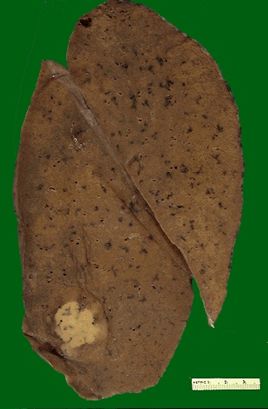
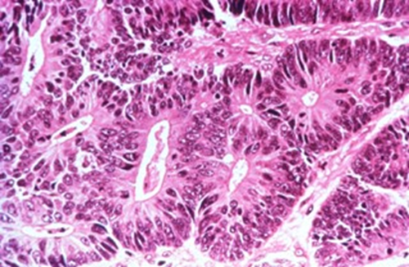
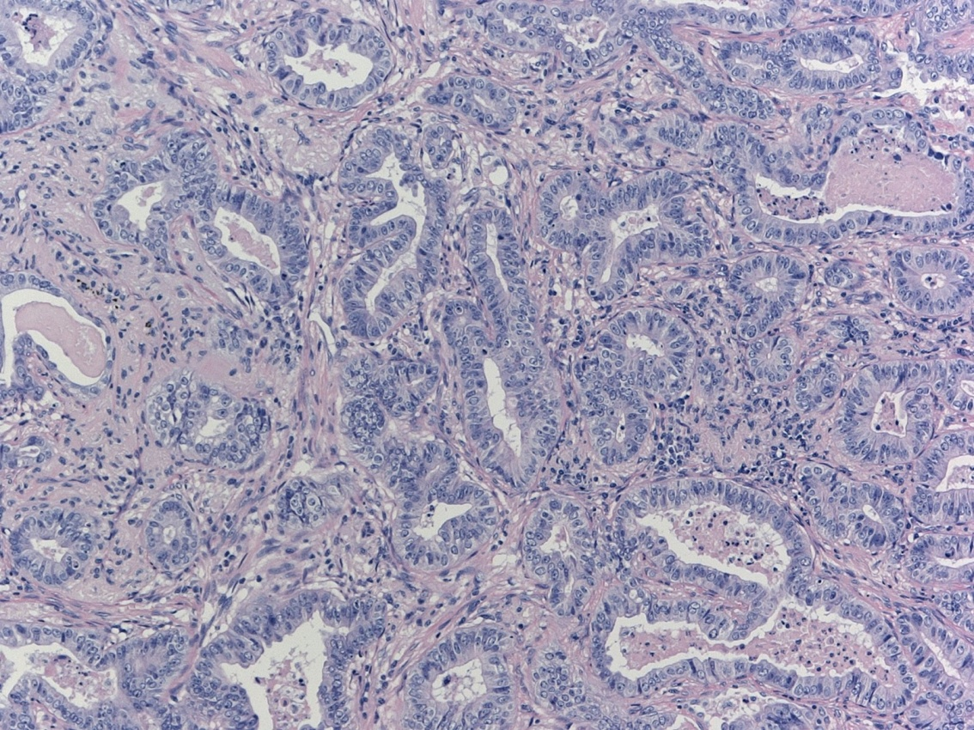
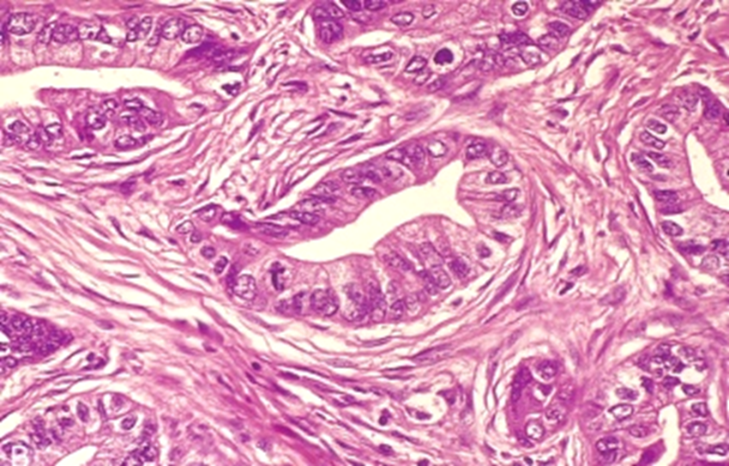
Adenocarcinoma- bronchial derived
Grossly, well-circumscribed, grey-white masses that are commonly peripheral and rarely cavitate
Histologically, they assume a variety of forms, including typical adenocarcinoma with mucus secretion, papillary etc.

Slide 17
Adenocarcinomas
Two forms:
Bronchial – derived carcinoma.
Bronchioloalveolar (derived) carcinoma (BAC)
- it is a less common subtype of adenocarcinoma presents with consolidated airspaces and often does not extend beyond the lungs.
- this cancer is usually multifocal with multiple diffuse nodules (miliary or pneumonic tumor) but can also be a single nodule, arising from Clara cells.
- Less clearly related to smoking, male=female.
- multiple densities on x-ray, mimicking pneumonia
- No invasion of stroma, pleura, or vessel
- Excellent prognosis

Slide 18
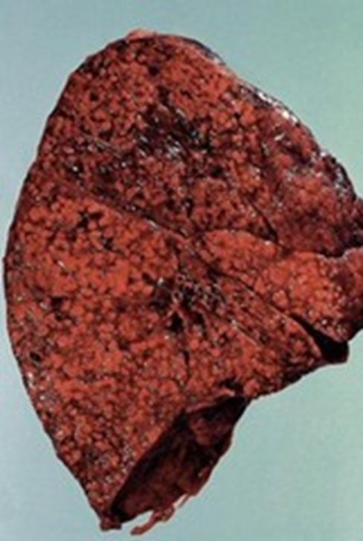
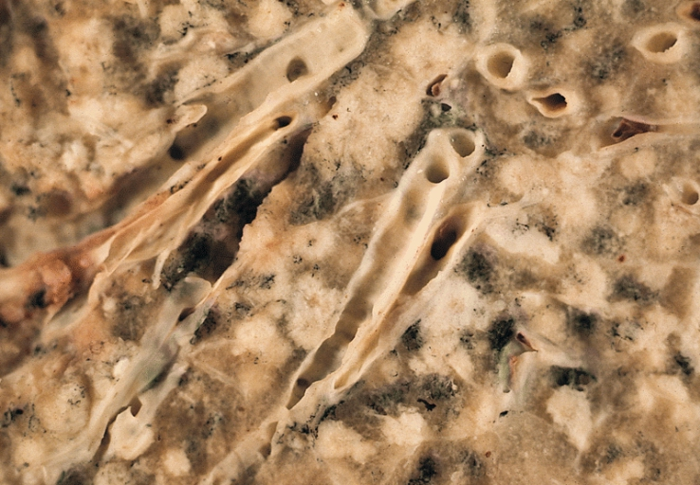
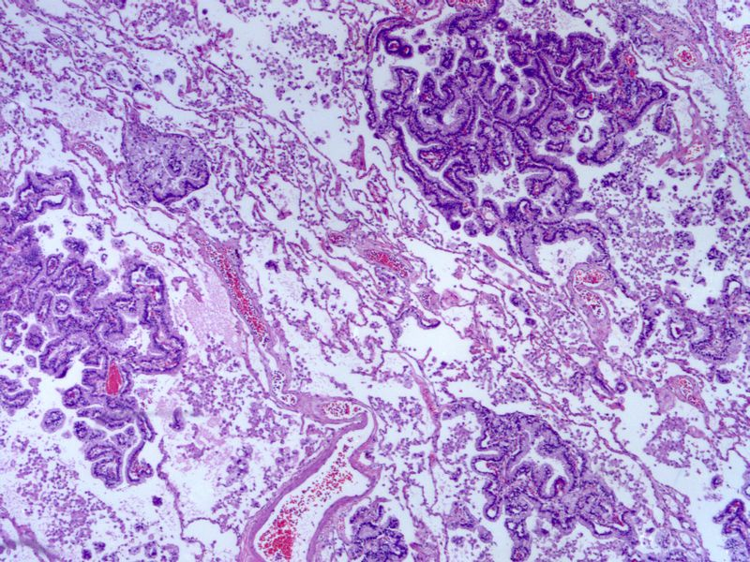
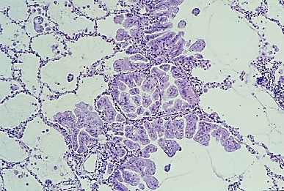
Adenocarcinoma BAC type
Malignant cells grow along alveolar septae
(Adenocarcinoma in situ.)

Slide 19
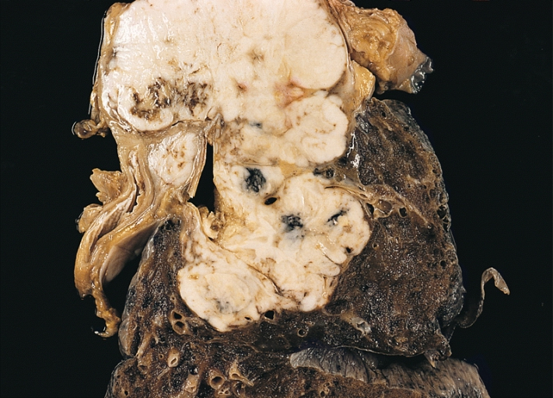
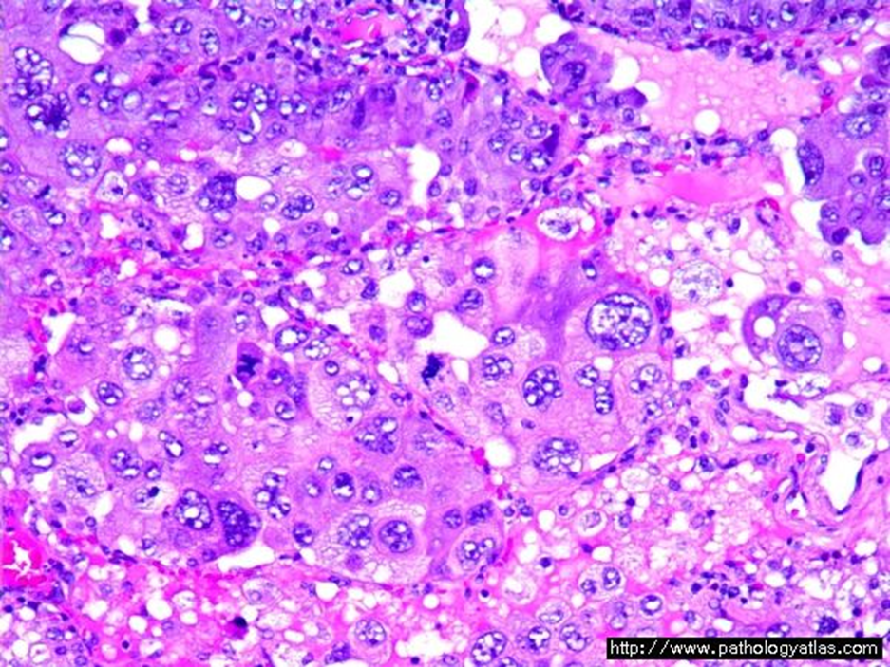
Large Cell Carcinoma
Frequency: 10 %
strongly associated with smoking
Large-cell carcinoma are usually located peripherally. These group of carcinomas are undifferentiated. They made up of large and anaplastic cells. They may exhibit neuroendocrine or glandular differentiation markers when studied by immunohistochemistry or electron microscopy.
Poor prognosis.

Slide 20
Small cell carcinomas
SCLC are a type neuroendocrine tumors arising from neuroendocrine cells.
Highly malignant and aggressive tumor, poor prognosis, rarely resectable.
More common in men.
Strongly associated with cigarette smoking. 95% of patients are smokers
Centrally located perihilar mass with early metastases (Early involvement of the hilar and mediastinal nodes)
Chemotherapy responsive
least likely form to be cured by surgery; usually already metastatic at diagnosis;
It may be associated with paraneoplastic syndrome, Cushing’s, and Eaton-Lambert syndrome
Ability to secrete a host of polypeptide hormones like ACTH, antidiuretic hormone (ADH), calcitonin, gastrin-releasing peptide and chromogranin.

Slide 21
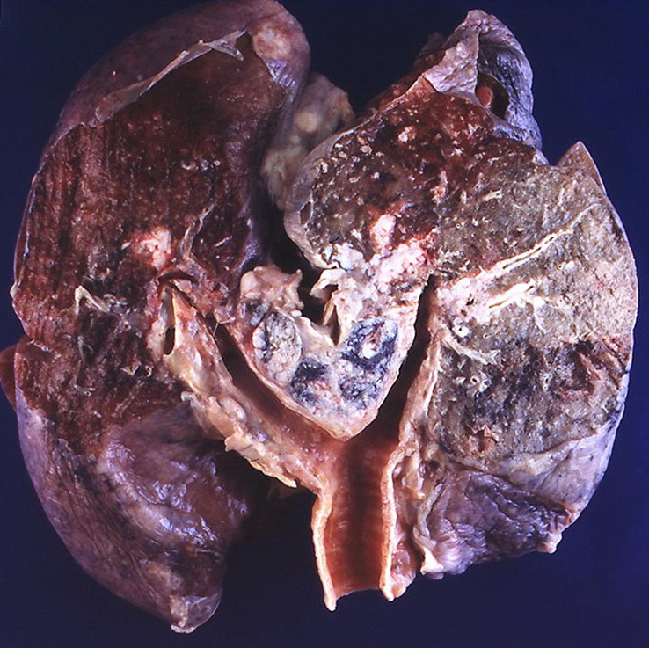
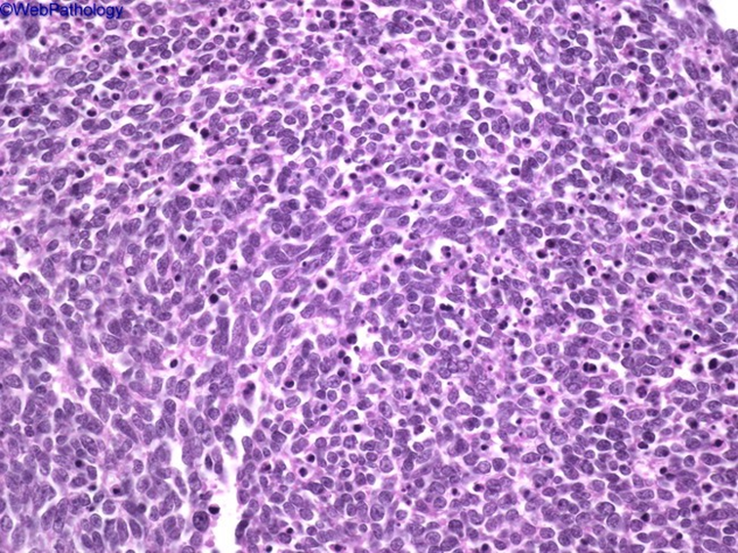
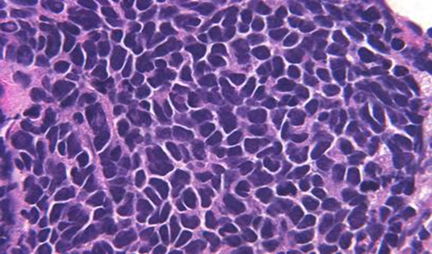
Small cell carcinomas
Microscopically composed of small, dark, round to oval, lymphocyte-like cells with little cytoplasm.
Electron microscopy: dense-core neurosecretory granules.

Slide 22
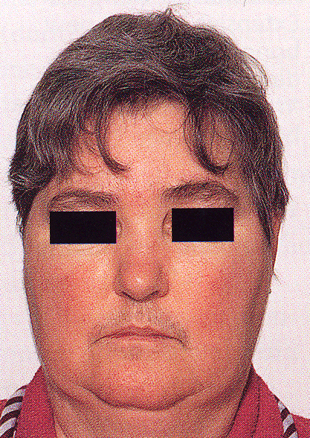
Cushing’s syndrome resulting from ectopic adrenocoticotrophin hormone (ACTH) secretion by a small-cell bronchial carcinoma. The facial appearance is similar to that of Cushing’s disease of other causes, but the disease often runs a very rapid course.

Slide 23
Central tumors
Peripheral tumors
Squamous cell CA
Small cell CA
Adenocarcinoma
- bronchial derived
- bronchioloalveolar
Large cell carcinoma

Slide 24
Molecular genetics in lung cancer
Most common oncogenes—KRAS, MYC family, HER-2/neu, BCL-2, EGFR (epidermal growth factor receptor)
b. Most common suppressor genes—p53 (most common), RB1, p16
Suppressor genes: p53 (most common), RB1, p16

Slide 25
Clinical features and complications of bronchogenic carcinoma
Can be silent or insidious lesions
chronic cough and expectoration, hemoptysis, and bronchial obstruction, often with atelectasis.
Bronchiectasis
Obstructive pneumonia
Pleural effusion
Hoarseness, chest pain, superior vena cava syndrome, pericardial or pleural effusion.
Symptoms due to metastatic spread.
NSCLC have a better prognosis than SCLC.
Outlook is poor for most patients.

Slide 26
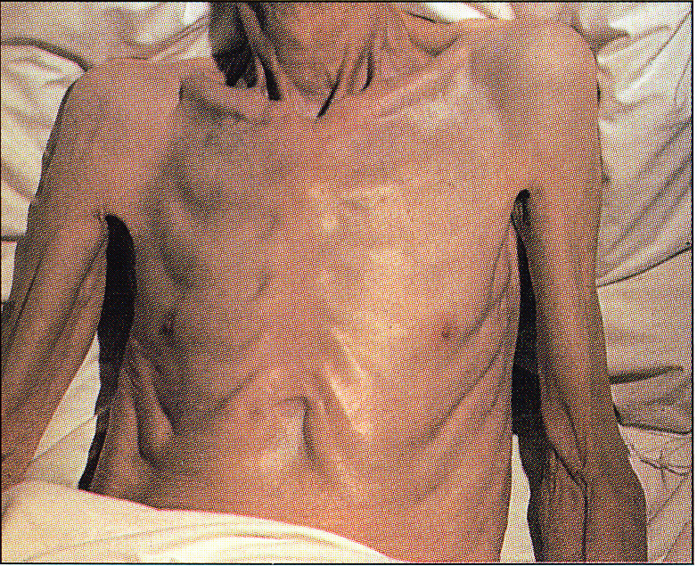
Cachexia may occur in a number of severe disorders, including chronic lung diseases such as pulmonary fibrosis, tuberculosis and emphysema, malignant disease, including bronchial carcinoma.

Slide 27
Clinical features: may also be manifest by the following
Superior vena cava syndrome: compression or invasion of the superior vena cava leads to obstruction of venous drainage which leads to dilation of veins in the upper part of the chest and neck resulting in swelling and cyanosis of the face, neck, and upper extremities including the breasts; edema of the conjunctiva etc.
Hoarseness from recurrent laryngeal nerve paralysis
Pleural effusion, often bloody.
Paraneoplastic syndrome
Pancoast tumor (superior sulcus tumor): Apical neoplasms may invade the brachial sympathetic plexus to cause severe pain, numbness and weakness in the distribution of the ulnar nerve(i.e. arm). The combination of clinical findings is known as Pancoast syndrome.
  Pancoast tumor is often accompanied by destruction of the first and second ribs and thoracic vertebrae.
  It often coexists with Horner syndrome in which there is invasion of the cervical thoracic sympathetic nerves and it leads to ipsilateral enophthalmos, miosis, ptosis, and facial anhidrosis.

Slide 28
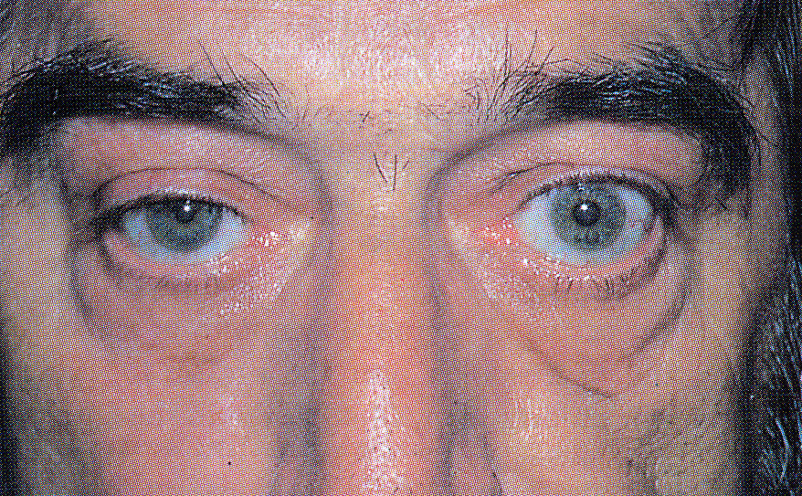
Horner’s syndrome resulting from a right Pancoast tumour. The patient had a right ptosis and a constricted right pupil, caused by tumour infiltration of the inferior cervical sympathetic ganglia.

Slide 29
Paraneoplastic syndrome
Paraneoplastic syndromes of lung cancer, are extrapulmonary, remote effects of tumors.
3% to 10% of lung cancers develop paraneoplastic syndromes.
In it the tumor cells produce various peptides which lead to metabolic and
neuromuscular disturbances unrelated to the primary tumor or metastases. e.g.
    small cell carcinomas may secrete ectopic ACTH (leading to Cushing's syndrome), or ADH (leading to water retention and hyponatremia)
    carcinoid tumors produce serotonin and bradykinin leading to carcinoid syndrome (flushing, wheezing, diarrhea, and cardiac valvular lesions).
    squamous cell carcinomas may secrete parathormone, parathyroid hormone-like peptide and prostaglandin E that lead to hypercalcemia.
    adenocarcinomas can lead to hematologic manifestations
    Other endocrine syndromes associated with primary lung carcinomas e.g. gonadotrophin production leading to gynecomastia, calcitonin production leading to hypocalcemia,
    hyperglycemia, thyrotoxicosis, and skin pigmentation etc.

Slide 30
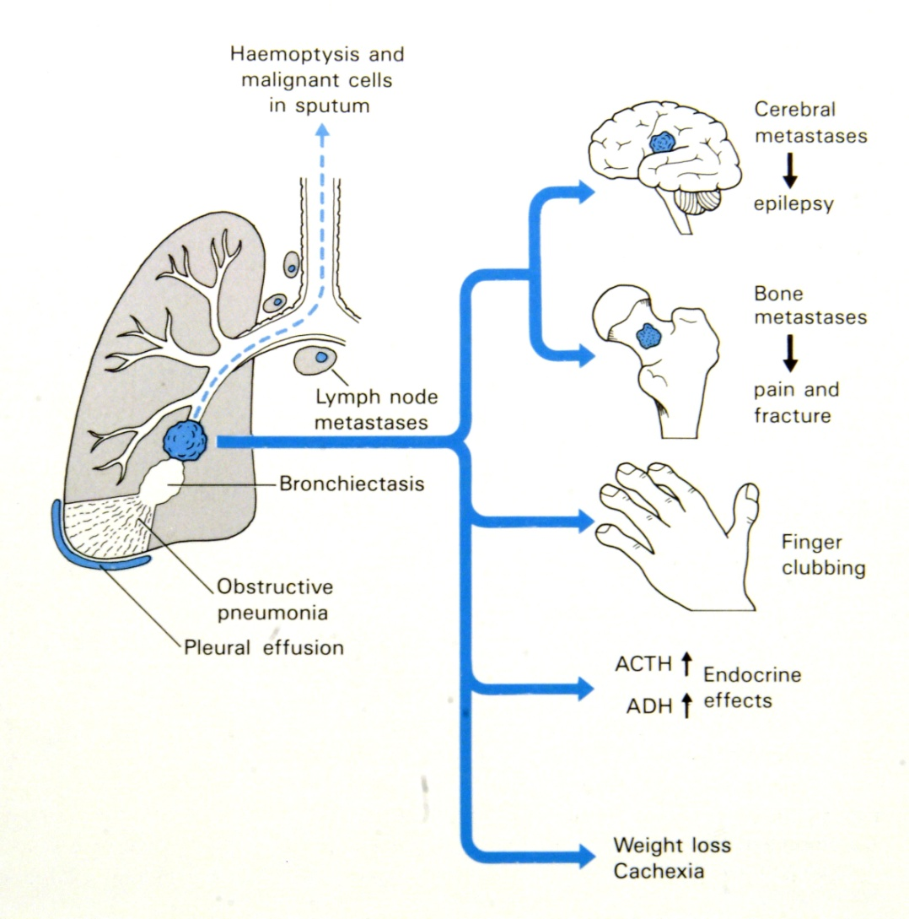
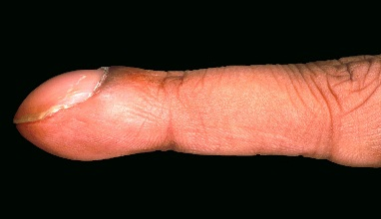
Clinical features and complication of bronchogenic carcinoma
Associated with various underlying pulmonary, cardiovascular, neoplastic, infectious, hepatobiliary, mediastinal, endocrine, and gastrointestinal diseases
It may occur, without evident underlying disease, as an idiopathic form or as a Mendelian dominant trait.

Slide 31
bronchogenic carcinoma
Spread of bronchogenic carcinoma
1. Lymphatic spread.
* successive chains of nodes (scalene nodes).
* involvement of the supraclavicular node
(Virchow’s node).
2. Extend into the pericardial or pleural spaces. Infiltrate the superior
vena cava.
A tumor may extend directly into the esophagus, producing obstruction, sometimes complicated by a fistula.
Phrenic nerve invasion usually causes diaphragmatic paralysis
5. May invade the brachial or cervical sympathetic plexus (Horner’s Syndrome).
6. Distant metastasis to liver (30-50%), adrenals (>50%), brain (20%)
and bone (20%).

Slide 32
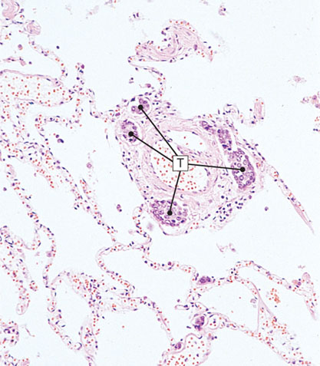
Diseases of Lung
Lymphangitis carcinomatosa

Slide 33

Diseases of Lung
Key Facts Lung cancer
. Caused by inhaled environmental agents, particularly smoking and radon.
. Peak incidence 40-70 years, most common form of cancer.
. Four main types: squamous cell, small-cell anaplastic, adenocarcinoma and large-cell anaplastic.
. Bronchoalveolar carcinoma is a special form of adenocarcinoma with a better prognosis than other types.
. Clinical division is into small-cell and non-small cell types (all others).
. Tumors may be central (all types) or peripheral (mainly adenocarcinomas).
. Small-cell carcinoma is neuroendocrine, highly malignant, and may be associated with ectopic endocrine syndromes.
. TNM staging used for NSCLC.
. Simple staging used for SCLC-Limited and Extensive.
. Overall survival 5-30% at 5 years, highly dependent on type and stage of disease.

Slide 34
Carcinoid tumor
Carcinoid tumors of the lung are neuroendocrine neoplasms and are thought to arise from the neuroendocrine cells normally found in the bronchial epithelium.
These neoplasms account for 2% of all primary lung cancers, show no sex predilection, and are not related to cigarette smoking or other environmental factor.
Usually seen in adults
Can be central or peripheral in location.
Originate in mainstem (large) bronchi.
    Tumor cells produce serotonin and bradykinin leading to carcinoid syndrome (flushing, wheezing, diarrhea, and cardiac valvular lesions).Tumor cells can also produce ectopic ACTH leading to Cushing syndrome.
Can occur in patients with Multiple Endocrine Neoplasia (MEN-I)
Low malignancy, Often resectable and curable.
Spreads by direct extension into adjacent tissues

Slide 35
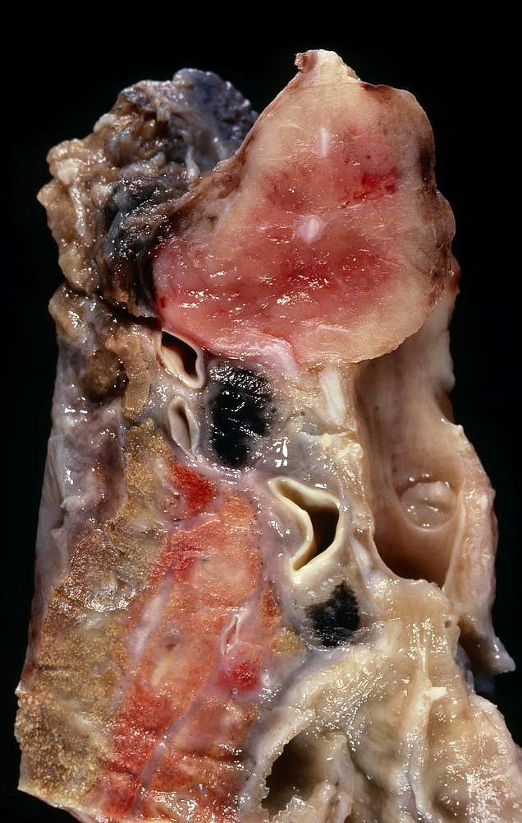
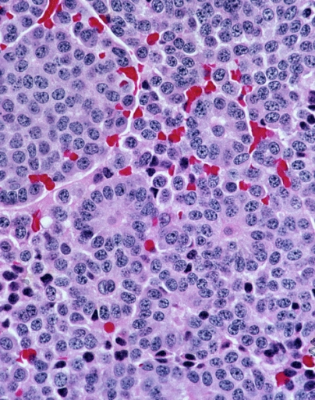
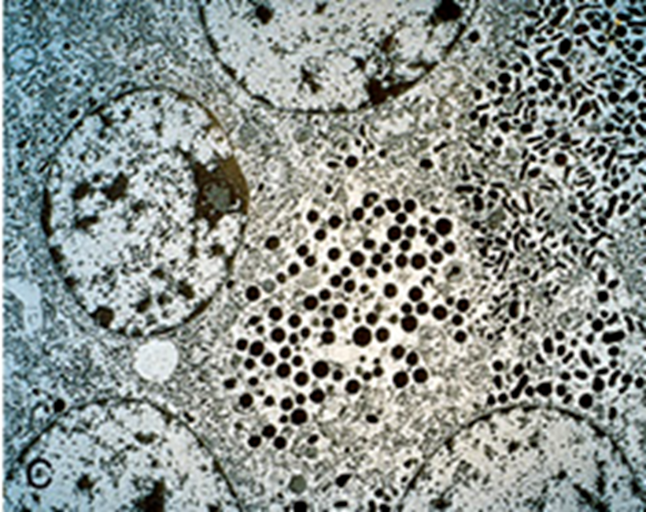
Morphology of typical carcinoid tuomors
Composed of uniform cuboidal cells that have regular round nuclei with few mitoses and little or no anaplasia.
Electron microscopy: dense-core neurosecretory granules

Slide 36
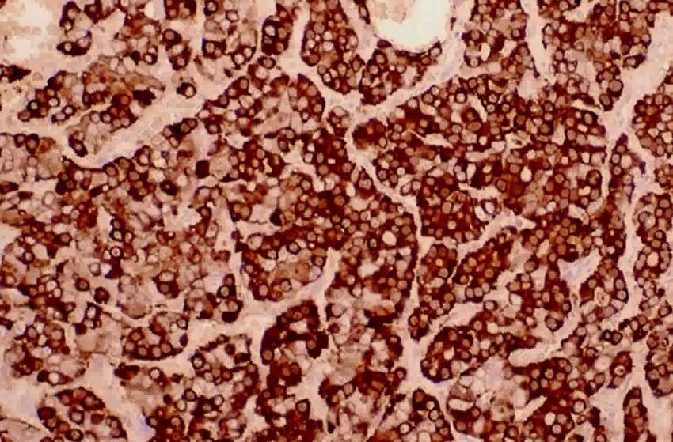
Carcinoid tuomors
Chromgranin positive

Slide 37
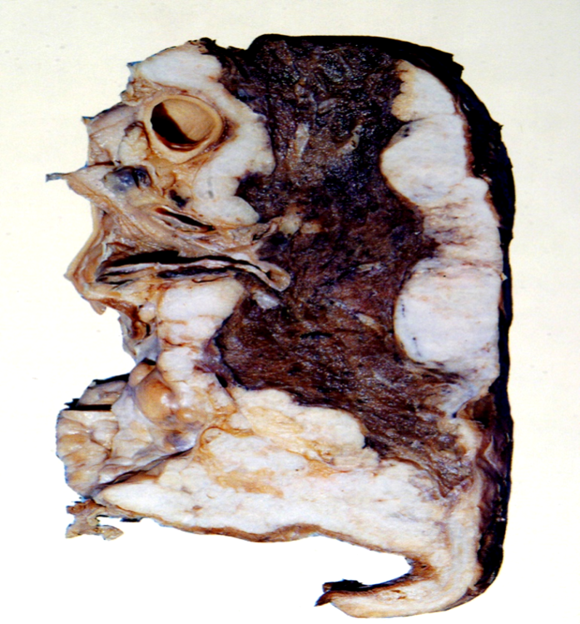
Mesothelioma
Malignant tumor of mesothelial cells lining the pleura
Highly malignant neoplasm
Most patients (70%) have a history of exposure to asbestos
Smoking is not related to mesothelioma
The average age of patients with mesothelioma is 60 years.
Pleural mesotheliomas tend to spread locally within the chest cavity, invading and compressing major structures.
Metastases can occur to the lung parenchyma and mediastinal lymph nodes, as well as to extrathoracic sites e.g. liver, bones, peritoneum etc.
Treatment is largely ineffective and prognosis is poor: few patients survive longer than 18 months after diagnosis

Slide 38
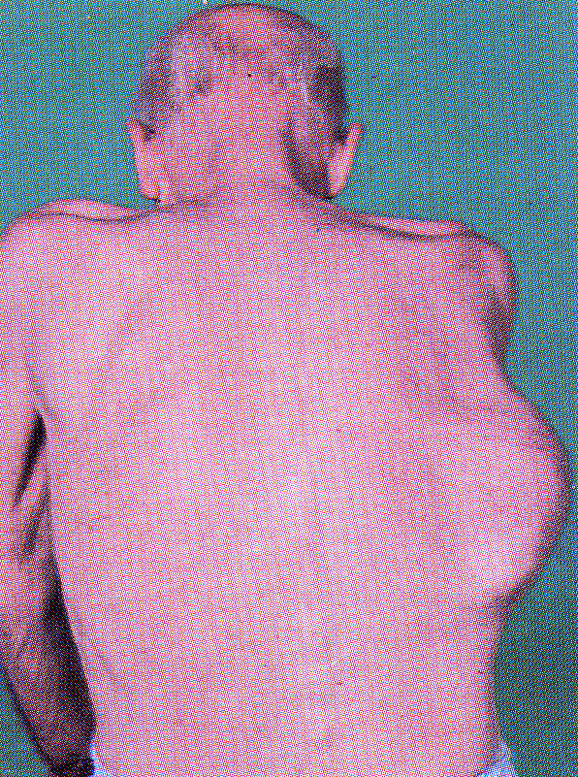
Mesothelioma. This patient presented with an asbestos link pleural plaque.

Slide 39
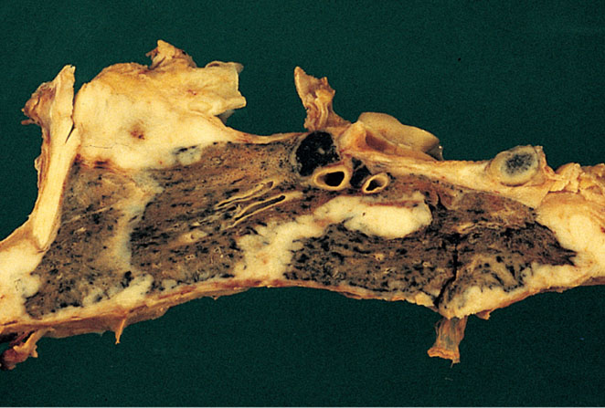
Diseases of Lung
Malignant mesothelioma. Mesothelioma is seen as a thick sheet of white tumor that encases the whole of the lung.

Slide 40
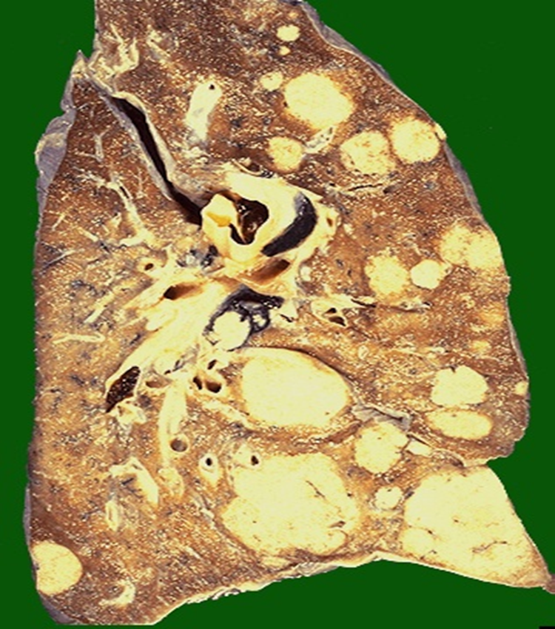
Carcinoma metastatic to the lung
Pulmonary Metastases are More Common than Primary Lung Tumors
Metastatic tumors in the lung are typically multiple and circumscribed. When large nodules are seen in the lungs radiologically, they are called cannon ball metastases .
The common primary sites are the breast, stomach, pancreas, and colon.
SP16-102

