Slide 1
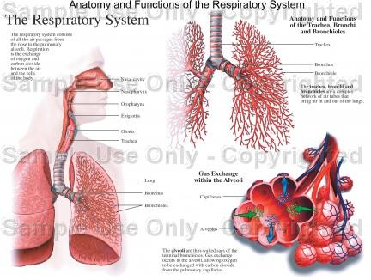
Respiratory Physiology
Dr. Aida Korish Associate Prof. Physiology
KSU
Dr.Aida Korish ( akorish@ksu.edu.sa)

Slide 2
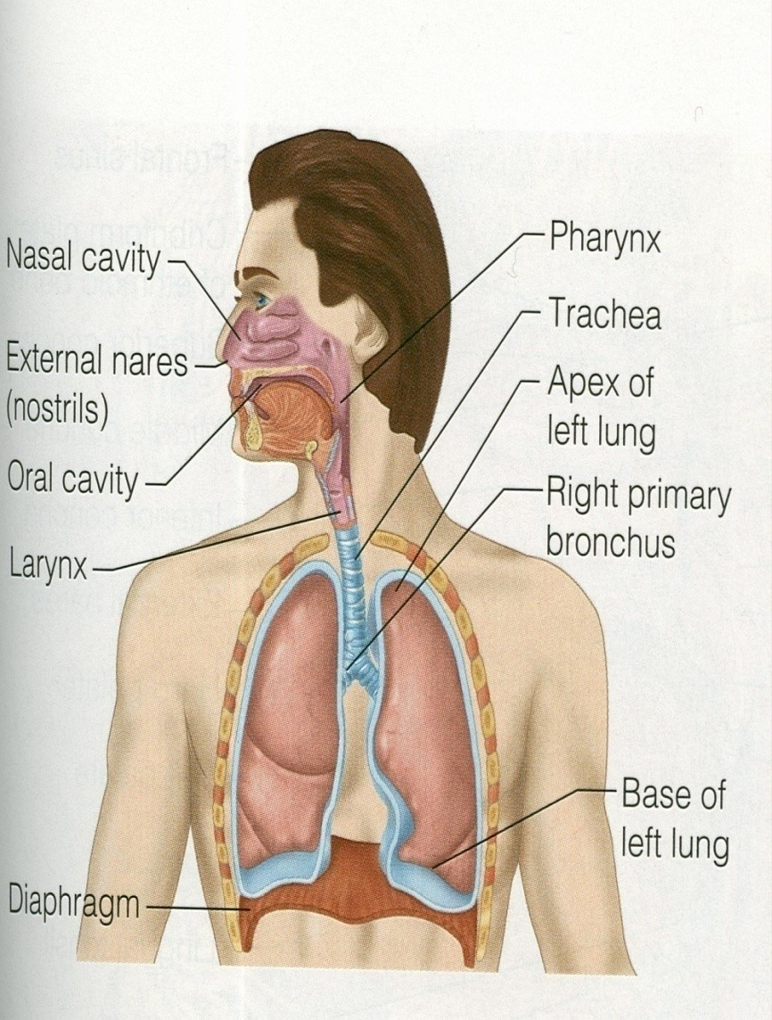
The main goal of respiration is to
Provide oxygen to tissues
Remove CO2
Respiratory system consists of:
passages (airways)
muscles
centers
Dr.Aida Korish ( akorish@ksu.edu.sa)

Slide 3
Functions and organization of the respiratory system
Dr.Aida Korish ( akorish@ksu.edu.sa)

Slide 4
Learning Objectives
By the end of this lecture you will be able to:-­‐
1-Describe the structures and functions
of the
conductive and respiratory zones of airways.
2-­‐Understand the diﬀerence between internal and external respiration.
3-­‐Understand the functions of the respiratory system, including non-­‐respiratory functions, like clearance mechanism by mucus and cilia, production of surfactant and its physiological signiﬁcance.
Dr.Aida Korish ( akorish@ksu.edu.sa)

Slide 5
Functions of the respiratory system include
Gas exchange (respiratory function).
Phonation: is the production of sounds by the movement of air through the vocal cords.
Pulmonary defense
Immunoglobulin A (IgA),
Alpha-1 antitrypsin
The pulmonary macrophages in the alveoli: engulf smaller particles which pass through the muco- cilliary barrier filter.

Slide 6
Cont..non respiratory functions of lung
Angiotensin I is converted to angiotensin II with the help of angiotensin converting enzyme formed by the lungs.
Regulating the acid-­‐ base status of the body by washing out extra carbon dioxide from the blood.
Secretion of important substances like surfactant .

Slide 7
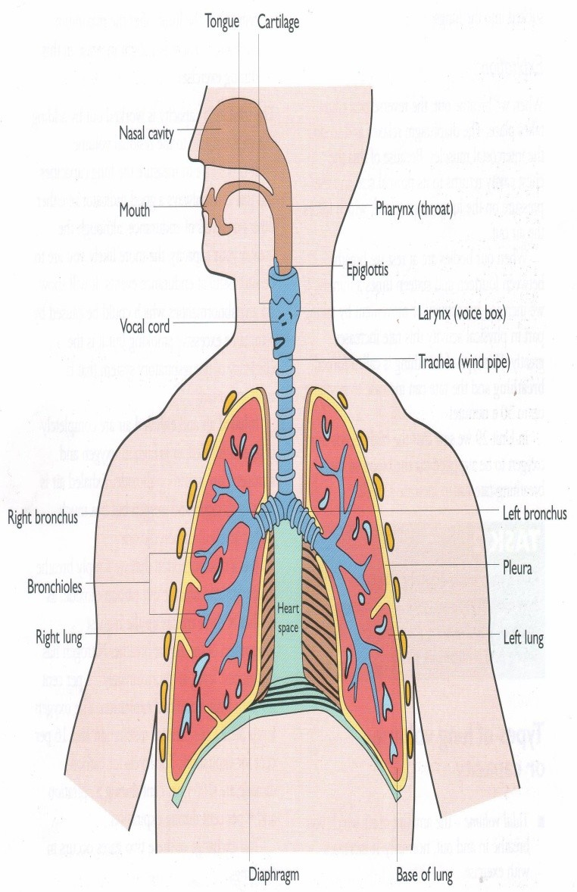
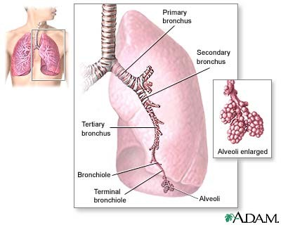
Respiratory passages ( airways)

Slide 8
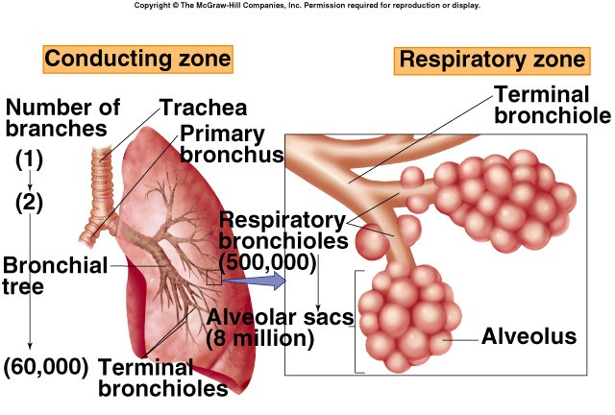
Respiratory passages airways can be divided into

Slide 9

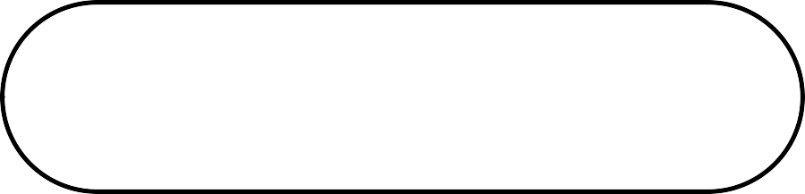
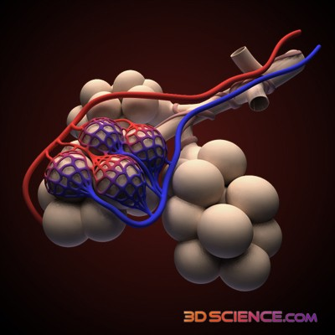
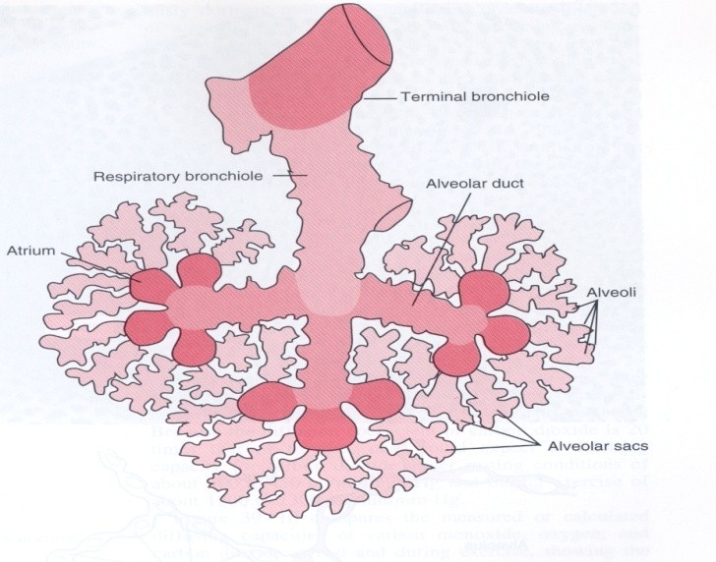
II-­‐ Respiratory Zone
(Respiratory unit)
I-­‐ Conductive Zone
•Starts from nose to the end of •
terminal bronchioles.
•Help warming, humidiﬁcation, ﬁltration of inspired air.
▪▪Contains the olfactory
Includes:
Respiratory bronchioles, alveolar ducts, alveolar sacs, alveoli
Function in gas exchange.
receptors for smell sensation.
▪▪ Conducts the sound during
speech.
▪▪ Protective function by cough
and sneezing reﬂexes.

Slide 10

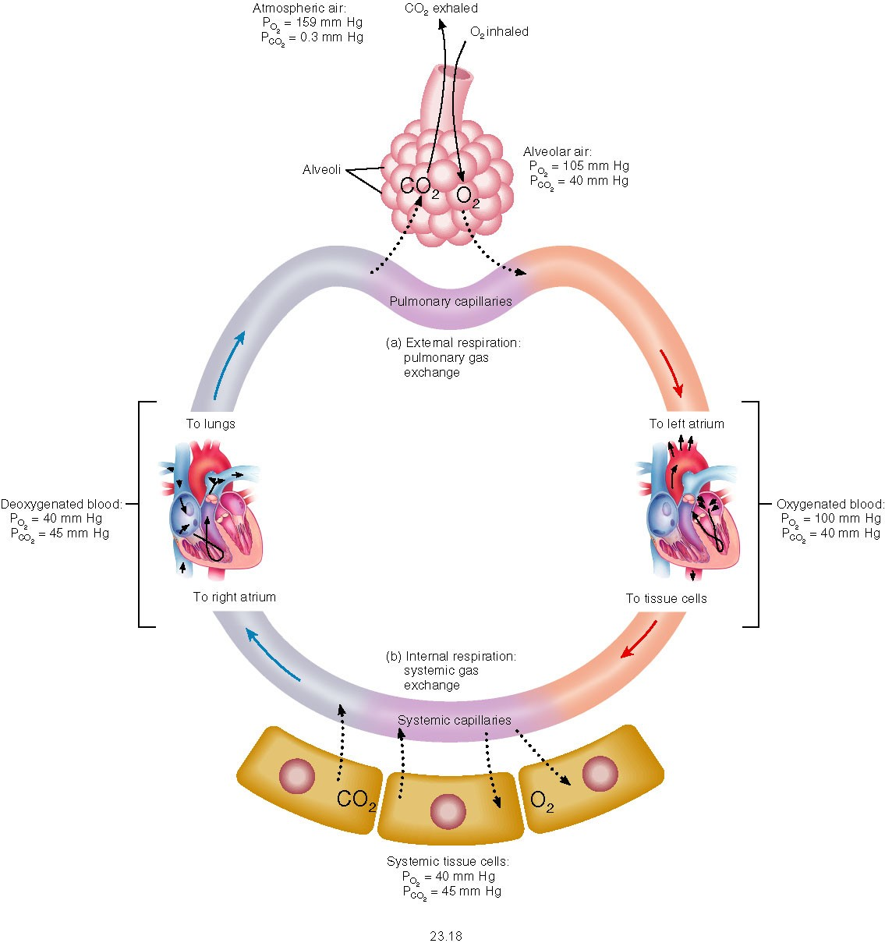
Internal & External Respiration

Slide 11
External respiration
3 major functional events occurs during it:
1-­‐Pulmonary ventilation: inward and outward movement of air between lung and atmosphere.
2-­‐ Diﬀusion of oxygen and CO2 between the alveoli and the pulmonary capillary blood
3-­‐ Transport of O2 & Co2 in the blood and body ﬂuids to and from the cells
Respiration could be either
Resting: normal breathing during resting conditions.
Forced (maximal): during exercise, in patients with asthma, allergy,…

Slide 12
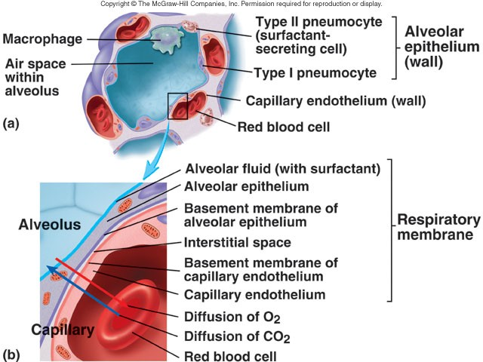
Lining cells of the alveoli
1-­‐ Type I alveolar cells
( type I pneumocytes)
2-­‐ Type II alveolar cells ( type II pneumocytes) (Secrete surfactant)
3-­‐ Alveolar macrophages

Slide 13
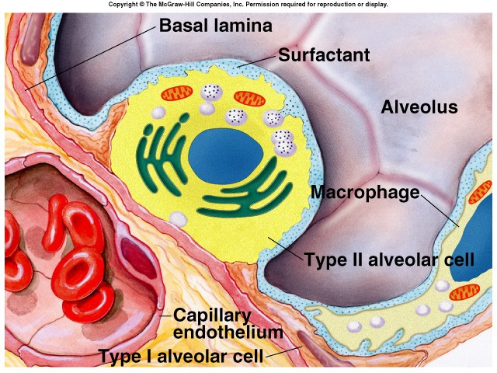
Surface Tension
H₂O molecules at the surface are attracted to other H₂O molecules by attractive forces that resist distension called surface tension.
Surface tension tends to oppose alveoli expansion.
Pulmonary surfactant reduces surface tension.

Slide 14
Surfactant
Surfactant is a complex substance containing phospholipids and a number of apoproteins.
Secreted by the Type II alveolar cells. The earliest detection from fetal alveoli begins between 6-­‐7th month but this could be delayed in others to wk 35 of intrauterine life.
Surfactant reduces surface tension throughout the lung, prevents alveolar collapse, decreases airway resistance and the work of breathing.

Slide 15
Cont…surfactant
Deficiency in premature babies cause respiratory distress syndrome of the new born (RDS) ( hyaline membrane disease)
Smoking in adult, hypoxia or hypoxemia (low oxygen in the arterial blood) or both, decrease the secretion of surfactant and cause adult respiratory distress syndrome.

Slide 16

Innervations of lungs and bronchi
Is by autonomic nerves.
Sympathetic stimulation causes dilatation of the bronchi
Parasympathetic stimulation causes constriction of the bronchi.
Locally secreted factors :histamine, slow reacting substances of anaphylaxis (SRSA) by mast cells, due to allergy ( as in patients with asthma) often cause bronchiolar constriction and increase airway resistance.

Slide 17
Mechanics of pulmonary ventilation

Slide 18
Learning Objectives
By the end of this lecture you will be able to:
List the muscles of respiration and describe their roles during inspiration and expiration.
Understand the importance of the following pressures in respiration: atmospheric, alveolar, intrapleural, and transpulmonary.
Explain why intrapleural pressure is always subatmospheric under normal conditions, and the significance of the thin layer of the intrapleural fluid surrounding the lung.
Define lung compliance and list the determinants of compliance.

Slide 19
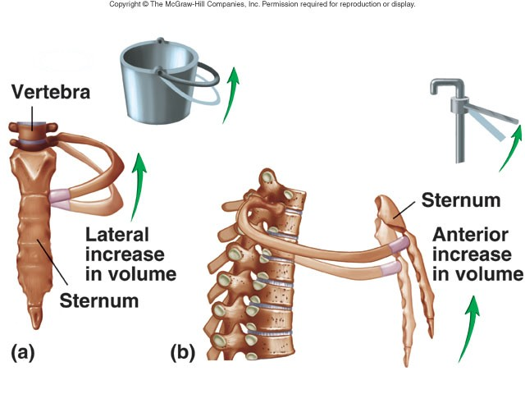

Slide 20
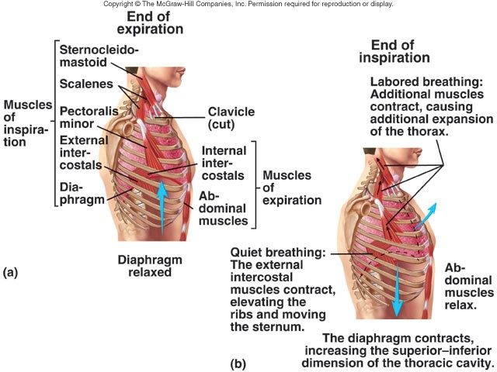
Respiratory muscles
Inspiratory muscles
(resting-­‐ forced)
Expiratory muscles
(forced expiration-­‐ muscles that depress the rib cage)

Slide 21
Deep Forceful Breathing
Deep Inspiration
  During deep forceful inhalation accessory muscles of inspiration participate to increase size of the thoracic cavity
    Sternocleidomastoid – elevate sternum
    Scalene – elevate first two ribs
    Pectoralis minor – elevate 3rd–5th ribs
Deep Expiration
  Expiration during forceful breathing is active process.
  Muscles of exhalation increase pressure in abdomen and thorax
    Abdominal muscles.
    Internal intercostals.

Slide 22
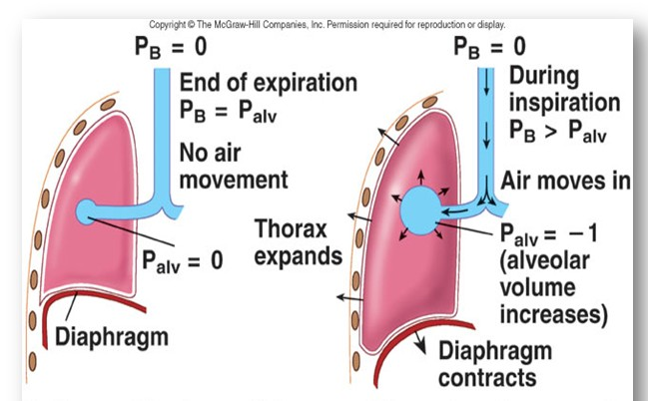
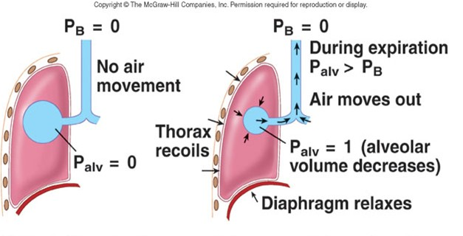
Air will flow from a region of high pressure to one of low pressure-- the bigger the difference, the faster the flow

Slide 23
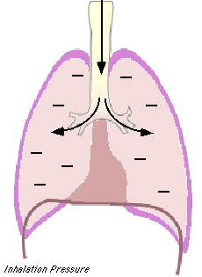
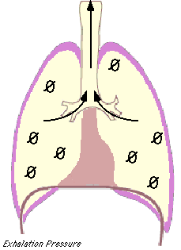
Pressure changes in the lungs during breathing
1-Intra-alveolar (intrapulmonary pressure
Between breathes = zero pressure During inspiration = (-1 mmHg). air
(tidal volume) flow from outside to
inside the lungs).
At the end of inspiration = zero. air flow stops.
During expiration = (+1 mmHg). air flow out of the Lungs

Slide 24
2-Intrapleural pressure (IPP):
Pressure in the pleural space
is negative with respect to atmospheric pressure at the end of normal expiration( -5cmH2O).
Why negative??:
  The lung's elastic tissue causes it to recoil, while that of the chest wall causes it to expand. Because of these 2 opposing forces the pressure in the pleural cavity becomes negative.
  The pleural space is a potential space, empty due to continuous suction of fluids by lymphatic vessels.
Dr.Aida Korish ( akorish@ksu.edu.sa)

Slide 25
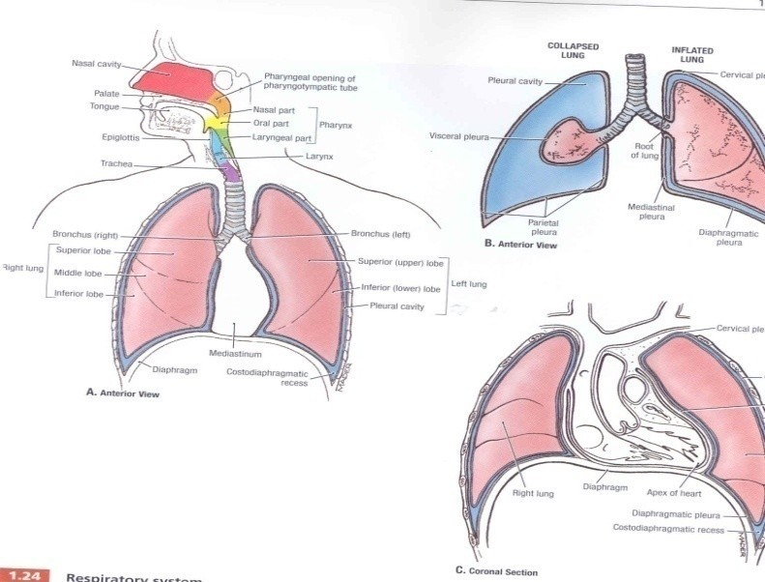
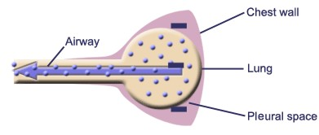
Values of IPP
(-5) cm H2O during resting position between breathes, and it becomes more –ve (-7.5) cm H2O during resting inspiration.
Forced ventilation
Insp. :-20 to - 40 cm H2O Exp. : + 30 cm H2O
Dr.Aida Korish ( akorish@ksu.edu.sa)

Slide 26
3-Transpulmonary pressure (TPp) (Extending Pressure)
The difference between the alveolar pressure (Palv) and the pleural pressure(Ppl).
TPp = Palv-Ppl
It is a measure of the elastic forces in the lungs that tend to collapse the lungs (the recoil pressure).
▪▪ It prevents lung collapse.
The bigger the volume of the lung the higher will be its tendency to recoil.
Dr.Aida Korish ( akorish@ksu.edu.sa)

Slide 27
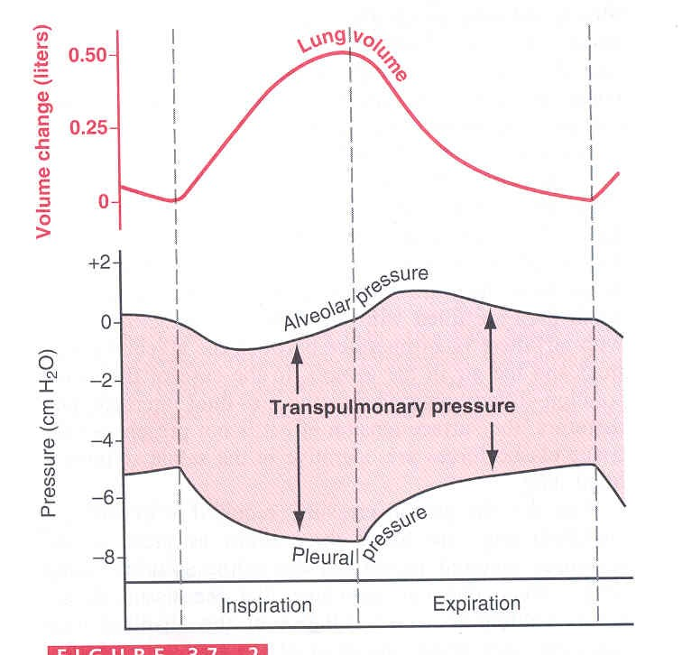
(Compliance of the lung) in a single respiratory cycle
Dr.Aida Korish ( akorish@ksu.edu.sa)

Slide 28
Is defined as, the ratio of the change in the lung volume produced per unit change in the distending pressure.
The extent to which the lungs expand for each unit increase in the transpulmonary pressure.
CL= Volume change (∆ V) Transpulmonary pressure change (∆ P)
• CL = (∆ V)
(∆ P)
Dr.Aida Korish ( akorish@ksu.edu.sa)

Slide 29
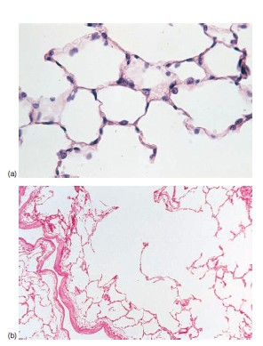
Cont…compliance of lung
For both lungs in adult = 200 ml of air /cm H20.
For lungs and thorax together = 110 ml/cm H20.
Is reduced in pulmonary fibrosis , pulmonary edema, diseases of the chest wall ( kyphosis, scoliosis)
Emphysema increases the compliance of the lungs because it destroys the alveolar septal tissue rich with elastic fibers that normally opposes lung expansion.
Dr.Aida Korish ( akorish@ksu.edu.sa)

