Slide 1
Respiratory ventilation
Dr.Aida Korish akorish@ksu.edu.sa

Slide 2
Learning objectives
By the end of the lecture you should be able to: -
Define the various lung volumes and capacities and provide typical values for each.
Define ventilation rates, their typical values, and their measurement.
Describe FEV₁ and its role in differentiating obstructive and restrictive lung diseases.
Describe the types of dead space. State a volume for the anatomical dead space.
Define the term minute ventilation and state a typical value. 6- Distinguish minute ventilation from alveolar ventilation.

Slide 3
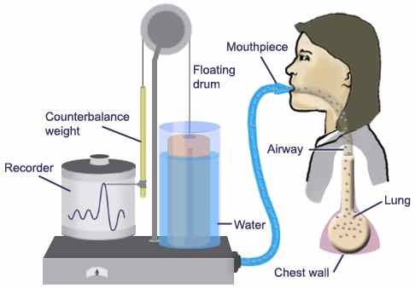
Spirometry

Slide 4
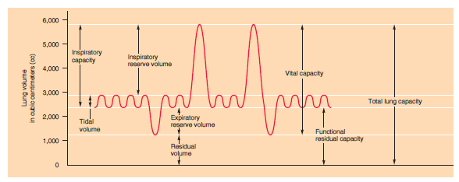
Spiromgram

Slide 5
Lung volumes and capacities
4 lung volumes:
Tidal volume (TV): Is the volume of air inspired or expired with each normal breath (~500 ml)
Inspiratory reserve (IRV): Is the extra volume of air that can be inspired over and above the normal tidal volume when the person inspires with full force(~3000 ml)
Expiratory reserve (ERV): Is the maximum extra volume of air that can be expired by forceful expiration after the end of a normal tidal expiration (~1100 ml).
Residual volume (RV): Is the volume of air remaining in the lungs after the most forceful expiration (~1200ml).

Slide 6
Pulmonary capacities
Two or more lung volumes are described as pulmonary capacity
1- Inspiratory capacity (IC):
Is the amount of air a person can breath in, beginning at the normal expiratory level and distending the lungs to the maximum amount.
IC= TV+ IRV= 500+ 3000= 3500 ml
2-The functional residual capacity (FRC)
Is the amount of air that remains in the lungs after normal tidal expiration. Acts as a buffer against extreme changes in alveolar gas levels with each breath.
FRC= ERV+ RV= 1100+ 1200= 2300 ml

Slide 7
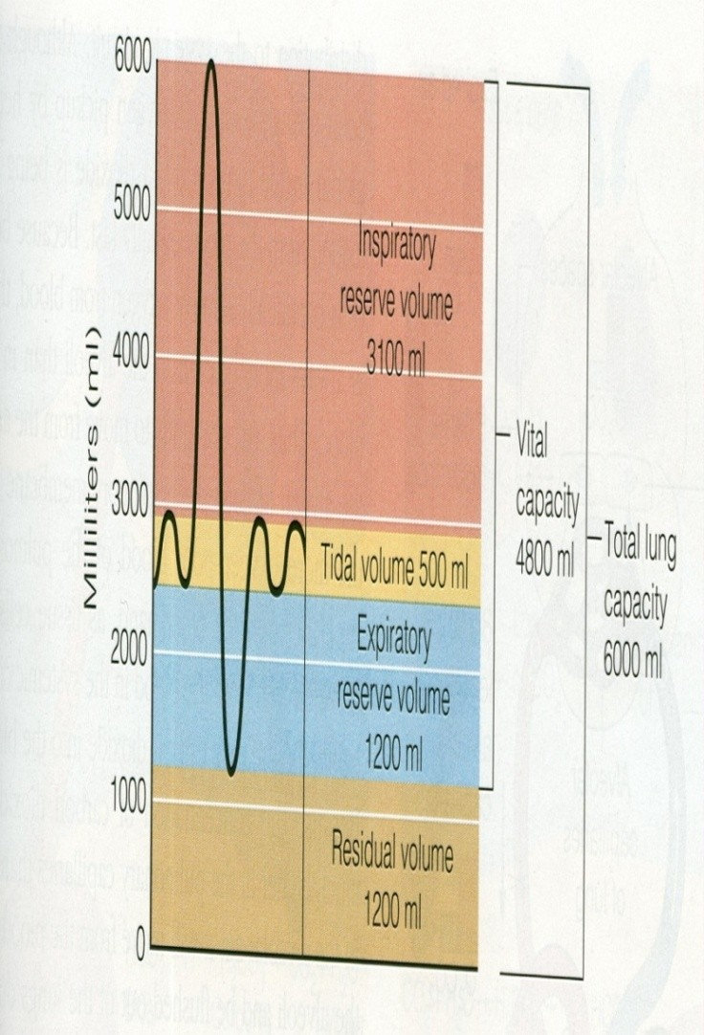
Cont… lung capacities
3-The vital capacity (VC):
The maximum amount of air a person can expel from the lungs after first filling the lungs to their maximum extent and then expiring to the maximum extent.
= TV+IRV+ERV = 500+3000+1100 =4600 ml

Slide 8
Cont.. Lung Capacities
4-The total lung capacity (TLC): is the maximum volume to which the lungs can be expanded with the greatest possible eﬀort
= TV+IRV+ERV+RV = 500+3000+1100+ 1200= 5800ml.
All lung volumes and capacities are 20-­‐25% less in women than men , they are greater in large athletic people than in small athenic people.

Slide 9
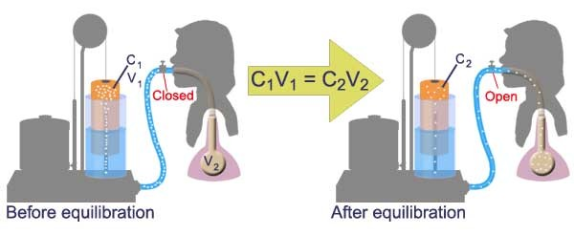
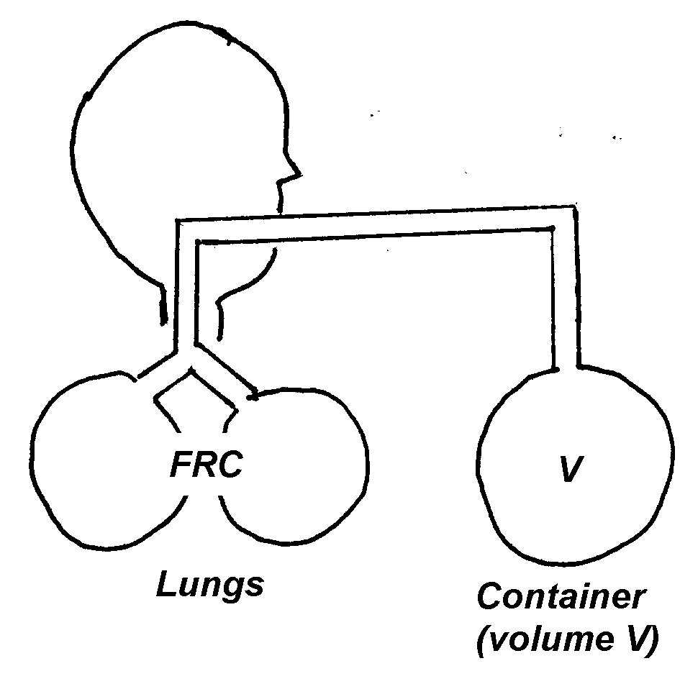
**Determination of the FRC, RV, TLC
Closed circuit Helium Dilution Method
C1xV1 = C2xV2
C1: concentration of Hi in spirometry V1: volume of air in the spirometry.
C2: Final concentration of helium V2 :Volume of spirometry+ FRC
FRC = ( Ci He (C1) - 1) Vi Spi (V1) Cf He (C2)

Slide 10
Forced Vital Capacity (FVC) and FEV1
(Timed vital capacity)
The person is asked to inspire as deeply as possible and then to breath out as hard and as fast as he can. The expiration is continued until he expired all the air out and thus forced vital capacity is obtained. During this process the volume of air expired in the ﬁrst second is collected and is known as FEV1.

Slide 11
FEV1/FVC ratio
Normally it is about 80%.
This ratio diﬀerentiate between obstructive and restrictive lung diseases
Is normal in restrictive lung diseases (e.g interstitial pulmonary ﬁbrosis)
It decreases in obstructive (bronchial asthma, emphysema)

Slide 12
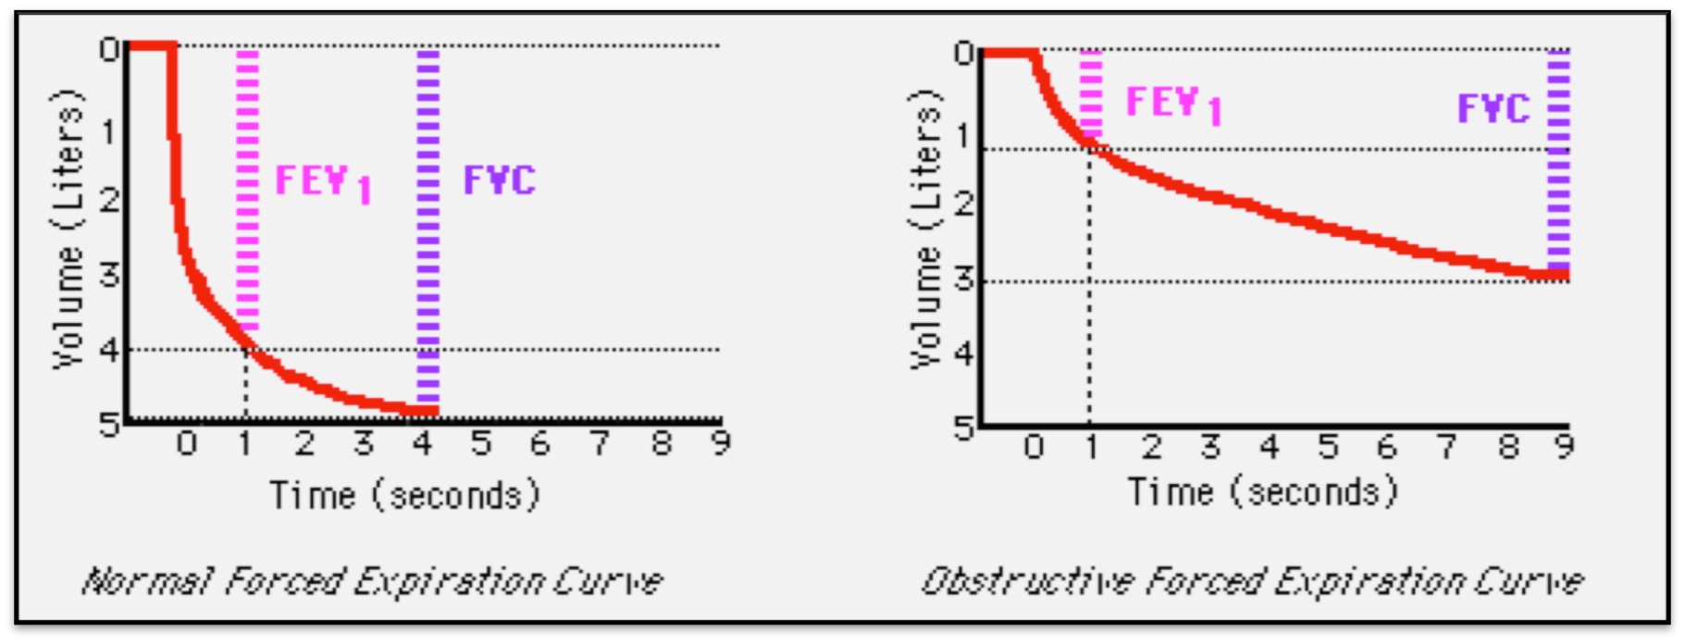
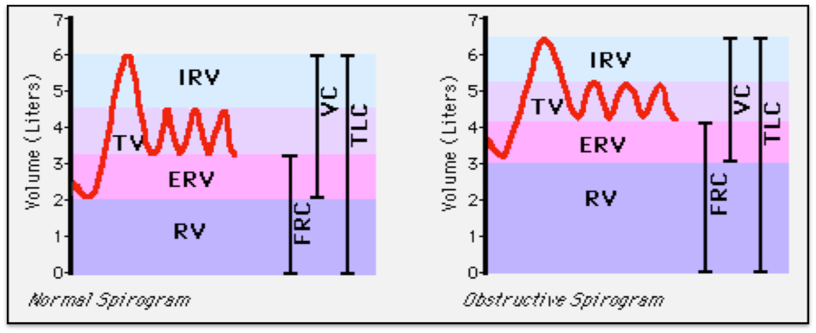
Obstructive Ventilatory Defect

Slide 13
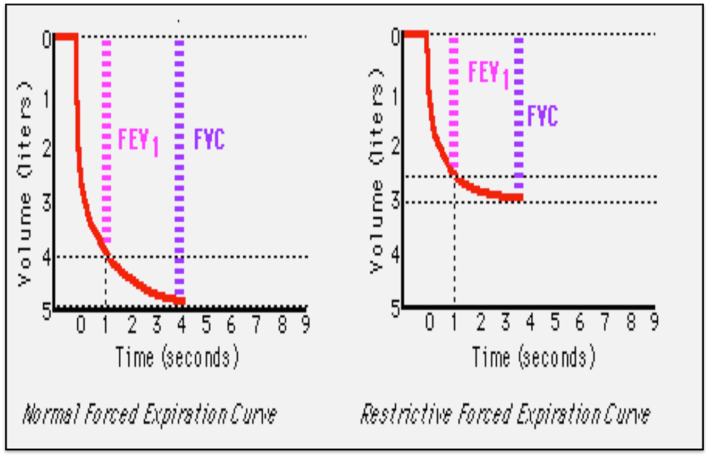
Restrictive Ventilatory Defect

Slide 14
Minute respiratory volume
MRV = Respiratory rate x Tidal volume
= RR X TV
= 12 X 500 = 6L/min.
it could rise to 200 L/min or more than 30 times normal if RR = 40 TV = 4600 ml in young adults man

Slide 15
Dead space and its effect on alveolar ventilation
The volume of air present in the conductive part of the respiratory passages= 150 ml.
Anatomical versus physiological dead space:
On occasion some of the alveoli are none functioning or partially functioning due to absent or poor blood flow so when the alveolar dead space is included, this called physiologic dead space.

Slide 16
Alveolar ventilation
Rate of alveolar ventilation per min
Is the total volume of new air entering the adjacent gas exchange area each minute.
It = (TV -­‐ Dead space volume) x RR
= 12 (500-­‐150) = 12x 350
= 4200ml/min

