Slide 1





LUNG FUNCTION IN HEALTH AND DISEASE: SPIROMETRY

Slide 2



SPIROMETRY
Spirometry is a widely used, effort depended basic lung
function test
Assess the lung performance
Assess physiological parameters; lung volumes,
capacities & flow rate
Differentiate between the obstructive and restrictive
lung conditions
Play a critical role in the diagnosis, differentiation and
management of respiratory illness.
Ruppel, Res Care Clin N Am 1997;
Pierce William, Aus Fam Phy J , 2005

Slide 3
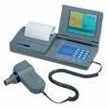


PHYSIOLOGICAL SPIROMETRY
CONDITIONS AND
Physiology conditions:
Age
Gender
Height
Weight
Ethnic group
Pregnancy
Cotes, 1995

Slide 4

INDICATIONS OF SPIROMETRY
Based on clinical features / abnormal lab tests Symptoms: Dsypnea, cough, sputum production, chest pain
Signs: Cyanosis, clubbing, chest deformity, diminished chest expansion, hyperinflation, diminished breath sounds, Prolongation of expiratory phase & crackles Arterial blood gas analysis: Hypoxemia, hypercapnia
Abnormal chest X Ray:
Cotes, 1995

Slide 5
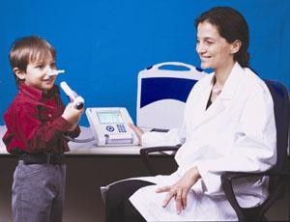
INDICATIONS OF SPIROMETRY
Describe the course of diseases affecting PFTs
Neuromuscular diseases: Gillian Barre Syndrome,
Myasthenia gravis
Pulmonary diseases: Obstructive airway diseases,
Interstitial lung diseases
Adverse reactions: Drugs with known pulmonary toxicity [Pulmonary fibrosis]

Slide 6
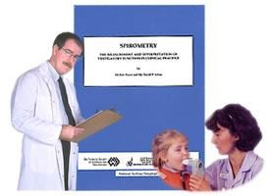

INDICATIONS OF SPIROMETRY
Monitoring indications
To assess the therapeutic interventions: Bronchodilator therapy
Steroid treatment for asthma Chronic obstructive lung disease Interstitial lung disease

Slide 7
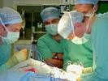

INDICATIONS OF SPIROMETRY
PRE OPERATIVE INDICATIONS
To determine the suitability for and management during and after anesthesia
To assess the risk for surgical procedures known to affect lung function
Cotes 1995; ACCP Chest 2003;
Regli et al., Anaesthesia, 2006

Slide 8
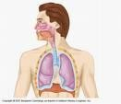
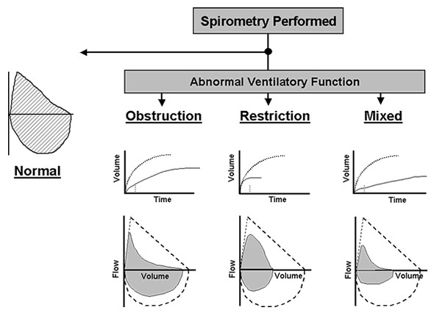
SPIROMETRY IN
RESPIRATORY DISEASES

Slide 9















DIAGNOSIS OF COPD
EXPOSURE TO RISK FACTORS
tobacco
occupation
indoor/outdoor pollution
SYMPTOMS
cough sputum dyspnea
➔
SPIROMETRY

Slide 10

SMOKERS AND SPIROMETRY
Smoker & Non Smoker:
Non Smoker: In normal healthy non smoker subject after the age of 30 the expected decline in Lung function parameter [FEV1] is 25–30 ml/ year
Smoker: The average rate of decline of lung function in smokers as measured by Forced Expiratory Volume in 1 sec [FEV1] is 60- 70 ml / year
Davis et al., Diabetes Care, 2004

Slide 11
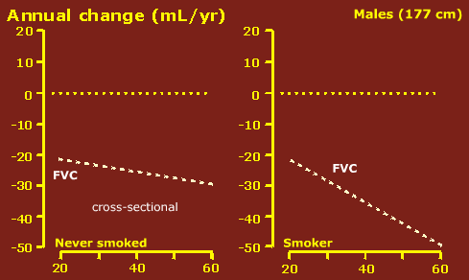
SMOKERS AND SPIROMETRY

Slide 12
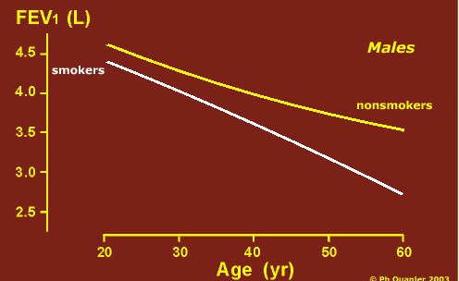
SMOKERS AND SPIROMETRY

