Slide 1
Eﬀects of exercise on the respiratory system.
Dr. Aida Korish Assoc. Prof Physiology
KSU

Slide 2
Objectives
By the end of this lecture the students should be able to: -­‐
Describe the eﬀects of moderate and severe exercise on oxygen consumption, and ventilation volumes.
Describe the eﬀects of exercise on arterial PO₂, PCO₂ and H⁺ ions.
Deﬁne the diﬀusing capacity of the respiratory membrane, and its typical values at rest, and explain its changes in exercise.
Explain causes of hyperventilation in exercise.

Slide 3
Eﬀect of Exercise on the respiratory system
The blood gases do not always have to become abnormal for respiration to be stimulated in exercise.
Instead, respiration is stimulated mainly by neurogenic mechanisms during exercise,

Slide 4
Regulation of respiration during exercise.
In strenuous exercise O2 consumption and CO2 formation may increase 20 folds but alveolar ventilation increases almost exactly in step with the increased levels of metabolism.
Therefore the arterial PO2, PCO2, PH all remain almost exactly normal.

Slide 5
Diﬀusion capacity of the respiratory membrane
➢➢ Is the volume of gas that diﬀuses through the membrane each minute for a pressure diﬀerence of 1mmHg.
➢➢ Diﬀusing capacity for oxygen at rest
21ml/min/mmHg
➢➢ Even if the oxygen pressure diﬀerence across the respiratory membrane is 11mmHg-­‐-­‐-­‐-­‐-­‐-­‐-­‐-­‐-­‐-­‐11x21= 230ml oxygen diﬀusing through the membrane each minute.
➢➢ During rest tissues consume 250 ml O2 /min

Slide 6
Changes in the oxygen-­‐ diﬀusing capacity during exercise
65ml/min/mmHg
This is due to increased number of open pulmonary capillaries which was dormant, thereby increasing the surface area for gas exchange.
In addition to increased alveolar ventilation.

Slide 7
Diﬀusing capacity for carbon dioxide
It diﬀuses 20 times greater than oxygen due to greater diﬀusion coeﬃcient which is 20 times that for oxygen.
Diﬀusion capacity for carbon dioxide 400ml/ min/mmHg.
During exercise 1200 to 1300ml/min/mmHg.

Slide 8
During exercise the oxygen requirement increased 20 times, and cardiac output increased and so the time blood remained in the pulmonary capillaries becomes less than half normal despite the fact that additional capillaries open up
But the blood is almost completely saturated with oxygen when it leaves the pulmonary capillaries.

Slide 9
Reasons for this are as follow:
1-­‐ The diﬀusing capacity for oxygen increases almost three fold during exercise, this results mainly from increasing numbers of capillaries participating in the diﬀusion, and a more even V/Q ratio all over the lung.
2-­‐ At rest the blood normally stays in the lung capillaries about three times as long as necessary to cause full oxygenation. Therefore, even with shortened time of exposure in exercise, the blood is still fully oxygenated or nearly so.

Slide 10
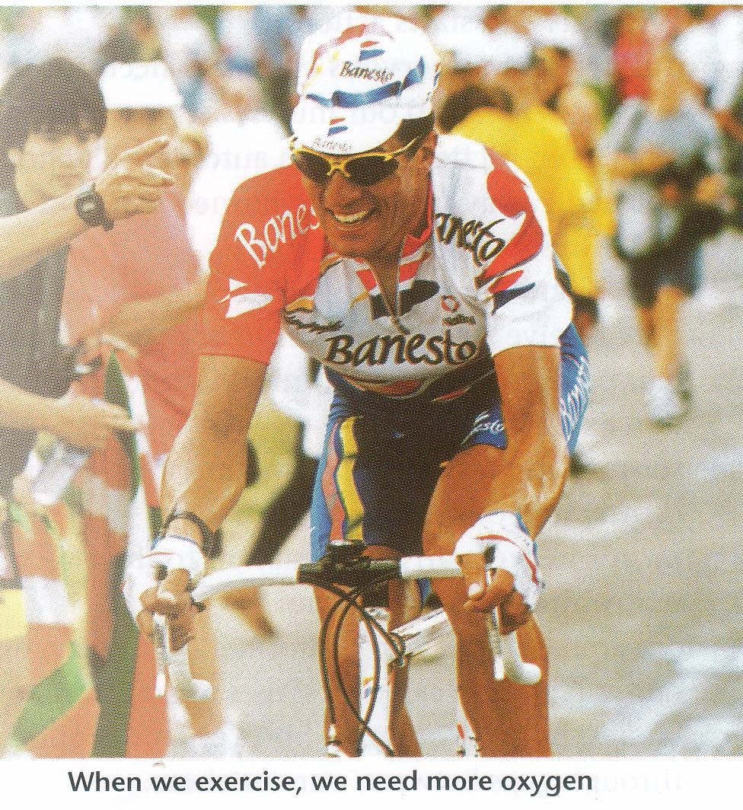
10

Slide 11
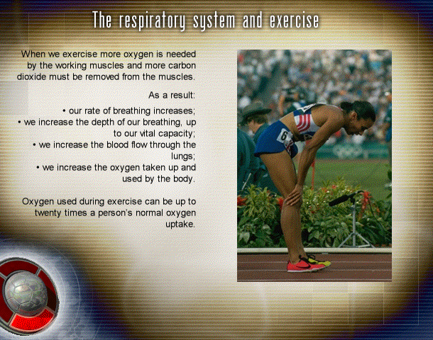

Slide 12
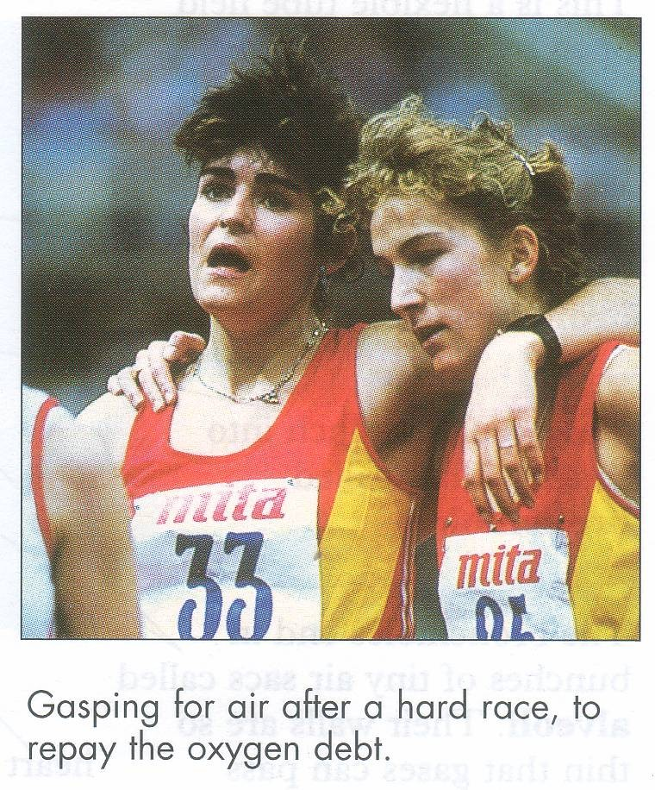

Slide 13
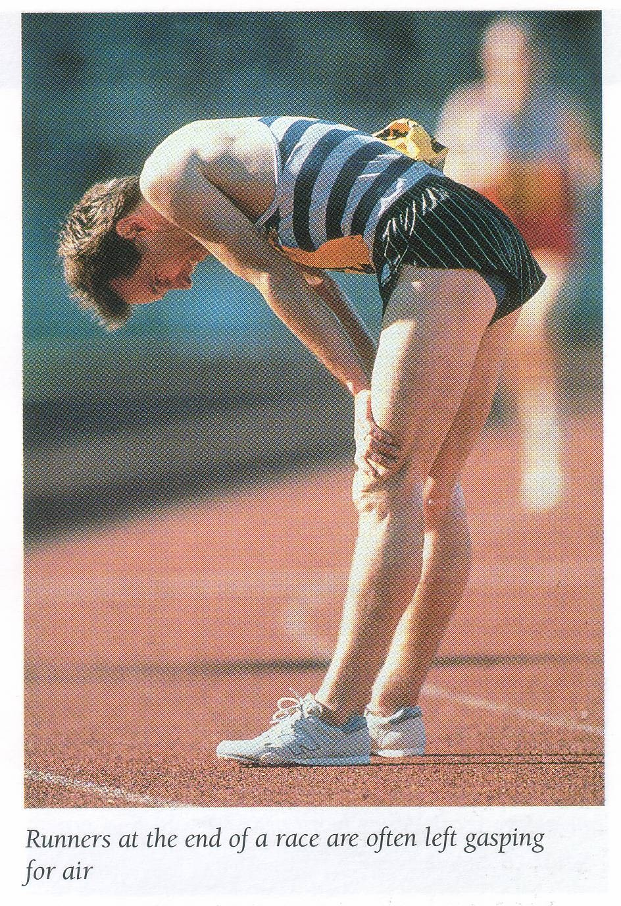

Slide 14
What cause intense ventilation during exercise?
Neural signals from the motor areas of the brain to the respiratory center.
The joint proprioceptors
Body temperature (hypothalamus).
Possibility that the neurogenic factor for control of ventilation during exercise is a learned response.

Slide 15


















Anaerobic energy sources
Phosphocreatine →Creatine + PO3
Glycogen →Lactic acid ↓
ATP→ADP+ AMP
Energy for muscle contraction

Slide 16








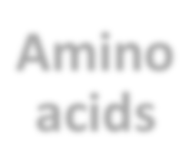
Aerobic system
Glucose
FaTy acids
+ O2 →CO2 + H2O+Urea
Amino acids

Slide 17
The phosphagen energy system.
The combined amounts of cell ATP and cell phosphocreatine are called the phosphagen energy system.
These together can provide maximal muscle power for 8 to 10 seconds, almost enough for the 100-­‐meter run.
Thus, the energy from the phosphagen system is used for maximal short bursts of muscle power.

Slide 18





Relation between exercise duration& energy source
Phosphagen system ↓
8 to 10 seconds
Aerobic system
↓
Unlimited time (as long as nutrients last)
Glycogen– lactic acid system →
1.3 to 1.6 minutes

Slide 19
Oxygen Consumption and Pulmonary Ventilation in Exercise.
Normal oxygen consumption for a young man at rest is about 250 ml/min.
 However, under maximal conditions,
this can be increased to approximately the following average levels:
 ml/min
Untrained average male -­‐-­‐-­‐-­‐-­‐-­‐-­‐-­‐-­‐-­‐-­‐-­‐-­‐-­‐3600
Athletically trained average male -­‐-­‐-­‐4000
Male marathon runner-­‐-­‐-­‐-­‐-­‐-­‐-­‐-­‐-­‐-­‐-­‐-­‐-­‐-­‐-­‐-­‐-­‐ 5100

Slide 20
OXYGEN DEBT-­‐
Oxygen Debt Is the Extra Consumption of Oxygen After Completion of Strenuous Exercise (about 11.5 liters)
You will develop oxygen debt after about 5 minutes or more of constant exercise. This is the point when the exercise becomes ANAEROBIC (without the use of oxygen) and which has to be paid back. If the exercise is just AEROBIC (with oxygen) there will be no oxygen debt.
20

