Slide 1


Gas Transfer
(Diffusion of O2 and CO2)
Dr.Aida Korish Associate Prof.PHysiology

Slide 2

Define partial pressure of a gas, how is influenced by altitude.
Understand that the pressure exerted by each gas in a mixture of gases is independent of the
pressure exerted by the other gases (Dalton's Law)
Understand that gases in a liquid diffuse from higher partial pressure to lower partial pressure (Henry’s Law)
Describe the factors that determine the concentration of a gas in a liquid.
Describe the components of the alveolar-capillary membrane (i.e., what does a molecule of gas pass through).
Knew the various factors determining gas transfer: -
Surface area, thickness, partial pressure difference, and diffusion coefficient of gas
State the partial pressures of oxygen and carbon dioxide in the atmosphere, alveolar gas, at the end of the pulmonary capillary, in systemic capillaries, and at the beginning of a pulmonary capillary.

Slide 3
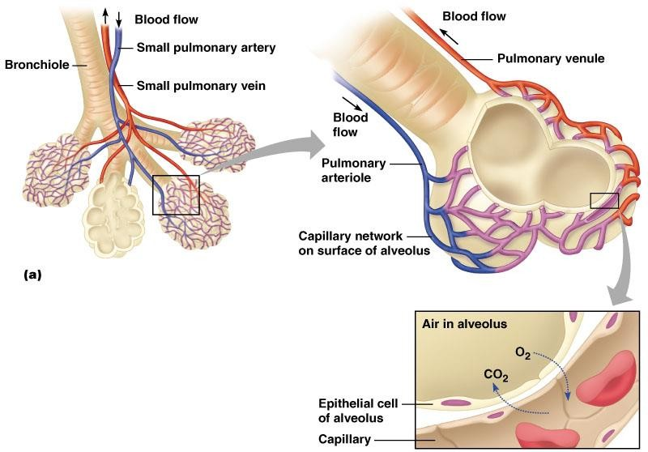
Gas exchange through the respiratory
membrane
Figure 10.8A

Slide 4
 After ventilation of the alveoli with fresh air the next step is the process called Diffusion of oxygen and carbon dioxide.
 The rate of diffusion of each of these gases is directly proportional to the pressure caused by this gas alone which is called the partial pressure of the gas
 Pressure is caused by the constant impact of kinetically moving molecules against a surface.

Slide 5
D α ΔP x A x S
d x √MW
P: Partial pressure differences
A: Surface area for gas exchange
d: Diffusion distance
MW: Molecular weight and (S)solubility of gas
O₂ has lower molecular weight than CO₂ But CO₂ is 24 times more soluble than O₂
Net result: CO₂ diffusion approx. 20 times faster than
O₂ diffusion

Slide 6
 S/ √MW
is called the diffusion coefficient of the gas.
For Oxygen = 1.0 carbon dioxide =20.0 nitrogen
=0.53.
The relative rates at which different gases at the same pressure
level will diffuse are proportional to their diffusion coefficient.

Slide 7

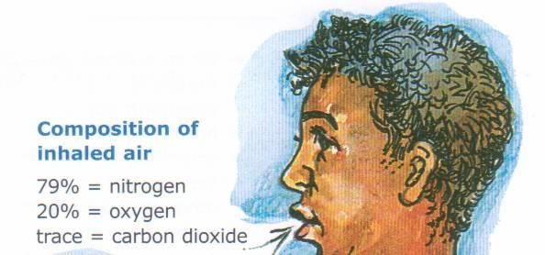
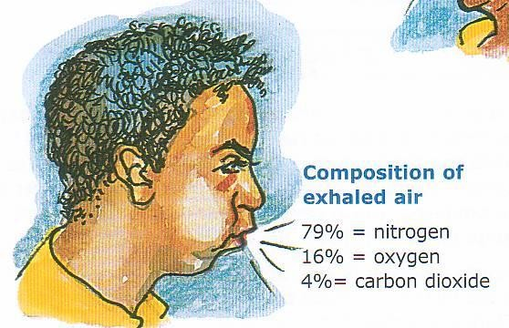



Slide 8
 Oxygen concentration in the atmosphere is 21%
So PO2 in atmosphere = 760 mmHg x 21% = 160 mmHg.
 This mixes with “old” air already present in alveolus to
arrive at PO2 of 104 mmHg in alveoli.
 Carbon dioxide concentration in the atmosphere is 0.04% So PCO2 in atmosphere =760 mmHg x 0.04% = 0.3 mm Hg
 This mixes with high CO2 levels from residual volume in
the alveoli to arrive at PCO2 of 40 mmHg in the alveoli.

Slide 9
Insert fig. 16.20

Slide 10
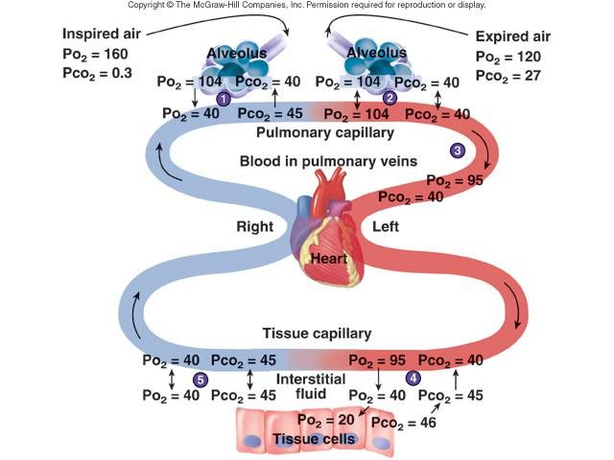

Slide 11
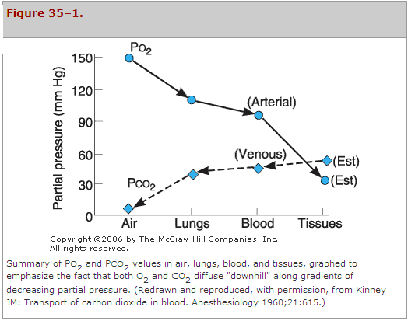

Slide 12
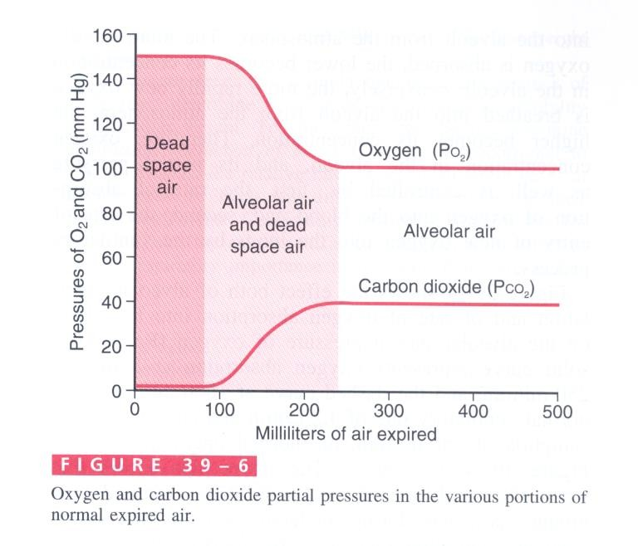

Slide 13
 At resting | condition 250 | ml | of oxygen enter | the
pulmonary | capillaries/min | at | ventilatory rate of | 4.2
L/min.
 During exercise 1000 ml of oxygen is absorbed by the pulmonary capillaries per minute, the rate of alveolar ventilation must increase 4 times to maintain the alveolar PO2 at the normal value of 104 mmHg.
 Normal rate of CO2 excretion is 200 ml/min, at normal rate of alveolar ventilation of 4.2 L/min.

Slide 14



Oxygen and Carbon dioxide
Transport
Dr.Aida Korish Associate Prof.PHysiology

Slide 15

Understand the forms of oxygen transport in the blood, the importance of
each.
Differentiate between O2 capacity, O2 content and O2 saturation.
Describe (Oxygen- hemoglobin dissociation curve)
Define the P50 and its significance.
How DPG, temperature, H⁺ ions and PCO₂ affect affinity of O₂ for Hemoglobin and the physiological importance of these effects.
Describe the three forms of carbon dioxide that are transported in the blood,
and the chloride shift.

Slide 16

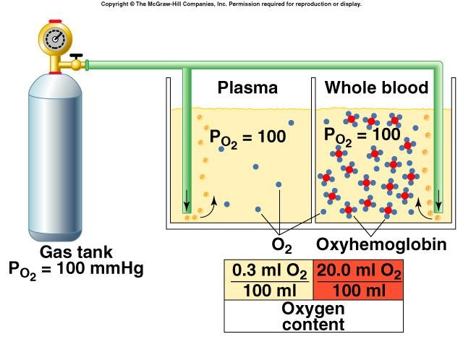

Slide 17
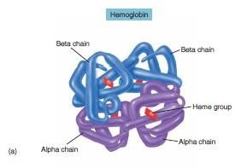
 O₂ is mostly transported in the blood bound to hemoglobin
 If the P_{O2} increases Hb binds O₂
 If P_{O2} decreases Hb releases O₂
 O2 binds to the heme group on hemoglobin, with 4 oxygens
/Hb

Slide 18

O₂ content: amount of O₂ in blood (mL O₂/100 mL blood)
O₂-binding capacity: maximum amount of O₂ bound to hemoglobin (mL O₂/100 mL blood) measured at 100% saturation.
Percent saturation: % of heme groups bound to O₂
% saturation of Hb
= oxygen content x 100
oxygen capacity
Dissolved O_{2:} Unbound O₂ in blood (mL O₂/100 mL blood).

Slide 19
 When blood is 100% saturated with O2: each gram of Hb carry
1.34 ml O2 So O2 content = 15g Hb x 1.34 O2=20 ml.
But when the blood is only 97% saturated with O2:each 100 ml blood contain 19.4 ml O2).
 Amount of oxygen released from the hemoglobin to the tissues is 5ml O2 per each 100ml blood.
So O2 content in venous blood =19.4-5= 14.4 ml.
 During strenuous exercise the oxygen uptake by the tissue increases 3 folds so 15 ml O2 is given /100 ml blood
So O2 content in venous blood =19.4-15=4.4 ml O2 /100ml blood.
At rest tissues consume 250 ml O2 /min and produce 200ml CO2

Slide 20
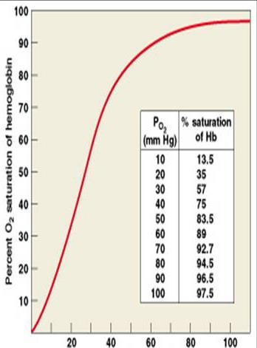
3% dissolved in plasma
97% bound to hemoglobin (oxyhemoglobin)
 Higher PO2 results in greater Hb
saturation.
2
 The relation between PO2 and Hb-O2 is not linear. The curve is called Oxyhemoglobin Saturation Curve
 Which is S- shaped or sigmoid

Slide 21
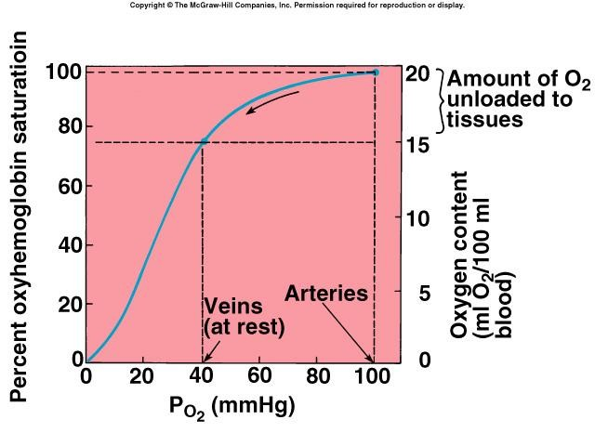

Slide 22
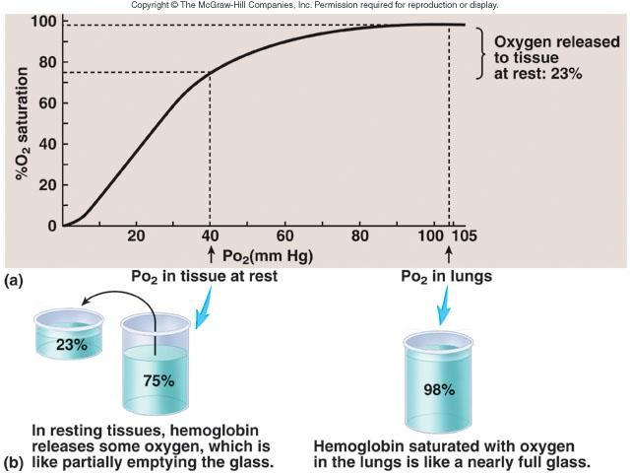

Slide 23
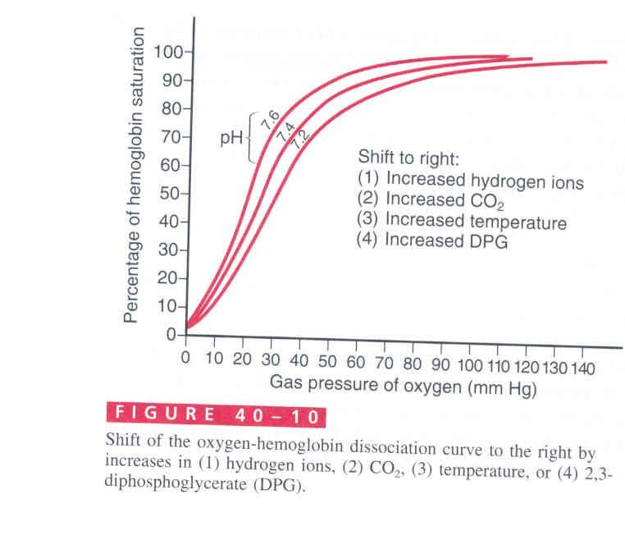
 The
curve
position of the dissociation
can be determined by
measuring the P50
 P50:The arterial PO2 at which 50% of the Hb is saturated with O2, normally P50= 26.5
 Decreased P50 means increased affinity
of Hb to O2 or shift of the curve to left
 Increased P50 means decreased affinity or shift of the curve to right

Slide 24
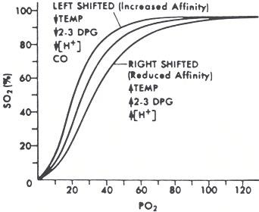

↓ pH

Slide 25
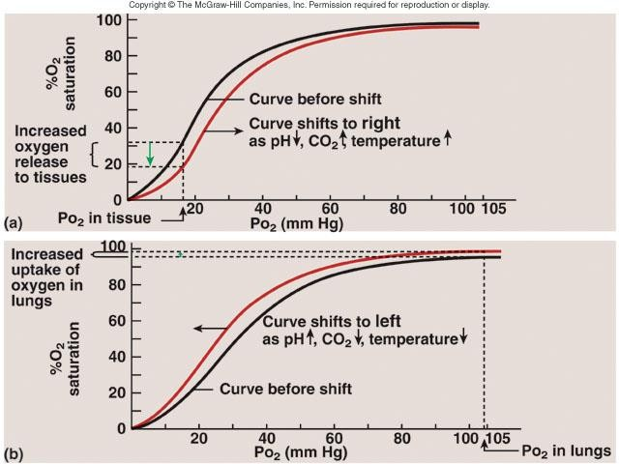

Slide 26

 Rt shift means the oxygen is unloaded to the tissues from Hb, while Lt shift means loading or attachment of oxygen to Hb.
Increased 2,3DPG, H+, Temperature , PCO2 shift the curve to right.
 2,3DPG is synthesized in RBCs from the glycolytic pathway , it binds tightly to reduced Hb. increased 2,3 DPG facilitate the oxygen release and shifts the dissociation curve to Rt.
 2,3 DPG increases in the RBCs in anemia and hypoxemia, and thus serves as an important adaptive response in maintaining tissue oxygenation
 Fetal Hb: has a P50 of 20 mmHg in comparison to 27 mmHg of adult Hb.

Slide 27
Effect of carbon dioxide and hydrogen ions on the
curve ( Bohr effect)
At lung movement of CO2 from blood to alveoli will decrease blood CO2 &H+ →shift the curve to left and increase O2 affinity to Hb allowing more O2 transport to tissues
At tissues: the reverse occur

Slide 28

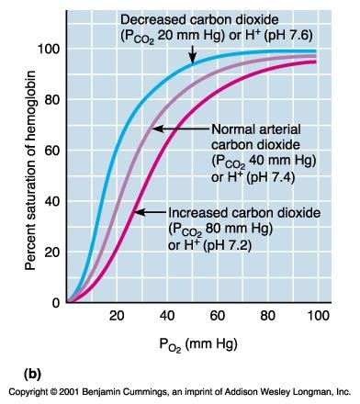


Slide 29
 Exercise increases Temp, H+, 2,3 DPG and shift the
curve to Rt.
 Utilization Coefficient The percentage of the blood that gives up its oxygen as it passes through the tissues capillaries is called utilization coefficient.
= O2 delivered to the tissues
O2 content of arterial blood
 Normally at rest = 5ml/20 ml= 25% ,
 during exercise it = 15 ml/20 ml= 75 % - 85%

Slide 30
 Only 3% of O2 is transported in the dissolved state,
 at normal arterial PO2 of 95 mmHg , about 0.29 ml of
oxygen is dissolved in each 100ml of blood.
 When the PO2 of the blood falls to 40 mmHg in tissue
capillaries, only 0.12 of oxygen remains dissolved.
 i.e 0.17 ml of oxygen is normally transported in the dissolved state to the tissues per each 100 ml of blood

Slide 31
 CO combines with Hb at the same point on the
Hb molecule as does oxygen,
 it binds with Hb about 250 times as much as O2 (affinity of Hb to CO is very high (250 times) that to O2.It causes Lt shift of the O2- Hb curve.

Slide 32
Carbon dioxide is transported in three forms.
 Dissolved CO2 7%
 bicarbonate ions 70 %
 Carbaminohemoglobin ( with Hb) 23%.
Each 100 ml of blood carry 4 ml of CO2 from the
tissues/min .

Slide 33

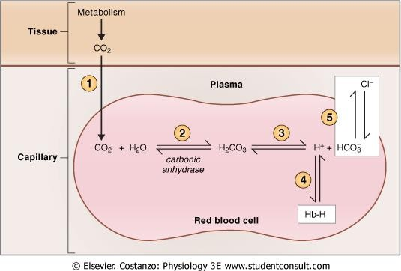
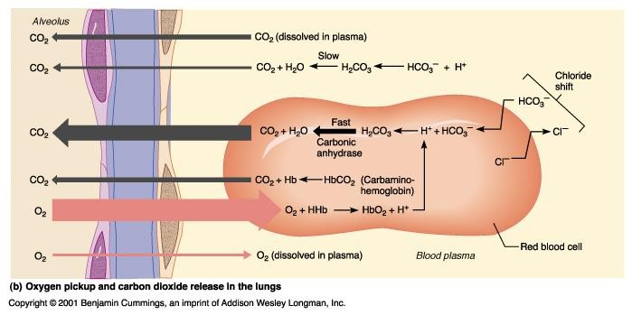
In Tissues
In Pulmonary capillaries

Slide 34

 When oxygen binds with hemoglobin , carbon dioxide is released- to increase CO2 transport
 Binding of Hb with O2 at the lung causes the Hb to become a stronger acid and , this in turn displaces CO2 from the blood and into the alveoli
 Change in blood acidity during CO2 transport.
Arterial blood has a PH of 7.41 that of venous blood with higher PCO2 falls to 7.37 ( i.e change of 0.04 unit takes place)

Slide 35
R= Rate of carbon dioxide output
Rate of oxygen uptake
 Normally it is 4/5= 82%
 When Carbohydrate diet is used
R = 1
 When fats only is used R=0.7
 A person on normal diet R=0.825

