Slide 1
Control of Breathing
Dr. Aida Korish
Assoc. Prof. Physiology
KSU
iaidakorish@yahoo.com

Slide 2
Objectives
By the end of this lecture you should be able to: -
•
Understand the role of the medulla oblongata in
determining the basic pattern of respiratory activity.
List some factors that can modify the basic breathing pattern like e.g.
a- The Hering-Breuer reflexes, b- The proprioreceptor reflexes, and c- The protective reflexes, like the irritant, and the J-receptors.
Understand the respiratory consequences of changing
PO₂, PCO₂, and PH.
Describe the locations and roles of the peripheral and central chemoreceptors.
Compare and contrast metabolic and respiratory acidosis
and metabolic and respiratory alkalosis.

Slide 3
Controls of rate and depth of respiration
Arterial PO2
When PO2 is VERY low (Hypoxia), ventilation
increases
Arterial PCO2
The most important regulator of ventilation is PCO2, small increases in PCO2, greatly increases ventilation
Arterial pH
As hydrogen ions increase (acidosis), alveolar ventilation increases.

Slide 4
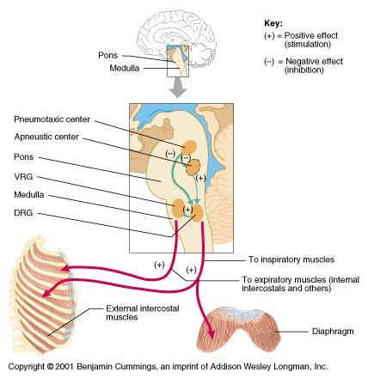
Respiratory Centers

Slide 5
Medullary Respiratory centers
Inspiratory area (Dorsal Respiratory Group) DRG
-Determines basic rhythm of breathing
-Causes contraction of diaphragm and external intercostals
Expiratory area (Ventral Respiratory Group) VRG
-Inactive during normal quiet breathing
-Activated by inspiratory area during forceful breathing
-Causes contraction of internal intercostals and abdominal muscles
The medullary respiratory center stimulates basic inspiration for about 2 seconds and then basic expiration for about 3 seconds (5sec/ breath = 12breaths/min).

Slide 6
Pontine Respiratory centers
Transition between inhalation and exhalation is
controlled by:
Pneumotaxic area
Inhibits inspiratory area of medulla to stop inhalation.
Breathing is more rapid when pneumotaxic area is active.
Apneustic area
Stimulates inspiratory area of medulla to prolong
inhalation.

Slide 8
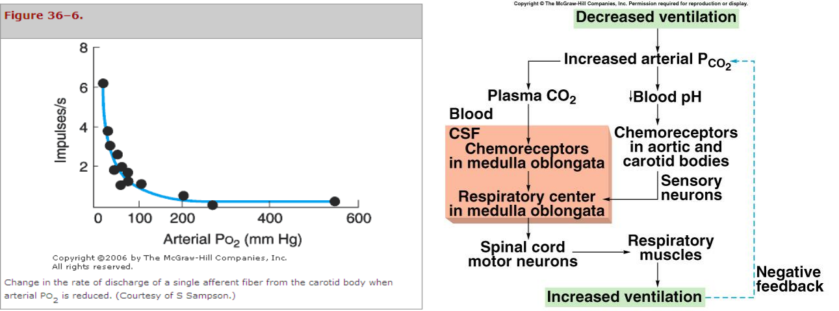
Chemoreceptor Control of Breathing

Slide 9
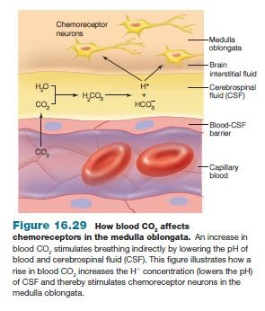
Effect of blood CO2 level on central chemoreceptors

Slide 10
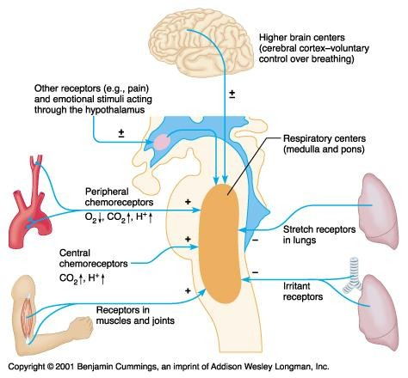
Factors Influencing Respiration

Slide 11
Hering-Breuer inflation reflex
When the lung becomes overstretched (tidal volume is 1 L or more), stretch receptors located in the wall bronchi and bronchioles transmit signals through vagus nerve to DRG producing effect similar to pneumotaxic center stimulation
Switches off inspiratory signals and thus stops further inspiration .
This reflex also increase the rate of respiration as does the pneumotaxic center.

Slide 13
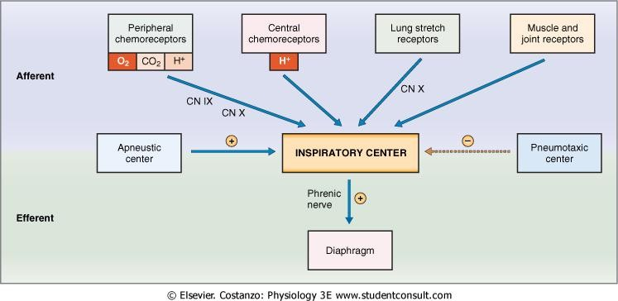
Cont..factors affecting respiration

Slide 14
Respiratory Acidosis
Respiratory Alkalosis
Hypoventilation.
Accumulation of CO₂ in the tissues.
P_{CO2} increases
pH decreases.
Hyperventilation.
Excessive loss of CO₂.
P_{CO2} decreases ( 35
mmHg).
pH increases.

Slide 15
Metabolic Acidosis
Metabolic Alkalosis
Ingestion, infusion, or production of a fixed acid.
decreased renal excretion of hydrogen ions.
loss of bicarbonate or other bases from the extracellular compartment
Excessive loss of fixed acids from the body
Ingestion, infusion, or excessive renal reabsorption of bases such as bicarbonate
pH increases.
The respiratory system can compensate for metabolic acidosis or alkalosis by altering alveolar ventilation

Slide 16
Effects of low and high gas
pressure on the body
Dr.Aida Korish Assoc.Prof.Physiology KSU
iaidakorish@yahoo.com

Slide 17
Objectives
By the end of this lecture you should be able to:
1-Describe the effects of exposure to low and high barometric pressures on the body.
2- Describe the body acclimatization to low barometric
pressure.
3-Define decompression sickness and explain how it can be avoided.
4-Understand the effects of high nitrogen pressure, and
nitrogen narcosis.

Slide 18
Effect of increased barometric pressure
( Deep sea diving).
When
human descend below the sea, the
pressure around them increased.
To prevent the lungs from collapse , air must be
supplied also under high pressure.
This exposes the blood in the lungs to extremely high alveolar gas pressure(hyperbarism).
Under certain limits these high pressures cause tremendous alterations in the physiology of the body.

Slide 19
Cont..
The
surrounding pressure increases by 1
atmosphere for every 10 meter (33 feet) of
depth in sea water.
Therefore at a depth of 31 meter ( 100 feet) in the ocean the diver is exposed to a pressure of 4 atmospheres.
These
problems confront SCUBA (self
contained under water breathing apparatus.

Slide 20
Effect of depth on the volume of the gases:
is compression of gases to smaller and smaller volumes. 1L (sea level )→1/2 L at 33 feet and so on
Effect of depth on density of gases
increase in density of gas and hence increased work of
breathing.
Nitrogen effect at high nitrogen pressure
has 2 principle effects:
* Nitrogen narcosis ( anesthetic effect)
* Decompression thickness.

Slide 21
Nitrogen narcosis
Nitrogen like most other anesthetic gases, dissolve freely in the fats of the body including the membranes and other lipid structures of the neurons.
This leads to alteration of the electrical conductance of the membranes, reduces their excitability and subsequent narcosis develops.
At 120 feet: the diver lose many of his cares.
At 150 feet: there is a feeling of euphoria and drowsiness and impaired performance.
At higher pressure: loss of coordination and finally
coma might develop.

Slide 22
Decompression sickness ( Cassion’s disease)
It is a syndrome caused by a decrease in the ambient pressure which occur in animal and men when the tissues of the body contain an excess of physically inert gas.
During descent , the high partial pressure of nitrogen (encountered when breathing compressed air at depth) forces this poorly soluble gas into solution in body tissue particularly in fat ( it has a high N2 solubility).
On ascending, this inert gas comes out of physical solution forming a gaseous phase (bubbles), leading to symptoms and signs.

Slide 23
Cont.. Decompression sickness
During slow ascent N2 is slowly removed from the tissues since the partial pressure there is higher than that in the arterial blood and alveolar gas.
If decompression is rapid bubbles of gaseous nitrogen are released, in tissues and blood, causing the symptoms of decompression sickness (the bends or caisson disease)

Slide 24
Symptoms & signs of decompression
sickness(DS)
The mildest form of DS is fatigue or drowsiness after decompression.
Locally there is skin itch
Other sever symptoms may occur e.g.:
bubbles in the tissues cause sever pains particularly
around the joints.
Neurological symptoms include paresthesia, itching, paralysis, and inner ear disturbances.

Slide 25
Cont.. DS
Thoracic pains: dyspnea, substernal pain, cyanosis, and cough.
Bubbles in the coronary arteries may cause
myocardial damage.
Decompression sickness shock, capillaries become permeable to plasma and hypovolemia rapidly develop.
Edema may be prominent and shock is also usually complicated by pulmonary edema

Slide 26
Treatment of decompression symptoms
Rapid recompression in a pressure chamber followed by slower decompression. This reduces the volume of the bubbles and forces them back into solution.
In a very deep dives, the risk of decompression sickness can be reduced if a helium-O2 mixture is breathed during the dive..

Slide 27
Cont.. Treatment of DS
Helium is more desirable than nitrogen in deep
dives because it has:
¼-1/5 the narcotic effect of nitrogen on CNS.
1/7 the molecular weight of nitrogen.
low
density leading to decreased air way
resistance of diver.
High diffusion through tissues.
Helium is about 1/2 as soluble as nitrogen in body fluids. This reduces the quantity of bubbles that can form in tissues when the diver is decompressed after diving

Slide 28
Effects of low oxygen pressure on the body
( Aviation-ascend to high altitude)
At the sea level the barometric pressure is 760 mmHg.
At 10,000 feet is 523 mmHg
At 50,000 feet 87 mmHg.
This decrease in barometric pressure is the basic cause of all the hypoxia problems in high altitude in physiology.

Slide 29
Alveolar PO2 at different altitudes
As the barometric pressure decreases, the oxygen partial pressure decreases proportionally, remaining less than 21 % of the total barometric pressure.
At sea level PO2= 159 mmHg.
At 20,000 feet PO2= 40 mmHg.
At 50,000 feet PO2= only 18 mmHg.

Slide 30
Cont…
Even
at high altitude CO2 is
continuously
excreted from the pulmonary blood into the alveoli. Also, water vaporizes into the inspired air from the respiratory surfaces.
Therefore, these two gases dilute the oxygen in the alveoli, thus reducing the oxygen concentration and therefore hypoxia develops.

Slide 31
Effects of acute hypoxia
Some of the important acute effects of hypoxia beginning at an altitude of approximately 12,000 feet, are:
Drowsiness, lassitude, mental and muscle fatigue, sometimes headache, occasionally nausea and sometimes euphoria.
All these progress to a stage of twitching or
convulsions above 18,000.
Above 23,000 feet the un acclimatized person
can enter into coma.

Slide 32
Acclimatization to low PO2
A person remaining at high altitudes for days , weeks or years becomes more and more acclimatized to low PO2.
So that it causes fewer deleterious effects on the body and it becomes possible for the person to work harder without hypoxic effects or to ascend to still higher altitude.

Slide 33
Principle means of acclimatization
1- Increase in pulmonary ventilation.
2- Increased red blood cells.
3-Increased diffusing capacity of the lungs.
4- Increased vascularity of the tissues.
5-Increased ability of the cells to utilize oxygen
despite the low PO2.

Slide 34
