Slide 1





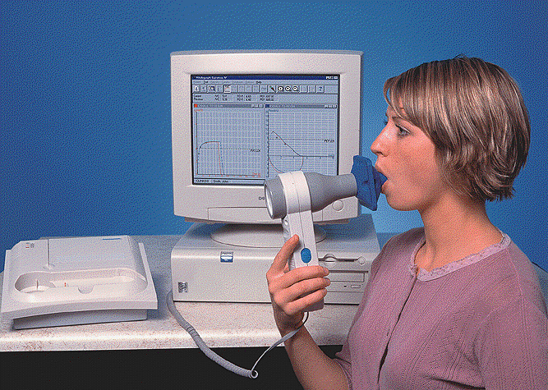
Dr.Thouraya Said

Slide 2






Spirometry
It provides an objective measurement of lung function.
It analyzes volume and velocity of expired air

Slide 3
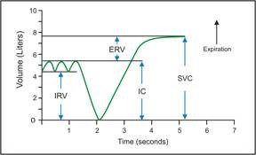
Static test
Performed without regard to time
Relaxed Vital capacity: Max Volume of air expired during relaxed expiration aCer a maximal inspiration

Slide 4




Dynamic test
Performed at forcible and max eﬀort against time
Measures the rate at which the lung changes volume during forced breathing.
Forced vital capacity
The max volume of air that can be forcibly and rapidly exhaled following a max inspiration.

Slide 5
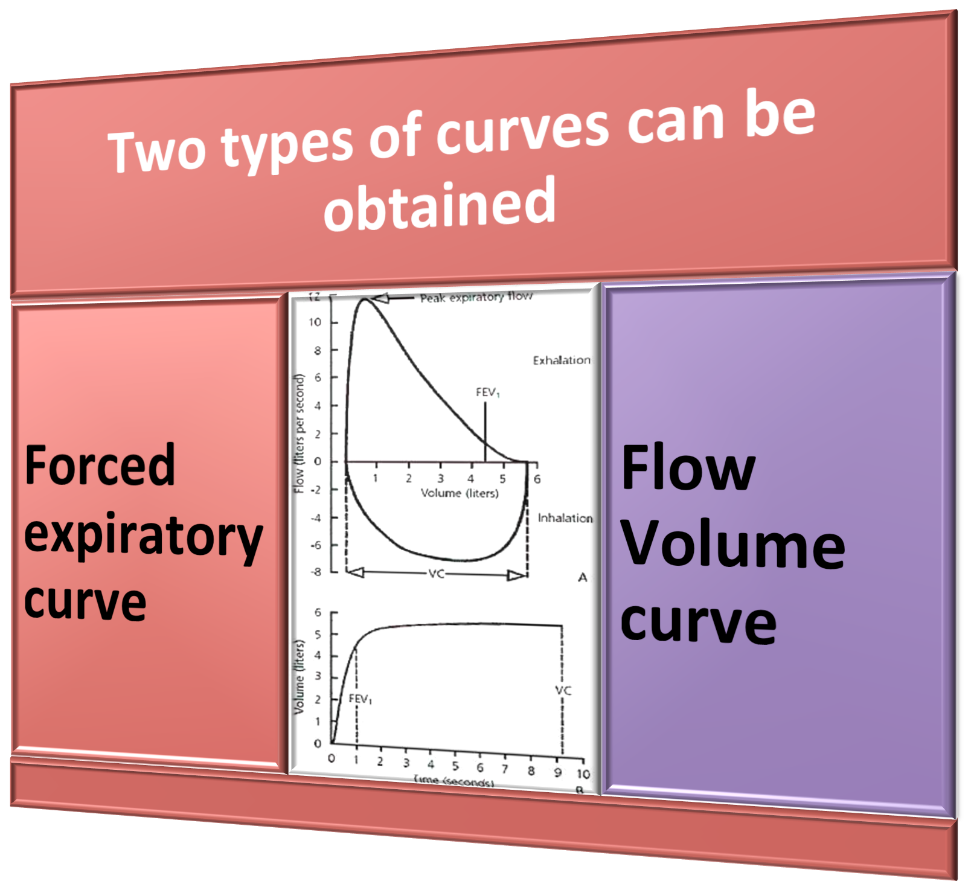

Slide 6
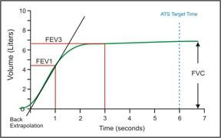
Forced Expiratory Curve
The subject takes a maximal inspiration and then exhales as rapidly, as forcibly,& as maximally as possible.
A plot of exhaled volume against time:

Slide 7


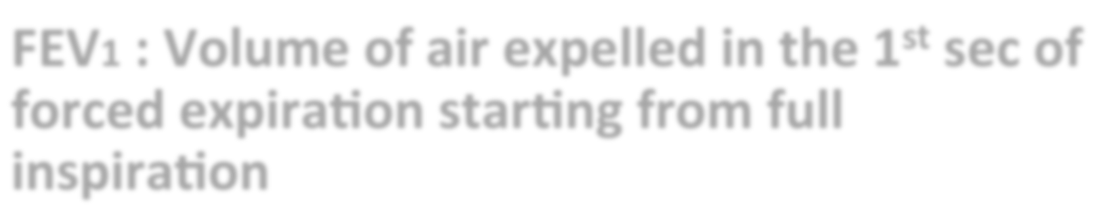




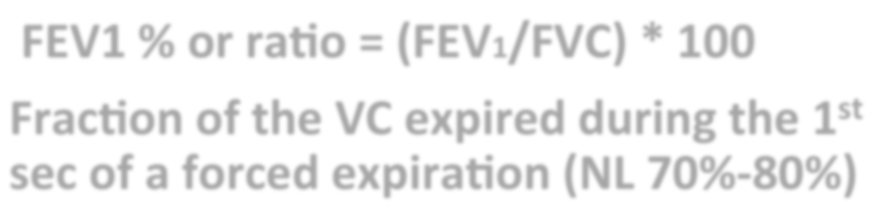
FEV1 : Volume of air expelled in the 1st sec of forced expiration starting from full inspiration
Plateau: FVC
FEV1 % or ratio = (FEV1/FVC) * 100
Fraction of the VC expired during the 1st sec of a forced expiration (NL 70%-80%)

Slide 8

Normal Trace Showing FEV₁ and FVC
FVC
5
Volume, liters
4
FEV₁ = 4L FVC = 5L
FEV₁/FVC = 0.8
3
2
1
1
2
3 4
Time, sec
5
6

Slide 9

The curve helps ≠
obstructive LD
Restrictive LD

Slide 10
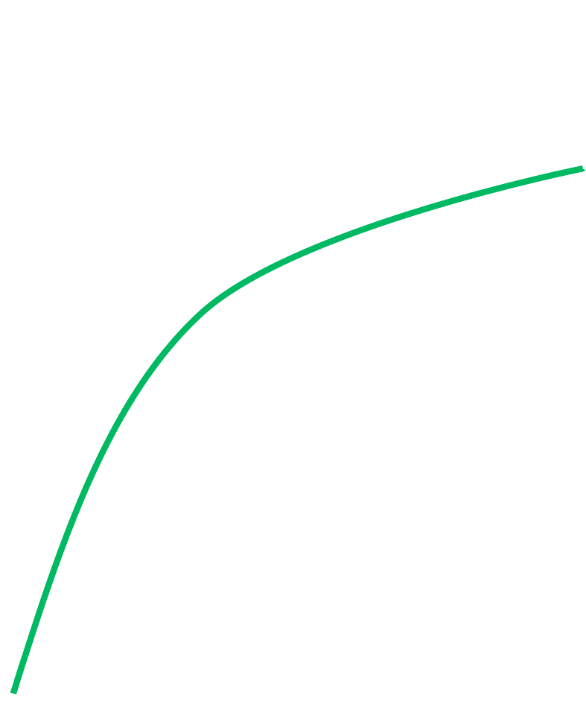
Obstructive lung disease
5
A
Expired Volume (l)
4
B
FVC
3
2
1
0
1 2 3 4 5
Time (s)

Slide 11
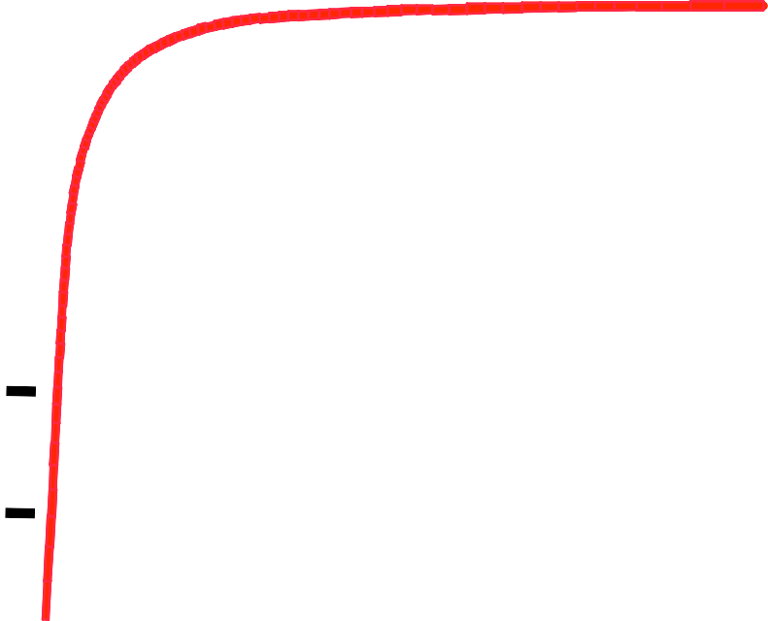


Obstructive Disease
5
Normal
Volume, liters
4
3
FEV₁ = 1.8L FVC = 3.2L
FEV₁/FVC = 0.56
2
Obstructive
1
1
2 3 4 5
Time, seconds
6

Slide 12
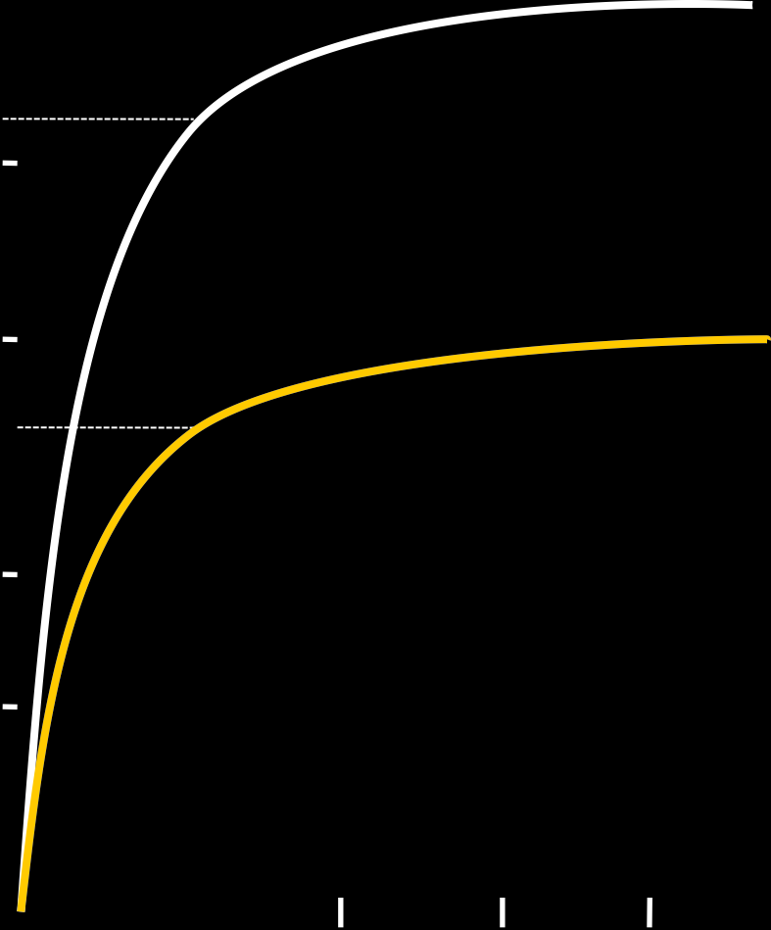
Restrictive lung disease
5
A
Expired Volume (l)
4
3
C
2
1
0
1 2 3 4 5
Time (s)

Slide 13
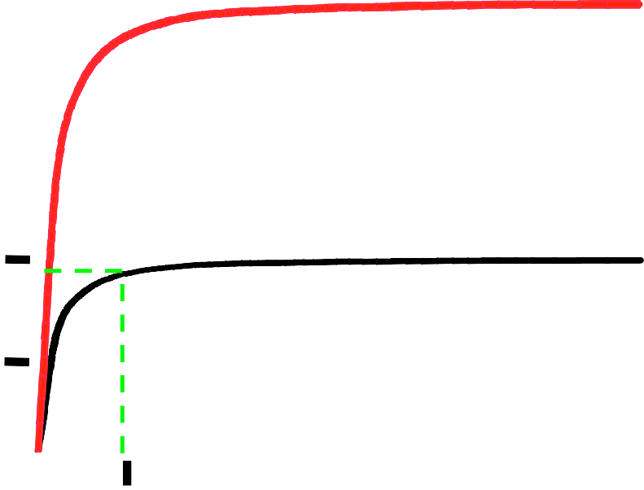

Restrictive Disease
5
4
3
2
1
Normal
Volume, liters
Restrictive
FEV₁ = 1.9L FVC = 2.0L
FEV₁/FVC = 0.95
1 2 3 4 5 6
Time, seconds

Slide 14
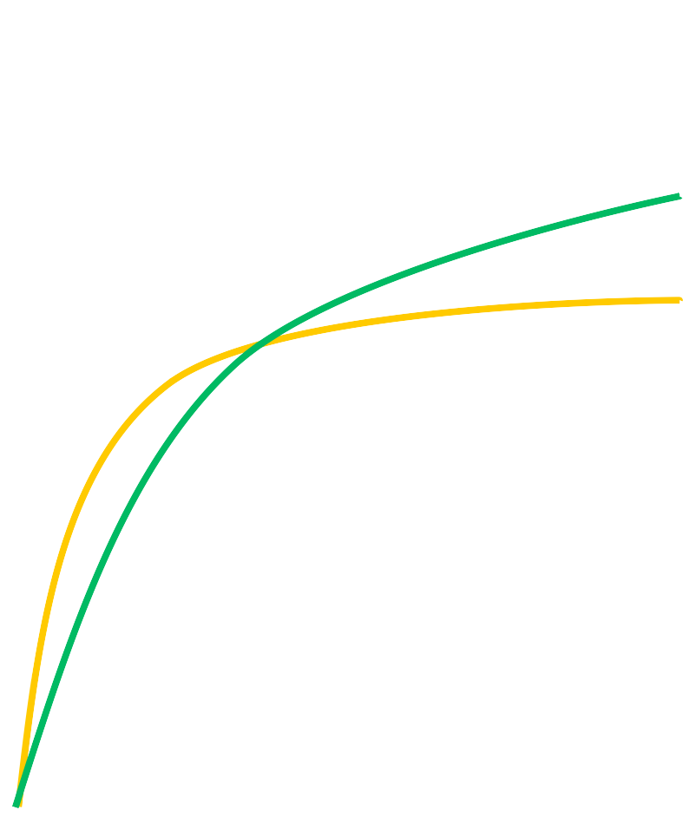
5
A
Expired Volume (l)
4
B
3
C
2
1
0
1 2 3 4 5
Time (s)

Slide 15
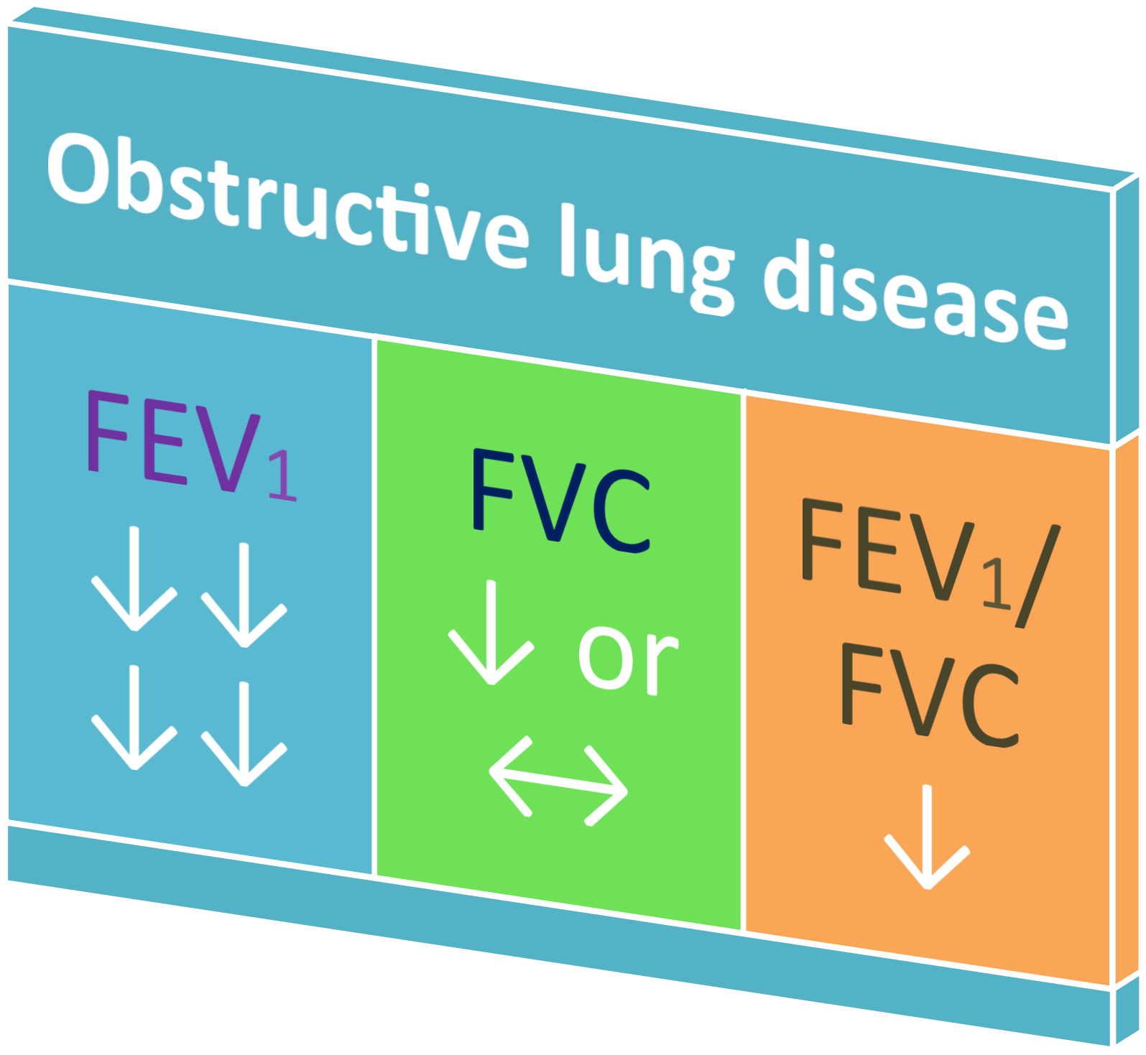

Slide 16
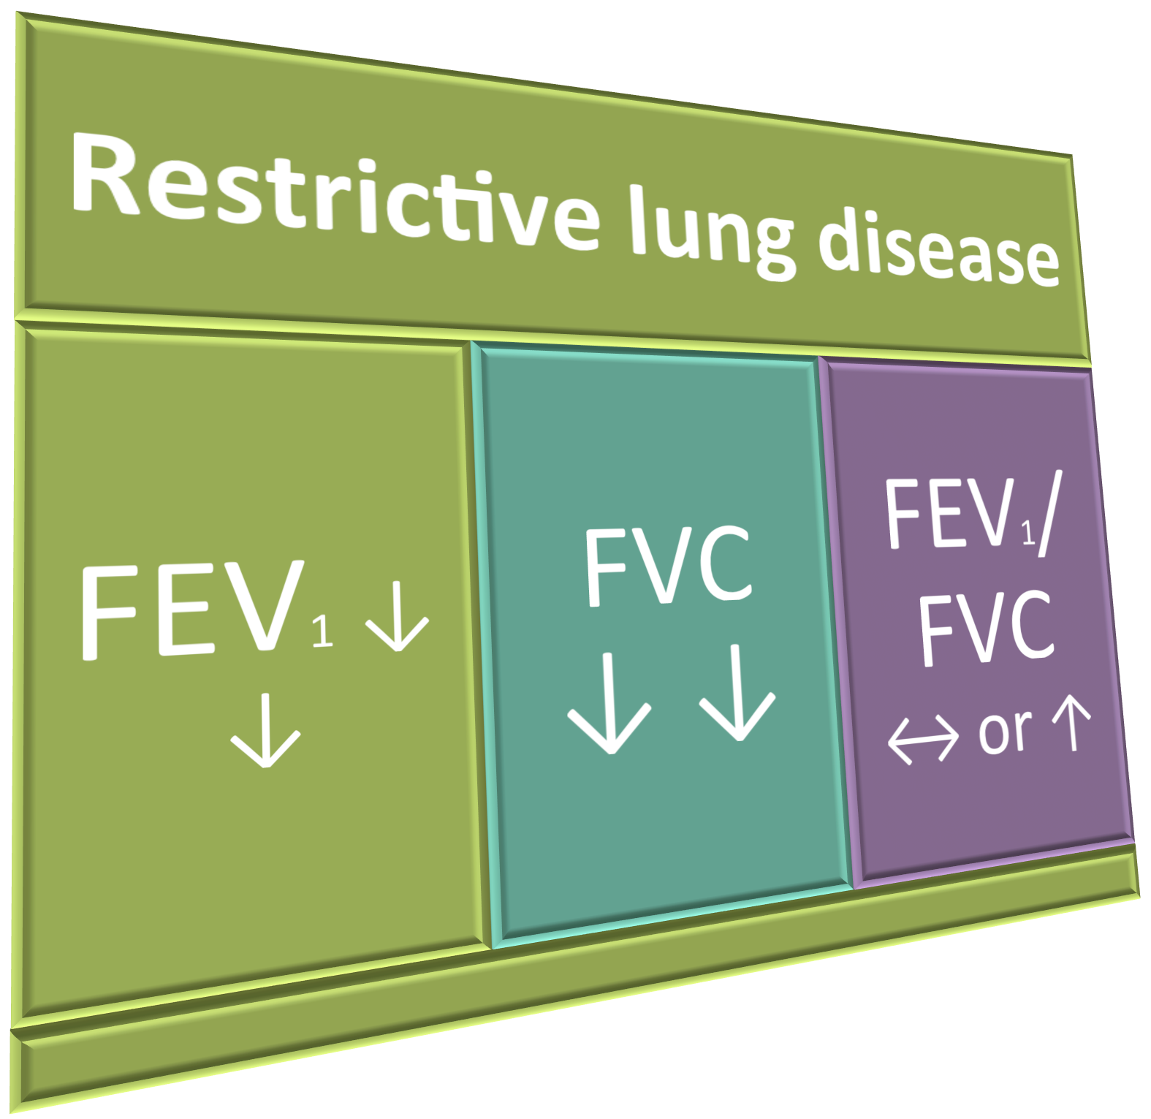

Slide 17
Volume | Normal | Obstructive | Restrictive
FVC | 5 | ↓ or ↔ (5) | ↓ (3)
FEV1 | 4 | ↓↓↓ (2) | ↓ (2.7)
FEV1% | 80% | ↓ (40%) | ↔ or ↑ (90)

Slide 18
Results interpretation
Results are reported as absolute values (litre) ,and as percentages of predicted values based on age, height, sex, ethnicity.
Normal: Both FVC and FEV1 ≥ 75% of predicted
If one or both of the parameters is < 75% predicted, calculate FEV1 ratio:
FEV1% ≥ 80% ------à Restrictive
FEV1% < 70 % ------à Obstructive

Slide 19
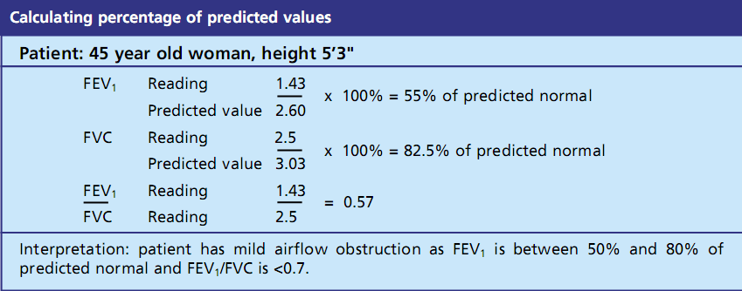

Slide 20
Flow
Volume loop
breathes normally (TV)
rapid max inspiratº
max inspiratº
Exhales Fast

Slide 21

This measures exp & insp ﬂow as a function of exhaled volume rather then against time.
Maximum expiratory flow (PEF)
Expiratory flow rate L/sec
FVC
RV
TLC
Inspiratory flow rate
L/sec
Volume (L)

Slide 22
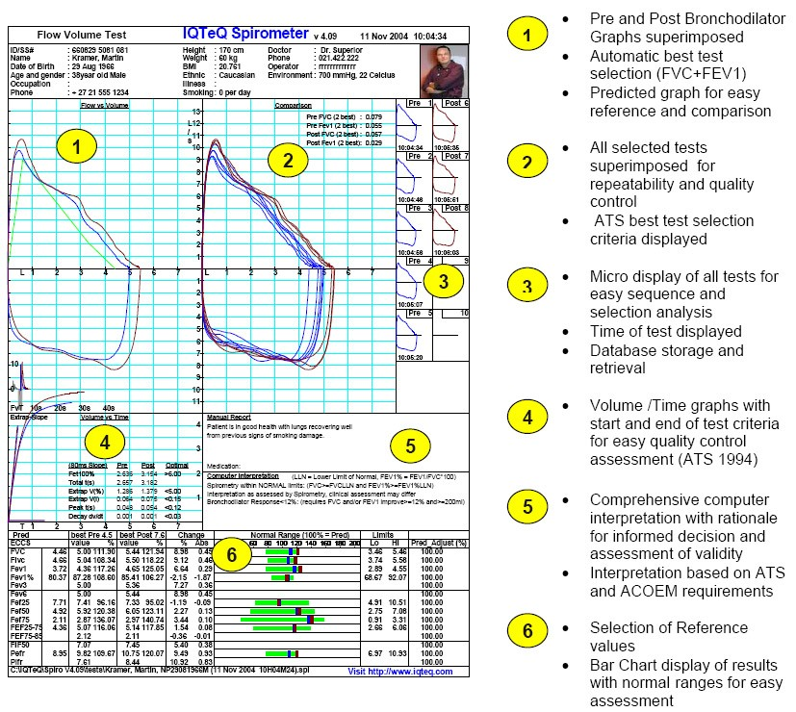
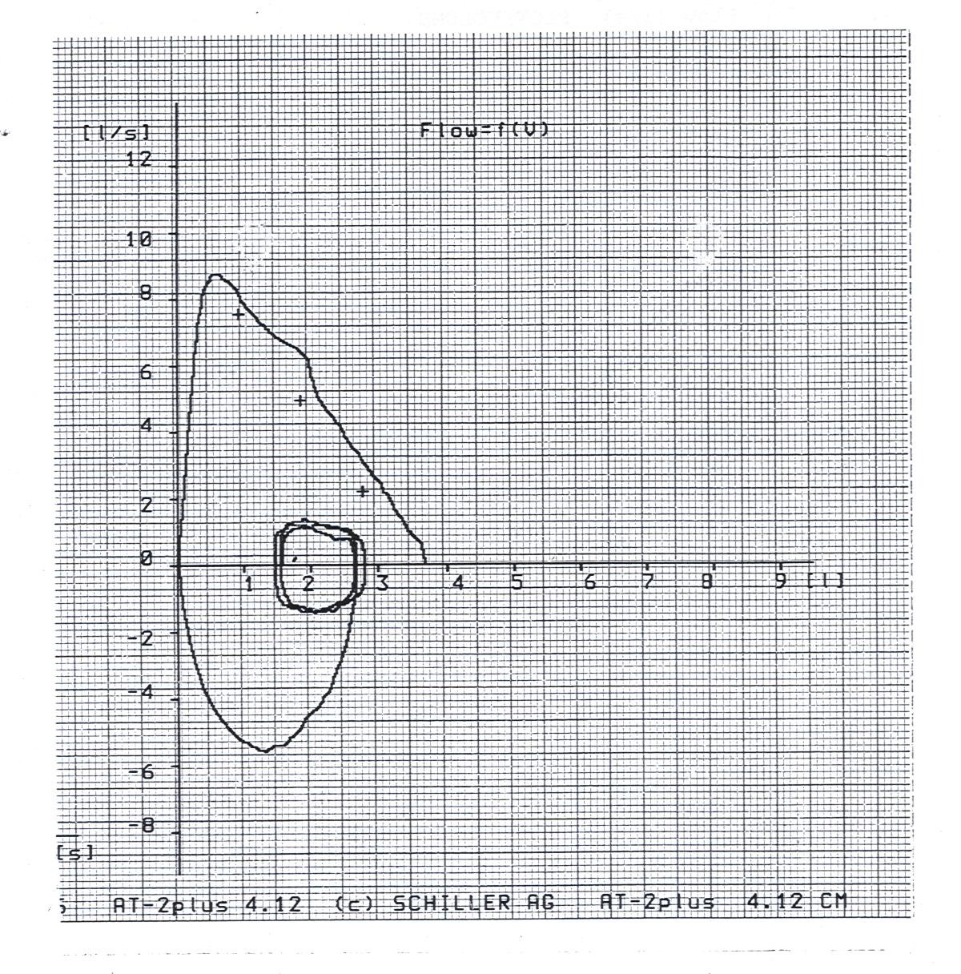

Slide 23
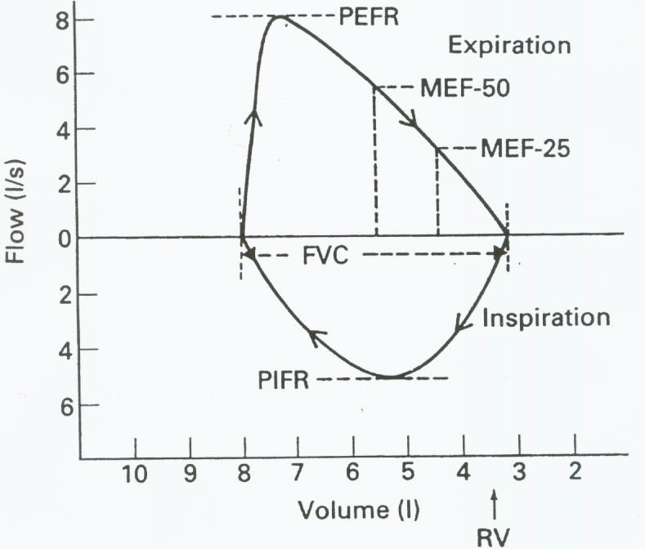
Flow Volume loop

Slide 24






Measurements on ﬂow V loop
•PEFR : Greatest ﬂow achieved during the maneuvre = 6- 12l/sec
•PIFR = max ﬂow speed achieved during forceful inspiratory eﬀort=6l/sec
•MEF50: max expiratory ﬂow at 50% of FVC = 4- 6 l
•FVC measured over the X-axis

Slide 25
Maximal Expiratory Flow
The inspiratory and the 1st early ﬂow rates of the expiratory curve : (ﬂows generated near the
TLC ) are eﬀort (muscle) dependent :
The greater one can raise pleural pressure (the harder one forces the air out), the greater the resulting air ﬂow

Slide 26
Flow Volume Loop and Flow
Limitation
At low lung Volume , as RV is approached, after a certain pleural pressure (Pip) is reached, ﬂow rate is eﬀort independent (it depends on the size of the bronchi)
Harder eﬀort generates higher Pip but no greater airﬂow, this is because the positive Pip that tends to collapse the airway exceeds the airway pressure that tends to keep the airways open: the airways narrow, preventing any further increase in airﬂow despite greater eﬀort.

Slide 27
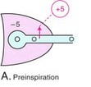
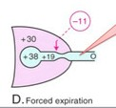
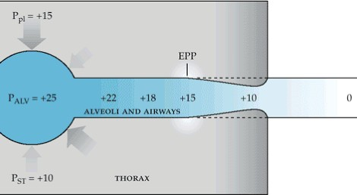

Slide 28


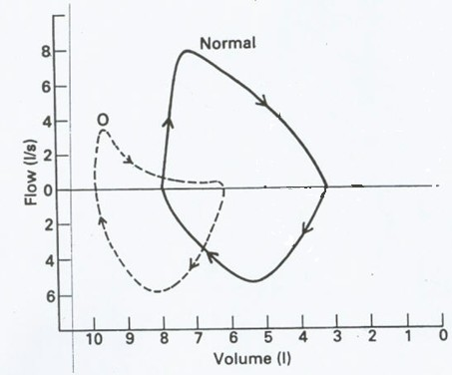


Obstructive LD
MEF50↓
Eﬀort independent part of curve: concave
PEFR↓
Inspiratory loop Normal

Slide 29

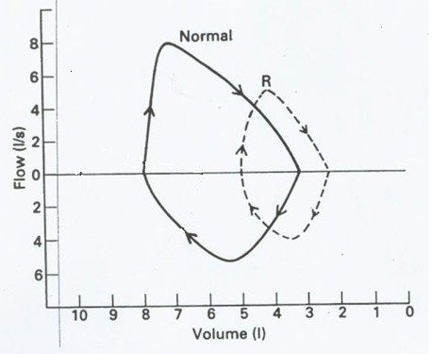


Restrictive LD
Miniature loop (elliptical)
All ﬂow parameters ↓

Slide 30
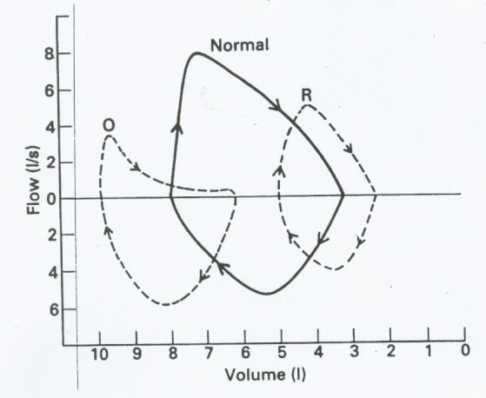

Slide 31

Importance of spirometry
Assess physical ﬁtness .
Helps in the diagnosis of certain pulmonary diseases (obstructive & restrictive).
Follow disease progression.

Slide 32




