Slide 1
Immunology of Asthma
Immunology Unit
Department of Pathology
King Saud University

Slide 2
Immunology of Asthma
Objectives:
To the difference between extrinsic and intrinsic asthma
To be familiar with types of allergens and their role in allergic sensitization
To understand the inflammatory processes operating in allergic asthma
To know about the airway remodeling

Slide 3
Asthma is a clinical syndrome characterized by:
1. Episodes of reversible airway obstruction
2. Increased bronchial reactivity
3. Airway inflammation

Slide 4
Patients with asthma present with one or more of the following symptoms:
1. Breathlessness (difficulty in breathing)
2. Wheezing
3. Persistent cough
4. Chest tightness

Slide 5
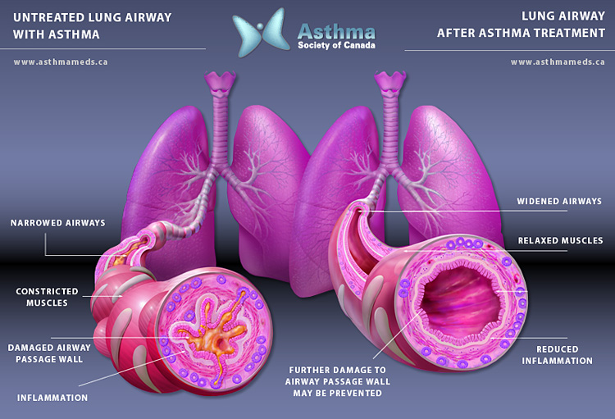
Airway Obstruction in Asthma

Slide 6
Classification of Asthma
Intrinsic (non-atopic)
2. Extrinsic (atopic)
( Atopy: genetic tendency to develop allergy)

Slide 7
Non-atopic (intrinsic) asthma
(10-33% of asthmatics)
Negative skin tests
No clinical/family history of allergy
Serum IgE levels are usually normal
Older patients
More severe

Slide 8
Atopic (extrinsic) asthma
Allergies trigger asthma attacks in:
60-90% Children
50% Adults
Approximately 75-85% of patients with asthma
have positive (immediate) skin test reactions
to various allergens

Slide 9
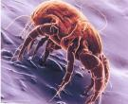

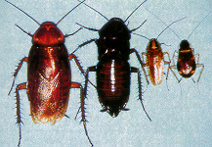
Role of Allergens in Asthma
Allergen sensitization is linked to the risk of developing asthma
Indoor allergens
  House dust mites
  Domestic pets (cat fur & dander)
  Cockroaches (insects)
  Molds (fungal spores)

Slide 10
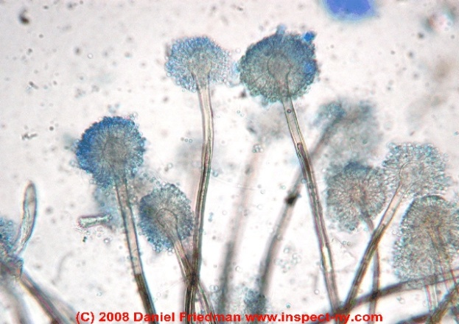


Outdoor allergens:
- Fungal spores (e.g. Alternaria)
- Grass, tree & weed pollens
Fungal spores
Grass pollens
Tree pollens

Slide 11
Antigen presenting cells (APCs) in the lung:
Two subsets of dendritic cells (DCs) in the lungs:
One subset of DCs called respiratory tract myeloid DCs (mDCs) help in the development of asthma symptoms
Second subset known as plasmacytoid DCs (pDCs) aid in respiratory tolerance to allergens

Slide 12
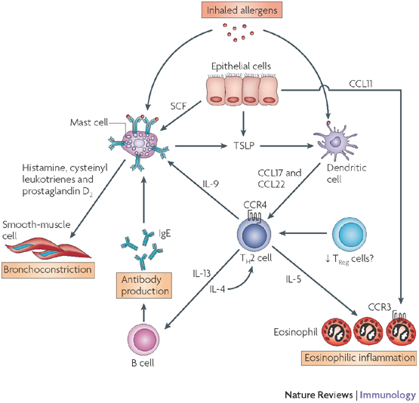
In susceptible individuals
First encounter with allergens activate B-cells to produce IgE
Inhaled allergen
Subsequently:
Inhaled allergens activate submucosal mast cells in the lower airways
Mediators are released within seconds causing:
1. Bronchoconstriction
2. Influx of eosinophils
& other inflammatory cells

Slide 13
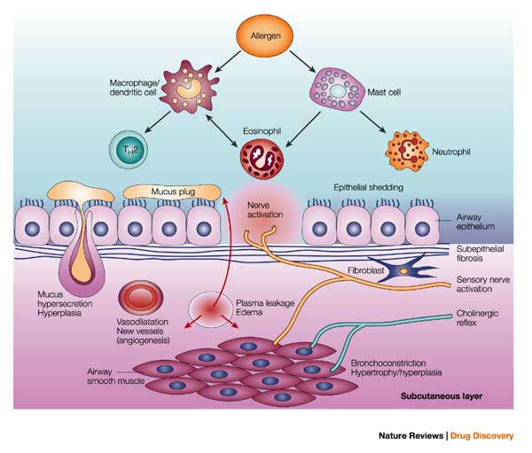
Asthma results from complex interactions among the inflammatory cells that involve:
Airway epithelium
Nervous system
Bronchial smooth muscles

Slide 14
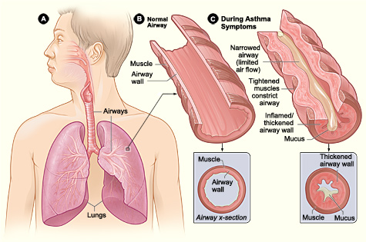
Factor contributing to airflow obstruction leading to difficulty in breathing include:

Slide 15
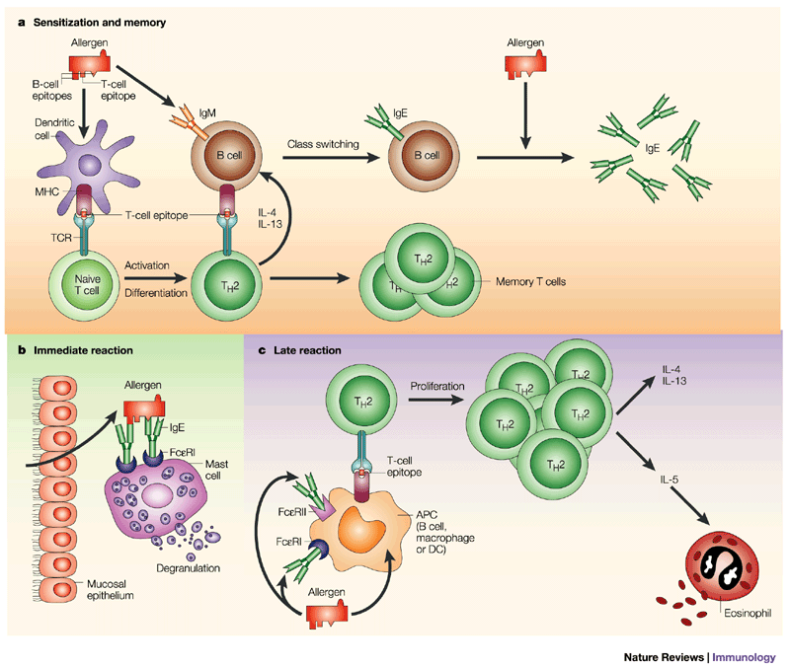
Response to allergen occur in two phases

Slide 16
Early allergic response
1. Occurs within minutes
2. Manifests clinically as:
- Bronchial constriction
- Airway edema
- Mucus plugging
Is reversible and responds to bronchodilators

Slide 17
Late allergic response:
1. Appears 4 to 10 hours later
2. Results from infiltration by inflammatory cells.
3. Activation of lymphocytes & eosinophils
Responds to steroids
(Anti-inflammatory drugs)

Slide 18
Th2 cells and role of cytokines in allergic asthma

Slide 19
Allergens drive T-cells towards Th 2 type:
Th2 secrete the cytokines:
IL-4, IL-5, IL-9 & IL-13
which promote :
1. Production of IgE by B cells
2. Eosinophil attraction and infiltration
3. Airway inflammation
4. Increased bronchial reactivity

Slide 20
Role of IL-4 in allergic asthma
The main role of IL-4 is carried out during the initial priming of Th2 cells :
1. Regulates isotype switching in B cells to IgE
2. Induces MHC II on antigen-presenting cells
3. Induces adhesion molecule expression
4. Activate mast cells and eosinophils

Slide 21
Role of IL-13 in allergic asthma
IL-13 induces inflammation
Stimulates mucus hyper-secretion
Induces sub-epithelial fibrosis

Slide 22
Role of IL-5 in allergic asthma
IL-5 induces an increase in eosinophil production in the bone marrow
2. Release of eosinophils from the bone marrow into circulation

Slide 23
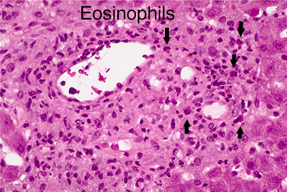
Role of eosinophils in allergic asthma
Eosinophils initiate asthmatic symptoms by causing tissue damage in the airways of the lungs
Production of eosinophils is inhibited by IL-10

Slide 24
Role of regulatory T – cells:
Regulatory T cells suppress the effector mechanisms that induce asthmatic symptoms
Asthmatics may lack functional regulatory T cells that can inhibit an asthmatic response

Slide 25
Activation of inflammatory cells (mast cells, eosinophils etc,) is a major inducer of airway inflammation.
Airway inflammation is the hallmark in the asthmatic lung
which leads to :
Increased bronchial reactivity

Slide 26
Products of the inflammatory cells act on :
Airway smooth muscle cells
Lung fibroblasts
3. Mucous glands
and cause :
Airway Remodeling

Slide 27
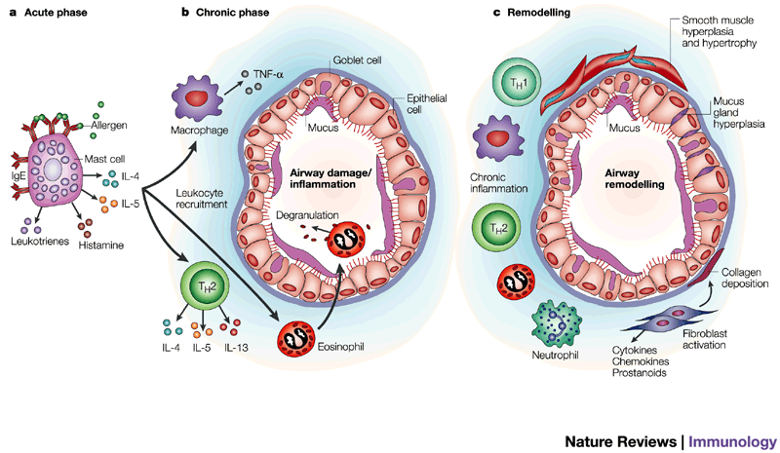
1. Smooth muscle hyperplasia & hypertrophy
2. Mucous gland hyperplasia
3. Collagen deposition
Airway remodeling refer to:
4. fibroblast activation
5. Chronic inflammation
4. Fibroblast activation

Slide 28
Inflammatory cells & their mediators
Airway inflammation
Increased bronchial Airway remodelling reactivity

Slide 29
Outcome of increased airway reactivity
Predisposes patients to develop asthma attacks
on exposure to non-specific irritants:
1. Chemical irritants
2. Smoke & strong perfumes
3. Sulphur dioxide & air pollutants
4. Viral and bacterial respiratory infections

Slide 30
Outcome of airway remodeling
Can ultimately lead to fibrosis and irreversible airway obstruction in some patients

Slide 31
Take home message
1. Asthma is characterized by episodic reversible
airway obstruction
2. Classified in 2 types: intrinsic & extrinsic
3. In the extrinsic type allergens drive T-cells
into Th2 pattern
4. Airway inflammation is a hallmark finding in
the asthmatic lung
5. Inflammatory cells lead to increased bronchial
reactions & airway remodeling which is not revisable

