Slide 1
Upper Respiratory Tract Infection URTI
Dr Ali Somily

Slide 2
Objectives
To learn the epidemiology and various clinical presentation of URT
To identify the common etiological agents causing these syndromes
To study the laboratory diagnosis of these syndromes
To determine the antibiotic of choice for treatment

Slide 3
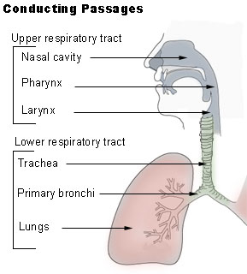
Definition
Pharyngitis
Otitis Media
Sinusitis
Epiglottitis

Slide 4
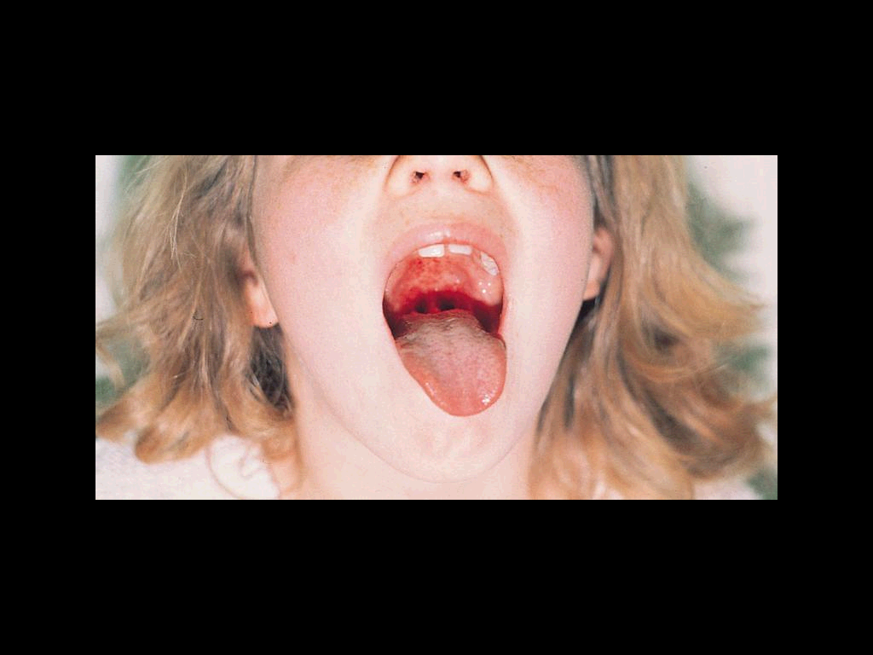
Pharyngitis
Late fall, winter, early spring
5 to 15 years
erythema, edema, and/or exudates
Tender, enlarged >1 cm lymph nodes
Fever 38.4 to 39.4º C
No signs and symptoms of viral infections

Slide 5
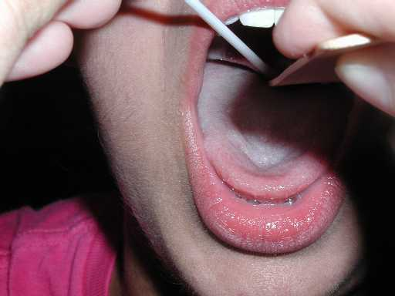
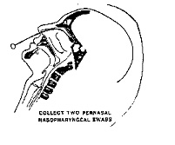
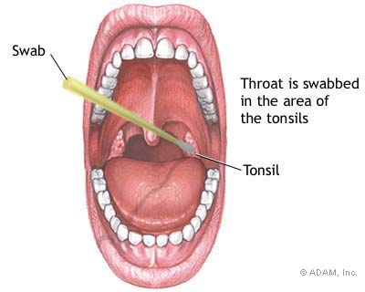
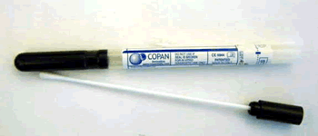
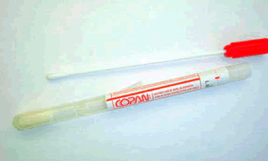
Pharyngitis
Etiology
Viral is the most common i.e Respiratory viruses, Enterovirus, HSV, EBV, HIV.
Bacterial Group A streptococcus
Arcanobacterium haemolyticum (15-25y)
Neisseria gonorrhoeae
Anaerobic bacteria i.e Lemierre's syndrome
Corynebacterium diphtheriae

Slide 6
Diagnosis of Group A Streptococcus
Rapid Bacterial antigen detection
Culture
Antistreptolysin O

Slide 7
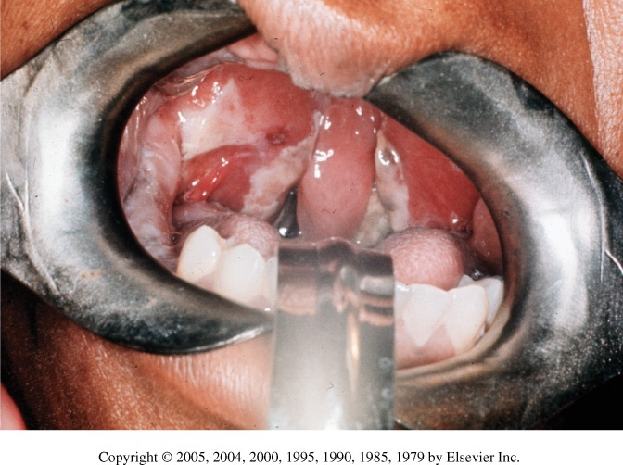
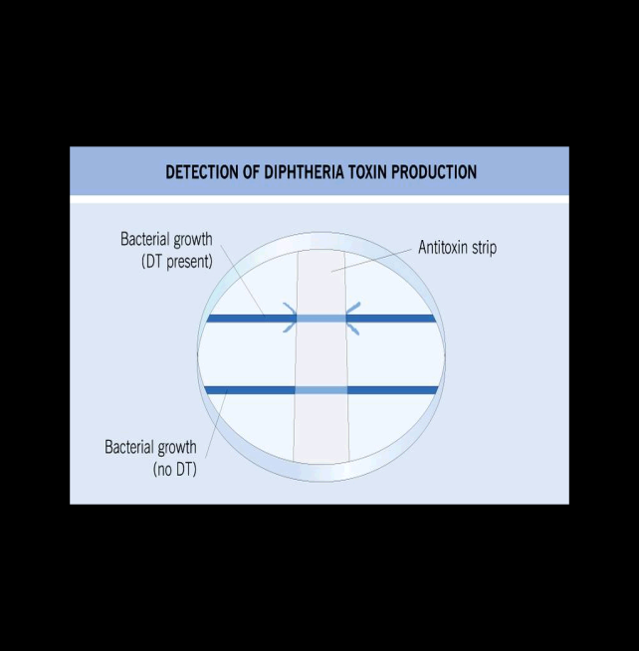
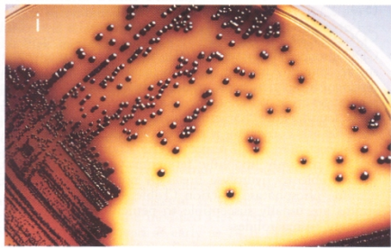
Corynebacterium diphtheriae
One of the most common causes of death in unvaccinated children 1-5yrs.
Toxin mediated disease
Rapid progression tightly adhering gray membrane in the throat
Tinsdale media
ELIK’s Test for confimation
Penicillin or erythromycin

Slide 8
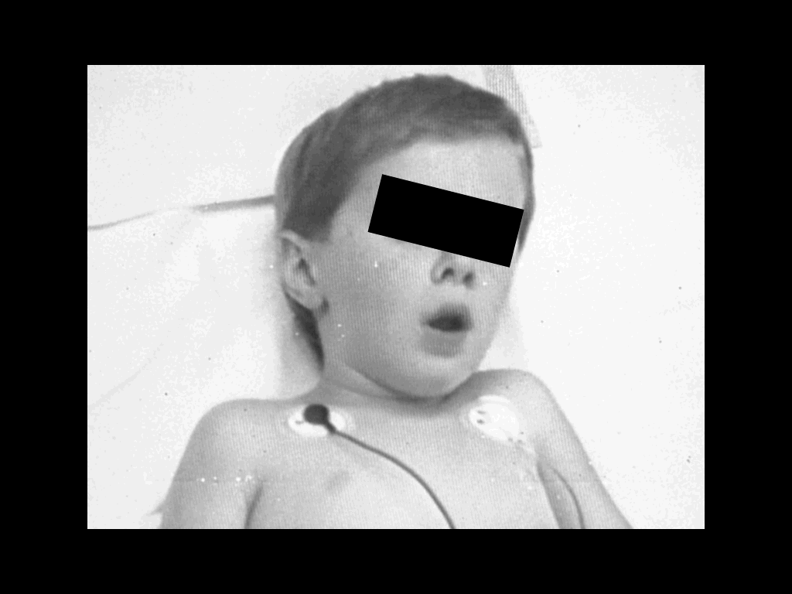
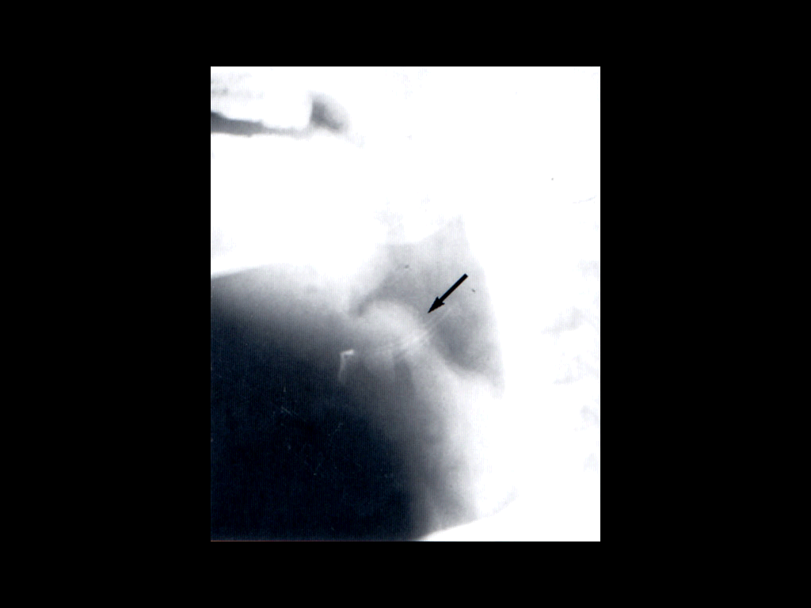
Epiglottitis
Usually young unimmunized children presented with dysphasia, drooling, and distress
H.influenzae Type b
S.pneumonae
S.aureus or Beta hemolytic streptococcus
Viral or Candida
Ceftriaxone

Slide 9
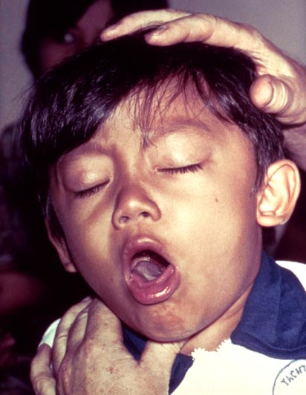
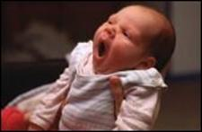
Pertussis (whooping cough)
Bordetella pertussis (GNB)
Pertussis toxin (PT )*
Filamentous hemagglutinin (FHA
Pertactin (PRN)
Incubation period 1 to 3 wks
Catarrhal Stage 1-2 weeks
Paroxysmal Stage 1-6 weeks
Convalescent Stage 3-6 weeks
Leukocytosis with lymphocyte predominance
Nasopharyngeal (NP) swabs
Charcoal-horse blood T media
Regan-Lowe, Bordet-Gengou
Treatment erthromycin and prevention by vaccination

Slide 10
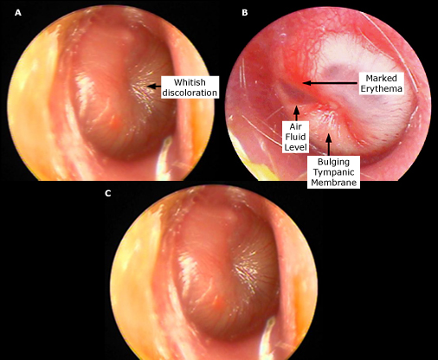
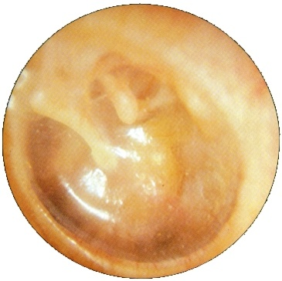
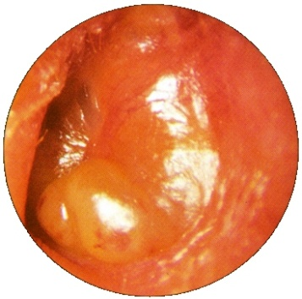
Acute otitis media
S. pneumoniae
H. influenzae
GAS
S. aureus
Moraxella catarrhalis
Viral and fungal
Tympanocentesis
Amoxicillin or AMC
Mastoiditis treat for 2 wks

Slide 11
Bacterial sinusitis
Acute sinusitis
Children
Viral etiology 13%
Mainly clinical diagnosis
Aspiration in case Immunocompramized , treatment failure
Diagnosis X-rays CT/MRI
Periorbital cellulitis R/O sinusitis by CT/MRI
Post-septal involvement treat as meningitis
Chronic sinusitis
Less local symptoms
Mimic allergic rhinitis
Dx Image less useful than acute (changes persist after TTT) and to R/O tumor
Obtain odontogenic X-rays if maxillary sinus
Notes:
Microbiology and treatment of acute bacterial sinusitis in children Author Ellen R Wald, MD Section Editors Sheldon L Kaplan, MD Ellen M Friedman, MD Robert A Wood, MD Deputy Editor Mary M Torchia, MD Last literature review version 17.2: May 2009 | This topic last updated: May 24, 2009 (More)
INTRODUCTION — Acute sinusitis is a disease that results from infection of one or more of the paranasal sinuses. A viral infection associated with the common cold is the most frequent etiology of acute sinusitis, more properly called viral rhinosinusitis. Approximately 6 to 13 percent of viral rhinosinusitis in children is complicated by acute bacterial sinusitis (ABS).
Uncomplicated viral rhinosinusitis usually resolves without treatment in 7 to 10 days. Although untreated ABS also may resolve without treatment, treatment with antibiotics hastens recovery and may decrease the risk for orbital and intracranial complications. Distinguishing between acute viral rhinosinusitis and ABS is important so that antibiotics, which are ineffective in uncomplicated viral rhinosinusitis, can be used judiciously.
The treatment of ABS in children will be discussed here. The clinical features and diagnosis of ABS in children and acute sinusitis and rhinosinusitis in adults are discussed separately. (See "Clinical features; evaluation; and diagnosis of acute bacterial sinusitis in children" and see "Acute sinusitis and rhinosinusitis in adults").
MICROBIOLOGY — Streptococcus pneumoniae, Haemophilus influenzae (non-typeable), and Moraxella catarrhalis are the predominant causes of ABS [1-3]. Few data regarding the microbiology of acute sinusitis in children have been generated since 1986 [4]. However, because of the similarity of the pathogenesis and microbiology of acute otitis media (AOM) and ABS, it is acceptable to regard data generated from cultures of middle ear fluid, obtained by tympanocentesis, from children with AOM as a surrogate for cultures of the paranasal sinuses [5,6].
The microbiology of AOM in the United States is changing. Since the mid-1990s there has been an increasing prevalence of penicillin-resistant S. pneumoniae. Many isolates of H. influenzae (35 to 50 percent), and M. catarrhalis (55 to 100 percent) also are beta-lactamase producing and resistant to penicillin [7,8]. In addition, perhaps related to the near universal immunization of infants with the pneumococcal conjugate vaccine in the United States, there has been a slight decrease in isolates of S. pneumoniae and an increase in isolates of H. influenzae recovered from middle ear aspirates [9]. However, an increase in the recovery of serotype 19A S. pneumoniae (a multiply-antibiotic resistant non-vaccine strain of pneumococcus) from tympanocentesis isolates of AOM has been reported in several case series [10,11]. Similar changes can be presumed to occur in the paranasal sinuses. (See "Resistance of Streptococcus pneumoniae to beta-lactam antibiotics" and see "Acute otitis media in children: Epidemiology, pathogenesis, clinical manifestations, and complications", section on Microbiology).
ANTIBIOTIC THERAPY — The goals of antibiotic therapy of ABS are to hasten recovery and prevent suppurative complications [12]. Successful antibiotic treatment depends upon administration of an appropriate antibiotic, in adequate doses, for a sufficient period of time [3].
Most children with ABS can be treated as outpatients. Those with severe symptoms, underlying immunodeficiency (primary or secondary), or potential orbital or intracranial complications should be hospitalized for intravenous antibiotic therapy and/or specialty or surgical care (show figure 1) [3].
Efficacy — There is some controversy in the literature regarding the effectiveness of antibiotics in the treatment of ABS. Some have argued that the difficulty in distinguishing viral rhinosinusitis from ABS and the high spontaneous cure rate of ABS obviate the need for antibiotics [13,14], whereas others are of the opinion that antimicrobial therapy is the cornerstone of management [12]. (See "Clinical features; evaluation; and diagnosis of acute bacterial sinusitis in children").
The data regarding antibiotic therapy for the treatment of ABS in children are unsatisfactory. Nonrandomized studies in adults have suggested that appropriate antibiotics at appropriate doses are effective in eradicating or reducing bacterial growth [1,15]. However, there have been no randomized, placebo-controlled trials of antibiotic treatment for ABS that have used pre- and post-treatment sinus aspirate culture as the standard for diagnosis and cure. Studies that use clinical and/or radiologic criteria for diagnosis and outcome may underestimate the benefit of antibiotic therapy because they are likely to include at least some patients with self-limited uncomplicated viral URI.
Only two prospective placebo-controlled studies regarding the efficacy of antibiotics in the treatment of ABS have been performed in children since 1986 [4,13].
The first study was published in 1986, before the widespread development of antibiotic-resistant pneumococci. In this study, 136 children (mean age 6 years) with radiologically confirmed clinical ABS (nasal discharge or daytime cough, or both of 10 to 30 days' duration) were randomly assigned to treatment with amoxicillin (40 mg/kg per day), amoxicillin-clavulanate (40 mg/kg per day of the amoxicillin component), or placebo. They underwent clinical assessment at 3 and 10 days [4]. Children with throat cultures positive for group A Streptococcus (n=28) and who did not complete their medication (n=15) were excluded from analysis. More children in the treatment groups than in the placebo group were cured or improved on days 3 and 10 of therapy (83 versus 51 percent and 79 versus 60 percent, respectively). The overall cure rates were 67 percent, 64 percent, and 43 percent for amoxicillin, amoxicillin-clavulanate, and placebo, respectively.
The second study was published in 2001. In this study 188 children (aged 1 to 18 years, mean age 8 years) from community pediatric practices who had 10 to 28 days of persistent sinus symptoms were randomly assigned to receive amoxicillin (40 mg/kg/day), amoxicillin-clavulanate (45 mg/kg per day of the amoxicillin component) or placebo [13]. The rate of improvement (79 to 81 percent), relapse (12 to 13 percent), recurrence (9 to 13 percent), and adverse effects (10 to 19 percent) were similar among groups. The lack of benefit with antibiotic therapy in this study may have been related to the use of a relatively low dose of amoxicillin in an era of potentially resistant S. pneumoniae, the exclusion of more seriously ill children (temperature >39ºC or facial pain), and a relatively older population [12,14,16].
A meta-analysis of six randomized controlled trials that compared antibiotics versus placebo or standard therapy in 562 children with rhinosinusitis for ≥10 days (eg, acute, subacute, and chronic sinusitis) found that antibiotics decreased overall clinical failure, defined as nasal discharge at follow up or no substantial improvement (risk ratio of 0.75 [95% CI, 0.63 to 0.92]), without significantly increasing adverse effects [17].
Whether treatment of ABS prevents serious complications has not been adequately studied [18].
Choice of antibiotic — Antibiotics that are used to treat ABS must provide antibacterial coverage for S. pneumoniae, H. influenzae, and M. catarrhalis. Additional factors to be considered include the severity of clinical illness, recent exposure to antibiotics, and other factors that increase the likelihood of infection with a resistant bacterial species.
Because of its general effectiveness, safety, low cost, and narrow spectrum, amoxicillin, with or without clavulanate, generally is considered to be the first line agent for the treatment of ABS in children [12,19].
There are few adequately powered studies that compare the efficacy of various antibiotics in the treatment of ABS. Guidelines for antibiotic therapy provided by the Sinus and Allergy Health Partnership used a mathematical model based on the best available evidence for pathogen distribution in ABS, pharmacokinetic and pharmacodynamic data, mechanisms of antimicrobial resistance, and antimicrobial resistance surveillance data [20-22]. Similarly, guidelines published by the American Academy of Pediatrics (AAP) developed suggestions for antimicrobial therapy based on theoretical calculations rather than on existing evidence [12]. They conclude that in the absence of any risk factors for resistant organisms, approximately 80 percent of children with ABS will respond to amoxicillin.
Outpatient therapy — We agree with the AAP guideline for the management of ABS in children (show figure 1) [12], and make the following recommendations for outpatient therapy:
For children with uncomplicated ABS that is of mild to moderate severity, who do not attend day care, and have not been treated with an antimicrobial in the preceding 90 days, we suggest one of the following regimens:
Amoxicillin (45 to 90 mg/kg per day in two divided doses), or
Amoxicillin-clavulanate (45 to 90 mg/kg per day of the amoxicillin component in two divided doses)
The dose range permits some individual judgment [12,23]. As an example, a lower dose may be used for a child who has his or her first sinus infection in October (when the rate of antibiotic resistance is low) [24]; later in the viral respiratory season, a higher dose (90 mg/kg per day) may be more appropriate.
For children who have uncomplicated ABS of at least moderate severity, have received an antimicrobial agent in the preceding 90 days, or who attend day care, we suggest one of the following regimens (show figure 1):
Amoxicillin-clavulanate (80 to 90 mg/kg per day of amoxicillin and 6.4 mg/kg per day of clavulanate in two divided doses), or
Cefdinir (14 mg/kg per day in 1 or 2 doses), or
Cefuroxime (30 mg/kg per day), or
Cefpodoxime (10 mg/kg per day once daily)
A single dose of ceftriaxone (at 50 mg/kg per day), given either intravenously or intramuscularly, can be used in children with vomiting that precludes administration of oral antibiotics [12]. Therapy with an oral antibiotic should be initiated 24 hours later, provided the vomiting has resolved.
Children with allergy to penicillins — Regimens for children with non-type 1 hypersensitivity reactions to penicillin (show table 1) include (show figure 1):
Cefdinir (14 mg/kg per day in 1 or 2 doses), or
Cefuroxime (30 mg/kg per day), or
Cefpodoxime (10 mg/kg per day once daily)
In patients with type 1 hypersensitivity reactions to penicillins (show table 1), appropriate regimens include:
Clarithromycin (15 mg/kg/day in 2 divided doses), or
Azithromycin (10 mg/kg per day on day 1 followed by 5 mg/kg per day as a single dose for 4 days)
Clindamycin (30 to 40 mg/kg per day) is another alternative, but should be reserved for patients with type 1 hypersensitivity reactions to penicillin who are known to be infected with penicillin-resistant pneumococci [12].
(See "Allergy to penicillins" and see "Use of cephalosporins, carbapenems, and monobactams in penicillin allergic patients").
Hospitalized patients — Seriously ill children with ABS should be hospitalized for intravenous antibiotics. Empiric therapy should provide coverage for highly resistant pneumococci and penicillin resistant H. influenzae and M. catarrhalis. Appropriate regimens include:
Cefotaxime (100 to 200 mg/kg per day every divided every 6 hours), or
Ceftriaxone (100 mg/kg per day divided every 12 hours)
Therapy should be adjusted based upon clinical response and culture results.
Duration — The optimal duration of therapy for patients with ABS has not received systematic study. Empiric recommendations are typically made for 10, 14, 21, or 28 days of therapy. As an alternative, we suggest that antibiotic therapy be continued until the patient becomes free of symptoms and then for an additional seven days [12,25]. This strategy, which individualizes treatment for each patient, guarantees a minimum duration of 10 days of therapy and prolongs therapy in children in whom the response to antibiotics has been more sluggish.
Treatment failure — Most patients with ABS who are treated with an appropriate antimicrobial agent respond within 48 to 72 hours with a diminution of respiratory symptoms and an improvement in general well-being [4]. If a child fails to improve, either the antimicrobial is ineffective or the diagnosis of sinusitis is not correct [12]. Sinus imaging and/or sinus aspiration may be indicated to confirm the diagnosis and tailor therapy. Refractory sinusitis may be a clue to immune deficiency [26]. (See "Approach to the child with recurrent infections").
For children with mild to moderate symptoms who do not improve while receiving an adequate dose of amoxicillin, antibiotic therapy may be changed to one of the following regimens (show figure 1):
Amoxicillin-clavulanate (80 to 90 mg/kg per day of amoxicillin and 6.4 mg/kg per day of clavulanate in 2 divided doses), or
Cefdinir (14 mg/kg per day in 1 or 2 doses), or
Cefuroxime (30 mg/kg per day), or
Cefpodoxime (10 mg/kg per day once daily)
If patients with mild to moderate symptoms fail to improve with one of these regimens, a trial of intravenous therapy with ceftriaxone (100 mg/kg per day divided every 12 hours) or cefotaxime (100 to 200 mg/kg per day) may be initiated (show figure 1).
Sinus imaging (plain radiographs in anteroposterior, lateral, and occipitomental views) should be performed before initiation of intravenous therapy to confirm the diagnosis (for patients who were not previously imaged). Sinus imaging, with contrast enhanced computed tomography (CT), should be performed in patients with symptoms or signs of intracranial or orbital complications. Sinus aspiration also may be indicated to appropriately tailor antibiotic therapy. (See "Clinical features; evaluation; and diagnosis of acute bacterial sinusitis in children", section on Complications of ABS).
Failure to improve in hospitalized patients who are receiving empiric antibiotic therapy warrants additional evaluation. Contrast enhanced CT imaging should be obtained to exclude orbital and intracranial complications. Sinus aspirate cultures should be obtained if they were not obtained at the time of admission. Antimicrobial therapy should be modified according to results of sinus aspirate cultures as soon as the results are available. If sinus aspirate cultures are unavailable or if no pathogens are isolated in an ill child who has not improved despite therapy with a third generation cephalosporin, the addition of vancomycin with or without metronidazole may be warranted. Consultation with an infectious disease specialist and/or otolaryngologist is suggested.
INDICATIONS FOR REFERRAL — Children with uncomplicated ABS can usually be managed by their primary care provider. Consultation with a specialist (eg, infectious disease, otolaryngology, immunology) may be warranted in the following circumstances [18,27]:
Intracranial or orbital complications
Need for sinus aspiration
Isolation of resistant or rare pathogens from sinus aspirate
Diagnosed or suspected immunodeficiency
Recurrent ABS, particularly if it exacerbates underlying pulmonary conditions (eg, asthma)
ADJUNCTIVE THERAPY — Adjunctive therapies for ABS, which may be used to reduce or improve sinus drainage, include [12,28,29]:
Saline nasal irrigation
Decongestants (topical or systemic)
Antihistamines
Intranasal corticosteroids
There are limited data regarding the efficacy of these therapies in children with ABS [29,30]. Saline nose drops and/or saline nasal sprays may be helpful in preventing crust formation and liquefying sinus secretions. Although the potential benefits are unproven, saline nasal irrigation is unlikely to be harmful or impede recovery and is suggested.
Decongestants may reduce tissue edema, improve ostial drainage, and provide symptomatic relief [28]. However, these benefits may be offset by an increased viscosity of secretions and decreased blood flow to the nasal mucosa, which may impair delivery of antibiotics to the sinuses. Similarly, antihistamines have the potential to dry secretions and impair sinus drainage. There are no data to support the use of antihistamines in children with ABS who do not have an underlying allergic component [12,28].
The use of a combination antihistamine-decongestant in the treatment of children with presumed ABS was evaluated in a single prospective study [31]. Children (aged 1 to 18 years) with presumed ABS were randomly assigned to treatment with a decongestant-antihistamine or placebo in addition to amoxicillin. Symptoms improved in all children within three days of initiation of antibiotics; there were no differences in symptom scores between groups on days 1, 3, or 14 of therapy. We do not suggest the use of decongestants or antihistamines in children with ABS.
Nasal corticosteroids theoretically may decrease inflammation of the mucous membranes, which contributes to obstruction of the ostia and impaired mucociliary clearance [32]. Only one study has evaluated the benefits of intranasal corticosteroids in addition to antibiotics in young children with presumed ABS [33]. In this study 151 children (1 to 15 years) with clinical and radiographic sinusitis were treated with amoxicillin-clavulanate and randomly assigned to budesonide or placebo nasal spray for three weeks. At the end of therapy, symptoms in patients in both groups were improved from baseline. Intranasal budesonide had a modest effect on cough and nasal discharge, but the effect was only noted during the second week of therapy. A study of intranasal corticosteroids in patients >14 years with ABS demonstrated a similar marginal effect [34]. We do not suggest the use of intranasal corticosteroids in children with ABS.
SUMMARY AND RECOMMENDATIONS
Streptococcus pneumoniae, Haemophilus influenzae (non-typeable), and Moraxella catarrhalis are the predominant causes of uncomplicated acute bacterial sinusitis (ABS) in otherwise healthy children. (See "Microbiology" above).
Most children with ABS can be treated as outpatients. Hospitalization is indicated for those with severe symptoms, underlying immunodeficiency (primary or secondary), or potential orbital or intracranial complications. (See "Antibiotic therapy" above).
We suggest children with ABS be treated with antimicrobial therapy (Grade 2A). The choice of antibiotic is based upon the degree of severity of illness, recent exposure to antibiotics, and the likelihood of infection with a resistant bacterial species. (See "Choice of antibiotic" above).
Respiratory symptoms of children with ABS typically improve within three days of initiation of appropriate antimicrobial therapy. Children whose symptoms fail to improve within this time-frame may require sinus imaging and/or sinus aspiration to confirm the diagnosis and/or tailor antibiotic therapy. (See "Treatment failure" above).
We suggest antimicrobial therapy be continued for seven days after the child is free of symptoms. (See "Duration" above).
We suggest saline nose drops and/or saline nasal sprays for children with ABS (Grade 2C). We suggest not using decongestants, antihistamines, or nasal corticosteroids (Grade 2B). (See "Adjunctive therapy" above).

Slide 12
Bacterial sinusitis
Acute sinusitis
S.pneumoniae
H.infuenza
M.catarrhalis
Treatment
Quinolones or
Ceftriaxone
For 1-2 weeks
Chronic sinusitis
S.pneumoniae
H.infuenza
M.catarrhalis
Oral anaerobes
Treatment
Same as acute sinusitis
Duration
For 2-4 weeks

Slide 13
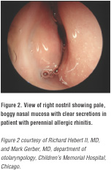
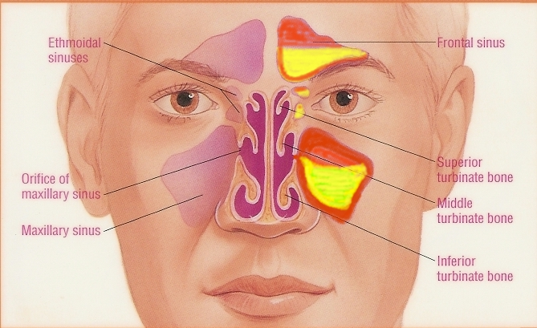
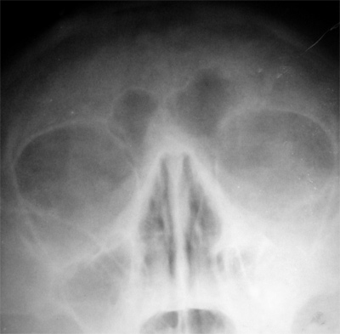
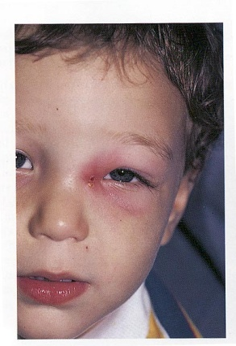
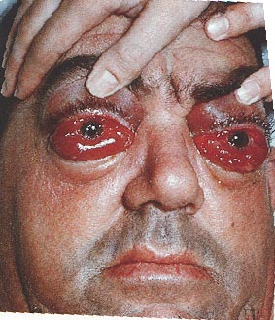
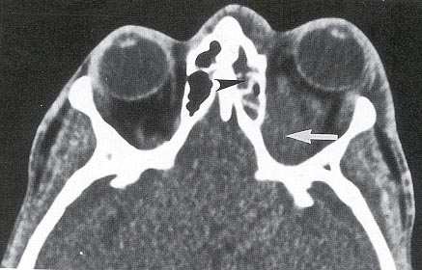
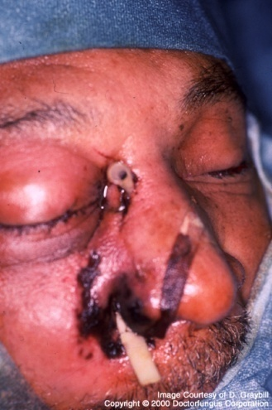
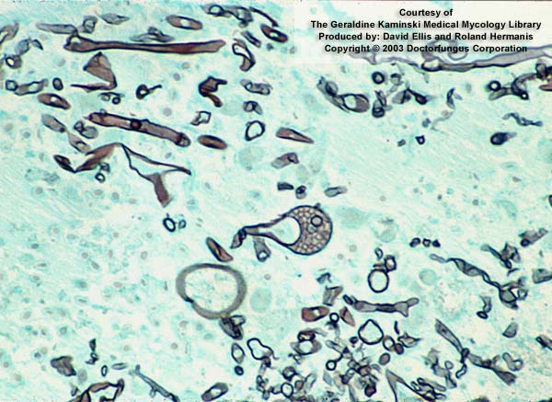
Clinical Presentations of Sinusitis
Notes:
Periorbital edema
Cellulitis
Nasal mucosa is reddened or swollen
Percussion or palpation tenderness over a sinus
Nasal discharge, thick, sometimes yellow or green
Postnasal discharge in posterior pharynx
Difficult transillumination
Swelling of turbinates
Boggy pale turbinates

Slide 14
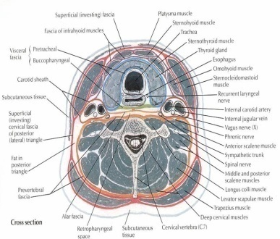
Deep neck space infections
Lateral pharyngeal, retropharyngeal or prevertebral space
Patients are toxic with unilateral posterior pharyngeal soft tissue mass on oral exam
Neck stiffness with retropharyngeal space infection/abscess
Retropharyngeal ( danger space) infection may extend to mediastinum and present as mediastinitis
Prognosis is poor without surgical drainage

Slide 15
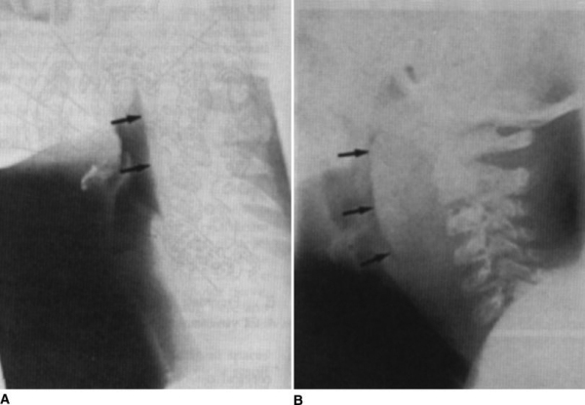
Deep neck space infections treatment
Usual pathogens
Oral streptococci and anaerobes
TTT
Merpenem or
Pipracillin
Clindamycin
Duration
2 weeks

Slide 16
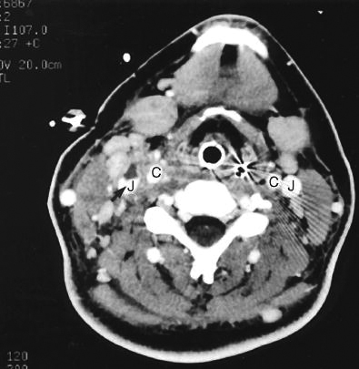
Other Infections
Lemierre’s syndrome
As a complication peritonsillar abscess or post-dental infection
Patient present with sore throat, fever and shock due IJV thrombophlebitis which leads to multiple septic emboli in the lung
Fusobacterium necrophorum
Medical TTT same as deep neck space infection
Venotomy if not respond to medical treatment

