Slide 1
Viral Infections of the Respiratory System
Dr. Abdulkarim Alhetheel
Assistant Professor
College of Medicine & KKUH

Slide 2
Outline
Introduction to respiratory viral infections
Characteristics of respiratory viruses
Mode of transmission
Clinical features
Lab diagnosis
Management & treatment

Slide 3
Respiratory Tract Infections
Are the commonest of human infections and cause a large amount of morbidity and loss of time at work (sick leave).
Are common in both children and adults.
Mostly caused by viruses.
Mostly are mild and confined to the upper respiratory tract (URT).
Mostly are self-limiting disease.
URT-infection may spread to other organs causing more severe infection and death.

Slide 4
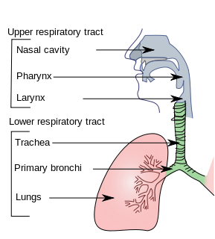
Clinical manifestations
Common cold (rhinitis).
Pharyngitis.
Tonsilitis.
Sinusitis & otitis media.
Croup (acute laryngotracheobronchitis).
Acute bronchitis.
Acute bronchiolitis.
Viral pneumonia.

Slide 5
The common respiratory viruses.
Name of the virus | Family | Disease
1-Influenza virus | Orthomyxoviridae | URT & LRT infection
2-Parainfluenza virus | Paramyxoviridae | URT & LRT infection
3-Respiratory syncytial virus | Paramyxoviridae | LRT infection
4-Rhinovirus | Picornaviridae | URT infection
5-Coronavirous | Coronaviridae | URT & LRT infection
6-Adenovirus | Adenoviridae | URT and eye infections
7-Human metapneumovirus | Paramyxoviridae | LRT infection
Upper respiratory tract infection includes: rhinitis (common cold), tonsillitis, pharyngitis.
Lower respiratory tract infection includes: croup, bronchitis, bronchiolitis, pneumonia.

Slide 6
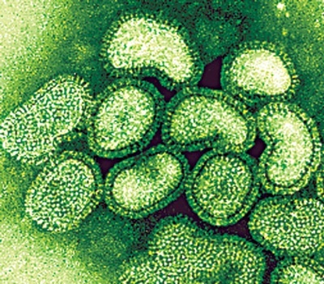
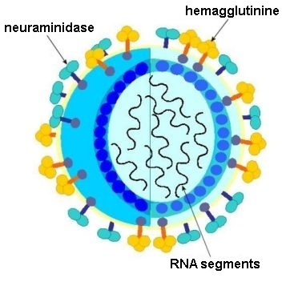
1- Influenza Virus
Family: Orthomyxoviridae.
Structural features: Enveloped virus with 2 projecting glycoprotein spikes:
Haemagglutinin (H)
Neuraminidase (N)
Genome: 8 Segmented - polarity ssRNA.
This virus is highly susceptible to mutations and rearrangements within the infected host.

Slide 7
Influenza viral proteins
Haemagglutinin (H):
Attachment to the cell surface receptors.
Antibodies to the HA is responsible for immunity.
16 haemagglutinin antigenic type, H1 – H16.
Human associated H antigenic type are H1, H2, H3.
Neuraminidase (N):
Responsible for release of the progeny viral particles from the infected cell.
9 neuraminidase antigenic type, N1 – N9.
Human associated N antigenic type are N1, N2.

Slide 8
Types of influenza virus
A
Infects human and Animal
Causes epidemic & pandemic
Causes epizootic in animal
Antigenic drift minor change
Antigenic shift major change
B
Infects human only
Causes outbreak
Antigenic drift only
C
Infects human only
Causes mild illness

Slide 9
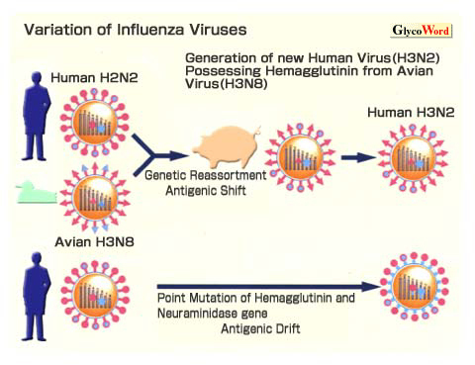

Slide 10
Influenza Virus
Divided into subtypes based on the haemagglutinine and neuraminidase proteins.
The currently circulating strains are: H1N1 & H3N2.
Pathogenesis: The virus infects the epithelial cells of the nose, throat, bronchi and occasionally the lungs.
Transmission: Inhalation of infectious aerosol droplets.
I.P.: 1-4 days.
Symptoms: Fever, malaise, headache, cough, chills, sore throat, and generalized pain.
Prognosis: Usually self-limiting disease.

Slide 11
Continued..
Complications: - Primary influenza pneumonia - 2nd bacterial pneumonia - Reye’s syndrome [fatty degeneration of CNS and Liver (Aspirin)]
Lab diagnosis: routine testing by Direct detection of Influenza A or B virus from sputum, nasopharyngeal swab, aspirate (NPA) or respiratory secretion by direct immunoflourecent assay (IFA).
Other detection methods: tissue culture, PCR.
Treatment:
1: Amantadine is effective against influenza A virus only.
2: Rimantadine, Oseltamivir (Tamiflu) or Zanamivir (Relenza) are effective against both influenza A & B viruses and can be used as treatment and prophylaxis.

Slide 12
Continued..
Prevention:
Influenza vaccine: Two types of vaccines available:
1- The flu shot vaccine: Inactivated (killed vaccine).
Given to people older than 6-months, including healthy people and those with chronic medical conditions.
2- The nasal spray flue vaccine (Flu mist): Live attenuated vaccine.
Approved for use in healthy people between 5-49 years of age.
Both vaccines contain two strains of the current circulating influenza A virus and the current circulating strain of influenza B virus.
Vaccine should be given in October or November, before the influenza season begins.

Slide 13
Avian flu
Viral etiology: Avian influenza type A virus (H5N1).
Family: Typical orthomyxovirus.
Epidemiology: Wild birds are the natural reservoir for the virus. They shed the virus in saliva, nasal secretion and feces.
All domestic poultry are susceptible to infection.
They become infected, when they eat food contaminated with secretion or excretion from infected bird.
Avian influenza viruses do not usually infect human.
High risk group includes those who working in poultry farms and those who are in close contact with poultry.

Slide 14
Continued..
Symptoms in human:
Ranges from typical flu to severe acute respiratory disease.
Diarrhea, abdominal pain and bleeding from the nose have been reported.
Treatment:
Should be initiated within 48 hours.
Oseltamivir and Zanamivir are used.
Lab diagnosis: PCR, detection of the viral RNA in throat swap.

Slide 15
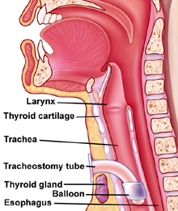
2- Parainfluenza Virus
Family: Paramyxoviridae.
Structural features: Enveloped virus with - polarity ssRNA genome, with 5 serotypes.
Transmission: Inhalation of infectious aerosol droplets mainly in winter.
Clinical syndrome:
Croup or acute laryngotracheobronchitis. PIV Type-I, II affect mainly in infants and young children. Fever, harsh cough, difficult inspiration can lead to airway obstruction which may require hospitalization and tracheostomy.
Bronchiolitis and Pneumonia: PIV Type-III in young children.

Slide 16
Continued..
Lab diagnosis: routine testing by Direct detection of the virus from sputum, nasopharyngeal swab, aspirate (NPA) or respiratory secretion by direct immunoflourecent assay (IFA).
Other detection methods: tissue culture, PCR.
Treatment and prevention: Supportive treatment, No specific treatment or vaccine available.

Slide 17
3- Respiratory Syncytial Virus (RSV)
Family: Paramyxoviridae.
Structural features: Enveloped virus with - polarity ssRNA genome.
Transmission: Inhalation of infectious aerosols mainly in winter.
Clinical syndromes:
Bronchiolitis: Life-threatening disease in infant especially under 6 month of life with respiratory distress and cyanosis can be fatal and can lead to chronic lung disease in later life.
Pneumonia: can also be fatal in infant.

Slide 18
Continued..
Lab diagnosis: routine testing by Direct detection of the virus from sputum, nasopharyngeal swab, aspirate (NPA) or respiratory secretion by direct immunoflourecent assay (IFA).
Other detection methods: Isolated of virus by cell culture from N.P.A with multinucleated giant cell or syncytia as cytopathic effect (C.P.E); PCR.
Treatment and prevention: Ribavirin administered by inhalation for infants with severe condition.
Vaccine: No vaccine available, but passive immunization immunoglobulin can be given for infected premature infants.

Slide 19
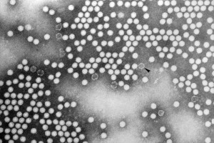
4- Rhinovirus
Family: Picornaviridae.
Structural features: Non-enveloped virus with + polarity ssRNA genome, more than 100 serotypes available.
Transmission: Inhalation of infectious aerosol droplets.
Clinical symptoms: The 1st cause of common cold. The main symptoms of common cold are sneezing, clear watery nasal discharge with mild sore throat, and cough.
Treatment and prevention: Usually self-limiting disease, no specific treatment, and no vaccine available.

Slide 20
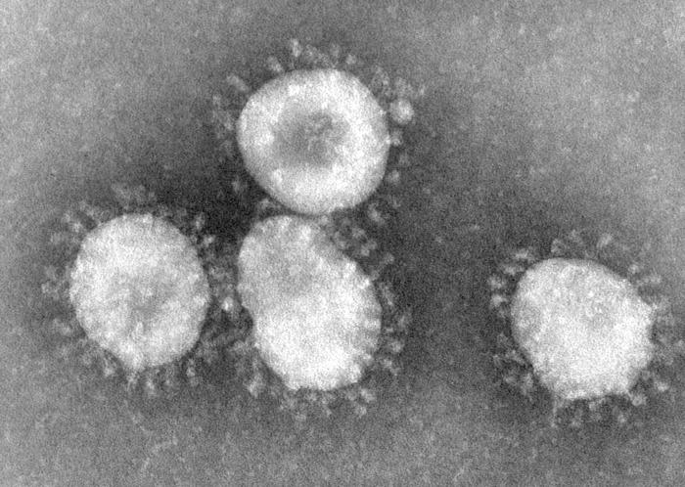
5- Coronavirus
Family: Coronaviridae.
Structural features: Enveloped virus with + polarity ssRNA genome.
Transmission: Inhalation of infectious aerosol droplets.
Clinical symptoms: The 2nd cause of common cold.
Corona virus can also cause severe respiratory diseases ( will be discussed in the 2nd lecture)
Lab diagnosis: PCR or Tissue culture.
Treatment and prevention: No specific treatment or vaccine available.

Slide 21
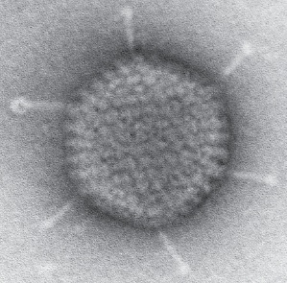
6- Adenovirus
Family: Adenoviridae.
Structural features: Non-enveloped virus with ds-DNA genome.
Pathogenesis: Adenovirus infects epithelial cell lining respiratory tract, conjunctiva, urinary tract, gastrointestinal tract and genital tract.
Clinical syndrome:
Phrayngitis and tonsilitis.
Pharyngioconjunctivitis
Conjunctivitis.
Pneumonia: in preschool children.
Gastroenteritis.
Acute hemorrhagic cystitis.
UTI (Cervicitis and urethritis).
Lab diagnosis: routine testing by Direct detection of the Ag from NPA by direct IFA. Other detection methods: tissue culture, PCR.
Treatment and prevention: No specific treatment or vaccine.

Slide 22
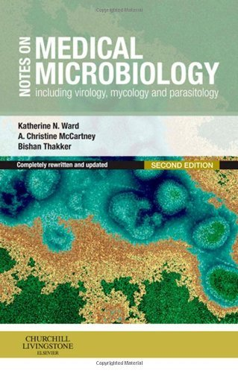
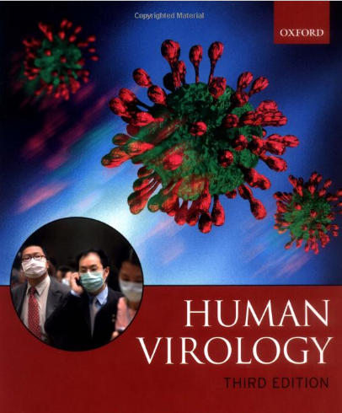
Reference books &the relevant page numbers
Notes on Medical Microbiology
By; Katherine N. Ward, A. Christine McCartney, and Bishan Thakker.
(2009)
Pages; 329-340.
Human Virology
By; Leslie Collier and John Oxford.
(2006)
Pages, 71-95.

Slide 23
Thank you for your attention!
Questions?

