Slide 1
MERS-CoV & other viruses transmitted by respiratory system
Dr. Abdulkarim Alhetheel
Assistant Professor
College of Medicine & KKUH

Slide 2
Outline
Introduction to severe respiratory viral infections and examples of childhood fever
Characteristics of MERS-CoV, Measles, Mumps, Parvovirus B19 viruses
Mode of transmission
Clinical features
Lab diagnosis
Management & treatment

Slide 3
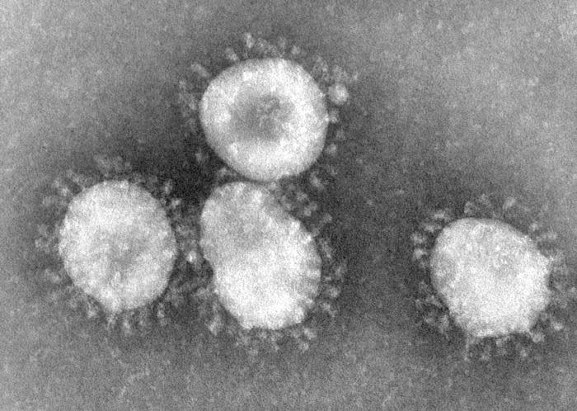
Severe forms Coronavirus
Family: Coronaviridae.
Structural features: Enveloped virus with + polarity ss-RNA genome.
Transmission: Inhalation of infectious aerosol droplets.
Clinical symptoms: The 2nd cause of common cold.
Coronavirus also causes zoonotic disease (the virus is capable of infecting humans and animals including birds, camels and others).

Slide 4
SARS-CoV
Severe Acute Respiratory Syndrome (SARS)
In winter of 2002, a new respiratory disease known as (SARS) emerged in China after a new mutation of coronavirus.
The disease spread worldwide due to travelling.
The animal reservoir may be bats.
SARS starts with high fever followed by cough with difficulty in breathing (atypical pneumonia).
Associated with high mortality due to respiratory failure.

Slide 5
MERS-CoV
Middle East Respiratory Syndrome (MERS) is viral respiratory illness first reported in Saudi Arabia in 2012. It is caused by a coronavirus.
Epidemiology: So far, all the cases have been linked to countries in and near the Arabian Peninsula.
Highly infectious, peak in winter.
Incubation period 2-14 days.
Transmission:
This virus spread from ill people to others through close contact, such as caring for or living with an infected person. However, there is no evidence of sustained spreading in community settings.
Evidence also suggested that the virus can be acquired from direct close contact with animals.

Slide 6
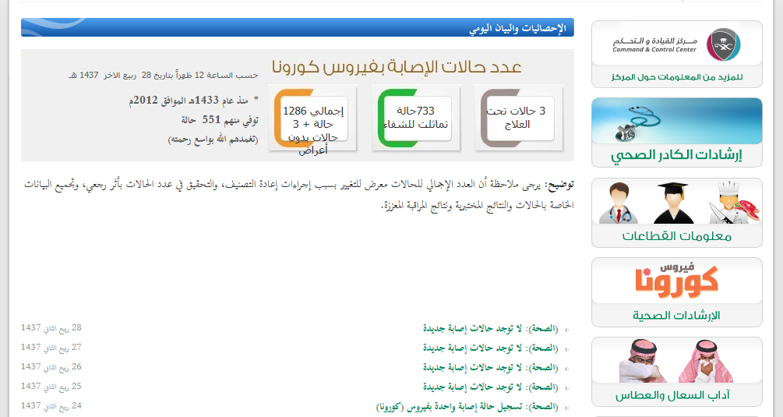

Slide 7
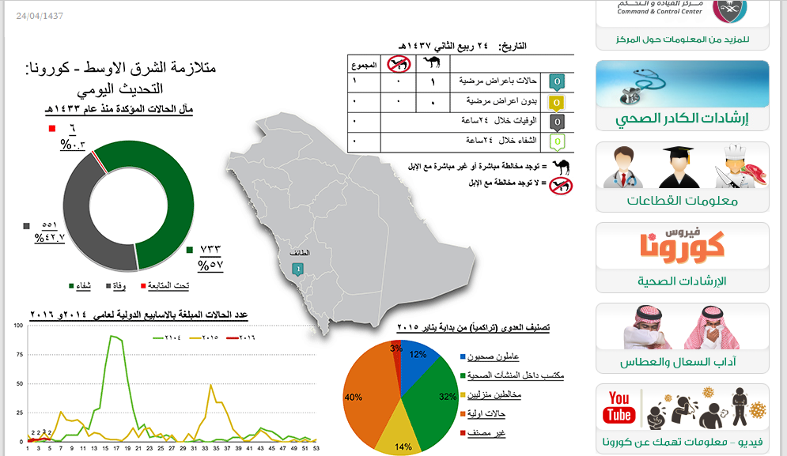

Slide 8
Clinical Features:
Most people with confirmed MERS-CoV infection developed severe acute respiratory illness.
They had fever, cough, and shortness of breath.
Some people also had gastrointestinal symptoms including diarrhea and nausea/vomiting.
Some infected people had mild symptoms (such as cold-like symptoms) or no symptoms at all and they recovered completely.
Complications:
Severe complications include pneumonia and kidney failure. About 30% of people with MERS died.
Most of the people who died had an underlying medical condition. People with pre-existing medical conditions (or comorbidities) such as diabetes, cancer, and chronic lung, heart, and kidney disease may be more likely to become infected with MERS, or have a severe case. Individuals with weakened immune systems are also at higher risk for getting MERS or having a severe case.

Slide 9
Lab diagnosis: Detection of the viral nucleic acid by PCR. Other methods: Serology by detection of IgM Ab, isolation of the virus from NPA by cell culture.
Treatment: No specific antiviral treatment. For severe cases, current treatment includes care to support vital organ functions.
Prevention:
People are advised to protect themselves from respiratory illnesses by taking everyday preventive actions:
• Wash your hands often with soap and water for 20 seconds, and use an alcohol-based hand sanitizer.
• Cover your nose and mouth with a tissue when you cough or sneeze, then throw the tissue in the trash.
• Avoid touching your eyes, nose and mouth with unwashed hands.
• Avoid personal contact, such as kissing, or sharing cups or eating with sick people.
• Clean and disinfect frequently touched surfaces such as toys and doorknobs.

Slide 10
Measles Virus
Family: Paramyxovidae.
Structural features: Enveloped virus with - polarity ss-RNA genome.
Transmission: Inhalation of infectious aerosol droplets.
Epidemiology: Measles virus infects human only.
Most cases in preschool children, very infectious, infection occurs mainly in winter and spring.
Pathogenesis:
The virus infects first epithetical cells of upper respiratory tract, then the virus spread to the blood causing viremia and infect the endothelial cells of blood vessels. The virus reaches the lymphoid tissue where it replicates further and disseminates to the skin causing maculopopular rash.

Slide 11
Clinical features:
I.P.: 7- 14 days.
Prodromal symptom: Fever, cough, conjunctivitis and running nose
Koplik’s spot: Small red papules with white central dots appear mostly in buccal mucosa.
Rash: Maculopapular rash first on face, trunk, extremities.
The rash is red, become confluent, last 4 or 5 days, then disappears leaving brownish discoloration of the skin and final desquamation.
Recovery complete in normal children with life long immunity.
Complication also can occur.

Slide 12
Koplik’s Spot

Slide 13
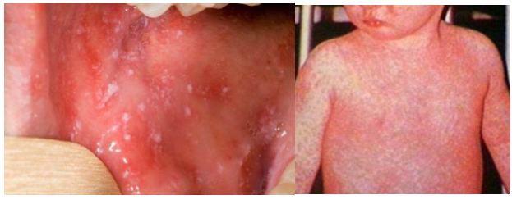
Measles

Slide 14
Complication:
1- Encephalitis: Acute or subacute sclerosing panencephalitis (SSPE)
2- Giant cell pneumonia: rare in immunocompromised children due to direct invasion of measles virus to the lung tissue.
Lab diagnosis: Serology by detection of IgM Ab, and in case of SSPE detection of measles antibodies in CSF or detection of viral NA using PCR.
Treatment and prevention: No specific treatment, Prevention by giving the live attenuated vaccine (MMR) for Measles, Mumps and Rubella (given to all children 15 month and booster dose at school entry). Give excellent long last protection.

Slide 15
Mumps Virus
Mumps: is an acute benign viral parotitis.
Parotitis (painful inflammation and swelling of salivary gland and mainly parotid glands), it is a disease of children (5-15 years), but also can be seen in young adult with more complicated feature.
Virology Aspect:
Family: Paramyxoviridae.
Structural features: Enveloped virus with - polarity ss-RNA genome.
The viral envelope is covered with two glycoprotein spikes, hemagglutinine and neuraminidase.
Transmission: Inhalation of infectious aerosol droplets during sneezing and coughing, direct contact with saliva.

Slide 16
Epidemiology: Mumps virus infects human only.
Highly infectious, peak in winter.
Long incubation period 18-21 days.
Pathogenesis:
Infection started in the epithelial cells of upper respiratory tract, then virus spread by viremia to parotid gland mainly and to other organs as: testes, ovaries, pancreas and CNS.
Clinical Features:
Classic mumps starts with moderate fever, malaise, pain on chewing or swallowing, particularly acidic liquids.
Sudden onset of fever and painful swelling of parotid gland.
Self-limiting disease resolve within one week.
Solid and long life immunity developed.

Slide 17
Complications:
Aseptic meningitis.
Encephalitis.
Pancreatitis.
Thyroiditis.
after puberty:
Orchitis: inflammation of one or both testicles. usually unilateral, rarely leads to sterility.
Oophoritis: inflammation of ovaries.
Lab diagnosis: Serology by detection of IgMAb, viral culture and isolation of the virus from saliva or detection of viral NA using PCR.
Treatment and prevention:
No specific antiviral treatment.
MMR: Live attenuated vaccine for Measles, Mumps and Rubella given to all children 15 month and booster dose at school entry. Give excellent long last protection.

Slide 18
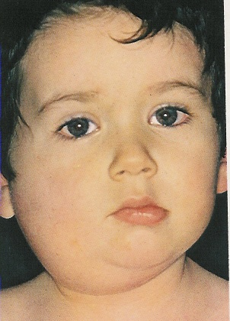
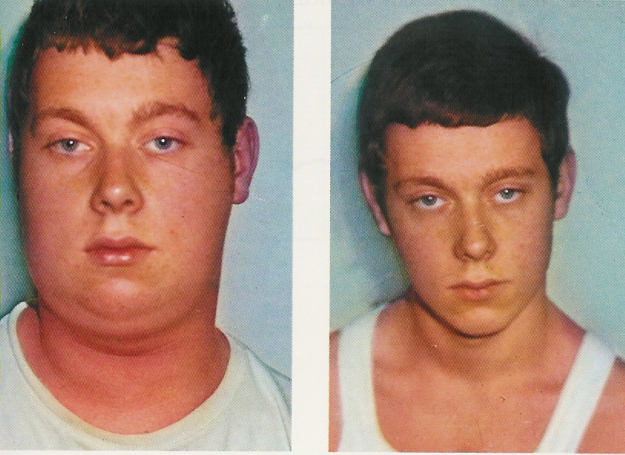
During Infection
After Recovery

Slide 19
Parvovirus B19
Family: Parvoviridae.
Structural features: Small unenveloped ss-DNA with icosahedral capsid. One antigenic type.
IP: 4-10 days.
Transmission: Inhalation of respiratory droplets, blood transfusion, mother to baby.
Epidemiology and target group: Worldwide and mostly in winter and spring season, Children (5-10 years).
The virus causes slapped cheek, erythema infectiosum, fifth disease.
Pathogenesis:
The virus infects the endothelial cells of the blood vessels in the skin, and the red blood cells precursors (erythroblast) in the bone marrow, which account for aplastic anemia.
Immunocomplexes may attribute to the development of the rash.

Slide 20
Clinical features:
The disease starts with fever, sneezing and coughing.
Followed by the development of the maculopapular rash.
The rash is red, confluent, fine, most intense on the cheek.
The rash may appear on the trunk and limbs.
Lesions fades from the center leaving the periphery red, developing characteristic reticular or lace-like pattern.
There is mild generalized lymphadenopathy.
Arthralgia with swelling and pain in the joints are seen in women.
Recovery: is complete.

Slide 21
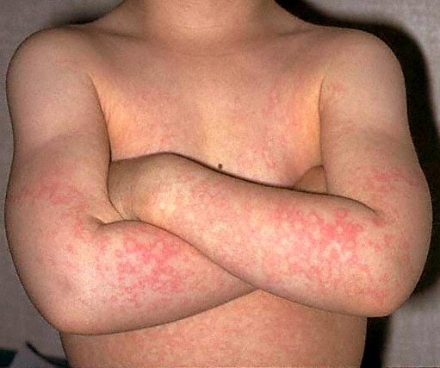
Slapped cheek / erythema infectiosum

Slide 22
Complications:
Aplastic crisis sudden and temporary disappearance of erythroblasts from the bone marrow, seen in patients with hemolytic anemia. The bone marrow does not produce RBC.
Chronic anemia occurs in the immunocompromised when the immune system is unable to produce antibodies to neutralize the virus.
Hydrops fetalis occurs during pregnancy when the mother become infected with parvovirus B19.
Lab diagnosis: detection of Ig-M antibody by ELISA or detection of viral NA using PCR.
Prevention: There is no vaccine available.
Treatment: There is no specific antiviral therapy.

Slide 23
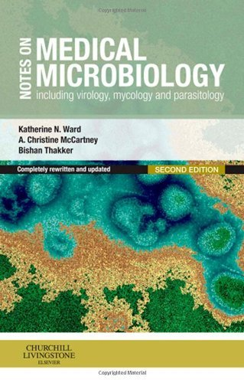
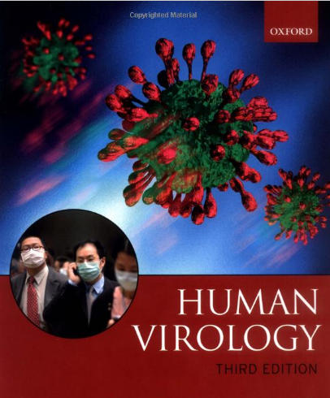
Reference books
Notes on Medical Microbiology
By; Katherine N. Ward, A. Christine McCartney, and Bishan Thakker.
(2009)
Human Virology
By; Leslie Collier and John Oxford.
(2006)

