Slide 1

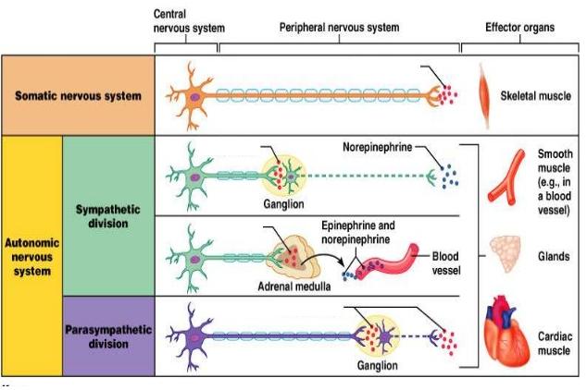
Anticholinergic Drugs
Neuromuscular blockers
Ganglionic blockers
Muscarinic blocker
Ach
Nn
Ganglionic blockers
Ganglionic blockers
M
Nm
Ach
Ach
Ach
Nn
Ach
Nn

Slide 2
Anticholinergic Drugs
Learninig Outcomes
Classify anticholinergic drugs
Outline pharmacodynamic actions of anticholinergic drugs
Discuss their pharmacokinetic properties
Define their clinical uses
List their ADRs & contraindications

Slide 3
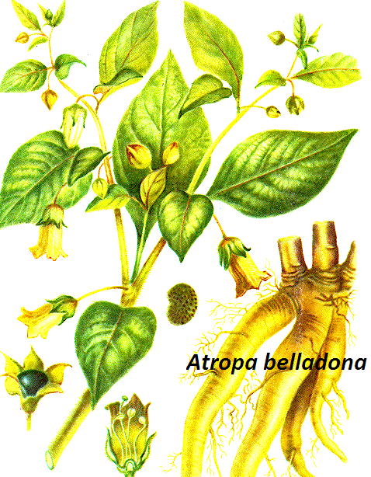
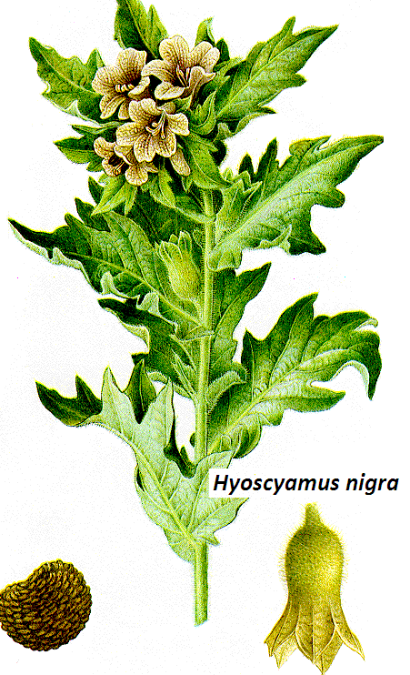
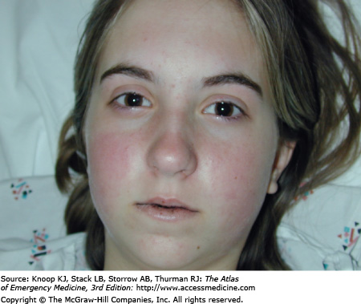
Anticholinergic Drugs
Antinicotinic Drugs
Antimuscarinic Drugs
According to source
Natural
Atropine
Hyoscine
According to structure
According to selectivity
Semisynthetic
Homatropine
Tertiary amines
Non-selective
Synthetic
Ipratropium, tropicamide
Quaternary ammonium
Propantheline
Selective
Pirenzepine(M1)

Slide 4
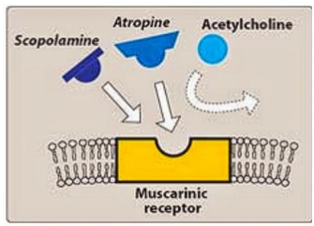
Mechanism of action
Competitively block muscarinic receptors
Salivary, bronchial, and sweat glands are most sensitive
Smooth muscle and heart are intermediate
Gastric glands and gastric smooth muscles are the least.

Slide 5
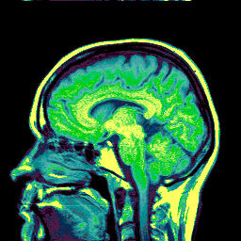
Pharmacodynamic Actions
CNS:-
Atropine at clinical dose, initial stimulation followed by slower longer –lasting sedative effect
Hyoscine →sedative effect
Atropine stimulates many medullary centers,
vagal, respiratory, and vasоmotor.
High doses of atropine cause cortical excitation, restlessness, disorientation, hallucinations, and delirium followed by respiratory depression and coma

Slide 6
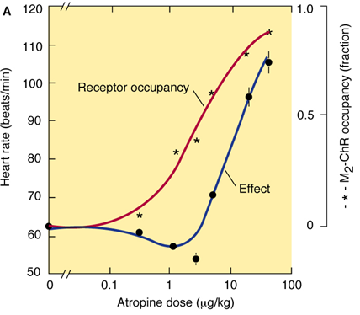
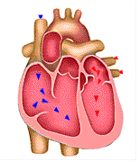
Pharmacodynamic Actions
CVS:-
Atropine causes tachycardia in isolated heart, due to blockade of M₂-receptors on SA node
In intact animals, initial bradycardia followed by tachycardia
Atropine shortens the refractory period of AV conduction
Atropine does not influence BP. It blocks the
vasodepressor action of cholinergic agonists

Slide 7
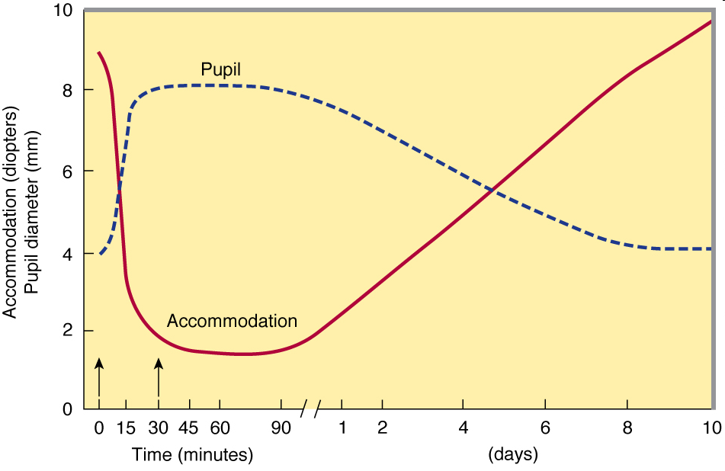
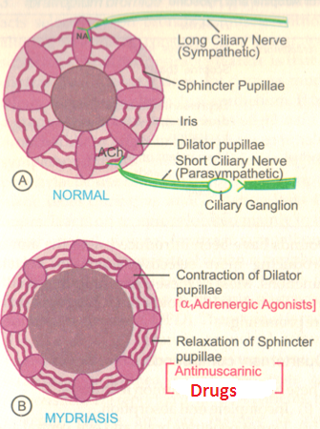
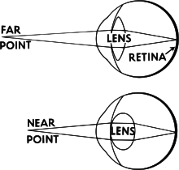

Pharmacodynamic Actions
Eye:-
Relaxes cilliary muscle abolition of light reflex & [cycloplagia].
Relaxes pupillae constrictor →mydriasis
Increase intraocular pressure
↓ Lachrymal secretions

Slide 8
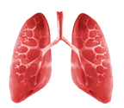
Pharmacodynamic Actions
Respiratory system
Atropine→ bronchodilation &↓ of secretion

Slide 9
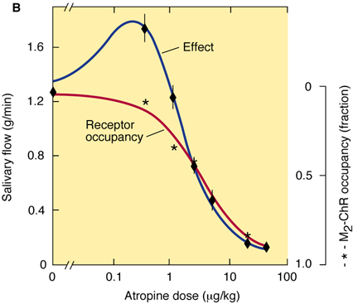
Pharmacodynamic Actions
GIT:-
↓Motility
↓ Secretion.

Slide 10
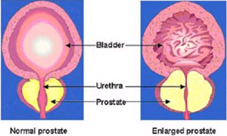
Pharmacodynamic Actions
Genitourinary tract:-
Atropine has relaxant action on the uriters & bladder wall
Urinary retention can occur in older men with
prostatic hyperplasia.

Slide 11
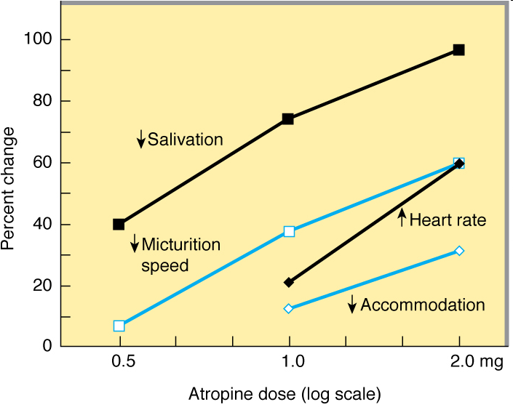
Pharmacodynamic Actions
Summary of Effects
Sweat glands:-
Atropine decreases sweat secretion (M₃-blockade)
In children modest doses →”atropine fever”

Slide 12
Pharmacokinetics
Atropine and hyoscine are rapidly absorbed from the GIT
When applied to the eyes they penetrate the cornea.
Passage of atropine across BBB is restricted.
50% of atropine is metabolized in the liver and excreted unchanged in urine.
Atropine has t_{1/2 of} 3–4 h
Hyoscine is more completely metabolized and has better BBB penetration.

Slide 13
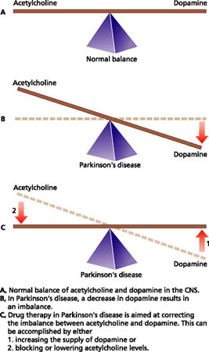
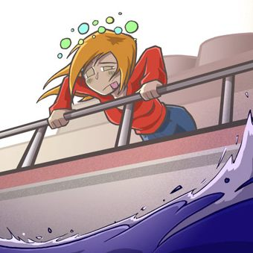
Clinical Uses
CNS:-
i-Parkinsonism:-
Benzhexol, benztropine
ii-Motion sickness
Hyoscine

Slide 14
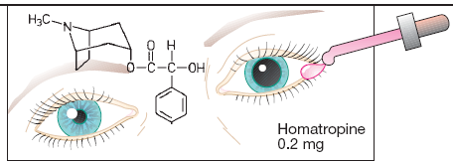
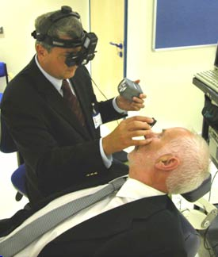
Clinical Uses
Ophthalmic disorders:-
Ophthalmoscopic examination of retina

Slide 15
Clinical uses
GIT:-
Biliary & renal colic.
Ulcer Pirenzepine
Urinary urgency caused by minor inflammatory bladder disorders. Urinary incontinence (oxybutynin)
Irritable bowel syndrome, colonic diverticular disease e.g. dicyclomine
Traveler's diarrhoea with opioid [Atropine + diphenoxylate ]

Slide 16
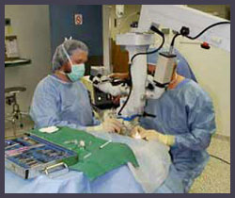
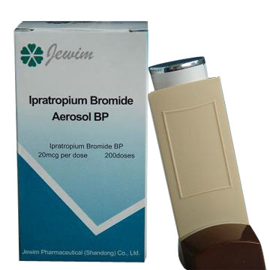
Clinical Uses
Respiratory disorders:-
Bronchial asthma & chronic obstructive pulmonary disease (COPD)
Pre- operative medication when anaesthetic →↑secretion & laryngospasm
Ipratropium(inhalation)
Hyoscine→ amnesia,

Slide 17
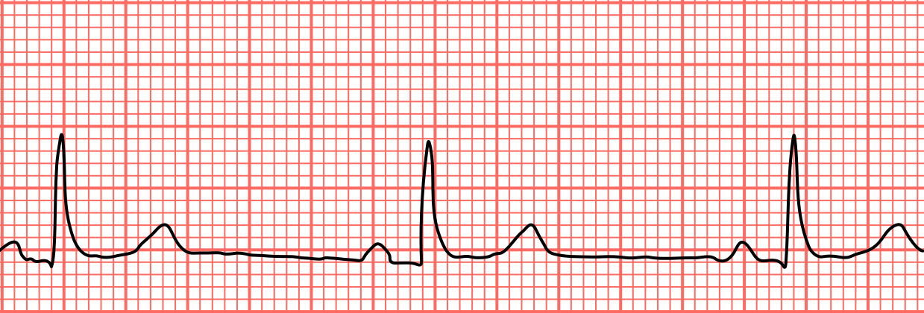
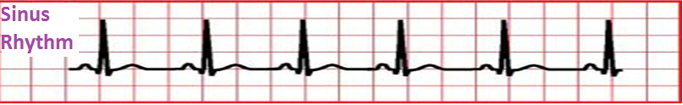
Clinical Uses
Cardiovascular effects:-
Pain of myocardial infarction → depression of SA, AV node
Sinus bradycardia

Slide 18
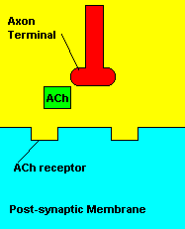
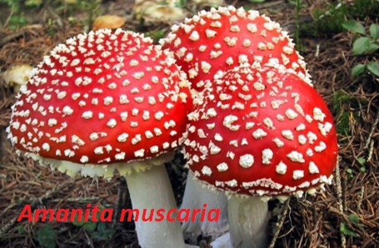
Clinical Uses
Cholinergic poisoning:-
Cholinesterase inhibitors “insecticides”.
Mushroom poisoning.

Slide 19
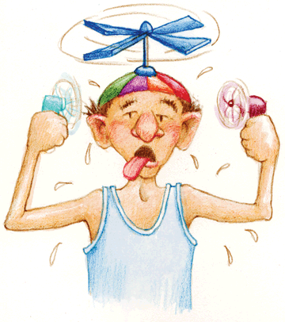
Clinical Uses
Hyperhydrosis:-

Slide 20
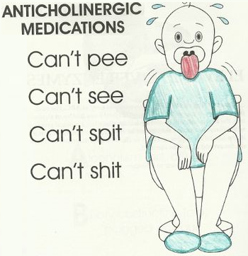
Adverse Effects
Mydriasis, blured vision
Confusion, agitation, delirium
Dry mouth , hot flushed skin,
Constipation, urinary retention
Tachycardia
↑ Body temperature

Slide 21

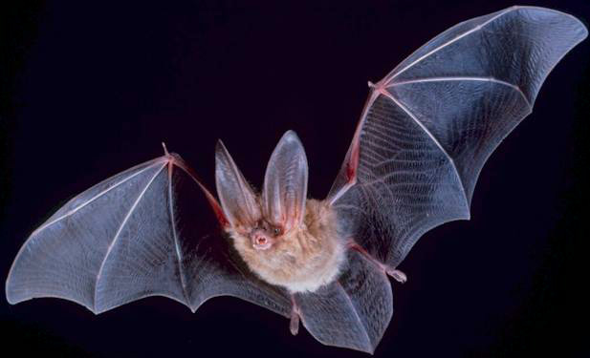
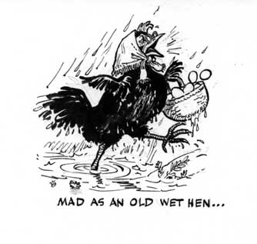
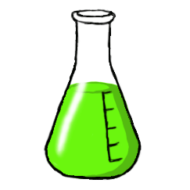
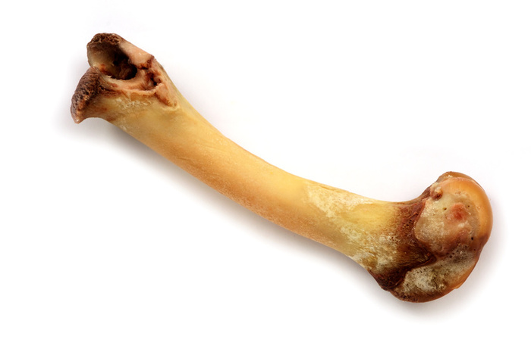
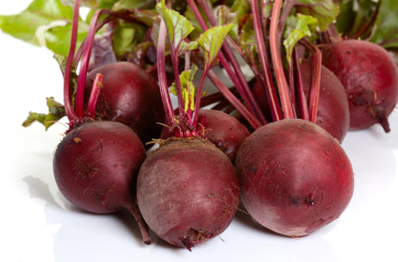
The Mnemonic
Red as a beet
Mad as a hen
Dry as a bone
Full as a Flask
Blind as a bat
Hot as Hell fire

Slide 22
Contra-indications
Glaucoma
Elderly people with prostatic hypertrophy
Tachycardias secondary to thyrotoxicosis or cardiac insufficiency
GI obstructive disease
Paralytic ileus.
Non selective M blockers →ulcer

Slide 23
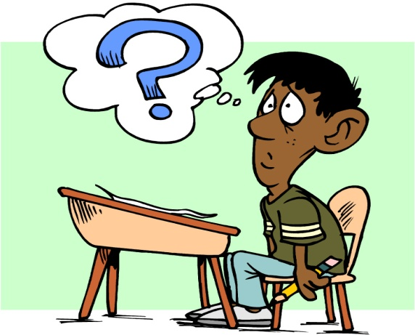
Quiz 1?
A patient is brought into the emergency room. Upon examination you find the following: a high fever, rapid pulse, no bowel sounds and dilated pupils that do not respond to light. His lungs are clear. His face is flushed and his skin is dry. He is confused, disorientated and reports 'seeing monsters'. Based on these symptoms, you suspect he has been 'poisoned'. Which of the following, is the MOST obvious cause of poisoning?
A. Neostigimine
B. Physostigmine
C. Atropine sulfate
D. Acetylcholine

Slide 24
Quiz 2?
You are working in the post anesthesia care unit of a hospital. You have just received a patient back from surgery and you are monitoring his status. Knowing that the patient has received atropine, which of the following statements/observations is UNEXPECTED?
A. The patient is complaining of extreme thirst.
B. The patient complains he is unable to clearly see
the clock located just across from him.
C. The patient's heart rate is elevated.
D. The patient reports he has cramping and diarrhea.

