Slide 1
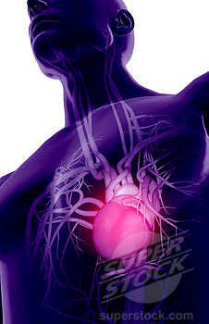
Major Blood Vessels
By Drs. Sanaa Alshaarawy & Khaleel Alyahya.

Slide 2
Objectives
At the end of the lecture, the student should be able to:
Define the veins, and understand the general principle of the venous system.
Describe the superior & inferior Vena Cava and their tributaries.
List major veins and their tributaries in the body.
Describe the Portal Vein.
Describe the Portocaval Anastomosis.

Slide 3
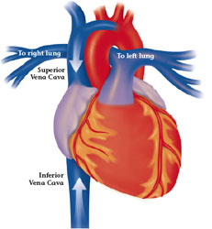
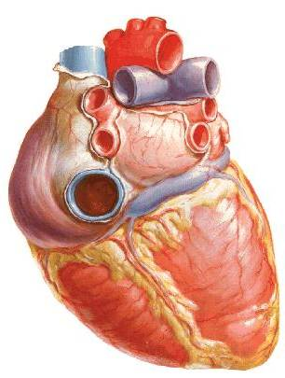
Veins
Veins are blood vessels that bring blood back to the heart.
All veins carry deoxygenated blood
  with the exception of the pulmonary veins and umbilical veins.
There are two types of veins:
  Superficial veins: close to the surface of the body
    NO corresponding arteries
  Deep veins: found deeper in the body
    With corresponding arteries
Veins of the systemic circulation:
  Superior and inferior vena cava with their tributaries
Veins of the portal circulation:
  Portal vein

Slide 4
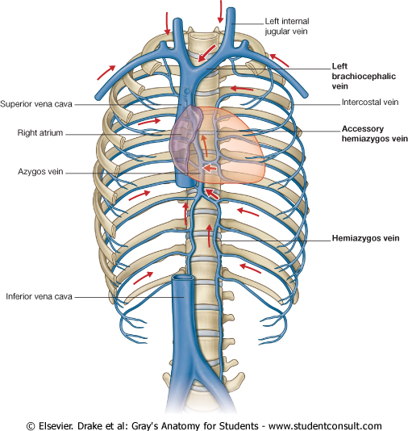
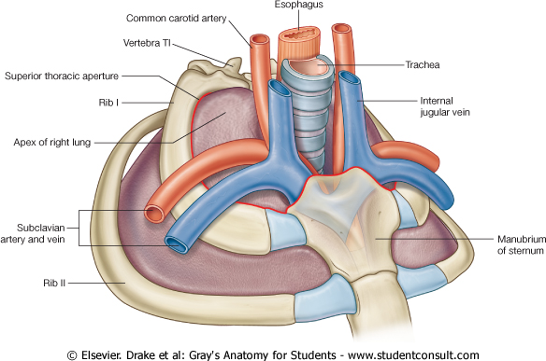
Superior Vena Cava
Formed by the union of the right and left Brachiocephalic veins.
  Brachiocephalic veins are formed by the union of internal jugular and subclavian veins.
Drains venous blood from:
  Head &neck
  Thoracic wall
  Upper limbs
It Passes downward and enter the right atrium.
Receives azygos vein on the posterior aspect just before it enters the heart.

Slide 5
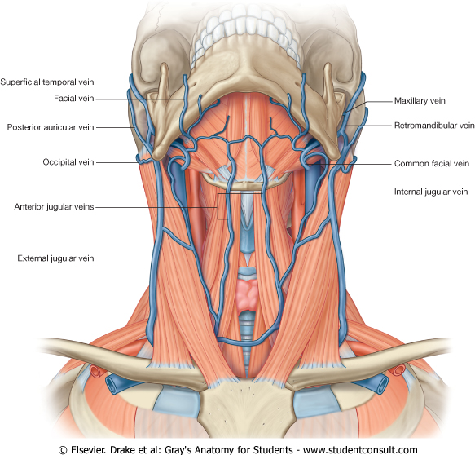
Veins of Head & Neck
Two divisions:
  Superficial Veins
    External Jugular veins
    Anterior jugular veins
  Deep Veins
    Internal Jugulars veins.

Slide 6
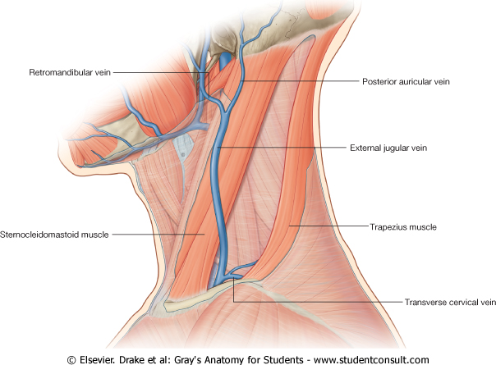
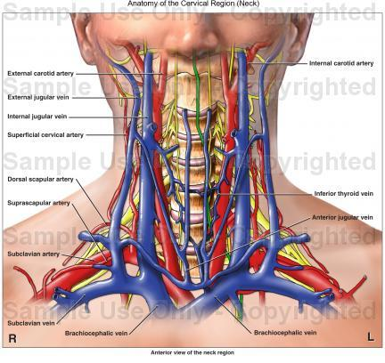
Superficial Veins of Head & Neck
External Jugular Veins:
  Lies superficial to the sternomastoid muscle
  It passes down the neck and it is the only tributary of the subclavian vein.
  It drains blood from:
    Outside of the skull
    Deep parts of the face.

Slide 7
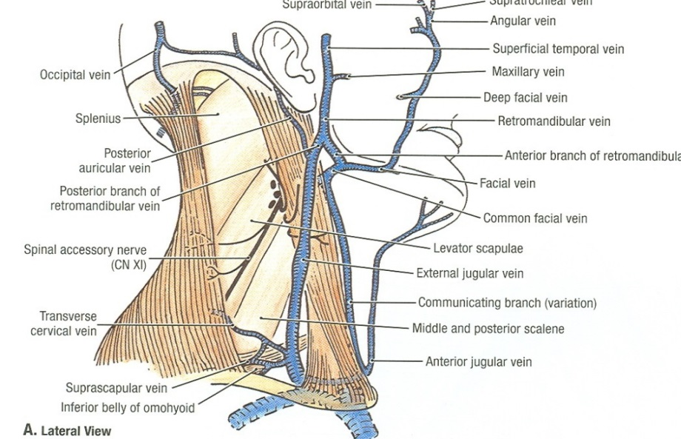
Superficial Veins of Head & Neck
Anterior jugular veins:
  It begins in the upper part of the neck by the union of the submental veins.
  It descends close to the median line of the neck, medial to the sternomastoid muscle.
  At the lower part of the neck, it passes laterally beneath that muscle to
  drain into the external jugular vein.
  Just above the sternum the two anterior jugular veins communicate by a transverse vein to form the jugular arch.

Slide 8
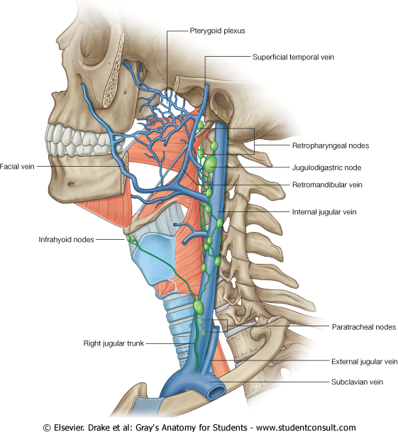
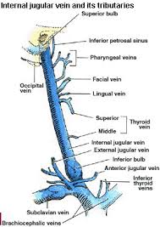
Deep Veins of Head & Neck
Internal Jugular vein:
  Drains blood from the brain,face, head & neck.
  It descends in the neck along with the internal and common carotid arteries and vagus nerve, within the carotid sheath.
  Joins the subclavian vein to form the brachiocephalic vein.
  Tributaries:
    Superior thyroid
    Lingual
    Facial
    Pharyngeal.
    Occipital veins
    Dural venous sinuses (inferior petrosal
    sinus).

Slide 9
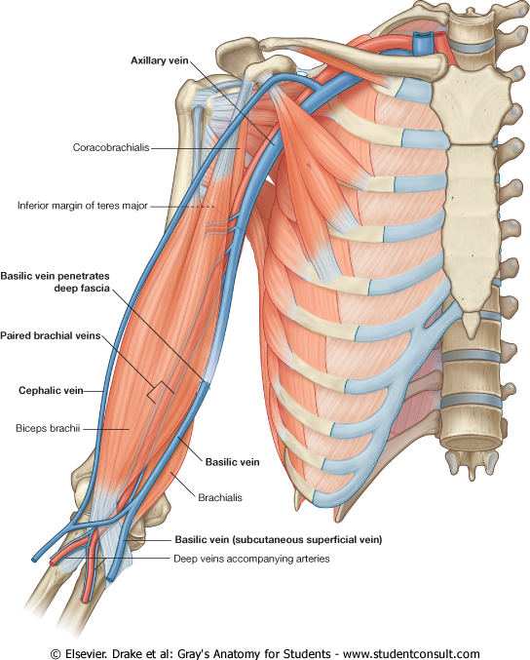
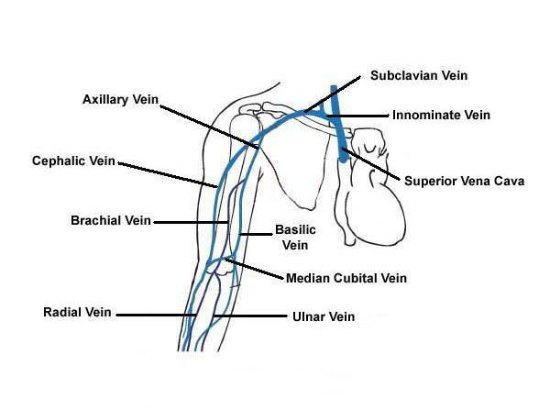
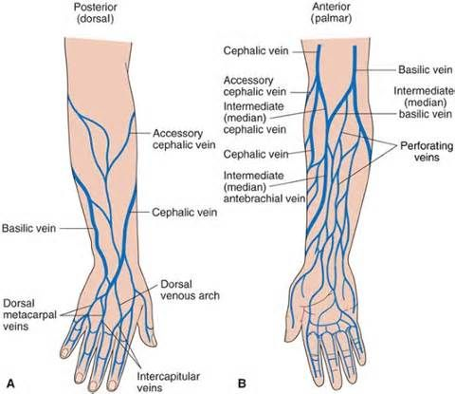
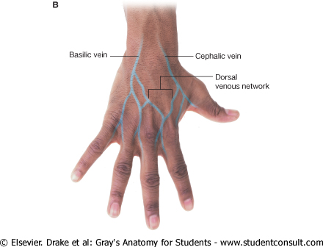
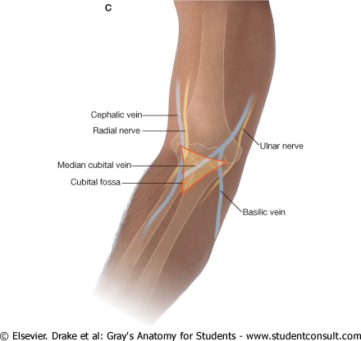
Veins of Upper Limbs
Two divisions:
  Superficial Veins
  Deep Veins

Slide 10
Veins of Upper Limbs
  Superficial Veins
  Cephalic vein
    Ascends in the superficial fascia
    on the lateral side of the biceps.
    Drains into the Axillary vein.
  Basilic vein
    Ascends in the superficial fascia
    on the medial side of the biceps.
    Halfway up the arm, it pierces
    the deep fascia
    At the lower border of the
    teres major it joins the
    venae comitantes of the
    brachial artery to form the
    Axillary vein.

Slide 11
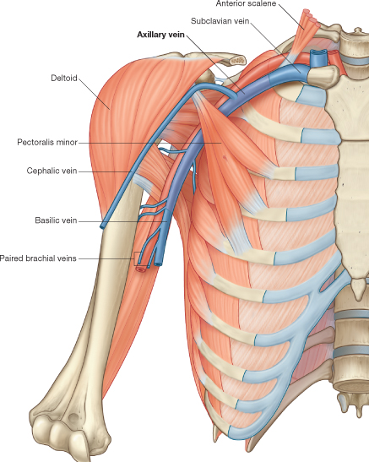
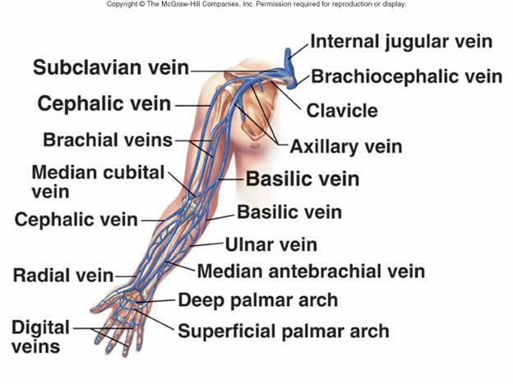
Veins of Upper Limbs
  Deep Veins
  Venae commitantes
    Which accompany all the large arteries, usually in pairs.
  Axillary vein
    Formed by the union of basilic vein and the venae comitantes of the brachial artery.

Slide 12
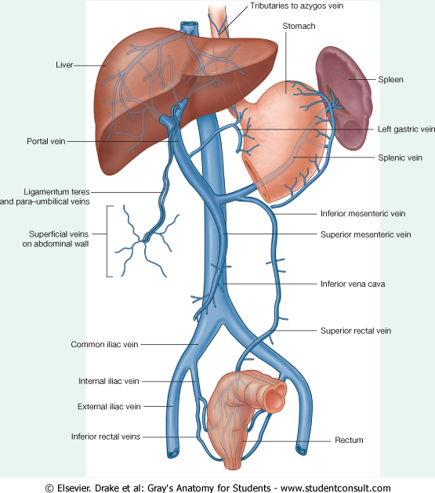
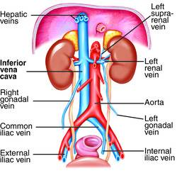
Inferior Vena Cava
Drains most of the blood from the body below the diaphragm to the right atrium.
Formed by the union of the 2 common iliac veins behind the right common iliac artery at the level of the 5th lumbar vertebra.
Ascends on the right side of the aorta
Pierces the central tendon of diaphragm at the level of the 8th thoracic vertebra.
inferior vena cava

Slide 13
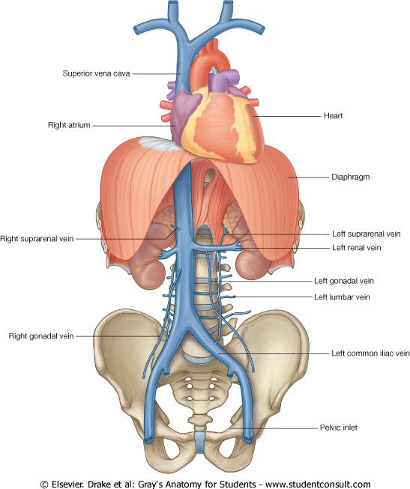
Tributaries of Inferior Vena Cava
Two common iliac veins
Median sacral vein
Four paired lumbar veins
Right gonadal vein
  the left vein drains into the left renal vein
Paired renal veins
Right suprarenal vein
  the left vein drains into the left renal vein
Hepatic veins
Paired inferior phrenic vein

Slide 14
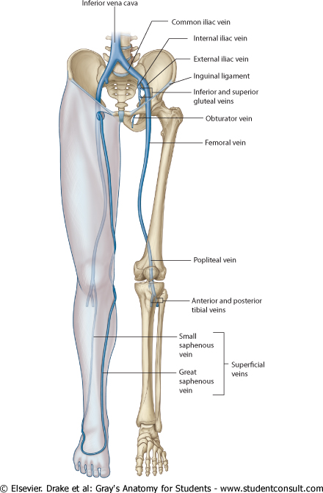
Veins of Lower Limbs
Two divisions:
  Superficial Veins
  Deep Veins

Slide 15
Veins of Lower Limbs
  Superficial Veins
  Form a network in the subcutaneous tissue.
  Pattern is variable
  They are the tributaries of the:
    Great (long) saphenous vein
    Small (short) saphenous vein

Slide 16
Great Saphenous Vein
  The longest vein
  Begins from the medial end of the dorsal venous arch of the foot.
  Passes upward in front of the medial malleolus with the saphenous nerve.
  Then it ascends in accompany with the saphenous nerve in the superficial fascia over the medial side of the leg.

Slide 17
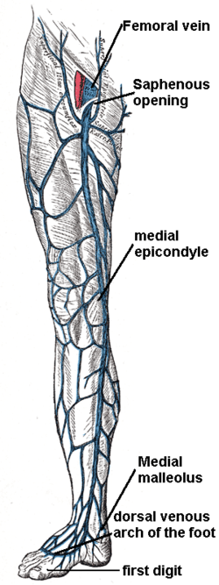
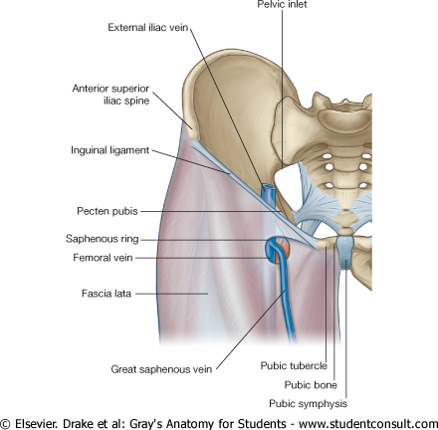
Great Saphenous Vein
  Ascends obliquely upwards, and lies behind the medial border of the patella.
  Passes behind the knee and curves forward around the medial side of the thigh.
  Hooks through the lower part of the saphenous opening in the deep fascia to join the femoral vein about 1.5 in. (4 cm) below and lateral to the pubic tubercle.

Slide 18
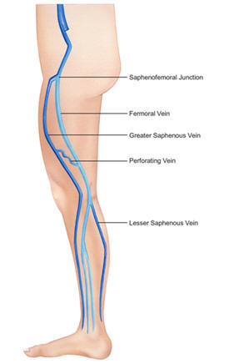
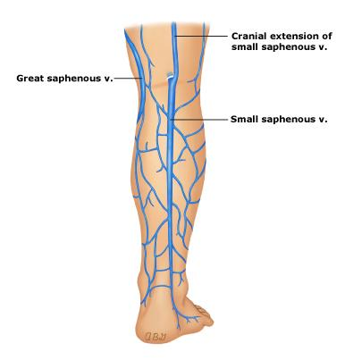
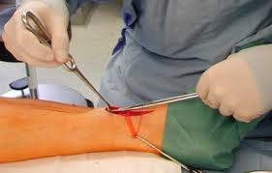
Great Saphenous Vein
It is connected to the small saphenous vein by one or two branches that pass behind the knee.
Numerous perforating veins connect the great saphenous vein with the deep veins (femoral vein)
The perforating veins have valves which allow blood flow from superficial to deep veins.
The great saphenous vein is used in venous grafting and saphenous vein cutdown (take care of the saphenous nerve)
Surgically, the great saphenous vein can be harvested and used as a vessel in coronary artery bypasses.

Slide 19
Small Saphenous Vein
Arises from the lateral end of the dorsal venous arch.
Ascends behind the lateral malleolus in company with the sural nerve.
Follows the lateral border of the tendocalcaneus and then runs up to the middle of the back of the leg.
  Pierces the deep fascia in the lower part of the popliteal fossa
  Drains into the popliteal vein
  Has numerous valves along its course.
  Anastomosis freely with great saphenous vein.

Slide 20
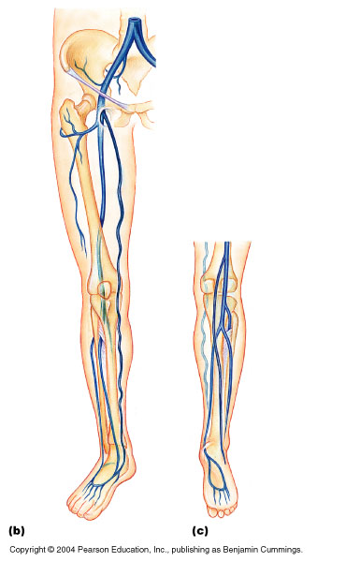
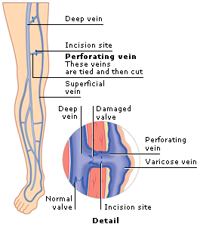
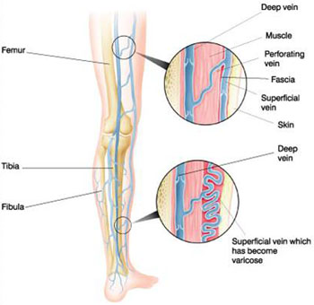
Veins of Lower Limbs
  Deep Veins
  Comprise the venae comitantes, which accompany all the large arteries, usually in pairs.
  Venae comitantes unite to form the popliteal vein, which continues as the femoral vein.
  Receive blood from superficial veins through perforating veins.
External iliac
vein
Femoral vein
Popliteal vein

Slide 21
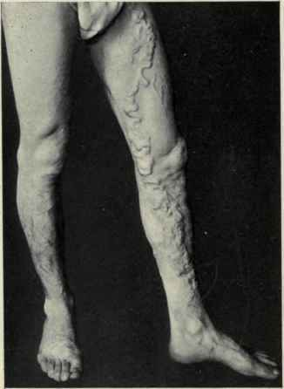
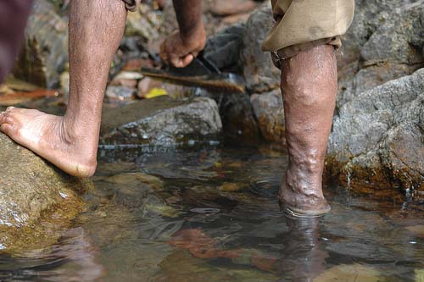
Mechanism of Venous Return from Lower Limb (FYI)
Much of the saphenous blood passes from superficial to deep veins through the perforating veins
The blood is pumped upwards in the deep veins by the contraction of the calf muscles (calf pump).
This action of ‘calf pump’ is assisted by the tight sleeve of deep fascia surrounding these muscles.
Vericose veins: If the valves in the perforating veins become incompetent, the direction of blood flow is reversed and the superficial veins become varicosed. Most common in posterior & medial parts of the lower limb, particularly in old people.

Slide 22
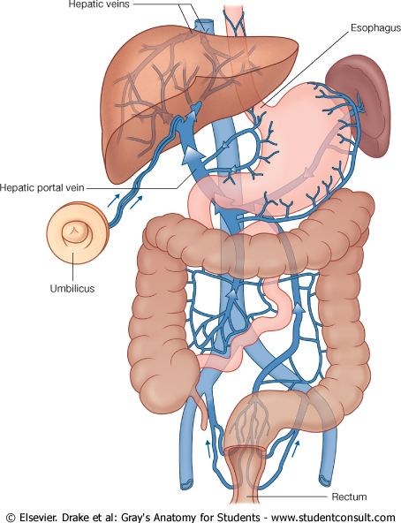
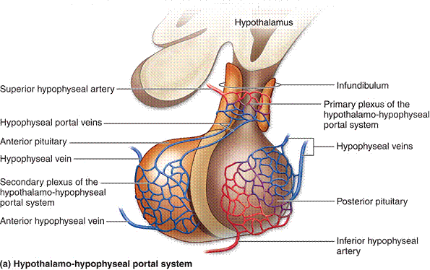
Portal Circulation
A portal venous system is a series of veins or venules that directly connect two capillary beds.
Examples of such systems include the hepatic portal system and hypophyseal portal system.

Slide 23
Hepatic Portal Vein
Drains blood from the gastrointestinal tract and spleen
It is formed by the union of the superior mesenteric and splenic veins.
Immediately before reaching the liver, the portal vein divides into right and left that enter the liver.
Tributaries:
right and left Gastric veins.
cystic vein.
para-umbilical veins

Slide 24
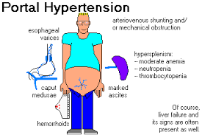
Portocaval Anastomosis
A portacaval anastomosis (also known as portal systemic anastomosis) is a specific type of anastomosis that occurs between the veins of portal circulation and those of systemic circulation.
The anastomotic channels become dilated (varicosed) in case of portal hypertension.

Slide 25
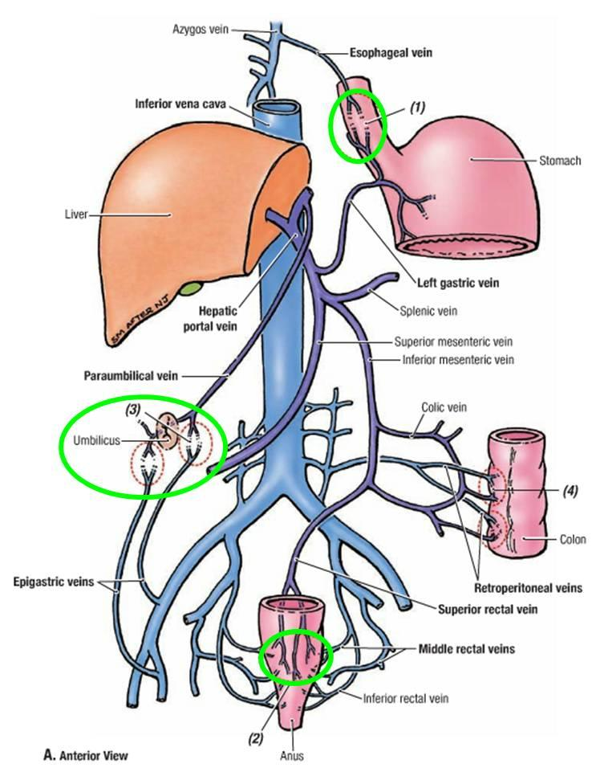
Sites of Portocaval Anastomosis
Lower end of esophagus:
(esophageal varices) left gastric vein & azygos vein.
Lower part of rectum: (Hemorrhoids) superior rectal vein & middle rectal and inferior rectal veins.
Para umbilical region: (Caput Medusae) Para umbilical veins & superficial epigastric vein
Retroperitoneal: colic Veins & veins of the posterior abdominal wall
Patent ductus venosus: (intrahepatic)
Left branch of portal vein & inferior vena
cava.

Slide 26

QUESTION?

