Slide 2
Lipoprotein Metabolism
By
Reem M. Sallam, M.D., MSc., Ph.D.

Slide 3
Introduction
Lipid compounds:
Relatively water insoluble
Therefore, they are transported in
plasma (aqueous) as Lipoproteins

Slide 4
Lipoproteins and Related Clinical
Problems
Atherosclerosis and hypertension
Coronary heart diseases
Lipoproteinemias (hypo- and hyper-)
Fatty liver

Slide 5
Lipoprotein Structure
Protein part: Apoproteins or apolipoproteins
Abbreviations: Apo-A, B, C, D, E Functions:
Structural and transport function
Enzymatic function Ligands for receptors
Lipid part:
According to the type of lipoproteins
Different lipid components in various combinations

Slide 6
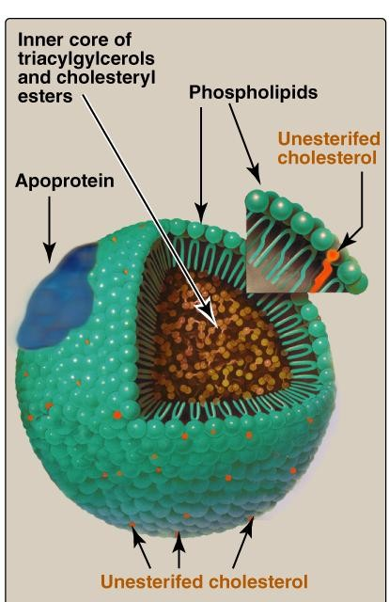
Spherical molecules of lipids and proteins (apoproteins)
Outer coat:
Apoproteins
Phospholipids
Cholesterol (Unesterified)
Inner core:
TG
Cholesterol ester (CE)
Lipoprotein Structure

Slide 7
Types of Lipoproteins
What’s different in various types of
lipoproteins?
They differ in lipid and protein composition
and therefore, they differ in
Size and density
Electrophoretic mobility

Slide 8
Chylomicrons
Very low density Lipoprotein (VLDL)
Low density Lipoprotein (LDL)
High density Lipoprotein (HDL)
Types and Composition of Lipoproteins

Slide 9
Ultracentrifugation of
Lipoproteins

Slide 10
Lipoprotein Electrophoresis

Slide 11
Plasma Lipoproteins
For triacylglycerol transport (TG-rich):
Chylomicrons: TG of dietary origin
VLDL: TG of endogenous (hepatic) synthesis
For cholesterol transport (cholesterol-rich):
LDL: Mainly free cholesterol
HDL: Mainly esterified cholesterol

Slide 12
Chylomicrons
Assembled in intestinal mucosal cells
Lowest density
Largest size
Highest % of lipids and lowest % proteins
Highest triacylglycerol (dietary origin)
Carry dietary lipids to peripheral tissues
Responsible for physiological milky appearance of plasma (up to 2 hours after meal)

Slide 13
Very Low Density Lipoproteins
VLDLs
Assembled in liver
High triacylglycerol (hepatic origin)
Carry lipids from liver to peripheral tissues
Nascent VLDL: contains Apo B-100
Mature VLDL:
Apo B-100 plus
Apo C-II and Apo E
(from HDL)

Slide 14
Metabolism of VLDLs
Assembled and secreted by liver
Mature VLDLs in blood
Modifications of circulating VLDLs
End products: IDL and LDL
Related diseases:
Hypolipoproteinemia: Abetalipoproteinemia
Hyperlipoproteinemias:
Type I hyperlipoproteinemia
Familial type III hyperlipoproteinemia

Slide 15
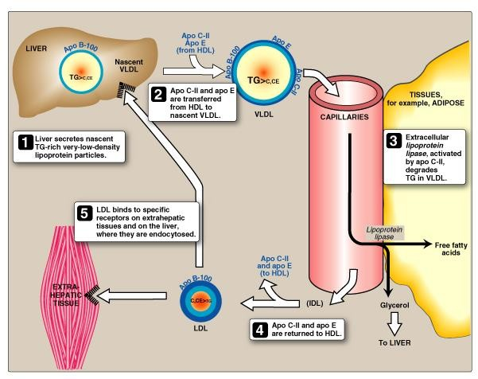
VLDL Metabolism

Slide 16
Metabolism of VLDLs: Mature VLDLs
Assembled and secreted by liver directly into blood as nascent form
Mature VLDLs: contain Apo B-100 plus Apo C-II and Apo E. ApoC-II is required for activation of lipoprotein lipase
Lipoprotein lipase is required to degrade TG into glycerol and fatty acids

Slide 17
Lipoprotein lipase
Extracellular enzyme, anchored by heparan sulfate to the
capillary walls of most tissues
Predominantly present in adipose tissue, cardiac & skeletal muscle
Requires ApoC-II for activation
Degrades TG into glycerol and free fatty acids
Insulin stimulates its synthesis and transfer to the luminal
surface of the capillary
If deficient (or if apo C-II is deficient) → type 1 hyperlipoproteinemia = familial lipoprotein lipase deficiency)

Slide 18
Modifications of Circulating VLDLs
Degradation of TG by lipoprotein lipase →, VLDLs become
Smaller in size
More dense
Apo C & Apo E return back to HDL
Some TG are transferred from VLDL to HDL in exchange with cholesterol ester (By cholesterol ester transfer protein)
VLDL IDL (returns Apo E to HDL) LDL

Slide 19
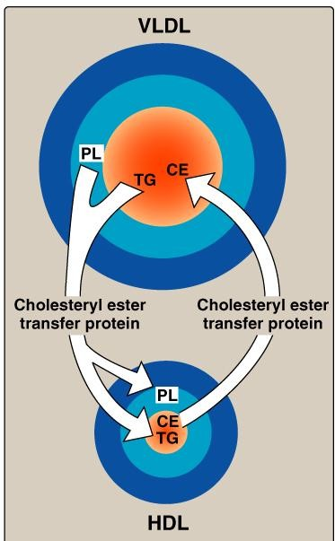
Lipid-Transfer Protein

Slide 20
VLDLs-Related Diseases
1- Hypolipoproteinemia
Abetalipoproteinemia
Defect in TG-transfer protein
Apo B-100 cannot be loaded with lipid
Accumulation of TG in liver
2- Fatty Liver (hepatic steatosis)
Imbalance between hepatic synthesis of TG
and secretion of VLDLs.
Accumulation of TG in liver

Slide 21
VLDLs-Related Diseases, continued…
3- Hyperlipoproteinemia
Type I Hyperlipoproteinemia
Familial Lipoprotein lipase deficiency
Due to deficiency of lipoprotein lipase or its cofactor
(Apo C-II)
Shows a dramatic accumulation (≥1000 mg/dl) of chylomicrons in plasma
Usually associated with acute abdomen due to acute pancreatitis
↑ plasma TG even in the fasted state Type III Hyperlipoproteinemia
•
•
•
(Familial dysbetalipoproteinemia)
due to Apo E deficiency
Associated with hypercholesterolemia & premature
atherosclerosis

Slide 22
THANK YOU ☺

