Slide 2
Lipoproteins and Atherosclerosis
By
Reem M. Sallam, M.D.,MSc, Ph.D.

Slide 3
Introduction
A key element for cholesterol homeostasis is the balance between:
Cholesterol transport from liver to peripheral
tissues by LDL (bad cholesterol carrier)
Reverse cholesterol transport from peripheral
tissues to liver by HDL (good cholesterol carrier)
Imbalance results in cholesterol deposition in the wall of blood vessels, thickening of the wall and narrowing of the lumen “Atherosclerosis”

Slide 4
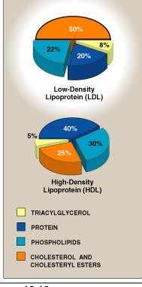
Composition of LDL and HDL
Low density lipoprotein (LDL) Mostly free cholesterol
High density lipoprotein (HDL) Mostly cholesterol ester More % protein
More % phospholipids

Slide 5
Low Density Lipoproteins (LDL)
Produced in the circulation as the end product of VLDLs Compared to VLDLs:
It contains only apo B-100 Smaller size and more dense Less TG
More cholesterol & cholesterol ester
Transport cholesterol from liver to peripheral tissues Uptake of LDL at tissue level by
LDL receptor-mediated endocytosis
Recognized by apo B-100

Slide 6
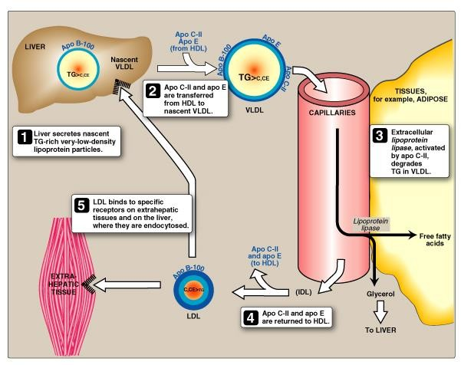
LDL Metabolism

Slide 7
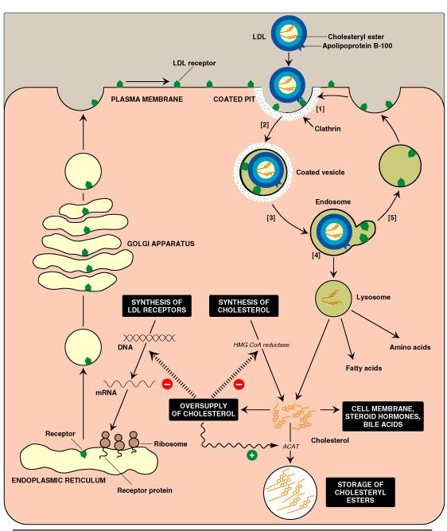
LDL: Receptor-Mediated Endocytosis

Slide 8
Receptor-Mediated Endocytosis
LDL receptor:
Cell surface glycoprotein
High-affinity, tightly regulated
LDL/Receptor binding and internalization of
the complex by endocytosis
Release of cholesterol inside the cells for:
Utilization
Storage as cholesterol ester Excretion
Degradation of LDL:
into amino acids, phospholipids and fatty acids
Degradation or recycling of receptor

Slide 9
LDL Receptor-Mediated Endocytosis: Regulation
Down-regulation:
High intracellular cholesterol content
Degradation of LDL receptors
Inhibition of recepotor synthesis at gene level Decrease No. of receptor at cell surface
Decrease further uptake of LDL
Decrease de novo synthesis of cholesterol
Up-regulation:
Low intracellular cholesterol content Recycling of LDL receptors
Stimulation of recepotor synthesis at gene level
Increase No. of receptor at cell surface
Increase further uptake of LDL Increase de novo synthesis of cholesterol

Slide 10
HDL Metabolism
PC = Phosphatidylcholine/Lecithin

Slide 11
High Density Lipoproteins (HDL)
Produced by intestine and liver
Nascent HDL:
Disk-shaped
Contains apo A-I, C-II and E Contains primarily phospholipid (PC)
Mature HDL (HDL₂):
First, the HDL₃ collects cholesterol (C)
Then, C is converted to CE (C- ester)
The HDL₂ is the spherical mature particle

Slide 12
Functions of HDL
Reservoir of apoproteins
e.g., Apo C-II and E to VLDL
Uptake of cholesterol:
From other lipoproteins & cell membranes
(HDL is suitable for uptake of cholesterol because of high content of PC that can both solublizes cholesterol and acts as a source of fatty acid for cholesterol esterification)
Esterification of cholesterol: Enzyme:PCAT/LCAT Activator: Apo A-I
Substrate: Cholesterol, Co-substrate: PC
Product: Cholesterol ester (& Lyso-PC)
Reverse cholesterol transport

Slide 13
Why Is HDL a Good Cholesterol carrier?
Inverse relation between plasma HDL
levels and atherosclerosis …. How?
Reverse cholesterol transport involves:
Efflux of cholesterol from peripheral tissues and other lipoproteins to HDL₃
Esterification of cholesterol & binding of HDL₂ to liver and steroidogenic cells by scavenger receptor class B (SR-B1)
Selective transfer of cholesterol ester into these cells
Release of lipid-depleted HDL₃

Slide 14
Atherosclerosis
Pathogenesis:
Modified (oxidized) LDL … Oxidative stress
Uptake of oxLDL by macrophage scavenger receptor: Scavenger receptor class A (SR-A)
Low-affinity, non-specific receptor Un-regulated receptor
Foam cell transformation Atherosclerotic plaque formation

Slide 15
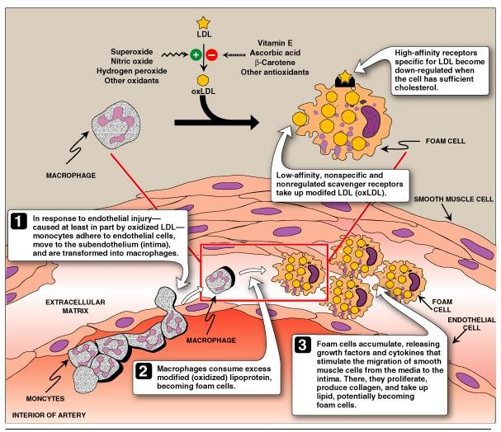
Athersclerotic plaque Formation

Slide 16
Laboratory Investigation of Atherosclerosis
Serum lipid profile:
10-12 hours (O/N) fasting Measurement of
Serum triglyceride level
(reflect chylomicron and VLDL levels)
Serum total cholesterol level
(reflect LDL and HDL levels) Serum HDL-cholesterol level Serum LDL-cholesterol level
Others, Serum lipoprotein electrophoresis Serum apoprotein levels e.g., apo-B

Slide 17
LDL-related Diseases
Hyperlipoproteinemia: Type IIa Hyperlipoproteinemia (Familial hypercholestrolemia)

Slide 18
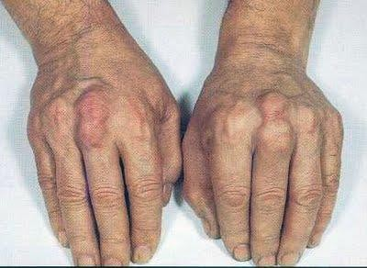
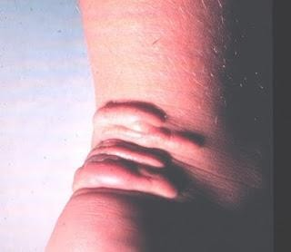
Type IIa Hyperlipoproteinemia (Familial hypercholestrolemia)
Functional defect of LDL-receptor
Increase plasma LDL level & therefore,
plasma cholesterol level
Pre-mature atherosclerosis and increased risk for early-onset ischemic heart diseases
Associated with the presence of tendon
xanthomas on hands and ankles

Slide 19
THANK YOU ☺

