Slide 1
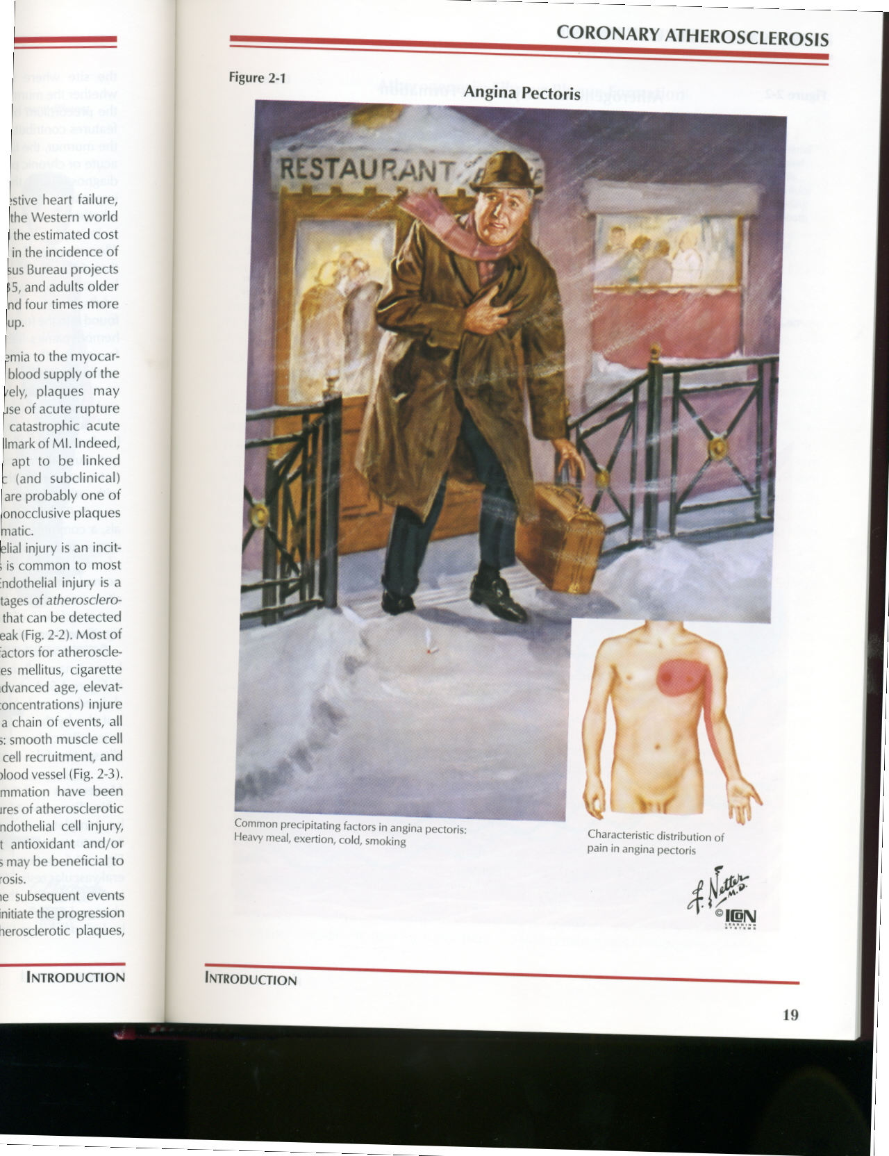
Antianginal Drugs
Learning outcomes
Recognize variables contributing to a balanced myocardial supply versus demand
Differentiate between drugs used to alleviate acute anginal attacks and those meant for prophylaxis & improvement of survival
Detail the pharmacology of nitrates and other drugs used as antianginal therapy

Slide 2
Minicase
Helmi, a 62-year-old male smoker with type 2 diabetes mellitus and hypertension presents with a 4-month history of exertional chest pain. Physical examination shows a blood pressure of 152/90 mm Hg but is otherwise unremarkable. The ECG is normal, and laboratory tests show a fasting blood glucose value of 110 mg/dL, glycosylated hemoglobin 6.0%, creatinine 1.1 mg/dL, total cholesterol 160, LDL 120, HDL 38, and triglycerides 147 mg/dL. He exercises for 8 minutes, experiences chest pain, and is found to have a 2-mm ST-segment depression at the end of exercise.

Slide 3
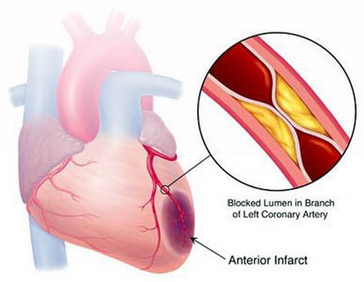
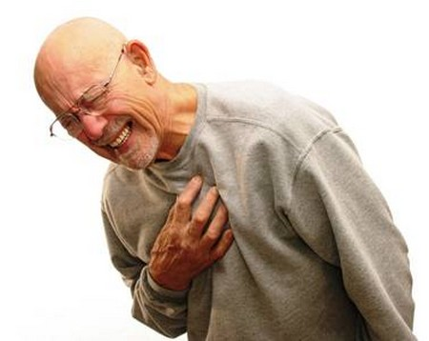
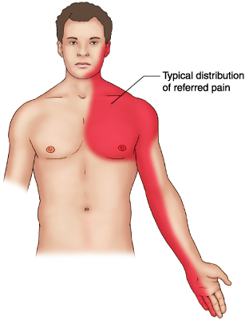
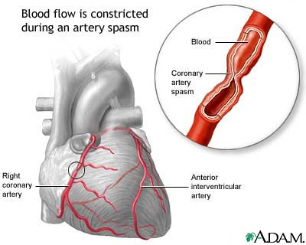
Which signs or symptoms of helmi suggest diagnosis of angina pectoris?
A clinical syndrome of chest pain (varying in severity) due to ischemia of heart muscle
Pain is caused either by obstruction
Pain is due to (accumulation of metabolites K⁺, PGs, Kinins, Adenosine….) secondary to the ischemia
Or spasm

Slide 4

Minicase
What life style modifications should Helmi carry out?

Slide 5
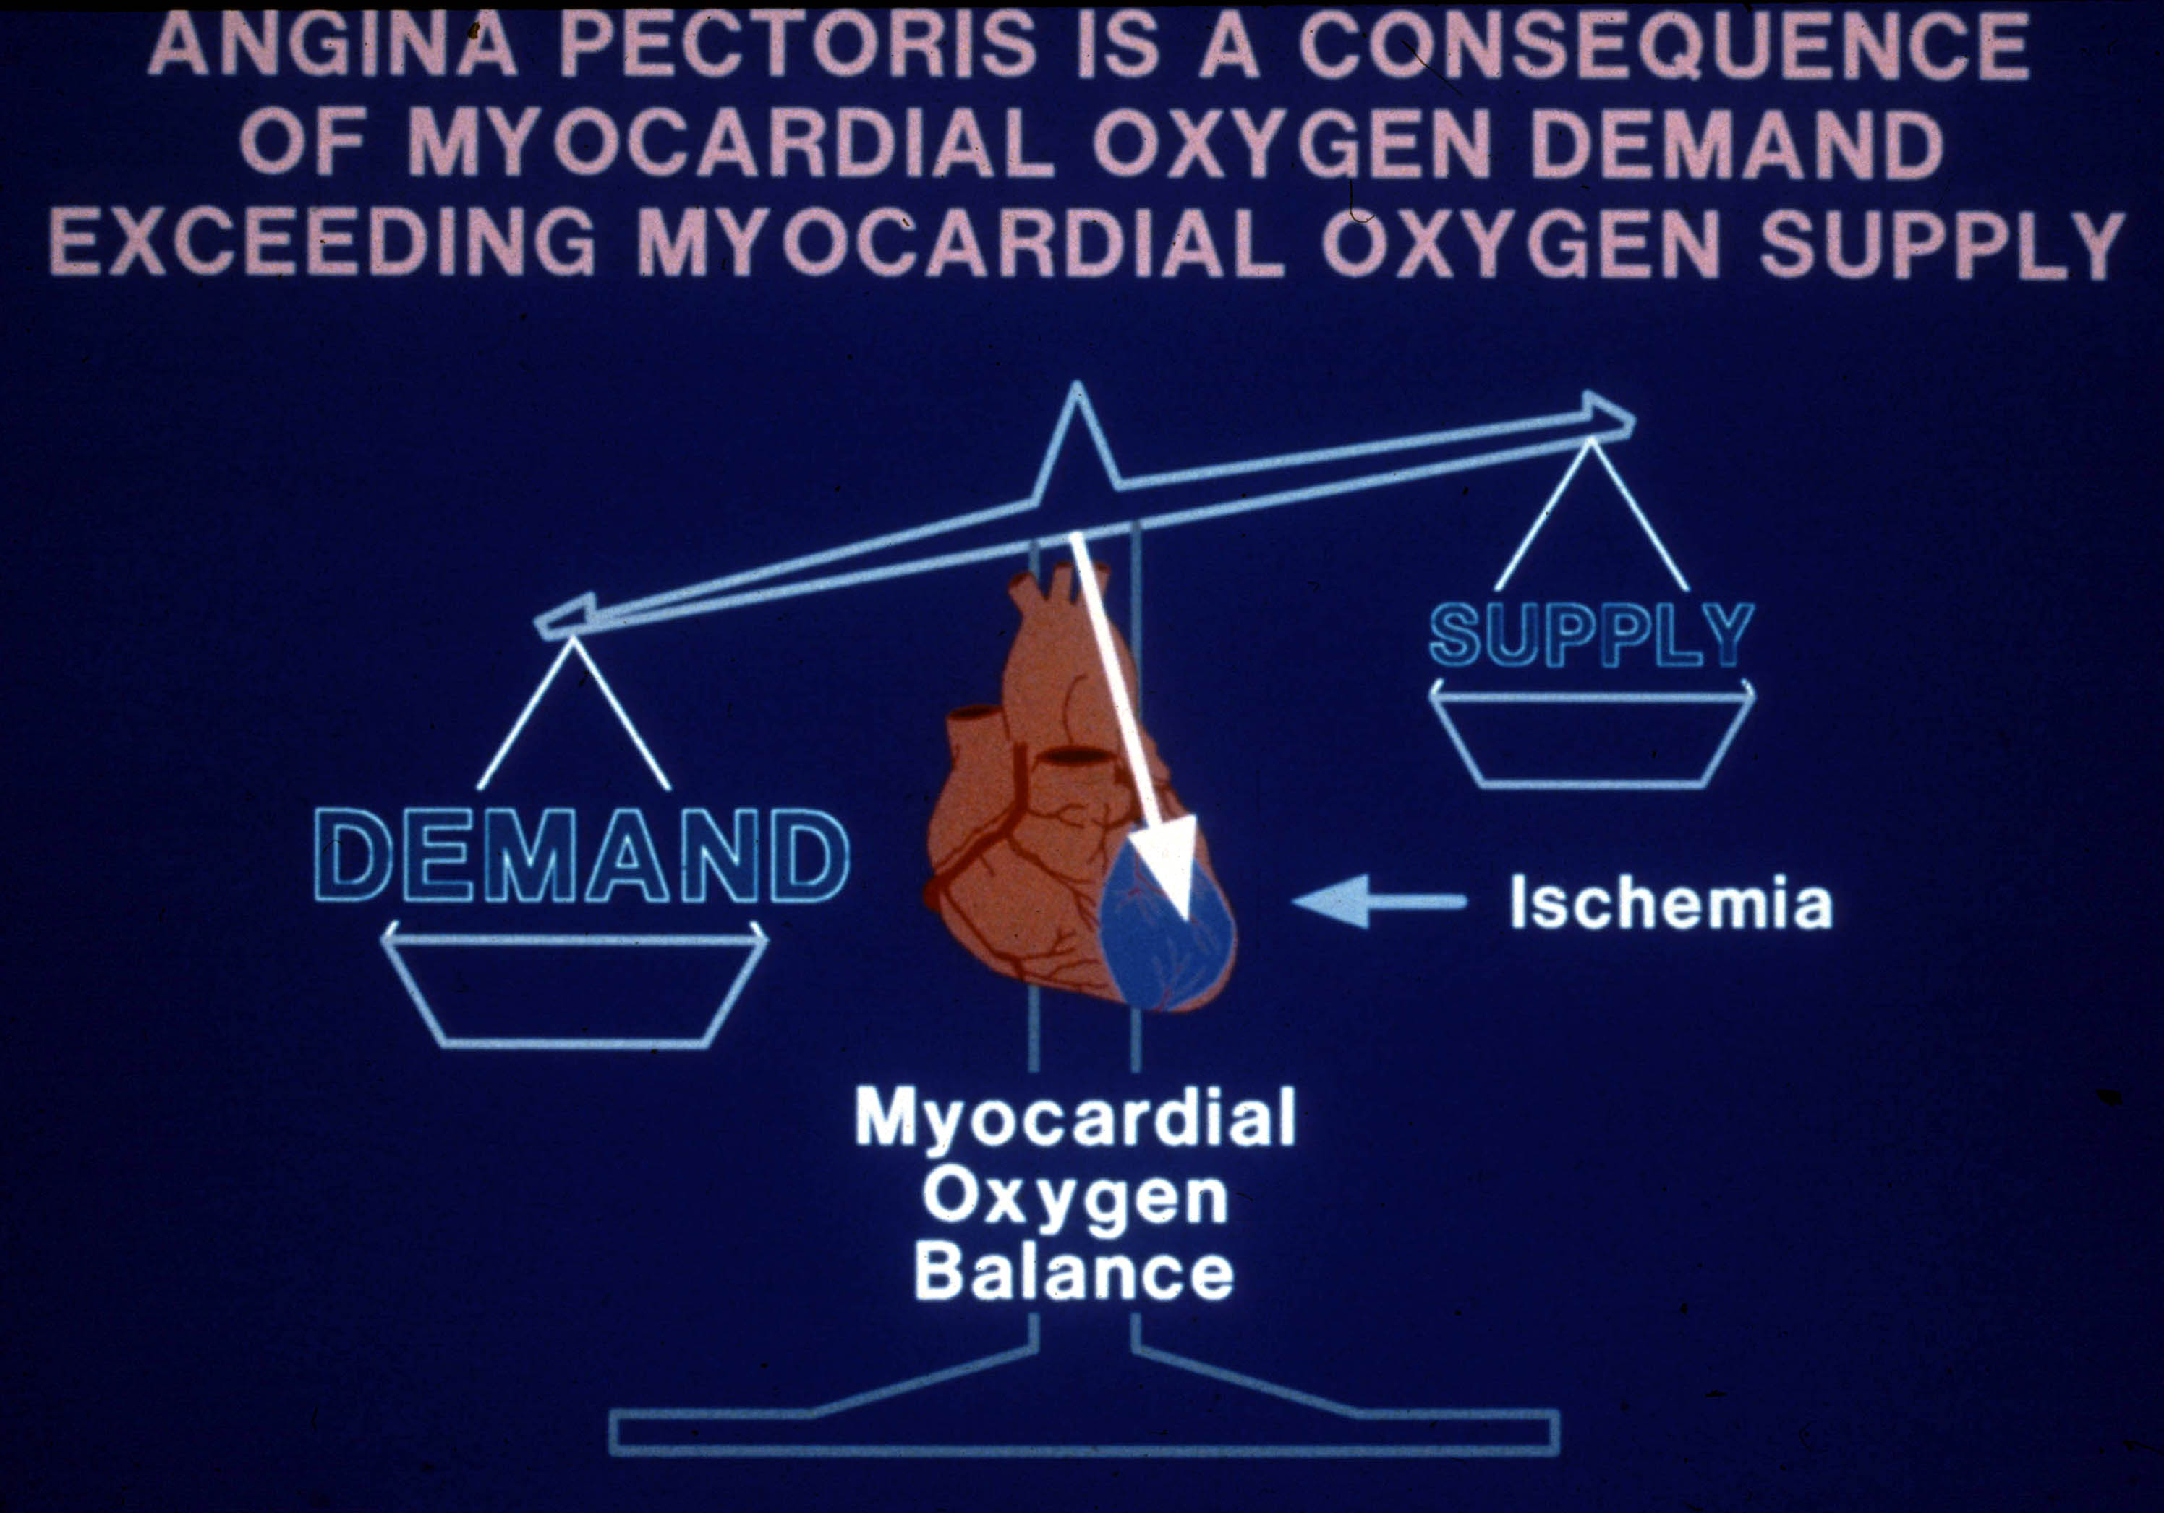
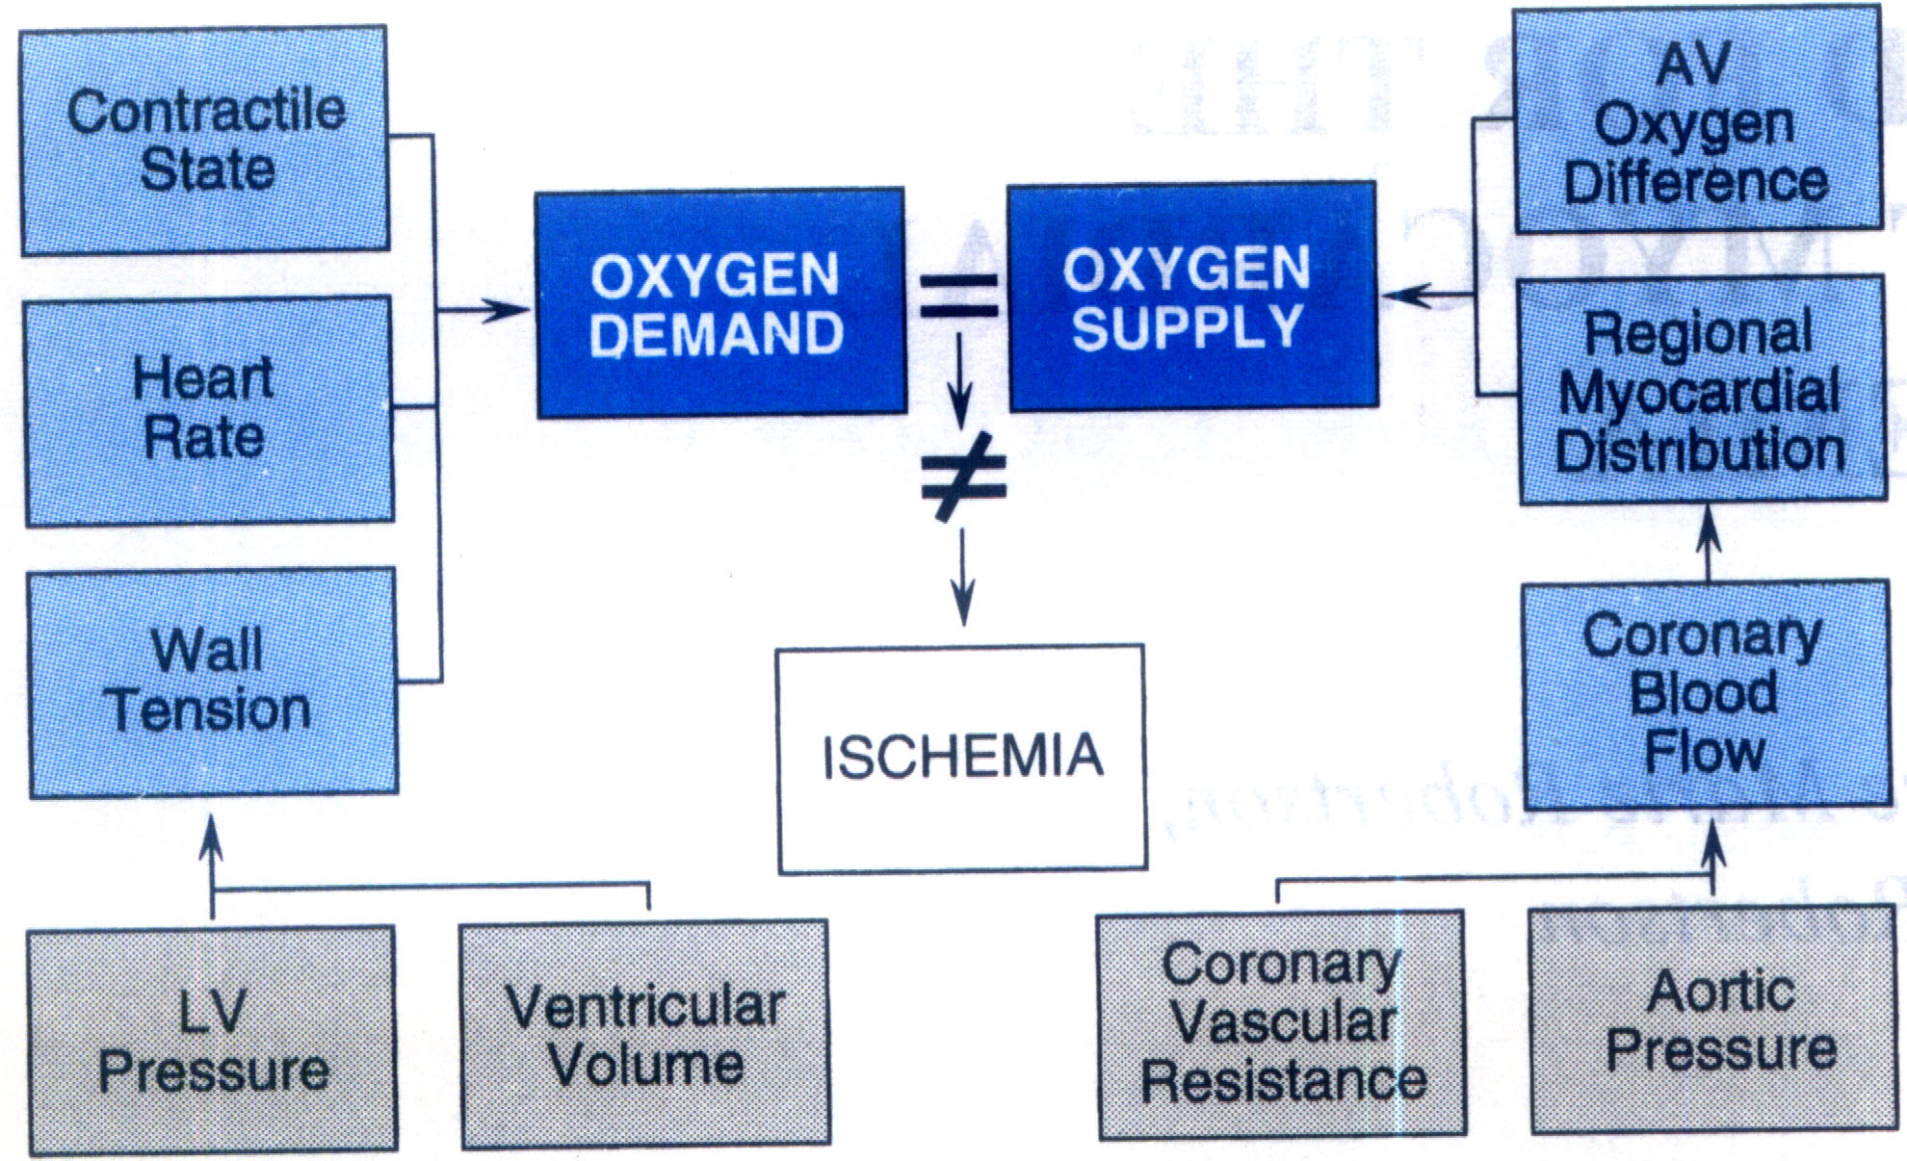
What is Basic mechanism of angia pectoris?
What are the determinants of oxygen demand and supply?

Slide 6
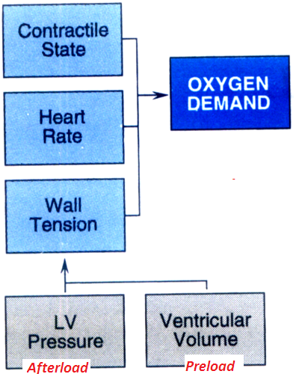
Myocardial oxygen demand is determined by:-
Myocardial oxygen demand is diminished by:-
Reducing contractility
Reducing heart rate
Reducing the preload
Reducing the afterload

Slide 7
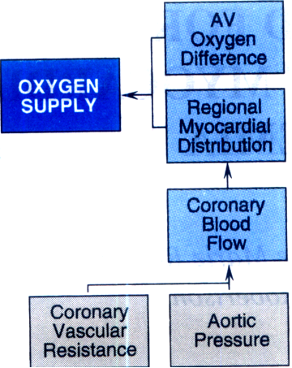
Myocardial oxygen supply is determined by:-
Myocardial oxygen supply is enhanced by:-
Reducing coronary vascular resistance
Prolonging diastolic period
Reducing external compression
Dilating collateral vessels
Reducing LV end diastolic pressure

Slide 8
Minicase
What triggers the onset of symtoms in helmi?
What factors worsen the symptoms in case of Helmi?

Slide 9
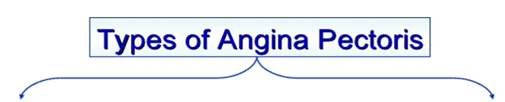
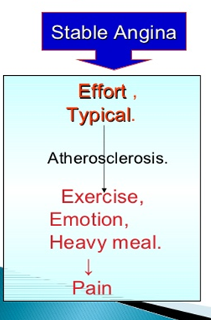
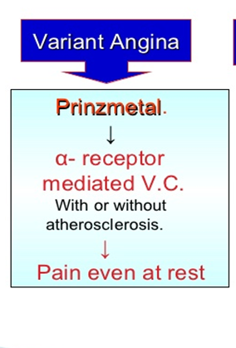
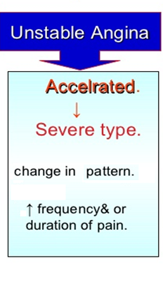

Slide 10
Minicase
What is the possible underlying cause of Helmi’s exertional pain?

Slide 11
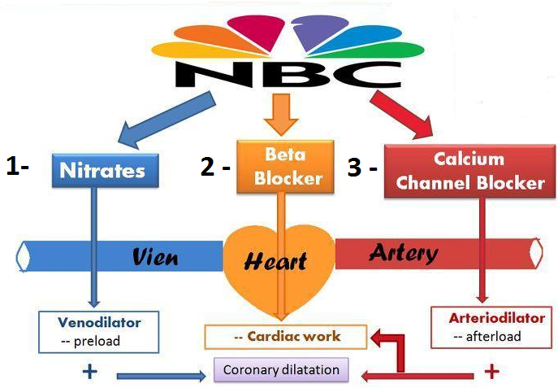
Treatment of angia pectors
1-Agents that improve symptoms & ischemia
Potassium channel openers
Metabolically- acting agents
Ranolazine Ivibradine

Slide 12
Treatment of angia pectors
2-Agents that improve prognosis
Aspirin / Other antiplatelets
Statins
ACE Inhibitors
β-Adrenoceptor blockers

Slide 13
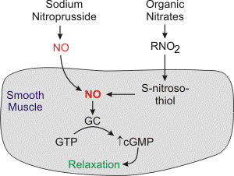
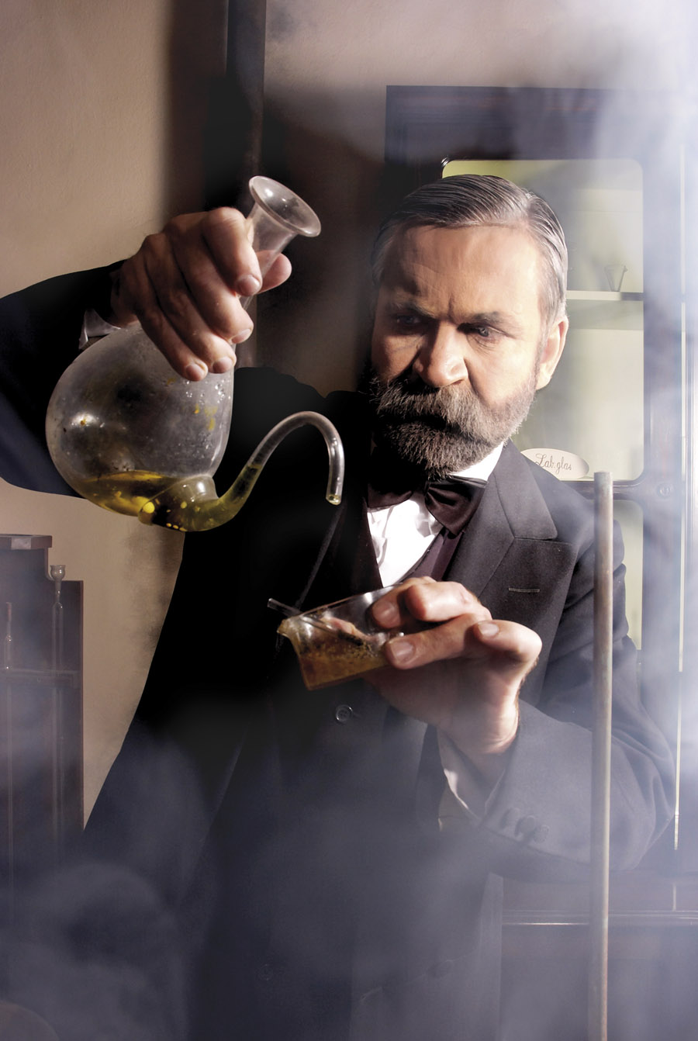
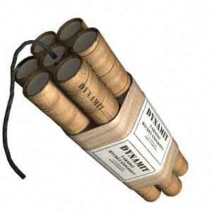
Organic nitrates
Mechanism of action
Long acting
Isosorbide mononitate
Short acting
Nitroglycerine
Nitric oxide binds to guanylate cyclase in vascular smooth muscle cell to form cGMP.
cGMP activates PKG to produce relaxation

Slide 14
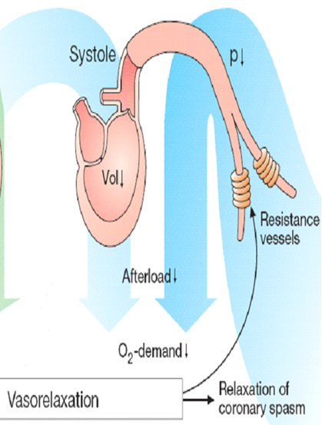
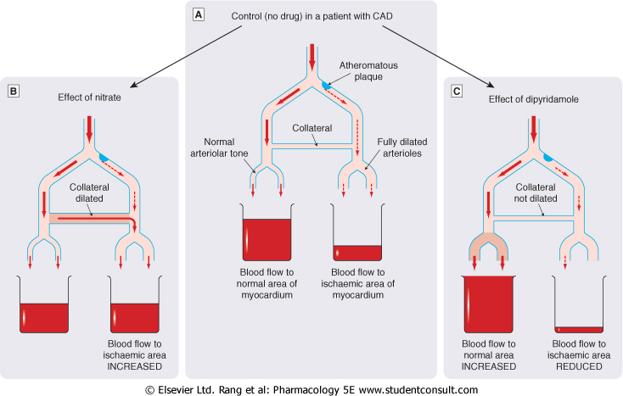
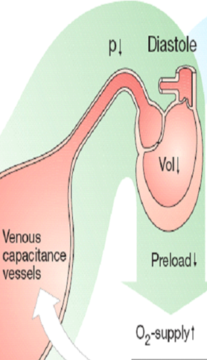
Hemodynamic effects of nitrates
Shunting of flow from normal area to ischemic area by dilating collateral vessels
Venous vasodilatation
With Nitrates
Coronary vasodilatation
Preload
Myocardial perfusion
Arterial vasodilatation
Afterload

Slide 15
Think-pair-share
Match the effects of nitrates in treatment of angina with their results
Effects
1-↓Arterial pressure
Results
2-Reflex ↑ in contractility
A-↓ O2 demand
3-↑Collateral flow
B-↑ O2 demand
4-↓Ventricular volume
C-Relief of coronary artery spasm
5-Reflex tachycardia
6-↓Left ventricular diastolic pressure
D-Improved perfusion to ischemic myocardium
7-↓Diastolic perfusion time due to tachycardia
E-Improve subendocardial perfusion
8-Vasodilation of epicardial coronary arteries
F-↓ myocardial perfusion

Slide 16
pharmacokinetics
Nitroglycrine [GTN]
Oral isosorbide dinitrate & mononitrate
Very well absorbed & 100% bioavailability
Significant first pass metabolism occurs in the liver (10-20%) bioavailability
The dinitrate undergoes denitration to two mononitrates both possess antianginal activity
Given sublingual or via transdermal patch, or parenteral
(t_{1/2} 1-3 hours)
Further denitrated metabolites conjugate to glucuronic acid in liver. Excreted in urine.

Slide 17
Indications
IN STABLE ANGINA;
Acute symptom relief  sublingual GTN
IN VARIANT ANGINA sublingual GTN
IN UNSTABLE ANGINA  IV GTN
Prevention; Persistant prophylaxis  Isosorbide mono or dinitrate
Prevention; Situational prophylaxis  sublingual GTN
Heart Failure
Refractory AHF  IV GTN
CHF  Isosorbide mononitrate + hydralazine
[ if contraindication to ACEIs]
AMI IV GTN

Slide 18
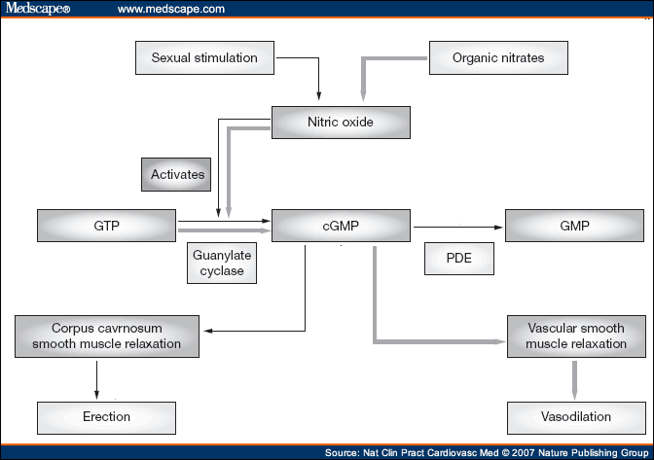

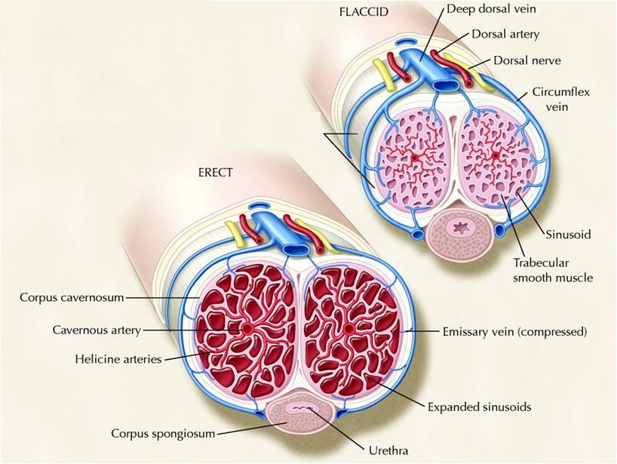
contraindications
Concomitant administration of PDE₅ Inhibitors
Known sensitivity to organic nitrates
    Glaucoma; nitrates  aqueous humour formation
    Head trauma or cerebral haemorrhage , Increase intracranial pressure.
Uncorrected hypovolemia

Slide 19
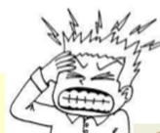
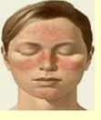
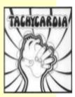
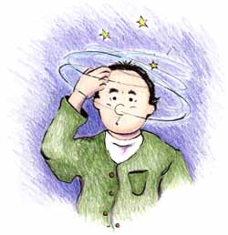
Adverse drug reactions
Throbing headache
Flushing in blush area
Tachcardia & palpitation
Postural hypotension, dizziness & syncope
Rarely methemoglobinema

Slide 20
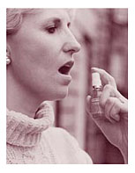
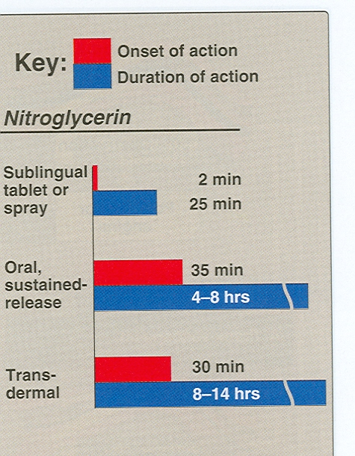
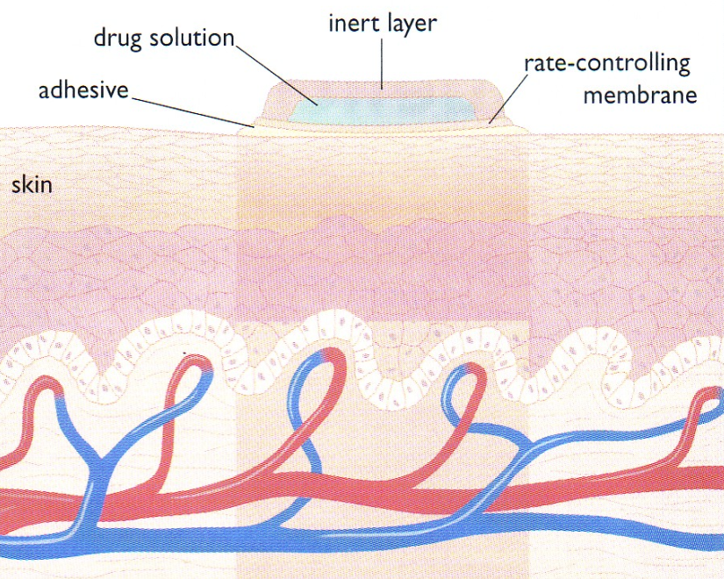
Preparations
Nitroglycerine
Sublingual tablets or spray
Transdermal patch
Oral or bucal sustained release
I.V. Preparations

Slide 21
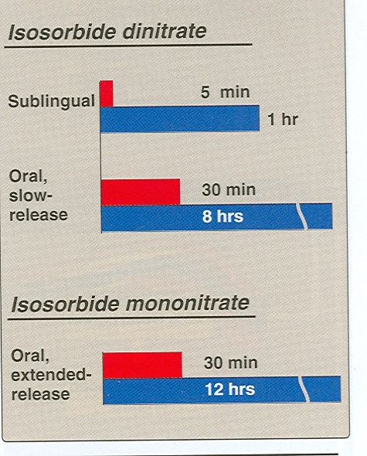
Preparations
Isosorbide dinitrate
Dinitrate Sublingual tablets
Dinitrate Oral sustained release
Infusion Preparations
Mononitrate Oral sustained release

Slide 22
Nitrates tolerance
Loss of vasodilator response of nitrates on use of long-acting preparations (oral, transdermal) or continuous intravenous infusions, for more than a few hours without interruption.
Mechanism
1-Compensatory neurohormonal counter-regulation
2-Depletion of free-SH groups

Slide 23
Minicase
If Helmi was prescribed nitrates & tolerance developed to their effects, how to overcome tolerance to nitrates?
  Nitrate tolerance can be overcome by:
Smaller doses at increasing intervals (Nitrate free periods twice a day).
Giving drugs that maintain tissue SH group e.g. Captopril.

Slide 24
Task- selection of a P-drug
Instructions:
1- Select a leader for your group
2- Discuss the case according to the steps shown in the sheet
3- Use your internet access to obtain evidence for efficacy, toxicity, convenience & cost.
4- Due to time constrains divide yourself into groups of five, each doing one search e.g. evidence for efficacy.
5- You have 10 minutes to do this and 1 minute to report to the class.

Slide 25
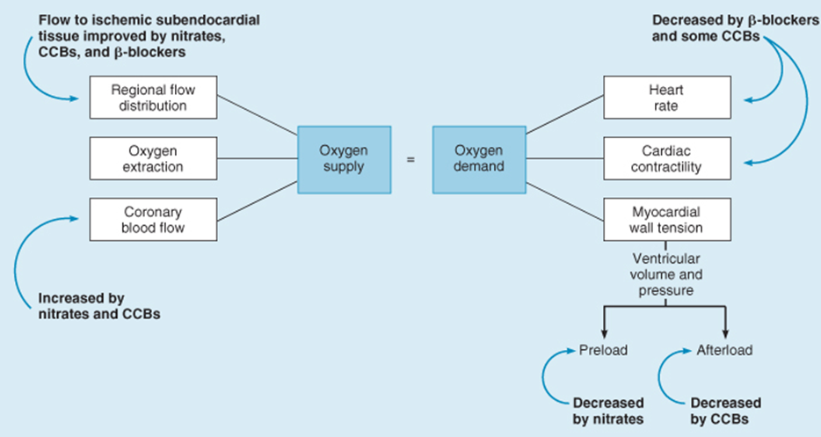
General mechanism of antianginal drugs

