Slide 1
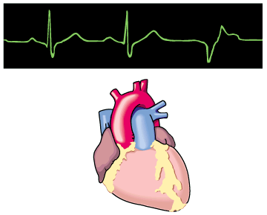
Antiarrhythmic Drugs
Prof. Abdulrahman Almotrefi

Slide 2
Cardiovascular Pharmacology
Antiarrhythmic drugs
Drugs in heart failure
Antihypertensive drugs
Antianginal drugs
Antihyperlipidemic drugs

Slide 3
Learning objectives
By the end of this lecture, students should be able to:
Understand definition of arrhythmias and their
different types
- describe different classes of Antiarrhythmic drugs
and their mechanism of action
understand their pharmacological actions, clinical
uses, adverse effects and their interactions with
other drugs.

Slide 4
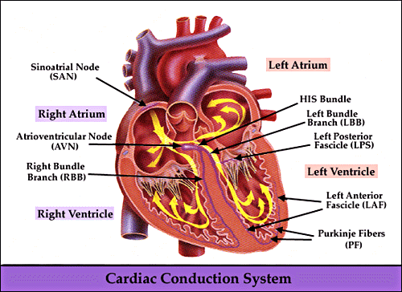

Slide 5
CARDIAC CONDUCTION SYSTEM
- S.A. node
- Inter-nodal pathways
- A.V. node
- Bundle of His and branches
- Purkinje fibers

Slide 6
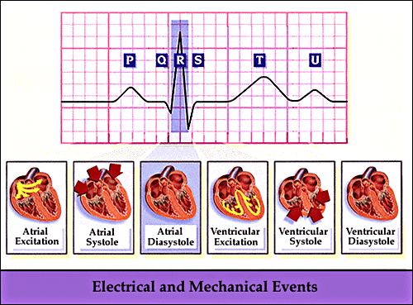
Electrocardiogram (ECG)

Slide 7
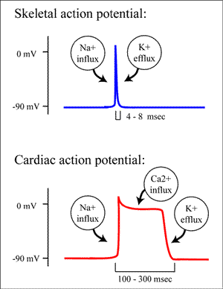
CARDIAC ACTION POTENTIAL

Slide 8
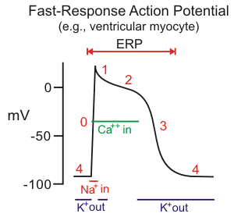

Slide 9
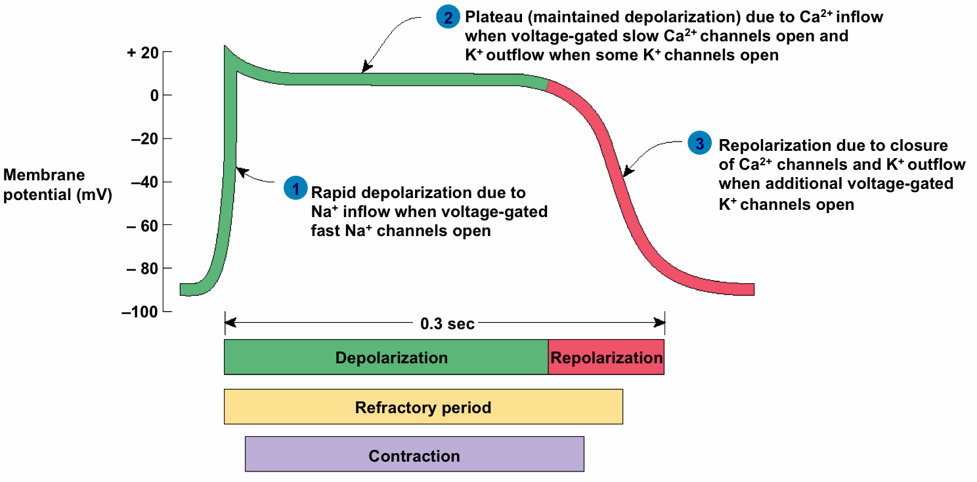
CARDIAC ACTION POTENTIAL
Non-pacemaker (ventricular muscle)

Slide 10
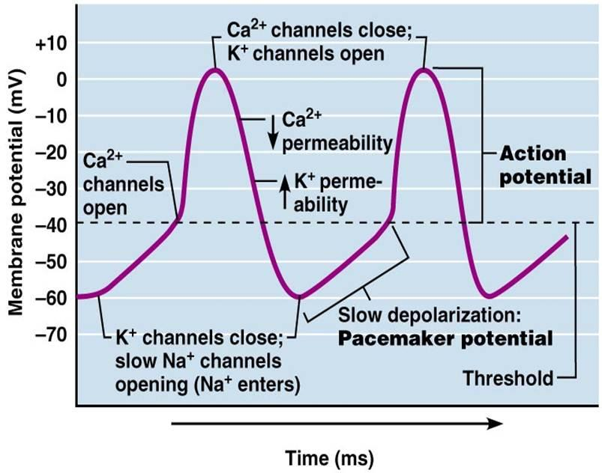
CARDIAC ACTION POTENTIAL
Pacemaker (SA node)

Slide 11
WHAT IS ARRHYTHMIA?
An abnormality in the :
■ rate ............... high= tachycardia
low = bradycardia

Slide 12
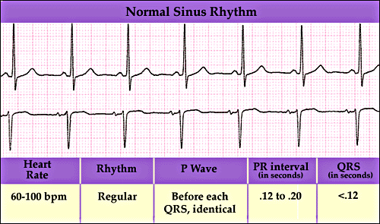

Slide 13
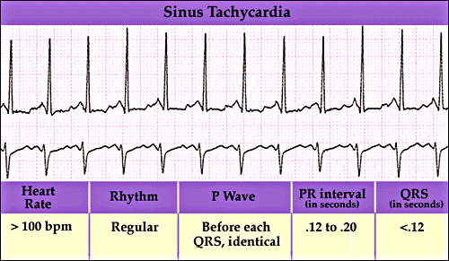

Slide 14
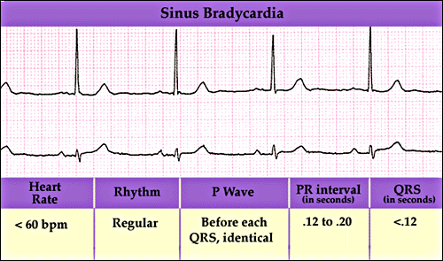

Slide 15
WHAT IS ARRHYTHMIA?
An abnormality in the :
■ rate ............... high= tachycardia
low = bradycardia
■ regularity ..... Extrasystoles
( PAC, PVC )

Slide 16
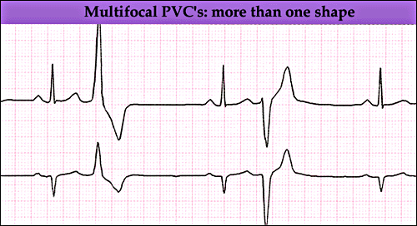

Slide 17
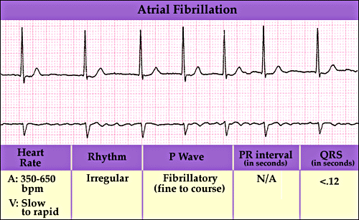

Slide 18
WHAT IS ARRHYTHMIA?
An abnormality in the :
■ rate ............... high= tachycardia
low = bradycardia
■ regularity ..... extrasystoles
■ site of origin ... ectopic pacemakers
■ or disturbance in conduction

Slide 19
Therapeutic use of antiarrhythmic drugs
The ultimate goal of therapy
⬇
Restore normal rhythm & conduction
⬇ ⬇
Maintenance of Prevention of more
normal rhythm serious arrhythmias

Slide 20
How antiarrhythmic drugs produce these effects?
Slow conduction velocity
Altering the excitability of cardiac cells by prolonging the effective refractory period
Suppressing ectopic pacemaker activity by inhibiting phase 4 slow depolarization

Slide 21
CLASSIFICATION
OF
ANTIARRHYTHMIC DRUGS

Slide 22
Vaughn Williams classification
CLASS I
Na+ channel blockers
( membrane stabilizing drugs)
CLASS II:
β- adrenoceptor blockers
CLASS III:
Drugs that prolong action potential duration
CLASS IV:
Calcium channel blockers

Slide 23
CLASS I
Drugs that block the influx of Na ions through Na channels
⬇
1- decrease the rate of rise of
rapid depolarization (Phase O)
2- decrease phase 4 slow
diastolic depolarization
(suppress pacemaker activity)
(membrane stabilizing effect)

Slide 24
CLASS I
Sub classified according to their effect on action potential duration :
- Ia : prolong action potential duration
- Ib : shorten action potential duration
- Ic : no effect on action potential duration

Slide 25
CLASS I a
Ia : prolong action potential duration
e.g.
Quinidine
Procainamide

Slide 26
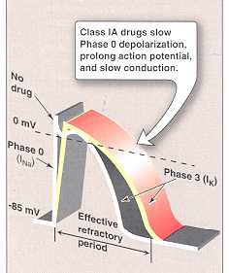

Slide 27
CLASS I a
QUINIDINE
pharmacological actions :
Cardiac (direct) :
1- Membrane stabilizing effect
2- Blocking of K channels
⬇
prolongation of action potential duration
( refractory period )
3- ECG changes:
- prolongs P-R and Q-T interval
- widens QRS complex

Slide 28
CLASS I a
QUINIDINE
pharmacological actions :
Actions on A.N.S. (indirect) :
1- Anticholinergic effect
⬇
Increase conduction through the A.V. node
( risk of ventricular tachycardia )
2- α-adrenergic blocking effect
⬇
may cause vasodilatation & reflex sinus tachycardia
( seen more after I.V. dose )

Slide 29
CLASS I a
QUINIDINE
Therapeutic uses:
- common uses: atrial flutter & fibrillation
- can be used for ventricular tachycardia
maintaining sinus rhythm after D.C. cardio version

Slide 30
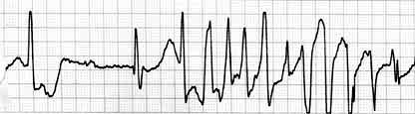
CLASS Ia
QUINIDINE
Adverse effects :
quinidine syncope: episodes of fainting
due to torsades de pointes (twisting of the spikes)
developing at therapeutic plasma levels

Slide 31
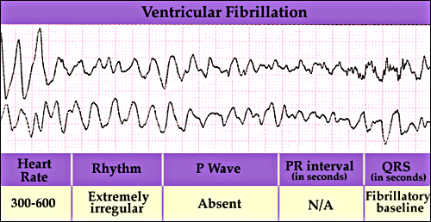
Torsades de pointes
- may terminate spontaneously or lead to
⬇
fatal ventricular fibrillation

Slide 32
CLASS I a
QUINIDINE
Adverse effects :
Anticholinergic adverse effects:
Dry mouth
Blurred vision
Urinary retention
constipation
Hypotension
- due to depressing contractility & vasodilatation
GIVEN ORALLY ( Rarely given I.V. )

Slide 33
CLASS I a
PROCAINAMIDE
Similar to quinidine except :
1- less toxic on the heart...
can be given I.V.
2- more effective in ventricular than in
atrial arrhythmias
3 - No anticholinergic or α-blocking actions

Slide 34
CLASS I a
PROCAINAMIDE
Adverse effects:
- In long term therapy it causes reversible
lupus erythematosus-like syndrome
- Hypotension
- Torsades de pointes
- Hallucination & psychosis

Slide 35
CLASS I b
Shorten action potential duration
e.g.
Lidocaine
Mexiletine

Slide 37
CLASS Ib
LIDOCAINE
Therapeutic uses :
treatment of emergency ventricular arrhythmias
e.g. :
1 - during surgery
2 - following acute myocardial infarction
- NOT effective in atrial arrhythmias
- NOT effective orally (3% bioavailability)
given I.V. bolus or slow infusion
t_{1/2} = 2 hours

Slide 38
CLASS Ib
LIDOCAINE
Adverse effects:
hypotension
similar to other local anesthetics,
causes CNS adverse effects such as:
- paresthesia
- tremor
- dysarthria (slurred speech)
- tinnitus
- confusion
- convulsions

Slide 39
CLASS Ib
MEXILETINE
- EFFECTIVE ORALLY
Therapeutic uses :
1- ventricular arrhythmia
2- digitalis-induced arrhythmias
t_{1/2} = 10 hours
ADVERSE EFFECTS :
1- nausea , vomiting
2- tremor , drowsiness, diplopia
3- arrhythmias & hypotension

Slide 40
CLASS Ic
have no effect on action potential duration
e.g.
Flecainide

Slide 41
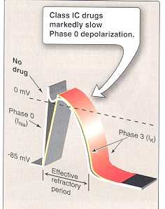

Slide 42
CLASS Ic
FLECAINIDE
Therapeutic uses :
supraventricular arrhythmias
- Wolff-Parkinson-White syndrome
- very effective in ventricular arrhythmias, but
very high risk of proarrhythmia
- should be reserved for resistant arrhythmias

Slide 43
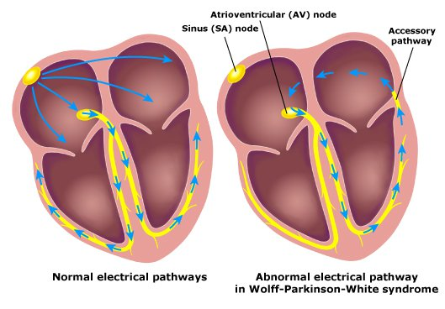
Wolff-Parkinson-White syndrome
Pre-excitation of the ventricles due to an accessory pathway known as the Bundle of Kent.

Slide 44
CLASS Ic
FLECAINIDE
Adverse effects:
1- proarrhythmia
2- CNS :
dizziness, tremor, blurred vision,
abnormal taste sensations, paraesthesia
3- heart failure due to -ve inotropic effect

Slide 45
CLASS II DRUGS
β- ADRENOCEPTOR BLOCKERS
pharmacological actions :
block β₁- receptors in the heart
⬇
reduce the sympathetic effect on the heart
⬇
1 - decrease automaticity of S.A. node and
ectopic pacemakers
2 - prolong refractory period ( slow conduction )
of the A.V node

Slide 46
CLASS II DRUGS
β- ADRENOCEPTOR BLOCKERS
Therapeutic uses :
1- atrial arrhythmias associated with emotion:
e.g. : - after exercise
- thyrotoxicosis
2- WPW
3- digitalis-induced arrhythmias

Slide 47
CLASS II DRUGS β- ADRENOCEPTOR BLOCKERS
Therapeutic uses :
Esmolol :
- very short acting ( half-life = 9 min. )
- given I.V. for rapid control of ventricular rate in
patients with atrial flutter or fibrillation
Propranolol, Atenolol, Metoprolol :
- used in patients who had myocardial infarction to
reduce incidence of sudden death due to ventricular
arrhythmias

Slide 48
CLASS III DRUGS
Prolong the action potential duration and refractory period
Prolong phase 3 repolarization

Slide 49
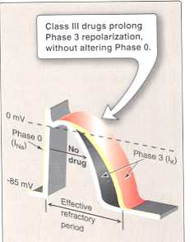

Slide 50
CLASS III DRUGS
AMIODARONE
pharmacological actions :
- prolongs action potential duration and therefore
prolongs refractory period ( Main effect )
- additional class Ia, II & IV effects
- vasodilating effects
( due to its α- & β-adrenoceptor blocking effects
and its calcium channel blocking effects )

Slide 51
CLASS III DRUGS
AMIODARONE
Therapeutic uses :
1- main use : serious resistant ventricular arrhythmias
2- maintenance of sinus rhythm after D.C. cardio version
3- resistant supraventricular arrhythmias ( e.g. WPW )

Slide 52
CLASS III DRUGS
AMIODARONE
Adverse effects:
- bradycardia & heart block, heart failure
- pulmonary fibrosis
- hyper- or hypothyroidism
- photodermatitis & skin deposits
( patients should avoid exposure to the sun)
- may cause bluish discoloration of the skin

Slide 53
CLASS III DRUGS
AMIODARONE
Adverse effects:
- CNS: tremor, headache, ataxia, paresthesia
- constipation
- corneal micro deposits
- hepatocellular necrosis
- peripheral neuropathy

Slide 54
CLASS III DRUGS
AMIODARONE
Pharmacokinetics:
- extremely long t_{1/2} = 13 - 103 DAYS
- metabolized to its major active metabolite
N-desethylamiodarone by cytochrome P450 3A4
and CYP2C8
- eliminated primarily by hepatic metabolism
- cross placenta and appear in breast milk

Slide 55
CLASS III DRUGS
AMIODARONE
Drug Interactions:
1 - As amiodarone is metabolized by CYP3A4 & CYP2C8,
drugs (or substances) that inhibit these enzymes
⬇
increase serum concentration of amiodarone
e.g. : Loratadine
Ritonavir
Trazodone
Cimetidine
Grapefruit juice

Slide 56
CLASS III DRUGS
AMIODARONE
Drug Interactions:
2 - drugs that are inducers of these enzymes
⬇
decrease serum concentration of amiodarone
e.g. : Rifampin
3 - Reduces clearance of several drugs e.g.
quinidine, warfarin, procaiamide, flecainide

Slide 57
PURE CLASS III
Ibutilide
Given by rapid I.V. infusion
Used for the acute conversion of atrial flutter or fibrillation to normal sinus rhythm
Causes QT interval prolongation
( may cause torsades de pointes )

Slide 58
Class 1V calcium channel blockers
Verapamil, Diltiazem
main site of action is A.V.N & S.A.N
cause:
- slowing of conduction
- prolongation of effective refractory period

Slide 59
Class 1V
calcium channel blockers
Therapeutic uses :
1- atrial arrhythmias
2- re-entry supraventricular arrhythmias
e.g. WPW
3- NOT effective in ventricular arrhythmias

Slide 60
CLASS V
MISCELLENIOUS ANTIARRHYTHMIC DRUGS
ADENOSINE
DIGITALIS

Slide 61
ADENOSINE
- endogenous nucleoside
Mechanism of action :
inhibits cAMP by binding to adenosine A1 receptors
causing the following actions:
1 - Opening of potassium channels
(hyperpolarization)

Slide 62
ADENOSINE
Mechanism of action :
2 - decreasing conduction velocity mainly at AVN
( negative dromotropic effect )
3- inhibiting phase 4 pacemaker action potential ( SAN)
( negative chronotropic effect )

Slide 63
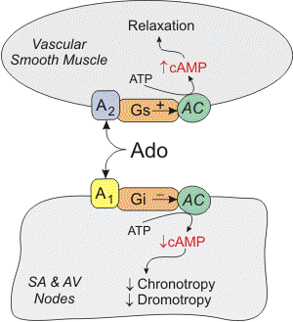

Slide 64
ADENOSINE
Therapeutic uses :
■ half-life = less than 10 sec.
■ drug of choice for acute management of
paroxysmal supraventricular tachycardia
■ preferred over verapamil – safer
and does not depress contractility

Slide 65
ADENOSINE
Adverse effects:
■ flushing in about 20% of patients
■ shortness of breath and chest burning in 10% of
patients ( bronchospasm )
■ brief AV block ( contraindicated in heart block)

Slide 66
BRADYARRHYTHMIAS
ATROPINE
■ used in sinus bradycardia after myocardial
infarction and in heart block
■ in emergency heart block isoprenaline may
be combined with atropine ( caution )

Slide 67
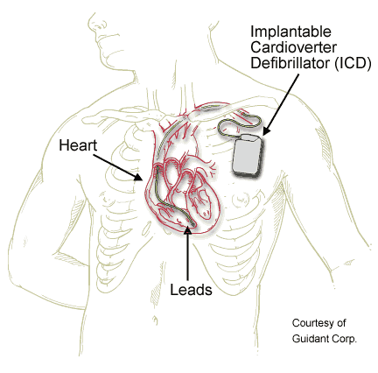
NONPHARMACOLOGIC THERAPY
OF ARRHYTHMIAS
Implantable Cardiac Defibrillator (ICD)
- can automatically detect and treat fatal
arrhythmias such as ventricular fibrillation

Slide 68

Thank you

