Slide 1
Drug Therapy
of
Heart Failure
Prof. Abdulrahman Almotrefi

Slide 2
Learning objectives
By the end of this lecture, students should be able to:
- Describe the different classes of drugs used for treatment of acute & chronic heart failure and their mechanism of action
Understand their pharmacological effects, clinical
uses, adverse effects and their interactions with
other drugs

Slide 3
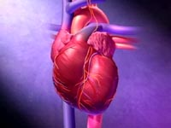
HEART FAILURE
?
Inability of the heart to maintain an adequate cardiac output to meet the metabolic demands of the body.

Slide 4
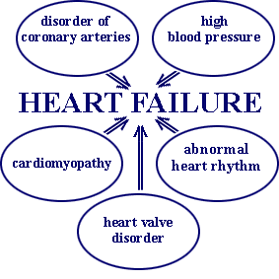
CAUSES OF HEART FAILURE

Slide 5
Symptoms of Heart failure
- Tachycardia
- Decreased exercise tolerance (rapid fatigue)
- Dyspnea ( pulmonary congestion )
- Peripheral edema
- Cardiomegaly

Slide 6
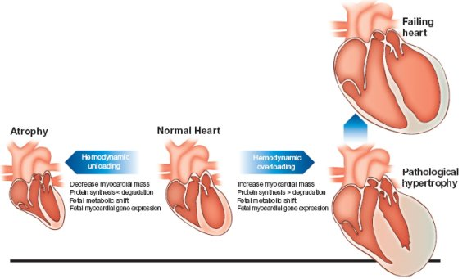

Slide 7
Pathophysiology of CHF
↓ Force of contraction
Low C.O.
↓ Carotid sinus firing
↓ Renal blood flow
Activate renin-angiotensin-
Aldosterone system
Activate sympathetic system
↑ Sympathetic discharge
ALDOST.
Ag. II
Remodeling
Salt & Water
Retention
Volume expansion
Vasoconstriction
↑ Force of
Cardiac .cont.
Venous VC
Arterial VC
↑ HR .
↑ Preload
↑ Preload
↑ Afterload

Slide 8
Factors affecting cardiac output and
heart failure
1- Preload
2- Afterload
3- Cardiac contractility

Slide 9
Drugs used in the treatment of heart failure
I- Drugs that decrease preload
1 - Diuretics
2 - Aldosterone antagonists
3 - Venodilators
II- Drugs that decrease afterload
1 - Arteriodilators

Slide 10
Drugs used in the treatment of heart failure
III- Drugs that decrease both preload & afterload
( Combined arteriolo- & venodilators )
1- Angiotensin converting enzyme (ACE) inhibitors
2- Angiotensin receptor antagonists
3- α₁-adrenoceptor antagonists
4- Direct vasodilators

Slide 11
Drugs used in the treatment of heart failure
IV- Drugs that increase contractility
  1- Cardiac glycosides (digitalis)
  2- β- adrenoceptor agonists
  3- Phosphodiesterase inhibitors

Slide 12
I- Drugs that decrease preload
1-Diuretics:
Mechanism of action in heart failure :
reduce salt and water retention
⬇
decrease ventricular preload and venous pressure
⬇
reduction of cardiac size
⬇
Improvement of cardiac performance

Slide 13
I- Drugs that decrease preload
1-Diuretics:
Chlorothiazide
- first-line agent in heart failure therapy
- used in volume overload ( pulmonary and/ or
peripheral edema )
- used in mild congestive heart failure

Slide 14
I- Drugs that decrease preload
1-Diuretics:
Furosemide
a potent diuretic
used for immediate reduction of pulmonary congestion & severe edema associated with :
- acute heart failure
- moderate & severe chronic failure

Slide 15
I- Drugs that decrease preload
2-Aldosterone antagonists:
Spironolactone
- nonselective antagonist of aldosterone receptor
- a potassium sparing diuretic used in
congestive heart failure
- improves survival in advanced heart failure
Eplerenone
- a new selective aldosterone receptor antagonists

Slide 16
I- Drugs that decrease preload
3-Venodilators:
Nitroglycerine
Isosorbide dinitrate
  used I.V. for severe heart failure when the
  main symptom is dyspnea due to pulmonary
  congestion
  dilates venous blood vessels and reduce
  preload

Slide 17
II- Drugs that decrease afterload
1- Arteriodilators:
Hydralazine
  - used when the main symptom is rapid
  fatigue due to low cardiac output
  reduce peripheral vascular resistance

Slide 18
III- Drugs that decrease both
preload & afterload
1-Angiotensin converting enzyme (ACE) inhibitors:
- are now considered as first-line drugs for
chronic heart failure along with diuretics
first-line drugs for hypertension therapy

Slide 19
Angiotensin converting enzyme inhibitors
MECHANISM OF ACTION
VASOCONSTRICTION
VASODILATATION
ALDOSTERONE
VASOPRESSIN
SYMPATHETIC
Angiotensinogen
RENIN
BRADYKININ
Angiotensin I
A.C.E.
Inhibitor
Breackdown
ANGIOTENSIN II

Slide 20
ACE Inhibitors
Pharmacokinetics:
Captopril, Enalapril and Ramipril
- rapidly absorbed from GIT after oral administration.
- food reduce their bioavailability
Enalapril , Ramipril
- prodrugs, converted to their active metabolites in the liver
- have long half-life & given once daily
Enalaprilat
the active metabolite of enalapril
given I.V. in hypertensive emergency

Slide 21
ACE Inhibitors
Adverse effects:
1- acute renal failure, especially in patients
with renal artery stenosis
2- hyperkalemia, especially in patients with
renal insufficiency or diabetes
3- severe hypotension in hypovolemic patients
(due to diuretics, salt restriction or
gastrointestinal fluid loss)

Slide 22
ACE Inhibitors
Adverse effects:
4- dry cough sometimes with wheezing
5- angioneurotic edema ( swelling in the
nose , throat, tongue, larynx)
6- dysgeusia ( reversible loss or altered taste )

Slide 23
ACE Inhibitors
Contraindications:
- during the second and third trimesters
of pregnancy
( due to the risk of : fetal hypotension
renal failure & malformations )
- renal artery stenosis

Slide 24
III- Drugs that decrease both
preload & afterload
2- Angiotensin receptor blockers (ARBs) :
Losartan, Valsartan , Irbesartan
Mechanism of action:
- block AT₁ receptors
- decrease action of angiotensin II

Slide 25
Useful Effects of ACE Inhibitors & ARBs
In Heart Failure
1 - Decrease peripheral resistance ( Afterload )
2 - Decrease Venous return ( Preload)
3 - Decrease sympathetic activity
(By blocking sympathetic nerve release & reuptake of norepinephrine)
4- Inhibit cardiac and vascular remodeling
associated with chronic heart failure
⬇
Decrease in mortality rate

Slide 26
III- Drugs that decrease both
preload & afterload
3- α-ADRENOCEPTOR BLOCKERS :
Prazosin
- block α- receptors in arterioles and venules
- reduce blood pressure by decreasing both
afterload & preload which help heart failure
patients

Slide 27
III- Drugs that decrease both
preload & afterload
4- Direct acting vasodilators:
  Sodium nitroprusside
  - given I.V. for acute or severe heart failure
  - acts immediately and effects lasts for 1-5 minutes

Slide 28
IV- Drugs that increase contractility
1- Cardiac glycosides ( digitalis) :
Digoxin
Pharmacological actions:
1- increase the force of myocardial contraction ( +ve inotropic effect )
⬇
increase left ventricle emptying
⬇
increase cardiac output

Slide 29
IV- Drugs that increase contractility
1- Cardiac glycosides ( digitalis) :
Digoxin
2- Slow heart rate by vagal stimulation
( -ve chronotropic effect )
Mechanism of action :
- Inhibit Na⁺ / K⁺ ATPase enzyme
( the sodium pump )

Slide 30
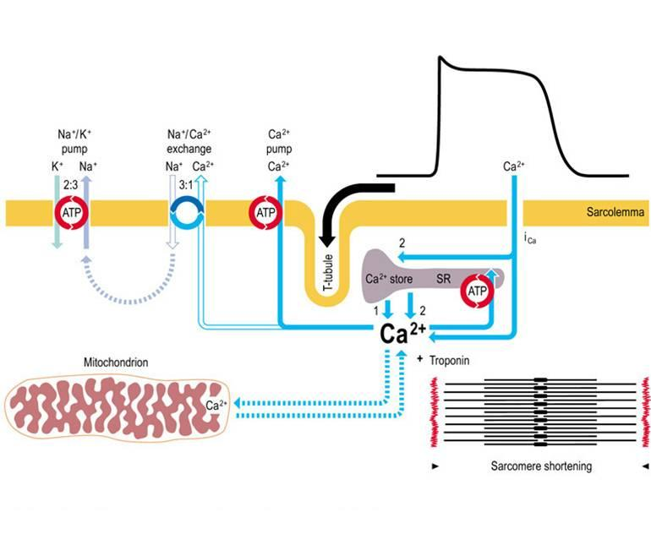
MECHANISM OF ACTION OF DIGOXIN

Slide 31
IV- Drugs that increase contractility
1- Cardiac glycosides ( digitalis) :
Digoxin
Therapeutic uses:
- Congestive heart failure
Atrial arrhythmias:
- Atrial flutter
- Atrial fibrillation
- Supraventricular tachycardia

Slide 32
IV- Drugs that increase contractility
1- Cardiac glycosides ( digitalis) :
Digoxin
Pharmacokinetics of digoxin:
- has narrow therapeutic index
- oral absorption: 40-80% (variable bioavailability)
- 85% is excreted unchanged in the urine

Slide 33
IV- Drugs that increase contractility
1- Cardiac glycosides ( digitalis) :
Digoxin
Adverse effects (Cardiac):
- digitalis-induced arrhythmias
- extrasystoles
- coupled beats (Bigeminal rhythm)
- ventricular tachycardia or fibrillation
- cardiac arrest

Slide 34
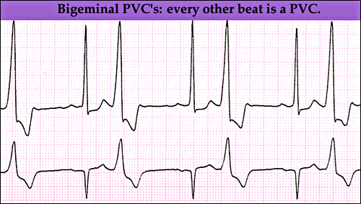

Slide 35
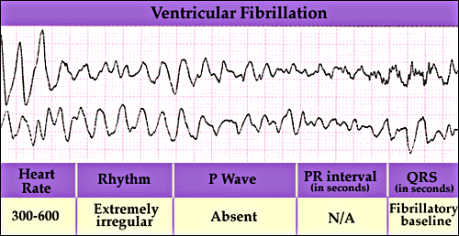

Slide 36
IV- Drugs that increase contractility
1- Cardiac glycosides ( digitalis) :
Digoxin
Adverse effects (non-cardiac) :
GIT :
anorexia ,nausea, vomiting, diarrhea
( the earliest signs of toxicity )
CNS:
headache, visual disturbances, drowsiness

Slide 37
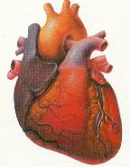


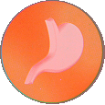
Treatment OF ADVERSE EFFECTS
HEART
CNS
Vision
GIT
???
Atropine
Antiarrythmics
K supplements
FAB fragment
Digoxin , diuretic

Slide 38
IV- Drugs that increase contractility
1- Cardiac glycosides ( digitalis) :
Digoxin
Factors that increase toxicity:
- Renal diseases
- Hypokalemia
- Hypomagnesemia
- Hypercalemia

Slide 39
IV- Drugs that increase contractility
2- β-Adrenoceptor agonists:
Dobutamine
Selective β₁ agonist
Uses : Treatment of acute heart failure in
cardiogenic shock

Slide 40
IV- Drugs that increase contractility
3- phosphodiesterase -III inhibitors:
Amrinone & Milrinone
Mechanism of action:
Inhibit phosphodiesterase -III ( cardiac & B. Vessels)
⬇
inhibit cAMP degradation (↑ cAMP )
⬇ ⬇
Increase cardiac dilatation of arteries & veins
Contractility (reduction of preload & afterload )

Slide 41
IV- Drugs that increase contractility
3- phosphodiesterase -III inhibitors :
Therapeutic uses:
- Milrinone is the PDE-III inhibitor in clinical use
- used only intravenously for management of
acute heart failure
not safe or effective in the longer ( > 48 hours) treatment of patients with heart failure
Amrinone not used now because it causes
thrombocytopenia

Slide 42
IV- Drugs that increase contractility
3- phosphodiesterase -III inhibitors :
Adverse effects:
- nausea ,vomiting
- thrombocytopenia
- liver toxicity
Enoximone & vesnarinone are new drugs
in clinical trials

Slide 43
The use of β-adrenoceptor blockers
in heart failure
The elevated adrenergic activity in chronic
heart failure patients cause structural
remodeling of the heart (cardiac dilatation &
hypertrophy)
β-blockers:
- reduce the progression of chronic heart failure
not used in acute heart failure

Slide 44
The use of β-adrenoceptor blockers
in heart failure
Mechanism of action:
β-blockers:
1- attenuate cardiac remodeling
2- slow heart rate, which allows the left ventricle
to fill more completely
3- decrease renin release
⬇
reduce mortality & morbidity of patients with HF

Slide 45
The use of β-adrenoceptor blockers
in heart failure
β-blockers:
Second generation:
cardioselective ( β₁-receptors )
e.g. Bisoprolol, Metoprolol
- Third generation:
have vasodilator actions ( α- blocking effect)
e.g. Carvedilol , Nebivolol

Slide 46
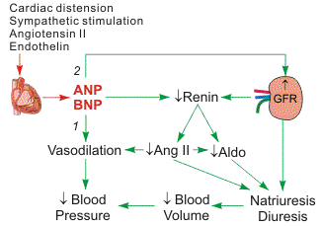
Natriuretic Peptides
BNP is secreted by the ventricular myocardium in
response to stretch
elevated BNP is associated with advanced heart failure ( compensatory mechanism in HF )

Slide 47
Natriuretic Peptides
Nesiritide
purified preparation of human BNP, manufactured by recombinant DNA technology
increases cyclic-GMP in vascular smooth muscle, leading to smooth muscle relaxation, & reduction
of preload and afterload
indicated for the treatment of patients with acutely decompensated heart failure who have dyspnea at rest or with minimal activity

Slide 48
Management of chronic heart failure
Reduce work load of the heart
  - Limit patient activity
  - Reduce weight
  - Control hypertension
Restrict sodium
Stop smoking

Slide 49
Heart Failure Functional Classification
NYHA Class | Symptoms
I | Cardiac disease, but no symptoms and no limitation in ordinary physical activity, e.g. no shortness of breath when walking, climbing stairs etc.
II | Mild symptoms (mild shortness of breath and/or angina), slight limitation during ordinary activity.
III | Marked limitation in activity due to symptoms, even during less-than-ordinary activity, e.g. walking short distances (20–100 m).Comfortable only at rest.
IV | Severe limitations. Experiences symptoms even while at rest. Mostly bedbound patients.

Slide 50
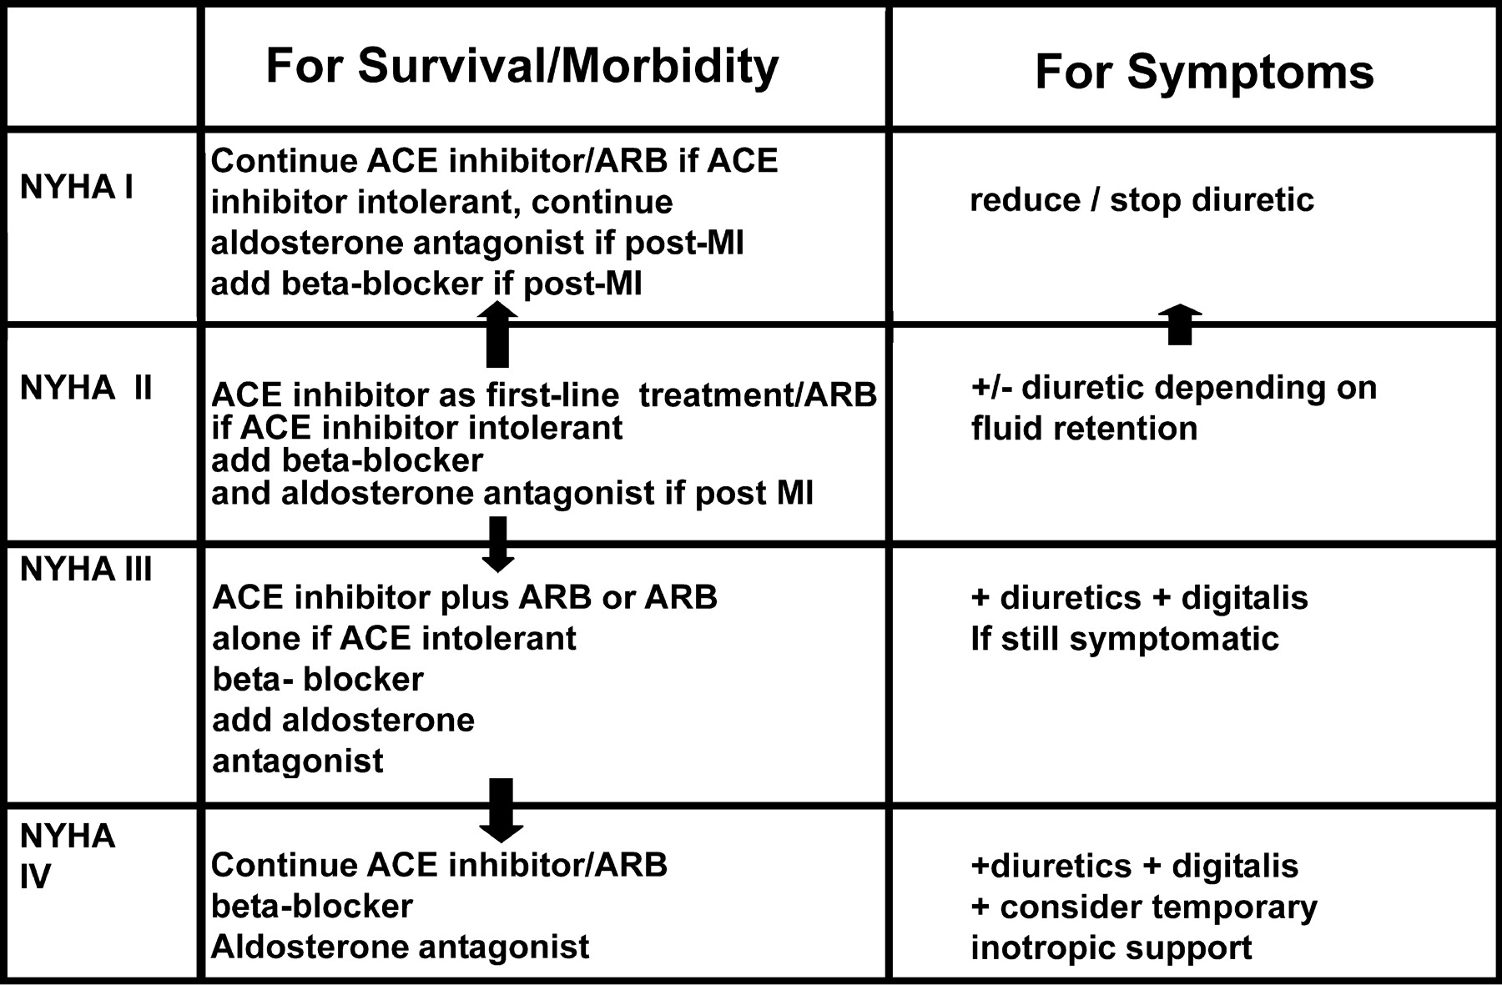
Management of chronic heart failure

Slide 51
Use of vasodilators
hydralazine and isosorbide dinitrate :
- should be considered black patients with advanced heart failure due to left ventricular systolic dysfunction in addition to standard therapy.
- should be considered patients who are intolerant of an angiotensin converting enzyme inhibitor and an angiotensin II receptor blocker due to renal dysfunction
.

Slide 52
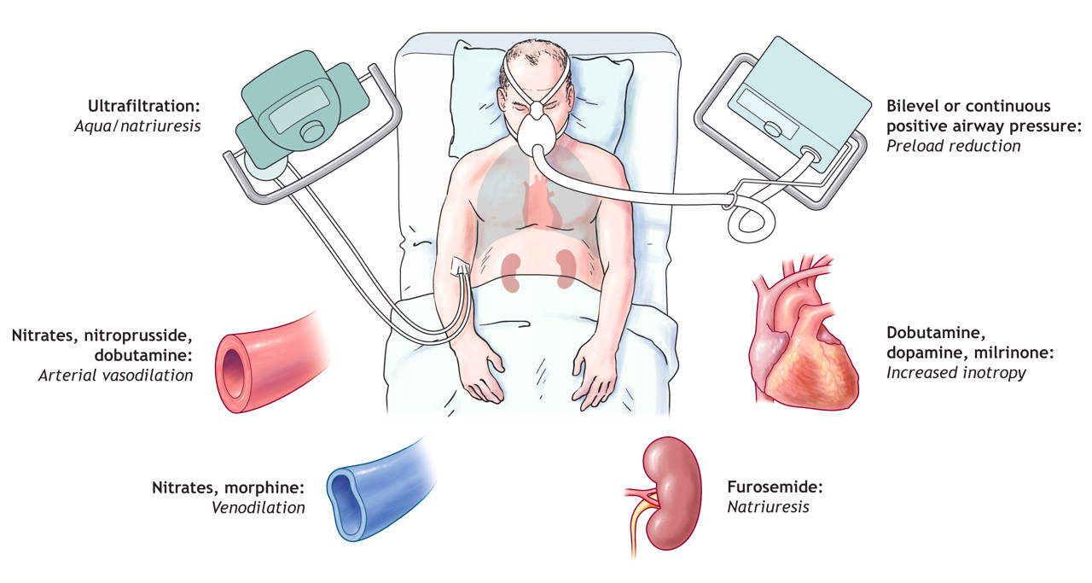
Management of acute heart failure

Slide 53
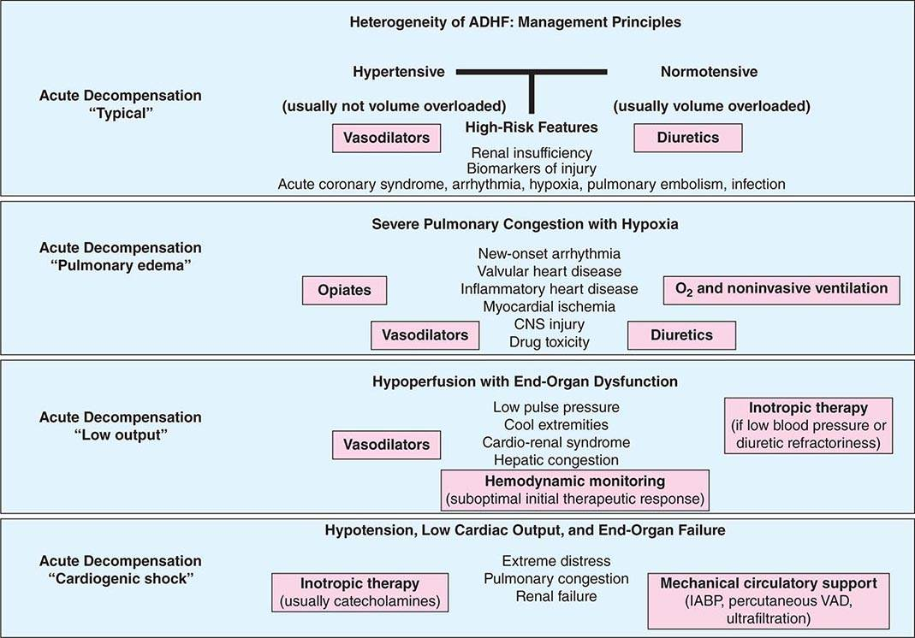

Slide 54

Thank you

