Slide 1
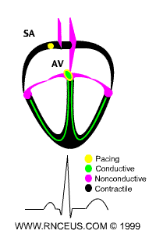
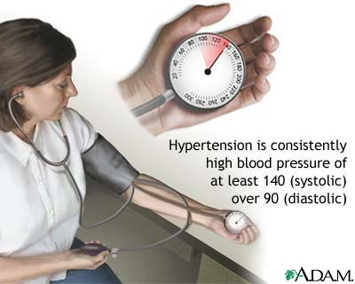
Antihypertensive drugs

Slide 2
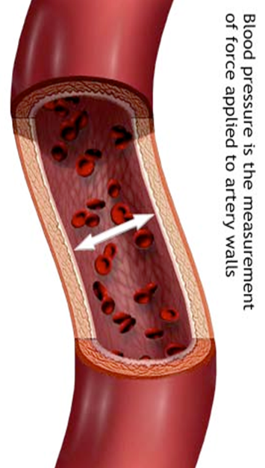
Antihypertensive drugs
ILOS
Identify factors that control blood pressure
Outline the pharmacologic classes of drugs used in treatment of hypertension
Describe mechanism of action, therapeutic uses & common adverse effects and contraindications of each class of drugs
Select the suitable antihypertensive drug used to treat a specific patient according to efficacy, safety and cost

Slide 3
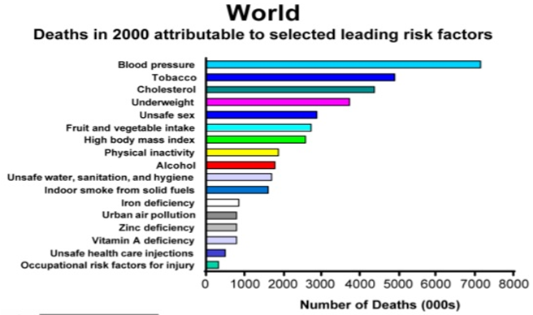
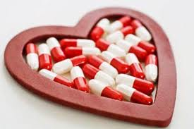
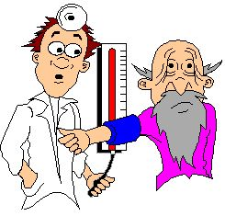
hypertension
Prevalence 25-30%
In majority of cases, it is symptomless “Silent Killer”
Number One cause of death

Slide 4
The rule of halves of Hypertension
For every 800 adults in the community
400 are hypertensive (either ↑ SBP or ↑ DBP or both)
Of them only 200 are diagnosed HT
Of them only 100 are started on treatment
Of them only 50 are on correct drug
Of them in only 25 the goal B.P. is attained
Means 25 ÷ 400 = 6% only have goal BP

Slide 5

Clinical case
Osman a 51-year-old man (95 Kg weight, 176 cm tall) is referred for evaluation of his BP. He is diabetic for 5 years and hypertensive since 12 years, with no history of hypertension target-organ damage. Examination revealed normal heart sounds, no peripheral edema, and mild arteriolar narrowing in the fundus. His BP was 156/90 mmHg, similar in both arms and did not change on standing. Urine analysis showed an unremarkable dipstick evaluation. The patient was suspected as having drug- resistant hypertension.
His medications are listed in the accompanying table.
Name | Dose | Frequency
Hydrochlorothiazide | 25mg | Daily
Valsartan | 160mg | Daily
Diltiazem, long-acting | 300mg | Daily
Clonidine | 0.2mg | Twice daily
Metoprolol, long acting | 100mg | daily
Simvastatin | 40mg | Daily
Fenofibrate | 145mg | Daily
Metformin | 1g | Twice daily

Slide 6

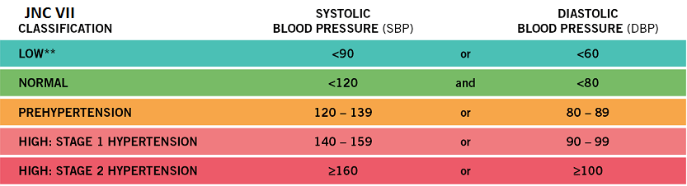

Clinical case
The seated BP of Osman was 156/90, what are the target BP values for treatment of hypertensive patients?
What are the classes of hypertension?
Osman is diabetic, what are the target BP values for a diabetic?

Slide 7
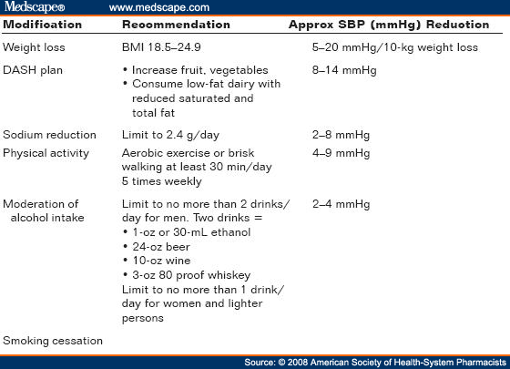
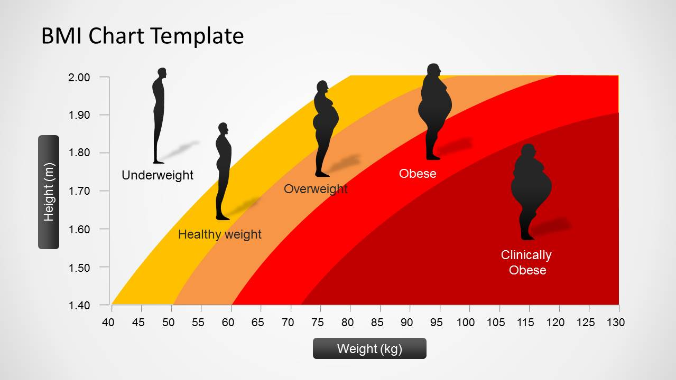
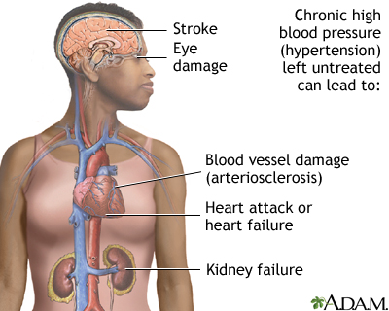
Clinical case
Osman has no history of hypertension- target organ damage. What are organs affected adversely by persistent high BP?
Osman is 95 kg. Is this weight proper for his length (176cm)?
What are the lifestyle modifications, a hypertensive patient should follow?

Slide 8
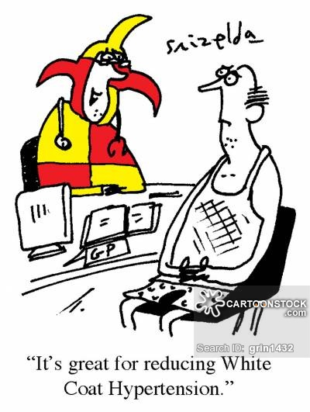
Clinical case
Could the “white coat phenomenon” be the cause for Osman’s high blood pressure readings?
In a Turkish study involving 438 patients, 43% were found to be white coat hypertensives (high pulse rate)

Slide 9
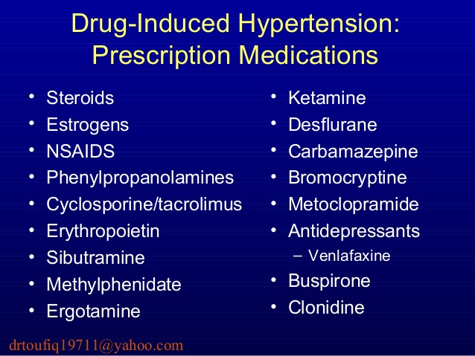
Clinical case
Could the failure of control of Osman BP be due to secondary drug – induced effects?
Which drugs elevate blood pressure?

Slide 10
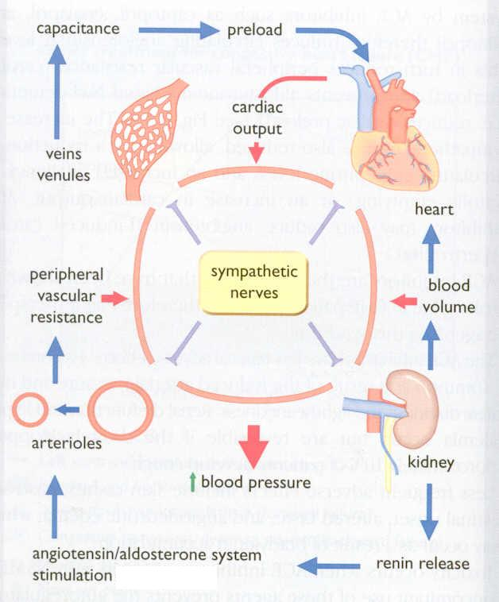
FACTORS IN BLOOD PRESSURE CONTROL

Slide 11
Classification of
Antihypertensive drugs
1-Diuretics
2- Drugs acting on the renin-angiotensin-
aldosterone system (RAAS)
3- Calcium channel blockers
4-Vasodilators
5-Drugs acting on sympathetic nervous system

Slide 12

Diuretics
Hydrochlorothiazide , chlorthalidone & furosemide
Thiazide diuretics
Long- term
initial
Duretics may be adequate in
mild to moderate hypertension
Na⁺ in vessel wall
sodium
& water loss
Mechanism of action
Na⁺-Ca²⁺ exchange
blood volume
Ca²⁺ in smooth muscle cell
Cardiac
outrput
The initial diuresis lasts 4-6 weeks and then replaced by a decrease in PVR
Peripheral resistance
Decrease in BP

Slide 13
Diuretics
Loop diuretics produce more potent diuresis but a smaller decrease in PVR
Loop diuretics are useful in hypertensive patients with either renal impairment, or heart failure ( edema)
Potassium- sparing diuretics have minimal effect on lowering BP

Slide 14
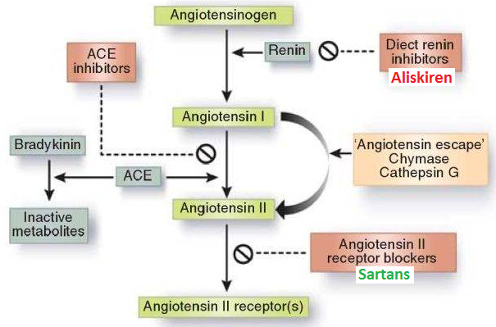
Drugs acting on the renin- angiotensin - aldosterone (RAAS) system
1- Angiotensin-converting enzyme inhibitors (ACEIs)
Captopril
Lisinopril
Enalapril
Ramipril
2-Angiotensin receptors
blockers (ARBs)
Losartan
Valsartan

Slide 15
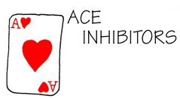
1- Angiotensin-converting enzyme inhibitors (ACEIs)
Particularly effective when hypertension results from excess renin production ( renovascular hypertension, white & young)
The antihypertensive effect of ACE inhibitors results primarily from vasodilatation ( reduction of peripheral resistance ) with little change in cardiac output;
a fall in aldosterone production may also contribute

Slide 16
Angiotensin-converting enzyme inhibitors
pharmacokinetics
Polar, excreted in urine
Do not cross BBB
Have a long half-life & given once daily
Enalapril & ramipril are prodrugs
Rapidly absorbed from GIT after oral administration
Food reduces their bioavailability
It takes 2-4 weeks to notice the full antihypertensive effect of ACEIs
Enalaprilat is the active metabolite of enalapril given by i.v. route in hypertensive emergency

Slide 17
Angiotensin-converting enzyme inhibitors
Clinical uses
1- Treatment of essential hypertension
2- Hypertension in patients with chronic
renal disease, ischemic heart
disease, diabetes
3-Treatment of heart failure

Slide 18
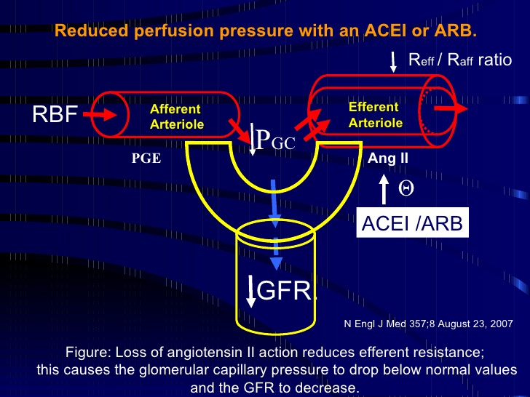
Angiotensin-converting enzyme inhibitors
adrs
Dry cough
Acute renal failure, especially in patients with renal artery stenosis
Severe hypotension in hypovolemic patients
Cause renal agensia/failure in the fetus
resulting in oligohydraminosis

Slide 19
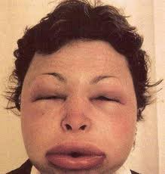
Adrs of ACEIs
Angioneurotic edema, swelling of the nose, throat, tongue, larynx (caused by inhibition of bradykinin metabolism which accumulate in bronchial mucosa)
First dose effect (severe hypotension) - give at bed time -starts with small dose and increase the dose gradually
adrs specific to captopril
Skin rash, fever
Dysgeusia = reversible loss or altered taste
Proteinuria and neutropenia
These effects are due to a sulfhydryl group in the molecule of captopril

Slide 20
Angiotensin-converting enzyme inhibitors
contraindications
During the second and third trimesters of pregnancy due to the risk of: fetal hypotension, anuria ,renal failure & malformations
Renal artery stenosis
Potassium-sparing diuretics
NSAIDs impair their hypotensive effects by blocking bradykinin-mediated vasodilatation

Slide 21
2- Angiotensin receptors blockers (ARBs)
Losartan, Valsartan, Candesatran, Telmisartan
Cause selective block of AT1 receptors
No effect on bradykinin, no cough, no angioedema
Produce more complete inhibition of angiotensin as there are other enzymes ( not only ACE) that can generate angiotensin

Slide 22
Angiotensin receptors blockers
losartan
Has a potent active metabolite
Orally effective
Long half-life, taken once daily
Do not cross BBB
valsartan
No active metabolites
Same contraindications as ACEI
Same ADRs, except for
dry cough & angioneurotic edema

Slide 23
Plasm a Le ve ls Be fo re Aft e r
Ald o s t e r o n e Hig h Lo w
Pot assium (m Eq / L) 3.5 4.3
Re n in No r m a l Hig h
An g io t e n s in II Hig h Lo w
Plasm a Le ve ls Be fo re Aft e r
Ald o s t e r o n e Hig h Lo w
Pot assium (m Eq / L) 3.5 4.3
Re n in No r m a l Hig h
An g io t e n s in II Hig h Lo w
Think- pair-share
A 63-year-old hypertensive woman had been receiving an
antihypertensive drug for 15 days. The following serum
values were obtained from the patient before and after drug therapy.
A
Plasma level | Before | After
Aldosterone | High | Low
Potassium (mEq/l) | 3.5 | 4.3
Renin | Normal | High
Angiotensin II | High | Low
Which drug the woman has been receiving

Slide 24
Clinical case
Osman was prescribed hydrochlorthiazide & valsartan.
What is the rationale for combining hydrochlorothiazide and valsartan?

Slide 25

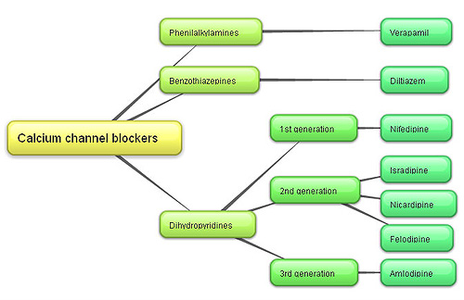
3-Calcium channel blockers
V ery
N ice
D rugs
Verapamil act more on myocardium
Dihydropyridine group act mainly on smooth muscle, Nifedipine
Diltiazem has intermediate effect

Slide 26
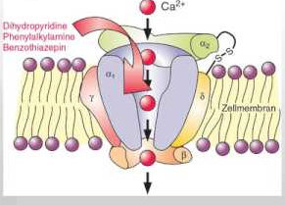
Calcium channel blockers
Mechanism
Block the influx of calcium through calcium channels resulting in:-
1- Peripheral vasodilatation
2- Decrease cardiac contractility

Slide 27
Calcium channel blockers
pharmacokinetics
Given orally or IV
Onset 1-3 min after IV, 0.5-2hr after oral
Well absorbed
Verapamil & diltiazem have active metabolites,
nifedipine has not
Verapamil and nifedipine are highly bound to plasma protiens ( more than 90%) while diltiazem is less ( 70-80%)
Sustained-release preparations can permit once-daily dosing

Slide 28
Calcium channel blockers
Clinical uses
Treatment of chronic hypertension
Nicardipine can be given by I.V. route in hypertensive emergency
Sustained- release formulations are preferred for the treatment of hypertension due to the short half- life of CCBs

Slide 29
Calcium channel blockers
adrs
Headache, flushing, hypotension
Nifedipine: Tachycardia
Verapamil & Diltiazem: peripheral edema (ankle edema *)
Verapamil: constipation

Slide 30
Clinical case
Osman was prescribed thiazides & diltiazem. What is the benefit of combining thiazides and diltiazem? (ankle edema)
The BP of Osman did not change on standing. What is your conclusion?
The BP of Osman was almost the same in both arms. What does that imply?

Slide 31
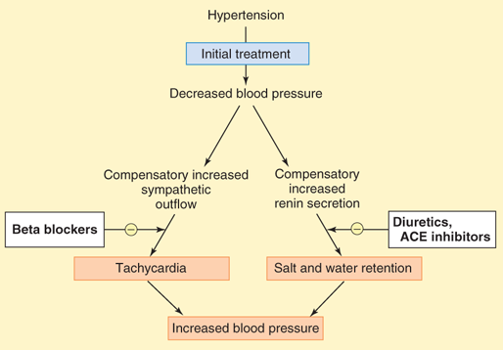
4- vasodilators
Classified into arterial, venous or mixed vasodilators
Once vasodilators are administered, fall in BP produced will activate the sympathetic system & the RAAS

Slide 32
vasodilators
Sodium nitroprusside | Diazoxide | Minoxidil | Hydralazine
Arterio & venodilator | Arteriodilator | Arteriodilator | Arteriodilator | Site of action
Release of nitric oxide ( NO) | Opening of potassium channels | Opening of potassium channels in smooth muscle membranes by minoxidil sulfate ( active metabolite ) | Direct | Mechanism of action
Intravenous infusion | Rapid intravenous | Oral | Oral | Route of admin.

Slide 33
vasodilators
Sodium nitroprusside | Diazoxide | Minoxidil |  | Hydralazine
Severe hypotension | Hypotension, reflex tachycardia, palpitation, angina, salt and water retention ( edema) |  |  |  |  | Adverse effects
1.Methemoglobinduring infusion 2. Cyanide toxicity 3. Thiocyanate toxicity | Inhibit insulin release from β cells of the pancreas causing hyperglycemia Contraindicated in diabetics |  | Hypertrichosis. Contraindicated in females |  | lupus erythematosus like syndrome | Specific adverse effects

Slide 34
vasodilators
Sodium nitroprusside |  | Diazoxide | Minoxidil |  | Hydralazine
1.Hpertensive emergency |  | 1.Hypertensive emergency | 1.Moderate –severe hypertension |  | 1.Moderate -severe hypertension. | Therapeutic uses
In combination with diuretics & β-blockers
2.Severe heart failure | 2. Treatment of hypoglycemia due to insulinoma |  | 2. baldness | 2.Hypertensive pregnant woman

Slide 35
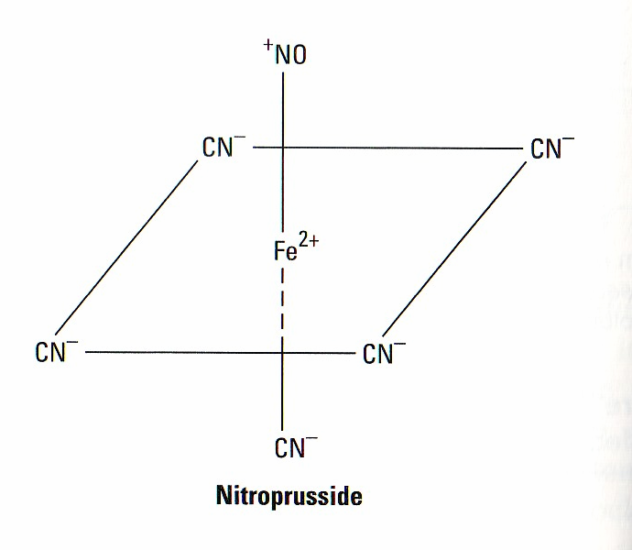
vasodilators
Sodium nitroprusside
adrs
Headache, palpitations which disappear when infusion is stopped
Cyanide accumulation cause cyanide poisoning ( metabolic acidosis, arrhythmias, severe hypotension and death)

Slide 36
5-Sympatholytic Drugs
i-ß Adrenoceptor blockers
Propranolol, atenolol, metoprolol
β- adrenoceptors are used in mild to moderate hypertension
In severe cases used in combination with other drugs
May take two weeks for optimal therapeutic response
Evidence support the use of ß-blockers in patients with concomitant coronary artery disease
When discontinued, ß- blockers should be withdrawn gradually

Slide 37
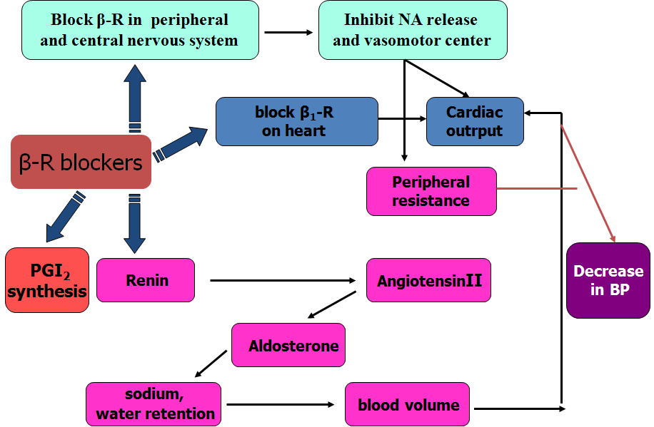
ß- Adrenoceptor blockers
mechanism
They lower blood pressure by :
i-Decreasing cardiac output.
ii-Inhibiting the release of renin
iii- Central mechanism

Slide 38
ß Adrenoceptor blockers
ADrs
Hypoglycemia !!!!!
Fatigue
Mask the symptoms of hypoglycemia in diabetes
Increased triglycerides
Aggravate peripheral arterial disease
Erectile dysfunction

Slide 39
Sympatholytic drugs
ii- α Adrenoceptor blockers
Block α- receptors in arterioles and venules
Reduce blood pressure by decreasing both afterload & preload
Prazosin, short- acting causes first dose hypotension & postural hypotension
Doxazosin, is preferred long half- life

Slide 40
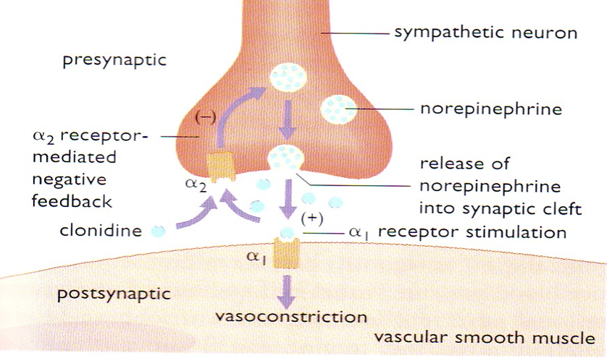
III- Centrally- acting Sympatholytic drugs
Clonidine
α2-agonist, diminishes central adrenergic outflow & ↑ parasympathetic outflow
Abrupt withdrawal may lead to rebound hypertension
Does not decrease renal blood flow or glomerular filtration
Useful in the treatment of hypertension complicated by renal disease and resistant hypertension

Slide 41
III- Centrally- acting Sympatholytic drugs
Sympatholytic drugs
α- methyldopa
An α- 2 agonist, is converted to methyl noradrenaline centrally to diminish the adrenergic outflow from the C.N.S
Lead to reduced total peripheral resistance, and a decreased in blood pressure
α -Methyldopa is the first line treatment of hypertension in pregnancy

Slide 42
Clinical case
List the reasons, why Osman failed to respond to antihypertensive therapy?

Slide 43
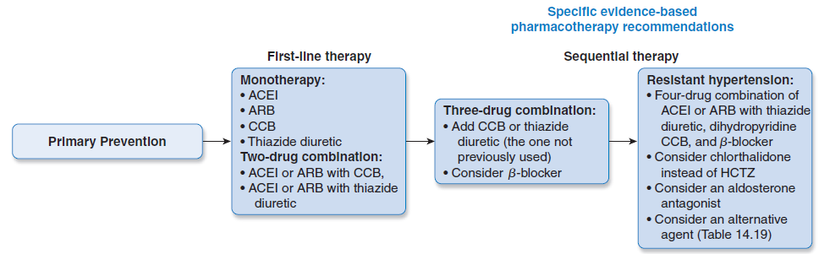
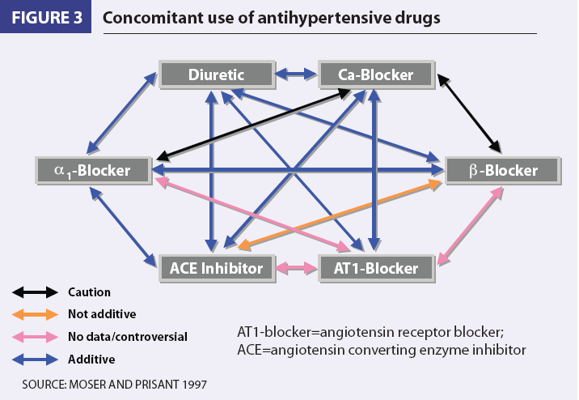
Clinical case
Could the failure of Osman control of BP be due to the use of inappropriate combinations of drugs?
Use of combinations→↓ individual dose→↓ ADRs
Select a drug that ↓ the ADR of another, e.g. thiazides versus ACEI
Select a drugs that act by different mechanisms

Slide 44
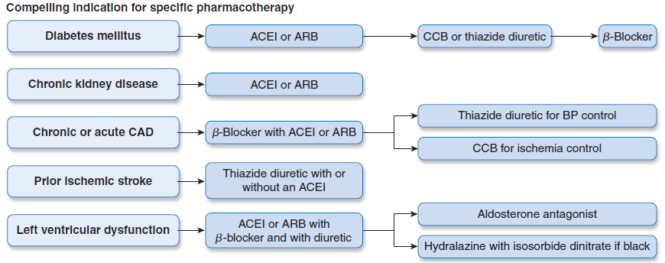
Antihypertensive drugs

Slide 45
Memory matrix
Enter + or – in the cells to indicate the presence or absence of a feature
Compelling contraindications of antihypertensive drugs
 | HF | Pregnancy | Hypokalemia | Bradycardia | Asthma | Hyperkalemia | Gout
Diuretics
ACEI
CCB
ß-blockers
ARB

Slide 46
