Slide 1


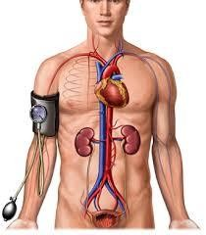


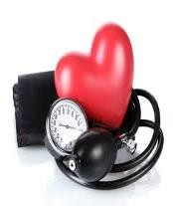







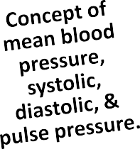

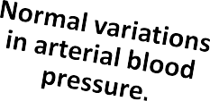





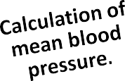
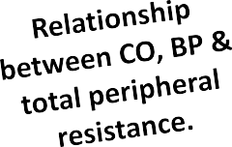
3/6/2016
Cardiovascular Physiology
Cardiovascular Physiology
Arterial Blood Pressure
Dr. Abeer A. Al-Masri, PhD
A. Professor,
Consultant Cardiovascular Physiologist, Faculty of Medicine, KSU.
Lecture Outcomes
Dr. Abeer A. Al-Masri, Faculty of Medicine, KSU
2

Slide 2

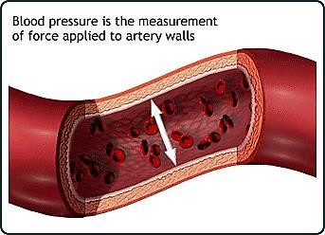
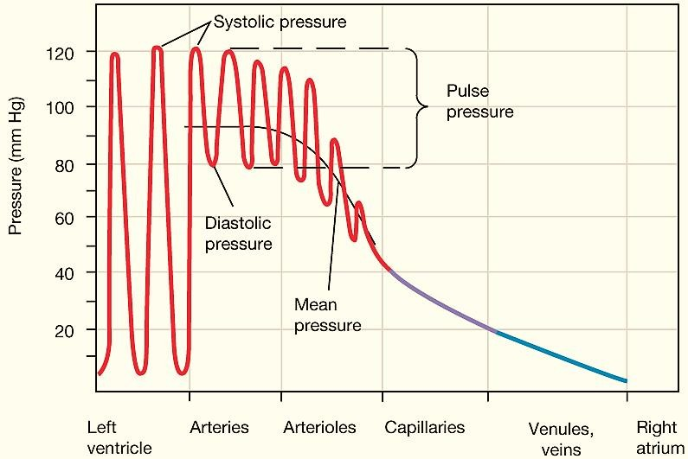
3/6/2016
Cardiovascular Physiology
What is meant by Arterial Blood Pressure?
= Lateral pressure created by the heart as it pumps blood, against any unit area of the vessel wall.
In normal adult ≈ 120/80 mmHg
Top number (Systolic):
= Pressure while the heart is beating.
Bottom number (Diastolic):
= Pressure while the heart is relaxing.
Dr. Abeer A. Al-Masri, Faculty of Medicine, KSU
3
Pressure changes throughout the systemic circulation
Dr. Abeer A. Al-Masri, Faculty of Medicine, KSU
4

Slide 3
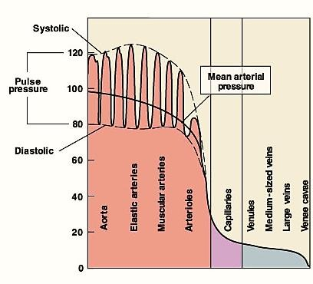
3/6/2016
Cardiovascular Physiology
Pressure changes throughout the systemic circulation
Blood flows down a pressure gradient.
Highest at the heart.
↓ over distance.
↓ 90% from aorta to vena cava.
Greatest drop in pressure occurs in arterioles.
No large fluctuations in capillaries & veins.
BP averages 120 mm Hg in aorta & drops to 0-2 mm Hg in RA
5
Dr. Abeer A. Al-Masri, Faculty of Medicine, KSU
Variations in Arterial Blood Pressure
Aortic pressure:
  120 mmHg systolic.
  80 mmHg diastolic.
Normal arterial pressure:
  110 – 130 mmHg systolic.
  70 – 85 mmHg diastolic.
Dr. Abeer A. Al-Masri, Faculty of Medicine, KSU
6

Slide 4



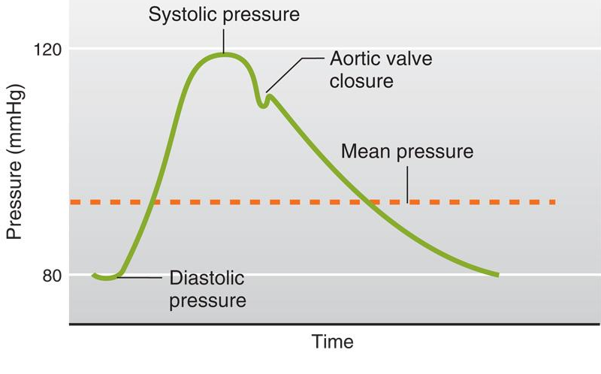
3/6/2016
Cardiovascular Physiology
American Heart Association
Recommended Blood Pressure Levels
Adult BP range 110 – 130 / 70 – 85 mmHg
BP Category | Systolic (mmHg) |  | Diastolic (mmHg) | Follow-up
Optimal | < 120 | & | < 80 | Recheck 2 years
Normal | < 130 | & | < 85 | Recheck 2 years
High Normal (Pre-hypertension) | 130-<140 | or | 85-<90 | Recheck 1 year
Dr. Abeer A. Al-Masri, Faculty of Medicine, KSU
7
Aortic pressure changes … 120/80
 | Mean Pressure = diastolic P + 1/3 (systolic P - diastolic P)
Pulse pressure = Systolic P – Diastolic P
Adapted from Guyton |  | 8

Slide 5
3/6/2016
Cardiovascular Physiology
Factors Affecting ABP
Sex … M > F … (equal @ menopause)
Age … Elderly > children …(atherosclerosis)
Emotions …↑ … (neural factors)
Exercise …↑ … (↑ venous return)
Hormones …↑ (e.g. Adrenaline, noradrenaline, thyroid H)
Gravity … ↑ Lower limbs > upper limbs
Race … (? dietary factors, or stress)
Sleep … ↓ … (↓ venous return)
Pregnancy …↑ … (↑ metabolism)
Temperature … Heat (vasodilatation); Cold (vasoconstriction)
Dr. Abeer A. Al-Masri, Faculty of Medicine, KSU
9
Factors Determining ABP
Cardiac output (Flow.)
Peripheral Resistance.
Blood volume.
Blood Pressure = Cardiac Output X Peripheral
Resistance
(MABP)
(CO)
Blood Flow
(PR)
Peripheral resistance
Dr. Abeer A. Al-Masri, Faculty of Medicine, KSU
10

Slide 6
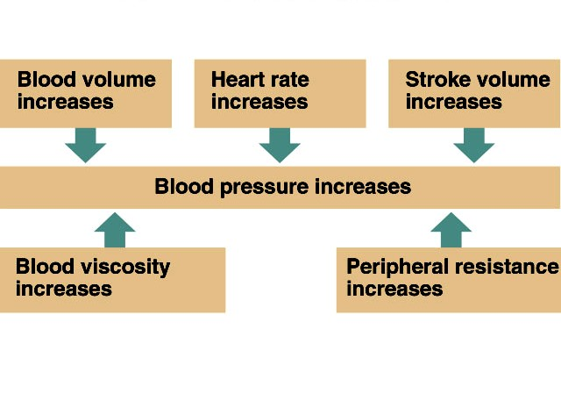
3/6/2016
Cardiovascular Physiology
Cardiac Output (CO)
Cardiac output (CO) is the amount of blood pumped by ventricles per minute.
Factors determining CO:
  Stroke volume
  Heart rate
Cardiac Output = Stroke Volume X Heart Rate
Cardiac Output
(CO)
= output of
ventricles / minute
≈ 5 L/min
(av. 5-6 L/min)
Stroke Volume (SV)
= output of ventricles / beat
70 ml/beat (av. 70-80 ml/bt)
Heart Rate (HR)
= beats/ minute
≈ 70-75 beats/min (N. 60-100 beats/min)
Dr. Abeer A. Al-Masri, Faculty of Medicine, KSU
11
Blood Volume depends on:
Fluid intake.
Fluid loss.
CO = SV X HR
Resistance depends on:
Size & length of blood vessel.
Thickness (viscosity) of blood.
Adapted from Guyton
12

Slide 7

3/6/2016
Cardiovascular Physiology
Blood Flow
Amount of blood moving through a vessel in a given time period.
Generally is equal to Cardiac output (CO.)
Affected by: pressure & resistance.
_{Q =} ∆P
R
Directly proportional to pressure differences.
Inversely proportional to resistance.
Dr. Abeer A. Al-Masri, Faculty of Medicine, KSU
13
Resistance (R)
= tendency of vascular system to oppose flow
1
Flow =
R
Influenced by:
Length of the tube (L), radius of the tube (r), & viscosity of the blood (η)
In a normal human, length of the system is fixed, so blood viscosity & radius of the blood vessels have the largest effects on resistance..
Poiseuille’s Law
R = 8ηL/ πr⁴
Dr. Abeer A. Al-Masri, Faculty of Medicine, KSU
14

Slide 8

3/6/2016
Cardiovascular Physiology
Poiseuille’s Law
Fluid Flow (Q) through Cylindrical Tubes.
Flow decreases (↓) when resistance increases.
Flow resistance decreases (↓) when vessel diameter increases.
Q =
(Pi - Po) π r⁴
8ηL
Difference in Pressure
Viscosity
Length
Radius
Dr. Abeer A. Al-Masri, Faculty of Medicine, KSU
15
Total Peripheral Resistance
R =
∆P Q
Systemic Circulation:
_{TPR =} Aortic Pressure - RAP
Flow
Pulmonary Circulation:
Pul. R. =
Pul. Art. P. - LAP
Flow
15 - 5 mmHg
83.3 ml/sec
_{TPR =} 100 - 0 mmHg
83.3 ml/sec (5 L/min)
Pul. R. =
TPR =
1.2 (PRU’s)
Pul. R. = 0.12 (PRU’s)
Dr. Abeer A. Al-Masri, Faculty of Medicine, KSU
16

Slide 9


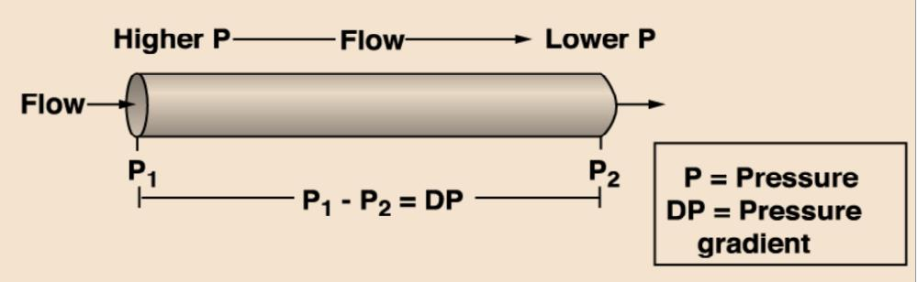


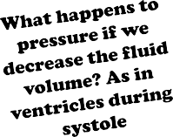


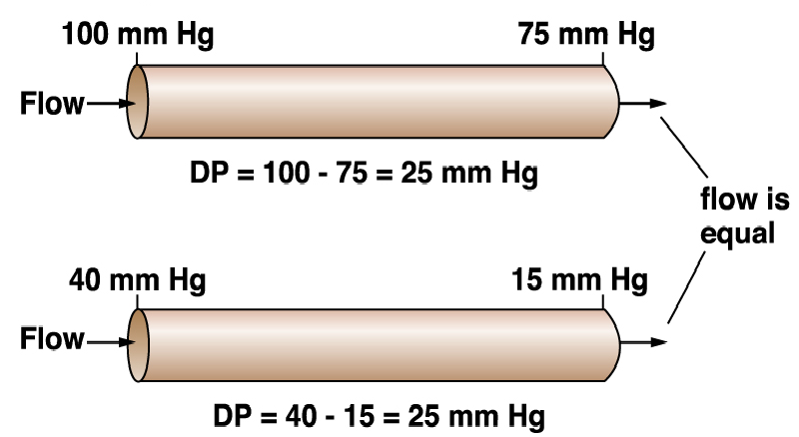
3/6/2016
Cardiovascular Physiology
Blood Flow and Pressure
P directly proportional to F
Blood flows down a pressure gradient.
Absolute value of pressure is not important to flow, but the difference
in pressure (DP or gradient) is important to determining flow.
Resulting pressure is called the driving pressure in vascular system
Dr. Abeer A. Al-Masri, Faculty of Medicine, KSU 17
How does the flow differ in these two vessels?
Dr. Abeer A. Al-Masri, Faculty of Medicine, KSU
18

Slide 10







3/6/2016
Cardiovascular Physiology
Resistance to Flow in the Cardiovascular System Basic Concepts Rt = R1 + R2 + R3 …. Series Resistance 1/Rt = 1/R1 + 1/R2 + 1/R3 … Parallel Resistance R1 Series Parallel _{R2} R1 R2 R3 _{R3} What Really Happens in the CVS? Lower R Higher R Lower R _{Artery} Capillaries
Dr. Abeer A. Al-Masri, Faculty of Medicine, KSU | Arterioles | 19
Resistance to Flow in the Cardiovascular System
If: R₁ = 2; R₂ = 4; R₃ = 6 Peripheral Resistance Units (PRU’s)
Series arrangement gives:
R_{T} = R₁ + R₂ + R₃ R_{T} = 12 (PRU’s)
Parallel arrangement gives:
R_{T} =
1
= 1.94 (PRU’s)
1 ₊ 1 ₊ 1
R₃
R₁ R₂
Dr. Abeer A. Al-Masri, Faculty of Medicine, KSU
20
10

Slide 11

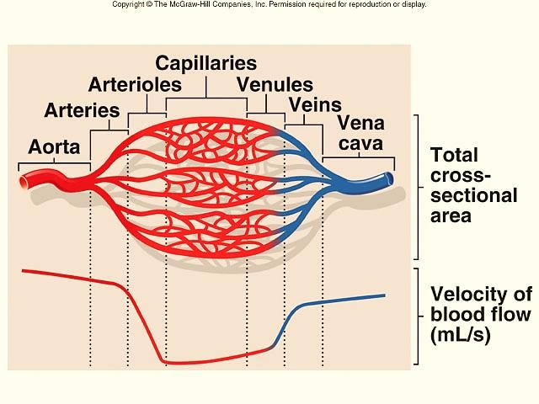



3/6/2016
Cardiovascular Physiology
Cross-Sectional Area
As diameter of vessels ↓, the total cross-sectional area
↑ & velocity of blood flow ↓
21
Velocity and Cross Sectional Area
A = 2cm² 10cm² 1cm²
Q =10ml/s
a
b
c
V = 5cm/s 1cm/s 10cm/s
V = Q / A
Dr. Abeer A. Al-Masri, Faculty of Medicine, KSU
22
11

Slide 12
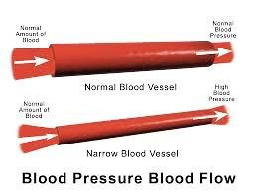
3/6/2016
Cardiovascular Physiology
Effect of Radius on Pressure
Dr. Abeer A. Al-Masri, Faculty of Medicine, KSU
23
Compliance of Blood Vessels
Compliance = distensibility.
Compliance is the volume of blood that the vessel can hold at a given pressure.
C = V
P
Vascular compliance, is the tendency for blood vessel volume to increase as BP increases.
Dr. Abeer A. Al-Masri, Faculty of Medicine, KSU
24

Slide 13
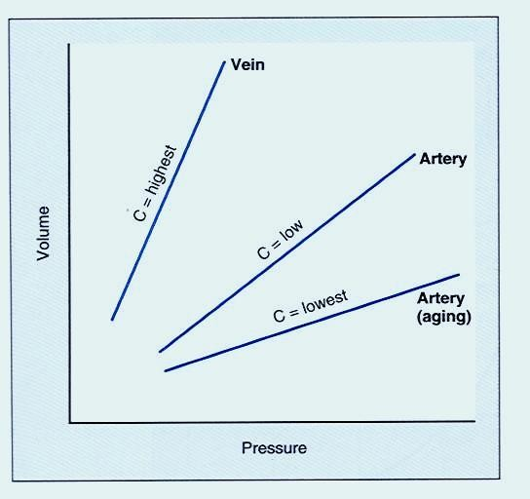

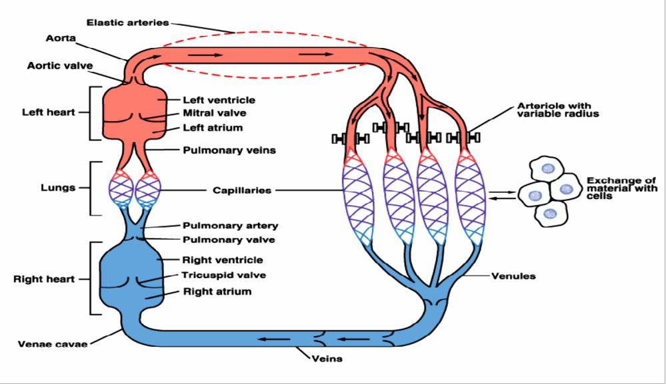
3/6/2016
Cardiovascular Physiology
Venous system has a large compliance & acts as a blood reservoir (high volume & low pressure)
C = V
P
C = Compliance
V = Volume
P = Pressure
Dr. Abeer A. Al-Masri, Faculty of Medicine, KSU
25
Vascular system possesses different mechanisms for promoting continuous flow of blood to the capillaries:
Elastic recoil
Smooth m. regulation of diameter
Sphincters
Valves
Muscular arteries
Dr. Abeer A. Al-Masri, Faculty of Medicine, KSU
26

Slide 14

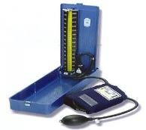
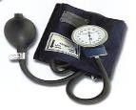
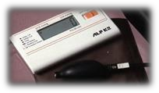
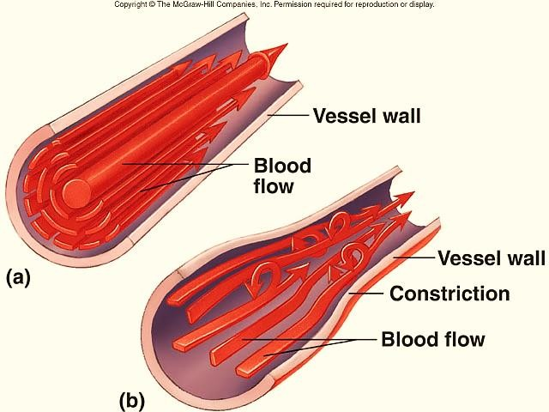
3/6/2016
Cardiovascular Physiology
Measurement of Arterial
Blood Pressure
Two methods: Direct & indirect
Sphygmomanometer:
  Indirect method, "Estimate of pressure"
  Many types:
    Mercury sphygmomanometer
    Aneroid equipment
    Automatic equipment
  Blood Pressure Cuff Size:
    Small – children & small adults
    Average
    Large – overweight & large adults
Dr. Abeer A. Al-Masri, Faculty of Medicine, KSU 27
Laminar and Turbulent Flow
Laminar flow
  Stream-lined
  Outermost layer moving slowest & center moving fastest
Turbulent flow
  Interrupted
  Fluid passes a constriction,
sharp turn, rough surface
  Rate of flow exceeds critical velocity
Dr. Abeer A. Al-Masri, Faculty of Medicine, KSU
28

Slide 15
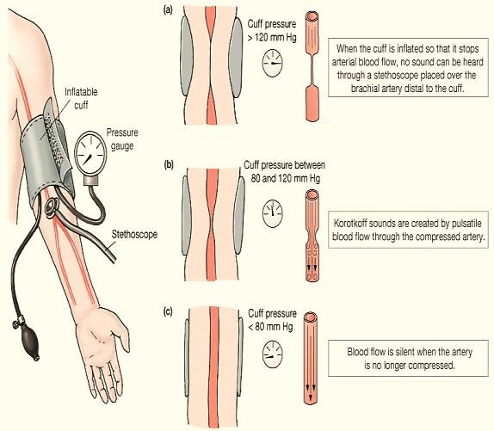
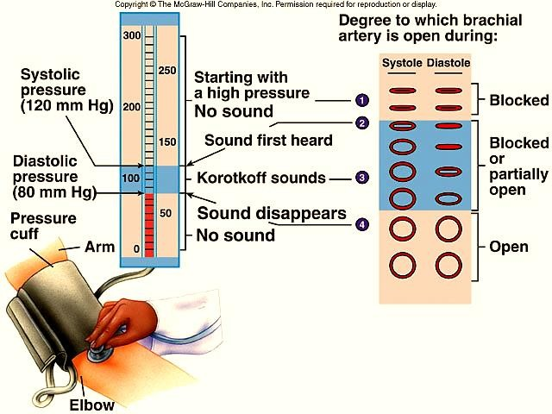
3/6/2016
Cardiovascular Physiology
Blood Pressure (BP): Measurements
BP is measured by listening for Korotkoff sounds produced by turbulent flow in arteries:
Systolic pressure
= when 1st sound is heard
Diastolic pressure
= when last sound is heard
Dr. Abeer A. Al-Masri, Faculty of Medicine, KSU
29
Blood Pressure (BP): Measurements
30

Slide 16
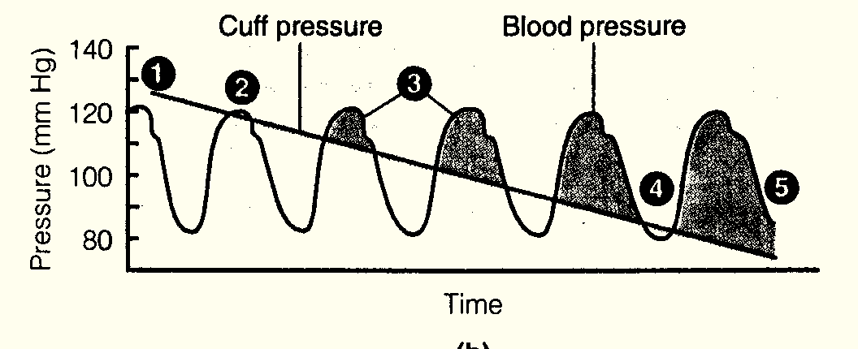


3/6/2016
Cardiovascular Physiology
Measuring Blood Pressure Turbulent Flow
Cuff pressure > systolic blood pressure.. No sound
The first sound is heard at peak systolic pressure.
Sounds are heard while cuff pressure < blood pressure.
Sound disappears when cuff pressure < diastolic pressure.
31
Thank You

