Slide 1




C A R D I O V A S C U L A R P H Y S I O L O G Y
SHOCK
DR . A B E E R A . A L - MA S R I
A . P R O F E S S O R & C O N S U L T A N T
CA R D I O V A S CU L A R P H Y S I O L O G I S T FA C U L T Y O F M E D I C I N E , K S U

Slide 2




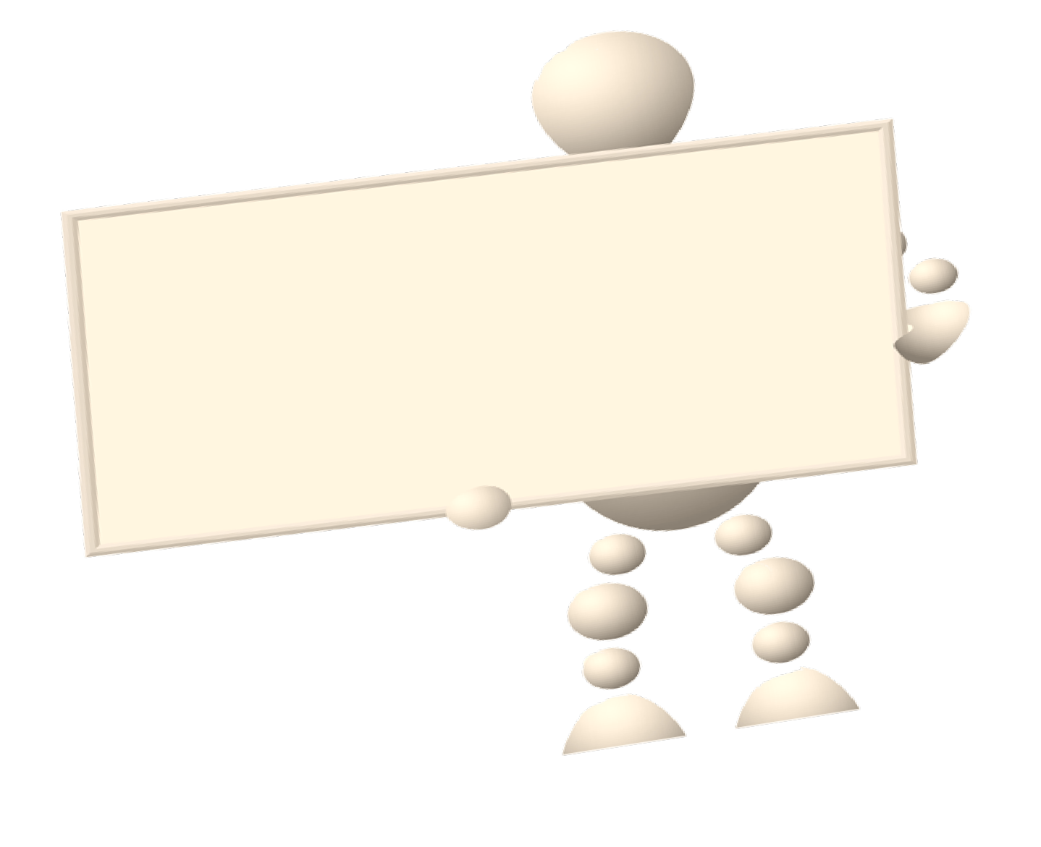





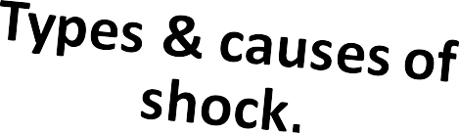

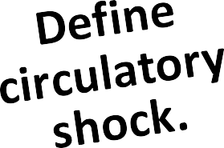




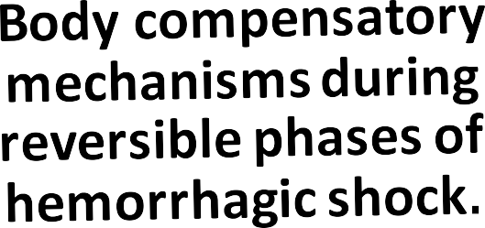


Dr. Abeer A. Al-Masri, Faculty of Medicine, KSU

Slide 3
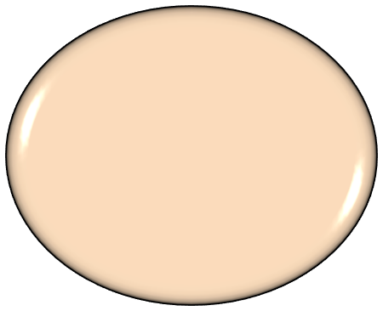
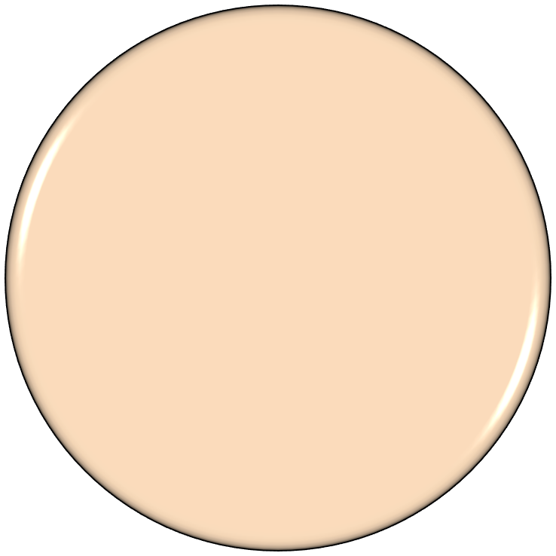

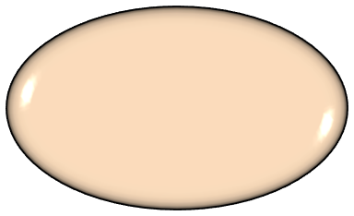
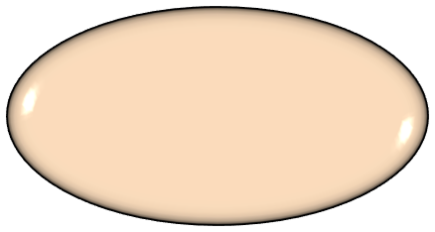
BASIC UNIT OF LIFE
Cells get
their needed energy to stay alive.
Cell
No oxygen,
no energy.
No energy, no life.
Dr. Abeer A. Al-Masri, Faculty of Medicine, KSU

Slide 4
WHAT IS SHOCK ?
Any condition in which the circulatory system is unable to provide adequate circulation & tissue perfusion, resulting in failure to deliver oxygen to the tissues & vital body organs relative to its metabolic requirement.
Defined as Circulatory Shock.
Results in organ dysfunction & cellular damage.
If not quickly corrected, it may lead to irreversible shock & death.
Dr. Abeer A. Al-Masri, Faculty of Medicine, KSU

Slide 5





TYPES OF CIRCULATORY SHOCK
Circulatory Shock
MAP = CO X PR
MAP = CO X PR
Low Output Shock
High / N Output Shock
Hypovolemic
Distributive Neurogenic/Spinal
Distributive
Obstructive
Vasogenic
Cardiogenic
Anaphylactic
Psychogenic
Septic/ Toxic
Dr. Abeer A. Al-Masri, Faculty of Medicine, KSU

Slide 6
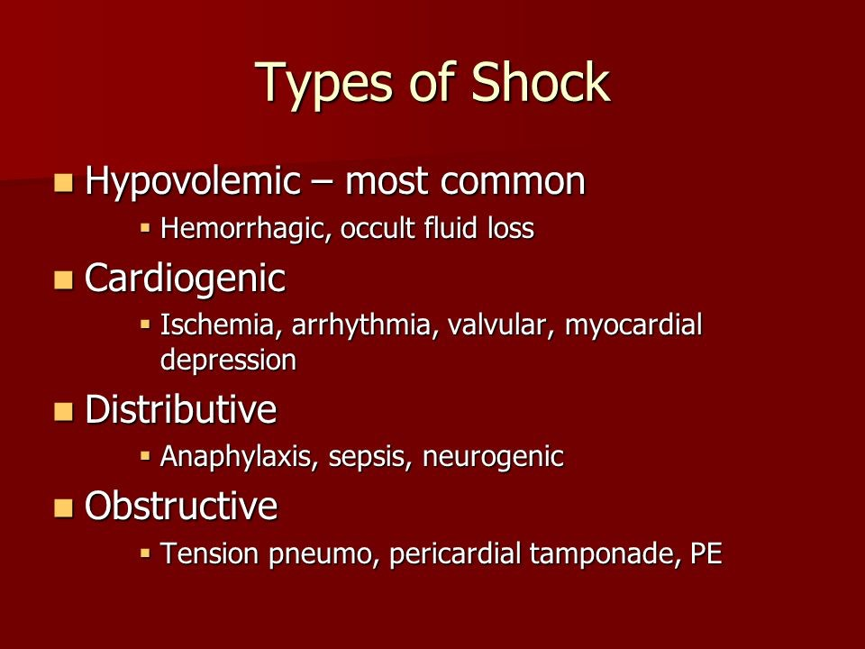

Slide 7
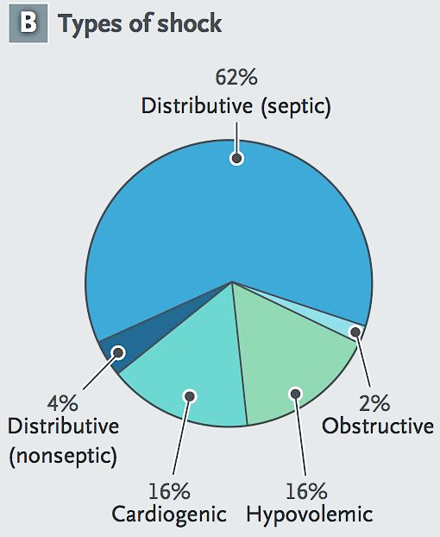

Slide 8

HYPOVOLEMIC SHOCK
q Low CO due to:
MAP = CO X PR
Inadequate blood/plasma volume (loss of 15-25% / 1-2 L).
Reduced venous return (preload.).
q Causes:
Blood loss: Hemorrhage.. internal or external. (commonest.)
Fluid/plasma loss: Vomiting, diarrhea, burn, excess sweating, dehydration, trauma.
Dr. Abeer A. Al-Masri, Faculty of Medicine, KSU
8

Slide 9
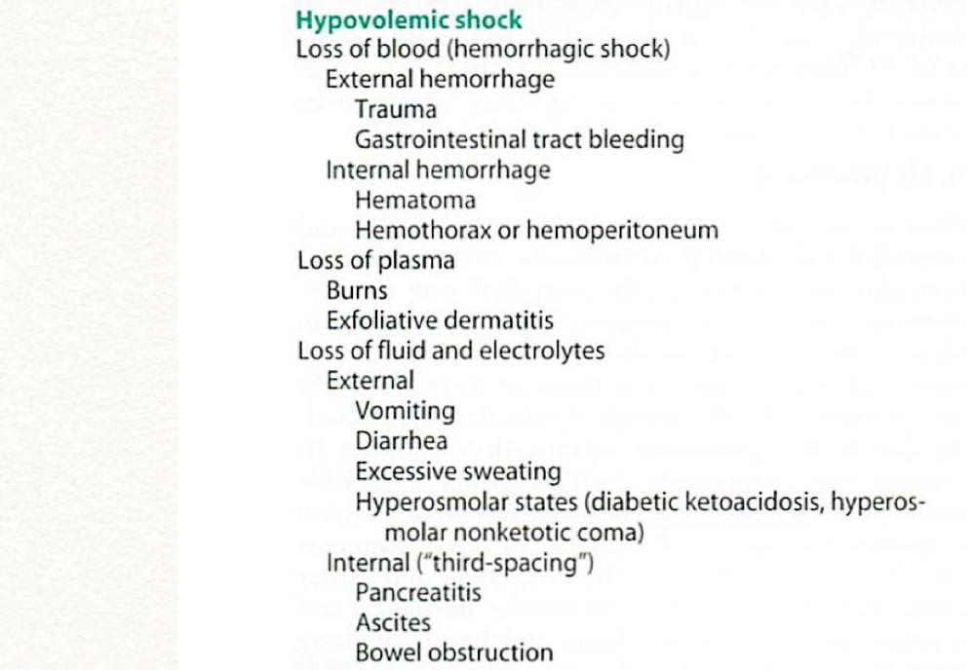
9

Slide 10
CARDIOGENIC SHOCK
q Low CO due to:
MAP = CO X PR
Failure of myocardial pump, despite adequate ventricular filling pressure.
q Causes:
Myocardial Infarction.. (Most common.)
Myocarditis.
Cardiomyopathy.
Cardiac tamponade.
Acute valvular dysfunction, e.g. rupture of papillary muscle post MI.
Congestive heart failure.
Sustained Arrhythmias, e.g. heart block, ventricular tachycardia.
Pulmonary embolism.
q Is associated with loss of > 40% of LV myocardial function.
q Mortality rate is high (60-90%).

Slide 11
OBSTRUCTIVE SHOCK
q CO is reduced by vascular obstruction:
Obstruction of venous return:
  e.g. Vena Cava Syndrome (usually neoplasms).
Compression of the heart:
  e.g. hemorrhagic pericarditis → cardiac tamponade.
Obstruction of the outflow of the heart:
  Aortic dissection.
  Massive pulmonary embolism.
Pneumothorax.
MAP = CO X PR

Slide 12

DISTRIBUTIVE SHOCK: HIGH/ NORMAL OUTPUT
q CO is normal or elevated.
q Distribution is inappropriate.
q Shock is due to loss of vascular resistance.
MAP = CO X PR

Slide 13

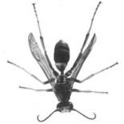
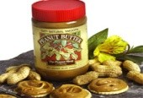
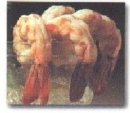

DISTRIBUTIVE SHOCK: HIGH/ NORMAL OUTPUT
q Septic/ Toxic/ Endotoxic Shock:
MAP = CO X PR
Bacterial endotoxin triggers peripheral vasodilatation & endothelial injury. Hyperdynamic state.
•
•
q Anaphylactic shock:
•
•
•
•
Massive & generalized allergic reaction. IgE- mediated hypersensitivity.
Histamine triggers peripheral vasodilation & ↑ capillary permeability. Can lead to low output distributive shock.
q Psychogenic shock:
•
•
•
•
•
Simple fainting (syncope.) Caused by stress, pain, or fright.
↓ HR & vessels dilate.
Brain becomes hypoperfused. Loss of consciousness.

Slide 14
NEUROGENIC/ SPINAL SHOCK .. (VENOUS POOLING)
q Circulatory failure:
Loss or drop in vasomotor (vascular) tone/ spinal cord injury.
Generalized peripheral vasodilation.
Blood volume remains normal.
CO is severely reduced as blood is pooled in peripheral veins.. (Capacity of blood ↑, & venous return ↓.)
Behaves like hypovolemic shock.

Slide 15
PATHOPHYSIOLOGY OF SHOCK
q Reduce capillary perfusion.
q Inadequate tissue oxygen.
q Shift to anaerobic metabolism.
q Metabolic acidosis.
q Release of free radicals & oxidative stress.
q Tissue damage.
q Apoptosis.

Slide 16
METABOLIC CHANGES & CELLULAR RESPONSE TO SHOCK
1. Spasm of pre/post capillary sphincters:
→ reduced capillary perfusion.
→ hypoxic tissue damage, (oxidative stress.)
→ anaerobic metabolism (anaerobic glycolysis.)
→ lactic acid production.
→ metabolic acidosis (intracellular acidosis).
→ Failure of Na+/K+ pump (inc [Na+] & [C++]).
→ Lysosomes, nuclear membranes & mitochondrial breakdown.

Slide 17
METABOLIC CHANGES & CELLULAR RESPONSE TO SHOCK
After 3 - 5 hrs of shock → precapillary sphincters dilate (venules are still constricted) → blood stagnation in capillaries → hypoxia continue + fluid leaves to extra vascular compartment → further reduction in circulating blood volume.
Granulocytes accumulation at injured vessels → free radicals release → further tissue damage.

Slide 18
METABOLIC CHANGES & CELLULAR RESPONSE TO SHOCK
Damage in GIT mucosa → allows bacteria into circulation.
Cerebral ischemia → depression of VMC → vasodilation + ↓ HR
(vasomotor center .. sympathetic)
further decrease in blood pressure.
Myocardial ischemia → depressed contractility + myocardial damage
more shock & acidosis.
Respiratory distress syndrome occurs due to damage of capillary endothelial cells & alveolar epithelial cells, with release of cytokines.
Multiple organ failure & death.

Slide 19
COMPENSATORY MECHANISMS
q ↓ BP stimulates baroreceptors reflex → sympathetic stimulation.
q Acidosis stimulates chemoreceptors reflex → sympathetic stimulation.
q Renin-Angiotensin Mechanism:
Angiotensin II & III: powerful vasoconstrictors.
Aldosterone: Na+ & water retention.
q ADH (vasopressin):
Water retention, vasoconstriction & thirst stimulation.
q Plasma proteins synthesis.
q Fluid- shift mechanism.

Slide 20
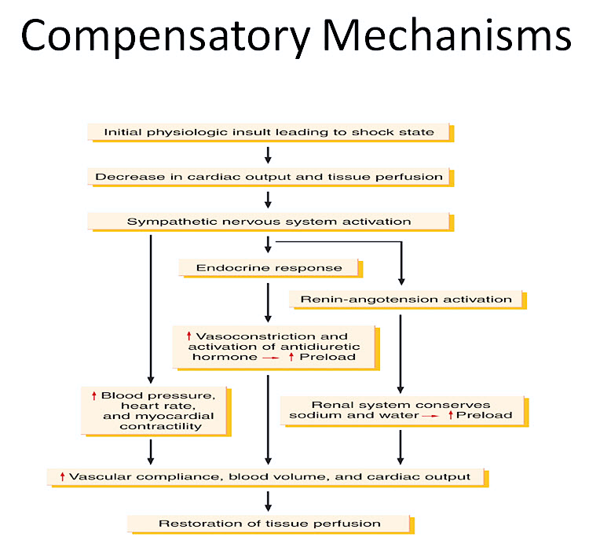
20

Slide 21




IN NORMAL MICROCIRCULATION
Hydrostatic Pressure= 0 mmHg
NFP = - 5 mmHg
Interstitial Fluid
NFP = +5 mmHg
Venous Blood
 | Blood Capillary
Arterial Blood
Hydrostatic Pressure = 20 mmHg
Colloid Osmotic Pressure= 25 mmHg
Hydrostatic Pressure = 30 mmHg
q At arterial end:
§ Water moves out of the capillary with a NFP of +5 mmHg.
§
Hydrostatic pressure dominates at the arterial end & net fluid flows out of the
circulation.
q At venous end:
§ Water moves into the capillary with a NFP of -5 mmHg.
§
Oncotic pressure dominates at the venous end & net fluid will flow into the
bloodstream.

Slide 22
FLUID- SHIFT MECHANISM IN SHOCK
In shock, the hydrostatic pressure decreases & oncotic pressure is constant, as a result:
  The fluid exchange from the capillary to the extracellular space decreases.
  The fluid return from the extracellular space to the capillary increases.
That will increase the blood volume & will increase BP helping to compensate shock situations.

Slide 23


Fluid – Shift Mechanism In Shock
Hydrostatic Pressure= 0 mmHg
Increase inflow
Interstitial Fluid
Decrease outflow
Venous Blood
Hydrostatic Pressure = 10 mmHg
Arterial Blood
Hydrostatic Pressure = 20 mmHg
Blood Capillary
Colloid Osmotic Pressure= 25 mmHg

Slide 24
STAGES OF SHOCK
q Reversible shock: (Compensated)
Changes can be reversed by compensatory mechanism
(neurohormonal activation) or by treatment.
Defense mechanisms are successful in maintaining perfusion.
Non-progressive.
q Progressive:
Defense mechanisms begin to fall.
Multi-organ failure.
q Irreversible shock:
Complete failure of compensatory mechanisms.
Can lead to death.

Slide 25

POSSIBLE MECHANISM IN
DEVELOPMENT IRREVERSIBLE SHOCK
Shock Stimulus
Lysosomal Activation, Release Proteases Splitting of Plasma Proteins
Vasoactive Peptides, Amines, etc.
Hypotension, Fluid Loss Irreversible Shock
Dr. Abeer A. Al-Masri, Faculty of Medicine, KSU
25

Slide 26
SIGNS/SYMPTOMS:
HYPOVOLEMIC SHOCK
Hypotension… (? ≤ 85/40 mmHg)
Tachycardia… Compensation for ↓ MAP sensed by Baroreceptors.
Rapid, weak, & thready pulse… (? 140/min).
Intense thirst.
Tachypnea (rapid respiration)… Compensation for hypoxia sensed by Chemoreceptors.
Restlessness… due to hypo-perfusion.
Cold, pale skin… due to hypo-perfusion.
Oliguria (low urine output)/ Anuria (no urine output).
Blood test: Lactic acidosis.

Slide 27
SIGNS/SYMPTOMS:
CARDIOGENIC SHOCK
Similar signs & symptoms to that of hypovolemic shock.
Congestion of lungs & viscera: (CXR)
  Interstitial pulmonary oedema.
  Alveolar edema.
  Cardiomegaly.

Slide 28
SIGNS/SYMPTOMS:
SEPTIC SHOCK
q Patient flushed & warm due to his hyperdynamic state.

Slide 29
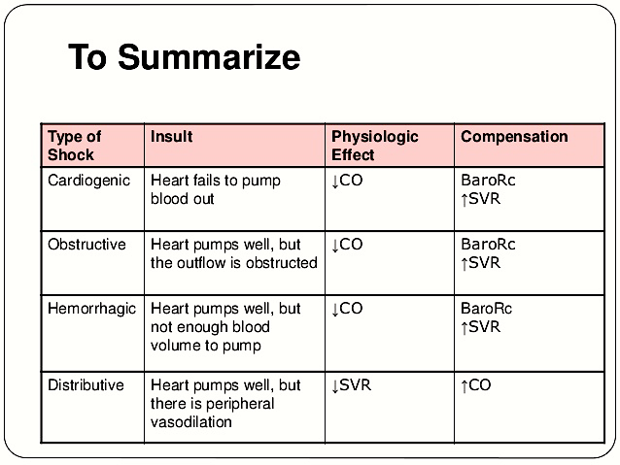
29

Slide 30
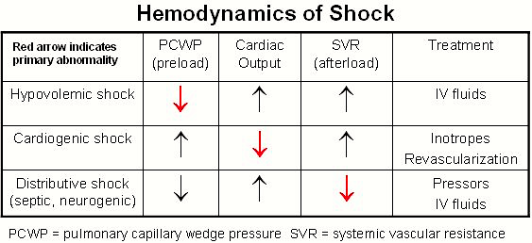
30

Slide 31
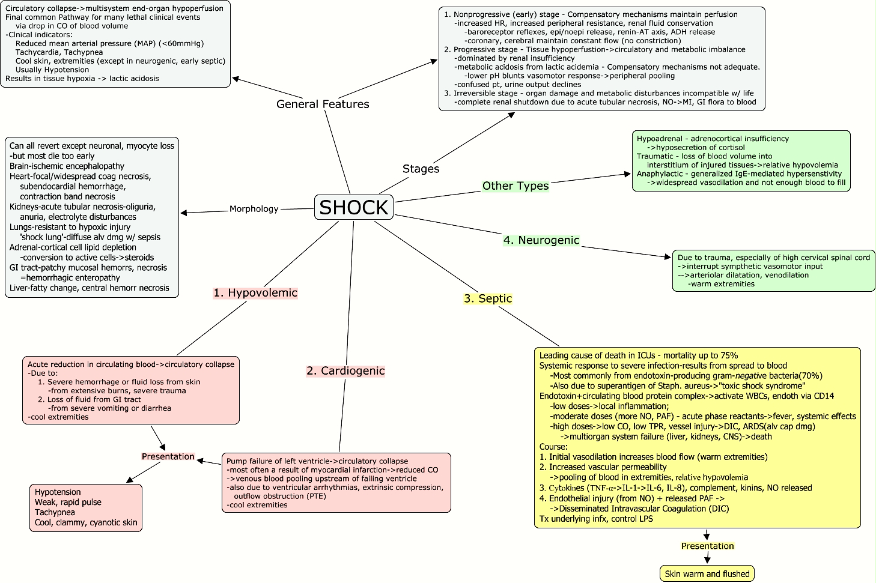
31

Slide 32


Thank You

