Slide 1











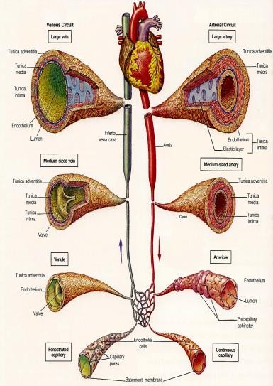
3/8/2016
Cardiovascular Physiology
C A R D I O V A S C U L A R P H Y S I O L O G Y
C A P I L L A RY C I R C U L AT I O N
D R . A B E E R A . A L - M A S R I
A . P R O F E S S O R & C O N S U L T A N T
C A R D I O V A S C U L A R P H Y S I O L O G I S T F A C U L T Y O F M E D I C I N E , K S U
CLASSIFICATION OF THE VASCULAR SYSTEM
Aorta
… (elastic recoil)
Arteries
… (muscular, low resistance vessels)
Arterioles
… (high resistance vessels)
Capillaries
… (exchange vessels)
Venules
Veins
… (capacitance vessels)
Dr. Abeer Al-Masru, Faculty of Medicine, KSU.
2

Slide 2
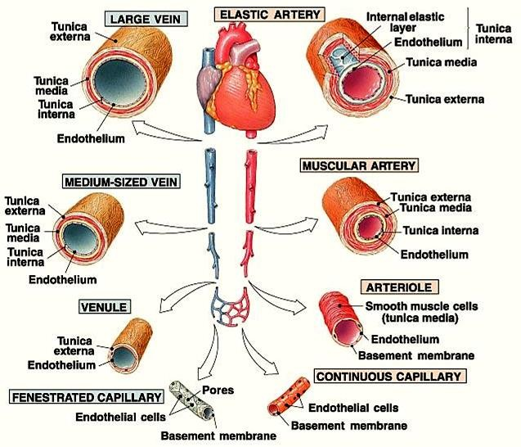
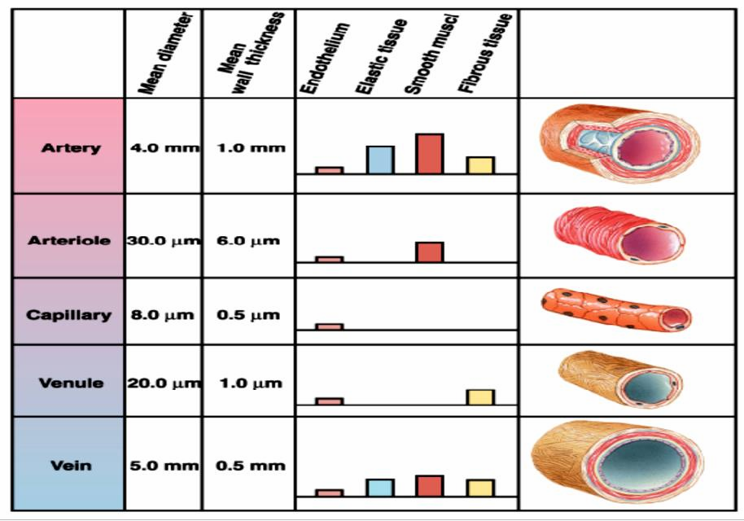
3/8/2016
Cardiovascular Physiology
BLOOD VESSEL COMPARISON
3
Structure of vasculature changes in response to different needs
4

Slide 3
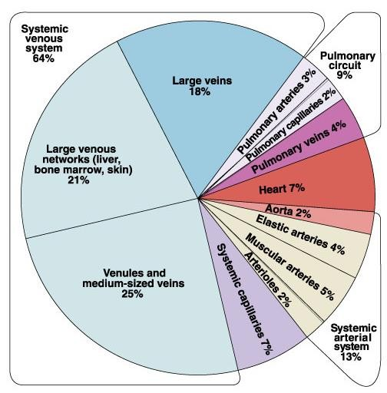
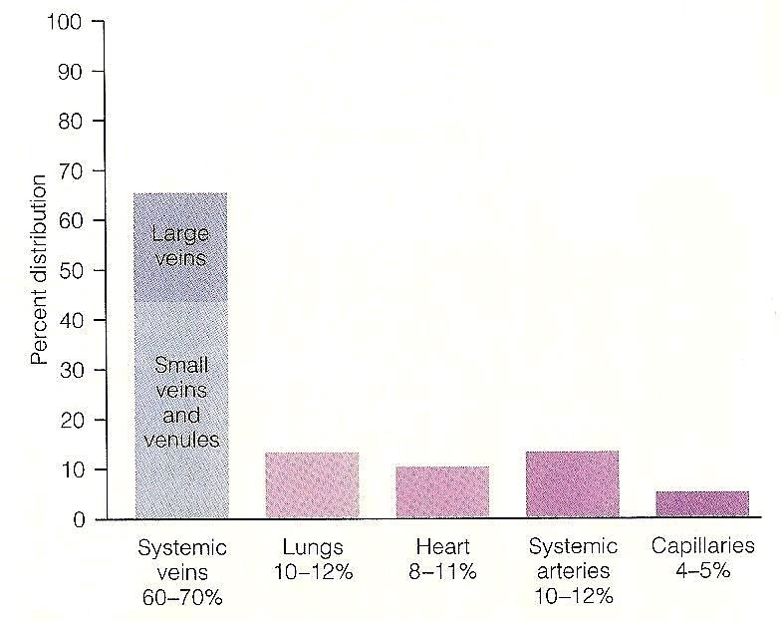
3/8/2016
Cardiovascular Physiology
5
DISTRIBUTION OF BLOOD WITHIN THE
CIRCULATORY SYSTEM AT REST
6

Slide 4
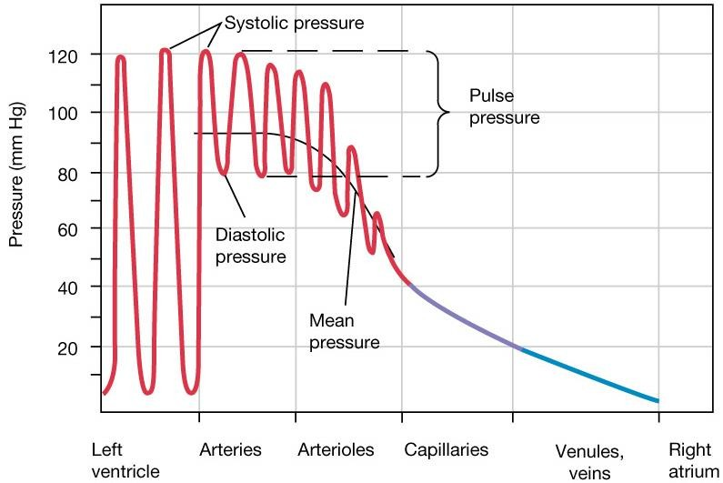
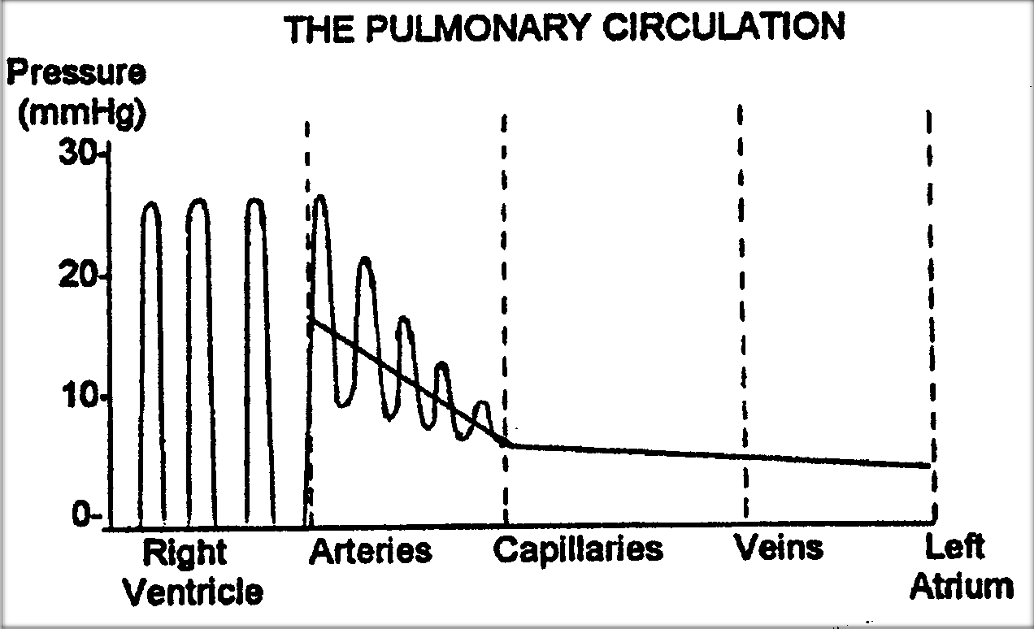
3/8/2016
Cardiovascular Physiology
PRESSURE THROUGHOUT THE SYSTEMIC CIRCULATION
7
Pressure In The Pulmonary Circulation
NORMAL
8

Slide 5
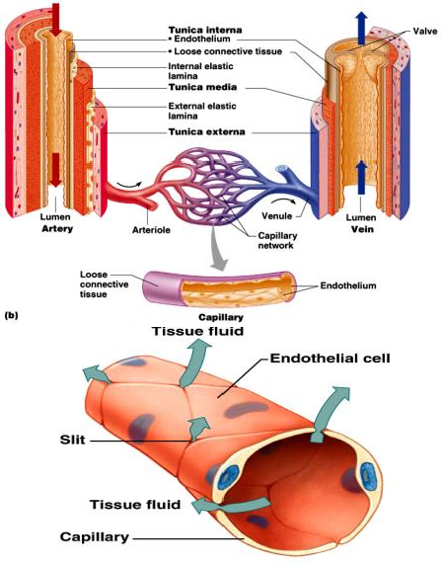
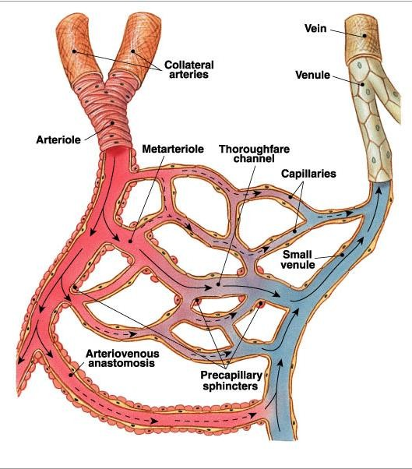
3/8/2016
Cardiovascular Physiology
CAPILLARIES
Smallest blood vessels.
  One endothelial cell thickness.
Exchange vessels.
  Provide direct access to cells.
  Most permeable.
  Permits exchange of nutrients & wastes.
Dr. Abeer Al-Masru, Faculty of Medicine, KSU.
9
CAPILLARY NETWORK
Blood flows from arterioles through metarterioles, then through capillary network
Venules drain network
Smooth muscle in arterioles, metarterioles, precapillary sphincters regulates blood flow
10
Dr. Abeer Al-Masru, Faculty of Medicine, KSU.

Slide 6
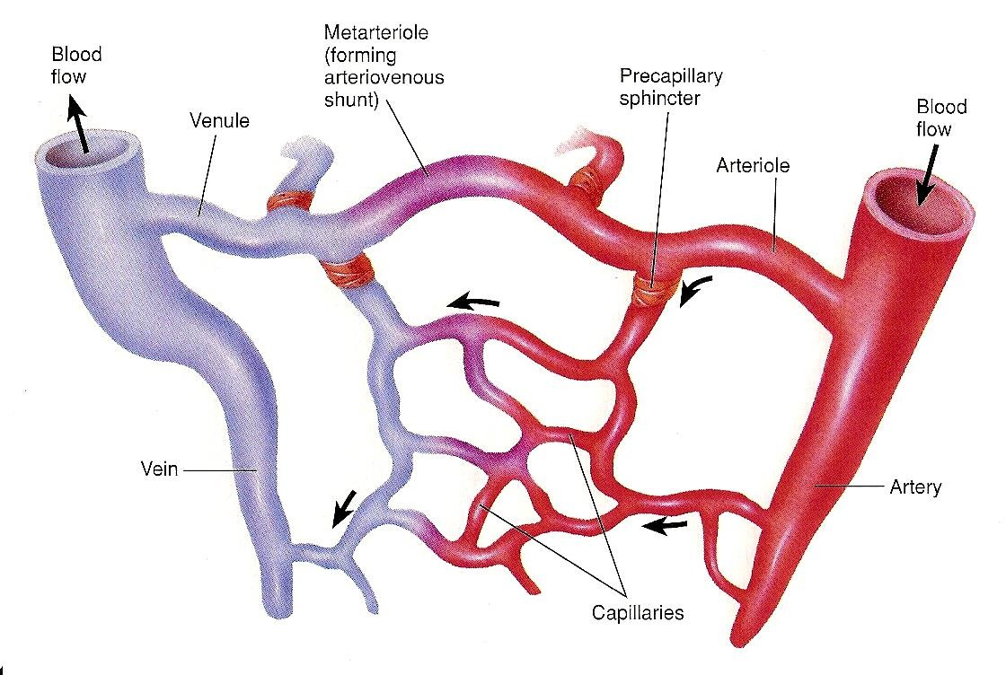
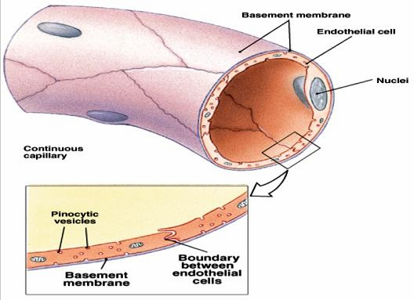
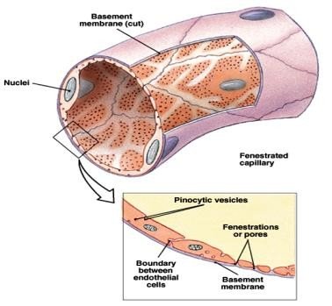
3/8/2016
Cardiovascular Physiology
11
TYPES OF
CAPILLARIES
Types classified by diameter/permeability
  Continuous
    Do not have fenestrae.
  Fenestrated
    Have pores.
  Sinusoidal
    Large diameter with large
fenestrae.
Dr. Abeer Al-Masru, Faculty of Medicine, KSU.
12

Slide 7
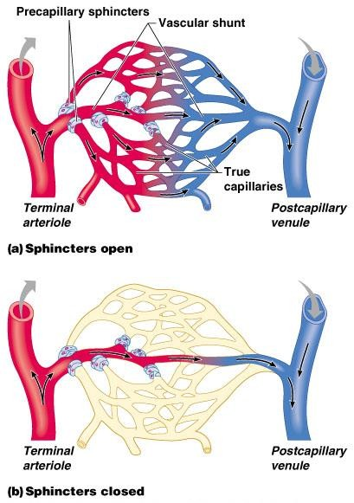


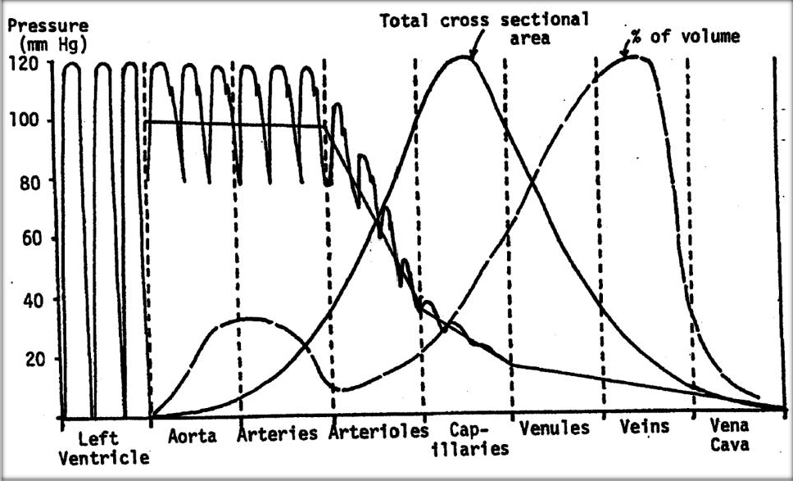
3/8/2016
Cardiovascular Physiology
Capillary Beds
Capillary beds consist of two types of vessels:
  Vascular shunt – directly connects an arteriole to a venule.
  True capillaries – exchange vessels.
    Oxygen & nutrients cross to cells
    Carbon dioxide & metabolic waste products cross into blood
Dr. Abeer Al-Masru, Faculty of Medicine, KSU.
13
Total Cross Sectional Area
Capacity Vessels
Dr. Abeer Al-Masru, Faculty of Medicine, KSU.
15

Slide 8
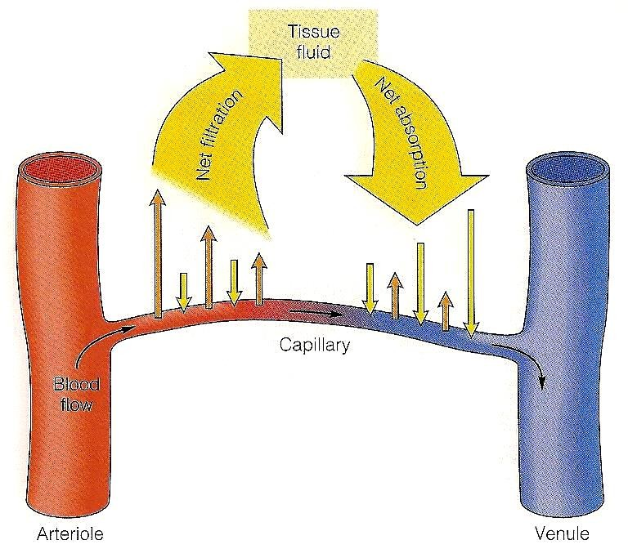
3/8/2016
Cardiovascular Physiology
EXCHANGE OF FLUID BETWEEN CAPILLARIES AND TISSUES
Dr. Abeer Al-Masru, Faculty of Medicine, KSU.
16
CAPILLARY EXCHANGE AND INTERSTITIAL FLUID VOLUME REGULATION
Blood pressure, capillary permeability, & osmosis affect movement of fluid from capillaries.
A net movement of fluid occurs from blood into tissues.
Fluid gained by tissues is removed by lymphatic system.
Dr. Abeer Al-Masru, Faculty of Medicine, KSU.
17

Slide 9
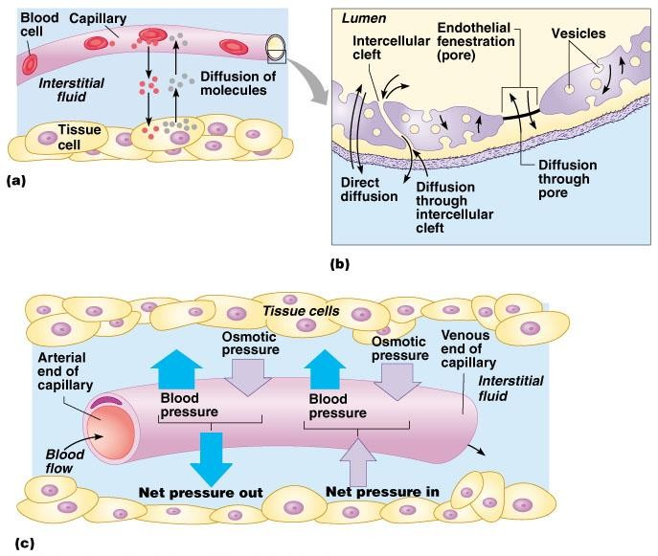
3/8/2016
Cardiovascular Physiology
Diffusion at Capillary Beds
Dr. Abeer Al-Masru, Faculty of Medicine, KSU.
18
FLUID BALANCE
Filtration vs. Reabsorption
40-
Outward Forces:
Capillary blood pressure
(P_{c} = 30-35 to 10-15 mmHg)
Interstitial fluid pressure
(P_{IF} = 0 mmHg)
Interstitial fluid colloidal osmotic pressure
(μ_{IF} = 3 mmHg)
TOTAL = 38 to 18 mmHg
PRESSURE (mmHg)
30-
20-
10-
0-
Inward Force:
1. Plasma colloidal osmotic pressure (μ_{C} = 25- 28 mmHg)
Dr. Abeer Al-Masru, Faculty of Medicine, KSU.
19

Slide 10
3/8/2016
Cardiovascular Physiology
FLUID FILTRATION & REABSORPTION IN NORMAL MICROCIRCULATION
Hydrostatic Pressure= 0 mmHg
Osmotic Pressure= 3 mmHg
NFP = - 5 to -7 mmHg
Interstitial Fluid
NFP = +5 to +10 mmHg
Venous Blood
Hydrostatic Pressure = 10-15 mmHg
Blood Capillary
Colloid Osmotic Pressure= 25 mmHg
Arterial Blood
Hydrostatic Pressure = 30-35 mmHg
At arterial end:
  Water moves out of the capillary with a NFP of +5 mmHg.
  Hydrostatic pressure dominates at the arterial end & net fluid flows out of the circulation.
At venous end:
  Water moves into the capillary with a NFP of -5 mmHg.
  Oncotic pressure dominates at the venous end & net fluid will flow into the
bloodstream
Dr. Abeer Al-Masru, Faculty of Medicine, KSU.
20
LYMPHATIC SYSTEM
Lymphatic vessels present b/w capillaries.
3 basic functions:
  Drain excess interstitial (tissue) fluid back to the bl, in order to maintain original bl volume.
  Transports absorbed fat from small intestine to the bl.
  Helps provide immunological defenses against pathogens.
Dr. Abeer Al-Masru, Faculty of Medicine, KSU.
21

Slide 11
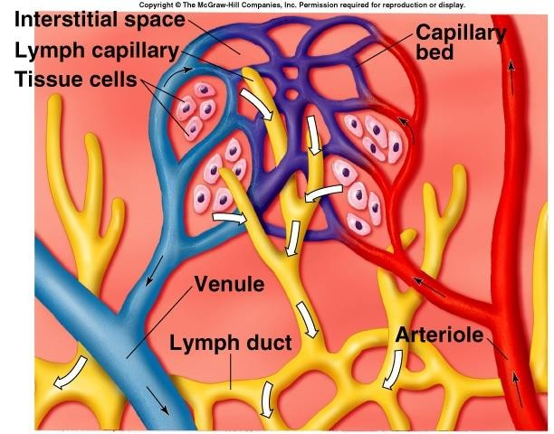


3/8/2016
Cardiovascular Physiology
LYMPHATIC SYSTEM
22
Thank Y₂o₃ u
Dr. Abeer Al-Masru, Faculty of Medicine, KSU.

