Slide 1

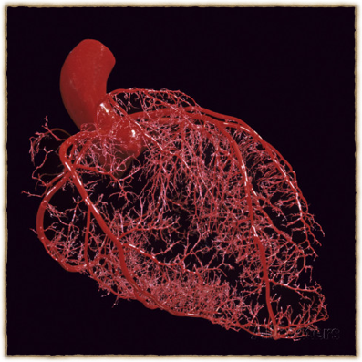
Coronary Circulation
Dr. Abeer A. Al-Masri Associate Professor & Consultant,
Physiology Department, Faculty of Medicine, KSU.

Slide 2

Coronary Circulation
Consists of:
Arterial supply.
Venous drainage.
Lymphatic drainage.

Slide 3
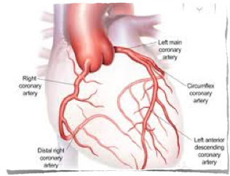
Arterial Supply
Cardiac muscle is supplied by two coronary arteries:
Right coronary artery (RCA.)
Left coronary artery (LCA.)
both arise from the coronary sinuses just superior to the aortic valve cusps at the aortic root.

Slide 4


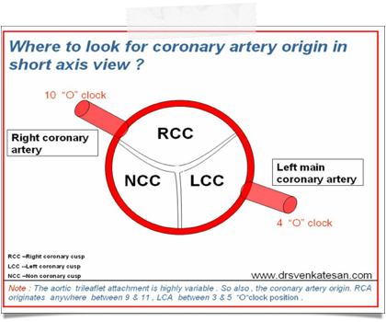
Arterial Supply
The aortic valve has three cusps: left coronary (LC), right coronary (RC), & posterior
non-coronary (NC) cusps.
There may be variations in the number, shape & location of coronary ostia or origins of the coronary arteries, most of which are of no clinical significance.
Coronary arteries deliver oxygenated blood to the cardiac muscle.

Slide 5
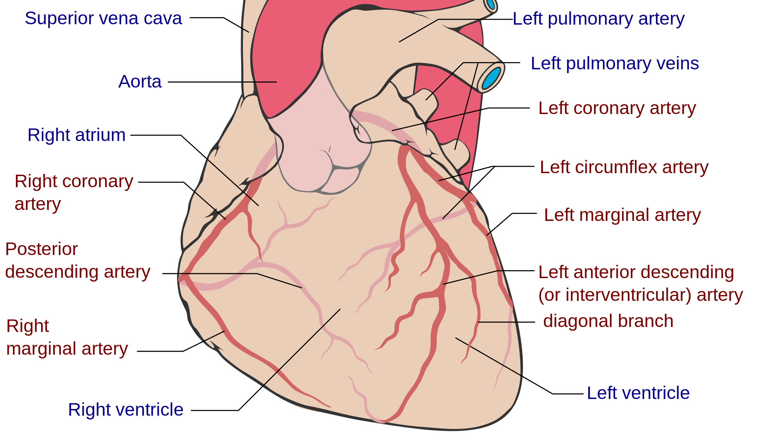
Coronary Circulation

Slide 6

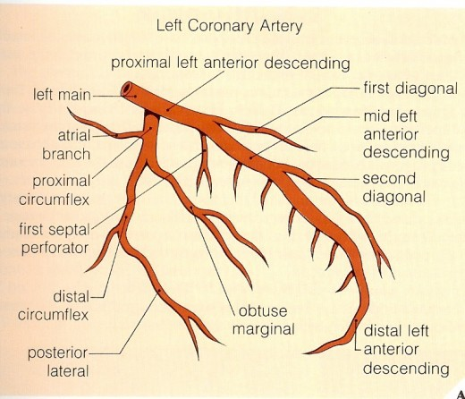
The Left Coronary Artery
Larger than the right coronary artery.
Arises from the left coronary sinus.
Terminates by
anastomosing with the right coronary artery.

Slide 7

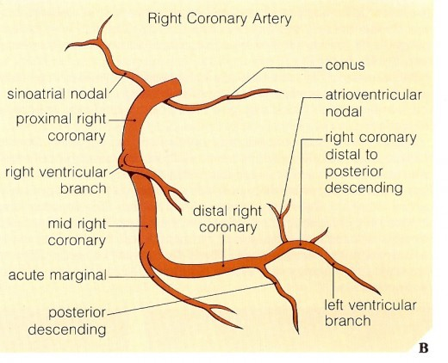
The Right Coronary Artery
Smaller than the left coronary artery.
Arises from the right coronary sinus.
Terminates by
anastomosing with the left coronary artery.

Slide 8
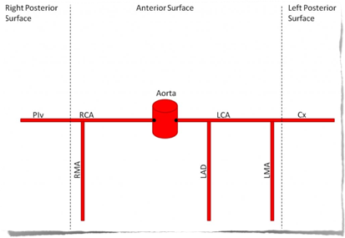
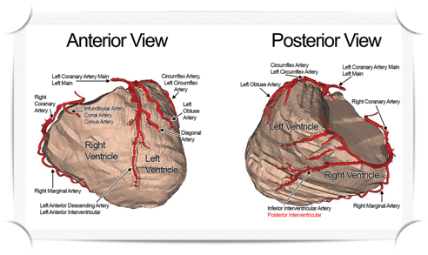
Branches of The Coronary Arteries
LCA:
Left Anterior Descending (LAD.)
Marginal Artery.
Circumflex Artery (CX.)
RCA:
Marginal Artery.
Posterior Descending Branch.

Slide 9
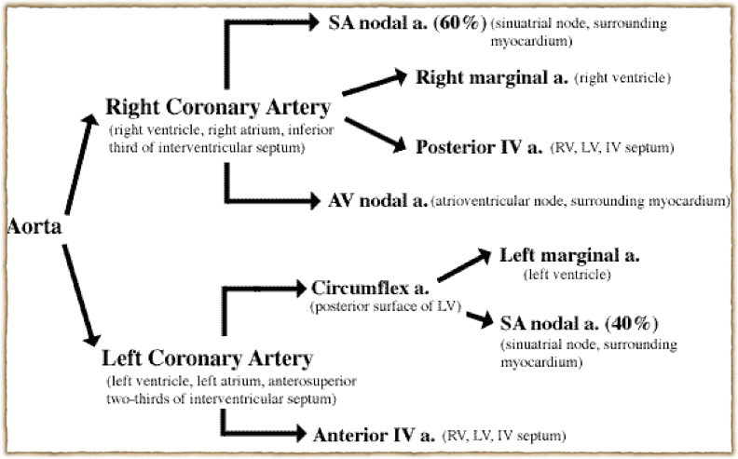
Branches of The Coronary Arteries

Slide 10
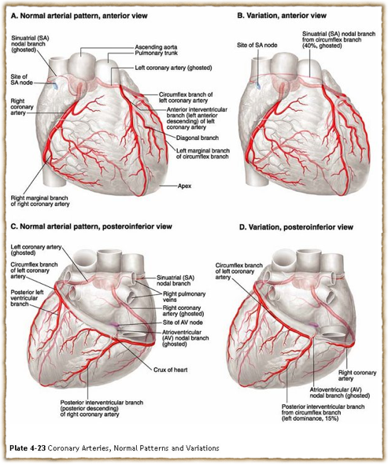




Variations
10

Slide 11
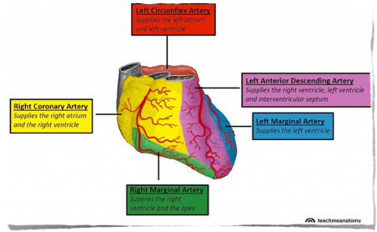
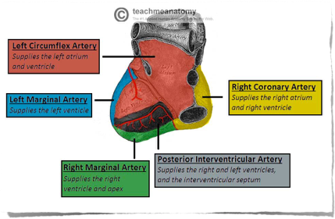
Areas of Distribution of Coronary Arteries

Slide 12
Areas of Distribution of Left Coronary Artery
LCA supplies:
Anterior & apical parts of the heart.
Anterior 2/3rd of the inter ventricular (IV) septum.
CX branch supplies:
Lateral & posterior surfaces of the heart.

Slide 13

Areas of Distribution of Right Coronary Artery
Right atrium. Ventricles:
Greater part of Rt ventricle, except the area adjoiningthe anterior inter ventricular groove.
Inferiorpart of Lt ventricle adjoiningthe posteriorinter ventricular groove.
Posterior 1/3rd of the inter ventricular septum. The conducting system of the heart, except:
A part of the Lt branch of AV- Bundle.
The SA- nodeis suppliedby the LCA in 40 of cases.

Slide 14

Collateral Circulation
Cardiac anastomosis:
The two coronary arteriesanastomose in the myocardium.
Extra cardiac anastomosis: the two coronary arteries anastomose with,
Vasa vasorum of the aorta.
Vasa vasorum of pulmonary arteries.
Internal thoracic arteries.
The bronchial arteries.
Phrenic arteries.
Extra cardiac channels open up in emergencies when the coronary arteries are blocked.

Slide 15

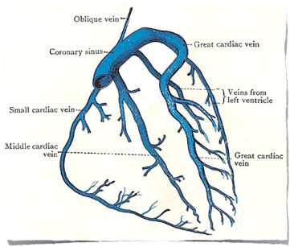
Venous Drainage of The Heart
Venous drainage brings deoxygenated cardiac blood back to the heart.
Cardiac venous drainage occur through:
Coronary sinus, which lies in the
posterior part of the atrioventricular groove & is a continuation of the great cardiac vein.
Anterior, middle & small cardiac veins.
Venae Cordis Minimae (smallest cardiac veins.)

Slide 16

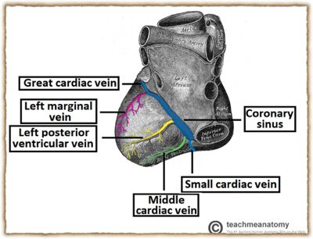
Venous Drainage of The Heart
Most of the venous blood return to the heart into the Rt atrium through the coronary sinus via the cardiac veins.
5- 10 drains directly into heart chambers, Rt atrium & Rt ventricle, by the anterior cardiac vein & by the small veins that open directly into the heart chambers.

Slide 17
Lymphatic Drainage of The Heart
Lymphatics of the heart accompany the two coronary arteries & form two trunks:
The right trunk, ends in the brachiocephalic node.
The left trunk, ends into the tracheo-bronchial lymph nodes at the bifurcation of the trachea.

Slide 18

Coronary Dominance
A person can be:
Right dominant,
Left dominant, or
Co-dominant.
Coronary dominance depends on which artery (or arteries) gives rise to the posterior descending artery (PDA), which runs along the posterior side of the heart & supplies the AV- node.

Slide 19

Coronary Dominance
Coronary dominance is recognized by the presence of septal perforating branches arise from:
The right coronaryartery is dominant, in 80–85 cases.
The circumflex branch of the left coronaryartery, in 8-10 cases.
balanced or co-dominance is found in 7-10 of population where the posterior inter ventricular artery is formed by both Rt coronary & LCX arteries.
Clinical importance:
In Lt dominance, a block in LCA affect the entire Lt ventricle & IV septum.
In Rt or balances dominance, a block in RCA at least spares part (2/3) of the septum & Lt ventricle.

Slide 20

Coronary Blood Flow
Coronary blood flow (CBF) at rest in humans is about
225-250 mL/min, which is about 5 of the cardiac output.
CBF increases in proportion to exercise or work output.
At rest, the heart extracts 60-70 of oxygen from each unit of blood delivered to the heart due to presence of more mitochondria which generate energy for contraction by aerobic metabolism (other tissue extract only 25 of O2.)
20

Slide 21

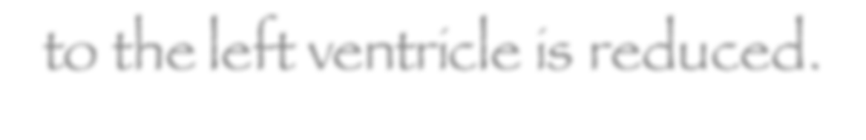
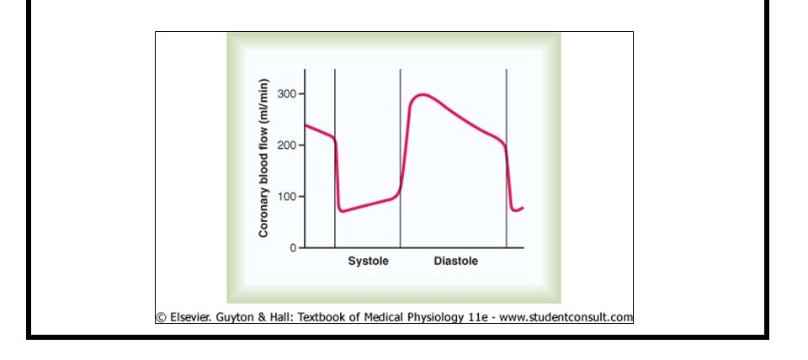

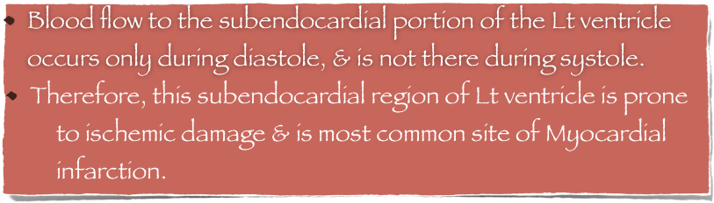
Phasic Changes in Coronary Blood Flow During Systole & Diastole
During systole, coronary arteries are compressed & the blood flow to the left ventricle is reduced.

Slide 22
Factors Affecting Coronary Blood Flow
Pressure in the aorta. Chemical factors.
Neural factors.

Slide 23
Effect of Pressure Gradient of Aorta & Different Chambers of the Heart
 |  | Pressure (mmHg) in |  | Pressure difference (mmHg) between aorta &
 | Aorta | Lt Ventricle | Rt Ventricle | Lt Ventricle | Rt Ventricle
Systole | 120 | 120 | 25 | 0 | 95
Diastole | 80 | 0-2 | 0-2 | 80 | 80

Slide 24
CBF to the Rt side is not much affected during systole.
- Pressure difference between the aorta & Rt
ventricle is greater during systole than during diastole, therefore more blood flow to Rt ventricle occurs during systole.

Slide 25
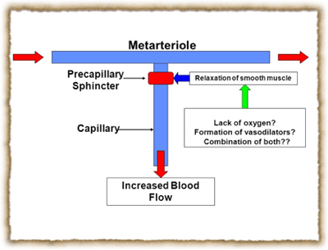
Chemical Factors Affecting Coronary Blood Flow
Chemical factors causing Coronary vasodilatation (Increased coronary blood flow):
Lack of oxygen.
Increased local concentration of Co2.
Increased local concentration of H⁺ ion.
Increased local concentration of k ⁺ ion.
Increased local concentration of Lactate, Prostaglandin, Adenosine,
Adenine nucleotides.

Slide 26
Neural Factors Affecting Coronary Blood Flow
Sympathetic stimulation.
Parasympathetic stimulation.

Slide 27

Effect of Sympathetic Stimulation on Coronary Blood Flow
Coronary arteries have:
Alpha Adrenergic receptors, which mediate vasoconstriction (more epicardial.)
Beta Adrenergic receptors, which mediate vasodilatation (more in the intramuscular arteries.)
Indirect effect of sympathetic stimulation:
Sympathetic stimulation in intact bodywill lead to release of adrenaline& nor adrenaline, increasing HR & force of contraction. Vasodilator metabolites will be released leading to coronary vasodilatation.
Direct effect of sympathetic stimulation:
Experimentally, injection of noradrenalin after blocking of the Beta adrenergic receptors in un anesthetized animals elicits coronary vasoconstriction.

Slide 28

Benefits of indirect effect of nor adrenergic discharge
When systemic blood pressure decreases very low. Reflex increase of nor adrenergic discharge.
Increase CBF secondary to metabolic changes in the myocardium.
In this way, circulation of the heart is preserved while the flow to other organs compromised.

Slide 29

Effect of Parasympathetic Stimulation on Coronary Blood Flow
Vagal stimulation (Parasympathetic) causes coronary vasodilatation.
However, parasympathetic distribution is not great.
There is more sympathetic innervation of coronary vessels.

Slide 30
Effect of Tachycardia on Coronary Blood Flow
CBF is reduced with tachycardia, as the diastolic period will be shortened.
30

Slide 31
Control of Coronary Blood Flow
CBF shows considerable auto regulation.
Local muscle metabolism is the primary controller:
Oxygen demand is a major factor in local coronary blood flow regulation.
Nervous control of CBF:
Direct effects of nervous stimuli on the coronary vasculature.
Sympathetic greater effects than parasympathetic.
31

Slide 32




