Slide 1
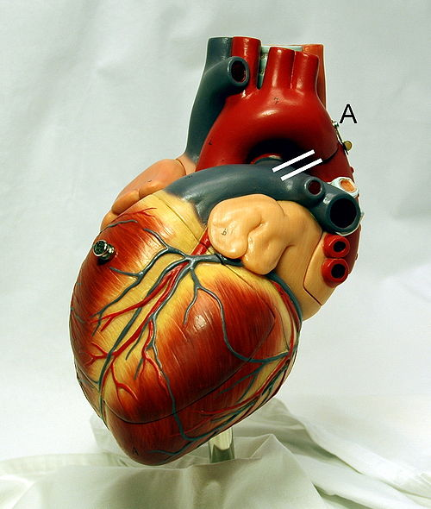
Cardiovascular System Block Cardiac electrical activity (Physiology)
Dr. Mona Soliman, MBBS, MSc, PhD
Head, Medical Education Department
Associate Professor of Physiology
Chair of Cardiovascular Block
College of Medicine
King Saud University

Slide 2
Cardiac Electrical Activity
Automaticity of the heart: the heart is capable of
Generating rhythmical electrical impulses
Conduct the impulses rapidly through the heart
The atria contract about one sixth of a second ahead of ventricular contraction
To allows filling of the ventricles before they pump the blood into the circulation
Why?

Slide 3
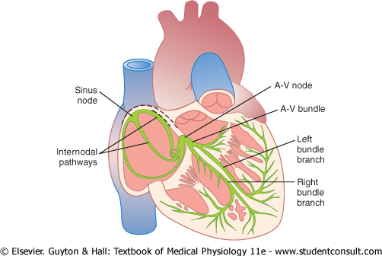
The Specialized Excitatory and Conductive System of the Heart
The sinoatrial (S-A node)
The internodal pathway
The atrioventricular (A-V node)
The atrioventricular bundle (Bundle of His)
Purkinje fibers

Slide 4
Conduction of Impulses
Sinoatrial node (S-A node):
Located in the superior lateral wall of the right atrium near the opening of the superior vena cava
Pacemaker of the heart
Its rate of rhythmic discharge is greater than any other part in the heart
Highest frequency
Is capable of originating action potentials
Why?

Slide 5
Conduction of Impulses

Slide 6
Conduction of Impulses
Atrioventricular (A-V) node:
Located in the posterior wall of the right atrium
Delay in the conduction of impulses (0.1 sec)
Allows time for the atria to empty the blood into the ventricles before ventricular contraction begin
Why?

Slide 7
Conduction of Impulses

Slide 8
Conduction of Impulses
The Purkinje System
Purkinje fibers are very large fibers
Transmit action potentials at a very high velocity (0.1-4.0 m/sec)
very high permeability of gap junctions
→ ions are transmitted easily from one cell to the next
→ enhance the velocity of transmission
Ventricular muscle contract at almost the same time
Why?

Slide 9
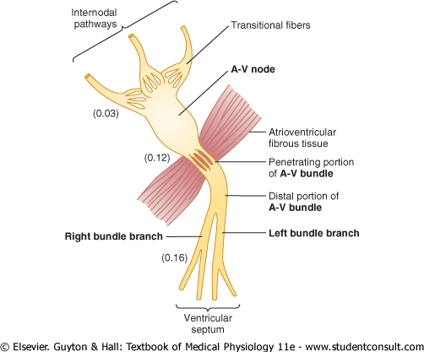
Conduction of Impulses
The Purkinje System
Penetrate atrioventricular
fibrous tissue
→ divides into right and left bundle branches
→ each branch spread toward the apex of the heart
→ divide into small branches
→ penetrate and become continuous with cardiac muscle fibers

Slide 10
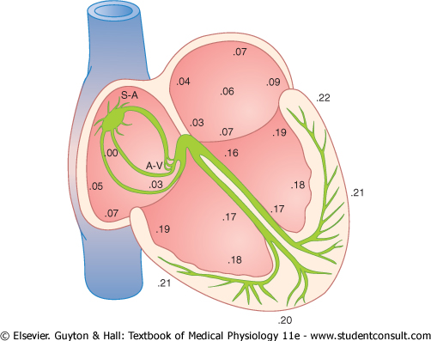
Spread of the cardiac impulse through the heart

Slide 11
Control of Excitation and Conduction in the Heart
The impulse normally arise s in the sinus node
The Sinus Node is the Pacemaker of the Heart
Its rate of rhythmical discharge is faster than that of any other part of the heart
Why?

Slide 12
Abnormal Pacemakers
Ectopic pacemaker: a pacemaker elsewhere than the sinus node
The cause:
Any other part of the heart develops a rhythmical discharge rate that is more rapid than that of the sinus node
Example: the A-V node or in the Purkinje fibers

Slide 13
Abnormal Pacemakers
Blockage of transmission of the cardiac impulse from the sinus node to the other parts of the heart
Example: A-V block
→ cardiac impulses fails to pass from atria into the ventricles
the atria continues to beat at the normal rate of rhythm of the S-A node
a new pacemaker develops in the Purkinje system with a new rate

Slide 14
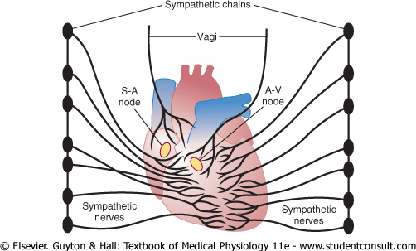
Control of Heart Rhythmicity and Impulse Conduction by the Cardiac Nerves
The heart is supplied with both sympathetic and parasympathetic nerves
Parasympathetic nerves (vagi): mainly to the S-A and A-V nodes
Sympathetic nerves: all parts of the heart with strong supply to the ventricles

Slide 15
Parasympathetic stimulation of the heart
↓ rate of rhythm of the S-A node
↓ transmission of impulses to the A-V node
Strong stimulation of the vagi:
Stop completely the rhythmical excitation by the S-A node
Block completely transmission of cardiac impulses from the atria to the ventricle
Some point in the Purkinje fibers develops a rhythm of its own
“Ventricular Escape”

Slide 16
Sympathetic stimulation of the heart
↑ rate of rhythm of the S-A node
↑ transmission of impulses to the A-V node
↑ force of contraction

Slide 17
For further readings and diagrams:
Textbook of Medical Physiology by Guyton & Hall
Chapter 10 (Rhythmical Excitation of the Heart)

Slide 18
Good Luck

