Slide 1



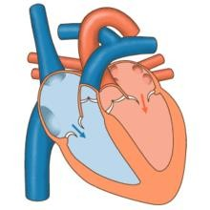












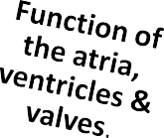

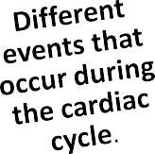
2/23/2016
Cardiovascular Physiology
Cardiovascular Physiology
Cardiac Cycle- 1
Dr. Abeer A. Al-Masri, PhD
A. Professor,
Consultant Cardiovascular Physiologist, Faculty of Medicine, KSU.
At end of this lecture you should be able to know:
2

Slide 2
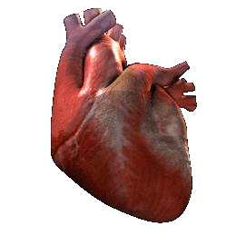

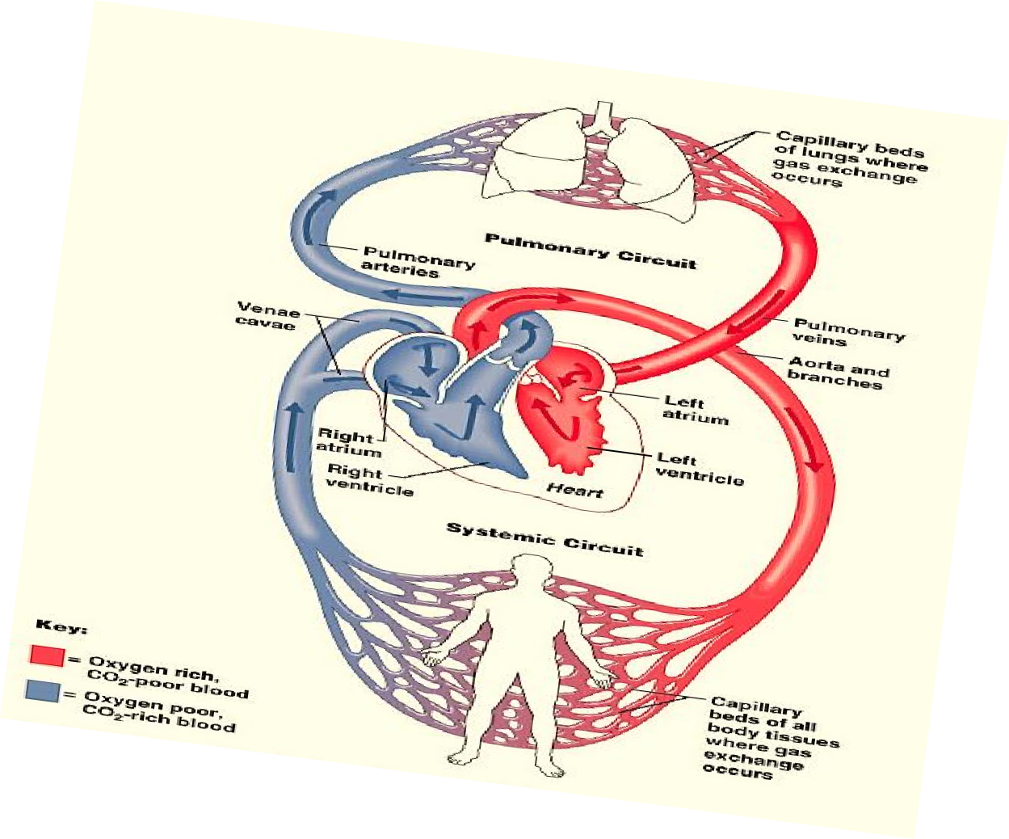


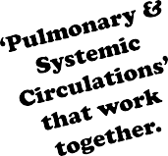
2/23/2016
Cardiovascular Physiology
Pump
3
The Heart is a double pump
4

Slide 3
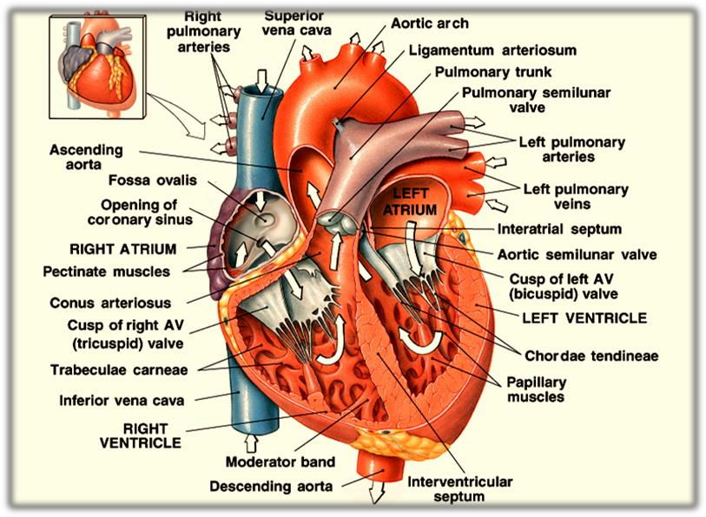





2/23/2016
Cardiovascular Physiology
5
4 valves.
Found at entry & exit of each
ventricle.
Allow blood to flow in only ONE direction.
When AV- vs open, semilunar- vs close & vice versa.
Opening & closure of vs occur as a result of pressure gradient across the vs.
AV cusps are held by chordae tendinea to muscular projections called Papillary muscles.
6

Slide 4
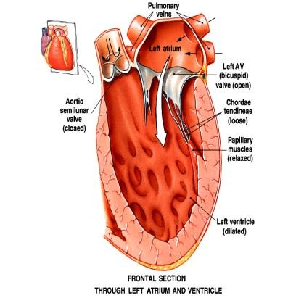
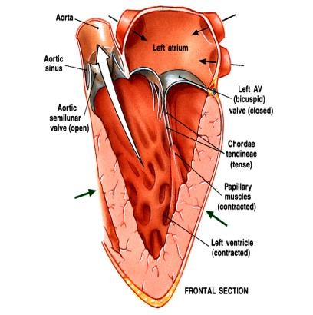
2/23/2016
Cardiovascular Physiology
7
General Principles
Contraction of the heart generates pressure changes, & results in orderly blood movement.
Blood flows from an area of high pressure to an area
of low pressure.
Events in the right & left sides of the heart are the same, but with lower pressures in the right side.
8

Slide 5

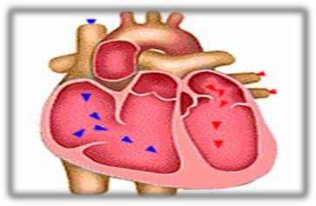
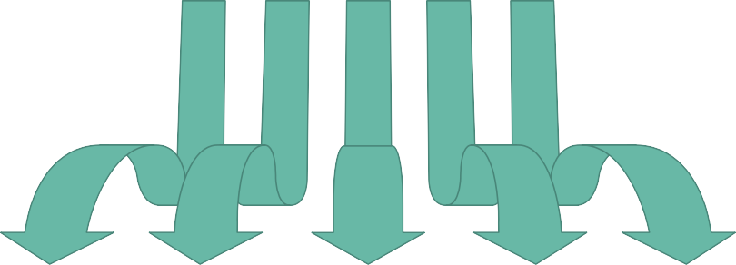












2/23/2016
Cardiovascular Physiology
Cardiac Cycle ?
Sequence of events that take place in the heart in each beat
I: Mechanical events II: Volume changes III: Pressure changes IV: Heart sounds
V: Electrical events (ECG)
Cardiac cycle duration = 0.8 sec …
When HR 72 bpm
  Shortened when HR ↑
9
Events in the Cardiac Cycle
1
Mechanical
events
2
Volume
changes
3
Pressure
changes
4
Heart
sounds
5
Electrical
events (ECG)
10

Slide 6


2/23/2016
Cardiovascular Physiology
Mechanical Events:
Each heartbeat consists of 2 major periods:
Systole .. (Contraction)
Diastole .. (Relaxation)
Ventricular diastole
repeated in Ventricular
(Relaxation)
next beat
systole
(Contraction)
Atrial .. systole & diastole
Ventricular .. systole & diastole
11
Mechanical Events’ Periods
Normally diastole is longer > systole:
Ventricular systole = 0.3 sec
Ventricular diastole = 0.5 sec
Atrial systole = 0.1 sec
Atrial diastole = 0.7 sec
Importance of long ventricular diastole?
  Coronary blood flow
  Ventricular filling
12

Slide 7
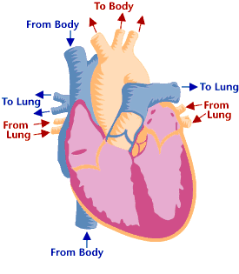





















































2/23/2016
Cardiovascular Physiology
Mechanical Events: Intra-Cardiac Pressures
120/80
mmHg
25-30/4-12
mmHg
2-8
mmHg
2-10
mmHg
25-30/2-8
mmHg
120/3-12
mmHg
13
14
N.B. ? Considered ‘8’ phases if including 1st phase of diastole

Slide 8
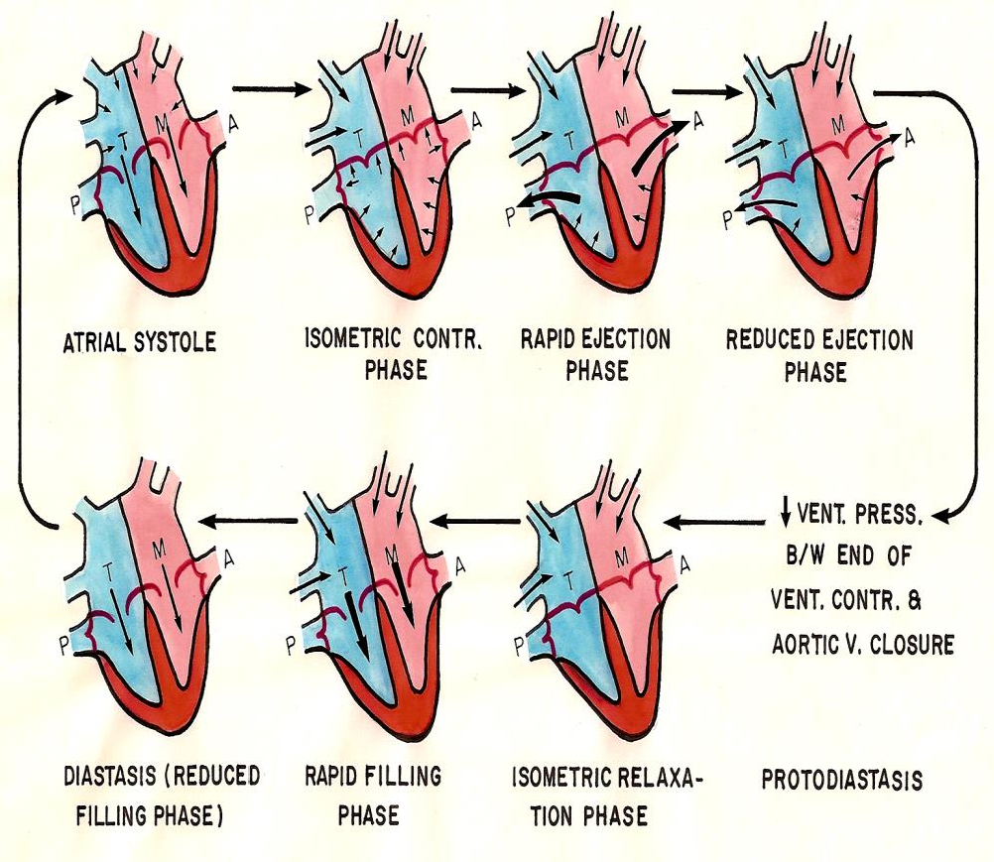

2/23/2016
Cardiovascular Physiology
15
Mechanical Phases of cardiac cycle:
1. Atrial Systole:
At end of ventricular diastole … (lasts 0.1 sec.) Preceded by atrial depolarization.
Valves: AV- vs open (semilunar- vs closed.)
Volume changes: Tops off last 27-30% of ventricular filling.
Pressure changes: ↑ Atrial pressure.
4th Heart sound heard.
Blood arriving the heart can’t enter atria, it flows back up jugular vein.
16

Slide 9
2/23/2016
Cardiovascular Physiology
Mechanical Phases of cardiac cycle:
2. Isovolumetric Contraction Phase:
At beginning of ventricular systole … (Lasts ≈ 0.04 sec.) Period between closure of AV- vs & opening of Semilunar- vs. Preceded by ventricular depolarization.
Starts with closure of AV- vs.
1st Heart sound heard. Ventricle is a closed chamber.
Volume in ventricle = EDV
Ventricle contracts with no changes in volume.
Ventricular pressure ↑
Aortic v opens at the end of this phase, when LV exceeds 80 mmHg.
17
Mechanical Phases of cardiac cycle:
3. Maximum (Rapid) Ejection Phase:
Semilunar- vs open at beginning of this phase:
o When LV pressure exceeds 80 mmHg.
Almost 75% of ventricular blood is ejected, i.e. 75% of SV. Ventricular pressure reaches 120 mmHg.
4. Reduced Ejection Phase:
End of systole.
Almost 25% of ventricular blood is ejected, i.e. 25% of SV.
Aortic- v closes at the end of this phase when LV pressure reaches 110 mmHg.
18

Slide 10
2/23/2016
Cardiovascular Physiology
Mechanical Phases of cardiac cycle:
5. Isovolumetric Relaxation Phase:
Period between closure of semilunar- vs & opening of AV- vs. Beginning of diastole … (Lasts ≈ 0.04 sec.)
Preceded by ventricular repolarization.
2nd Heart sound heard .
LV is a closed chamber, i.e. relax with no changes in volume. Volume of blood in ventricle = ESV.
AV- vs open at the end of this phase.
19
Mechanical Phases of cardiac cycle:
Rapid Filling Phase:
Atrial pressure > ventricular pressure. AV- vs open.
≈ 60-70% of blood passes passively to the ventricles along pressure gradient.
3rd Heart sound heard.
Reduced Filling Phase (Diastasis):
Remaining atrial blood flows slowly into ventricles. AV- vs still open.
20
10

Slide 11
2/23/2016
Cardiovascular Physiology
Definitions
End-diastolic volume (EDV):
Volume of blood in ventricles at the end of diastole.
▪ ≈ 110-130 mL.
Stroke volume (SV):
Amount of blood ejected from ventricles during systole.
≈ 70 mL/beat.
End-systolic volume (ESV):
Amount of blood left in ventricles at the end of systole.
▪ ≈ 40-60 mL.
Ejection fraction (EF):
Fraction of end-diastolic volume that is ejected.
▪ ≈ 60-65 %.
21
Events in the Cardiac Cycle
1
Mechanical
events
2
Volume
changes
3
Pressure
changes
4
Heart
sounds
5
Electrical
events (ECG)
22
11

Slide 12








2/23/2016
Cardiovascular Physiology
Ventricular Volume Changes
During the Cardiac Cycle
Ventricular Volume Changes
Phases | Ventricular volume
1. Atrial systole | ↑
Isometric contraction phase Rapid ejection phase Reduced ejection phase | Constant
 | ↓ rapidly
 | ↓ slowly
? Protodiastole Isometric relaxation phase Rapid filling phase Reduced filling phase | Constant
 | Constant
 | ↑ rapidly
 | ↑ slowly
24

Slide 13


2/23/2016
Cardiovascular Physiology
Pressure Changes During the Cardiac Cycle
Pressure Changes
Ventricular pressure Aortic pressure
Arterial pressure waves Pulmonary artery pressure
Atrial pressure
Jugular venous pressure
26

Slide 14
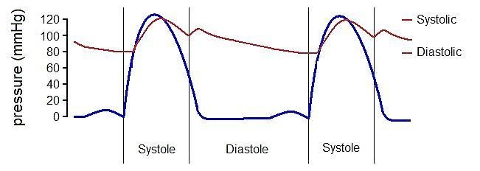
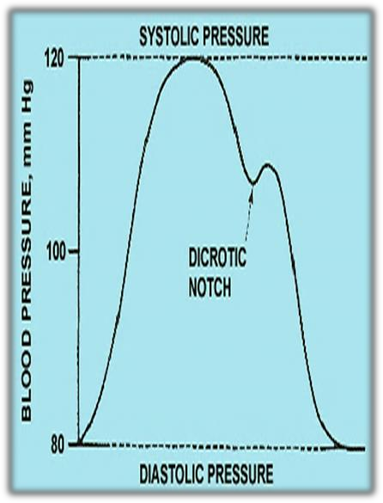
2/23/2016
Cardiovascular Physiology
 | Ventricular Pressure Changes … 120/3-12
Ventricular ⁰ Pressure 27
 | Aortic Pressure Changes … 120/80
Ascending or anacrotic limb: With ‘rapid ejection phase.’ Aortic press ↑ up to 120 mmHg. Descending or catacrotic limb: Passes in 4 stages. 28

Slide 15
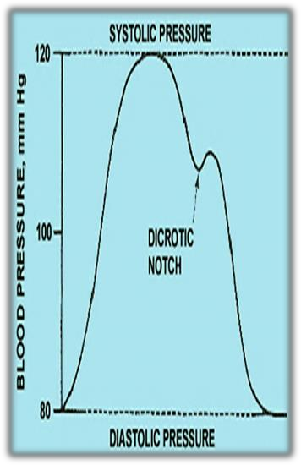
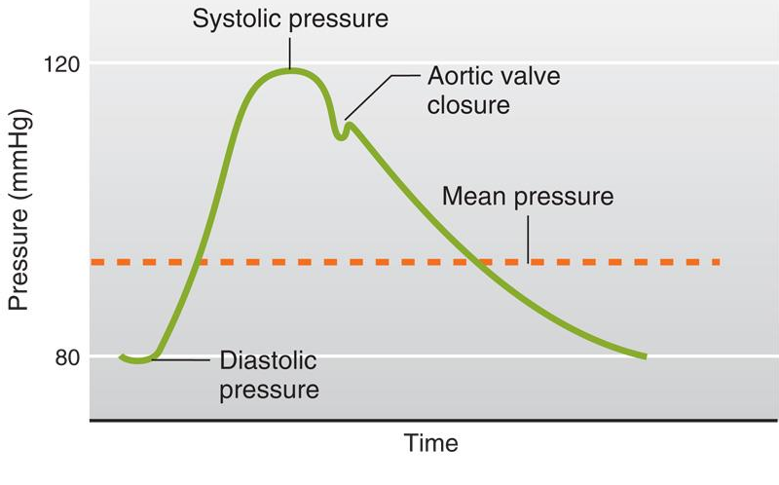

2/23/2016
Cardiovascular Physiology
↓ Aortic press:
With ‘reduced ejection phase.’
Amount of blood enters aorta < leaves.
Dicrotic notch (incisura):
Due to closure of aortic- v.
Sudden drop in aortic pressure.
At end of ventricular systole.
Dicrotic wave:
Due to elastic recoil of the aorta.
Slight ↑ in aortic pressure.
Slow ↓ aortic press: up to 80 mmHg. Due to continued flow of blood from aorta
→ systemic circulation.
29
Stages of the Descending / Catacrotic Limb:
Aortic pressure changes …
120/80
Mean Pressure = diastolic P + 1/3 (systolic P - diastolic P)
Pulse pressure = Systolic P – Diastolic P
30

Slide 16
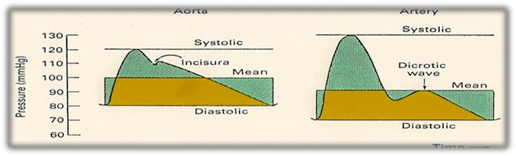
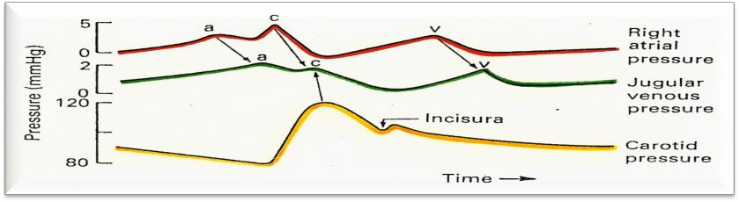
2/23/2016
Cardiovascular Physiology
Similar to aortic pressure waves, but sharper.
Reflects a systolic peak pressure of 110-130 mmHg & a diastolic pressure of 70-85 mmHg.
Similar to aortic pressure changes, but with difference in magnitude.
31
Arterial Pressure Changes … 110-130/70-85
Pulmonary Artery Pressure Changes … 25-30/4-12
 | Atrial Pressure Changes:
_{x} y Results in: 3 upward deflection → a, c, & v o 2 components in each wave: +ve (↑ press), -ve (↓ press) 2 downward deflection → x & y The 3 wave (a, c, & v) are equal to ONE cardiac cycle = 0.8 sec 32

Slide 17
2/23/2016
Cardiovascular Physiology
‘a’ wave: Atrial systole:
↑ atrial pressure during atrial systole.
‘c’ wave: Ventricular systole
o +ve → due to the bulging of AV- vs into the atria during ‘isovolumetric contraction phase.’
o -ve → due to the pulling down of the atrial muscle & AV cusps during ‘rapid ejection phase’, resulting in ↓ atrial pressure.
‘v’ wave:
o +ve → ↑ Atrial pressure due to ↑ venous return (VR) during
atrial diastole.
o -ve → ↓ ↓ atrial pressure during ‘rapid filling phase.’
33
Causes of atrial pressure waves
‘x’ descent:
Downward displacement of AV- vs during ‘reduced ejection phase.’
‘y’ descent:
↓ ↓ atrial pressure during ‘reduced filling phase.’
34
Causes of atrial pressure waves … (Cont.)

Slide 18
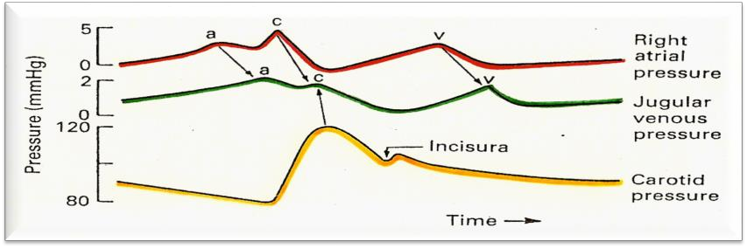


2/23/2016
Cardiovascular Physiology
Jugular venous pulse changes:
x
y
x
y
Similar recordings of transmitted delayed atrial waves:
3 upward waves: a, c, & v
2 downward waves: x & y
35
Heart Sounds Recorded During the Cardiac Cycle

Slide 19


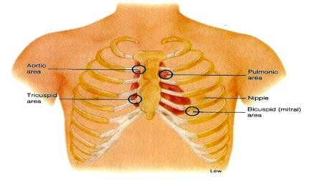
2/23/2016
Cardiovascular Physiology
Detected over anterior chest wall by:
Auscultation… (Stethoscope.)
Phonocardiography… (sound recording device.)
‘4’ heart sounds can be detected:
1st & 2nd heart sounds … (usually audible)
3rd & 4th heart sounds … (of low pitch, usually not audible)
Important for diagnosis of valvular heart diseases (murmurs)
37
Best heard at 4 certain areas:
Pulmonary area:
  2nd Lt intercostal space.
Aortic area:
  2nd Rt costal cartilage.
Mitral area:
  5nd Lt intercostal space crossing mid- clavicular line, or
  9 cm (2.5-3 in) from sternum.
Tricuspid area:
  lower part of sternum towards Rt side.
38

Slide 20
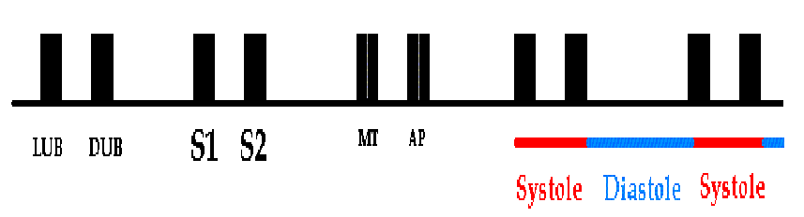


2/23/2016
Cardiovascular Physiology
39
Due to closure of the AV- vs.
Recorded at the beginning of the the ‘isovolumetric contraction phase.’
It marks beginning of ventricular systole. Long in duration .. 0.15 sec.
Of low pitch (LUB) .. Loud.
25-35 Hz.
Best heard at Mitral & Tricuspid areas.
40
20

Slide 21








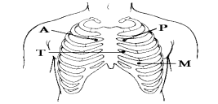
2/23/2016
Cardiovascular Physiology
Due to closure of semilunar- vs.
Recorded at the beginning of the ‘isovolumetric relaxation phase.’
Marks the beginning of ventricular diastole.
Short in duration .. 0.11-0.125 sec. Of high pitch (DUB) .. Soft & Sharp. 50 Hz.
Best heard at Aortic & Pulmonary areas.
41
S2 splits physiologically into 2 sounds during inspiration
= Physiological Splitting.
Physiological splitting during INSPIRATION
This splitting occurs due to delay closure
of pulmonary valve.
42

Slide 22


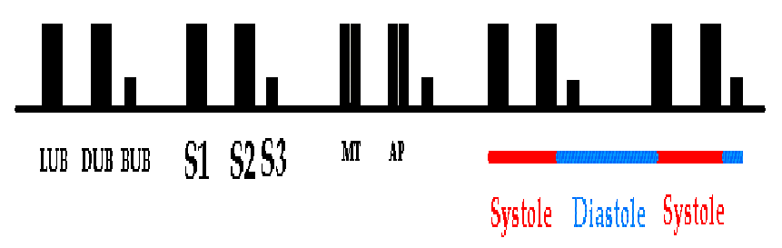

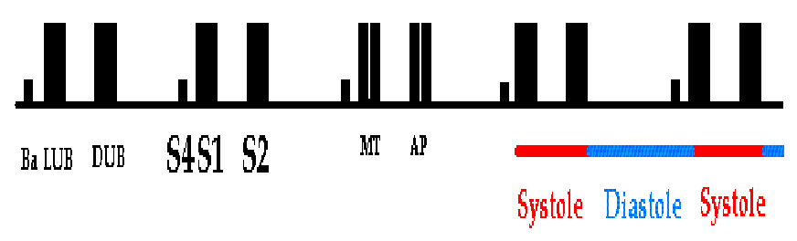
2/23/2016
Cardiovascular Physiology
Recorded during the ‘rapid filling phase’ due to rush of
blood into the ventricle.
S3 is usually not audible (very low pitch.)
0.05 sec.
? heard in children.
Best heard at Mitral area.
43
Recorded during ‘atrial systole.’
S4 is usually not audible (very low pitch.)
▪ 0.04 sec.
? heard in elderly.
Best heard at Mitral area.
44

Slide 23
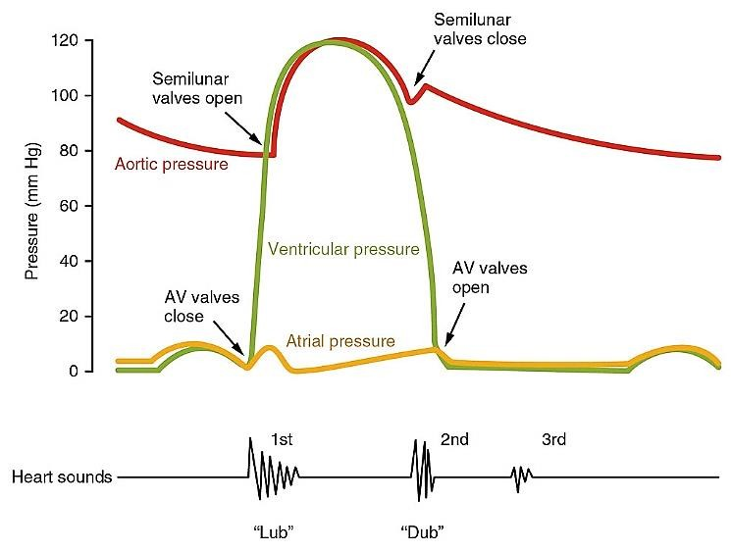





2/23/2016
Cardiovascular Physiology
45
Thank You

