Slide 1



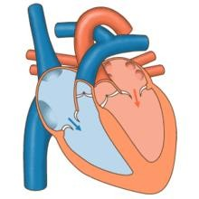







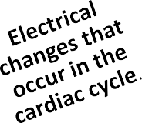
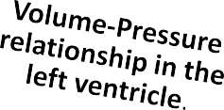






2/23/2016
Cardiovascular Physiology
Cardiovascular Physiology
Cardiac Cycle- 2
Dr. Abeer A. Al-Masri, PhD
A. Professor,
Consultant Cardiovascular Physiologist, Faculty of Medicine, KSU.
At end of this lecture you should be able to know:
2

Slide 2
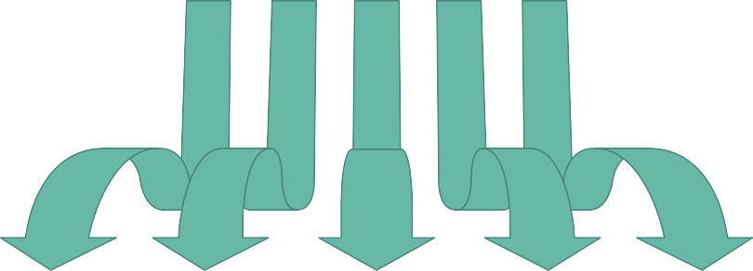















2/23/2016
Cardiovascular Physiology
Events in the Cardiac Cycle
1
Mechanical events
2
Volume changes
3
Pressure changes
4
Heart sounds
5
Electrical events (ECG)
3
Electrical Changes (ECG)
During the Cardiac Cycle

Slide 3
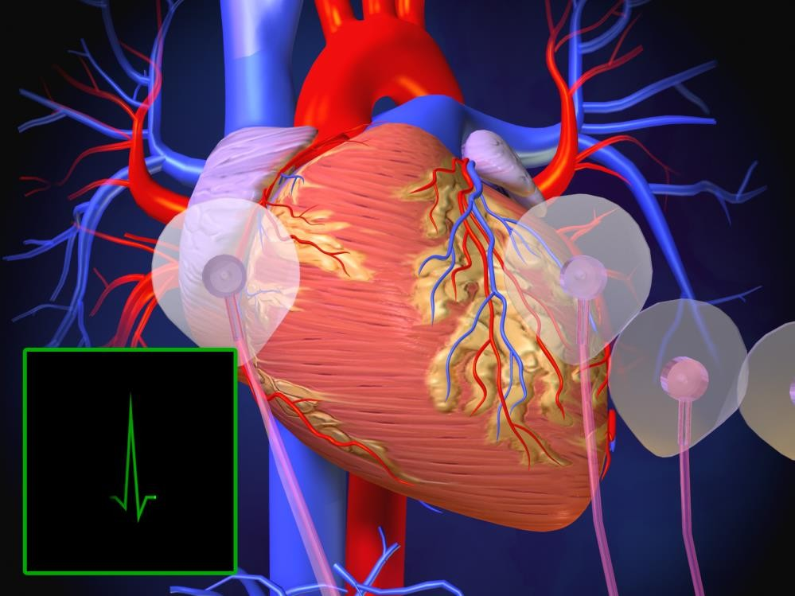



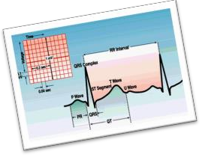
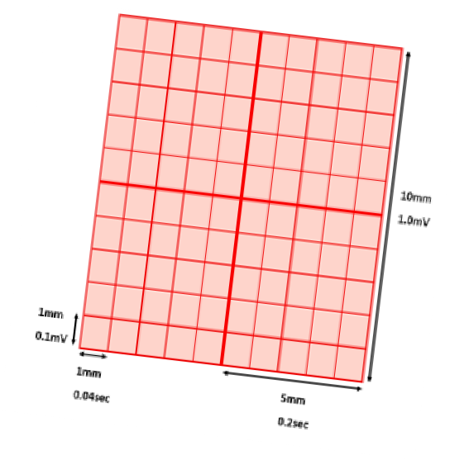
2/23/2016
Cardiovascular Physiology
ECG?
Record of the electrical activity (action potentials)
generated by the heart from chest surface, per unit time
5
ECG is displayed on a graph paper as waves.
Speed: ECG machine runs at 25mm/sec.
  X-axis is the time.
  1mm square corresponds to 0.04 sec.
Voltage is measured on vertical Y-axis.
▪ 0.1mV/mm (1mV=10mm.)
6

Slide 4

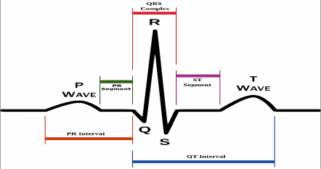







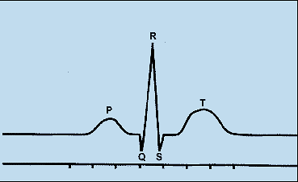
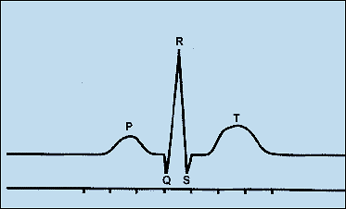



2/23/2016
Cardiovascular Physiology
ECG waveforms
One heartbeat is normally recorded as:
3 waves: P- wave, QRS- complex & T- wave.
  3 positive waves (P, R & T.)
  2 negative waves (Q & S.)
2 intervals between waves: PR & QT intervals.
2 segments: PR & ST segments.
7
ECG waves
P- Wave
QRS- Complex
T- Wave
Due to ventricular depolarization.
QRS complex is recorded before the onset of ventricular systole (isometric contraction phase.)
Due to ventricular repolarization.
T- wave is recorded before the onset of ventricular diastole.
Due to atrial depolarization.
P- wave is recorded before the onset of the atrial systole.
8

Slide 5
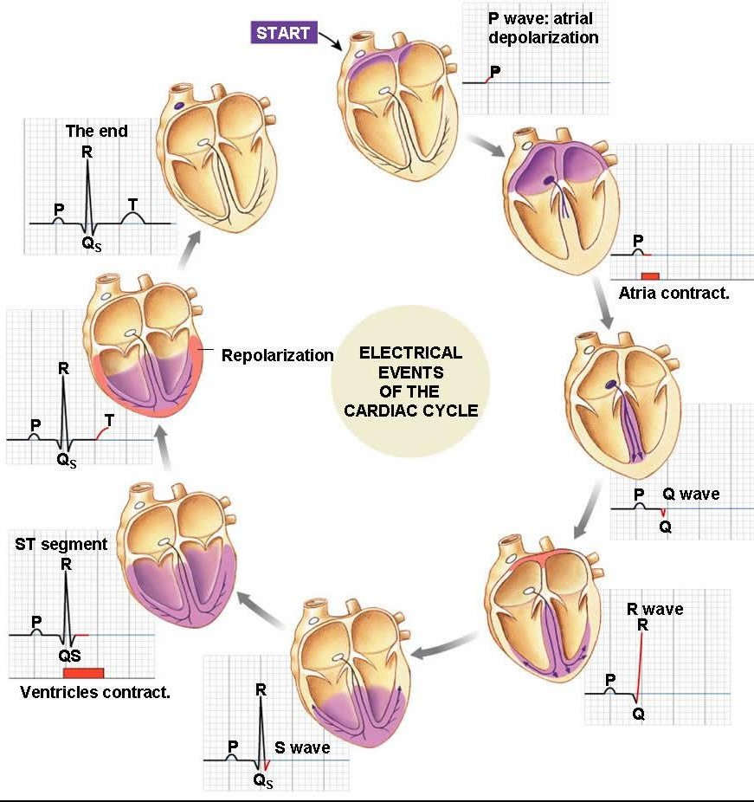
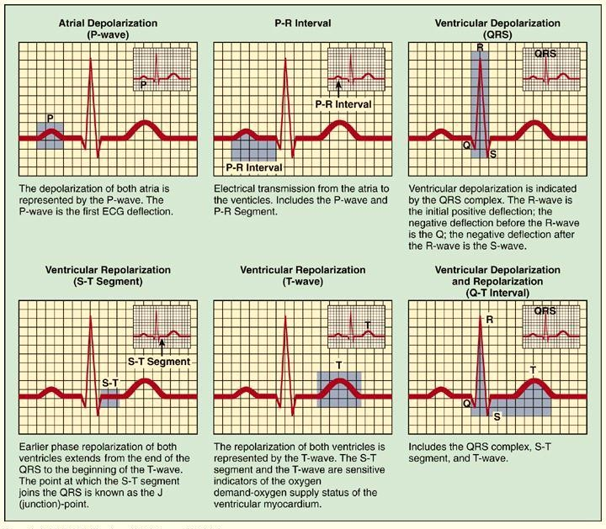
2/23/2016
Cardiovascular Physiology
9
10

Slide 6
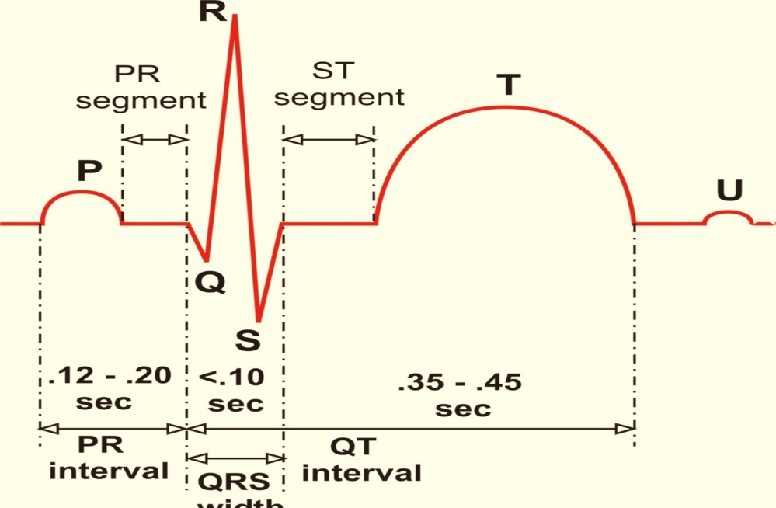


2/23/2016
Cardiovascular Physiology
Normal duration of ECG Waves & Intervals
0.3-0.32 sec
0.06 - 0.11 sec
11
Left Ventricular
Pressure versus Volume

Slide 7






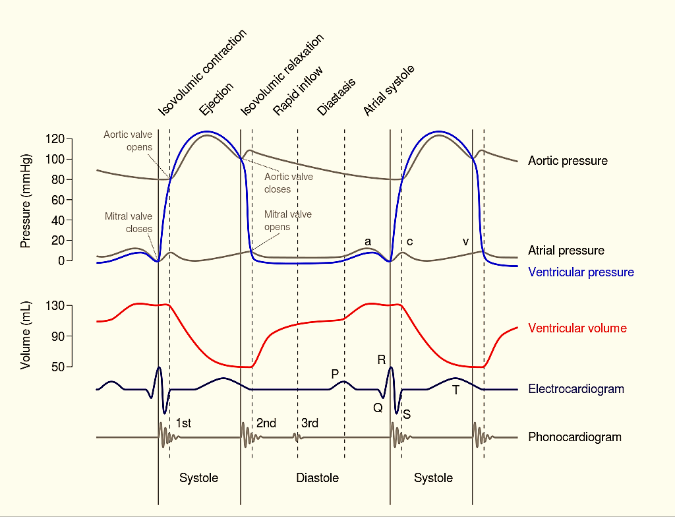
2/23/2016
Cardiovascular Physiology
Left Ventricular Pressure – Volume Curve “The Complete Picture”
14

Slide 8





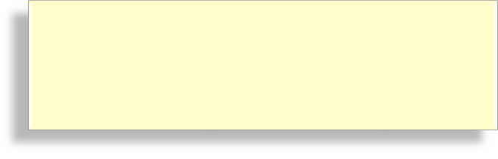
2/23/2016
Cardiovascular Physiology
Left Ventricular Pressure - Volume Loop
Left Ventricular
Pressure – Volume Loop
Correlation of intra-ventricular changes in volume & pressure that occur during one cardiac cycle
16

Slide 9
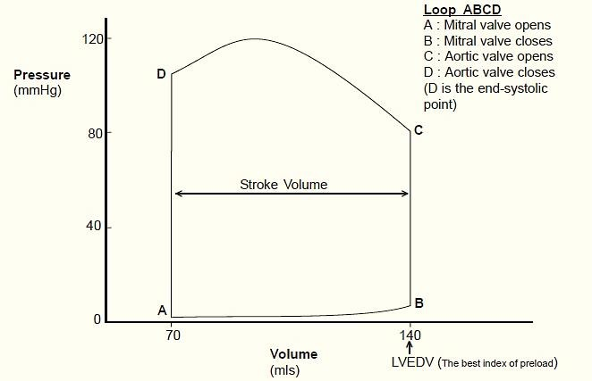
2/23/2016
Cardiovascular Physiology
Both ventricular systole & diastole can be divided into early & late phases.
Systole:
Early systole = ‘Isovolumetric Contraction.’
Late systole = Isotonic Contraction ‘Ejection Phase.’
Diastole:
Early diastole = ‘Isovolumetric Relaxation.’
Late diastole = Isotonic Relaxation ‘Filling Phase.’
17
Basic Myocardial Muscle Mechanics:
Ventricular Pressure - Volume Loop
Late Systole (Ejection phase)
←
Plots LV pressure against LV volume through one complete cardiac cycle
Systole: divided into,
Early systole Late systole
Diastole: divided into,
Early diastole Late diastole
Early Diastole (Isovolumetric relaxation)
↑
Early Systole
(Isovolumetric
Contraction)
↓
→
Late Diastole
(Filling phase)
ESV
EDV
18

Slide 10
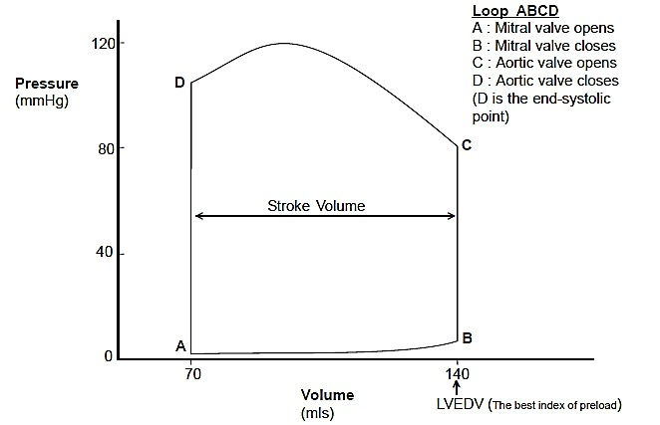
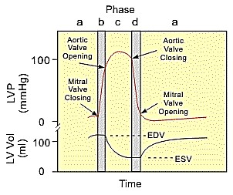
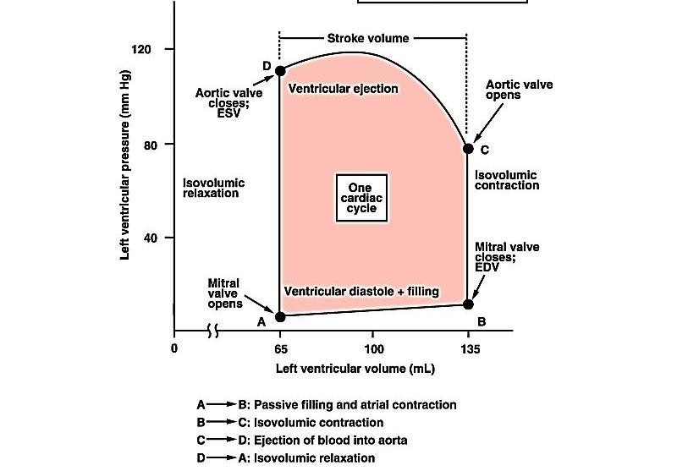

2/23/2016
Cardiovascular Physiology
Ventricular Pressure - Volume Loop
Late Systole (Ejection phase)
←
A – Mitral valve opens B – Mitral valve closes C – Aortic valve opens D – Aortic valve closes
Early Diastole (Isovolumetric relaxation)
↑
Early Systole (Isovolumetric Contraction)
↓
→
Late Diastole
(Filling phase)
ESV
EDV
19
Ventricular |  | Pressure | - Volume | Loop
End of Systole |  |  | Systolic BP Diastolic
Contractility | BP
Area = Work
Compliance |  | ESV | Beginning of Systole EDV SV = EDV - ESV 20
10

Slide 11


2/23/2016
Cardiovascular Physiology
Closer & opening of mitral & aortic- vs during each phase. Beginning of systole (B) & end (D.)
Early & late systolic periods. Beginning of diastole (D) & end (B.) Early & late diastolic periods.
Diastolic filling occurs between points A & B. Ejection occurs between points C & D.
21
What you should remember about Pressure – Volume loop?
Thank You
11

