Slide 1
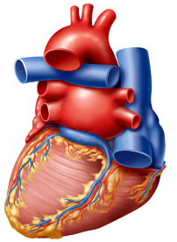
CARDIOVASCULAR BLOCK
HEART SOUNDS
Dr. Mona Soliman, MBBS, MSc, PhD
Head, Medical Education Department
Associate Professor of Physiology
Chair of Cardiovascular Block
College of Medicine
King Saud University
Prof. Shahid Habib
Dept of Physiology
King Saud University

Slide 2
OBJECTIVES
At the end of the lecture you should be able to …..
Enumerate the different heart sounds
Describe the cause and characteristic features of first and second heart sound
Correlate the heart sounds with different phases of cardiac cycle
Define murmurs and their clinical importance

Slide 3
HEART SOUNDS
Second
D U P
First
First
L U B B
L U B B
Systole
Diastole
Heart sounds

Slide 4
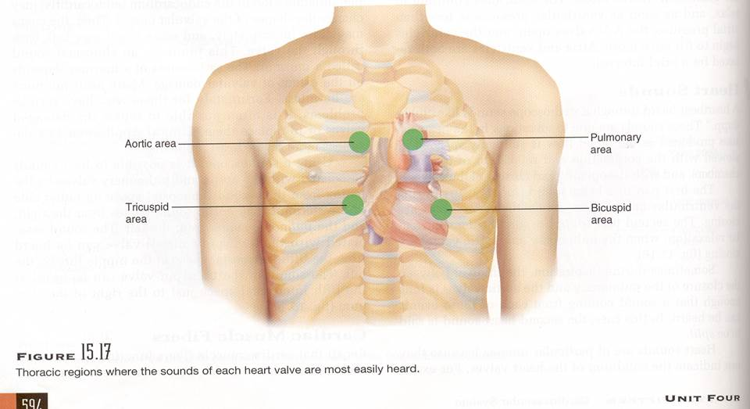
Areas of auscultation

Slide 5
Aortic, pulmonary, Mitral & tricuspid area.

Slide 6
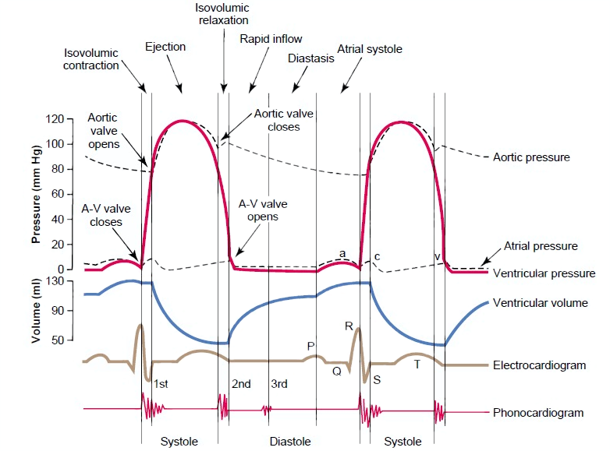
The Events of the Cardiac Cycle

Slide 7
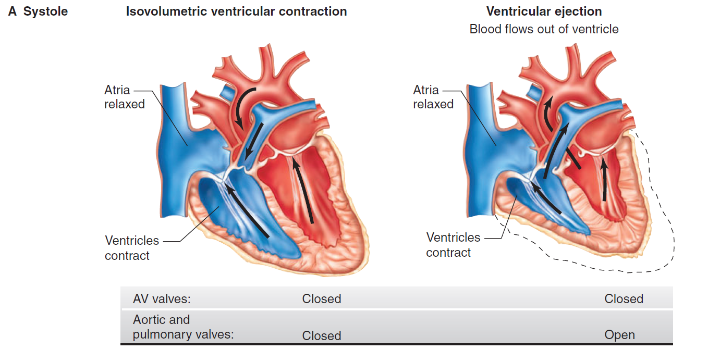

Slide 8
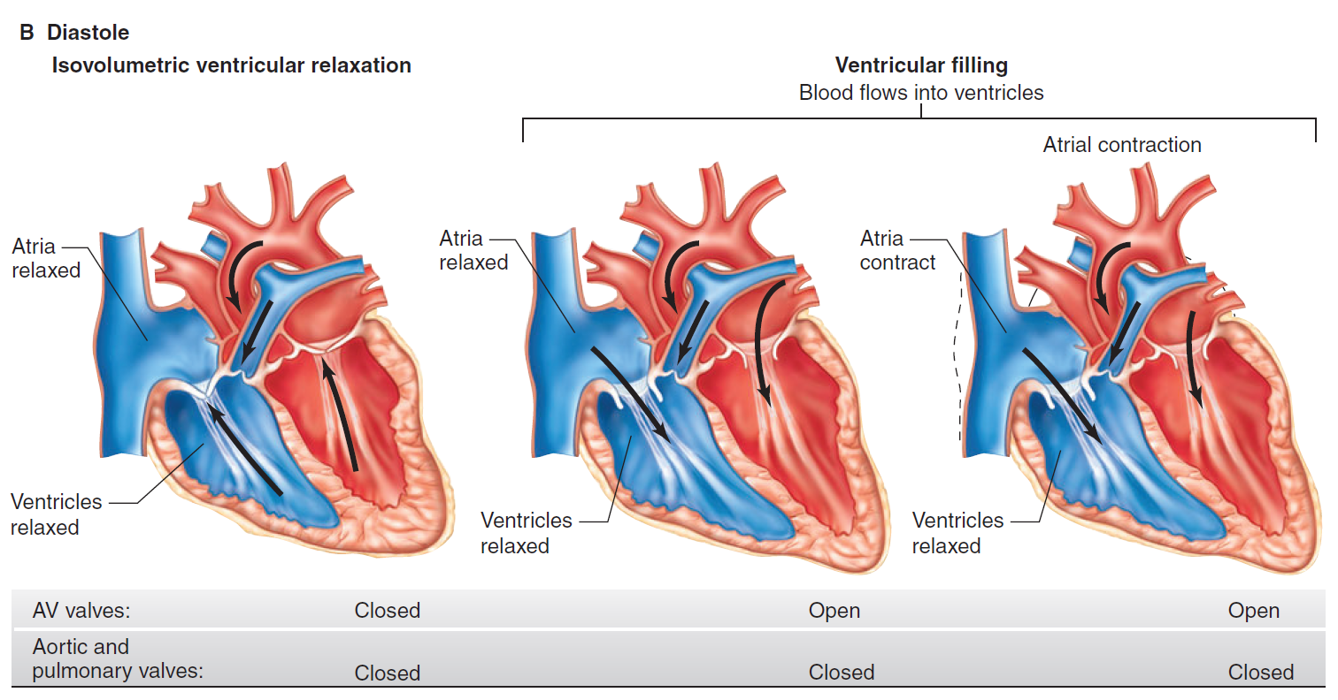

Slide 9
HEART SOUNDS
There are four heart sounds SI, S2, S3 & S4.
Two heart sound are audible with stethoscope S1 & S2 (Lub - Dub).
S3 & S4 are not audible with stethoscope Under normal conditions because they are low frequency sounds.
Ventricular Systole is between First and second Heart sound.
Ventricular diastole is between Second and First heart sounds.

Slide 10
First heart sound (S1)
It is produced due to the closure of Atrioventricular valves (Mitral & Tricuspid)
It occurs at the beginning of the systole and sounds like LUB
Frequency:50-60 Htz
Time: 0.15 sec
Its is heavier when compared to the 2nd heart sound.

Slide 11
Second heart sound (S2)
It is produced due to the closure of Semilunar valves (Aortic & Pulmonary)
It occurs at the end of the systole and sounds like DUB
Frequency:80-90 Htz
Time: 0.12 sec
It is short and sharp compared to the 1st hear sound

Slide 12
Third heart sound (S3)
It occurs at the beginning of middle third of Diastole
Cause of 3rd sound – Rush of blood from Atria to Ventricle during rapid filling phase of Cardiac Cycle. It causes vibration in the blood
Frequency:20-30 Htz
Time: 0.1 sec
S3 may be heard in children and young slim adults but usually pathological in old age.

Slide 13
Fourth heart sound (S4) or Atrial Sound
It occurs at the last one third of Diastole
(just before S1)
Cause of Fourth heart sound – Due to Atrial systole which causes rapid flow of blood from Atria to Ventricle and vibration in the blood.
Frequency: < 20 Htz
Note:
Third and Fourth heart sound are low pitched sounds therefore not audible normally with stethoscope
S4 may be heard in elderly but is usually pathologic in the young.

Slide 14
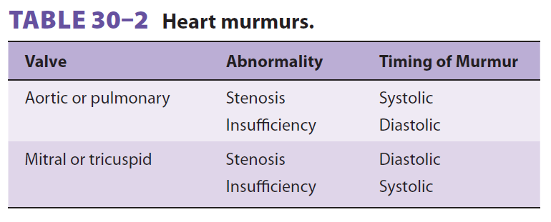
Heart Murmurs
Murmurs are abnormal sounds produced due to abnormal flow of blood.
OR
Murmurs are pathologic and added heart sounds that are produced as a result of turbulent blood flow

Slide 15
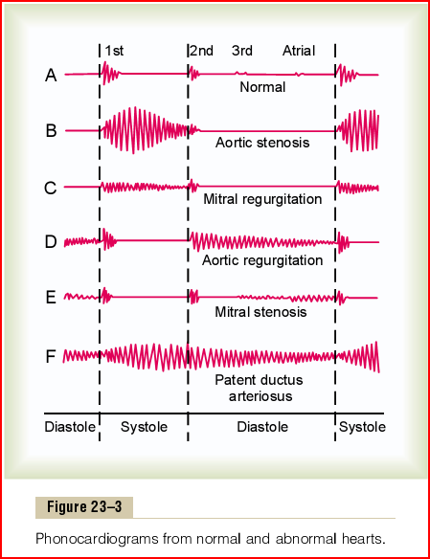

Slide 16
For further readings and diagrams:
Textbook of Medical Physiology by Guyton & Hall
Chapter 19 (Heart Sounds)

