Slide 1

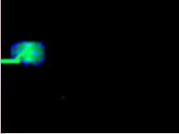
Electrocardiogram
Dr. Thouraya Said

Slide 2
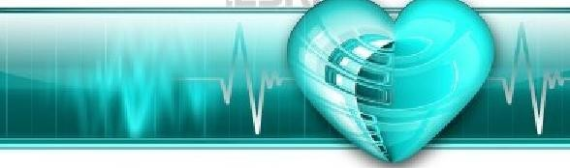
Contents
ECG paper.
ECG leads:
  Limb leads.
  Chest leads.
Interpretation of the ECG.
Cardiac axis
Heart rhythm.
Heart rate.

Slide 3

ECG records the electrical changes (depolarization and repolarization) that take place in the heart/per cycle.
These changes can be detected by electrodes attached to the surface of the body.
Subject supine, relaxed.
Temperature of the room : neutral.

Slide 4
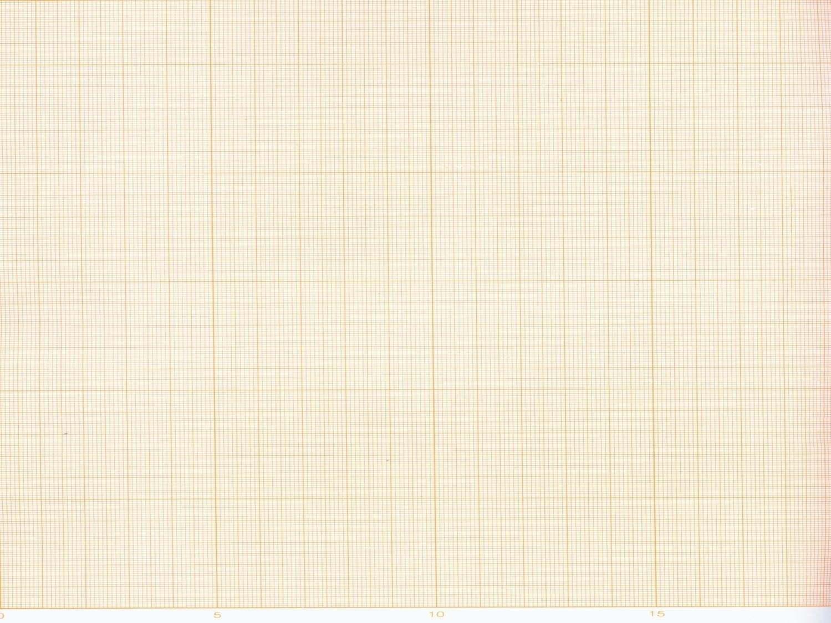
ECG Paper
The ECG is recorded on a graphic paper with standard- sized squares.
The horizontal axis: time measured in seconds.
➢1 small square (1mm): 0.04 seconds
➢1 large square: 0.20 seconds.
➢5 large squares: 1 second.
The vertical axis: changes of voltage.
➢10mm = 1cm = 1millivolt.
➢A signal of 1(mV) should move the stylus vertically 1 cm (2 large squares).
The standard paper speed is 25mm/sec.

Slide 5
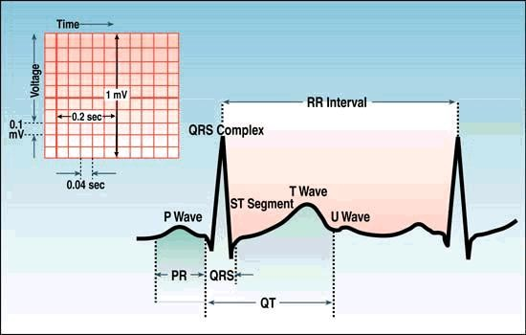
ECG Paper

Slide 6
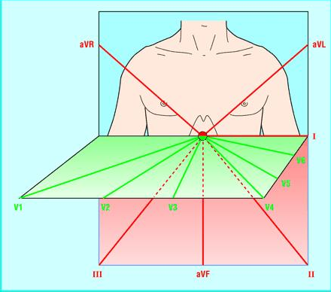
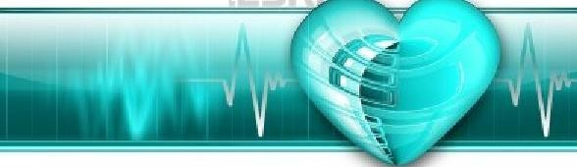
The 12 standard ECG leads
A lead is formed by a pair of electrodes.
Frontal Plane ( 6 limb leads) Bipolar Leads: I , II , and III Unipolar leads: aVR, aVL, aVF
Transverse Plane:
Unipolar chest leads: V1 to V6

Slide 7

3 bipolar limb leads: I, II, III
Record the difference in potential between 2 limbs.
ECG was first recorded by placing electrodes on 3 places: Right and Left arms and Left leg
(Recording +ve Ede) (-ve reference Ede)
Depolarization moving towards a +ve Ede produces a +ve deflection.
Depolarization moving in the opposite direction produces a –ve deflection.

Slide 8
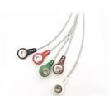
Lead I: Left arm Ede is +ve, the other is –ve.
Lead II: Edes on the right arm and the left leg with the leg +ve.
Lead III: Ede of the left arm is –ve, Ede of the left leg is +ve.
The 3 leads arranged as a triangle are known as
Einthoven’s triangle.

Slide 9
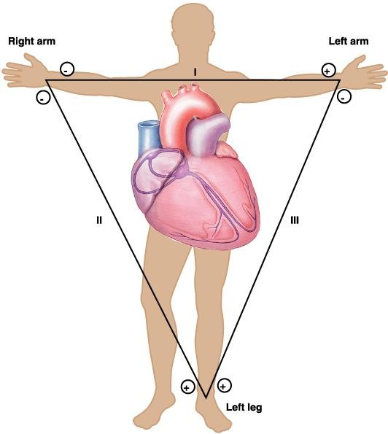
I
II
III

Slide 10
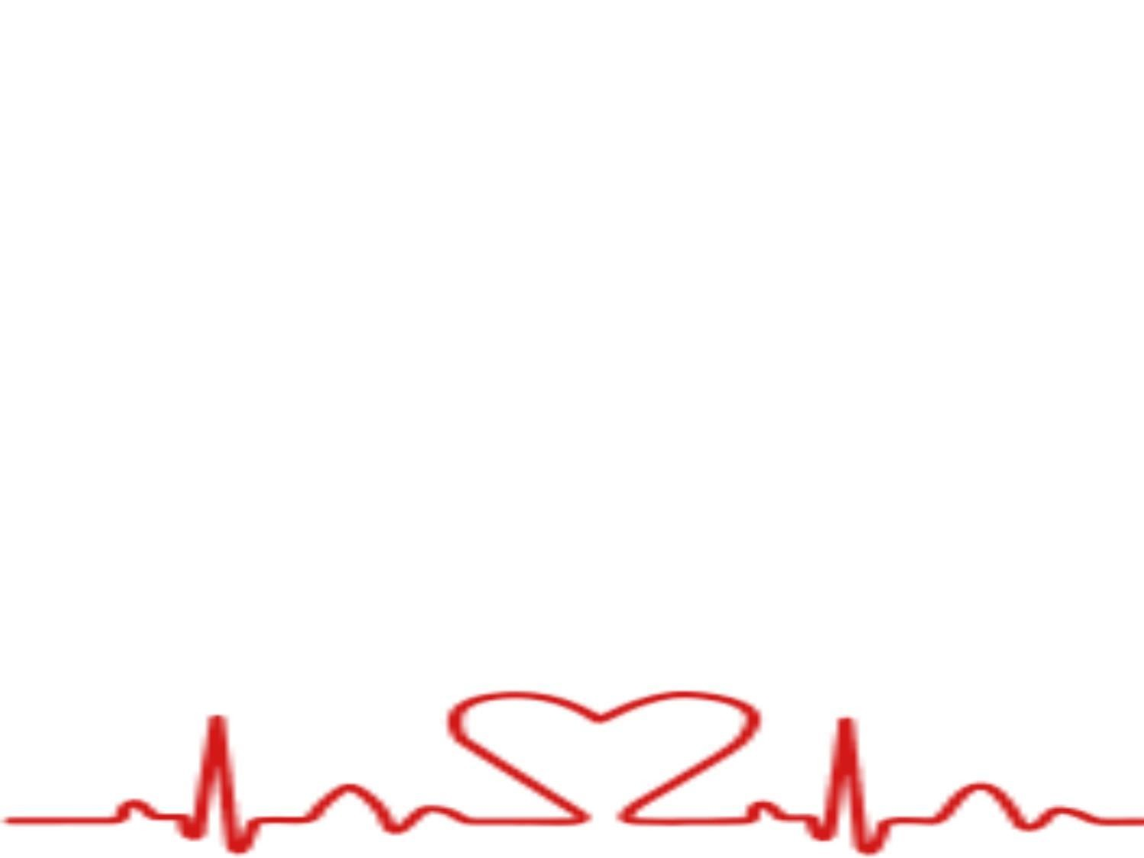
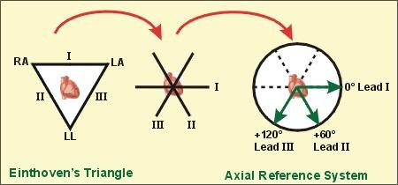
Formation of the triaxial system
& assignment of degrees to leads I, II, III
By bringing the sides of the triangle to the common center.
The axes are 60° apart.
Axis of a lead: direction from the negative to the positive electrode
Lead I (+) is at 0°
Lead II (+) is at +60°
Lead III (+) is at +120°

Slide 11
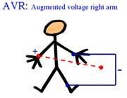
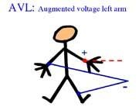
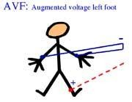
Augmented unipolar limb leads aVR, aVL, and aVF
Are recordings between 1 limb and the other 2 limbs.
aVR (augmented,Voltage, Right arm +ve)
aVL: uses left arm as +ve.
aVF: uses left leg as +ve.

Slide 12
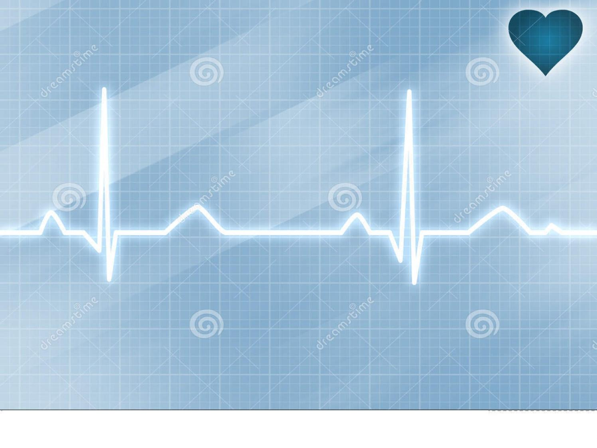
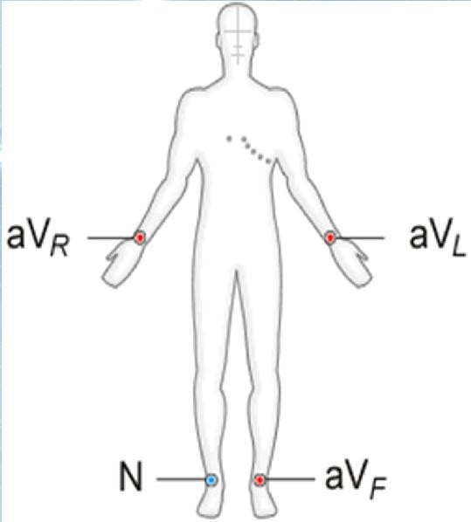
Leads aVR, aVL, aVF cross at # angles and produce an intersection of 3 other lines.
Angles of 60° like for lead I, II, III.
aVR-150°
aVL-30°
aVF+90

Slide 13

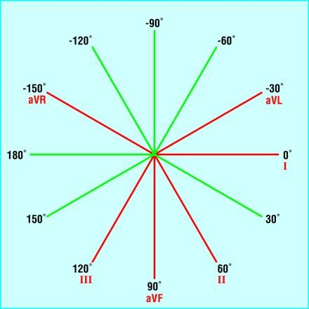
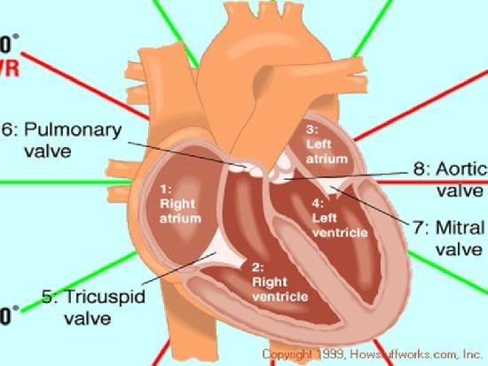
Formation of hexaxial system
Leads aVR, aVF, aVL divide the angles formed by lead I, II, III.
The leads cross precisely at 30°.

Slide 14
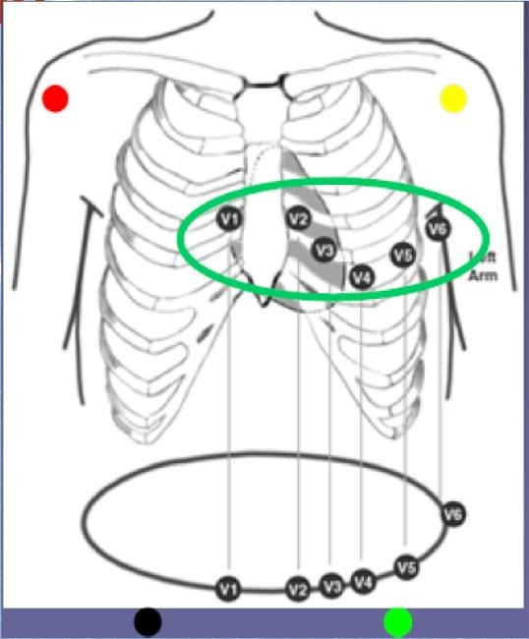
B: 6 standard “chest leads” depict electrical
events in the horizontal plan
One +ve Ede is placed on
6 different positions around the chest.
The reference –ve Ede is a combined limb lead.
e.

Slide 15
Chest leads:
V1 – Right sternal border, 4th ICS.
V2 – Left sternal border, 4th ICS.
V3 – Halfway between leads V2 & V4.
V4 – Left mid- clavicular line, 5th ICS.
V5 – Anterior axillary line, 5th ICS.
V6 – Mid axillary line, 5th ICS.

Slide 16
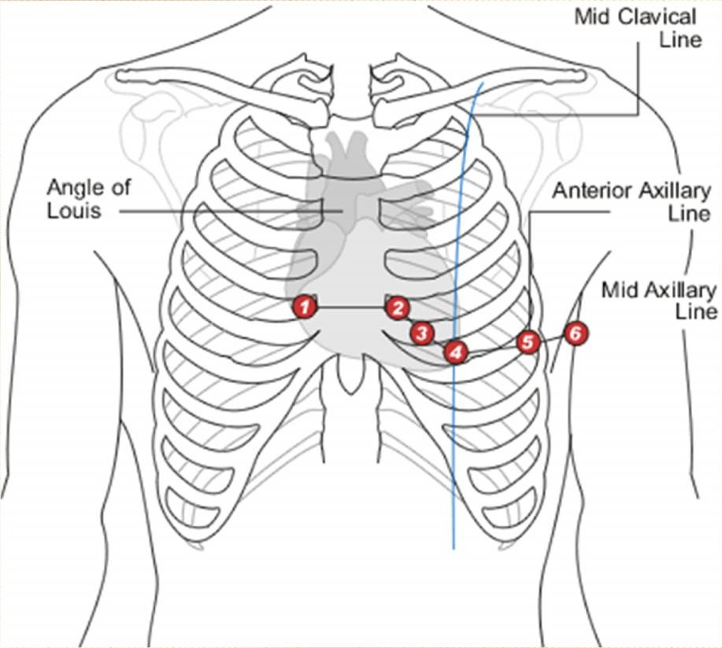

Slide 17
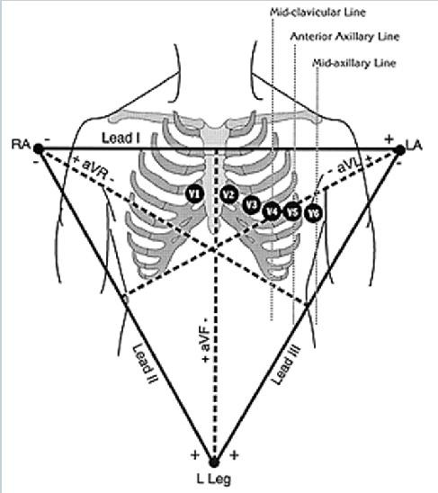

The standard 12-lead ECG
How many electrodes?
  10 electrodes
How many leads?
  12 leads

Slide 18
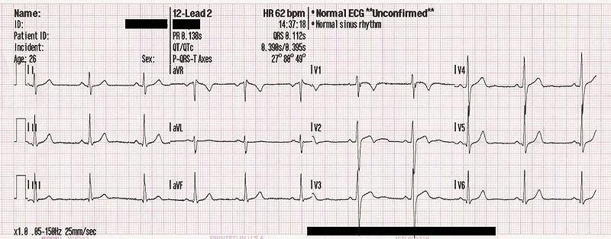
The 12-lead ECG

Slide 19
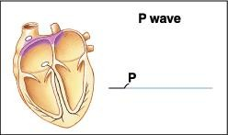
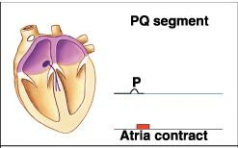
Interpretation of the normal ECG
Atrial activation:
The impulse originates at SA node, spreads through the atria.
This causes positive upward deflection.
The P wave represents the depolarization of both atria.
• Pw: <0.12 sec
< 2.5 mm

Slide 20

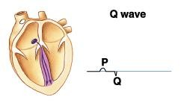
Septal Activation:
The impulse spreads to the AV node, common bundle of His and R and L bundle branches then enters the IV septum.
This occurs during PR segment.

Slide 21
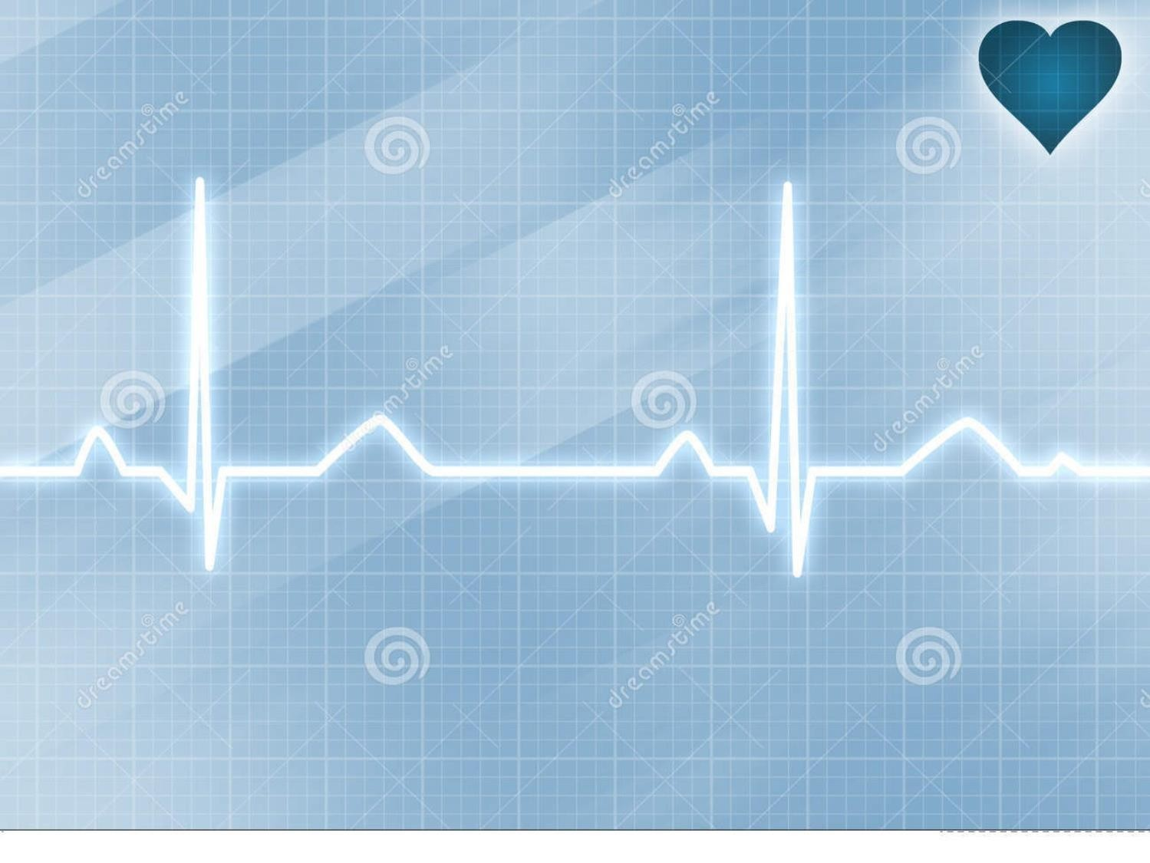
PR interval: P wave + PR segment.
Time of transmission of electrical impulse from the beginning of atrial depolarization to the beginning of ventricular depolarization.
PR: 0.12 - 0.20 seconds (less than 1 large square).
PR prolonged > 0.20 seconds. First degree heart block.
PR shortens as heart rate increases.

Slide 22
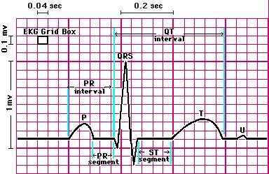

Slide 23
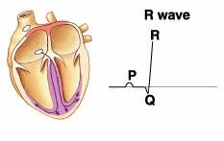
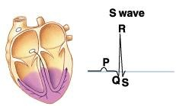
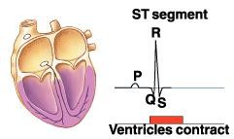
Ventricular depolarization
The wave of depolarization spreads in the Purkinje fibers to all parts of the ventricles.
The initial negative deflection is Q wave.
The first positive deflection is R wave.
The negative deflection after R wave is : S wave.
QRS duration: < 0.10 sec.

Slide 24
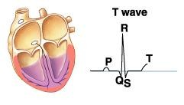
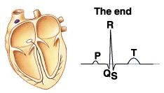
Ventricular repolarization: T wave
Ventricular repolarization represented by ST segment and T wave.
ST segment: period between the end of QRS and the start of T wave.
QT interval: from beginning of Q wave to end of T wave (ventricular dep and rep) < 0.43 sec.
ST interval: QT-QRS = 0.32 sec.

Slide 25
ECG intervals
Intervals | Normal Duration(s) |  | Events in the Heart During Interval
 | Average | Range
PR interval Pw + PR segment. | 0.18 | 0.12-0.20 < 1 large square | Atrial depolarization and conduction through AV node
QRS duration | 0.08 | To 0.10 | Ventricular depolarization and atrial repolarization
QT interval | 0.40 | To 0.43 | Ventricular depolarization plus ventricular repolarization
ST interval (QT minus QRS) | 0.32 | … | Ventricular repolarization

Slide 26
Examples of ECG abnormalities
Prominent U wave: hypokalaemia.
Tall T wave: hyperkalaemia.
Short QT interval: hypercalcaemia.
Prolonged QT interval: hypocalcaemia.
ST elevation, T inversion, large Q wave:
myocardial infarction.

Slide 27
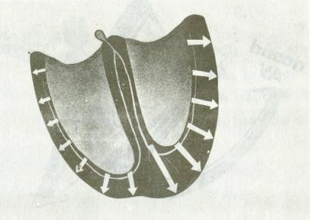
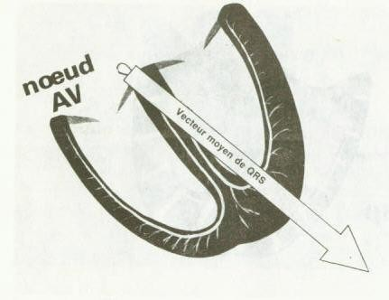
Cardiac axis
The mean QRS vector is the preponderant direction of the potential during depolarization.
The mean electrical axis of the ventricles is 59°.

Slide 28
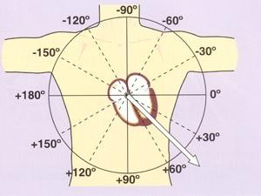

Slide 29
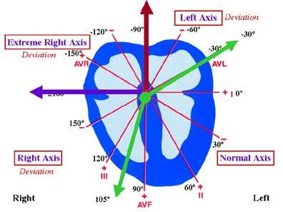

Slide 30
Normal Axis: | from -30 ° to +90 °
Left Axis Deviation: Obese (normal) LV hypertrophy L B B B | from -30 ° to -90 °
Right Axis Deviation: Thin tall (normal) R V hypertrophy R B B B | from + 90° to ± 180 °
Extreme Right Axis Deviation: | from -90 ° to ± 180°

Slide 31
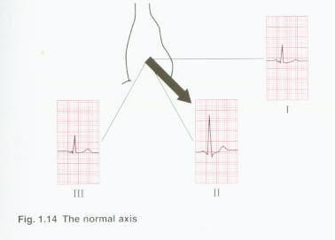
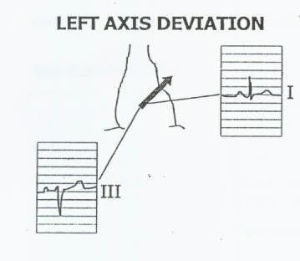
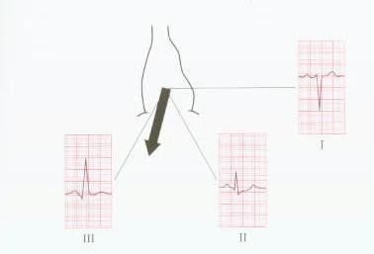
Inspection method
RIGHT AXIS DEVIATION

Slide 32
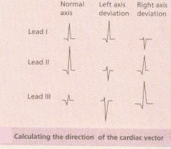

Slide 33
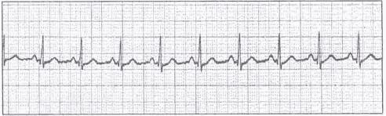
Rythm
Sinus rhythm: P wave before every QRS: Impulse from SA node
Sinus Regular : distance between R-R: constant
R R
Irregular : Unequal R-R intervals

Slide 34
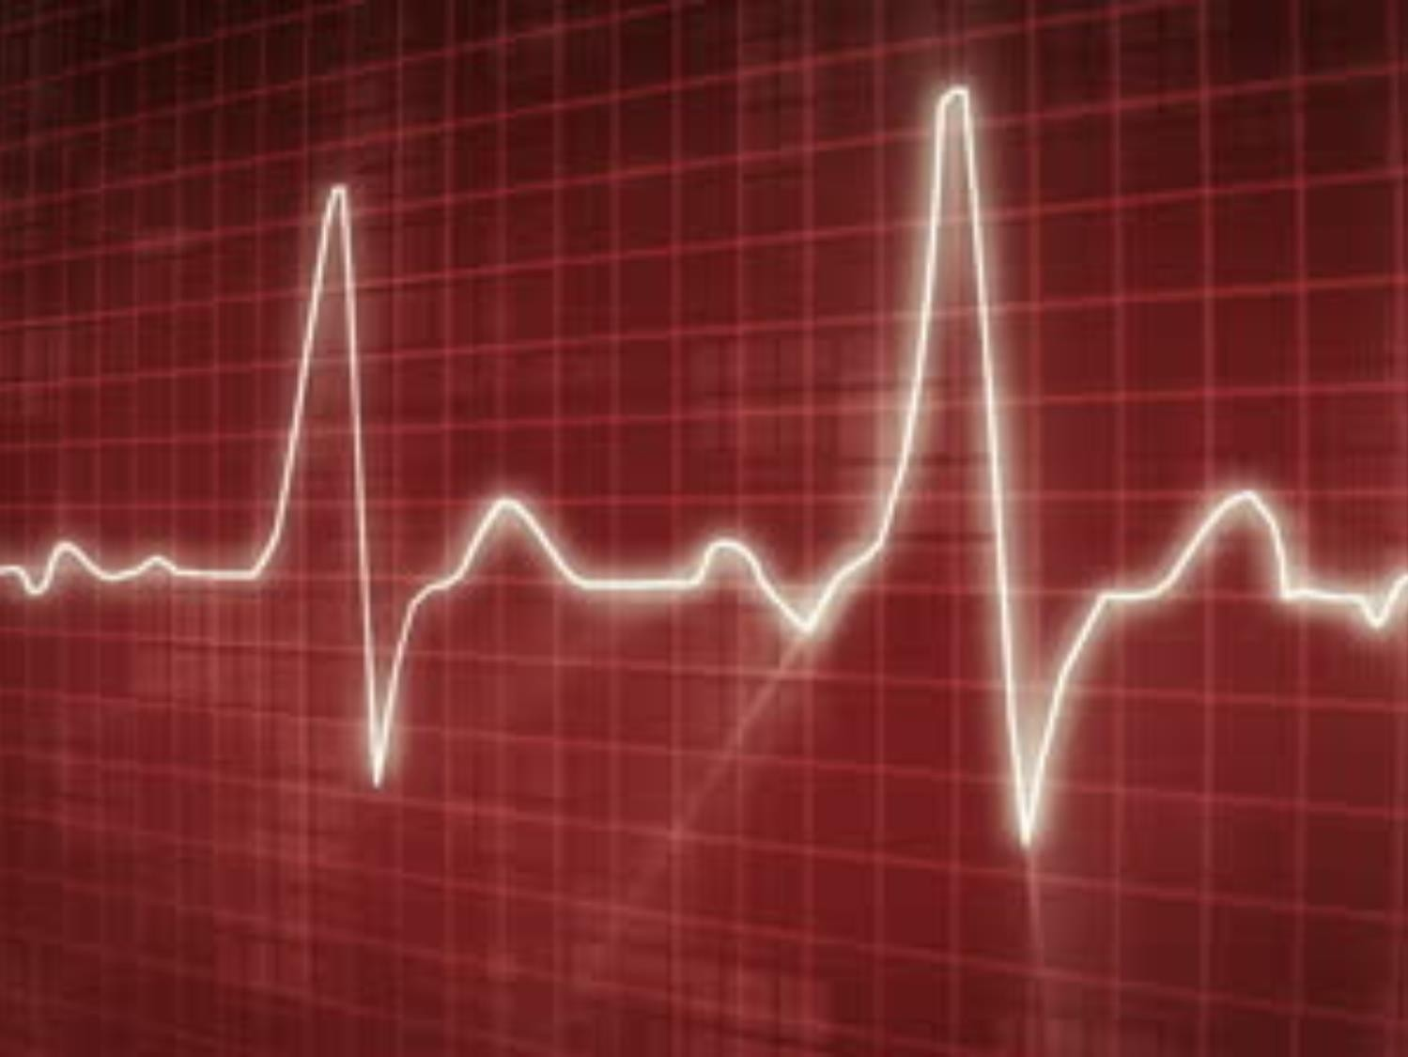
Rythm
Sinus arrythmia (normal physiological phenomenon)
Deep inspiration :Rwaves closer :fast rate
Deep expiration: bradycardia

Slide 35
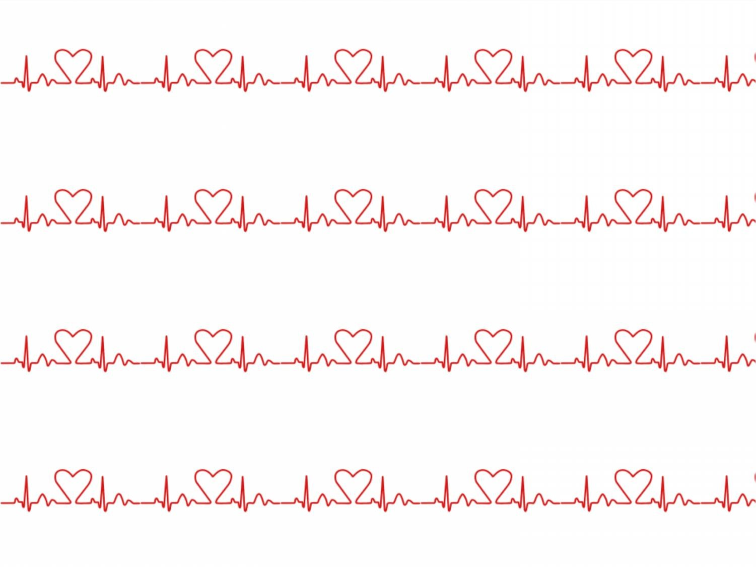
Heart rate
Examine the distance between QRS complexes.
If the distances are regular, use one of these two formulas:
300
Big squares between R-R
Or:
1500
Small squares between R-R
To obtain the heart rate in beats per minute.

Slide 36
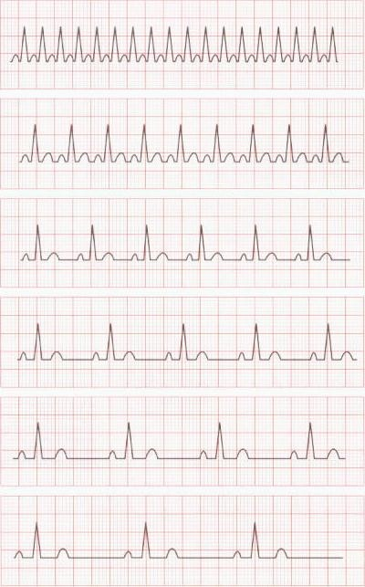
1 complex every 1 major division = 300/min
1 complex every 2 major divisions = 150/min
1 complex every 3 major divisions = 100/min
1 complex every 4 major divisions = 75/min
1 complex every 5 major divisions = 60/min
1 complex every 6 major divisions = 50/min

Slide 37
