Slide 1
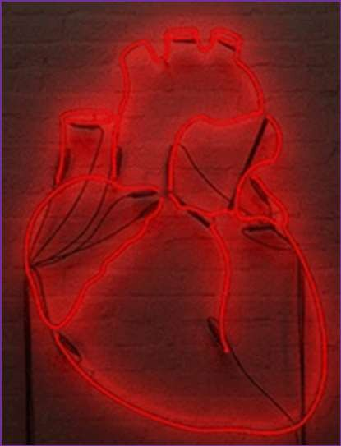
Dr. Thouraya Said

Slide 2
Objectives
Identify and understand:
The events causing the different waves of the JVP & CAP tracings.
Difference between JVP and CAP.
Correlation between JVP, CAP, ECG and Phoncardiogram.

Slide 3
The carotid pulse tells about the aorta
and left ventricular function.
JVP provides information regarding hemodynamic changes in the right side of the heart.
Evaluation of pulse waveform helps in the diagnosis of certain cardiac diseases & assessing their severity.

Slide 4
Distinguishing features between venous and arterial pulses
JVP | CAP
Visible but not palpable | Palpable
Obliterated by pressure | Not obliterated by pressure
2 pulsations per systole | 1 pulsation per systole
Decreases with inspiration | No effect of respiration
Enhanced by H-J-Reflex | No effect of abdominal pressure

Slide 5
Carotid arterial pressure
The carotid pulse can be taken on the right side of the neck over the
carotid artery in order to determine heart rate.
When blood is forced into the aorta during ventricular systole, two things happen:
Blood is moved forwards.
A pressure wave is set up which travels along the wall of arteries (faster than the flow of blood), expanding the arterial walls as it travels. The expansion of the arterial wall is palpable as the pulse.

Slide 6
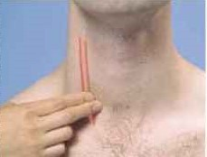
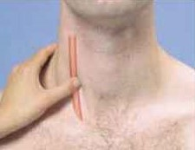
How to examine
Subject supine at 30° head slightly bent to the examined side.
Feel CAP on medial side of SCM alongside the lateral border of thyroid cartilage.
Apply transducer over CAP using soft rubber band & connect it to recorder.

Slide 7
Recorded CAP graph
Anacrotic limb (rapid upstroke):
Sharp rise in pressure to a peak of 120mmHg during maximum ejection phase of ventricular systole.
Dicrotic notch (Incisura):
Aortic valve snaps shut; blood rebounded against arterial walls produces slight elevation in pressure (marks beginning of ventricular diastole).
Dicrotic limb (descending limb after Incisura):
✵ in pressure to 80mmHg due to elastic recoil of arterial wall.

Slide 8
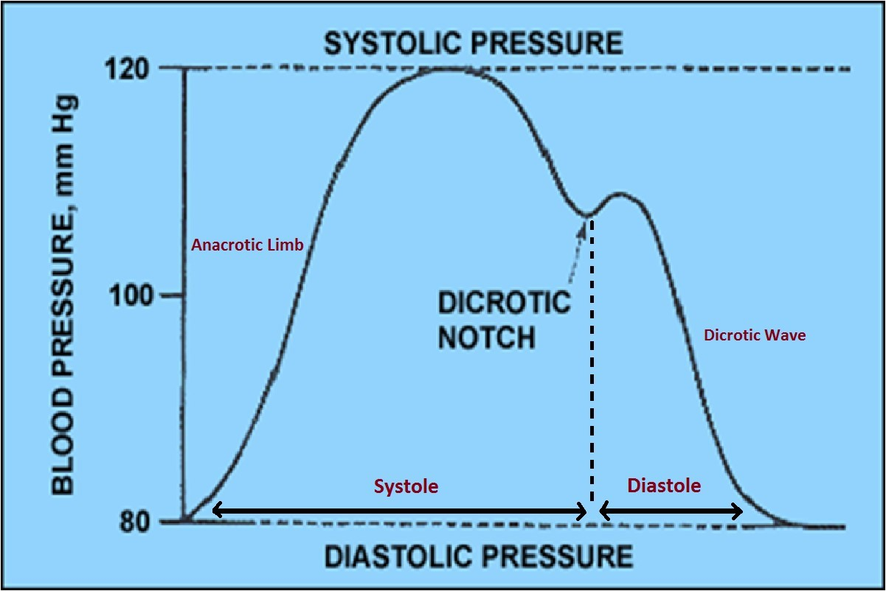

Slide 9
❑ Cardiac Cycle duration: 0.8 sec.
Ventricular systole:
Ventricular diastole:
0.3 sec.
0.5 sec.

Slide 10
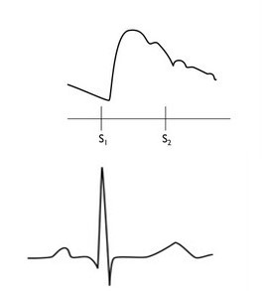
CAP and ECG
Dicrotic Notch (Dn) or Incisura:
Coincides with the second heart sound when we relate it to a phonocardiogram and occurs just after the T-wave when we relate it to an ECG.

Slide 11
Abnormal CAP
Aortic stenosis: pressure drops.
Aortic regurgitation: pulse strong.

Slide 12
Jugular Venous Pressure
❑ Pressure changes in the right atrium are transmitted directly to the internal jugular vein (IJV) as there are no valves between this vein and the right atrium.
❑ The external jugular vein is easier to see but has valves and is subject to compression as it enters the chest (tortuous course).

Slide 13
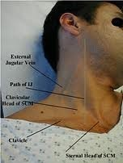
How to examine
Use the right IJV.
Patient at a 45° angle.
Head turned slightly to the left.
IJV runs from medial end of clavicle to the ear lobe under medial aspect of the SCM.
Find its pulsation between the 2 attachments of SCM.
More prominent with
Valsava manoeuvre.

Slide 14
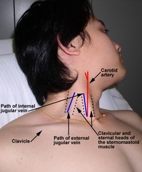

Slide 15
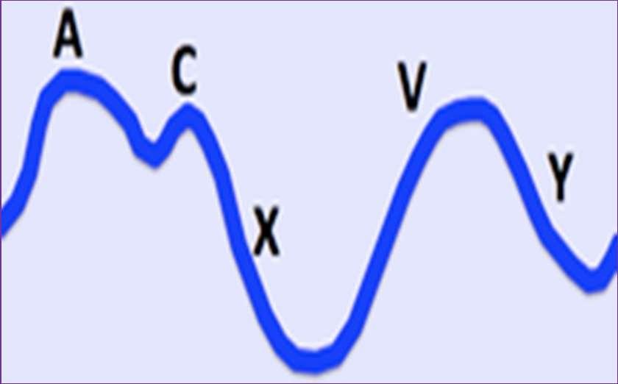
JVP waveform
Classically 3 visible peaks (waves) and 2 visible descents/troughs.

Slide 16
Causes of these waves
‘a’ wave: right atrial systole.
Right atrial contraction in late diastole to propel additional blood into ventricles.
‘c’ wave: transmitted manifestation of the rise in atrial pressure produced by bulging of tricuspid valve into the right atrium during isovolumentric ventricular contraction.

Slide 17
‘x’ descent: atrial relaxation.
Due to downward displacement of the tricuspid valve by the contraction of papillary muscles during ventricular systole.
‘v’ wave: rise in atrial pressure by venous return before tricuspid valve opens.
‘y’ descent: tricuspid valve opens. Passive rapid ventricular filling, decreasing right atrial pressure.

Slide 18
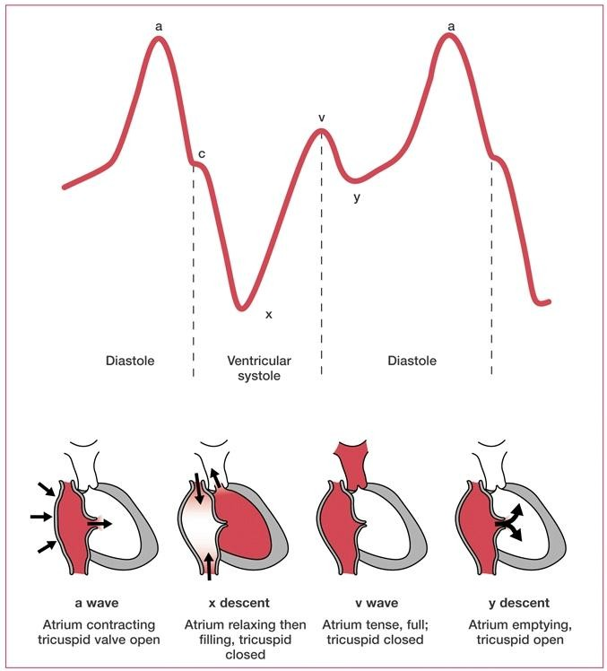

Slide 19
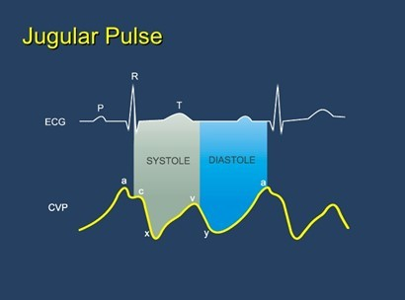
How to identify JVP tracing?
First identify v wave, you will find it between two descents x & y.
The a & c wave precede the x descent.
x more prominent than y.
c, x and v are systolic. y and a are diastolic.

Slide 20
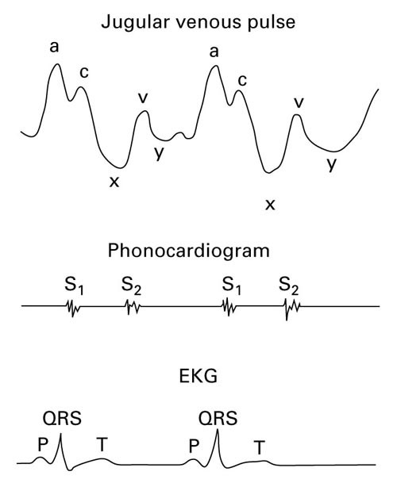
Correlations
❑ a wave:
Follows P wave of ECG.
Precedes upstroke of carotid pulse.
Just before S1.
c wave follows QRS and S1.
v wave peaks after S2 which is synchronous with dicrotic notch (late systole).

Slide 21
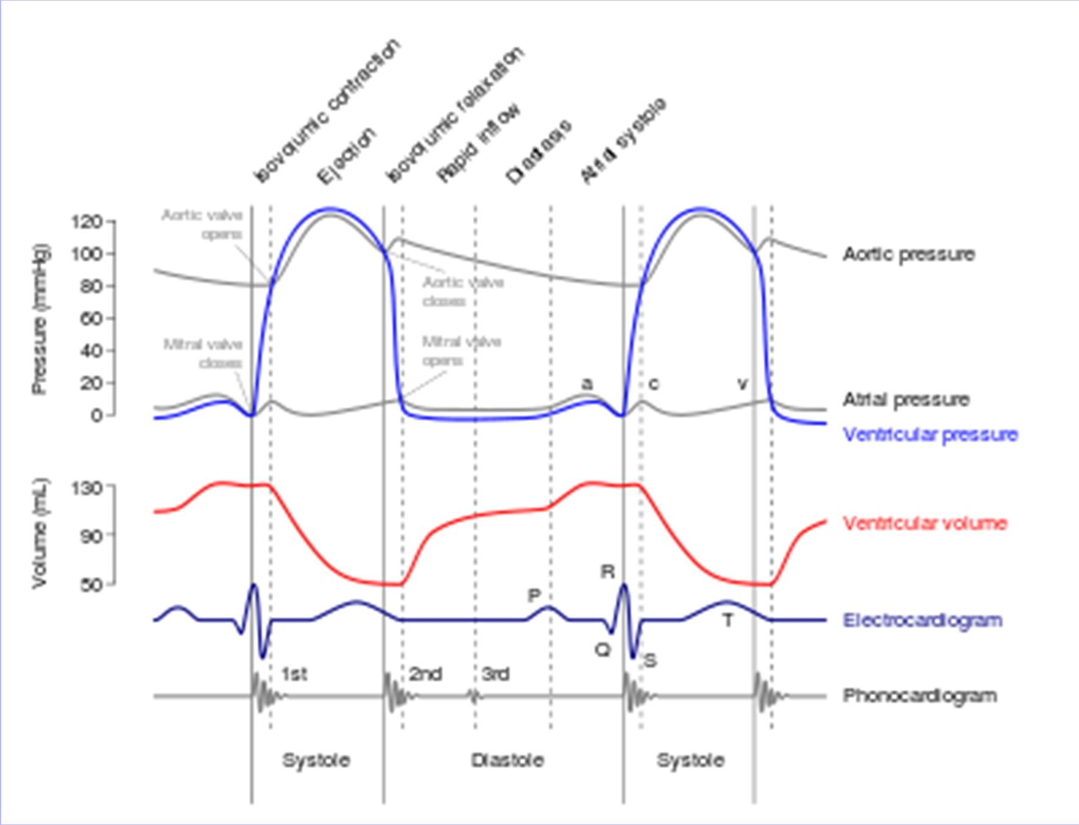

Slide 22
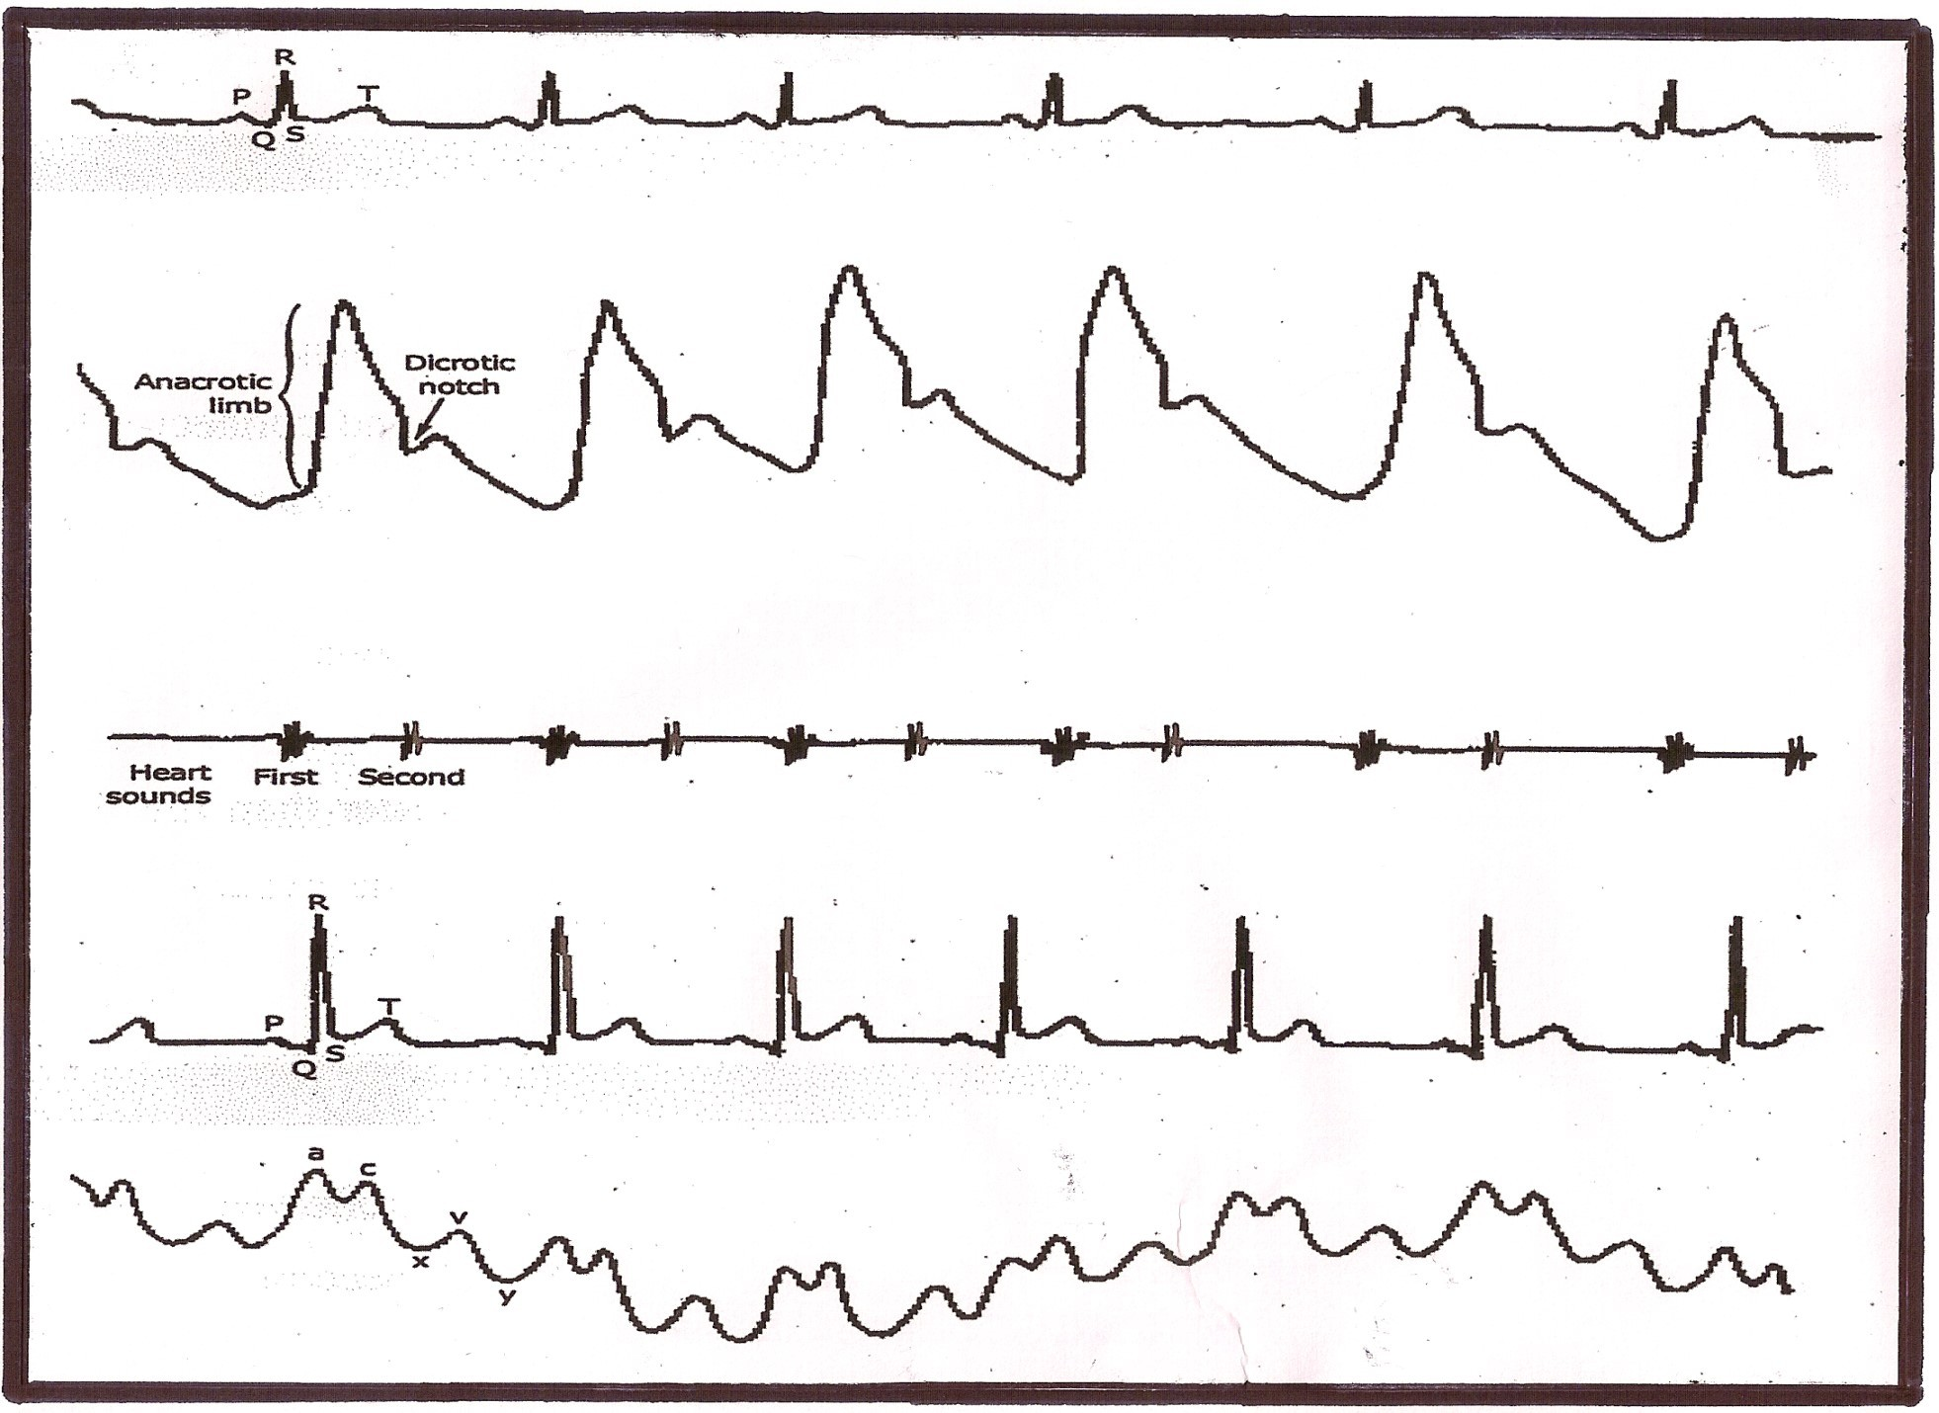

Slide 23
Clinical abnormalities
❑ a wave:
Prominent: Right heart failure, pulmonary stenosis,
pulmonary hypertension, tricuspid stenosis.
Absent: Atrial fibrillation.
Cannon wave: Complete AV block, atrial flutter,
ventricular tachycardia.
c wave: Prominent in tricuspid regurgitation.
v wave: Prominent in tricuspid regurgitation.

Slide 24
Thank you!

