Slide 1
Major arteries
of
the body
Prof. ahmed fathalla ibrahim

Slide 2
OBJECTIVES
At the end of the lecture, the student should be able to:
Define the word ‘artery’ and understand the general principles of the arterial system.
Define arterial anastomosis and describe its significance.
Define end arteries and give examples.
Describe the aorta and its divisions & list the branches from each part.
List major arteries and their distribution in the head & neck, thorax, abdomen and upper & lower extremities.
List main pulse points.

Slide 3
“ARTERIES”
Arteries carry blood from the heart to the body.
All arteries, carry oxygenated blood, EXCEPT the PULMONARY ARTERY which carry deoxygenated blood to the lungs.

Slide 4
GENERAL PRINCIPLES OF ARTERIES
The flow of blood depends on the pumping action of the heart.
Arteries have ELASTIC WALL containing NO VALVES.
The branches of arteries supplying adjacent areas normally ANASTOMOSE with one another freely providing backup routes for blood to flow if one artery is blocked, e.g. arteries of limbs.
The arteries whose terminal branches do not anastomose with branches of adjacent arteries are called “END ARTERIES”. End arteries are of two types:
Anatomic (True) End Artery: When NO anastomosis exists, e.g. artery of the retina.
Functional End Artery: When an anastomosis exists but is incapable of providing a sufficient supply of blood, e.g. splenic artery, renal artery.

Slide 5
AORTA
The largest artery in the body
Carries oxygenated blood to all parts of the body
Is divided into 4 parts:
Ascending aorta
Arch of aorta
Descending thoracic aorta
Abdominal aorta
2
1
3
4

Slide 6
ASCENDING AORTA
Originates from left ventricle.
Continues as the arch of aorta
Has three dilatations at its base, called aortic sinuses
Branches:
Right & Left coronary arteries (supplying heart), arise from aortic sinuses

Slide 7
ARCH OF AORTA
Continuation of the ascending aorta.
Leads to descending aorta.
Located behind the lower part of manubrium sterni and on the left side of trachea.
2
1
3
Branches:
Brachiocephalic trunk.
Left common carotid artery.
Left subclavian artery.

Slide 8
COMMON CAROTID ARTERY
Origin:
LEFT from aortic arch.
RIGHT from brachiocephalic trunk.
Each common carotid divides into two branches:
Internal carotid
External carotid

Slide 9
EXTERNAL CAROTID ARTERY
It divides behind neck of mandible into: Superficial temporal & maxillary arteries
It supplies:
Scalp: Superficial temporal, occipital, & posterior auricular arteries
Face: Facial artery
Maxilla & mandible: Maxillary artery
Tongue: Lingual artery
Pharynx: ascending pharyngeal artery
Thyroid gland: Superior thyroid artery
8
7
6
4
5
3
2
1

Slide 10
INTERNAL CAROTID ARTERY
Has NO branches in the neck
Enters the cranial cavity, joins the basilar artery (formed by the union of two vertebral arteries) and forms ‘arterial circle of Willis’ to supply brain.
In addition, it supplies
Nose
Scalp
Eye

Slide 11
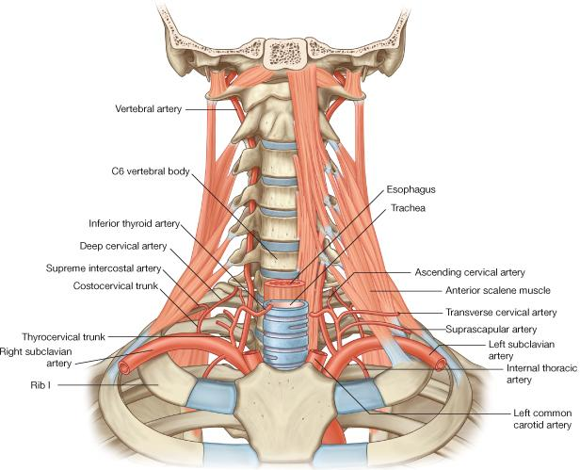
SUBCLAVIAN ARTERY
Origin:
LEFT: from arch of aorta
RIGHT: from brachiocephalic trunk
It continues, at lateral border of first rib, as axillary artery: artery of upper limb
Main branches:
Vertebral artery: supplies brain & spinal cord
Internal thoracic artery: supplies thoracic wall

Slide 12
ARTERIES OF UPPER LIMB
At lateral border of 1st rib
At lower border of teres major
Opposite neck of radius

Slide 13
DESCENDING THORACIC AORTA
It is the continuation of aortic arch
At the level of the 12th thoracic vertebra, it passes through the diaphragm and continues as the abdominal aorta
Branches:
Pericardial
Esophageal
Bronchial
Posterior intercostal

Slide 14
ABDOMINAL AORTA
It enters the abdomen through the aortic opening of diaphragm.
At the level of lower border of L4, it divides into two common Iliac arteries.
Branches: divided into two groups:
Single branches
Paired branches

Slide 15
MAIN BRANCHES OF ABDOMINAL AORTA
1
1
2
2
SINGLE BRANCHES
SUPPLYING
GASTROINTESTINAL TRACT
3
3
4
PAIRED BRANCHES
5

Slide 16
BRANCHES OF COMMON ILIAC ARTERY
EXTERNAL ILIAC ARTERY:
continues (at midpoint of inguinal ligament) as femoral artery the main supply for lower limb
INTERNAL ILIAC ARTERY:
supplies pelvis

Slide 17
ARTERIES OF LOWER LIMB
Femoral Artery
Is the main arterial supply to lower limb
Is the continuation of external iliac artery behind the midpoint of the inguinal ligament
Passes through adductor hiatus and continues as:
Popliteal Artery
Deeply placed in the popliteal fossa.
Divides, at lower end of popliteal fossa into:
1-Anterior Tibial Artery
2-Posterior Tibial Artery

Slide 18
PULSE POINTS IN HEAD & NECK

Slide 19
PULSE POINTS IN UPPER LIMB

Slide 20
PULSE POINTS IN LOWER LIMB

Slide 21
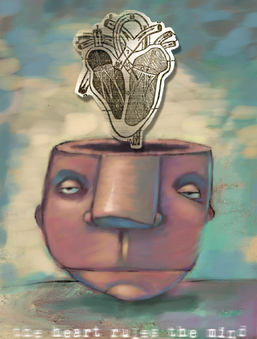
SUMMARY

Slide 25
Principal arteries of the human body:
1 internal carotid artery, 2 external carotid artery, 3 common carotid artery, 4 arch of the aorta, 5 descending aorta, 6 pulmonary vein, 7 left coronary artery, 8 celiac artery, 9 splenic artery, 10 left gastric artery, 11 inferior mesenteric artery, 12 abdominal aorta, 13 common iliac artery, 14 internal iliac artery, 15 external iliac artery, 16 femoral artery, 17 profunda femoris artery, 18 popliteal artery, 19 dorsalis pedis, 20 posterior tibial artery, 21 peroneal artery, 22 anterior tibial artery, 23 digital artery, 24 superficial palmar arch, 25 deep palmar arch, 26 ulnar artery, 27 radial artery, 28 common interosseous artery, 29 superior mesenteric artery, 30 right gastric artery, 31 hepatic artery, 32 right coronary artery, 33 brachial artery, 34 ascending aorta, 35 brachiocephalic artery, 36 axillary artery, 37 anterior circumflex humeral artery, 38 subclavian artery

Slide 26
QUESTION 1
Which one of the following is a functional end artery?
Splenic artery
Brachial artery
Central artery of the retina
Superior mesenteric artery

Slide 27
QUESTION 2
Which one of the following is a branch of subclavian artery?
Vertebral artery
Lingual artery
Basilar artery
Facial artery

Slide 28
QUESTION 3
Which one of the following arteries could be palpated opposite the lower border of the mandible?
Facial artery
Lingual artery
Superficial temporal artery
External carotid artery

Slide 29
THANK YOU

