Slide 1
Biochemical Markers of
Myocardial Infarction
Cardiovascular Block
Dr. Usman Ghani

Slide 2
Objectives
By the end of this lecture, the students should be able to:
Recall the criteria for diagnosis of myocardial infarction (MI)
Know about the features of an ideal MI marker
Understand the significance of plasma marker changes over time
Identify properties and diagnostic value of MI markers such as cardiac troponins, creatine kinase and myoglobin
Be familiar with some of the new markers

Slide 3
Overview
Myocardial infarction (MI)
Criteria for diagnosis of MI
Features of an ideal MI marker
Time-course of plasma enzyme changes
Cardiac troponins I and T
Creatine kinase (CK-MB)
Myoglobin
Heart fatty acid binding protein (h-FABP)

Slide 4
Myocardial infarction (MI)
Occlusion of coronary arteries
Restricted blood supply (oxygen) to heart tissue (ischemia)
Damage to heart tissue (infarction)
Release of enzymes and other proteins into the blood (markers)

Slide 5
Criteria for diagnosis of MI
Recommended by the European Society of Cardiology and American College of Cardiology
Requires presence of at least two of the following characteristics:
Typical heart attack symptoms
Characteristic rise and fall pattern of a cardiac marker in plasma
Rise and gradual fall of cardiac troponins
More rapid rise and fall of CK-MB
Typical ECG pattern
Reference: Alpert JS, Thygesen K, Antman E, Bassand JP. J Am Coll Cardiol. 2000, 36(3):959.

Slide 6
Case
A 66-year-old man had experienced central chest pain on exertion for some months, but in the afternoon of the day prior to admission he had had a particularly severe episode of the pain, which came on without any exertion and lasted for about an hour. On admission there were no abnormalities on examination and the ECG was normal. The troponin was clearly detectable.
Comment on these results. Has he suffered a myocardial infarction?
Comments: He has elevated troponin plus a typical history. This is sufficient to diagnose a myocardial infarction by the most recent definition, even in the absence of ECG changes.

Slide 7
Case, continued
A 66-year-old man had experienced central chest pain on exertion for some months, but in the afternoon of the day prior to admission he had had a particularly severe episode of the pain, which came on without any exertion and lasted for about an hour. On admission there were no abnormalities on examination and the ECG was normal. The troponin was clearly detectable.
Comment on these results. Has he suffered a myocardial infarction?
Comments: He has an elevated troponin plus a typical history. This is sufficient to diagnose a myocardial infarction by the most recent definition, even in the absence of ECG changes.
1- Typical heart attack symptoms
2- Characteristic pattern of a cardiac marker

Slide 8
Features of an ideal cardiac marker
High concentration in the myocardium
High sensitivity (detected even in low concentration at early stages of the disease)
High specificity (specifically detecting damage of cardiac tissue, and is absent in non-myocardial tissue injury)

Slide 9
Features of an ideal cardiac marker
Rapid release into plasma following myocardial injury
Good prognostic value (strong correlation between plasma level and extent of myocardial injury)
Easily measured (detectable by rapid, simple and automated assay methods)

Slide 10
Plasma MI markers
CURRENT MARKERS
Troponin T
Troponin I
Creatine kinase-MB (CK-MB)
Myoglobin
MARKERS WITH POTENTIAL CLINICAL USE
Heart fatty acid binding protein (hFABP) (tissue ischemia)
OBSOLETE MARKERS
Aspartate Transaminase (AST)
Lactate dehydrogenase (LDH)

Slide 11
Markers of diagnostic value in MI:
Cardiac troponins T and I
Creatine kinase (CK-MB)
Myoglobin
Markers of diagnostic value in tissue ischemia:
Heart fatty acid binding protein (hFABP)

Slide 12
Time-course of plasma enzyme changes
Plasma enzymes follow a pattern of activities after MI
The initial lag phase lasts for about 3 hours
Enzymes rise rapidly to peak levels in 18-36 hours
The levels return to normal based on enzyme half-life
Rapid rise and fall indicates diagnostic value

Slide 13
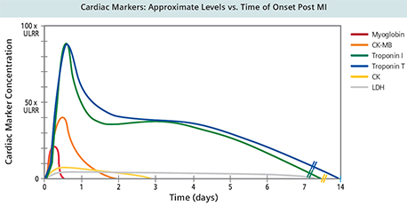

Slide 14
Blood samples collected after MI:
Baseline (upon admission)
Between 12 and 24 hours after the onset of symptoms

Slide 15
Marker changes in blood
Enzyme / Protein | Detectable (hours) | Peak value (hours) | Duration (days)
Cardiac troponins | 3-4 | ~48 | Up to 10
CK-MB | 3-10 | 12-24 | 2-3
Myoglobin | 1-4 | 6-9 | 1

Slide 16
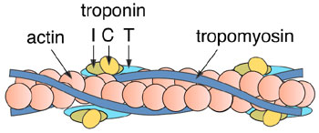
Troponins
Troponins are structural proteins in cardiac myocytes and in skeletal muscle
Cardiac troponins (cTn) are structurally different from muscle troponins
Involved in the interaction between actin and myosin for muscle contraction

Slide 17
Troponins
cTn are mainly bound to proteins, with small amount soluble in the cytosol
Highly specific markers for detecting MI
Two main cardiac troponins (cTn):
cTnI: inhibitory protein
cTnT: binds to tropomyosin

Slide 18
Troponins
Appear in plasma in 3-4 h after MI
Remain elevated for up to 10 days
After a MI, cytosolic troponins are released rapidly into the blood (first few hours)
Structurally bound troponins are released later for several days

Slide 19
Creatine kinase (CK)
Three main CK isoenzymes with two polypeptide chains B or M
Type | Composition | Comment
Skeletal Muscle | 98% CK-MM 2% CK-MB | Elevated in muscle disease
Cardiac muscle | 70-80% CK-MM 20-30% CK-MB | Cardiac muscle has highest amount of CK-MB
Brain | CK-BB
Plasma | Mainly CK-MM

Slide 20
CK-MB
CK-MB is more sensitive and specific for MI than total CK
It rises and falls transiently after MI
Appears in blood within 3-10 h. of heart attack
Peaks in blood in 12–24 h.
Returns to normal within 2-3 days
Relative index =
CK-MB mass / Total CK x 100
More than 5 % is indicative for MI

Slide 21
CK-MB
Advantages:
Useful for early diagnosis of MI
Useful for diagnosis of re-infarction
Disadvantages:
Not significant if measured after 2 days of MI (delayed admission)
Not highly specific (elevated in skeletal muscle damage)

Slide 22
CASE
A well-trained marathon runner collapsed as he was approaching the finishing line. His ECG was normal, but CK was elevated at 9500 U/L (reference range 30–200 U/L), and the CK-MB was 14% of the total CK (normally <6%). Troponin was undetectable. Comment on these results.
Comments: The total CK is substantially elevated, and CK-MB >6% can usually be taken to mean that it is of myocardial origin. However, the normal ECG and troponin are both reassuring. In trained endurance athletes, the proportion of CK-MB in muscle increases from the normal low levels and may be as high as 10–15%. An elevated CK-MB in such individuals can no longer be taken to imply a cardiac origin for the raised CK. Extreme exercise, especially in unfit individuals, causes an elevated CK, potentially to very high levels.

Slide 23
CASE
A well-trained marathon runner collapsed as he was approaching the finishing line. An ECG was normal, but CK was elevated at 9500 U/L (reference range 30–200 U/L), and the CK-MB was 14% of the total CK (normally <6%). Troponin was undetectable. Comment on these results.
Comments: The total CK is substantially elevated, and CK-MB >6% can usually be taken to mean that it is of myocardial origin. However, the normal ECG and troponin are both reassuring. In trained endurance athletes, the proportion of CK-MB in muscle increases from the normal low levels and may be as high as 10–15%. An elevated CK-MB in such individuals can no longer be taken to imply a cardiac origin for the raised CK. Extreme exercise, especially in unfit individuals, causes an elevated CK, potentially to very high levels.

Slide 24
Myoglobin
Myoglobin is a sensitive marker of cardiac damage
Appears in blood early (within 1-4 hours)
Rises very rapidly after the MI at about the same rate as CK-MB
It is non-specific because it is elevated in:
Muscle disease/injury
Acute and chronic renal failure

Slide 25
Heart fatty acid binding protein (h-FABP)
A cytosolic protein involved in fatty acid transport and metabolism
A promising marker to be used in combination with troponins
Higher amounts in myocardium than in brain, kidney and skeletal muscle
Appears in blood as early as 30 min. after acute ischemia
Peaks in blood in 6-8 h.
Returns to normal levels in 24-30 h.

Slide 26
B-type natriuretic peptide (BNP) (heart failure marker)
A peptide produced by the ventricles of the heart in response to:
Myocardial stretching and ventricular dysfunction after MI
Causes vasodilation, sodium and water excretion and reduces blood pressure
A marker for detecting congestive heart failure
Its serum levels are high in some pulmonary diseases
But in heart failure its levels are markedly high
An important marker for differential diagnosis of pulmonary diseases and congestive heart failure

Slide 27
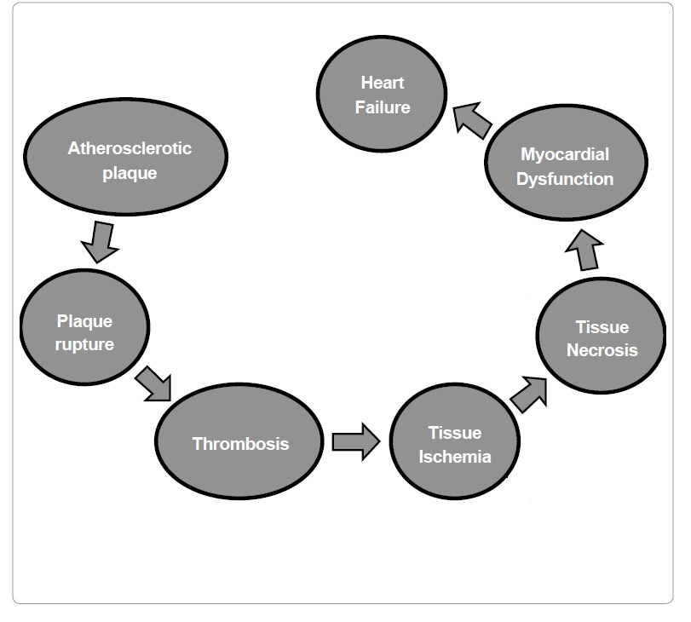
BNP
BNP
cTn
CK-MB
Myoglobin
h-FABP
Pathogenesis of MI with special focus on the biomarkers implicated in the development of MI.

Slide 28
Take home message
cTn
Currently the most definitive markers and are replacing CK-MB
Highly specific to heart muscle damage
They remain elevated in plasma longer than CK-MB
They have higher sensitivity and specificity than CK-MB
CK-MB
Its main advantage is for detecting re-infarction
Myoglobin
An early marker of MI
h-FABP
An early marker for detecting acute ischemia prior to necrosis

Slide 29
References
Lecture Notes on Clinical Biochemistry 9th Edition A.F. Smith, Blackwell Publishing, UK.
Sharma, N. and Ahmad, M.I. Biomarkers in acute myocardial infarction. J. Clin. Exp. Cardiol. 2012, 3: 11-18.

