Slide 1

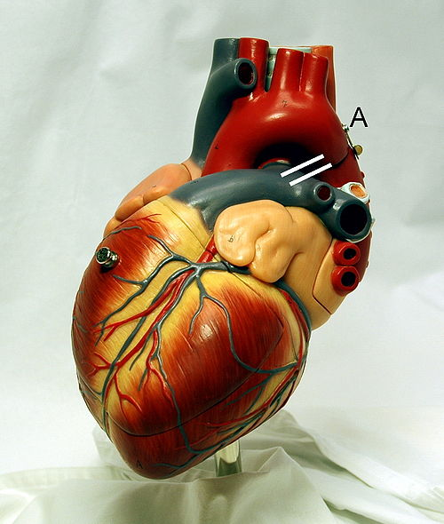
Cardiovascular System Block
Cardiac Arrhythmias
(Physiology)
Ahmad Hersi

Slide 2
Lecture Objectives
Describe sinus arrhythmias
Describe the main pathophysiological causes of cardiac arrhythmias
Explain the mechanism of cardiac block
Explain the origin of an ectopic foci
Enumerate the common arrhythmias and describe the basic ECG changes

Slide 3
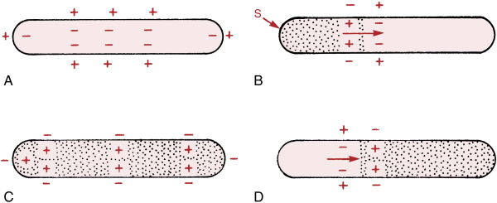
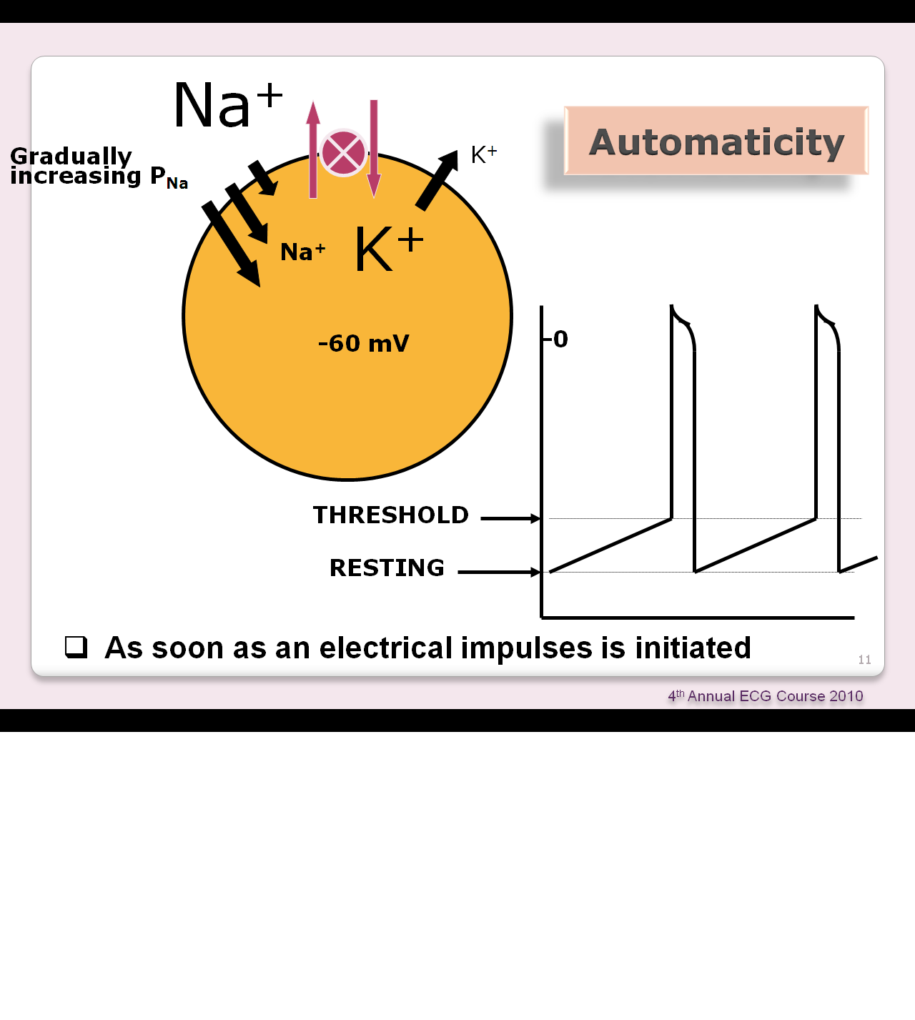
Depolarization and Repolarization

Slide 4
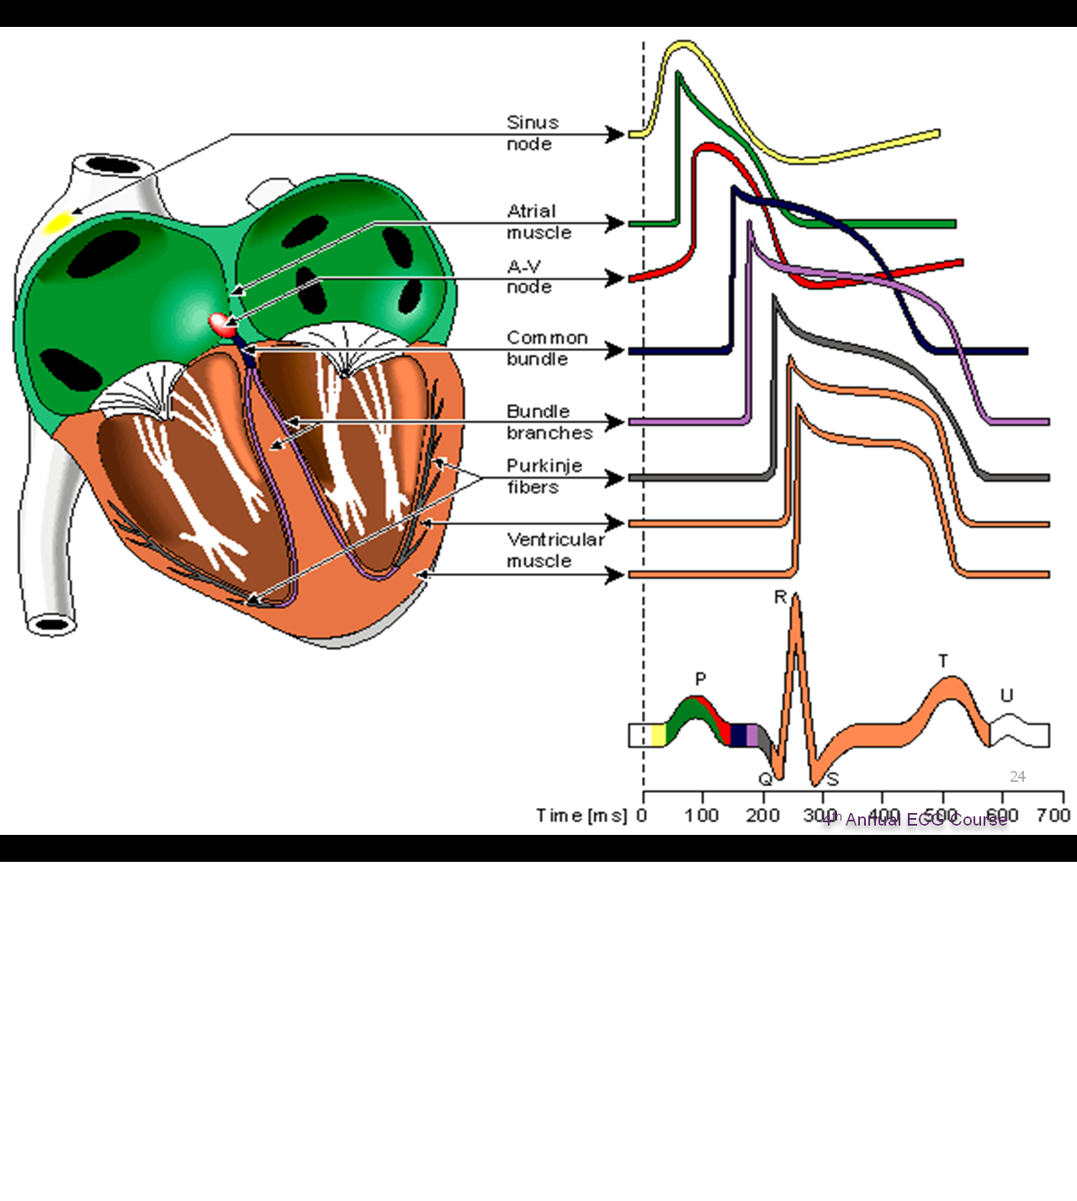

Slide 5
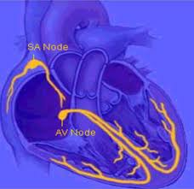
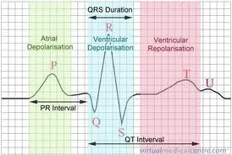
Electrical Conduction

Slide 6
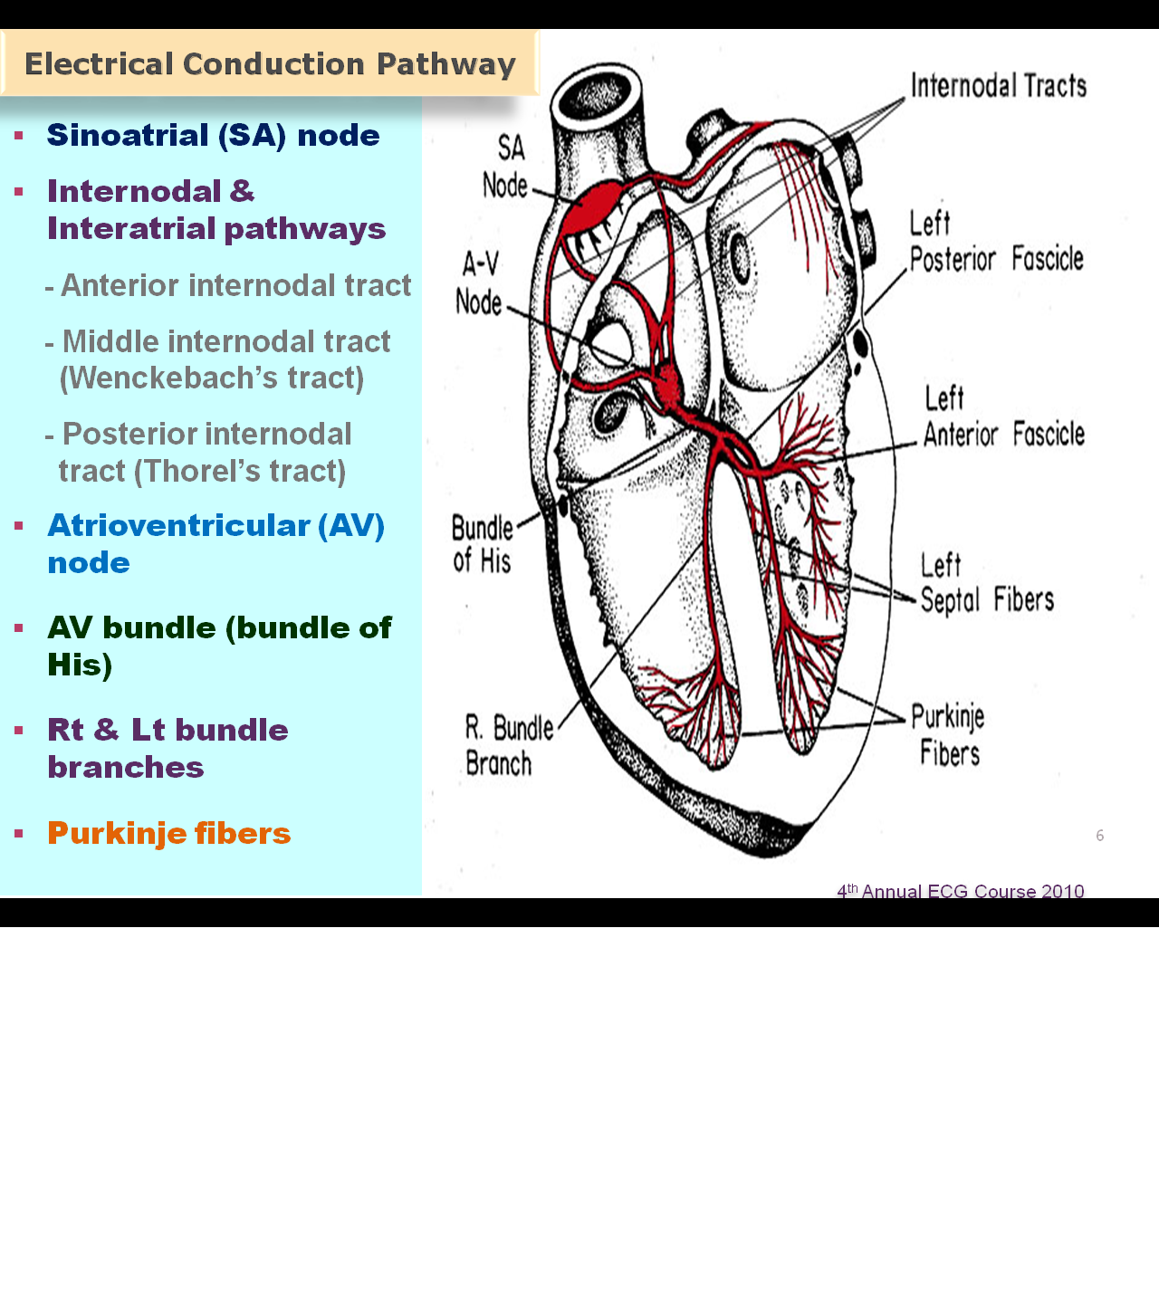
The Conduction System

Slide 7
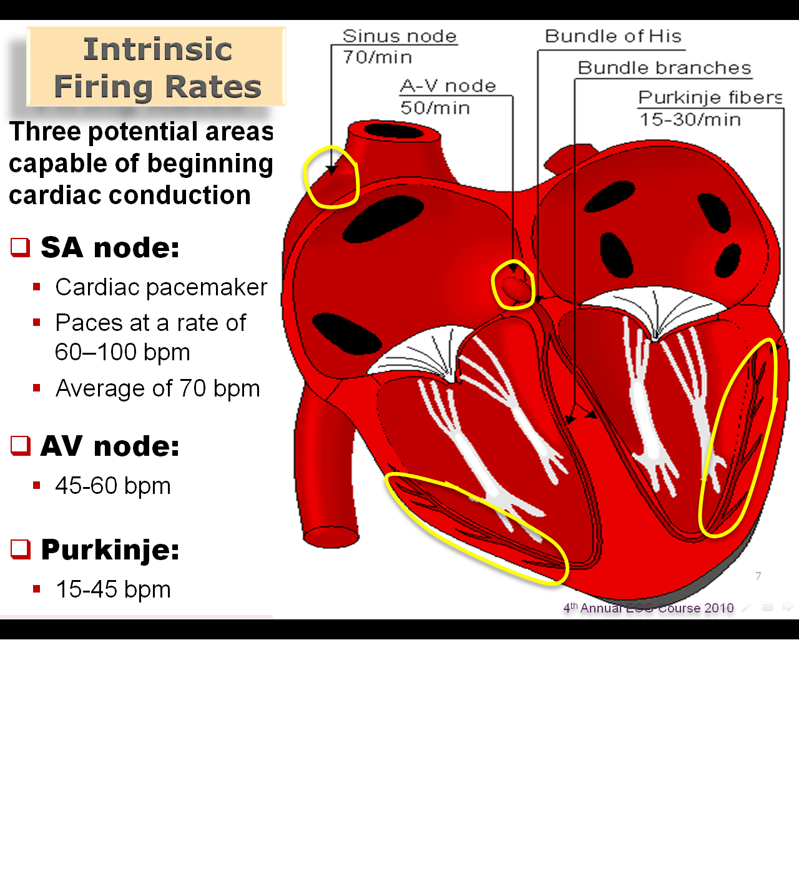

Slide 8
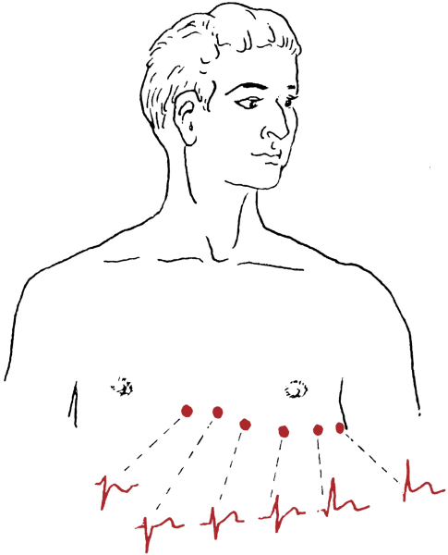
Chest Leads

Slide 9
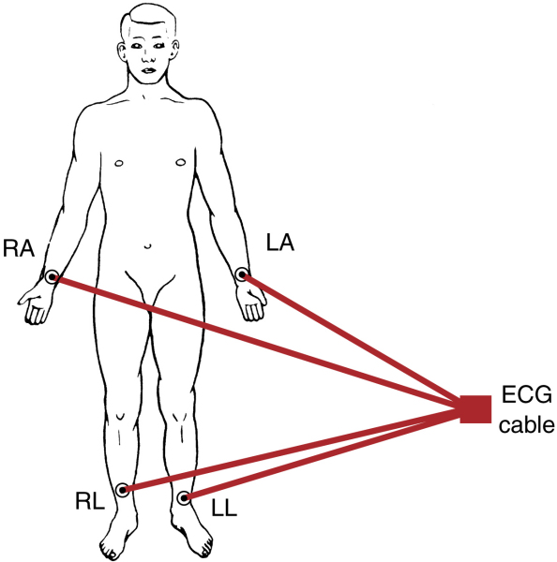
Limb leads

Slide 10
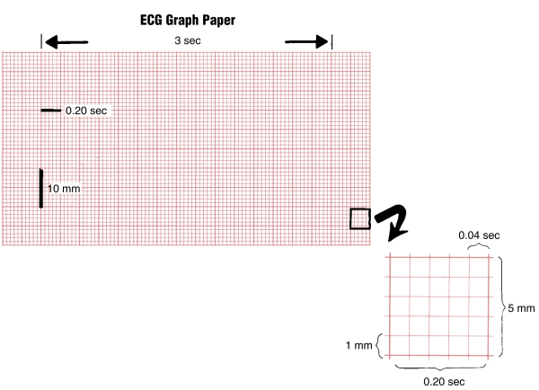

Slide 11
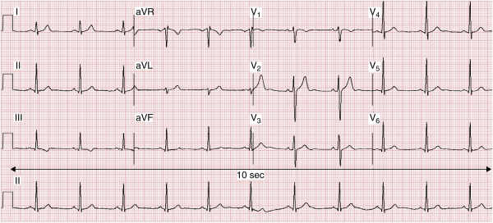
12 Leads EKG

Slide 12
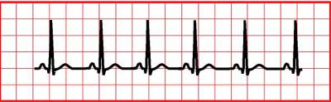
Normal Sinus Rhythm
Regular
Single p-wave precedes every QRS complex
P-R interval is constant and within normal range
P-P interval is constant

Slide 13
Rate
Normal sinus rate: (60-100).
Tachycardia: >100.
Bradycardia: <60.

Slide 14
Causes of Cardiac Arrhythmias
Abnormal rhythmicity of the pacemaker
Shift of the pacemaker from the sinus node to another place in the heart
Blocks at different points in the spread of impulse through the heart
Spontaneous generation of impulses in any part of the heart

Slide 15
Causes of Cardiac Arrhythmias
Rate above or below normal
Regular or irregular rhythm
Narrow or broad QRS complex
Relation to P waves

Slide 16
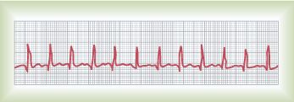
Abnormal Sinus Rhythm
Tachycardia: an increase in the heart rate
  Heart rate > 100 beats per minute
  Causes:
    Increased body temperature
    Sympathetic stimulation
    Drugs

Slide 17
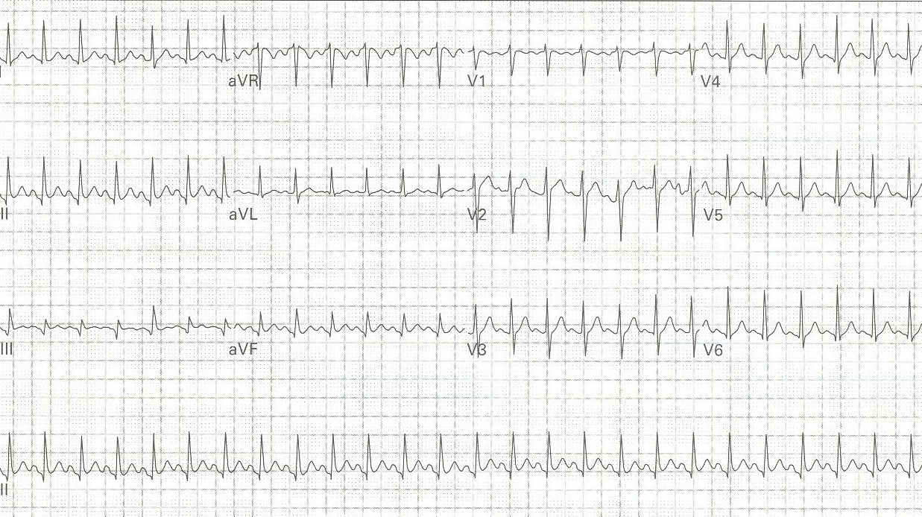
24 year-old pregnant woman with three days of frequent vomiting

Slide 18
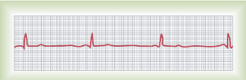
Abnormal Sinus Rhythm
Bradycardia:
  Slow heart rate < 60 beats per minute
  Causes:
    Parasympathetic stimulation

Slide 19
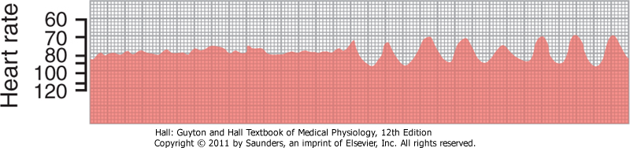
Sinus Arhythmia
Result from spillover of signals from the medullary respiratory center into the adjacent vasomotor center during inspiration and expiratory cycles of respiration
The spillover signals cause alternate increase and decrease in the number of impulses transmitted through the sympathetic and vagus nerves to the heart

Slide 20
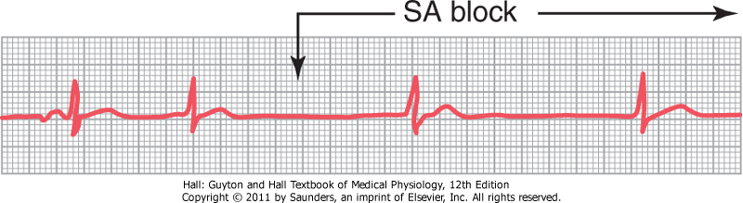
Abnormal Cardiac Rhythms that Result from Impulse Conduction Block
Sinoatrial Block
  The impulse from the S-A node is blocked before it enters the atrial muscle
  Cessation of P waves

Slide 21
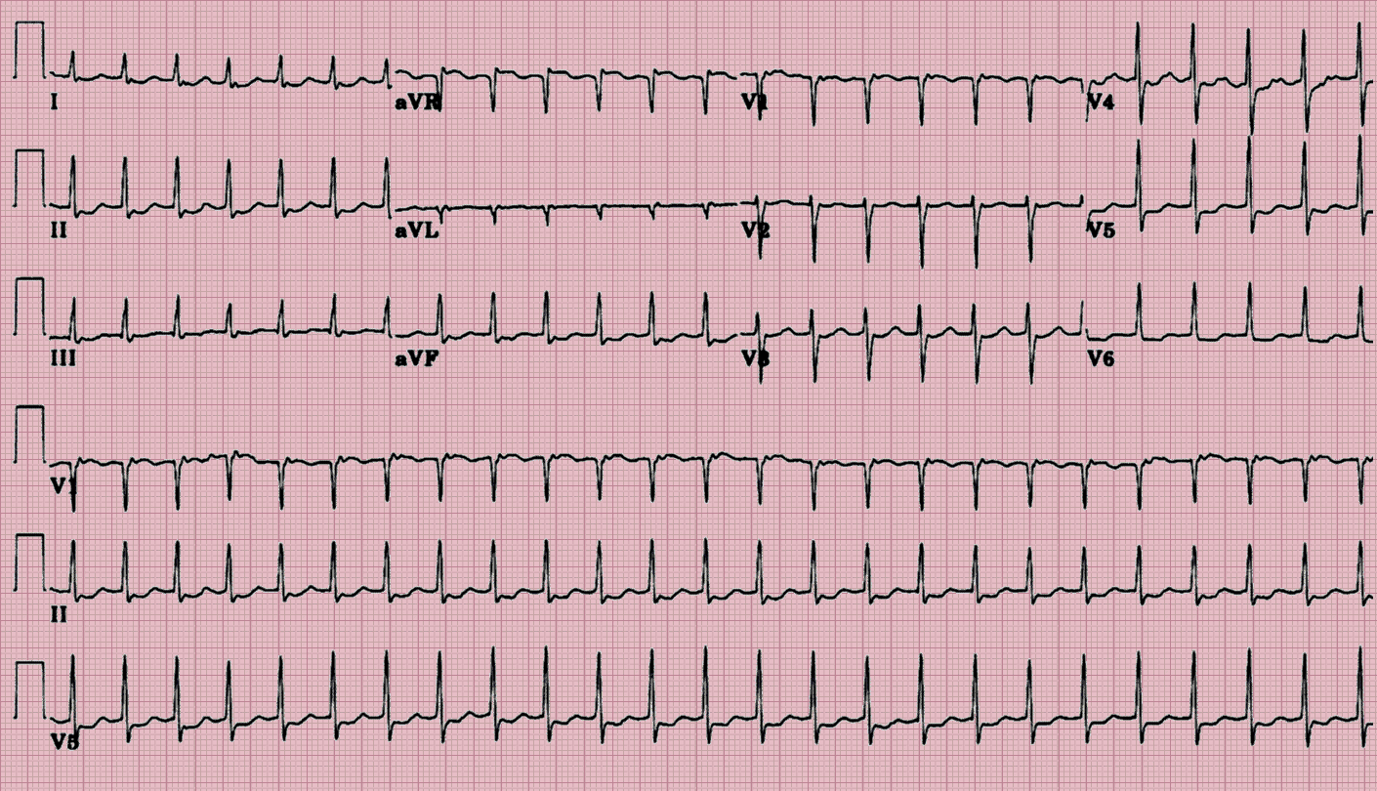
AVRT-Narrow Complex

Slide 22
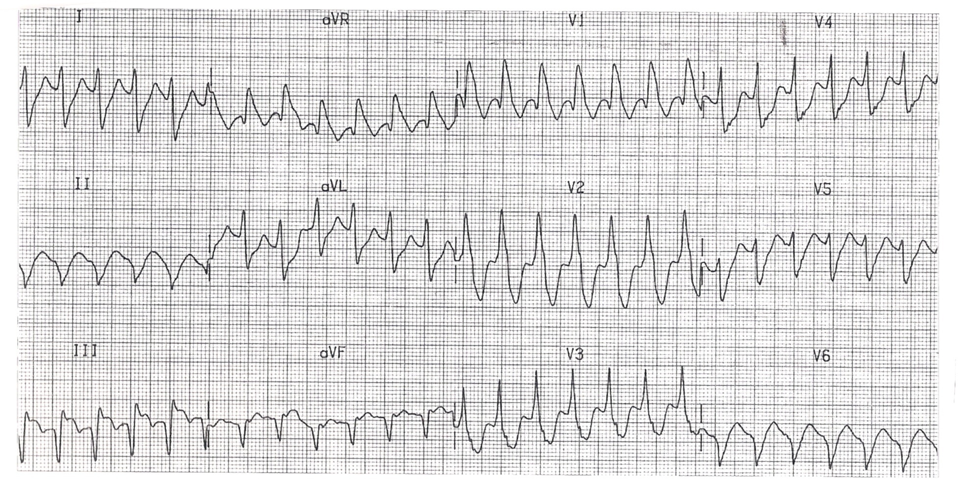

Slide 23
Abnormal Cardiac Rhythms that Result from Impulse Conduction Block
A-V Block
  When impulse from the S-A node is blocked
  Causes:
    Ischemia of the A-V node
    Compression of the A-V node by scar formation
    Inflammation of the A-V node
    Strong vagal stimulation

Slide 24
Types of the A-V Block
First degree block
Second degree block
Third degree block

Slide 25
Heart Block
1^{st○}
Constant PR prolongation without drop beat.
2^{nd○}
Mobitz1: Progressive PR prolongation + drop beat.
Mobits2: Constant PR prolongation + drop beat.
3^{rd ○}
Complete dissociation between P and QRS.

Slide 26
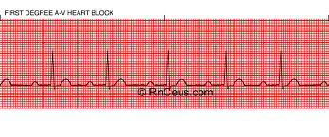
First Degree Heart Block

Slide 27
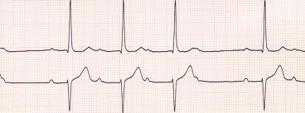
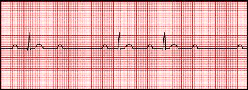
Second Degree Heart Block
Mobitz (I):
Mobitz (II):

Slide 28
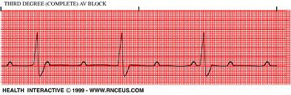
Third Degree Heart Block

Slide 29
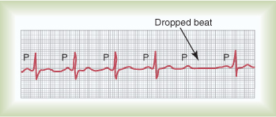
Types of the A-V Block
Second Degree Block
P-R interval > 0.25 second
Only few impulses pass to the ventricles
→ atria beat faster than ventricles
→“dropped beat” of the ventricles

Slide 30
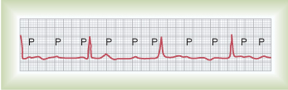
Types of the A-V block
Third degree block (complete)
Complete dissociation of P wave and QRS waves
→The ventricle escape from the influence of S-A node
Stokes-Adams Syndrome: AV block comes and goes

Slide 31
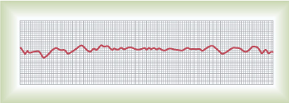
Ventricular Fibrillation
The most serious of all arrhythmias
Cause: impulses stimulate one part of the ventricles, then another, then itself. Many part contracts at the same time while other parts relax (Circus movement)
  Tachycardia
  Irregular rhythm
  Broad QRS complex
  No P wave
Treatment : DC shock

Slide 32
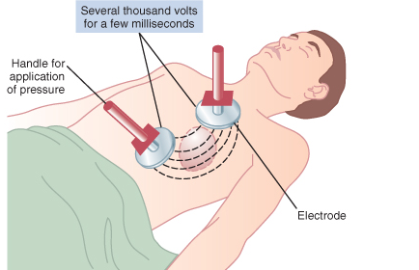
Ventricular Fibrillation
Treatment : DC shock

Slide 33
Atrial Fibrillation
Cause: as ventricular fibrillation
It occurs more frequently in patients with enlarged heart
The atria do not pump if they are fibrillating
The efficiency of ventricular pumping is decreased 20 to 30%
A person can live for years with atrial fibrillation

Slide 34
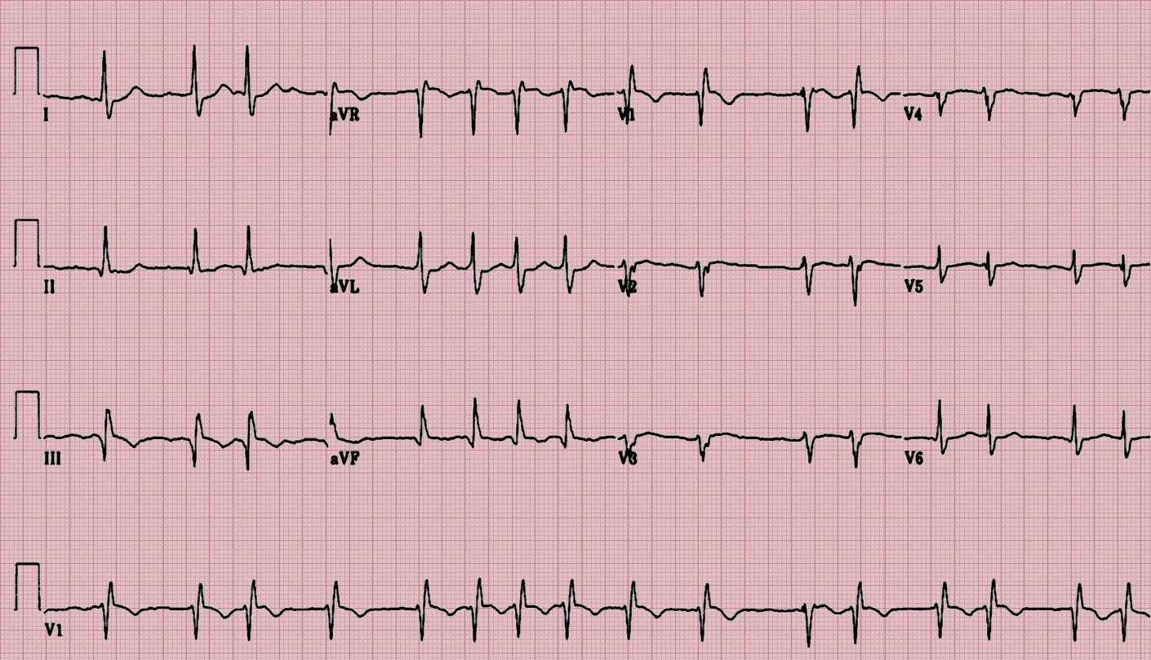

Slide 35
Atrial Flutter
A single large wave travels around and around in the atria
The atria contracts at high rate (250 time per minute)

Slide 36
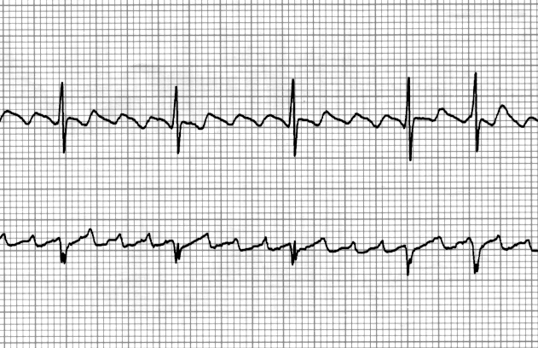

Slide 37
Ischemia and the ECG
One of the common uses of the ECG is in acute assessment of chest pain
Cause: restriction of blood flow to the myocardium, either:
  Reversible: angina pectoris
  Irreversible: myocardial infarction
Ischemia → injury → infarction

Slide 38
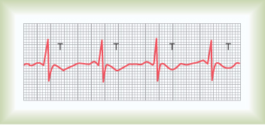
Reversible ischemia
  Inverted T wave
ST segment depression

Slide 39
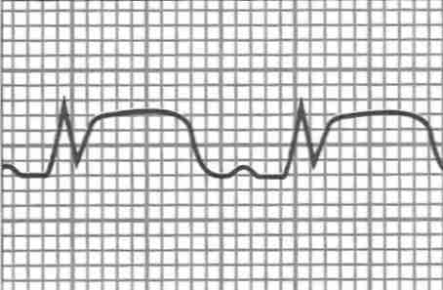
Myocardial Infarction
Complete loss of blood supply to the myocardium resulting in necrosis or death of tissue
ST segment elevation
Deep Q wave

Slide 40
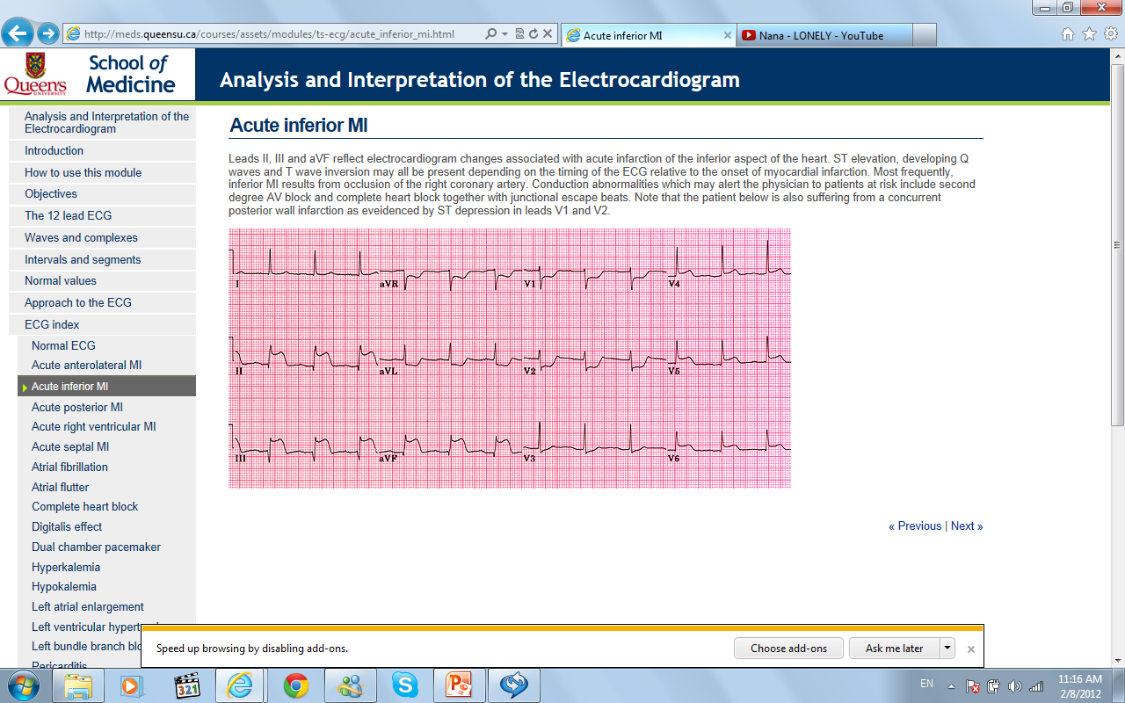
Infero-Posterior MI

Slide 41
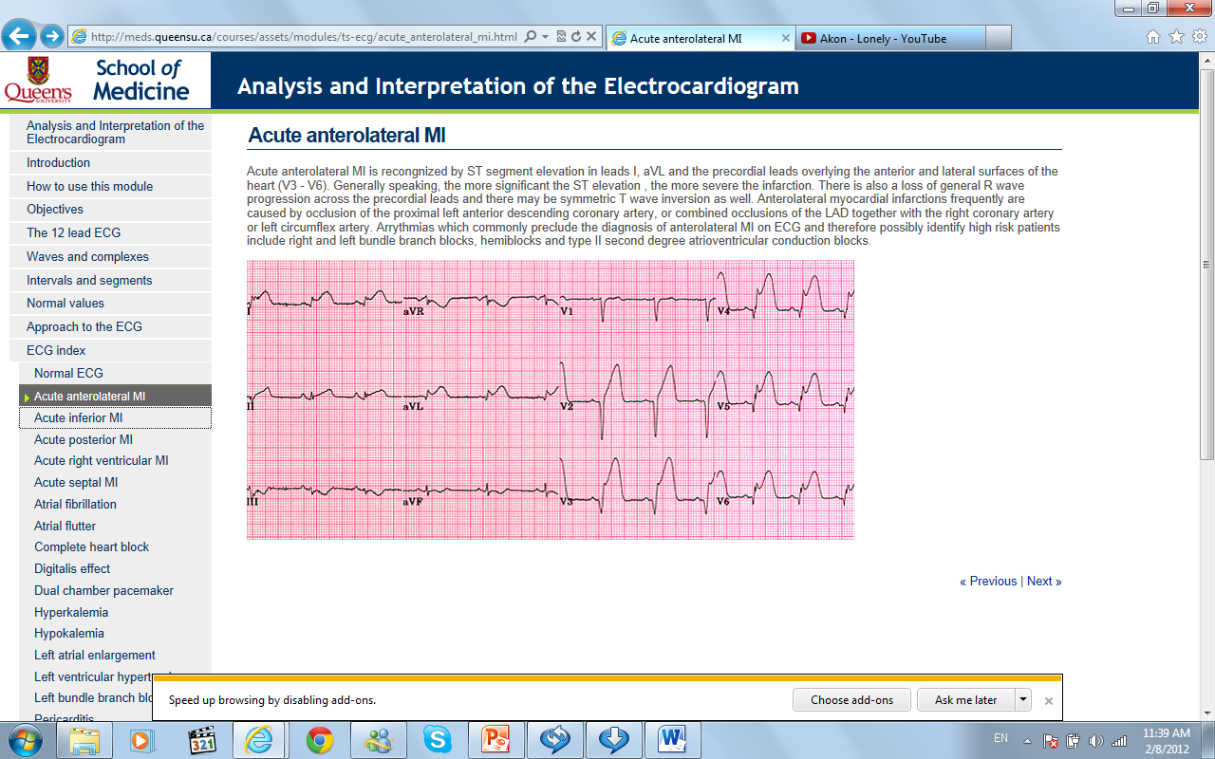
Antero-Lateral MI

Slide 42
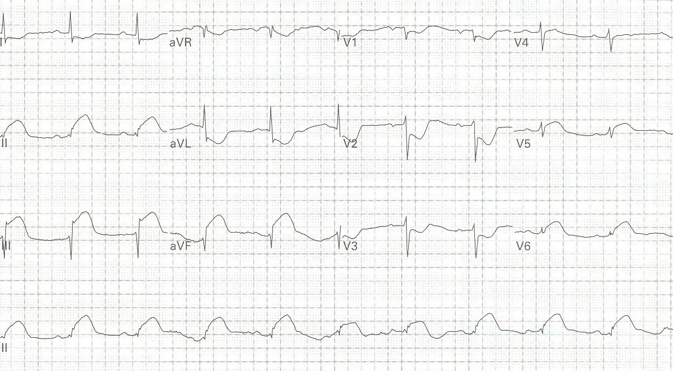
57 year-old man with chest pressure and diaphoresis

Slide 43
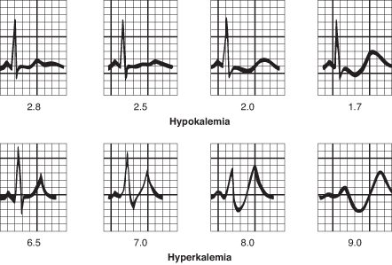
Potassium and the ECG
Hypokalemia:
  flat T wave
Hyperkalemia:
  Tall peaked T wave

Slide 44
For Further Readings and Diagrams:
Textbook of Medical Physiology by Guyton & Hall
Chapter 10 (Cardiac Arrhythmias and their Electrocardiographic Interpretation)

