Slide 1
Cardiovascular System. IHD, Angina & MI
Sufia Husain
Pathology Department
KSU, Riyadh
March 2015
Reference: Robbins & Cotran Pathology and Rubin’s Pathology

Slide 2
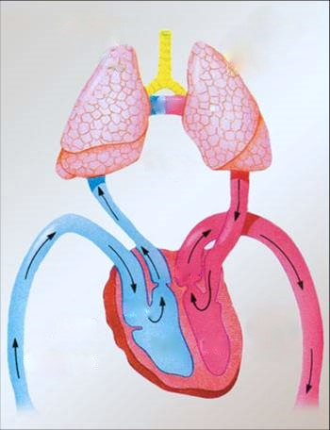
R
L

Slide 3
Ischemic Heart Disease/IHD (Coronary Heart Disease)
IHD = A group of closely related conditions/syndromes caused by an imbalance between the myocardial oxygen demand and blood supply. Usually caused by decreased coronary artery blood flow (“coronary artery disease”)
Four syndromes:
Angina pectoris (chest pain).
Acute myocardial infarction.
Sudden cardiac death.
Chronic ischemic heart disease with congestive heart failure.
The most common cause if IHD is coronary artery atherosclerosis
Less commonly it is due to vasospasm and vasculitis

Slide 4
Ischemic Heart Disease: Epidemiology-(coronary atherosclerosis)
Peak incidence: 60y for males and 70y for females.
Men are more affected than women.
Contributing factors are same as that of atherosclerosis e.g.
Hypertension.
Diabetes mellitus.
Smoking.
High levels of LDL.
Genetic factors (direct or indirect).
Lack of exercise.

Slide 5
Pathogenesis of Ischemic Heart Disease
Role of Critical stenosis or obstruction
Role of Acute Plaque Change
Role of Coronary Thrombus
Role of Vasoconstriction
Role of Inflammation

Slide 6
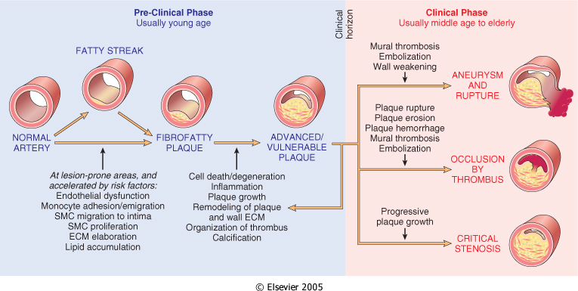
Pathogenesis of Ischemic Heart Disease
1) Role of Critical stenosis or obstruction:
(>=75% of the lumen of one or more coronary arteries by atherosclerotic plaque).

Slide 7
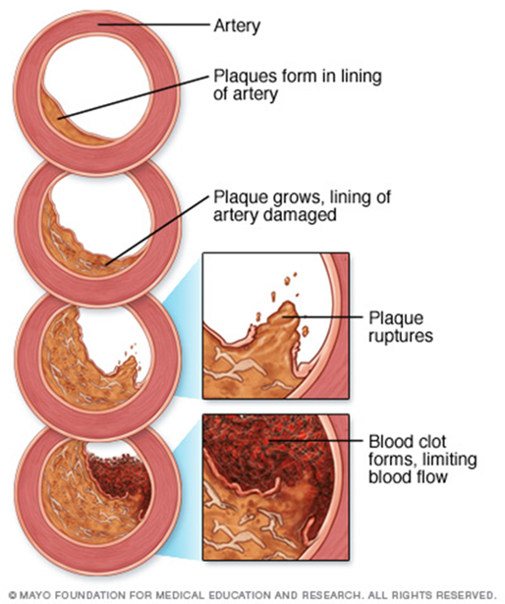
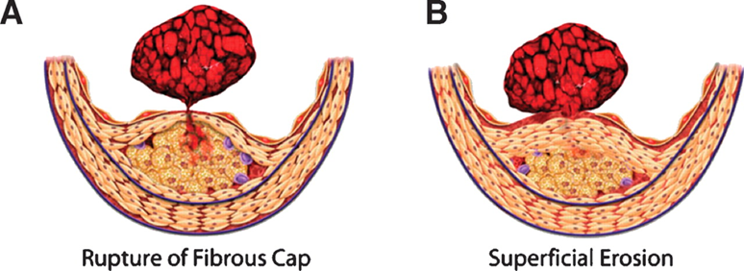
Pathogenesis of Ischemic Heart Disease
2) Role of Acute Plaque Change:
Disruption of a mildly stenosing plaque leading to rupture/ ulceration. This can lead to:
hemorrhage into the atheroma which will expand in volume.
exposure of the thrombogenic basement membrane just below the endothelial lining followed by thrombosis
Acute plaque change can cause myocardial ischemia in the form of unstable angina, acute myocardial infarction and (in many cases) sudden cardiac death.

Slide 8
Pathogenesis of Ischemic Heart Disease
3) Role of Coronary Thrombus:
thrombus superimposed on a disrupted but previously only partially stenotic plaque converts it to either
A total occlusion leading to acute transmural MI.
Or an partial/incomplete/subtotal occlusion leading to unstable angina, acute subendocardial infarction, or sudden cardiac death.
Thrombus in coronary artery can also embolize.
4) Role of Vasoconstriction:
Vasoconstriction reduces lumen size and can therefore potentiate plaque disruption.
5) Role of Inflammation:
Inflammatory processes play important roles at all stages of atherosclerosis.

Slide 9
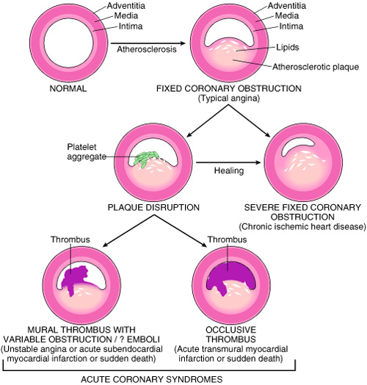
Ischemic Heart Disease: Pathogenesis
Notes:
*the augmented coronary flow because of vasodilatation is insufficient to meet the increase in myocardial demand of O2.

Slide 10
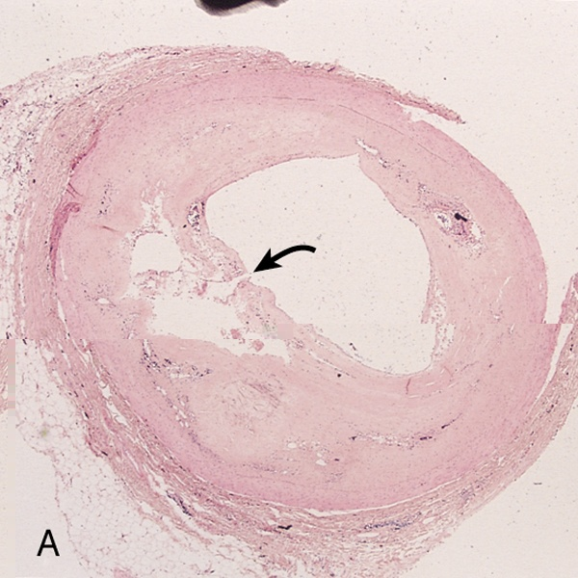
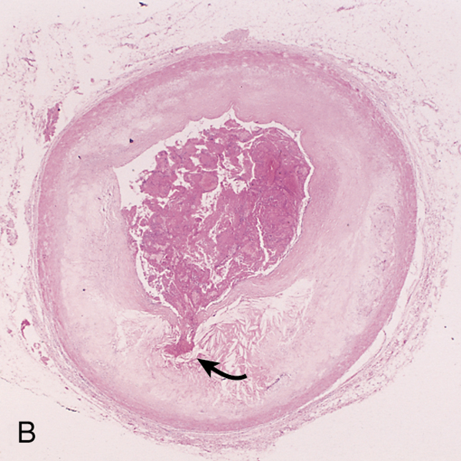
A. Plaque rupture without superimposed thrombus in a patient who died suddenly.
B. Acute coronary thrombosis superimposed on an atherosclerotic
plaque with focal disruption of the fibrous cap, triggering fatal
myocardial infarction.

Slide 11
Four closely related conditions/syndromes that come under IHD are:
Angina pectoris (chest pain).
Acute myocardial infarction (MI).
Sudden cardiac death.
Chronic ischemic heart disease with congestive heart failure.

Slide 12
Angina pectoris
Angina pectoris is a type of IHD characterized by paroxysmal and usually recurrent attacks of substernal or precordial chest discomfort, described as constricting, crushing, squeezing, choking, or knifelike pain. The pain may radiate down the left arm or to the left jaw (called as referred pain) .
Angina pectoris is due to inadequate perfusion and is caused by transient (15 seconds to 15 minutes) myocardial ischemia that falls short of inducing the cellular necrosis that defines infarction i.e. duration and severity is not sufficient for infarction
There are three types of angina pectoris:
Stable or typical angina
Prinzmetal or variant angina
Unstable or crescendo angina

Slide 13
Angina pectoris: Stable angina/ typical angina pectoris:
Stable angina/ typical angina is the most common form of angina. It is caused by atherosclerotic disease with usually ≥70% to 75% narrowing of lumen i.e. (critical stenosis or fixed chronic stable stenosis).
This reduction (70 to 75% stenosis) of coronary vessels makes the heart vulnerable, so whenever there is increased demand, e.g. physical activity, emotional excitement, or any other cause of increased cardiac workload, there is angina pain.
The chest pain is episodic and associated with exertion or some other form of stress.
Is usually relieved by rest (thereby decreasing demand) or with a strong vasodilator like nitroglycerin.

Slide 14
Angina Pectoris: Unstable or crescendo angina:
It is an unstable and progressive condition.
Pain occurs with progressively increasing frequency, and is precipitated with progressively less exertion, even at rest, and tends to be of more prolonged duration.
It is induced by disruption or rupture of an atheroma plaque with superimposed partial thrombosis.
Unstable angina is often the precursor of subsequent acute MI. Thus also called as preinfarction angina.

Slide 15
Angina Pectoris: Prinzmetal variant angina:
is an uncommon pattern of episodic angina that occurs at rest and is due to coronary artery spasm.
Prinzmetal angina generally responds promptly to vasodilators, such as nitroglycerin and calcium channel blockers.
Not related to atherosclerotic disease
The etiology is not clear.

Slide 16
Angina Pectoris. summary
Intermittent chest pain caused by transient, reversible ischemia
Typical (stable) angina
pain on exertion
fixed narrowing of coronary artery
Unstable (pre-infarction) angina
increasing pain with less exertion
plaque disruption and thrombosis
Prinzmetal (variant) angina
pain at rest
coronary artery spasm of unknown etiology

Slide 17
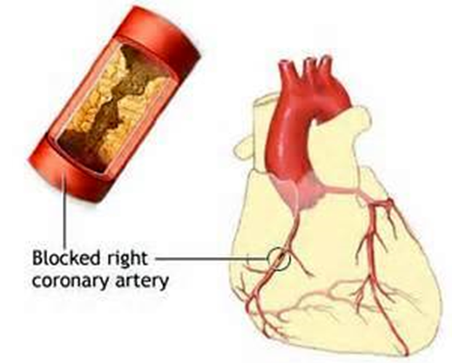
Myocardial Infarction (MI)
Definition: MI, also known as "heart attack," is the death of cardiac muscle (coagulative necrosis) resulting from ischemia.
Risks are the same as those of coronary atherosclerosis.

Slide 18
MI: commonly affected coronary vessel in persons with right dominant coronary artery heart (90% of population)
Left anterior descending artery (40-50%): it supplies the anterior left ventricle, apex and anterior two thirds of interventricular septum.
Right coronary artery (30-40%): it supplies the posterior wall of the left ventricle, posterior one third of interventricular septum.
Left circumflex artery (about 20%): it supplies the lateral wall of left ventricle.

Slide 19
Pathogenesis of MI
Most common cause is thrombosis on a preexisting disrupted atherosclerotic plaque. In the typical case of MI, the following sequence of events can be proposed:
Acute plaque change: a sudden change in the structure of an atheromatous plaque, like disruption, ulceration, or rupture and intraplaque hemorrhage.
Exposure of the thrombogenic subendothelial basement membrane and necrotic plaque contents resulting in thrombus formation.
Frequently within minutes, the thrombus evolves to completely occlude the lumen of the coronary vessel.

Slide 20
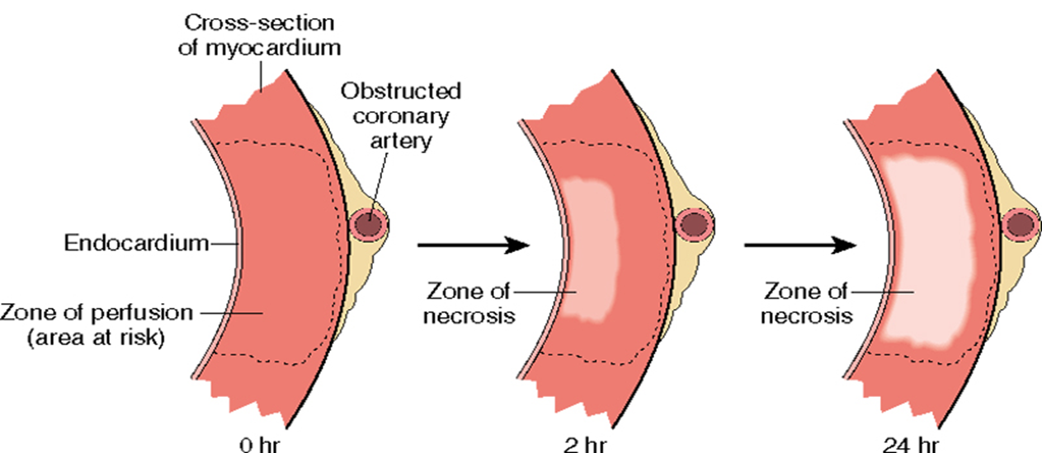
Pathogenesis of MI
Myocardial necrosis begins within 20-30 minutes, mostly starting at the subendocardial region (less perfused, high intramural pressure).
Infarct reaches its full size within 3-6 hrs., during this period, lysis of the thrombus by streptokinase or tissue plasminogen activator, may limit the size of the infarct.
Irreversible cell injury: 20-40 min

Slide 21
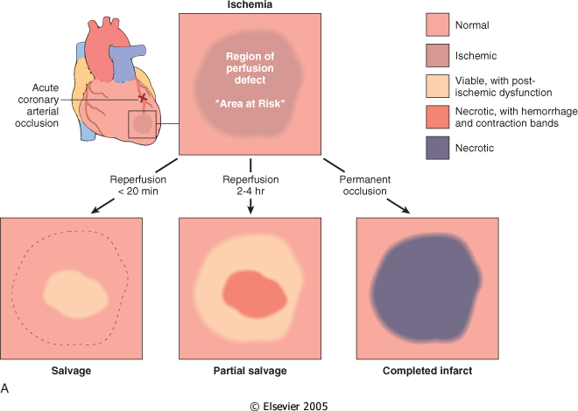
Notes:
If patient survive thrombi may lyse spontaneous or by rx
Or vasospasm relief , reestablish the flow
of reperfusion injury that can incite greater local damage than might have otherwise occurred without rapid restoration of blood flow. reperfusion injury is mediated in part by oxygen free radicals generated by the increased number of infiltrating leukocytes facilitated by reperfusion. Reperfusion-induced microvascular injury causes not only hemorrhage but also endothelial swelling that occludes capillaries and may prevent local blood flow (called no-reflow).
A reperfused infarct usually has hemorrhage because the vasculature injured during the period of ischemia is leaky after flow is restored

Slide 22
Pathogenesis of MI
The precise location, size, and specific morphologic features of an acute myocardial infarct depend on:
The location, severity, and rate of development of coronary atherosclerotic obstructions
The size of the area supplied by the obstructed vessels
The duration of the occlusion
The oxygen needs of the myocardium at risk
The extent of collateral blood vessels
Other factors, such as blood vessel spasm, alterations in blood pressure, heart rate, and cardiac rhythm.
In addition reperfusion may limit the size of the infarct.

Slide 23
Ischemic Heart Disease MI types and morphology
TYPES:
Transmural: Full thickness (>50% of the wall)
Subendocardial: Inner 1/3 of myocardium
MORPHOLOGY:
Begins with coagulative necrosis and inflammation (initially mainly neutrophils and later macrophages).
Followed by formation of granulation tissue.
Heals by formation of a fibrous scar.
Notes:
Transmural , sever coronary atherosclerosis with acute plaque rupture and superimposed thrombosis

Slide 24
Morphologic Changes in Myocardial Infarction
Time | Gross changes | Microscopic changes
0-4h | None | None
4-12h | Mottling | Coagulation necrosis
12-24h | Mottling | More coagulation necrosis; neutrophils come in
1-7 d | Yellow infarct center | Neutrophils die, macrophages come to eat dead cells
1-2 w | Yellow center, red borders | Granulation tissue
2-8 w | Scar | Collagen

Slide 25
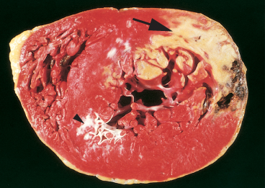
Acute Myocardial Infarction

Slide 26
MI: day 1, day 3, day 7

Slide 27
Microscopic features of myocardial infarction.
One-day-old infarct showing coagulative necrosis with few neutrophils, wavy fibers with elongation, and narrowing, compared with adjacent normal fibers (lower right).
Dense neutrophilic infiltrate in an area of acute myocardial infarction of 3 to 4 days' duration.
C. Nearly complete removal of necrotic myocytes by phagocytosis (approximately 7 to 10 days).

Slide 28
Granulation tissue approximately 3 weeks post Mi
healed mi with replacement of the necrotic fibers by dense collagenous scar. residual cardiac muscle cells are present
http://www.geocities.ws/m4pathology/Osce/Slides/histsch04.htm
http://webpathology.com/image.asp?case=781&n=32

Slide 29
Myocardial Infarction: Clinical Features
Pain:
Severe crushing sub-sternal chest pain, which may radiate to the neck, jaw, epigastrium, shoulder or left arm.
Pain lasts for hours to days and is not relieved by nitroglycerin.
No pain in 20-30% of patients (diabetics, hypertensive, elderly).
Pulse is rapid and weak.
Diaphoresis (sweating)
Dyspnea.
Cardiogenic shock can be seen in massive MI (>40%of lt. ventricle).
ECG shows typical findings of ischemia.

Slide 30
Ischemic Heart Disease Laboratory evaluation
Troponins: best marker, TnT, TnI (more specific).
TnI and TnT are not normally detectable in the circulation
After acute MI both troponins become detectable after 2 to 4 hours, peaks at 48 hours. Their levels remain elevated for 7 to 10 days
CK-MB is the second best marker:
It begins to rise within 2 to 4 hours of MI, peaks at 24 to 48 hours and returns to normal within approximately 72 hours
Lactate dehydrogenase (LD)… LD1.
Rise 24 hrs, peaks 72 hrs, persists 72 hrs.

Slide 31
Myocardial Infarction: Outcomes or complications
No complications in 10-20%.
80-90% experience one or more of the following complications:
Cardiac arrhythmia (75-90%). Patients have conduction disturbances and myocardial irritability which can lead to sudden death especially in ventricular arrhythmia.
Left ventricular failure with mild to severe pulmonary edema (60%).
Cardiogenic shock (10%).
Myocardial rupture: Rupture of free wall, septum, rupture of papillary muscle (leading to papillary muscle and associated valve incompetence/dysfunction)

Slide 32
Complications of MI
Thromboembolism (15-49%): the combination of myocardial abnormality in contractility (causing stasis) with endocardial damage (exposure of underlying thrombogenic basement membrane) can lead to cardiac/mural thrombosis and thromboembolism
Pericarditis
Infarct extension and expansion
Ventricular aneurysm in which the ventricle is dilated and the wall is thinned out.
External rupture of the infarct with associated bleeding into the pericardial space (hemopericardium).
Progressive late heart failure in the form of chronic IHD.

Slide 35
Myocardial Infarction (MI), summary
Necrosis of heart muscle caused by ischemia
Most due to acute coronary artery thrombosis
sudden plaque disruption
platelets adhere
coagulation cascade activated
thrombus occludes lumen within minutes
irreversible injury/cell death in 20-40 minutes
Prompt reperfusion can salvage myocardium

Slide 36
Myocardial Infarction (MI), summary
Clinical features
Severe, crushing chest pain ± radiation
Not relieved by nitroglycerin, rest
Sweating, nausea, dyspnea
Sometimes no symptoms
Laboratory evaluation
Troponins increase within 2-4 hours, remain elevated for a week.
CK-MB increases within 2-4 hours, returns to normal within 72 hours.
Complications
contractile dysfunction
arrhythmias
rupture
chronic progressive heart failure
Prognosis
depends on remaining function and perfusion
overall 1 year mortality: 30%
3-4% mortality per year thereafter

Slide 37
Chronic ischemic heart disease & Sudden cardiac death
Chronic ischemic heart disease
Progressive heart failure due to ischemic injury, either from:
prior infarction(s) (most common)
or chronic low-grade ischemia
Sudden cardiac death
Definition: Unexpected death from cardiac causes either without symptoms or within 1 to 24 hours of symptom onset
Results from a fatal arrhythmia, most commonly in patients with severe coronary artery disease

