Slide 1
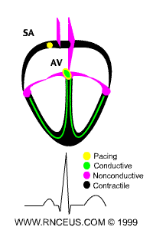
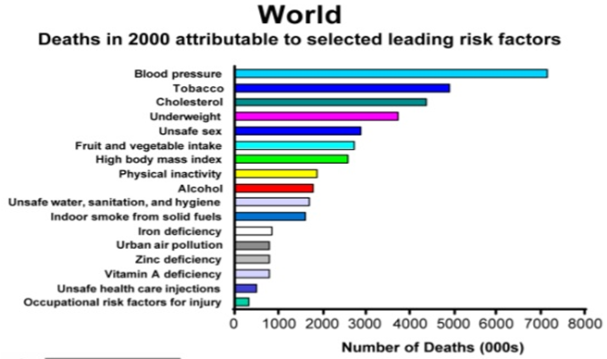
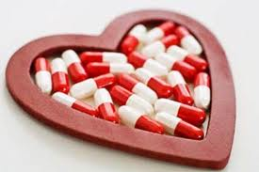
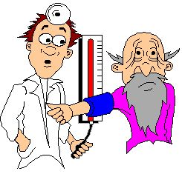
Antihypertensive drugs
Prevalence 25-30%
In majority of cases, it is symptomless “Silent Killer”
Number One cause of death

Slide 2
The rule of halves of Hypertension
For every 800 adults in the community
400 are hypertensive (either ↑ SBP or ↑ DBP or both)
Of them only 200 are diagnosed HT
Of them only 100 are started on treatment
Of them only 50 are on correct drug
Of them in only 25 the goal B.P. is attained
Means 25 ÷ 400 = 6% only have goal BP

Slide 3
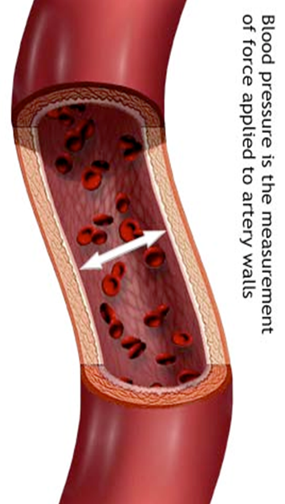
Antihypertensive drugs
ILOS
Outline the pharmacologic classes of drugs used in treatment of hypertension
Describe the mechanism of action , therapeutic uses & common adverse effects of each class of drugs
Select an antihypertensive drug to treat a specific patient according to efficacy, safety, suitability & cost

Slide 4
Antihypertensive drugs
Interactive Lecture
Segments
1-Minicase
2-Q & A
3-Think-pair-share
5-Task-Selection of a P-drug
6-Memory matrix

Slide 5

Clinical case
Osman a 51-year-old man (95Kg weight, 176cm tall) is referred
for further evaluation of his BP. He is a computer engineer and has
a past history of type 2 diabetes for 5 years and high BP for 12
years. His somatic complaints include fatigue and dry mouth.
He has no known history of hypertension target-organ damage,
and his medications are listed in the accompanying table .
He has no remarkable family history other than hypertension in
both parents. His seated BP was 156/90 mmHg and 158/90 mmHg in the right arm (similar to the left arm), with a regular heart rate of 70 beats/min.
His BP did not change on standing. His urinalysis showed an
unremarkable dipstick evaluation. The patient was suspected as having drug- resistant hypertension.
Name | Dose | Frequency
Hydrochlorothiazide | 25mg | Daily
Valsartan | 160mg | Daily
Diltiazem, long-acting | 300mg | Daily
Clonidine | 0.2mg | Twice daily
Metoprolol, long acting | 100mg | daily
Simvastatin | 40mg | Daily
Fenofibrate | 145mg | Daily
Metformin | 1g | Twice daily

Slide 6
Clinical case
List as many reasons as you can, why Osman failed to respond to antihypertensive therapy

Slide 7

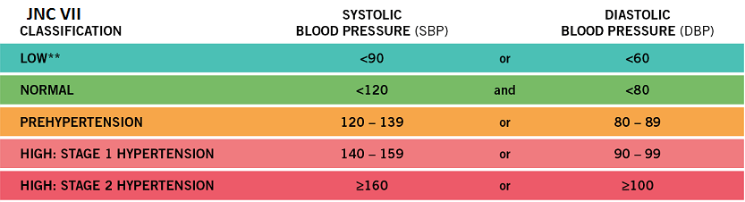

Clinical case
The seated BP of Osman was 156/90, what are the target BP values for treatment of hypertensive patients?
What stage of hypertension is Osman?
Osman is diabetic, what are the target BP values for a diabetic patient?

Slide 8
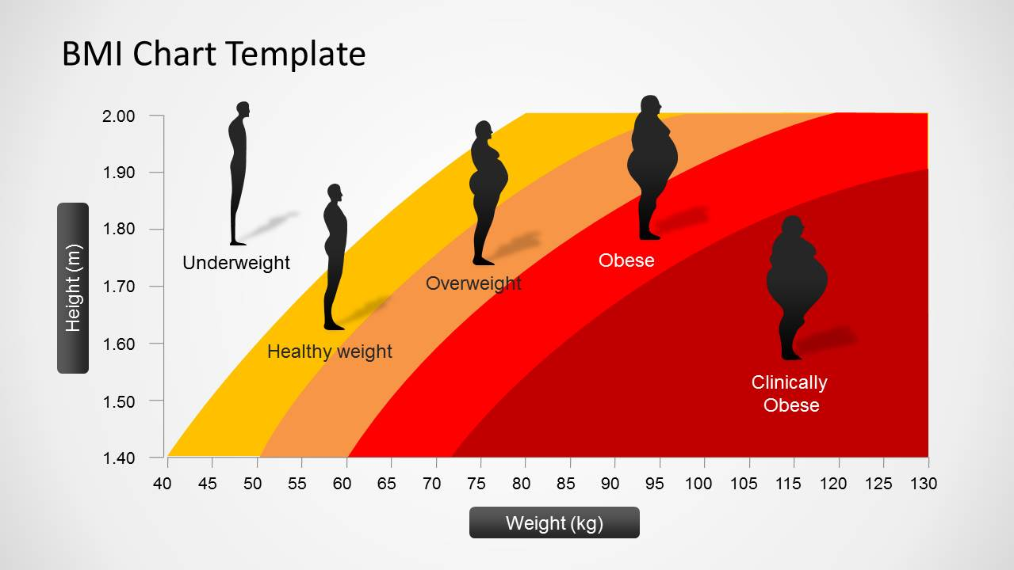
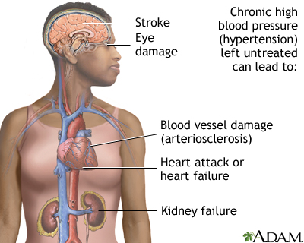
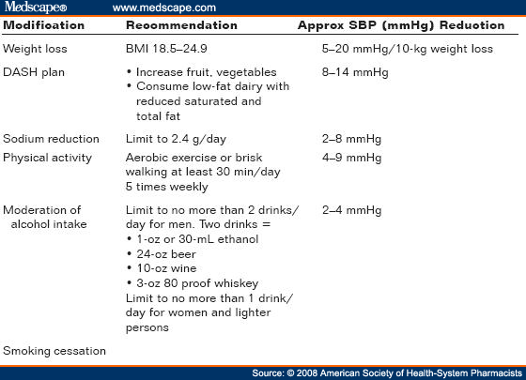
Clinical case
Osman has no history of hypertension- target organ damage. What are organs affected adversely by persistent high BP?
Osman is 95kg big. Is this weight proper for his length(176cm)?
If Osman has to reduce his body weight, what other lifestyle modifications should he do?

Slide 9
Antihypertensive drugs
classification
1-Diuretics
2-Drugs acting on the renin-angiotensin-
aldosterone system
3-Calcium channel blockers
4-Vasodilators
5-Drugs acting on sympathetic nervous system

Slide 10

Antihypertensive drugs
Diuretics
Thiazide diuretics
Long- term
initial
Hydrochlorothiazide , chlorthalidone & furosemide
Na⁺ in vessel wall
sodium, water
retention
Mechanism of action
Na⁺-Ca²⁺ exchange
blood volume
Ca²⁺ in smooth muscle cell
Cardiac
outrput
The intial diuresis lasts 4-6 weeks and then replaced by a decrease in PVR
Peripheral resistance
Decrease in BP

Slide 11
diuretics
Loop diuretics produce more potent diuresis but a smaller decrease in PVR
Loop diuretics are useful in hypertensive patients with either renal impairment, or heart failure
Potassium- sparing diuretics have minimal effect on lowering BP
Diuretics may be adequate in mild to moderate hypertension
According to ALLHAT, chlorthalidone is superior to an ACE inhibitor, a calcium channel blocker and an alpha1-adrenergic antagonist in preventing one or more CVD events.

Slide 12
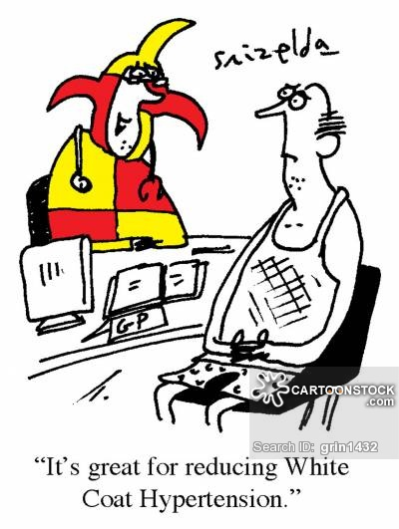
Clinical case
Could the “white coat phenomenon” be the cause for Osman’s high blood pressure readings?
In a Turkish study involving 438 patients, 43% were found to be white coat hypertensives

Slide 13
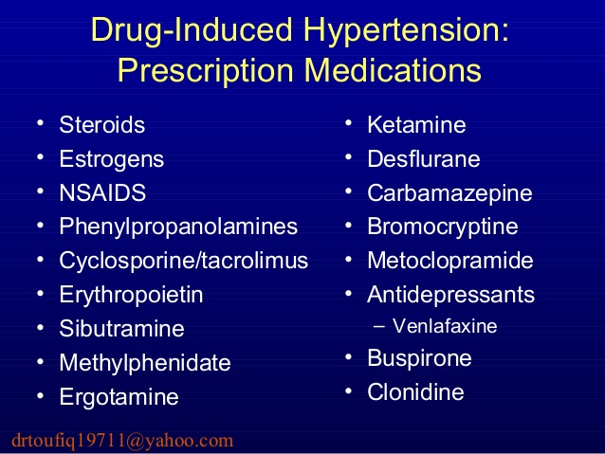
Clinical case
Could the failure of control of Osman BP be due to secondary drug – induced effects?
Which drugs elevate blood pressure?

Slide 14
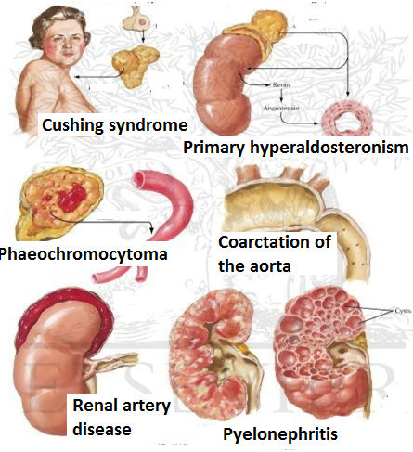
Clinical case
Could Osman be misdiagnosed? And the high BP is due to secondary disease causes?
Which secondary diseases cause elevation of BP?

Slide 15
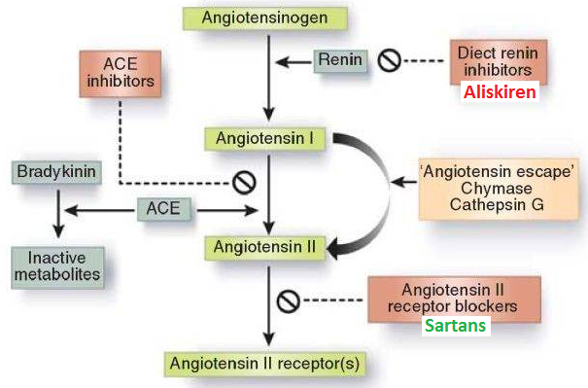
Antihypertensive drugs
ii- Drugs acting on the renin- angiotensin - aldosterone system
1- Angiotensin-converting enzyme inhibitors (ACEI)
Captopril
Lisinopril
Enalapril
Ramipril
2-Angiotensin receptors blockers

Slide 16
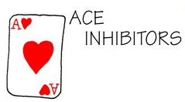
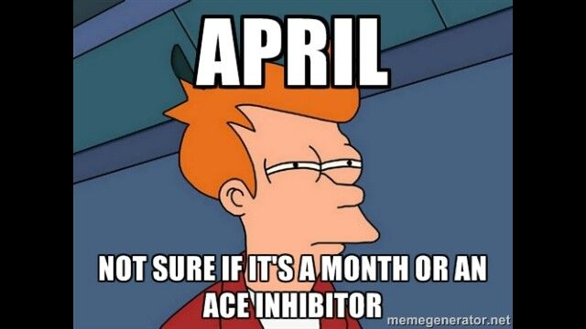
Antihypertensive drugs
1- Angiotensin-converting enzyme inhibitors (ACEI)
Particularly effective when hypertension results from excess renin production (renovascular hypertension, white & young)
The antihypertensive effect of ACE inhibitors results primarily from vasodilatation (reduction of peripheral resistance) with little change on cardiac output.
A fall in aldosterone production may also contribute

Slide 17
1- Angiotensin-converting enzyme inhibitors
pharmacokinetics
Polar, excreted in urine
Do not cross BBB
Have a long half-life & given once daily
Enalapril & ramipril are prodrugs
Rapidly absorbed from GIT after oral administration
Food reduces their bioavailability
It takes 2-4 weeks to see the full antihypertensive effect of ACIs
Enalaprilat is the active metabolite of enalapril given by i.v. route in hypertensive emergency

Slide 18
1- Angiotensin-converting enzyme inhibitors
Clinical uses
1-Treatment of essential hypertension
2-Hypertension in patients with chronic renal disease, ischemic heart disease, diabetes
3-Treatment of heart failure

Slide 19
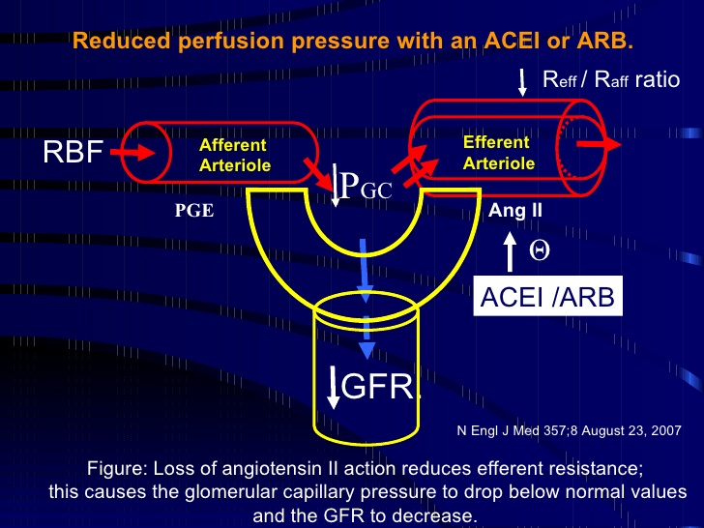
1- Angiotensin-converting enzyme inhibitors
adrs
Dry cough
Acute renal failure, especially in patients
with bilateral renal artery stenosis
Severe hypotension in hypovolemic patients
Cause renal agensia/failure in the fetus, resulting in oligohydraminosis

Slide 20
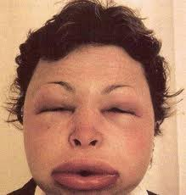
1- Angiotensin-converting enzyme inhibitors
adrs
Angioneurotic edema, swelling in the nose , throat, tongue, larynx
First dose effect
adrs specific to captopril
Skin rash, fever
Dysgeusia
Proteinuria and neutropenia

Slide 21
1- Angiotensin-converting enzyme inhibitors
contraindications
During the second and third trimesters of pregnancy due to the risk of : fetal hypotension ,anuria ,renal failure &
malformations
Bilateral renal artery stenosis
Potassium-sparing diuretics
NSAIDs

Slide 22
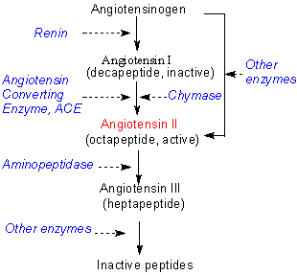
2-Angiotensin receptors blockers
Losartan
Valsartan
Cause selective block of AT1 receptors
No effect on bradykinin, no cough, no
angioedema
Produce more complete inhibition of
angiotensin

Slide 23
2-Angiotensin receptors blockers
losartan
Has a potent active metabolite
Orally effective
Long half-life, taken once daily
Do not cross BBB
valsartan
No active metabolites
Same ADRs, except for
dry cough & angioneurotic edema
Same contraindications as ACEI

Slide 24
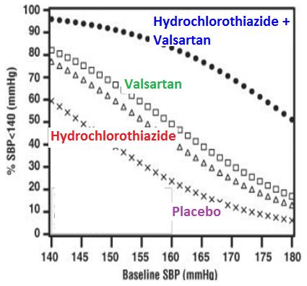
Clinical case
Osman was prescribed hydrochlorthiazide & valsartan. What is the rationale for combining hydrochlorothiazide and valsartan?

Slide 25
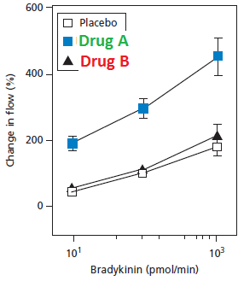
Think- pair-share
The brachial artery was continuously infused with bradykinin and the blood flow is monitored. Placebo, drug A and drug B (both affect the RAAS) induced the effects on blood flow shown in the graph.
What is drug A? Justify!
What is drug B? Justify!

Slide 26

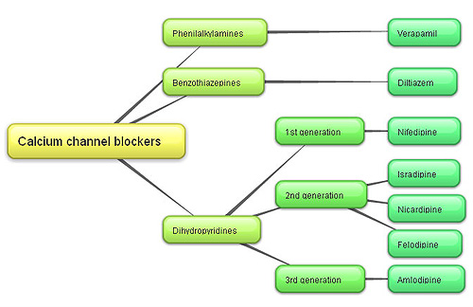
Antihypertensive drugs
3-Calcium channel blockers
Verapamil act more on the myocardium
Dihydropyridine group act mainly on smooth muscle, Nifedipine
V ery
N ice
D rugs
Diltiazem has intermediate effect

Slide 27
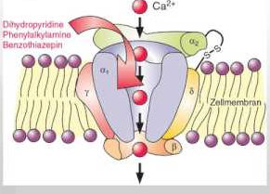
Calcium channel blockers
Mechanism
Block the influx of calcium through calcium channels resulting in:-
1- Peripheral vasodilatation
2- Decrease cardiac contractility

Slide 28
Calcium channel blockers
pharmacokinetics
Given orally or IV
Onset 1-3 min after IV, 0.5-2hr after oral
Well absorbed
Verapamil & diltiazem have active metabolites, nifedipine has not
Verapamil and nifedipine are highly bound to plasma proteins ( more than 90%) while diltiazem is less ( 70-80%)

Slide 29
Calcium channel blockers
Clinical uses
Treatment of chronic hypertension
Nicardipine can be given by I.V. route in hypertensive emergency
Sustained- release formulations are preferred for the treatment of hypertension due to the short half- life of CCBs

Slide 30
Antihypertensive drugs
adrs
Headache , Flushing , Hypotension
Nifedipine:-Tachycardia
Verapamil & Diltiazem:- peripheral edema (ankle edema)
Verapamil:- constipation

Slide 31
Clinical case
Osman was prescribed hydrochlorothiazide & diltiazem. What is the benefit of combining hydrochlorothiazide and diltiazem?

Slide 32
Clinical case
The BP of Osman was almost the same in both arms. What does that imply?

Slide 33
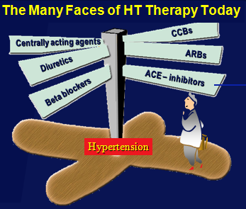
Task- Selection of a p-drug
Instructions:
1- Select a leader for your group
2- Discuss the case according to the steps shown in the sheet
3- Use your internet access to obtain evidence for efficacy, toxicity, convenience & cost.
4- Due to time constrains divide yourself into 4 groups, each doing one search e.g. evidence for efficacy.
5- You have 10 minutes to do this and 1 minute to report to the class.

Slide 34
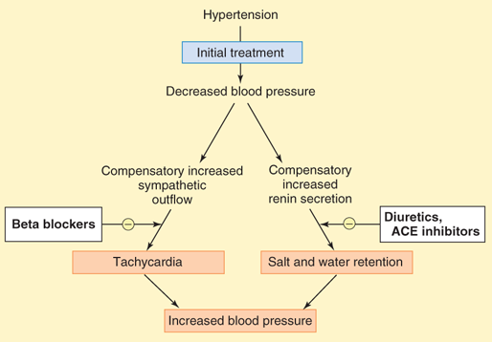
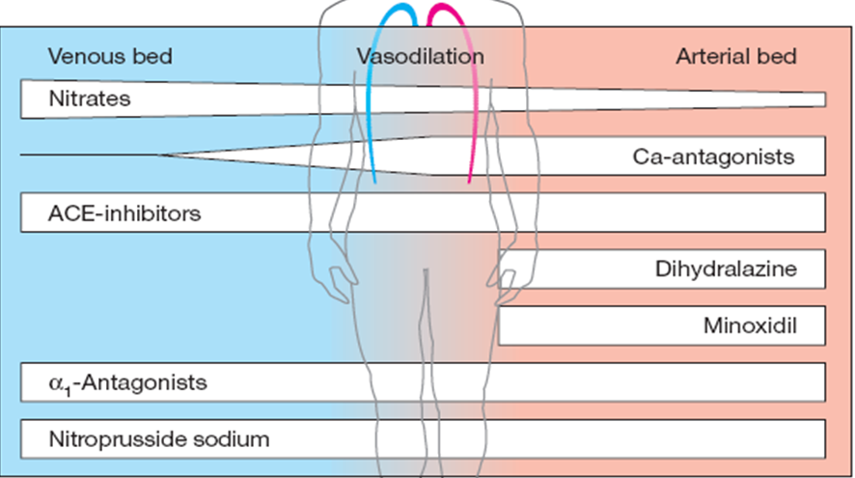
Antihypertensive drugs
4- vasodilators
Classified into arterial, venous or mixed vasodilators
Once vasodilators are administered, fall in BP produced will activate the sympathetic system & the RAAS

Slide 35
Antihypertensive drugs
vasodilators
Sodium nitropruside | Diazoxide | Minoxidil | Hydralazine
Arterio & venodilator | Arteriodilator | Arteriodilator | Arteriodilator | Site of action
Release of nitric oxide ( NO) | Opening of potassium channels | Opening of potassium channels in smooth muscle membranes by minoxidil sulfate ( active metabolite ) | Direct | Mechanism of action
Intravenous infusion | Rapid intravenous | Oral | Oral | Route of admin.

Slide 36
vasodilators
Sodium nitropruside |  | Diazoxide | Minoxidil |  | Hydralazine | Continue Vasodilators
1.Hpertensive emergency |  | 1.Hypertensive emergency | 1.Moderate –severe hypertension |  | 1.Moderate -severe hypertension. | Therapeutic uses
In combination with diuretic & β-blockers
2.Severe heart failure | 2.Treatment of hypoglycemia due to insulinoma |  | 2. baldness | 2.Hypertensive pregnant woman

Slide 37
vasodilators
Sodium nitropruside | Diazoxide | Minoxidil |  | Hydralazine |  | Continue Vasodilators
Severe hypotension | Hypotension, reflex tachycardia, palpitation, angina, salt and water retention ( edema) |  |  |  |  | Adverse effects
1.Methemoglobinduring infusion 2. Cyanide toxicity 3. Thiocyanate toxicity | Inhibit insulin release from β cells of the pancreas causing hyperglycemia Contraindicated in diabetics |  | Hypertrichosis. Contraindicated in females |  | lupus erythematosus like syndrome | Specific adverse effects

Slide 38
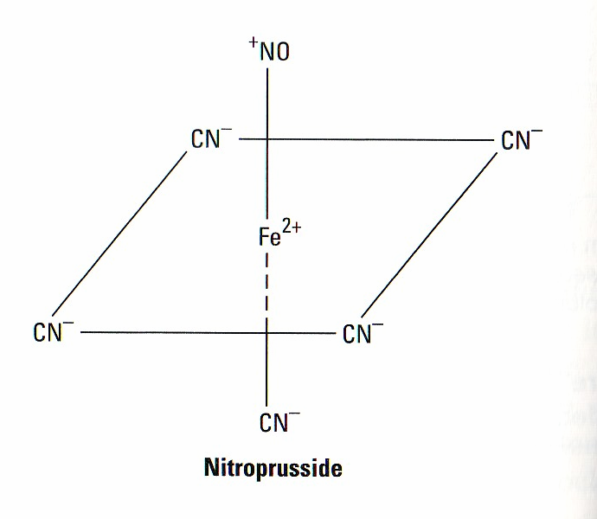
vasodilators
Sodium nitroprusside
adrs
Headache, palpitations which disappear when infusion is stopped
Cyanide accumulation cause cyanide poisoning (metabolic acidosis, arrhythmias, severe hypotension and death)

Slide 39
5-Sympatholytic Drugs
i-ß Adrenoceptor blockers
Propranolol, atenolol, metoprolol
They should not be the primary agent for primary prevention but are effective as add-on therapy
May take two weeks for optimal therapeutic response
Evidence support the use of ß-blockers in patients with concomitant coronary artery disease
When discontinued, ß- blockers should be withdrawn gradually

Slide 40
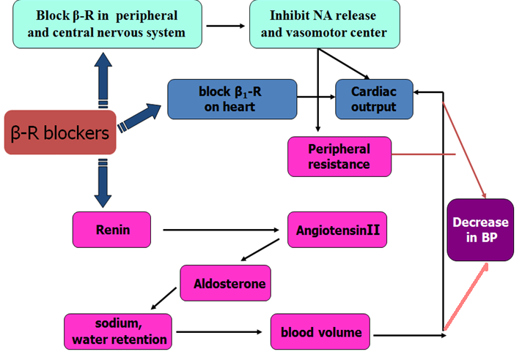
ß- Adrenoceptor blockers
mechanism
They lower blood pressure by :
i-Decreasing cardiac output.
ii-Inhibiting the release of renin
iii- Central mechanism

Slide 41
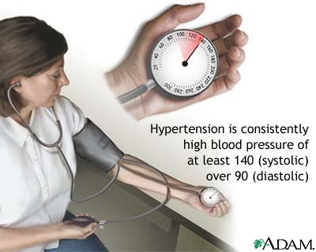
ß Adrenoceptor blockers
ADrs
Hypoglycemia
Fatigue
Mask the symptoms of hypoglycemia in diabetes
Increased triglycerides
Aggravate peripheral arterial disease
Erectile dysfunction

Slide 42
Sympatholytic drugs
ii- α Adrenoceptor blockers
Block α- receptors in arterioles and venules
Reduce blood pressure by decreasing both afterload & preload
Prazosin, short- acting causes first dose hypotension & postural hypotension
Doxazosin, is preferred →long half- life

Slide 43
Clinical case
The BP of Osman did not change on standing. What is your conclusion?

Slide 44
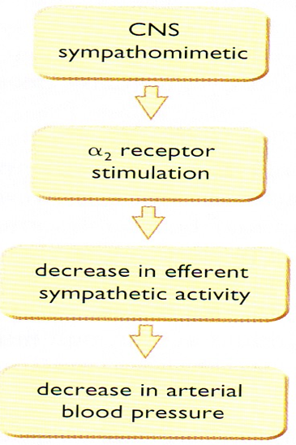
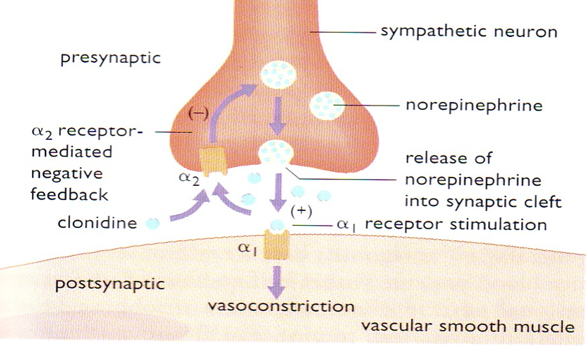
Iii- Centrally- acting
A- Clonidine
α2-agonist, diminishes central adrenergic outflow & ↑ parasympathetic outflow
Abrupt withdrawal may lead to rebound hypertension
Does not decrease renal blood flow or glomerular filtration
Useful in the treatment of hypertension complicated by renal disease and resistant hypertension

Slide 45
Sympatholytic drugs
Centrally- acting
B- α- methyldopa
An α- 2 agonist, is converted to methyl noradrenaline centrally to diminish the adrenergic outflow from the C.N.S
Lead to reduced total peripheral resistance, and a decreased in blood pressure
α -Methyldopa is the first line treatment of hypertension in pregnancy

Slide 46
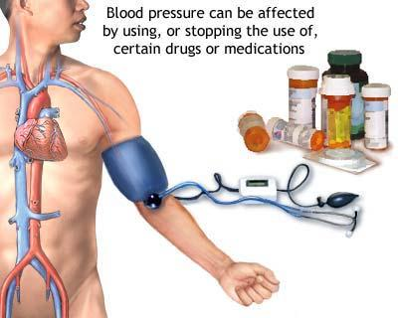
Clinical case
Is the concomitant prescribing of clonidine, diltiazem and metoprolol to Osman rational?

Slide 47
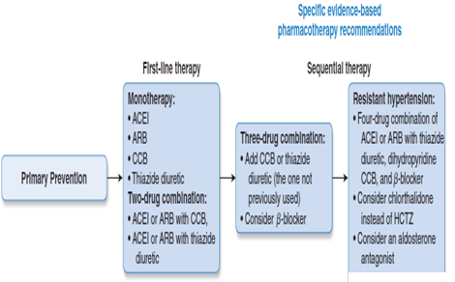
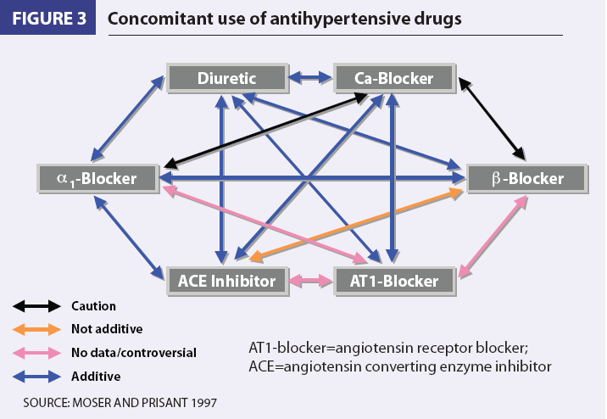
Clinical case
Could the failure of Osman control of BP be due to the use of inappropriate combinations of drugs?
Use of combinations→↓ individual dose→↓ ADRs
Select a drug that ↓ the ADR of another, e.g. thiazides versus ACEI
Select a drugs that act by different mechanisms

Slide 48
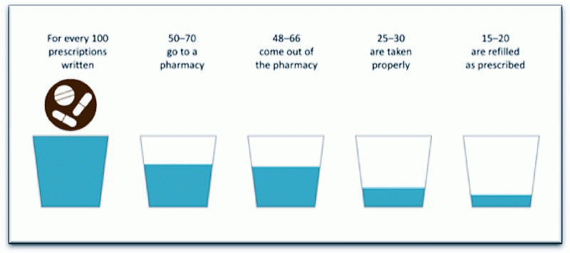
Clinical case
Could the failure of control of Osman’s BP be attributed to non adherence?
Could the somatic complaints
(fatigue and dry mouth)
indicate the adherence of
Osman to medication
regimen and which drugs
cause these symptoms?

Slide 49
Memory matrix
Enter + or – in the cells to indicate the presence or absence of a feature
Compelling contraindications of antihypertensive drugs
 | HF | Pregnancy | Hypokalemia | Bradycardia | Asthma | Hyperkalemia | Gout
Diuretics
ACEI
CCB
ß-blockers
ARB

Slide 50
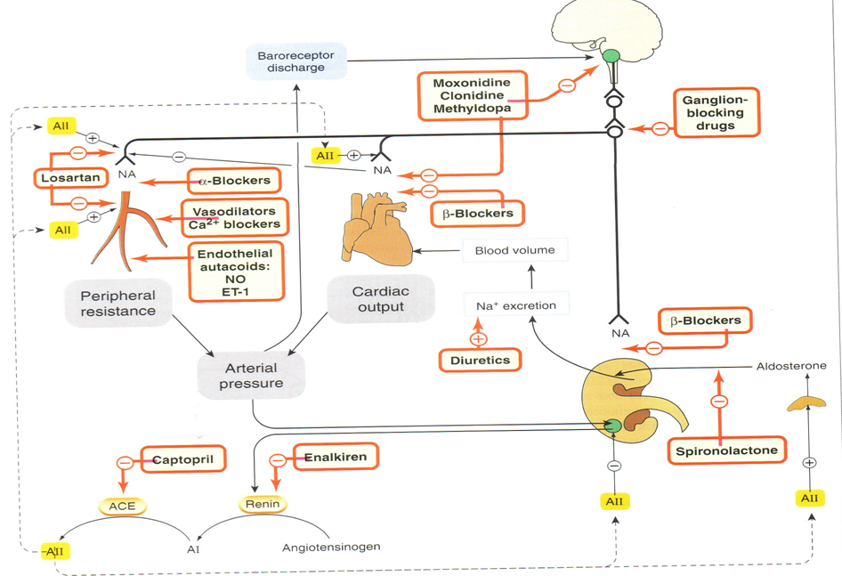
Control of blood pressure & site of drug action

Slide 51
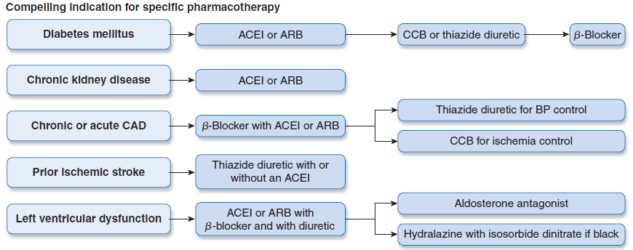
Antihypertensive drugs

