Slide 1
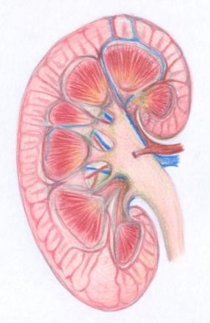

Clinical Chemistry Lectures
Renal Block
KIDNEY STONES
By: Reem M Sallam, MD, MSc, PhD

Slide 2
OBJECTIVES
Upon completion of this lecture, the students
should be able to:
  Recall general physiological and pathological
factors that favor kidney stones formation.
  Identify the chemical constituents and characteristics of kidney stones that help in identifying the causes, diagnosis, treatment and prevention of kidney stones.

Slide 3
What are kidney stones ?
Kidney stones (renal calculi)
are stones that are formed in renal tubules
&
are usually composed of products of metabolism
present in normal glomerular filtrate
often at concentrations near their maximum solubility

Slide 4
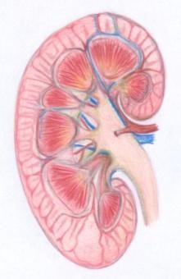

Conditions favouring kidney stones
formation
High urinary concentrations of constituents of glomerular filtrate
Change in pH of urine
Urinary stagnation
Lack of normal inhibitors of stone formation
in urine

Slide 5
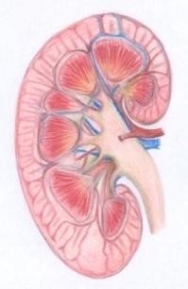

Conditions favouring kidney stones
formation
High urinary concentrations of one or more
constituents of glomerular filtrate due to:
  ↓urinary volume (with normal renal function)
    Restricted fluid intake
    ↑fluid loss over a long period of time
  ↑ rate of excretion of metabolic products forming
stones
    ↑ plasma volume (that increases filtrate level)
    ↓ tubular reabsorption from filtrate

Slide 6


Conditions favouring kidney stones
formation (cont.)
Change in pH of urine
  often due to bacterial infection
  ↑ precipitation of different salts at different pH:
    A persistently acidic urine → promotes uric acid
precipitation
    A persistently alkaline urine (due to upper urinary tract infection)→ promotes Mg Ammonium Phosphate crystals (Struvite stones)
Urinary stagnation:
  Due to obstruction of urinary outflow

Slide 7
Conditions favouring kidney stones
formation (cont.)
Lack of normal inhibitors in urine
  Inhibitors of stone formation: e.g.:
    Citrates
    Pyrophosphate
    Glycoproteins
  Inhibit the growth of Ca⁺⁺ salts crystals
  In type I renal tubular acidosis, hypocitraturia
→renal stones

Slide 8
Constituents of Kidney Stones
1- Stones of calcium salts 2- Uric Acid stones
3- Magnesium ammonium phosphate stones 4- Cystine stones
5- Others (xanthine, etc)

Slide 9
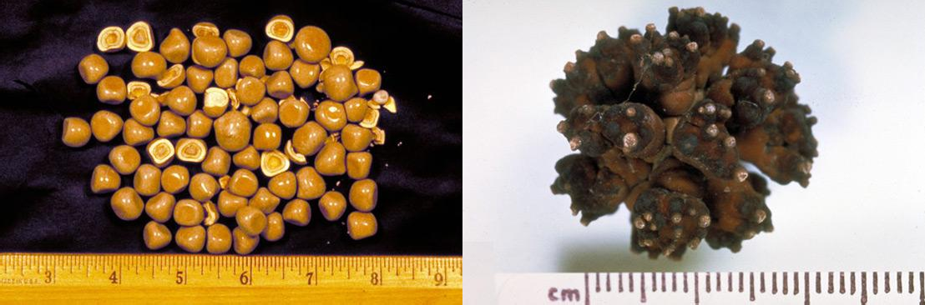
Stones of Calcium Salts
e.g. Calcium Oxalate Stones

Slide 10
1-Stones of calcium salts
Constituents of Kidney Stones:
80% of patients with nephrolithiasis form
calcium stones:
  Mostly: Ca-Oxalate
  Less often: Ca-Phosphate
Type of salt depends on:
  pH of urine &
  Availability of oxalate

Slide 11
1-Stones of calcium salts (cont.)
Constituents of Kidney Stones:
Characters:
  white, hard & radio-opaque
  Ca-Oxalate: smaller, lodge in ureter
  Ca-Phosphate: staghorn, in renal pelvis (big)

Slide 12


Constituents of Kidney Stones:
1-Stones of calcium salts (cont.)
Main causes favouring formation of calcium salts stones:
Hypercalciuria:
Defined as daily urinary Ca excretion >6.2 mmol in ♀ & >7.5 mmol in
♂
  due to hypercalcemia (most often due to 1^{ary} hyperparathyroism)
  sometimes, Ca⁺⁺ salts stones are found with no hypercalcemia
Hyperoxaluria (more important )
favours formation of calcium oxalates (even with no hypercalciuria)
causes:
  exogenous (diet rich in oxalate )
  ↑absorption (in fat malabsorption)
  1^{ary} hyperoxaluria: inborn errors , in childhood , urinary oxalates > 400 μmol/24 hours

Slide 13
Constituents of Kidney Stones:
1-Stones of calcium salts (cont.)
Conservative lines of treatment:
Treatment of primary condition (i.e. Infection, hypercalcemia, hyperoxaluria)
Reducing oxalates in diet (it is not recommended to reduce calcium
in diet)
↑ Fluid intake (if no glomerular failure).
Acidification of urine (as ppt. is favoured by alkaline
conditions)

Slide 14
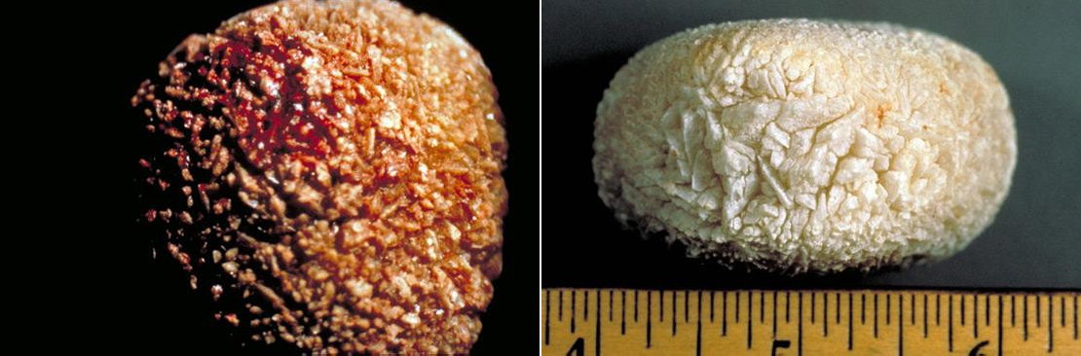
Uric acid stones

Slide 15
Constituents of Kidney Stones:
2-Uric acid stones
~ 8% of renal stones contains uric acid
may be associated with hyperuricemia (with or without clinical gout)
Acidification of urine→ favours Uric acid precipitation
Characteristics:
  small, friable & yellowish
  may form staghorn (if big)
  radiolucent (can’t be seen be plain X-ray)
  visualized by ultrasonography or I.V. Pyelogram

Slide 16
2-Uric acid stones, (Cont.)
Constituents of Kidney Stones:
Treatment:
  Treatment of cause of hyperuricemia
  ↓ purine-rich diet
  Alkalinzation of urine (e.g. by potassium citrate)
  ↑fluid intake

Slide 17
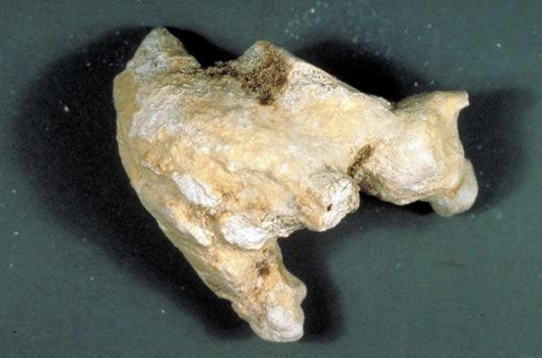
Mg ammonium phosphate (struvite) stone

Slide 18


Constituents of Kidney Stones:
3- Magnesium ammonium phosphate
stones
~ 10% of all renal stones
With chronic urinary tract infection (by urease splitting oraganisms as Proteus species → ammonia production from urea)
Alkaline urine pH (> 7.0)
Treatment:
  Aggressive prevention & treatment of the cause (urinary tract
infection)
  Urine acidification
  ↑ Fluid intake
  It may require complete stone removal (percutaneous
nephrolithotomy)
  Aggressive prevention & treatment of future urinary tract infection

Slide 19
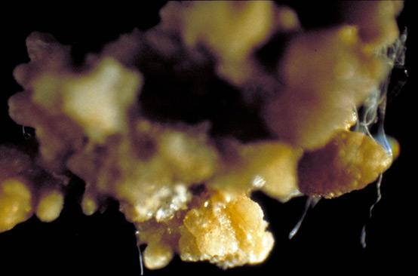
Cystine stones

Slide 20
Constituents of Kidney Stones:
4- cystine stones
Rare
occurs in cases of homozygous cystinuria (inborn
error of amino acid metabolism)
Soluble in alkaline urine (precipitates by acidic urine)
Treatment:
  ↑ fluid intake
  Alkalinzation of urine
  Penicillamine

Slide 21


Investigations of patients with renal calculi
Stone is available (with urine or by surgical intervention)
laboratory investigations for detection of stone chemical constituents:
  to know the cause
  for decision of lines for preventive treatment
Stone is not available
Blood analysis: calcium, uric acid, [PTH]
Urine analysis: volume, calcium & oxalate
Urine pH: > 8 suggestive of urinary tract infection (Mg amm. phosph.) Screening of urine for cystine: qualitative (if +ve: 24 hours urine) Renal tract imaging: CT, ultrasonography & I.V. pyelogram

Slide 22
To summarize: Evaluation & subsequent treatment
Retrieve stones and send for analysis.
Subsequent therapy depends on stone & biochemical abnormalities.
ALL patients should increase fluid intake to > 2L/day
Do a complete evaluation in certain patients (those with moderate-high risk:
  Middle-aged, White, Males, with + ve Family History
  Patients with chronic diarrheal states and/or malabsorption, pathological fractures, osteoporosis, UTIs, or gout.
  Patients with certain types of stones:
– e.g. stones composed of calcium phosphate (hard stone) or struvite (@ risk for staghorn calculi)

Slide 23
THANK YOU

