Slide 1
Lecture 2: Inborn Errors of aminoacid Metabolism
Dr. Sumbul Fatma

Slide 2
Inborn Errors of amino acid Metabolism
Caused by enzyme loss or deficiency due to gene mutation
Cofactors
Enzyme + Substrate
Product
Excess
Deficient

Slide 3
Inborn diseases of amino acid metabolism
Phenylketonuria
Maple syrup Urine Disease
Albinism
Homocystinuria
Alkaptonuria

Slide 4
Phenylketonuria (PKU)
Most common disease of aminoacid metabolism
Due to deficiency of phenylalanine hydroxylase enzyme
Results in hyperphenylalaninemia and tyrosine deficiency

Slide 5
Classical PKU
Phenylalanine
accumulated
Phenylalanine hydroxylase
Page 1009
The pathway of phenylalanine degradation

Slide 6
Other reasons for hyperphenylalanemia PKU contd..
Conversion of Phe to Tyr requires tetrahydrobiopterin (BH₄)
Even if phenylalanine hydroxylase level is normal
The enzyme will not function without BH₄
Hence Phe is accumulated
Atypical hyperphenylalaninemia:
Due to deficiency of dihydropteridine reductase, dihydrobiopterin synthetase enzymes

Slide 7
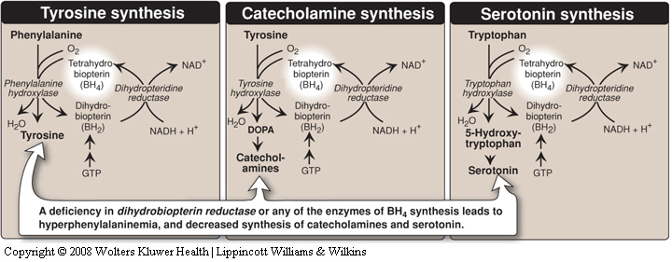
Aminoacids and Tetrahydrobipterin

Slide 8
Characteristics of PKU
In the absence of BH₄, Phe will not be converted to Tyr
No or less
Tyrosine/ also inhibited by excess Phe
Page 1002
Melanin
No or less melanin
Light skin in PKU patients
Melanin biosynthesis from tyrosine: Deficiency of tyrosinase leads to albinisim

Slide 9
Characteristics of PKU
Tyr will not be converted to catecholamines and Trp will not be converted to serotonin as they require BH₄
Catecholamines and serotonin are neurotransmitters

Slide 10
Characteristics of PKU
Elevated phenylalanine in tissues, plasma, urine
Phe is degraded to phenyllactate, phenylacetate, phenylpyruvate
Gives urine a mousy odor
Cause of mousy urine smell in PKU

Slide 11
Characteristics of PKU
CNS symptoms: Mental retardation, failure to walk or talk, seizures, microcephaly etc.
Hypopigmentation – fair hair, light skin colour and blue eyes
Urine has a musty (mousey) odor

Slide 12
Diagnosis and treatment of PKU
Prenatal diagnosis is done by detecting gene mutation in fetus
Neonatal diagnosis in infants is done by measuring levels of blood phe
Treatment: Life long phe-restricted diet and tyrosine supplementation

Slide 13
Maple Syrup Urine Disease
Due to deficiency of branched chain α-ketoacid dehydrogenase
The enzyme decarboxylates leucine, isoleucine and valine
These aminoacids accumulate in blood
Symptoms: mental retardation, physical disability, metabolic acidosis, etc.
Maple syrup odor of urine

Slide 14
Maple Syrup Urine Disease
Types:
Classic type: Most common, due to little or no activity of branched chain α-ketoacid dehydrogenase
Intermediate and intermittent forms: Higher enzyme activity, symptoms are milder
Thiamine-responsive form: High doses of thiamine increases α-ketoacid dehydrogenase activity

Slide 15
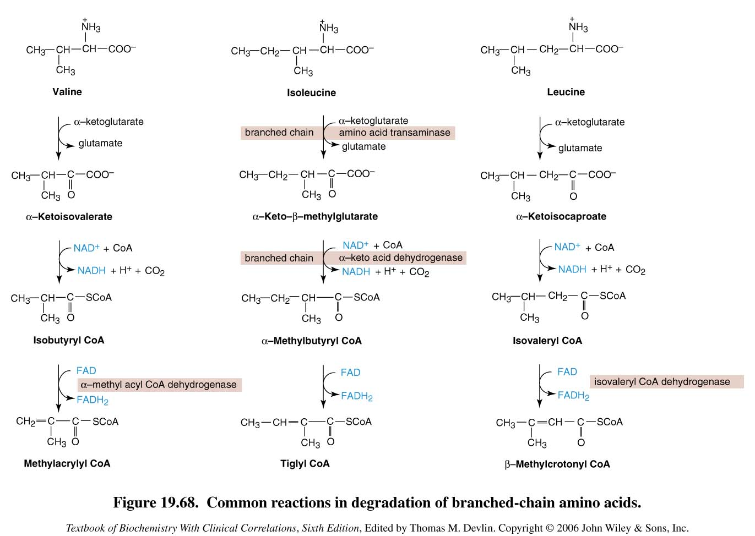
Valine, Isoleucine,
Leucine and their
keto acids
accumulated
Degradation of branched-chain amino acids: valine, isoleucine and leucine. Deficiency of branched chain a-keto acid dehydrogenase leads to MSUD.

Slide 16
Maple Syrup Urine Disease
Treatment: Limited intake of leucine, isoleucine and valine causes no toxic effects

Slide 17
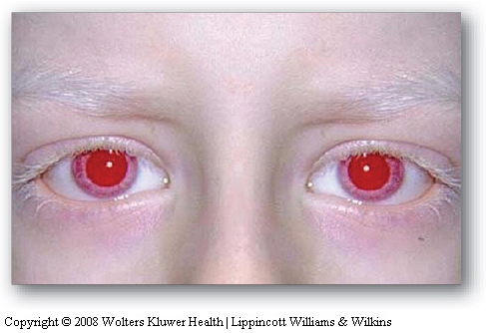
Albinism
A disease of tyrosine metabolism
Tyrosine is involved in melanin production
Melanin is a pigment of hair, skin, eyes
Due to tyrosinase deficiency
Melanin is absent in albino patients
Hair, skin, eyes appear white
Vision defects, photophobia
Tyrosine and DOPA
accumulated
Tyrosinase
Melanin
Melanin biosynthesis from tyrosine: Deficiency of tyrosinase leads to albinisim

Slide 18
Homocystinuria
Due to defects in homocysteine metabolism
Deficiency of cystathionine β-synthase
Converts homocysteine to cystathionine
High plasma and urine levels of homocysteine and methionine and low levels of cysteine
Homocysteine is a risk factor for atherosclerosis and heart disease
Skeletal abnormalities, osteoporosis, mental retardation, displacement of eye lens

Slide 19
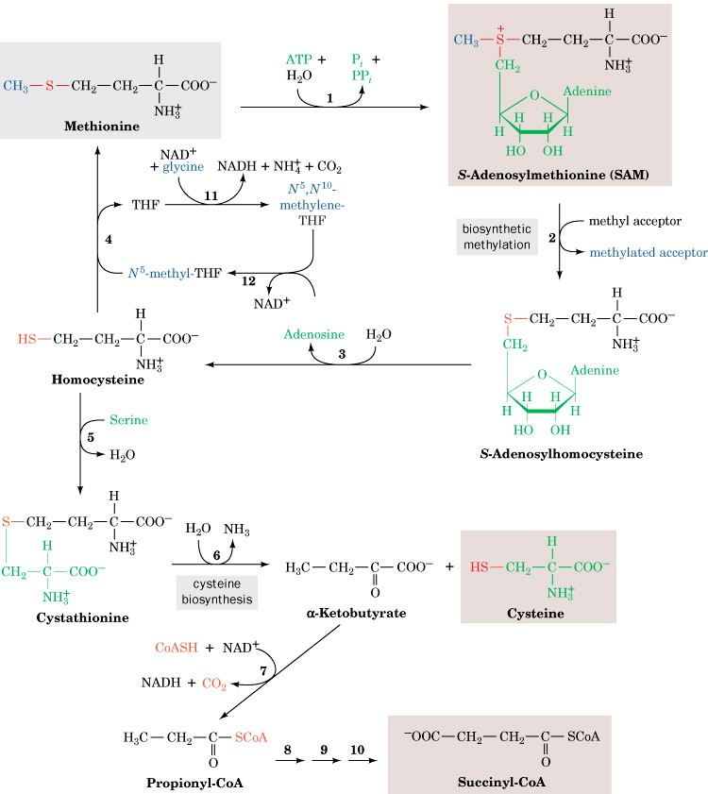
Methionine and its
metabolites are
accumulated
Cystathione b-synthase
Cysteine becomes
deficient
Page 1002
Methionine degradation pathway: Deficiency of cystathione b-synthase leads to homocystinuria / homocysteinemia

Slide 20
Treatment of Homocystinuria
Oral administration of vitamins B₆, B₁₂ and folate
Vitamin B₆ is a cofactor of cystathionine β-synthase
Methionine-restricted diet

Slide 21
Homocystinuria
Hyperhomocysteinemia is also associated with:
Neural tube defect (spina bifida)
Vascular disease (atherosclerosis)
A risk factor of heart disease

Slide 22
Alkaptonuria
A rare disease of tyrosine degradation
Due to deficiency of homogentisic acid oxidase
Tyrosine
catecholamine
Melanin
P-Hydroxyphenylpyruvatec
Homogentisic acid
Homogentisic acid oxidase
Fumarate
TCA cycle

Slide 23
Characteristics of Alkaptonuria
Homogentisic aciduria: elevated homogentisic acid in urine which is oxidized to dark pigment over time
Arthritis
Black pigmentation of cartilage, tissue
Usually asymptomatic until adulthood

Slide 24
Treatment of alkaptonuria
Restricted intake of tyrosine and phenylalanine reduces homogentisic acid and dark pigmentation

Slide 25
Summary
 | Disease | Enzyme | Aminoacids involved
1 | Phenylketonuria | Phenylalanine hydroxylase | Phenylalanine
2 | Maple syrup urine disease | α-ketoacid dehydrogenase | Isoleucine, leucine and valine
3 | Albinism | Tyrosinase | Tyrosine
4 | Homocystinuria | Cystathionine β-synthase | Methionine
5 | Alkaptonuria | Homogentisic acid oxidase | Tyrosine and phenylalanine

