Slide 1
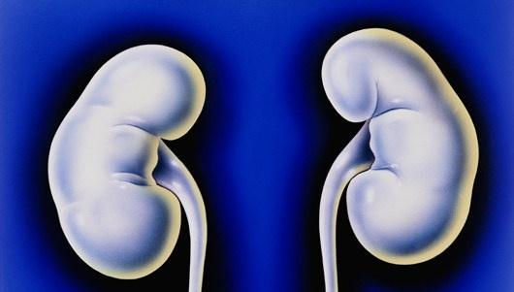
DEVELOPMENT
OF
KIDNEYS & URETES
Dr. Jamila El Medany

Slide 2
OBJECTIVES
At the end of the lecture, students should be able to:
Identify the embryological origin of kidneys & ureters.
Differentiate between the 3 systems of kidneys during development.
Describe the development of collecting & excretory parts of permanent kidney.
Describe the fetal kidney & identify the pre- and postnatal changes that occur in the kidney.
Enumerate the most common anomalies of kidneys & ureters.

Slide 3
EMBRYOLOGICAL ORIGIN
from

Slide 4
INTERMEDIATE MESODERM
Differentiates into:
Nephrogenic ridge (cord):
forms kidneys & ureters
2. Gonadal ridge: forms
gonads (testes or ovaries)

Slide 5
DEVELOPMENT OF KIDNEYS
Three systems of kidney develops:
Pronephric system:
- appears at beginning of 4th week
in cervical region
- analogous to kidney of fish
- formed of tubules & a duct
- not function in human
- disappears
Mesonephric system:
- appears at end of 4th week
in thoracic & abdominal regions
- analogous to kidney of amphibians
- formed of tubules & a duct
- function temporarily
-The duct: In male: forms genital duct
- In both sexes: forms ureteric bud
Metanephric system:
- appears at 5th week in pelvis
- starts to function at 9th week
Ureteric bud

Slide 6
METANEPHROS (PERMANENT KIDNEY)
Formed of 2 origins:
Ureteric Bud (derived from mesonephric duct):
gives Collecting part of kidney
2) Metanephric Blastema (Mass): derived from nephrogenic cord
gives Excretory part of kidney

Slide 7
COLLECTING PART
A- Ureteric bud elongates & penetrates metanephric mass.
B- Stalk of ureteric bud forms ureter & its cranial end forms renal pelvis.
C- Branching of renal pelvis gives 3 major calices. Branching of major calyces gives minor calyces.
D- Continuous branching gives straight & arched collecting tubules
A
B
C
D

Slide 8
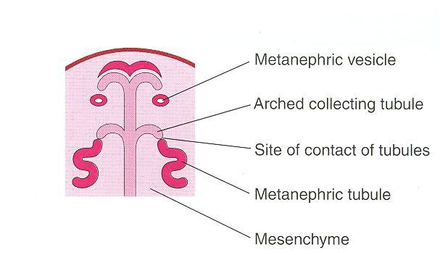
EXCRETORY PART
Each arched collecting tubule is surrounded by a cap of metanephric mass.
(metanephric vesicle).
The metanephric vesicle elongates to form an S-shaped metanephric tubule.

Slide 9
EXCRETORY PART
The end of each tubule forms Glomerular (Bowman’s) capsule.
Each glomerular capsule is invaginated by capillaries (Glomerulus).
The tubule lengthens to form: Proximal & Distal convoluted tubules + Loop of Henle

Slide 10
THE NEPHRON (FUNCTIONAL UNIT OF KIDNEY)
The Nephron is formed by fusion of:
Excretory tubule (from metanephric mass (cap).
Arched collecting tubule (from ureteric bud).
At Full Term:
each kidney contains: 800000 – 1000000 nephrons.
2)
1)

Slide 11
Criteria of The Fetal Kidney
The Kidney is subdivided into Lobes that are visible externally.
Lobulation diminishes at the end of fetal period.
Nephron formation is complete at birth.

Slide 12
CHANGES of kidney Before Birth
Abdominal aorta
Common iliac
artery
Position: The kidney ascends from pelvis to abdomen & attains its adult position, caudal to suprarenal gland.
Blood Supply: As the kidney ascends, its blood supply changes from renal branches of common iliac arteries into renal branches of abdominal aorta.
Rotation: Initially, the Hilum is ventral then rotates medially about 90° & becomes medial.

Slide 13
What Happens At The 9TH WEEK
Beginning of glomerular filtration (start of function).
The kidney attains its adult position. Receives its arterial supply from abdominal aorta.
The hilum is rotated medially

Slide 14
Changes of kidney After BIRTH
Increase in size: due to elongation of tubules and increase in connective tissue between tubules (not due to increase in number of nephrons)
Disappearance of kidney lobulation

Slide 15
Congenital Anomalies
Pelvic kidney: failure of ascent of one kidney (ureter is short)
Horseshoe kidney: the poles of both kidneys (usually the lower poles) fuse: the kidneys have a lower position than normal but have normal function

Slide 16
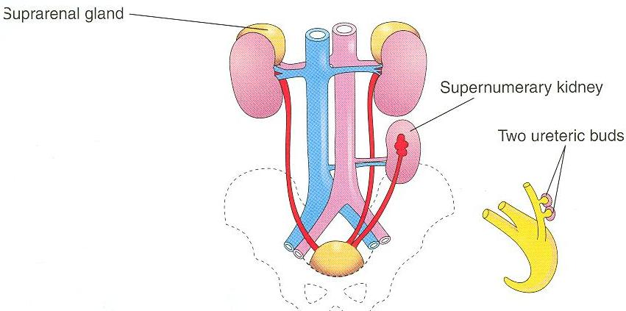
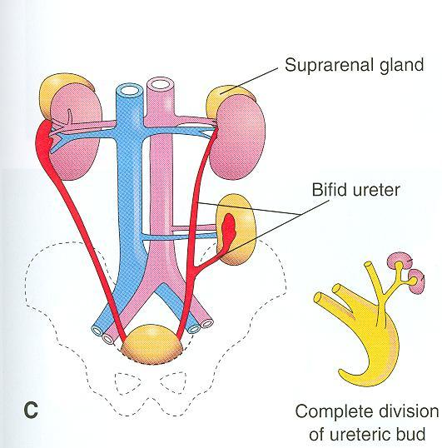
B
A- Unilateral renal agenesis: due to
absence of one ureteric bud
B- Supernumerary kidney: due to
development of 2 ureteric buds
C- Right side: malrotation of kidney
Left side: bifid ureter &
supernumerary kidney

Slide 17
GOOD LUCK

