Slide 1
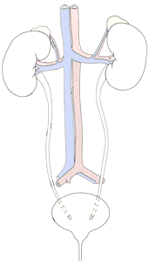
RENAL BLOCK
Pathology Practical
Prof. Ammar Al Rikabi
Dr. Sayed Al Esawy
Dr. Marie Mukhashin
Dr. Shaesta Zaidi
Prepared by:
Head of Pathology Department: Dr. Hisham Al Khalidi

Slide 2
NORMAL ANATOMY AND HISTOLOGY
Pathology Dept , KSU
Renal Block

Slide 3
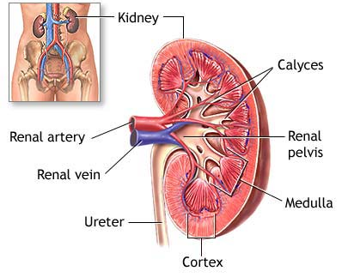
Anatomy of the Kidney
Pathology Dept , KSU
Renal Block

Slide 4
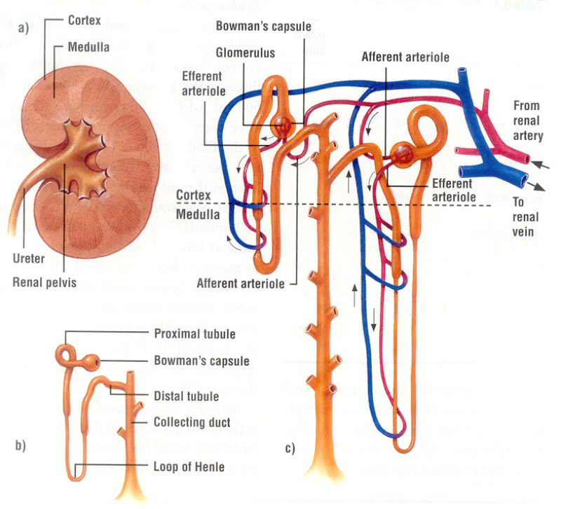
NEPHRON STRUCTURE
Pathology Dept , KSU
Renal Block

Slide 5
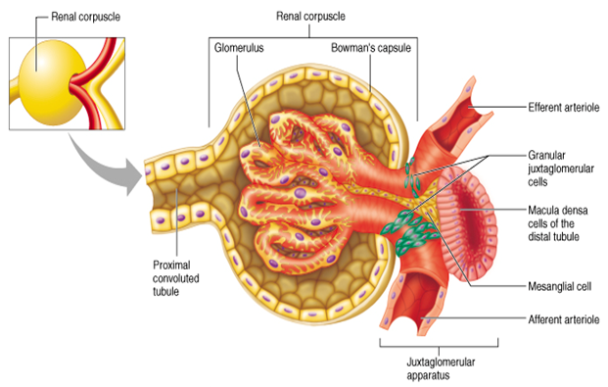
Renal Corpuscle
Pathology Dept , KSU
Renal Block

Slide 6
KIDNEY ANATOMY : NEPHRONS
Nephron is the functional unit of the kidney.
Each kidney contains about 1,000,000 to 1,300,000 nephrons.
The nephron is composed of glomerulus and renal tubules .
The nephron performs its function by ultra filtration at glomerulus and secretion and reabsorption at renal tubules.
Pathology Dept , KSU
Renal Block

Slide 7
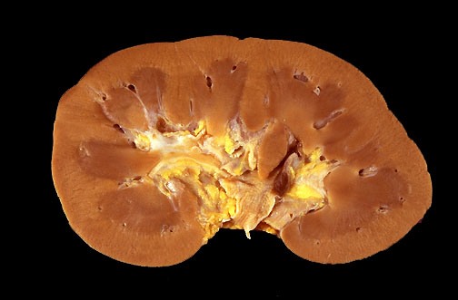
Normal Kidney - Gross
In cross section, this normal adult kidney demonstrates the lighter outer cortex and the darker medulla, with the renal pyramids into which the collecting ducts coalesce and drain into the calyces and central pelvis.
Pathology Dept , KSU
Renal Block

Slide 8
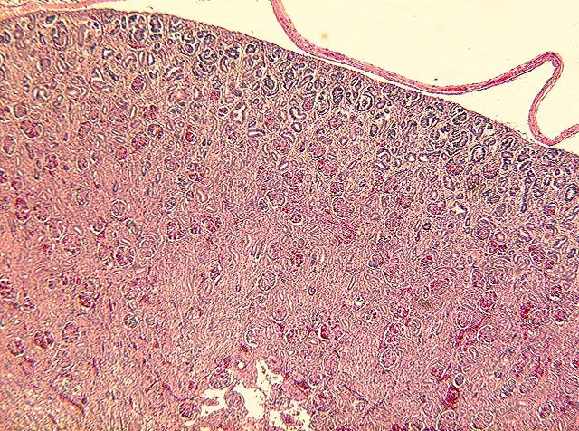
Kidney – Normal Histology
The kidneys show a well preserved lobular structure with indistinct corticomedullary demarcation
Pathology Dept , KSU
Renal Block

Slide 9
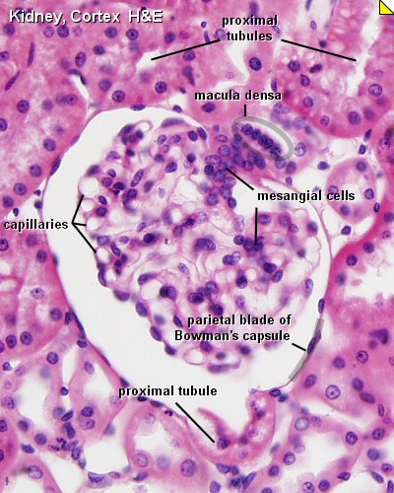
Renal Corpuscle – Normal Histology
Pathology Dept , KSU
Renal Block

Slide 10
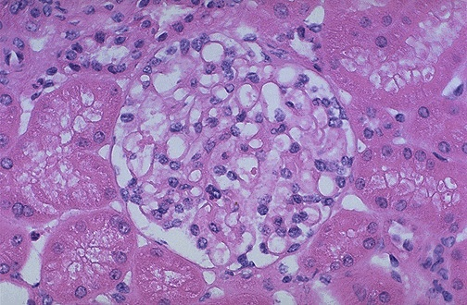
Renal Corpuscle – Normal Histology
Normal glomerulus by light microscopy. The glomerular capillary loops are thin and delicate. Endothelial and mesangial cells are normal in number. The surrounding tubules are normal
Pathology Dept , KSU
Renal Block

Slide 11
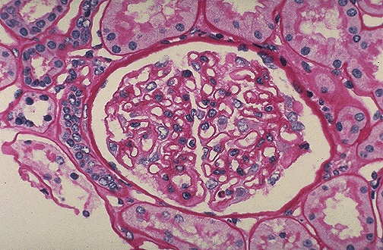
Renal Corpuscle – Normal Histology
Normal glomerulus is stained with PAS to highlight basement membranes of glomerular capillary loops and tubular epithelium.
Pathology Dept , KSU
Renal Block

Slide 12
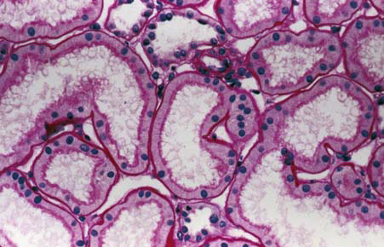
Normal Cortical Tubules
Normal cortical tubules, interstitium, and peritubular capillaries; most of the tubules are proximal, with well-defined brush borders (PAS stain).
Pathology Dept , KSU
Renal Block

Slide 13
ACUTE KIDNEY INJURY
PRACTICAL SESSION : 1
Pathology Dept , KSU
Renal Block

Slide 14
Acute Kidney Injury
Causes:
Pre-renal
(All those that decrease effective blood flow to the kidney)
Low blood volume, low blood pressure, and heart failure.
Renal artery stenosis, and renal vein thrombosis.
Renal ischemia.
Renal:
Glomerulonephritis (GN).
Acute tubular necrosis (ATN).
Acute interstitial nephritis (AIN).
Post-renal:
(is a consequence of urinary tract obstruction)
Benign prostatic hyperplasia.
Kidney stones.
Obstructed urinary catheter.
Bladder stone .
Bladder, ureteral or renal malignancy.
Pathology Dept , KSU
Renal Block

Slide 15
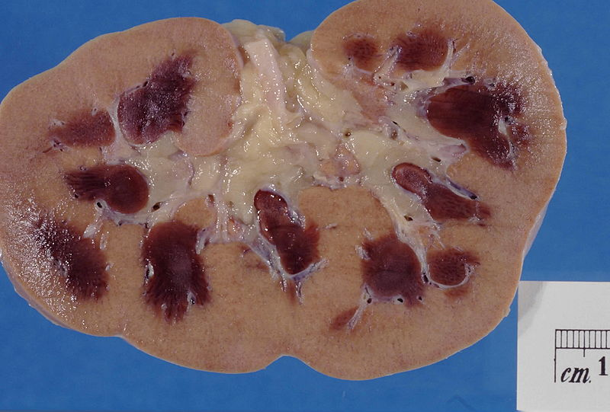
Acute Kidney Injury
Kidney showing :
Marked pallor of the renal cortex.
Congested renal medulla.
Pathology Dept , KSU
Renal Block

Slide 16
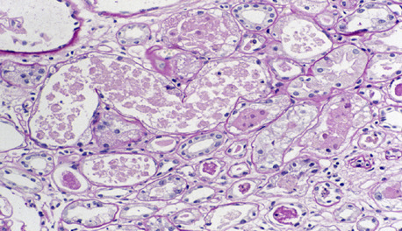
Acute Tubular Necrosis
Necrotic renal tubular cells.
Some tubules lined by flat and vacuolated epithelium.
Pathology Dept , KSU
Renal Block

Slide 17
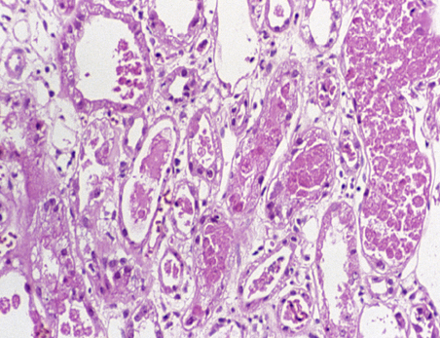
Acute Tubular Necrosis
There may also be degeneration and frank necrosis of individual cells or tubular segments in acute tubular necrosis, or flattened, regenerating type epithelium with degenerated cells in the lumen (middle left) (H&E x 200).
Pathology Dept , KSU
Renal Block

Slide 18
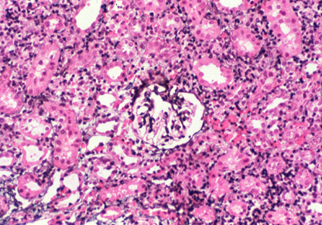
Acute Interstitial Nephritis
There is edema associated with an interstitial lymphoplasmocytic infiltrate. There are numerous causes for acute interstitial nephritis, including toxins, viral infections and drug-induced hypersensitivity reactions. The glomeruli are uninvolved, unless there is an associated minimal change disease-type injury caused by non steroidal
anti-inflammatory drugs
Pathology Dept , KSU
Renal Block

Slide 19
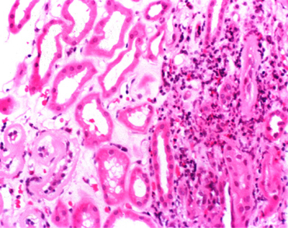
Acute Interstitial Nephritis
There is edema in addition to preexisting mild tubulointerstitial fibrosis in this case of acute interstitial nephritis caused by drug-induced hypersensitivity. There is a prominent interstitial eosinophilic component, in addition to lymphocytes and plasma cells (H&E stain x 100)
Pathology Dept , KSU
Renal Block

Slide 20
POLYCYSTIC KIDNEY
Pathology Dept , KSU
Renal Block

Slide 21
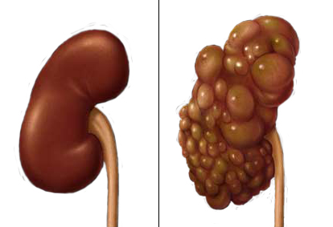
Normal vs Polycystic Kidney
Pathology Dept , KSU
Renal Block

Slide 22
Polycystic kidney – Gross Anatomy
Markedly enlarged kidney and replacement of the renal parenchyma by numerous cysts of variable sizes
Pathology Dept , KSU
Renal Block

Slide 23
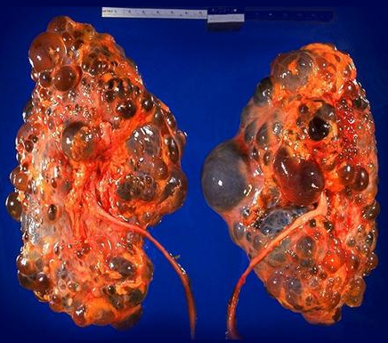
Polycystic kidney – Gross Anatomy
Bilateral autosomal dominant polycystic kidney disease
Pathology Dept , KSU
Renal Block

Slide 24
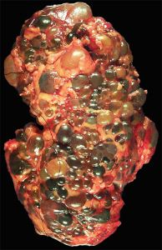
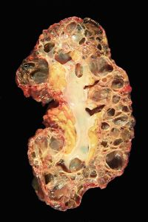
Gross Polycystic kidney and its Cut Section
Massively enlarged kidney disrupted by numerous cysts
Cut surface of the kidney, showing extensive cortical destruction by cysts
Pathology Dept , KSU
Renal Block

Slide 25
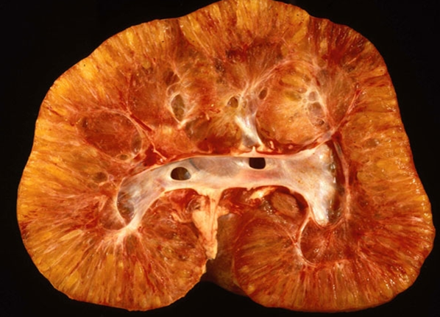
Infantile Polycystic kidney – Gross
Coronal section of an infantile polycystic kidney
Pathology Dept , KSU
Renal Block

Slide 26
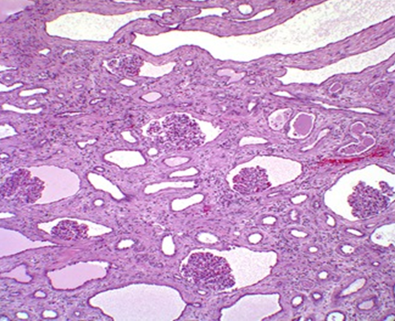
Polycystic kidney – Histopathology
Kidney of child with autosomal dominant PCKD.
a. Coronal section of a polycystic kidney.
b. histology demonstrating glomerular cysts .
Note the normal-sized glomeruli with the enlarged Bowman’s space and tubular cystic changes
Pathology Dept , KSU
Renal Block

Slide 27
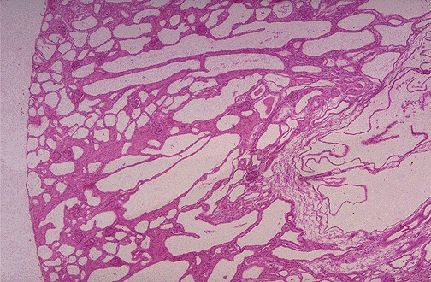
Polycystic kidney – Histopathology
Autosomal Recessive Polycystic Kidney Disease (ARPKD). Note that the cysts fill most of the parenchyma, and it is hard to find glomeruli.
Pathology Dept , KSU
Renal Block

Slide 28
ACUTE (POST-STREPTOCOCCAL) GLOMERULONEPHRITIS
Pathology Dept , KSU
Renal Block

Slide 29
Acute (Post-streptococcal) Glomerulonephritis
Section of the kidney shows:
The glomeruli are enlarged, lobulated and hypercellular with obliteration of capsular space.
Cellularity is due to proliferation of endothelial and mesangial cells with some neutrophils.
Many capillaries appear obliterated.
Tubules show degenerative changes.
Pathology Dept , KSU
Renal Block

Slide 30
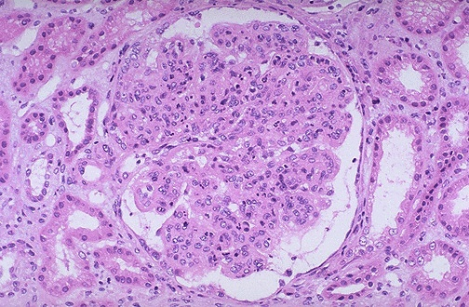
Acute (Post-streptococcal) Glomerulonephritis
This glomerulus is hypercellular and capillary loops are poorly defined. This is a type of proliferative glomerulonephritis known as post-infectious glomerulonephritis
Pathology Dept , KSU
Renal Block

Slide 31
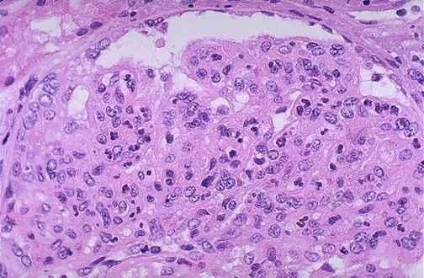
Acute (Post-streptococcal) Glomerulonephritis
The hypercellularity of post-infectious glomerulonephritis is due to increased numbers of epithelial, endothelial, and mesangial cells as well as neutrophils in and around the glomerular capillary loops
Pathology Dept , KSU
Renal Block

Slide 32
Acute (Post-streptococcal) Glomerulonephritis
High power LM of a hypercellular glomerulus; numerous capillaries contain inflammatory cells, mostly neutrophils
Pathology Dept , KSU
Renal Block

Slide 33
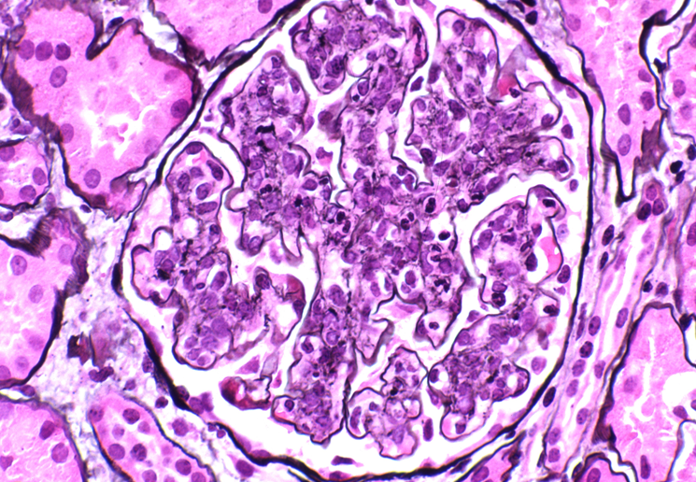
Acute Post-streptococcal Glomerulonephritis
Acute Poststreptococcal Glomerulonephritis is evident in this high-power silver stain with large number of PMNs. The glomerular basement membrane does not show splitting or spikes. There is proliferation of endothelial and mesangial cells and infiltrating cells and filling and distending capillary loops.
Pathology Dept , KSU
Renal Block

Slide 34
ACUTE & CHRONIC PYELONEPHRITIS
Pathology Dept , KSU
Renal Block

Slide 35
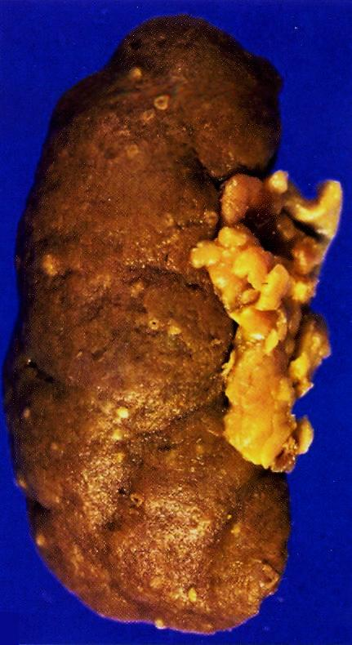
Pyelonephritis with small cortical abscesses
Pyelonephritis with small cortical abscesses
Pathology Dept , KSU
Renal Block

Slide 36
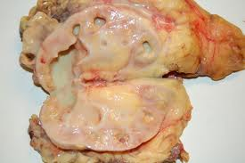
Classic picture of Pyelonephritis
This kidney is bisected to reveal a dilated pelvis and calyxes filled with a yellow-green purulent pus which is consistent with a pyelonephritis. The cortex and medulla are pale and the corticomedullary junction is ill-defined.
No tumors are seen.
Pathology Dept , KSU
Renal Block

Slide 37
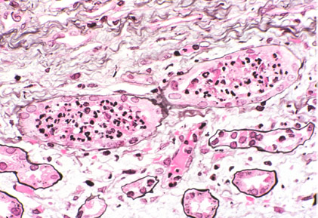
Acute Pyelonephritis - Histopathology
Acute pyelonephritis is diagnosed by intratubular aggregations of polymorphonuclear neutrophils (PMNs). There may be surrounding interstitial inflammation with a mixture of PMNs, lymphocytes,
and plasma cells, but the predominant inflammation is within the tubule
Pathology Dept , KSU
Renal Block

Slide 38
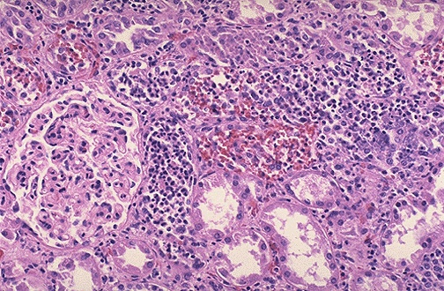
Acute Pyelonephritis - Histopathology
Numerous PMN's are seen filling renal tubules across the center and right of this picture. These leukocytes may form into a cast within the tubule. Casts appearing in the urine originate in the distal renal tubules and collecting ducts
Pathology Dept , KSU
Renal Block

Slide 39
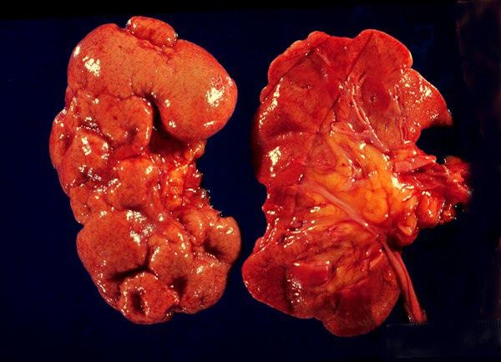
Chronic Pyelonephritis - Gross Pathology
a- Deformed and atrophic kidneys.
b- Deep cortical scars.
Pathology Dept , KSU
Renal Block

Slide 40
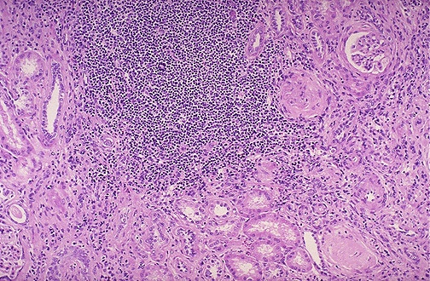
Chronic Pyelonephritis - Histopathology
This is chronic pyelonephritis where a large collection of chronic inflammatory cells . The severity of disease depends upon the amount of remaining functional renal parenchyma
Pathology Dept , KSU
Renal Block

Slide 41
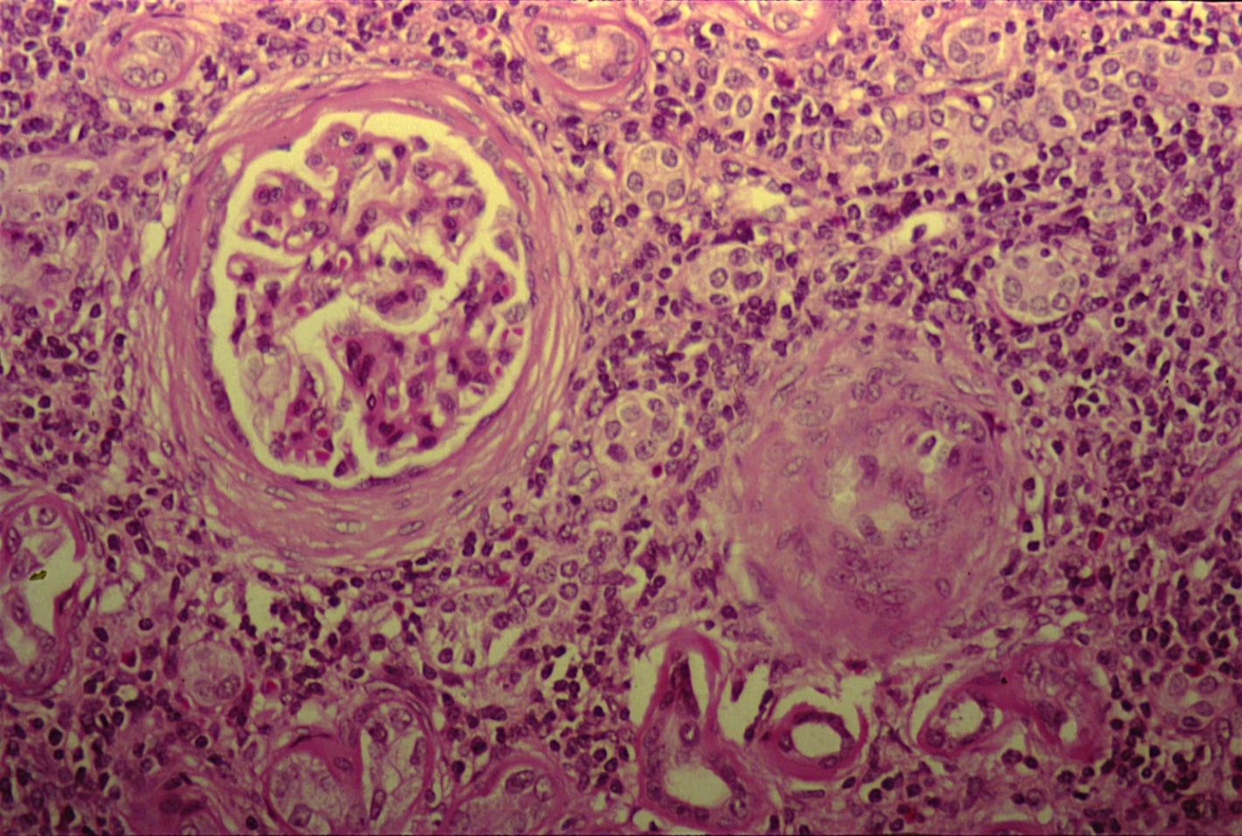
Chronic Pyelonephritis - Histopathology
High power shows periglomerular fibrosis , glomerular sclerosis and hyalinization with marked chronic interstitial inflammation .
Pathology Dept , KSU
Renal Block

Slide 42
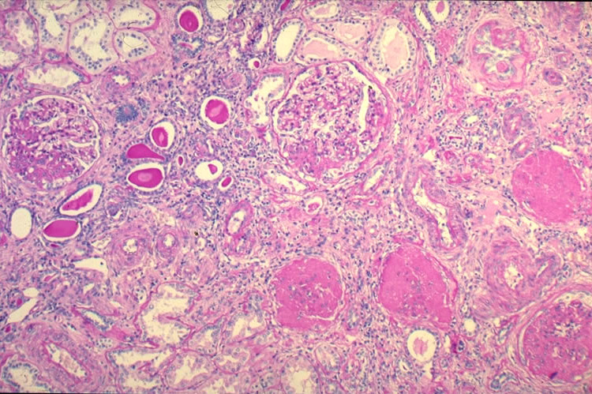
Chronic Pyelonephritis - Histopathology
Predisposing factors:
-Recurrent attacks of acute pyelonephritis.
-Drug-induced interstitial nephritis.
- Urinary tract obstruction or reflux.
a- Chronic interstitial inflammation.
b- Atrophy and thyroidization of renal tubules.
c- Hyalinization of glomeruli and interstitial fibrosis.
Renal Block
Notes:
a- Chronic interstitial inflammation.
b- Atrophy and thyroidization of renal tubules.
c- Hyalinization of glomeruli and interstitial fibrosis.

Slide 43
HYDRONEPHROSIS
Pathology Dept , KSU
Renal Block

Slide 44
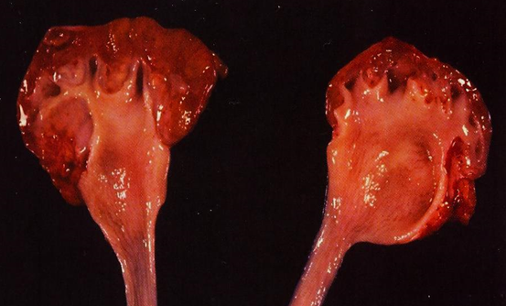
Hydronephrosis
Bisected kidney shows markedly dilated renal pelvis and calyces with atrophic and thin renal cortex /parenchyma
Pathology Dept , KSU
Renal Block

Slide 45
Hydronephrosis
The most common causes are:
Foreign bodies like calculi with
obstruction,
Atresia of the urethra,
Benign prostatic hyperplasia ,
Neoplasia of the prostate and
bladder
Spinal cord damage with paralysis of the bladder .
The picture shows markedly dilated renal pelvis and calyces with atrophic and thin renal cortex /parenchyma
Pathology Dept , KSU
Renal Block

Slide 46
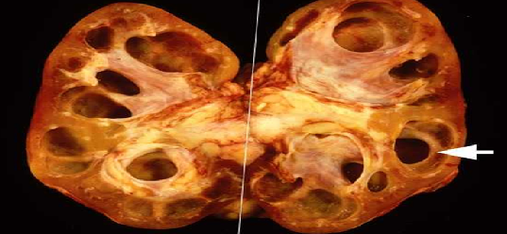
Hydronephrosis
Markedly dilated renal pelvis and calyces with atrophic and thin renal cortex
Pathology Dept , KSU
Renal Block

Slide 47
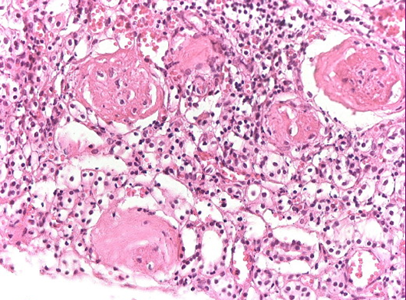
Chronic Pyelonephritis presenting as complication to Hydronephrosis
Thinning renal parenchyma with residual large renal vessels
in the hilum. Sclerosis of glomeruli with atrophic tubules
Pathology Dept , KSU
Renal Block

