Slide 1
Physiology of micturition
Notes:
1
This is something to understand well so you can then simplify for your clients or patients

Slide 2
Learning Objectives:
Identify and describe the Functional Anatomy of Urinary Bladder
Describe the mechanism of filling and emptying of the urinary bladder
Cystometrogram
Appreciate neurogenic control of the mechanism of micturition and its disorders.

Slide 3
Urinary Bladder
Anatomical consideration:
Body: Wall of bladder contain smooth muscle in different arrangement (detrusor muscle), contraction → emptying of bladder during micturition.
Neck
2 sphincters:
-internal urethral sphincters (IUS) in either side of urethra, made of smooth muscle.
-External urethral sphincter (EUS), made of skeletal muscle.

Slide 4
Detrusor – smooth muscle of the bladder wall
Trigone – smooth muscle at bladder base
Internal sphincter – smooth muscle at the bladder neck
External urethral sphincter – skeletal muscle

Slide 5
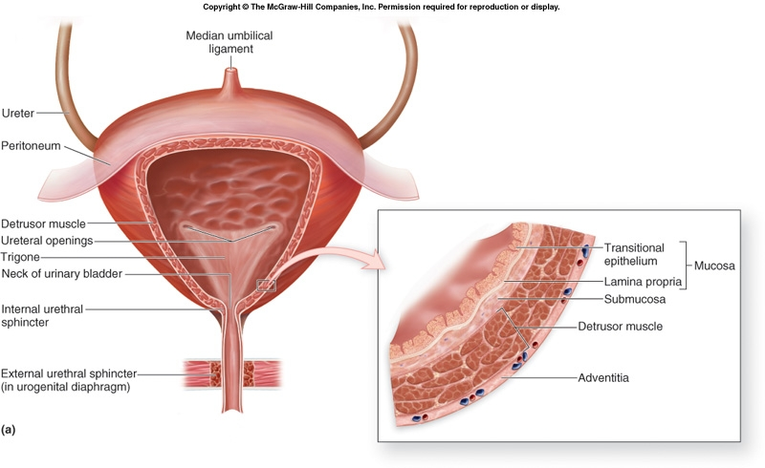

Slide 6
Innervations of UB

Slide 7
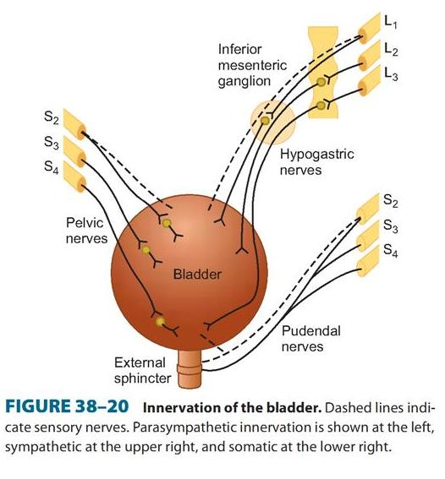
Nerve Supply to the Bladder
Sympathetic nerve (Hypogastric n)
B. Pelvic nerve (Parasympathetic)
C. Pudendal nerve (Somatic N)

Slide 8
INNERVATION OF THE BLADDER
 | Nerves | Characteristic | Function
1 | Pelvic nerves (parasympathetic fibers) S-2 and S-3 | Both sensory and motor nerve fibers | Contraction of bladder The sensory fibers detect the degree of stretch in the bladder wall
2 | Pudendal Nerve | somatic nerve | Fibers that innervate and control the voluntary skeletal muscle of the sphincter
3 | Hypogastric Nerves | sympathetic innervation (L2) | Stimulate mainly the blood vessels and have little to do with bladder contraction. Sensory nerve fibers of the sympathetic nerves also mediate the sensation of fullness and pain.

Slide 9
Autonomic Innervations of the bladder
 | Parasympathetic Supply | Sympathetic Supply
Nerve | Pelvic nerve | Hypogastric Nerve
Efferents: Origin: Supply: Functions | -LHCs of the S 2,3, and 4. -Body and neck of the bladder. a) Contraction of bladder wall. b) Relaxation of the bladder neck → stimulation of the detrusor ms of the body causes longitudinal layers to open the bladder neck. | - L1,2, and 3. - Bladder neck. a) Contraction of bladder neck, specially the middle layer→ facilitate the storage of urine. b) Relaxation of the bladder wall.
Afferents: | a) Carry input from stretch receptors in the bladder neck.. b) Detect bladder fullness. c) Carry pain and temperature sensation. | Transmit pain sensation Detect bladder fullness
Sympathetic supply to the bladder cause storage of urine.
Parasympathetic supply leads to the Passage of urine.

Slide 10
Somatic Innervations of the bladder
The Pudendal nerves (AHCs of S 2,3,and 4)
Its efferent fibers arise as the parasympathetic nerves from the 2nd, 3rd and 4th sacral segments of the spinal cord but from the AHCs.
They supply and control the activity of the external urethral sphincter

Slide 11
Micturition
Definition: Micturition is the process of emptying the urinary bladder through the urethra .
Filling of bladder.
Micturition reflex.
Voluntary control.

Slide 12
Micturition Reflex
Two processes are involved:
The bladder fills progressively until the tension in its wall is above a threshold level, and then
A nervous reflex called the micturition reflex occurs that empties the bladder → at 150-200mls of urine volume
The micturition reflex is an autonomic spinal cord reflex: however, it can be inhibited or facilitated by centers in the brainstem and cerebral cortex.

Slide 13
Micturition Reflexes
Center: sacral segments 2, 3 & 4.
Receptors: stretch (receptor) in the wall of bladder.
Afferent & efferent: pelvic nerve.
Response:
Contraction of detrusor muscle (body).
Relaxation of internal sphincter of urethra.
Relaxation of external urethral sphincter via the pudendal nerve which is somatic nerve originating from AHC of sacral segment 2, 3, & 4.

Slide 14
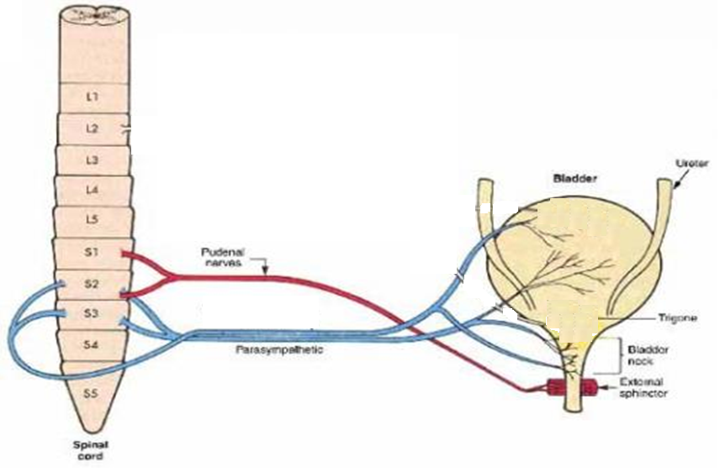
Stretch receptors
Center
S2,3,4,
↑ IVP
Contraction of wall
Afferents
Pelvic Nerve
Relaxation of int. sphincter
Efferent
Pelvic Nerve
Relaxation of ext. sphincter

Slide 15
Cystometry
Study the relationship between intravesical volume and pressure.
Done by inserting catheter and emptying the bladder, then recording the pressure while bladder filled at 50ml increment of water.
This plot is known as the cystometrogram.

Slide 16
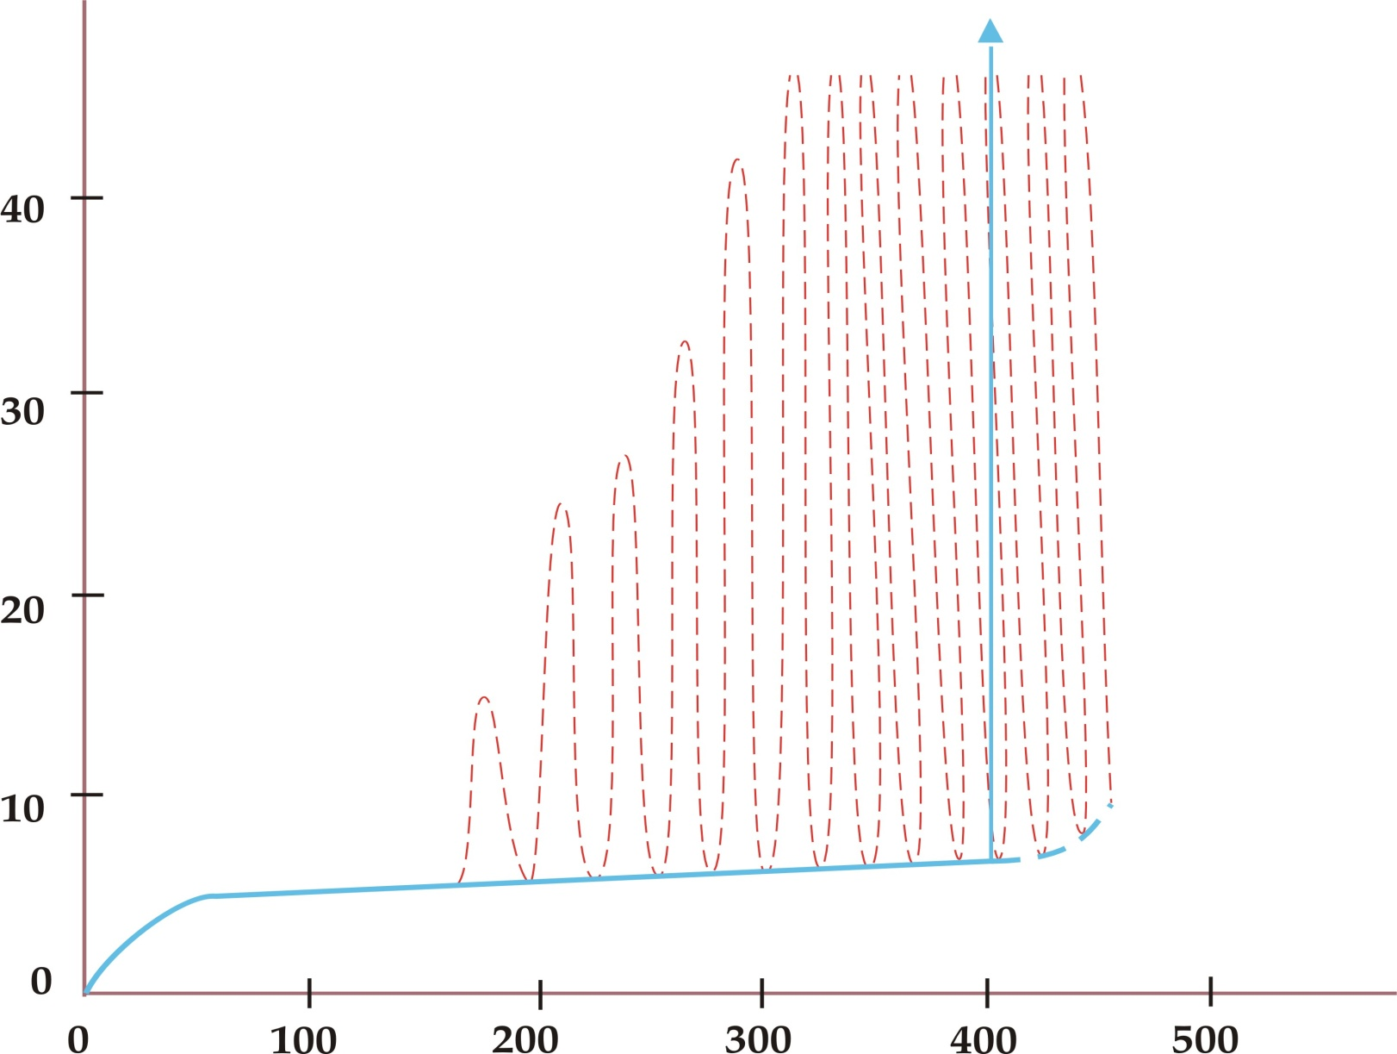
Cystometrogram
Micturition
contractions
Intravesical pressure
(centimeters of water)
lb
la
Basal cystometrogram
Volume (milliliters)
Guyton 312-313

Slide 17
Plot has 3 components (segments):
Ia – initial slight rise in pressure when the first increment in volume are produced
Ib – a long, nearly flat segment as further increments are produced (conscious level to void at about 150mL)
II – a sudden, sharp rise in pressure as the micturition reflex is triggered (sense of fullness and urge to void at about 400mL)

Slide 18
Laplace Law
The flatness of segment Ib is a manifestation of the law of Laplace, which states that the pressure in the spherical viscus equal to twice the wall tension divided the radius.
P = 2T / r

Slide 19
Sensations from the U.B at different urine volumes:
At a urine volume of 150 –300 ml ⇒ the first urge to void urine.
From 300 –400 ml ⇒ sense of fullness of the bladder.
From 400 –600 ml ⇒ sense of discomfort.
From 600 –700 ml ⇒ sense of pain.
Micturition reflexes start to appear at the first stage. They are progressively intensified in the subsequent stages up to stage 4. Micturition reflexes can be voluntarily suppressed.
At about 700 ml ⇒ break point ⇒ micturition can not be suppressed.

Slide 20
Control of Micturition reflex
It is a complete autonomic spinal reflex to get urine outside the body, that is facilitated or inhibited by higher brain centers.

Slide 21
Voluntary Control of Micturition

Slide 22
Higher Centers Control Micturition
1) Cerebral cortex: Motor cortex exerts a voluntary control of micturition either stimulation or inhibition.
2) Hypothalamus: There is facilitatory area in the hypothalamus.
3) Midbrain: Inhibition.
4) Pons: facilitation

Slide 23
Mechanism of voluntary control of micturition:
Filling of the bladder beyond 300 –400 ml causes stretching of sensory stretch receptors.
These sensory signals stimulate sacral segment, which is consciously appreciated by higher centers.

Slide 24
If the condition is favourable
The cortical centers facilitate micturition by discharging signals that leads to:
Stimulation of sacral micturition center.
Inhibition of pudendal nerves ⇒ relaxation of external urethral sphincter.
Contraction of anterior abdominal muscle & diaphragm to increase intra-abdominal pressure ⇒ the intra-vesical pressure is increased. This intensifies the micturition reflex.

Slide 25
If the conditions are unfavorable
The higher centers will inhibit the micturition reflex by:
Inhibition of sacral micturition center.
Stimulation of pudendal nerves ⇒ contraction of external urethral sphincter.

Slide 26
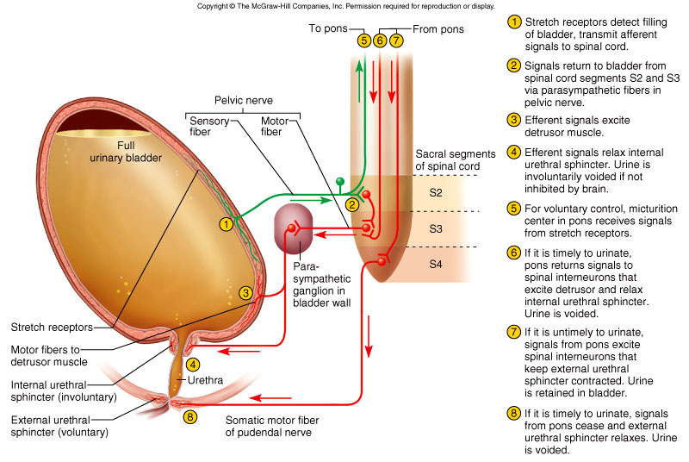

Slide 27
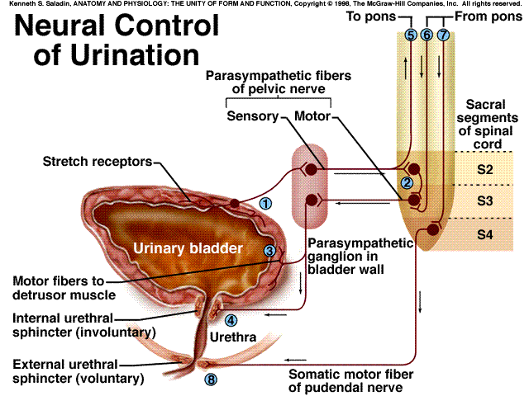
1) APs generated by stretch receptors
2) reflex arc generates APs that
3) stimulate smooth muscle lining bladder
4) relax internal urethral sphincter (IUS)
5) stretch receptors also send APs to Pons
6) if it is o.k. to urinate
APs from Pons excite smooth muscle of bladder and relax IUS
relax external urethral sphincter
7) if not o.k.
APs from Pons keep external
urethral sphincter contracted
stretch
receptors

Slide 28
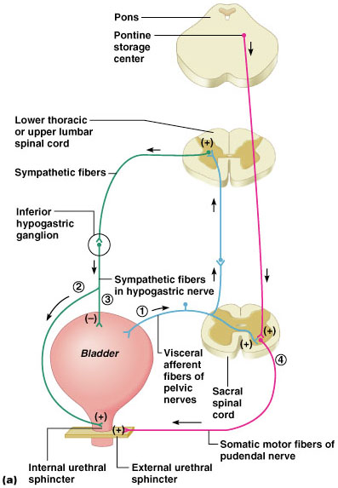
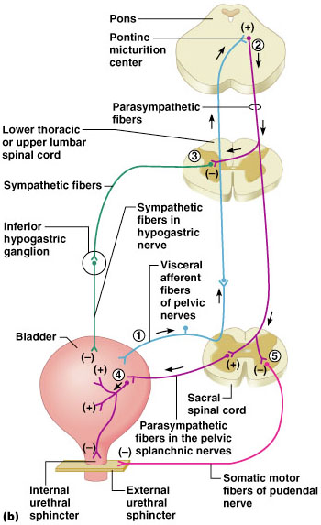
Micturition (Voiding or Urination)

Slide 29
Reflex and Voluntary Control of Micturition
Reflex Control
Voluntary Control
Bladder fills
Cerebral cortex
+
Stretch receptors
+
+
Motor neuron to external sphincter
Parasympathetic nerve
+
Bladder
External urethral sphincter opens when motor neuron is inhibited
Bladder contracts
External urethral sphincter remains closed when motor neuron is stimulated
Internal urethral sphincter mechanically opens when bladder contracts
Urination
No urination

Slide 30
Disturbances of micturition

Slide 31
Micturition reflex
stretch
receptors

Slide 32
Disturbances of micturition
Denervation of the afferent supply e.g.in tabes dorsalis (tabetic bladder):
Characterized by:
Loss of the U.B. sensations & reflex micturition.
Some intrinsic responses of the smooth muscle are retained.
The bladder becomes distended, thin walled & hypotonic( atonic bladder).
There is retention with overflow i.e. dribbling of urine when the bladder becomes over filled.
Notes:
Tabes dorsalis is a late manifestation of untreated syphilis and is characterized by a triad of clinical symptoms namely gait unsteadiness, lightning pains and urinary incontinence. It occurs due to a slow and progressive degeneration of nerve cells and fibers in spinal cord. It is one of the forms of tertiary syphilis or neurosyphilis.

Slide 33
Micturition reflex
stretch
receptors

Slide 34
Disturbances of micturition
Denervation of the afferent & efferent supply e.g. tumour, injury to cauda equina.
Characterized by:
Reflexes are abolished.
Intrinsic responses of the smooth muscles are increased.
The bladder is hypertonic.
This is due to denervation hypersensitivity because:
↓ degradation of acetyl choline by process of reuptake.
↓ cholinesterase in the tissue
↑ number of cholinergic receptors.
This condition is associated with uncontrolled periodic micturition about 25 – 100 ml at a time

Slide 35
Micturition reflex
stretch
receptors

Slide 36
ABNORMALITIES OF MICTURITION
 | ATONIC BLADDER | AUTOMATIC BLADDER
Lesion | Sensory nerve fibers from the bladder to the spinal cord are destroyed Crush injury to the sacral region of the spinal cord and tabes dorsalis | Spinal Cord Damage Above the Sacral Region resulting in Spinal shock
Feature | Bladder fills to capacity and overflows a few drops at a time through the urethra. This is called overflow incontinence. | return of excitability of micturition reflex until typical micturition reflexes returns & then, periodic (but unannounced) bladder emptying occurs which may be controlled by scratching or tickling
Notes:
Uninhibited Neurogenic Bladder Caused by Lack of Inhibitory Signals from the Brain. Therefore, facilitative impulses passing continually down the cord keep the sacral centers so excitable that even a small quantity of urine elicits an uncontrollable micturition reflex, thereby promoting frequent urination.
Essential functions and anatomy
The bladder has two functions – storage and voiding. Afferent
pathways (T12–S4) respond to pressure within the bladder
and sensation from the genitalia. As the bladder distends,
continence is maintained by suppression of parasympathetic
and reciprocal activation of sympathetic outflow. Both are
under some voluntary control. Voiding takes place by parasympathetic
activation of the detrusor, and relaxation of the
internal sphincter (Table 21.18).
Cortical awareness of bladder fullness is located in the
post-central gyrus, parasagittally, while initiation of micturition
is in the pre-central gyrus. Voluntary control of micturition
is located in the frontal cortex, parasagittally.
Neurological disorders of micturition
Urogenital tract disease is dealt with largely by urologists.
Incontinence is common and easy to recognize; neurological
causes are sometimes not obvious. These are:
Cortical:
■ Post-central lesions cause loss of sense of bladder
fullness.
■ Pre-central lesions cause difficulty initiating micturition.
■ Frontal lesions cause socially inappropriate micturition.
Spinal cord. Bilateral UMN lesions (pyramidal tracts) cause
urinary frequency and incontinence. The bladder is small and
hypertonic, i.e. sensitive to small changes in intravesical pressure.
Frontal lesions can also cause a hypertonic bladder.
LMN. Sacral lesions (conus medullaris, sacral root and pelvic
nerve – bilateral) cause a flaccid, atonic bladder that overflows
(cauda equina, p. 1177), often unexpectedly.
Management. Assessment of both urological causes (e.g.
calculi, prostatism, gynaecological problems) and potential
neurological causes of incontinence is necessary. Intermittent
self-catheterization is used by many patients, with for
example spinal cord lesions.

