Slide 1
Renal block
Abdulrhman Aleisa
Radiology department

Slide 2
objective
Modality used for assessment of the urinary system
  X-ray
  us
  Ct
  MRI
  Nuclear
Normal anatomy
Common pathologies
  Kidney
  Ureter
  Bladder
  Urethra

Slide 3
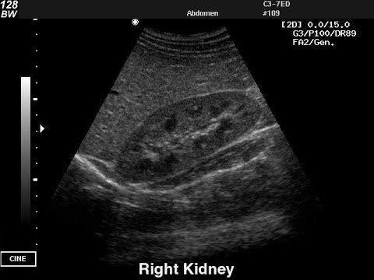
Modalities used
US
  Pros ( no ionizing radiation , inexpensive , portable)
  Cons (operator dependent, time consuming , )

Slide 4
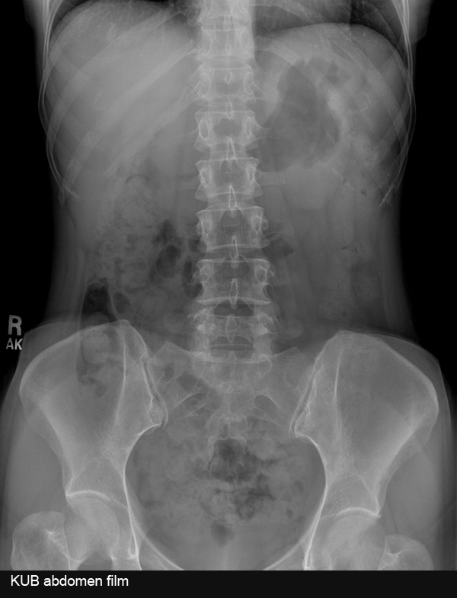
Modalities used
X rays
  Pros (inexpensive , quick )
  Cons ( ionizing radiation , not definitive )

Slide 5
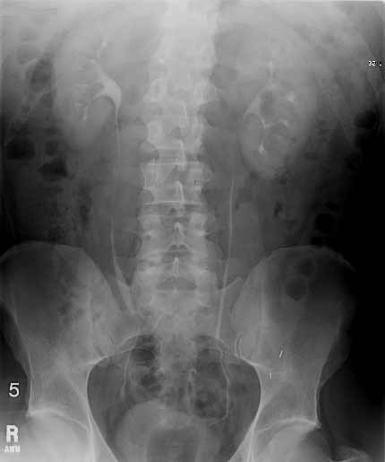
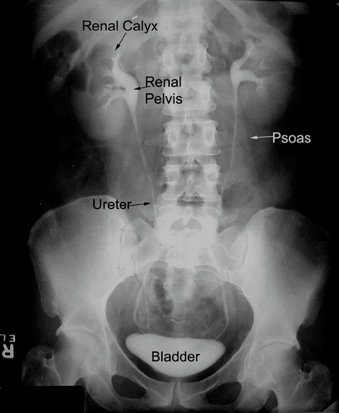

Slide 6
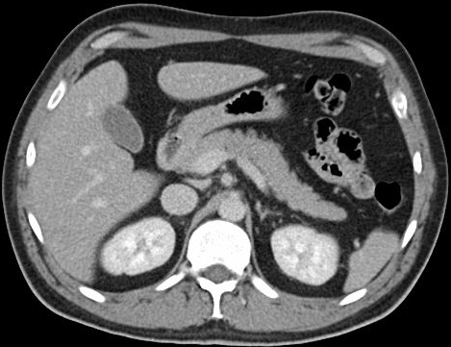
Modalities used
CT
  Pros ( quick , a lot of information )
  Cons ( ionizing radiation , expensive )

Slide 7
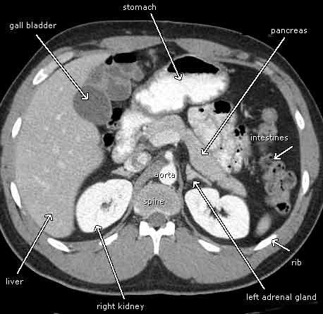

Slide 8
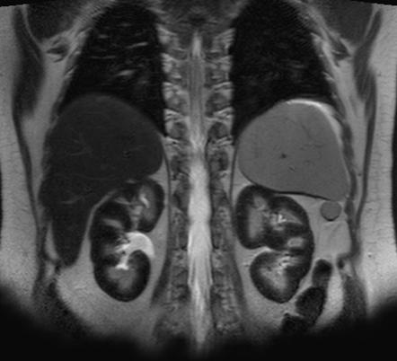
Modalities used
MRI
  Pros (no ionizing radiation , a lot of information )
  Cons ( expensive , time consuming )

Slide 9
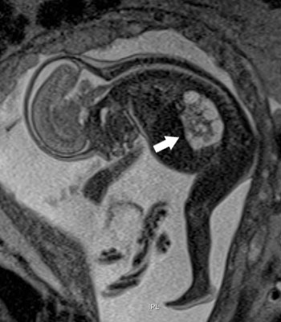

Slide 10
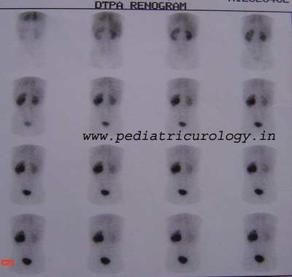
Modalities used
Nuclear scans
  Pros ( assess the function )
  Cons (time consuming , radioactive materials )

Slide 11
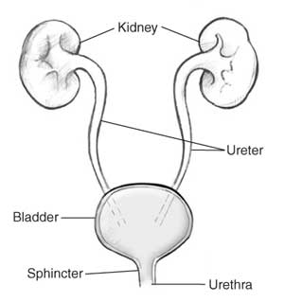
Anatomy of the urinary system

Slide 12
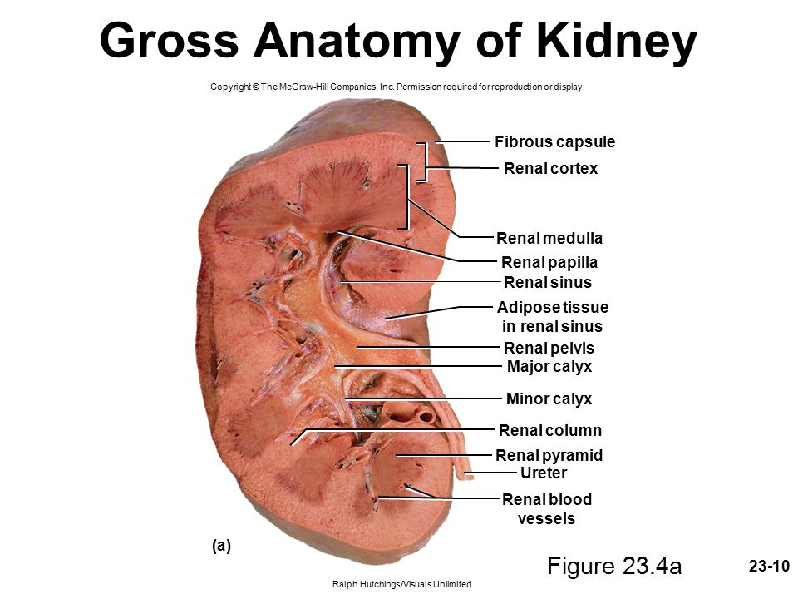
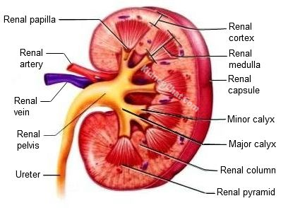
kidneys

Slide 13
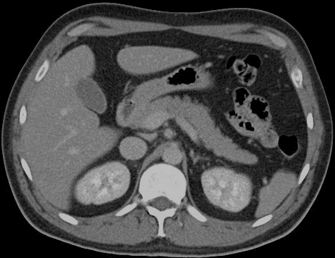
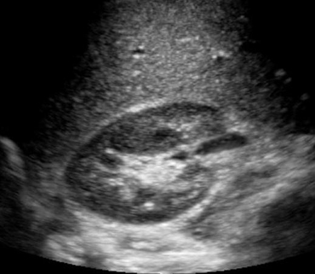
kidneys

Slide 14
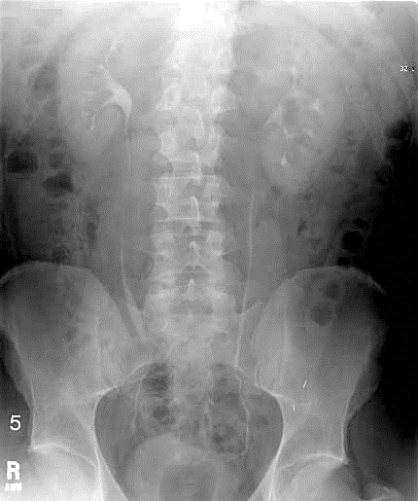
ureters

Slide 15
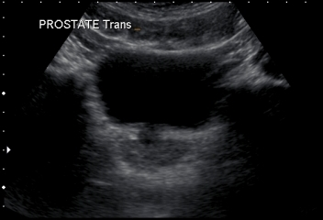
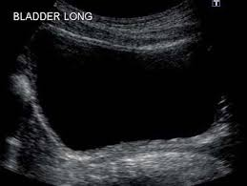
Urinary bladder

Slide 16
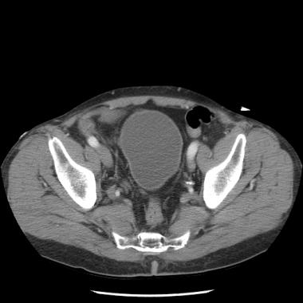
Urinary bladder

Slide 17
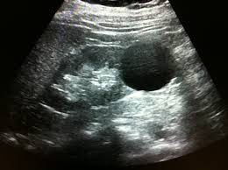
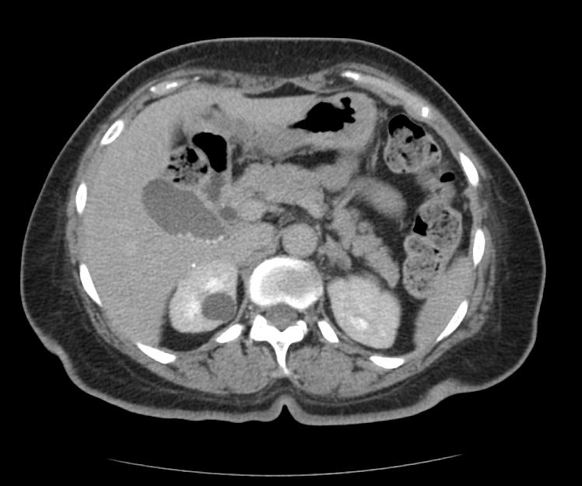
Common Kidney pathologies
Cysts (benign , common , bosniak classification )

Slide 18
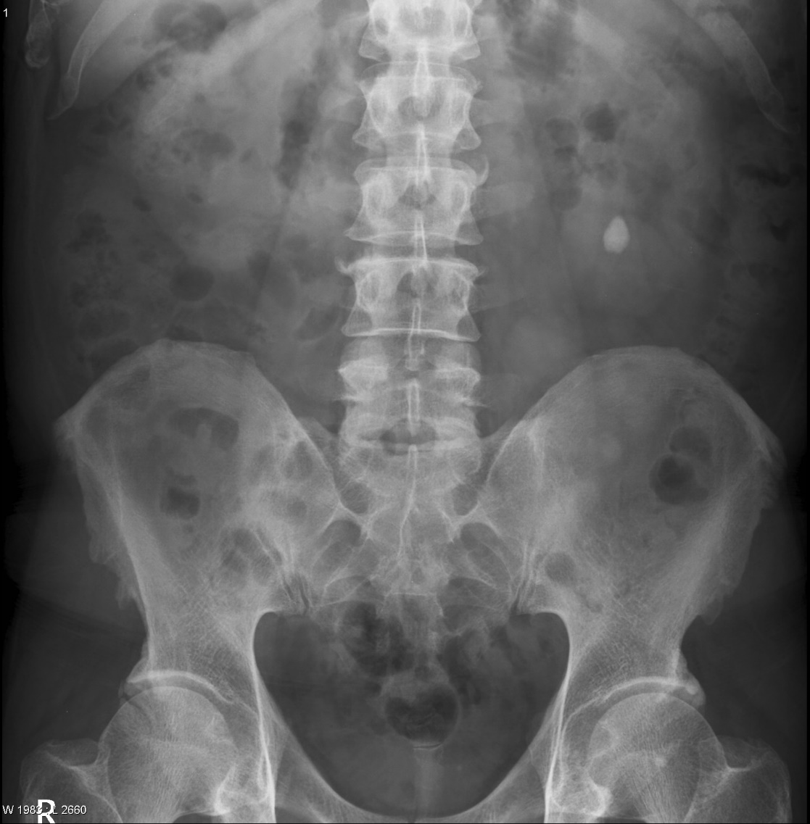
Common Kidney pathologies
Stones :
  Radio-opaque (calcium , struvite )
  Radio-lucent (uric acid , cysteine )

Slide 19
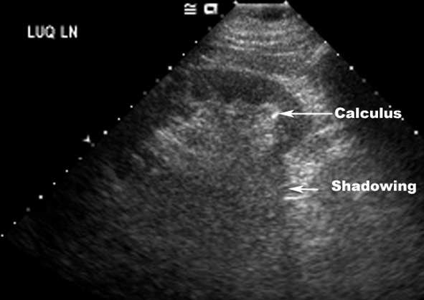
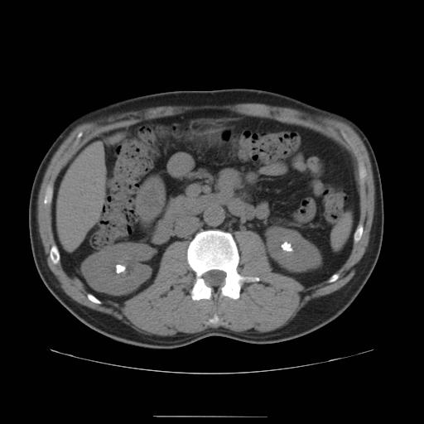

Slide 20
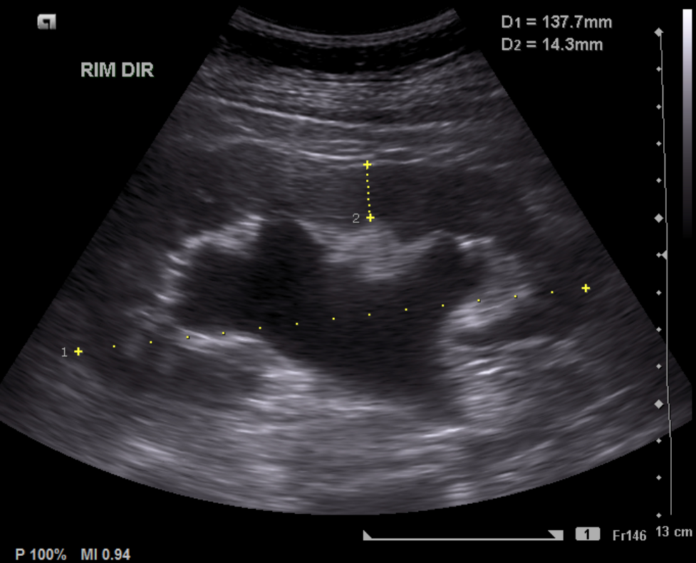
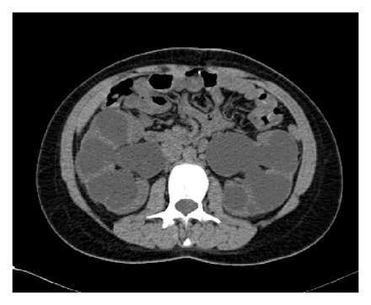
Common Kidney pathologies
hydronephrosis

Slide 21
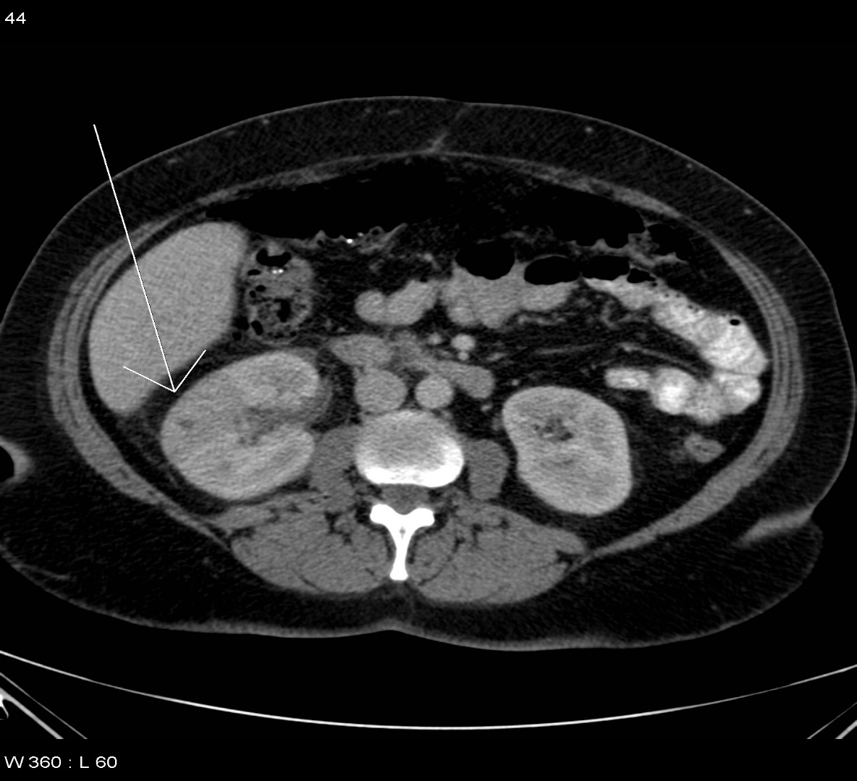
Common Kidney pathologies
Pyelonephritis

Slide 22
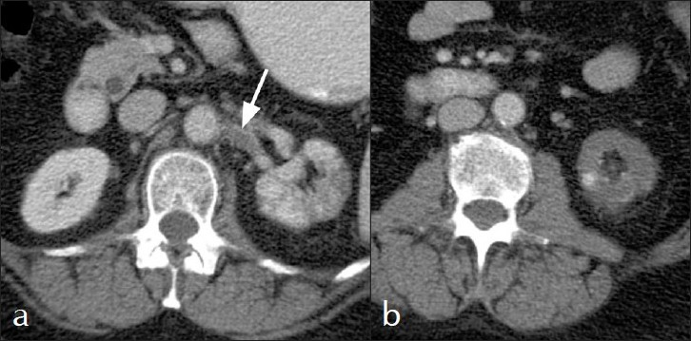
Common Kidney pathologies

Slide 23
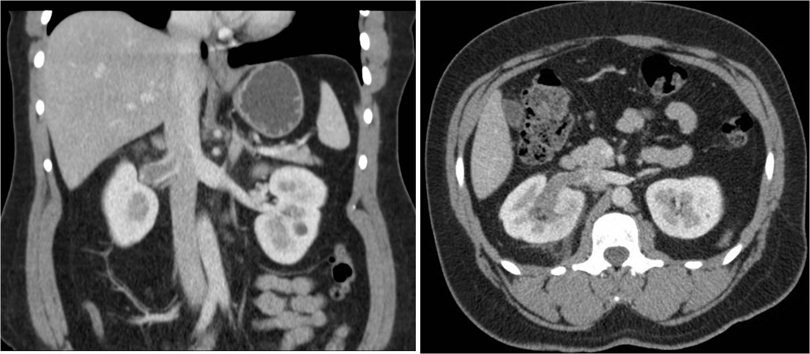
Common Kidney pathologies

Slide 24
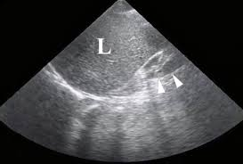
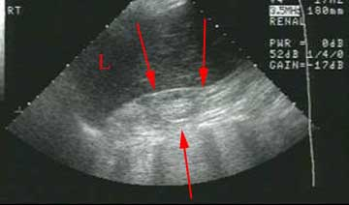
Common Kidney pathologies
ESRD

Slide 25
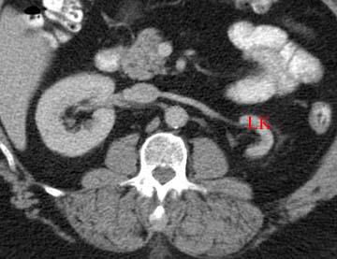
Common Kidney pathologies

Slide 26
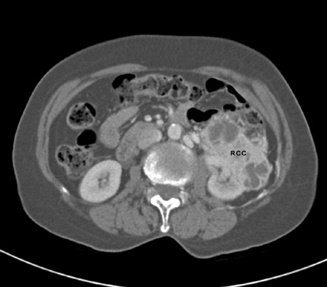
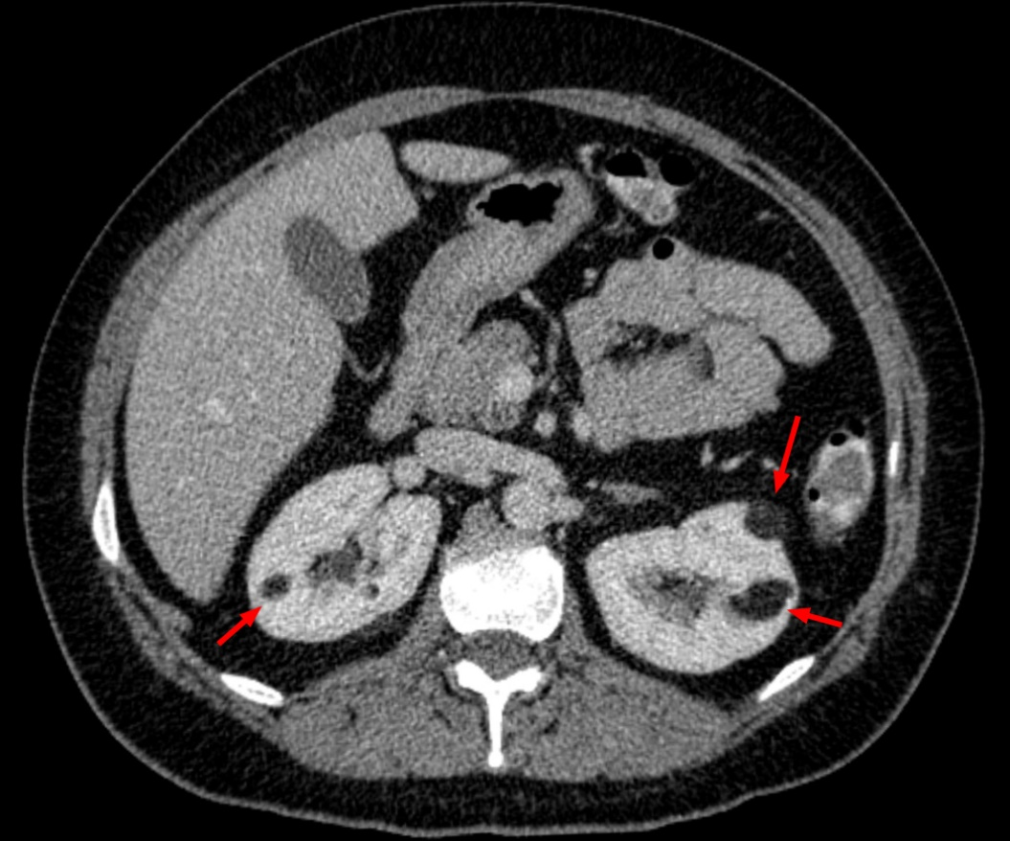
Common Kidney pathologies
tumors

Slide 27
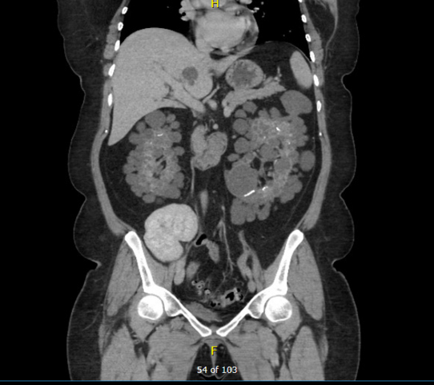
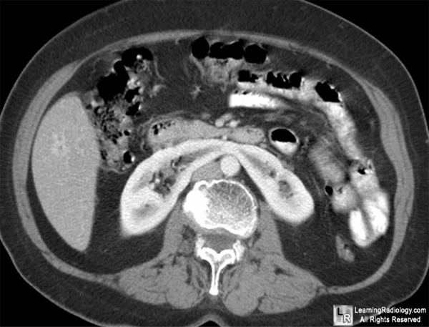
Common Kidney pathologies
Congenital

Slide 28
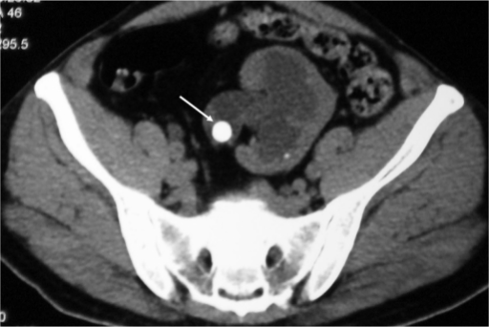
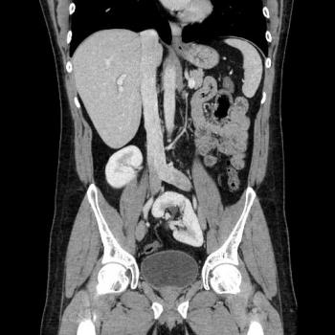

Slide 29
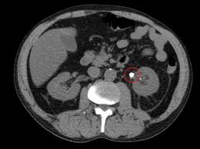
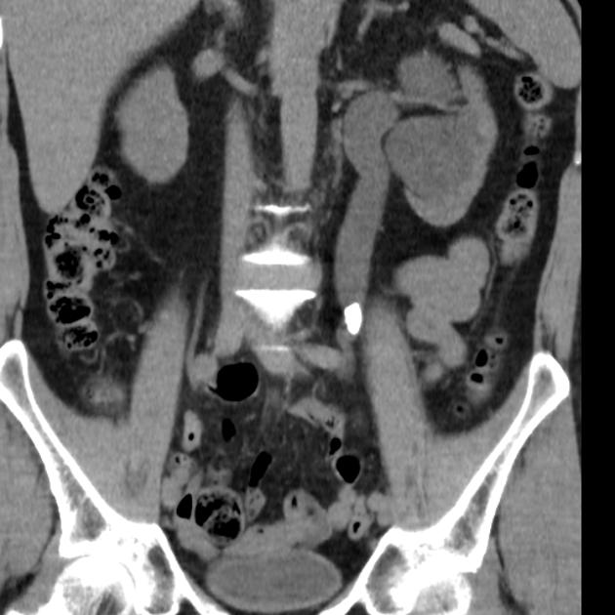
Common pathologies

Slide 30
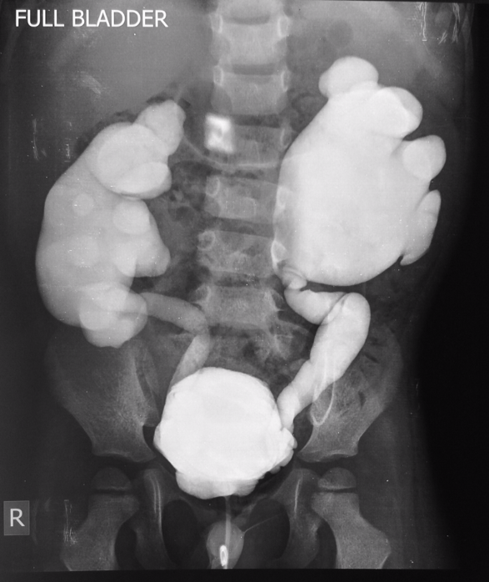
Common pathologies
vesicoureteral reflux disease

Slide 31
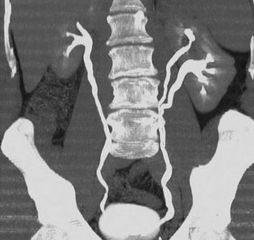

Slide 32
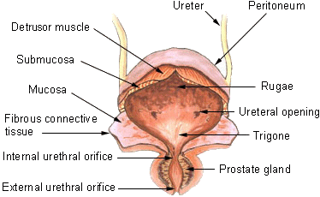
Urinary bladder

Slide 33
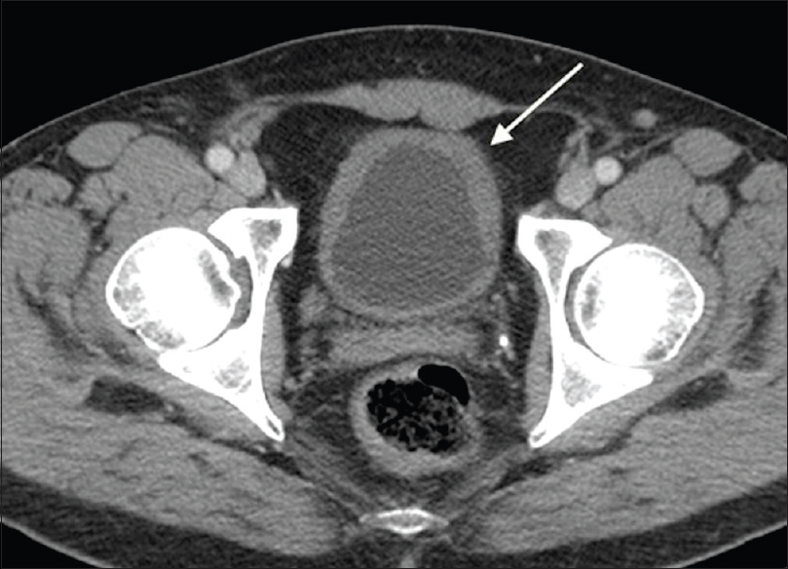
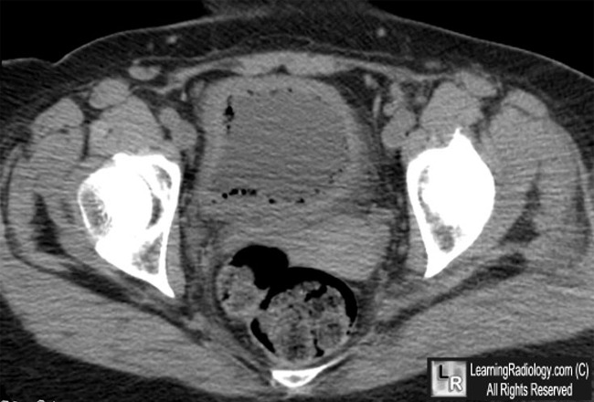
Common urinary bladder pathologies
Cystitis

Slide 34
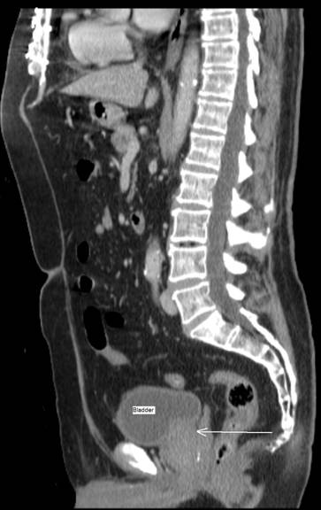
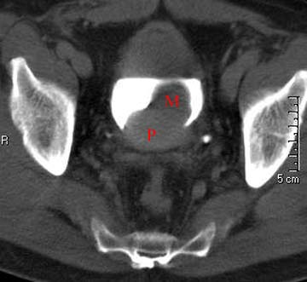

Slide 35
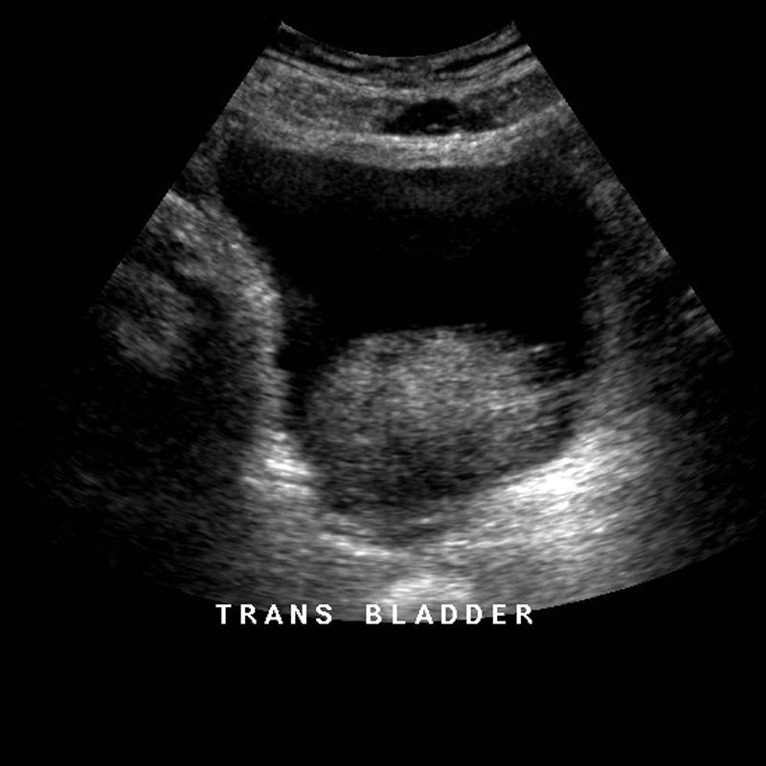

Slide 36
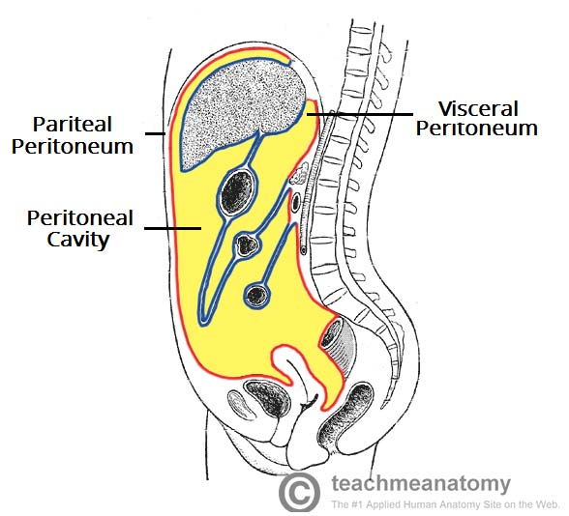
Common urinary bladder pathologies
Bladder rupture

Slide 37
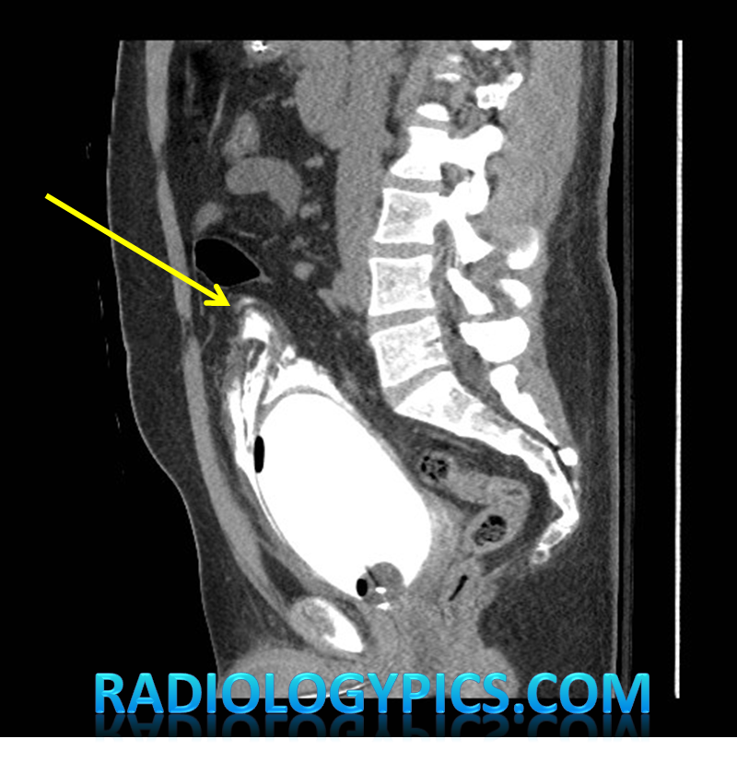
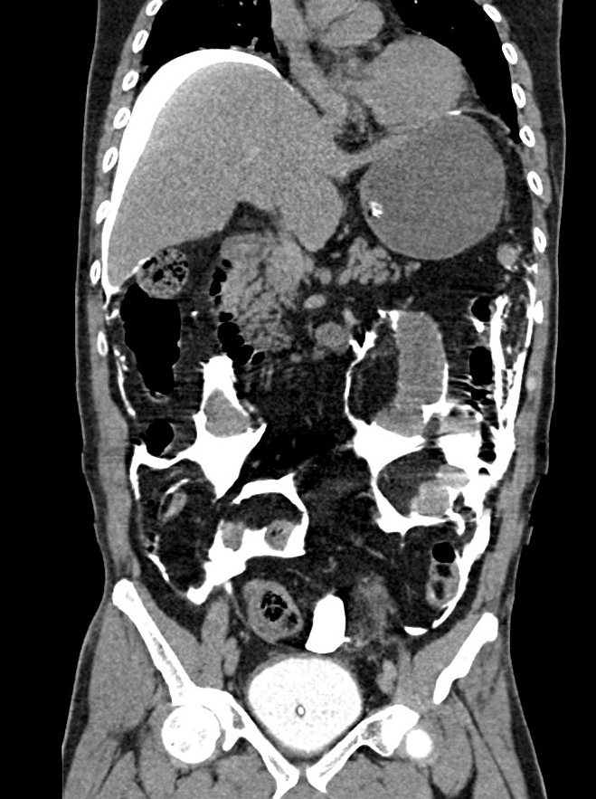
Common urinary bladder pathologies

Slide 38

Urethra

Slide 39


